Slide 1
Deconfining Effects and Dissociation Temperature of Quarkonia States
Palak D. Bhatt
Sardar Patel University, Vallabh Vidyanagar
2nd Heavy Flavour Meet
SINP (2-6 feb 2016)

Slide 2
INTRODUCTION
The heavy-ion collision programs of current and past experiments, aim to identify and characterize the properties of strongly interacting matter at high temperature with high density (QGP).
One of their goals is to produce de-confined quark matter (QGP).
QGP generated in heavy ion collision at high relativistic energies provides us a laboratory to study both the high energy regime of perturbative QCD and the low energy regimes (as it cools) where non-perturbative effects dominates.
Energetic partons (jets), EM signals, suppression of heavy flavour, etc., are the experimental signatures of the de-confined state.
Suppression of heavy flavour is one of the most striking characteristic due to the formation of QGP.
H.Satz and T.Matsui were the first to present an idea to probe QGP via colour screening.
The de-confinement occurs when colour screening shields a quark from the binding potential of any other quark or antiquark.

Slide 3
Because of this colour screening the attraction between the quarks is finite and it is characterized by Debye radius (r_{D}).
When the distance between quarks is more than the Debye radius, (i.e. r_{D} << r_{QQ}) then it will no longer represent a bound system in a medium.
Hence, it can be used as a probe, to find whether plasma of colour charges has been produced in an extended volume beyond the size of hadronic state or not.
Assuming an electric dipole whose length is longer than Debye radius (r_{D}) then it will no longer be a dipole rather will dissociate and become a part of the medium.
The similar kind of effect has been expected in Quark-Gluon Plasma where the particles carry colour charge and are in random motion. Instead of an electric dipole, a colour dipole in de-confined medium.
Quarks and gluons are screened in similar way the electric charges experiences the Debye screening in ordinary plasma.
Though there exist Effective Field Theory methods and lattice simulations to study the de-confinement mechanisms, study based on phenomenological model is very simple and an important tool to understand the screening effects on the binding energy of quarkonium.

Slide 4
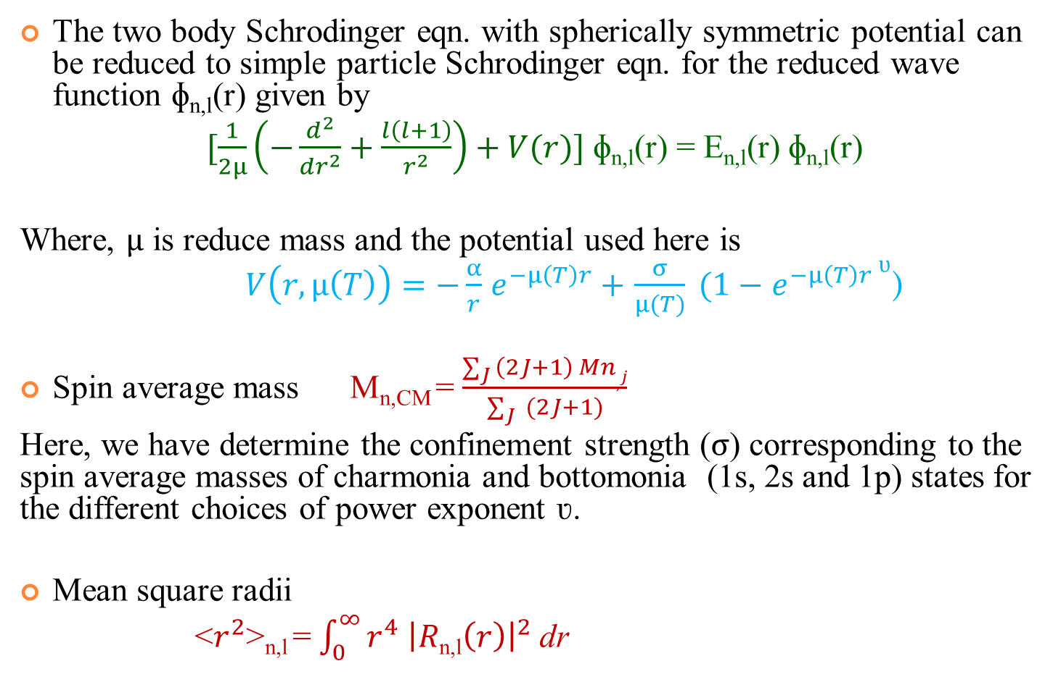
Quantum Mechanical Approach
The two body Schrodinger eqn. with spherically symmetric potential can be reduced to simple particle Schrodinger eqn. for the reduced wave function ɸ_{n,l}(r) given by
$[\frac{1}{2µ}\left(−\frac{d^{2}}{{dr}^{2}}+\frac{l\left(l+1\right)}{r^{2}}\right)+V(r)]$ ɸ_{n,l}(r) = E_{n,l}(r) ɸ_{n,l}(r)
Where, $µ$ is reduce mass and the potential used here is
$V\left(r,µ\left(T\right)\right)=−\frac{α}{r}$ $e^{−µ\left(T\right)r}+$ $\frac{σ}{µ(T)} (1−$ ${e^{−µ\left(T\right)r }}^{ʋ}$)
Spin average mass M_{n,CM} = $\frac{\sum_{J }{\left(2J+1\right) Mn,j}}{\sum_{J}{ (2J+1)}}$
Here, we have determine the confinement strength ($σ$) corresponding to the spin average masses of charmonia and bottomonia (1s, 2s and 1p) states for the different choices of power exponent ʋ.
Mean square radii
<$r^{2}$>_{n,l} =$\int_{0}^{∞}{r^{4} {\left|R\text{n}\text{,}\text{l}\left(r\right)\right|}^{2}}$ dr

Slide 5
the behavior of confinement potential strength (sigma) with respect to potential exponent ʋ (without screening effects) has been given by
Bottomonia
Charmonia

Slide 6
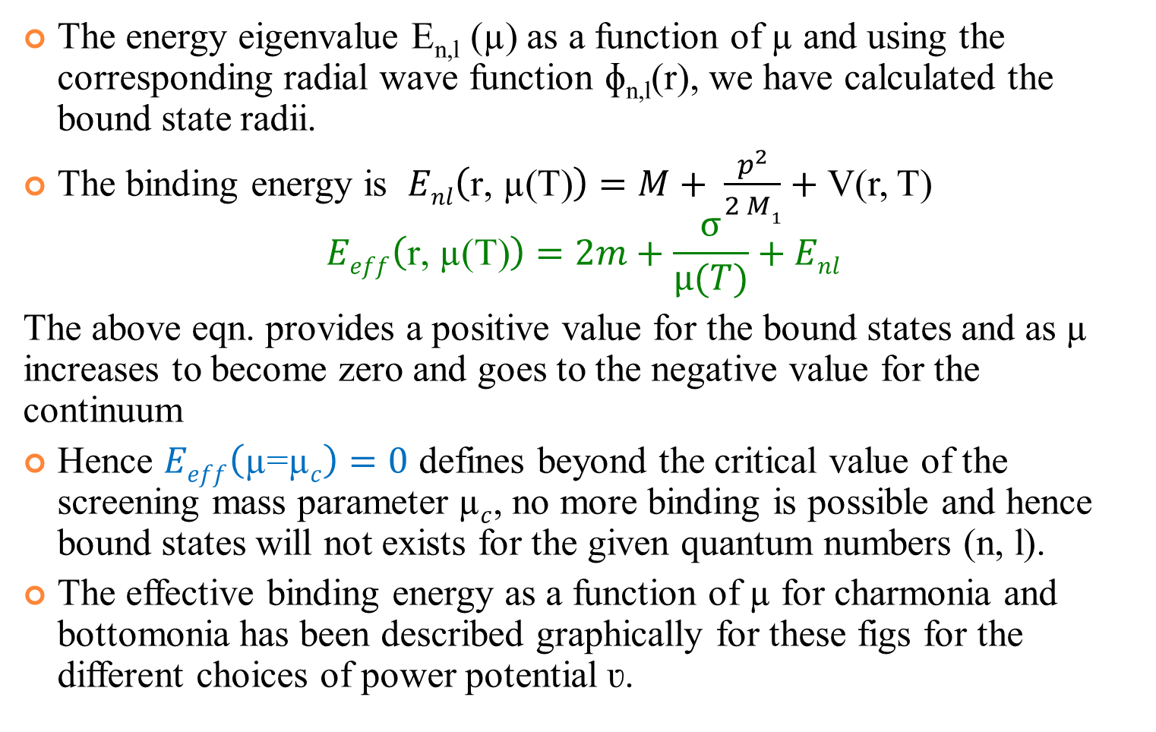

Properties of quarkonia state with screening (µ$≠0)$
The energy eigenvalue E_{n,l} (µ) as a function of µ and using the corresponding radial wave function ɸ_{n,l}(r), we have calculated the bound state radii.
The binding energy is $Enl\left(\text{r}\text{, µ(}\text{T}\text{)}\right)=M+ \frac{p^{2}}{2 M1}+$ V(r, T)
$$Eeff\left(\text{r}\text{, µ(}\text{T}\text{)}\right)=2m+\frac{σ}{µ(T)}+Enl$$
The above eqn. provides a positive value for the bound states and as µ increases to become zero and goes to the negative value for the continuum
Hence $Eeff\left(\text{µ}\text{=}\text{µ}c\right)=0$ defines beyond the critical value of the screening mass parameter $\text{µ}c$, no more binding is possible and hence bound states will not exists for the given quantum numbers (n, l).
The effective binding energy as a function of $\text{µ} \text{for}$charmonia and bottomonia has been described graphically for these figs for the different choices of power potential ʋ.

Slide 7
Charmonia

Slide 8
Bottomonia

Slide 9
For 1s-state
For 2s-state
charmonia
For 1p-state

Slide 10
1s-state
2s-state
bottomonia
1p-state

Slide 11
Charmonia
Bottomonia

Slide 12
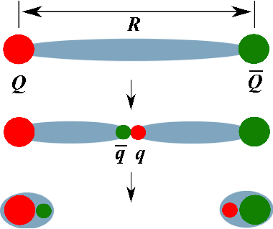

Vacuum Screening Mass
At T=0, i.e. no medium effects (µ=0) the light quarks are absent. In the presence of light quark, the quark-antiquark binding connected by a gluonic flux tube or string gets broken if its binding energy exceeds and spontaneously there will be a creation of a light-quark antiquark state out of vacuum.
So if we try to separate them, then two heavy-light pair get created which can be pulled apart without applying any further energy.
The breaking of string due to the creation of heavy-light pair of quarks is not exactly due to the colour screening although its effects are quite similar, the newly created triplet light quark-antiquark (q) screens heavy quark-antiquark (Q).
But these requires a virtual quark-antiquark pair from the environment. Hence $\left(\text{µ}\text{(}\text{T}\text{=0)}\right)≠0 exactly.$
It is expected that corresponding vacuum screening length to be the order of a fermimeter which is also confirmed by lattice studies.

Slide 13
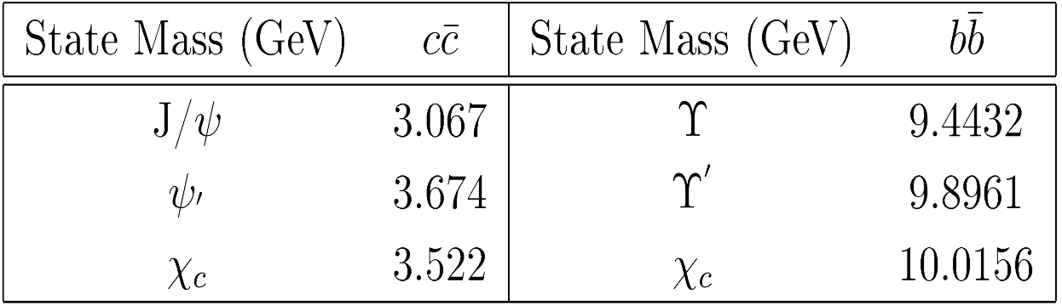
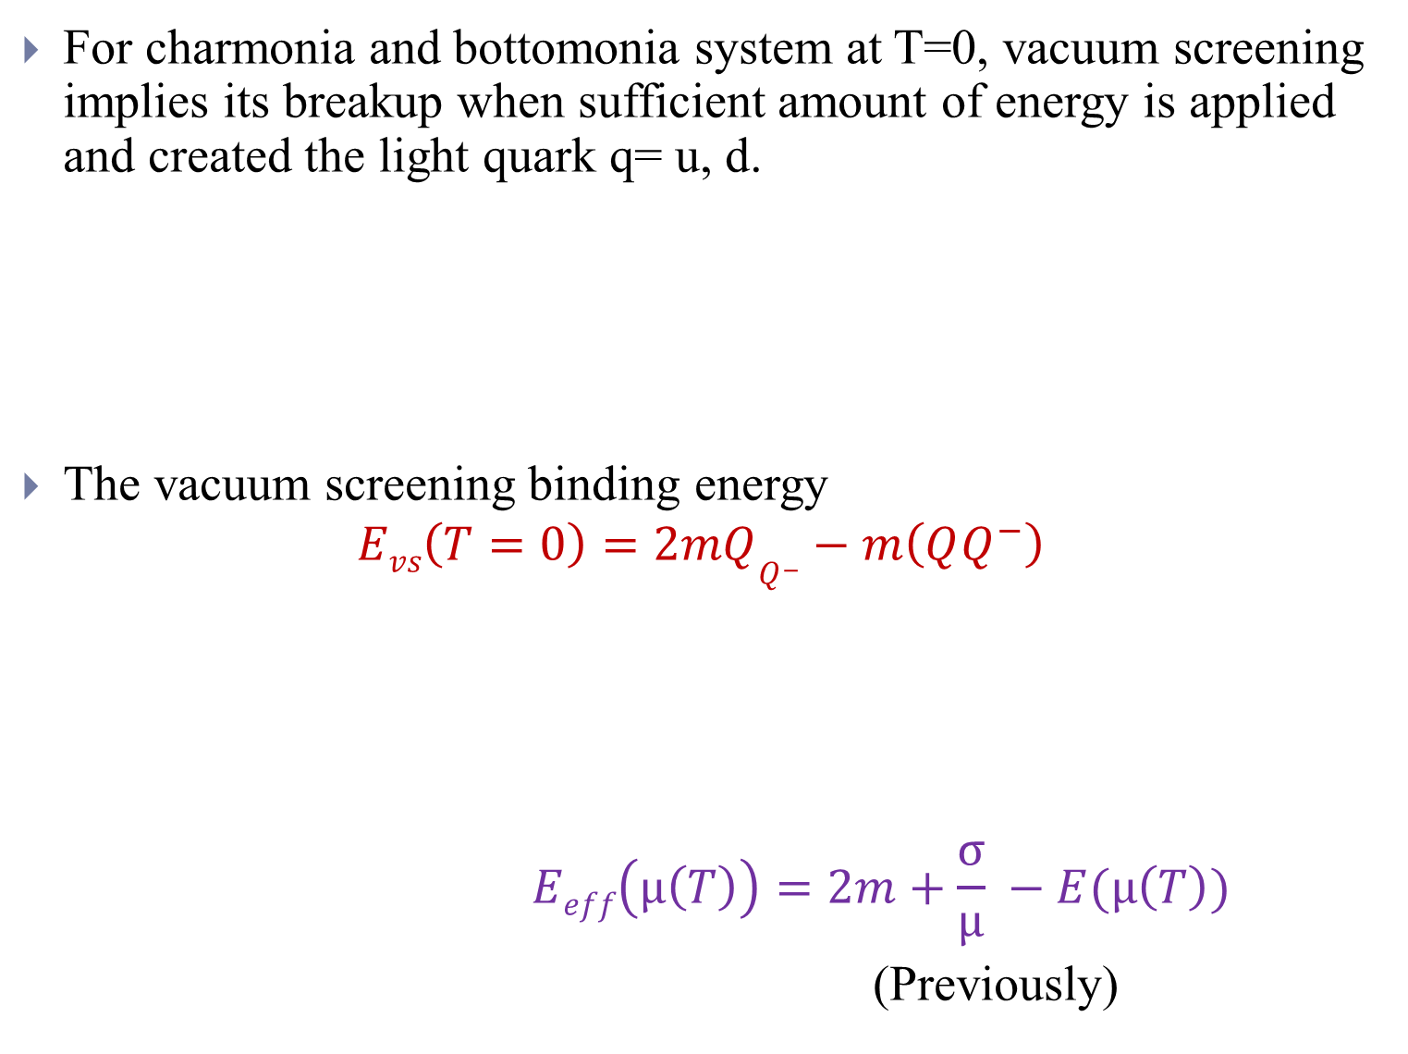
For charmonia and bottomonia system at T=0, vacuum screening implies its breakup when sufficient amount of energy is applied and created the light quark q= u, d.
The vacuum screening binding energy
$$Evs\left(T=0\right)=2mQQ^{−}−m\left(QQ^{−}\right)$$
$$Eeff\left(µ\left(T\right)\right)=2m+\frac{σ}{µ} −E(µ\left(T\right))$$
(Previously)

Slide 14
Charmonia
Bottomonia

Slide 15
Dissociation energy for the 1s,2s and 1p-state of charmonia, the line µ(T=0) indicates the vacuum screening limit at T=0 for the case of potential exponent ʋ=1.0

Slide 16
Dissociation energy for the 1s, 2s and 1p-state of bottomonia, the line µ(T=0) indicates the vacuum screening limit at T=0 for the case of potential exponent ʋ=1.0

Slide 17
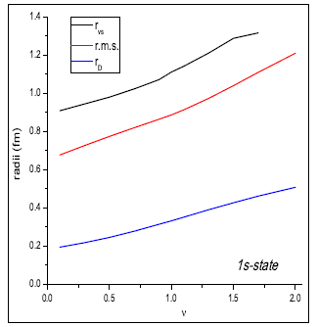

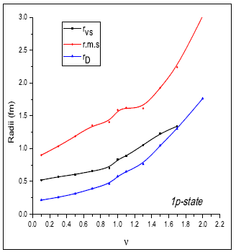
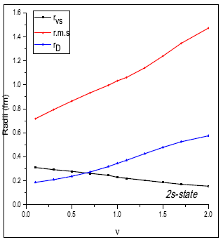
FOR CHARMONIA
Here, plot of rms radii at µ_{c} , colour screening radii (r_{D}=1/µ_{c}) and vaccum screening radii (r_{VS}=1/µ_{VS}) as a fuction of power exponent ν. The states of charmonia gets screened under vacuum screening effect, except the 1s-state of charmonia.

Slide 18
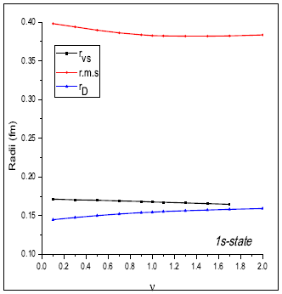
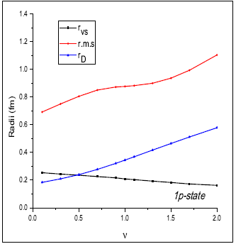
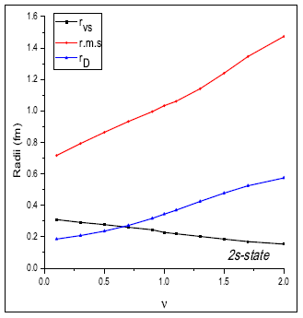
FOR BOTTOMONIA
Here, plot of rms radii at µ_{c} , colour screening radii (r_{D}=1/µ_{c}) and vaccum screening radii (r_{VS}=1/µ_{VS}) as a fuction of power exponent ν. The states of bottomonia gets screened under vacuum screening and medium screening effects.

Slide 19
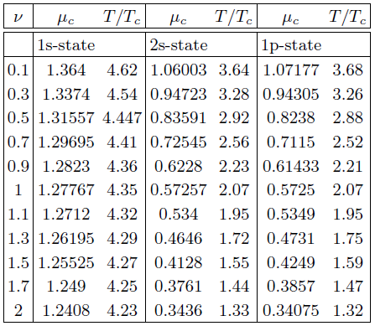
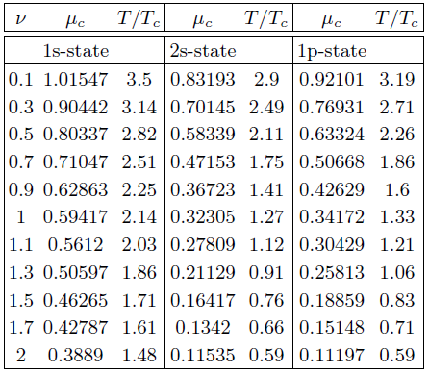
bottomonia
charmonia

Slide 20
Acknowlegment
To my guide Prof. P. C. Vinodkumar
And my colleagues Dr. Arpit Parmar, Dr. Manan Shah and Smruti Patel

Slide 21
Refrence
F. Karsch, M. T. Mehr, H. Satz, Z.Phys. C – Particles and Fields 37, 617-622 (1988).
Arpit Parmar, Bhavin Patel, P. C. Vinodkumar, Nuclear Physics A 848, 299-316 (2010).
S. Jacobs, M. G. Olsson, C. Suchyta: Phys. Rev. D 33, 3338 (1986).
W. Lucha and F. Schorberl, Int. J.Mod. Phys. C 10, 607 (1999), arXiv:hepph/9811453v2

Slide 22

Thank You

Slide 23
Backup slides

Slide 24
confinement potential strength (sigma)
CHARMONIA
BOTTOMONIA

