Slide 1





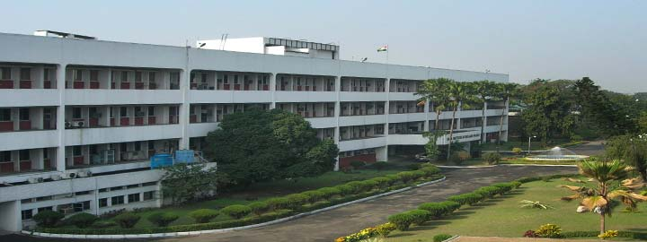
Rare decays of open flavor mesons using
relativistic Dirac formalism
Manan Shah*, #, P C Vinodkumar#
# Department of Physics, Sardar Patel University, Vallabh Vidyanagar-388 120
* P. D. Patel Institute of Applied Sciences, CHARUSAT, Changa-388 421
Gujarat, India
2nd Heavy Flavour Meet 2016
Saha Institute of Nuclear Physics
February 3-5, 2016

Slide 2
Outline
Introduction
Theoretical Methodology
Rare Leptonic decay widths
Pseudoscalar Decay Constant
Results and Discussion
Conclusion
Acknowledgements

Slide 3
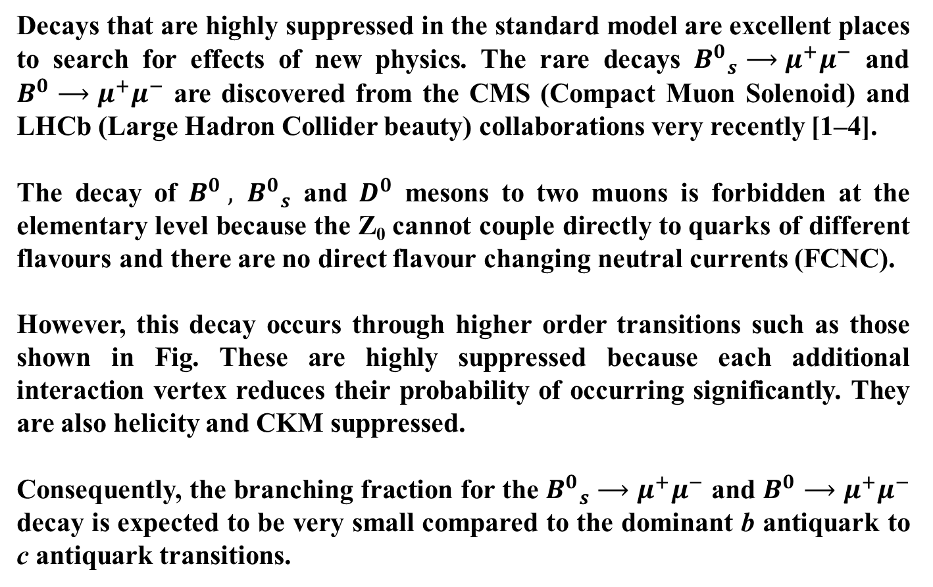
Introduction
Decays that are highly suppressed in the standard model are excellent places to search for effects of new physics. The rare decays ${B^{0}}_{s}⟶μ^{+}μ^{−}$ and $B^{0}⟶μ^{+}μ^{−}$ are discovered from the CMS (Compact Muon Solenoid) and LHCb (Large Hadron Collider beauty) collaborations very recently [1–4].
The decay of $B^{0} , {B^{0}}_{s}$ and $D^{0}$ mesons to two muons is forbidden at the elementary level because the Z₀ cannot couple directly to quarks of different flavours and there are no direct flavour changing neutral currents (FCNC).
However, this decay occurs through higher order transitions such as those shown in Fig. These are highly suppressed because each additional interaction vertex reduces their probability of occurring significantly. They are also helicity and CKM suppressed.
Consequently, the branching fraction for the ${B^{0}}_{s}⟶μ^{+}μ^{−}$ and $B^{0}⟶μ^{+}μ^{−}$ decay is expected to be very small compared to the dominant b antiquark to c antiquark transitions.

Slide 4
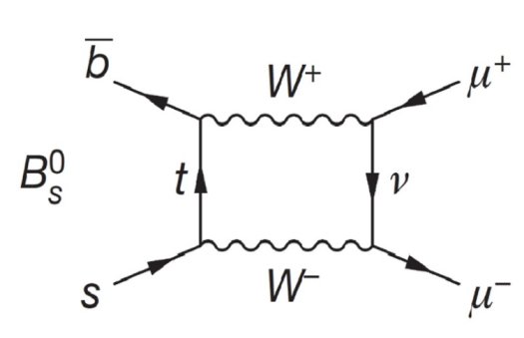
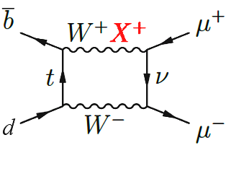
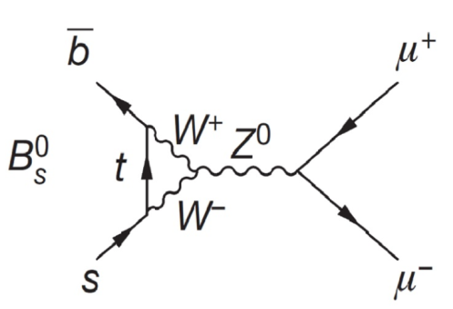
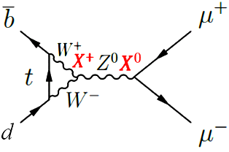
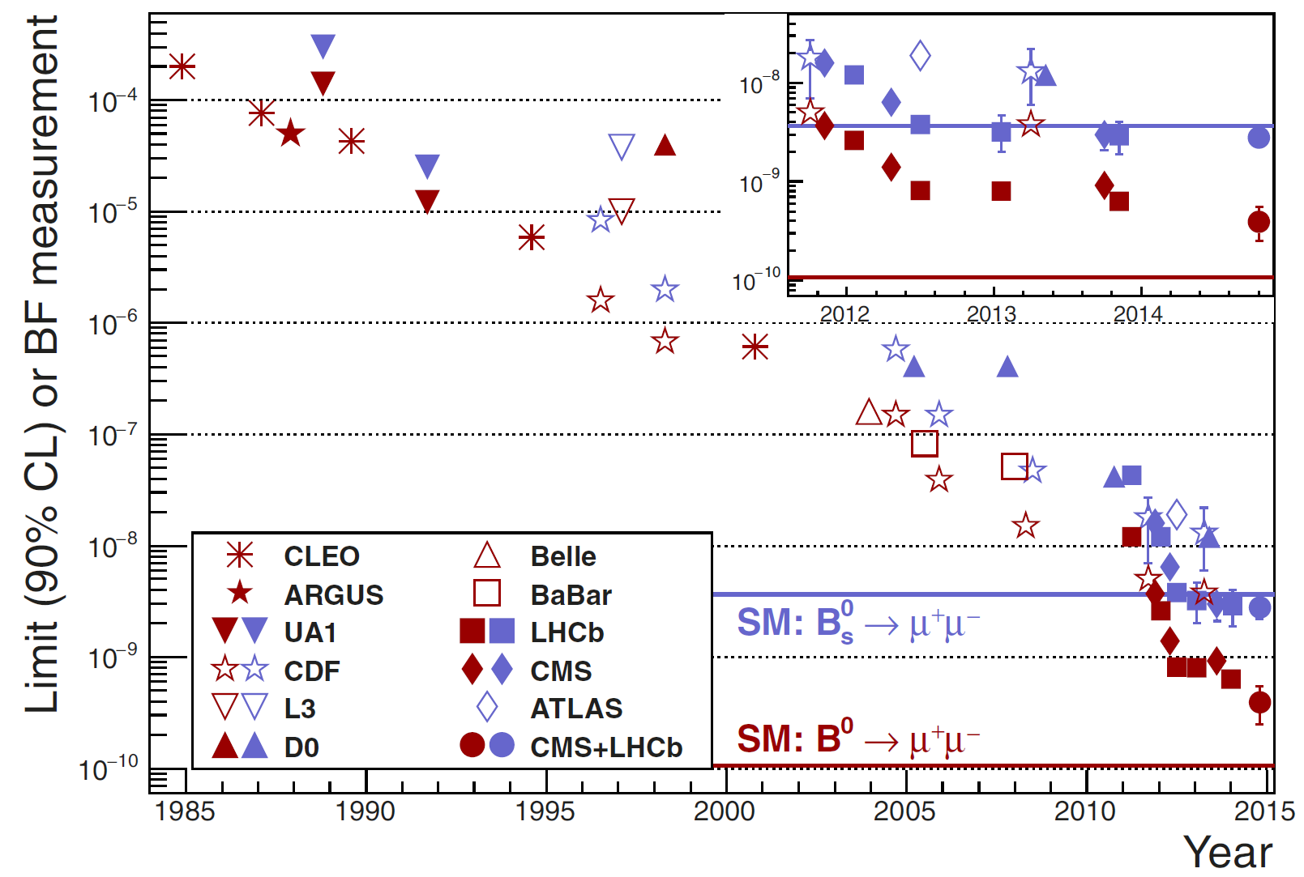
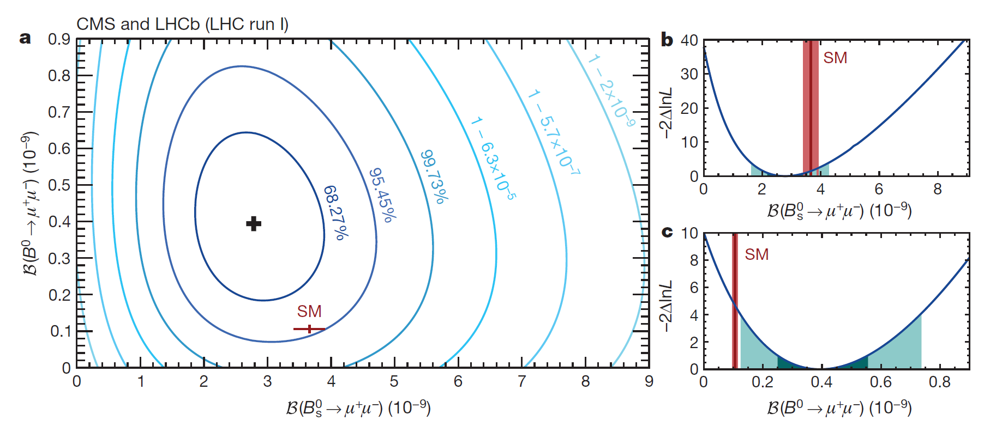
Introduction
Experimental Status

Slide 5
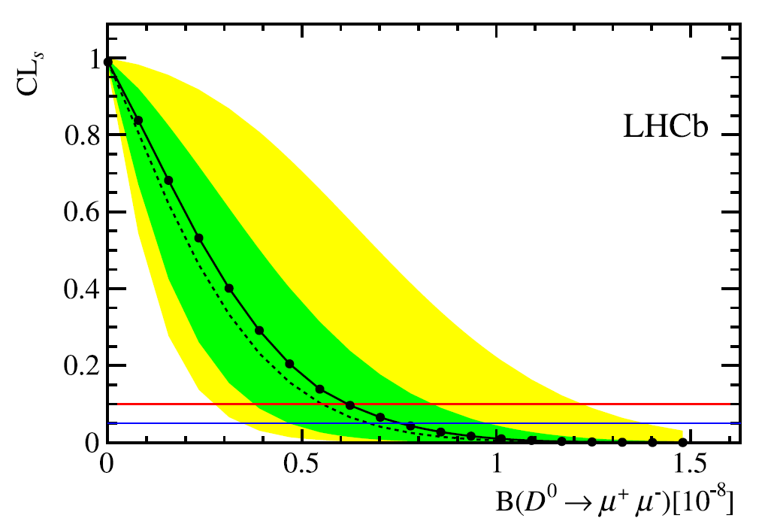

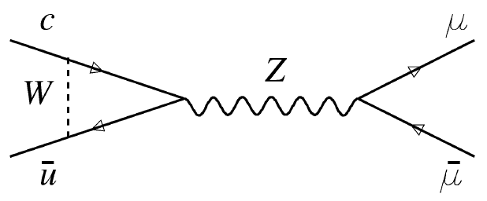
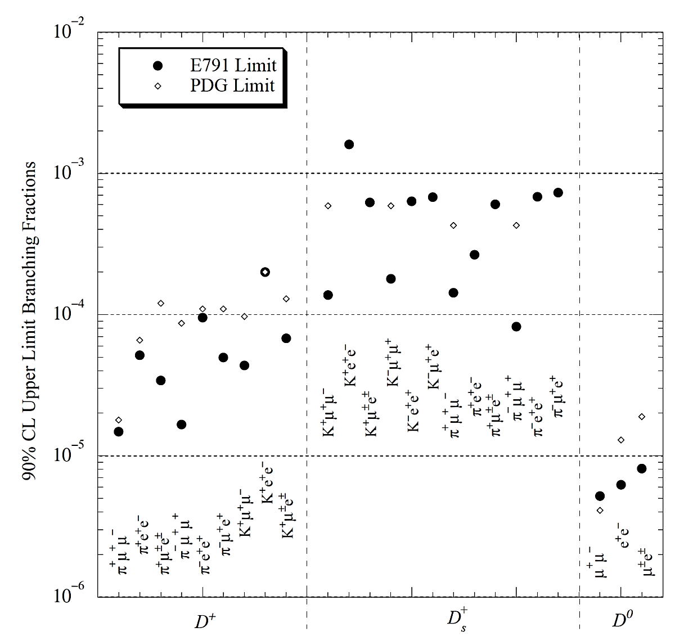


Introduction
Experimental Status
Annu. Rev. Nucl. Part. Sci. 53 (2003) 431
Fermilab E791 Collaboration (2001)
PHYSICAL REVIEW D 66, 014009 (2002)

Slide 6
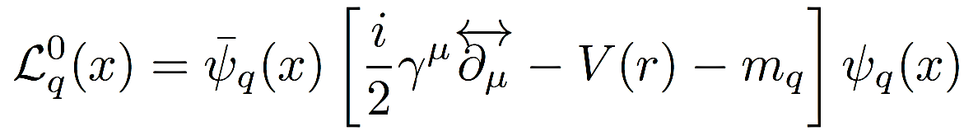
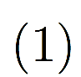
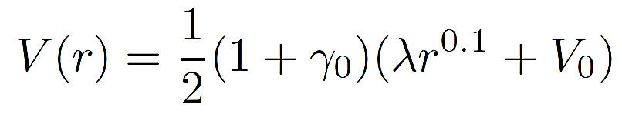

Theoretical Methodology
To first approximation, the confining part of the interaction is believed to provide the zeroth-order quark dynamics inside the meson through the quark Lagrangian density
For the present study, we assume that the constituent quarks inside the meson are independently confined by an average potential of the form [5, 6]
The bound constituent quark and antiquark inside the meson are in definite energy states.

Slide 7
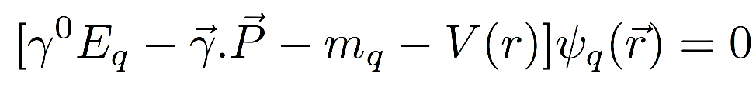

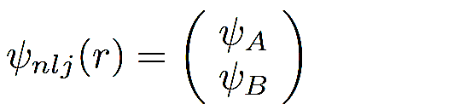
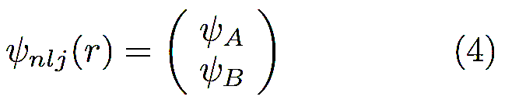
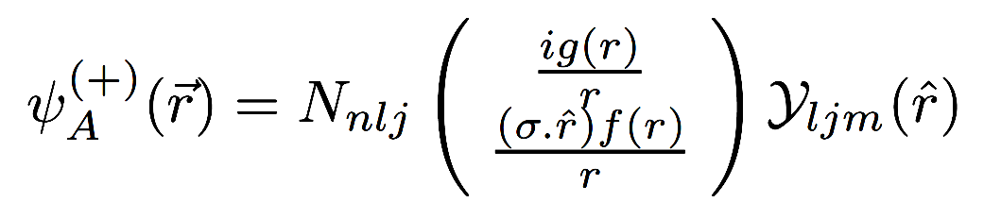
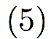
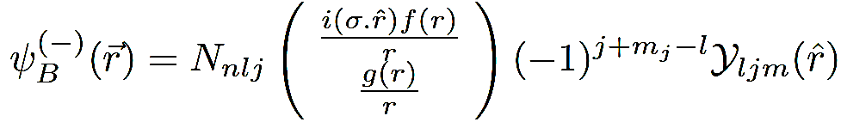

Dirac formalism
The Dirac equation is obtained from as
The solution of Dirac equation can be written as two component (positive and negative energies in the zeroth order) form as
Where the positive and negative energy solutions are written as
N_{nlj} is the overall normalization constant.

Slide 8
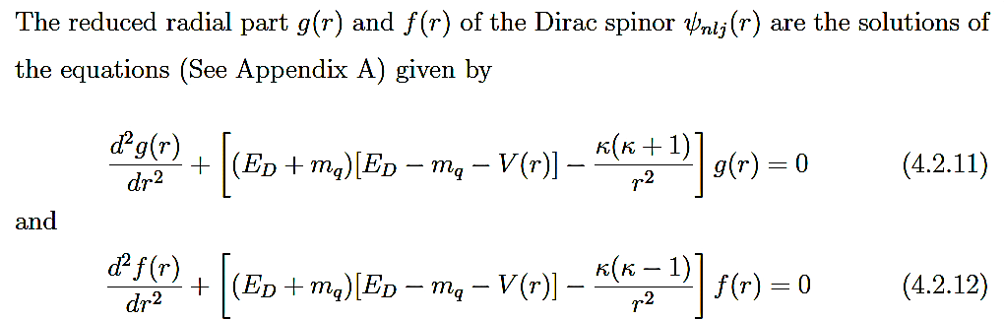
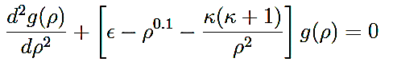
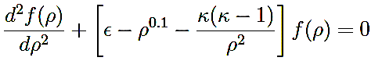
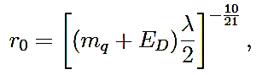
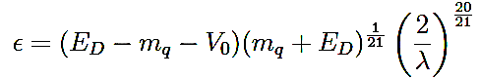
Dirac formalism
The reduced radial part g(r) and f(r) of the Dirac spinor of $ψ_{nlj}\left(r\right)$ are the solutions of the equations given by
It can be transformed into a convenient dimensionless form given as [7]
where $ρ=(r/r_{0})$ is a dimensionless variable with an arbitrary scale factor chosen conveniently as
and $ε$ is a corresponding dimensionless energy eigenvalue defined as

Slide 9
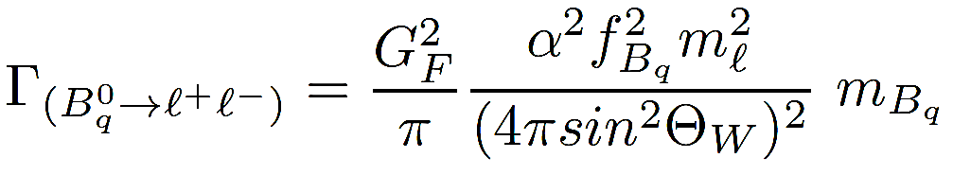
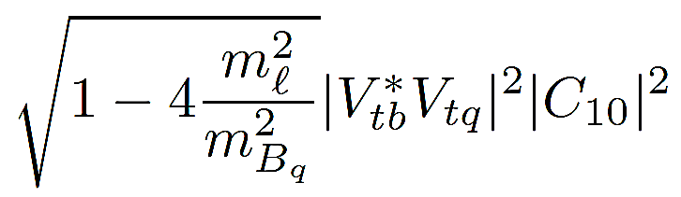
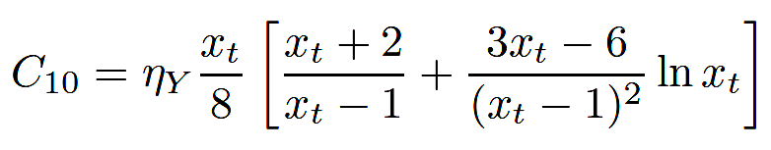
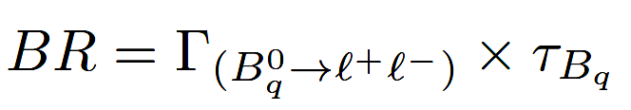
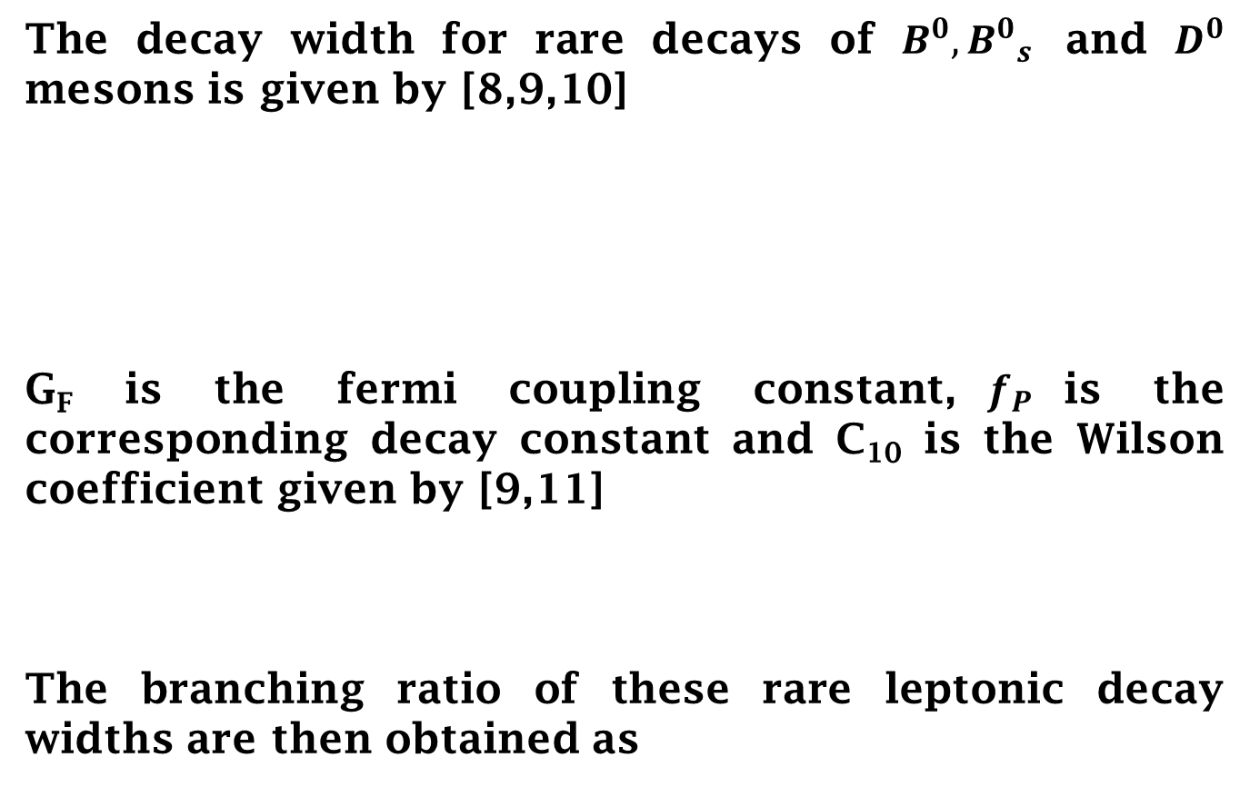
Rare Leptonic Decay Widths
The decay width for rare decays of $B^{0}, {B^{0}}_{s}$ and $D^{0}$ mesons is given by [8,9,10]
G_{F} is the fermi coupling constant,$f_{P}$is the corresponding decay constant and C₁₀ is the Wilson coefficient given by [9,11]
The branching ratio of these rare leptonic decay widths are then obtained as

Slide 10
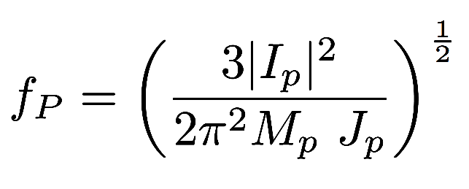
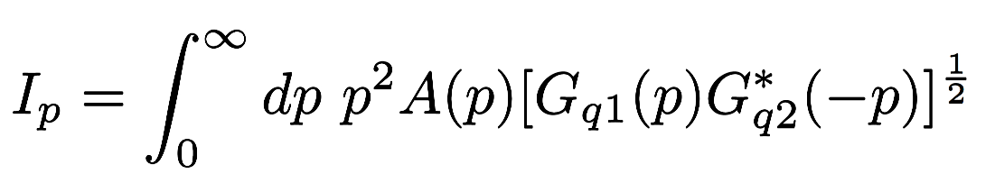
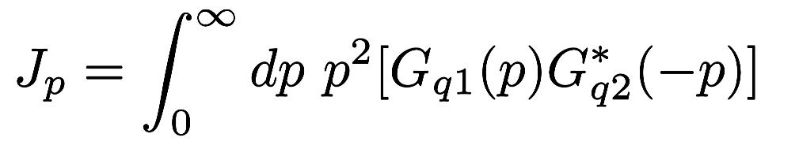
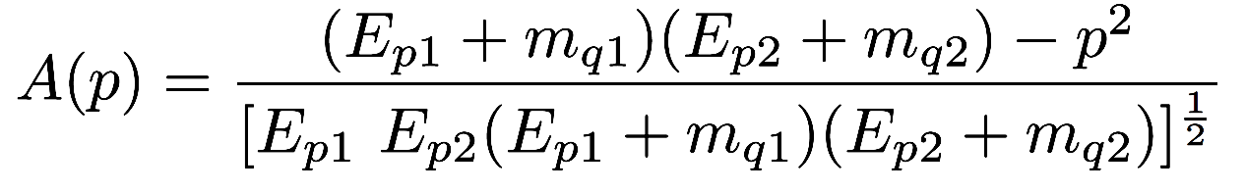
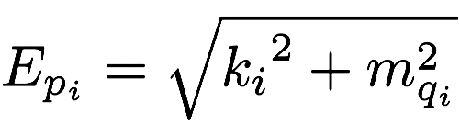
Pseudoscalar DecayConstant
In the relativistic quark model, the pseudoscalar decay constant can be expressed through the meson wave function in the momentum space [12,13]
Here M_{P} is mass of the pseudoscalar meson and I_{P} and J_{P} are defined as
;
Where
and .

Slide 11
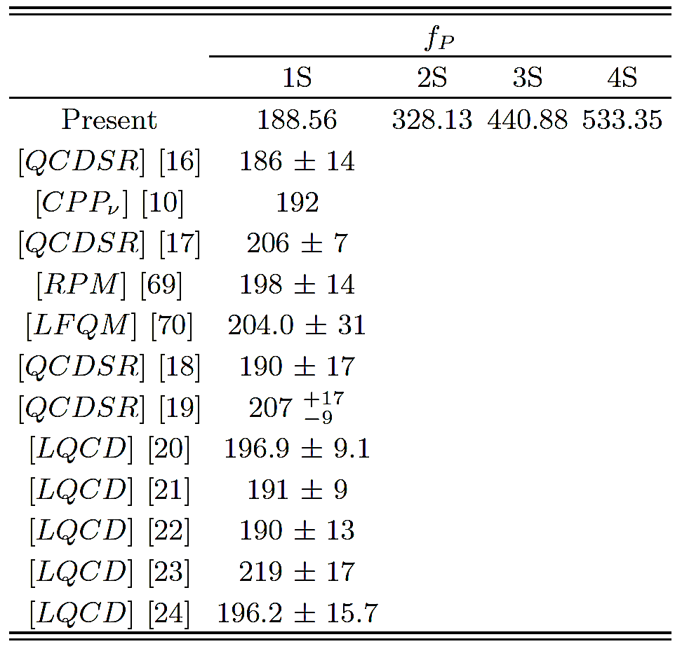
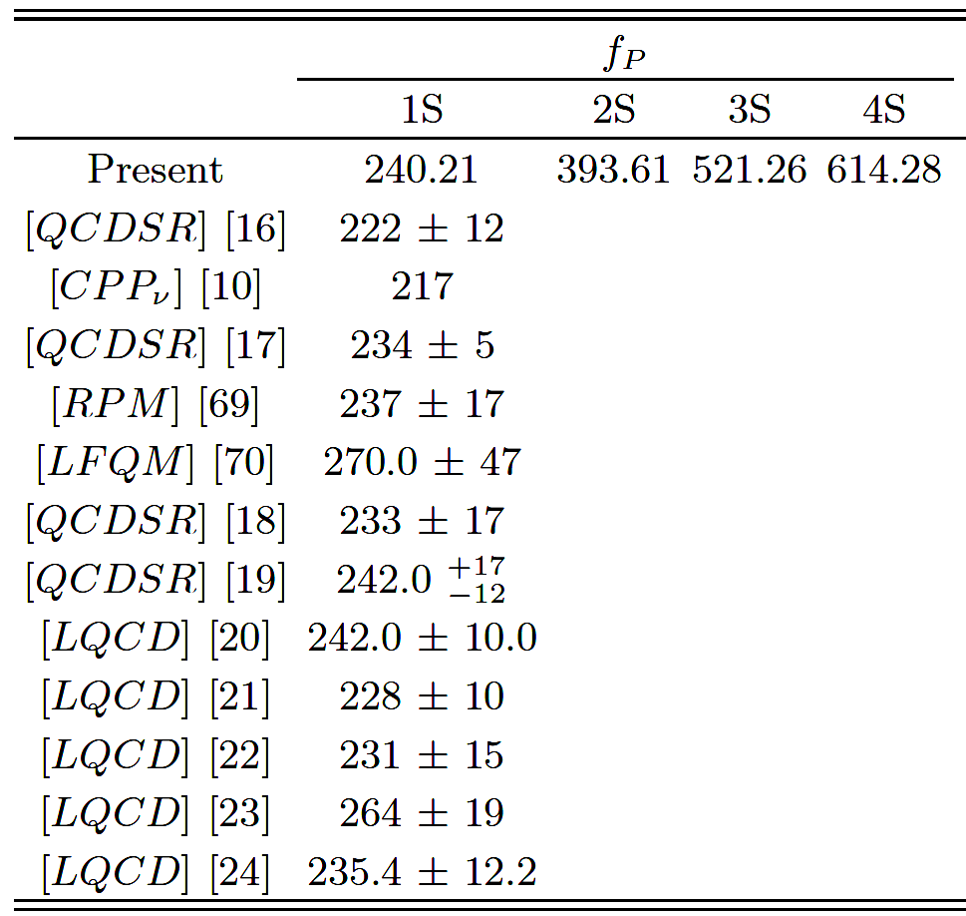


Results and Discussion
Pseudoscalar decay constant (f_{P} ) of $B^{0}$ and ${Bs}_{}^{0}$ systems (in MeV)
$B^{0}$ meson
${Bs}_{}^{0}$meson

Slide 12
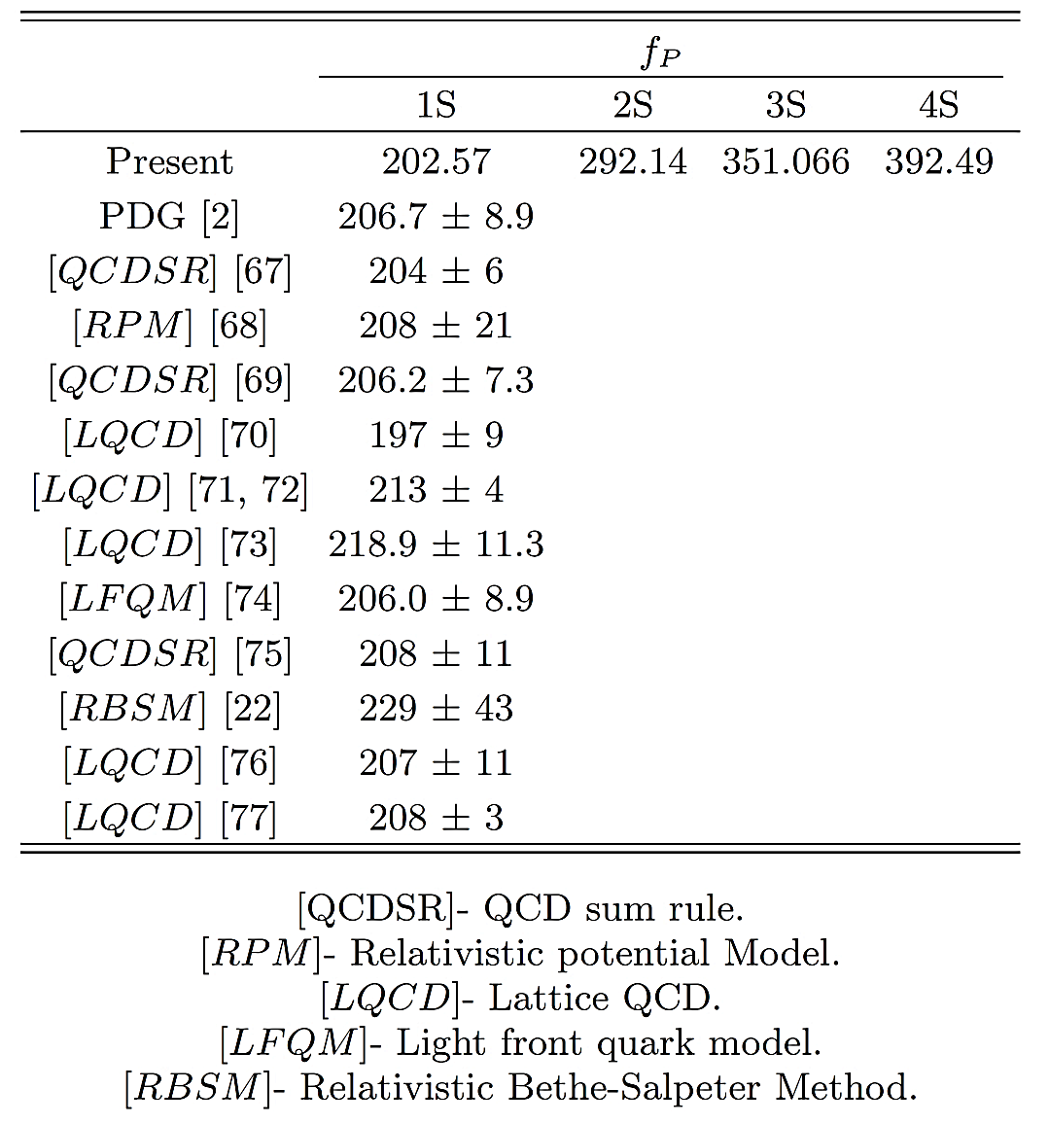
Results and Discussion
Pseudoscalar decay constant (f_{P} ) of $D_{}^{0}$ systems (in MeV)
D meson
Manan Shah, Bhavin Patel, P. C. Vinodkumar,
Eur. Phys. J. C 76 (2016) 36

Slide 13
Results and Discussion
The fitted model parameters
System Parameters | B⁰ | B_{S}⁰
Quark Mass (in GeV) | m_{u,d} = 0.003 and m_{b} = 4.67 | m_{s} = 0.1 and m_{b} = 4.67
Potential parameter (λ) | 2.3756 + A GeV^{ν+1}
V₀ | -2.6461 GeV
Centrifugal parameter (A) | (n*0.1030) GeV^{ν+1} , for l = 0; ((n + l )*0.086) GeV^{ν+1} , for l ≠ 0 | (n*0.1186) GeV^{ν+1} , for l = 0; ((n + l )*0.091) GeV^{ν+1} , for l ≠ 0
System Parameters | D⁰
Quark Mass (in GeV) | m_{u,d} = 0.003 and m_{b} = 1.27
Potential parameter (λ) | (2.2903 + B) GeV^{ν+1}
V₀ | -2.6711 GeV
Centrifugal parameter (B) | (n*0.153) GeV^{ν+1} , for l = 0; ((n + l )*0.1267) GeV^{ν+1}, for l ≠ 0.

Slide 14
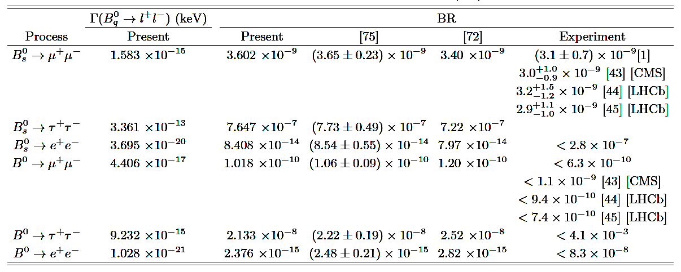
Conclusion
Branching ratio for rare decay of $B^{0}$ and ${Bs}_{}^{0}$ mesons
[10]
[15]
[14]
[2]
[3]
[4]
[2]
[3]
[4]
S. Chatrchyan et al. (CMS Collaboration), Phys. Rev. Lett. 111, 101804 (2013).
R. Aaij et al. (LHCb Collaboration), Phys. Rev. Lett. 110, 021801 (2013).
R. Aaij et al. (LHCb Collaboration), Phys. Rev. Lett. 111, 101805 (2013).
Christoph Bobeth, et al., Phys. Rev. Lett. 112, 101801 (2014).
K.A. Olive et al. (Particle Data Group), Chin. Phys. C 38, 090001 (2014).
K. Nakamura et al. (Particle Data Group), Phys. Rev. D 86, 010001 (2012).
P. Dimopoulos et al., JHEP, 01, 046 (2012).

Slide 15

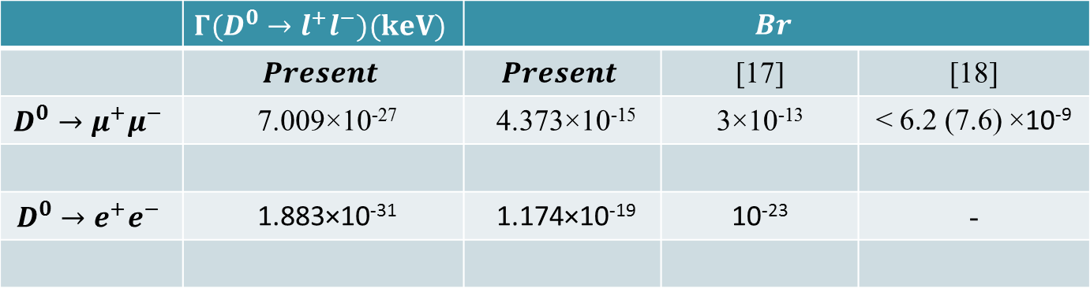
Conclusion
Branching ratio for rare decay of $D^{0}$ meson
 | $$Γ(D^{0}→l^{+}l^{−})(keV)$$ | $$Br$$
 | $$Present$$ | $$Present$$ | [17] | [18]
$$D^{0}→μ^{+}μ^{−}$$ | 7.009×10⁻²⁷ | 4.373×10⁻¹⁵ | 3×10⁻¹³ | < 6.2 (7.6) ×10⁻⁹
$$D^{0}→e^{+}e^{−}$$ | 1.883×10⁻³¹ | 1.174×10⁻¹⁹ | 10⁻²³ | -
Gustavo Burdman, Ian Shipsey, Annu. Rev. Nucl. Part. Sci., 53, 431 (2003).
R.Aaij et al. (LHCbCollaboration), Phys.Lett. B 725, 15 (2013).

Slide 16
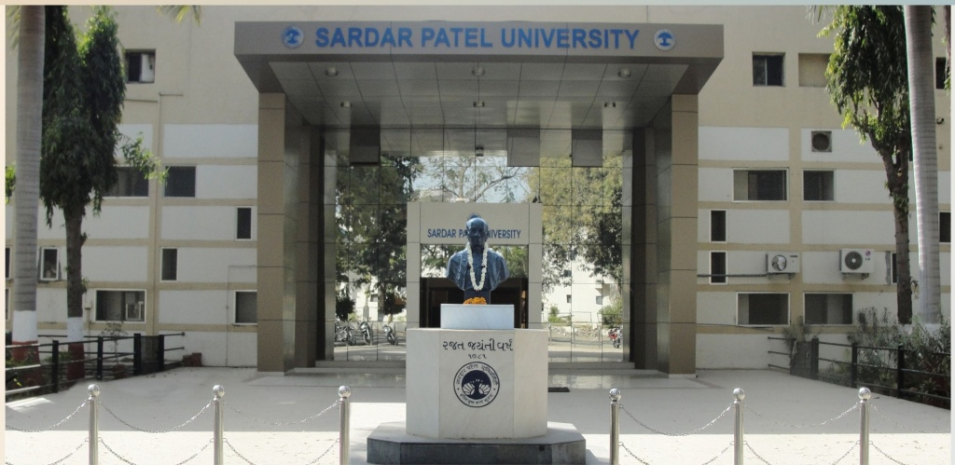
Acknowledgement
Colleagues: Bhavin Patel, Arpit Parmar, Smruti Patel and Palak Bhatt
The work is done under UGC Major research project No. F.40-457/2011(SR).

Slide 17
References
V. Khachatryan et al. (CMS and LHCb collaborations) Nature 522, 68 (2015).
S. Chatrchyan et al. (CMS Collaboration), Phys. Rev. Lett. 111, 101804 (2013).
R. Aaij et al. (LHCb Collaboration), Phys. Rev. Lett. 110, 021801 (2013).
R. Aaij et al. (LHCb Collaboration), Phys. Rev. Lett. 111, 101805 (2013).
N.Barik, B. K. Dash, and M. Das, Phys. Rev. D 31, 1652 (1985).
Manan Shah, Bhavin Patel and P. C. Vinodkumar, Phys. Rev. D 90, 014009 (2014), Proceedings of the DAE Symp. on Nucl. Phys. 58, 626 (2013).
N. Barik, S. N. Jena, Phys. Rev. D 26, 2420 (1982).
Christoph Bobeth, Martin Gorbahn and E. Stamou, Phys. Rev. D 89, 034023 (2014).
G. Buchalla and A.J. Buras, Nucl. Phys. B 400, 225 (1993).
Christoph Bobeth, et al., Phys. Rev. Lett. 112, 101801 (2014).
Andrzej J. Buras, arXiv:hep-ph/9806471 [hep-ph], TUMHEP-316/98.
N. Barik, P. C. Dash and A. R. Panda, Phys. Rev. D 47, 1001 (1993).
Hakan C Iftci and Huseyin Koru, Int. J. Mod. Phys. E 9, 407 (2000).
K.A. Olive et al. (Particle Data Group), Chin. Phys. C 38, 090001 (2014).
K. Nakamura et al. (Particle Data Group), Phys. Rev. D 86, 010001 (2012).
P. Dimopoulos et al., JHEP, 01, 046 (2012).
Manan Shah, Bhavin Patel, P. C. Vinodkumar, Eur. Phys. J. C 76, 36 (2016) .
Gustavo Burdman, Ian Shipsey, Annu. Rev. Nucl. Part. Sci., 53, 431 (2003).
R.Aaij et al. (LHCbCollaboration), Phys.Lett. B 725, 15 (2013).

Slide 18

Thank You
for your patience

