Slide 1
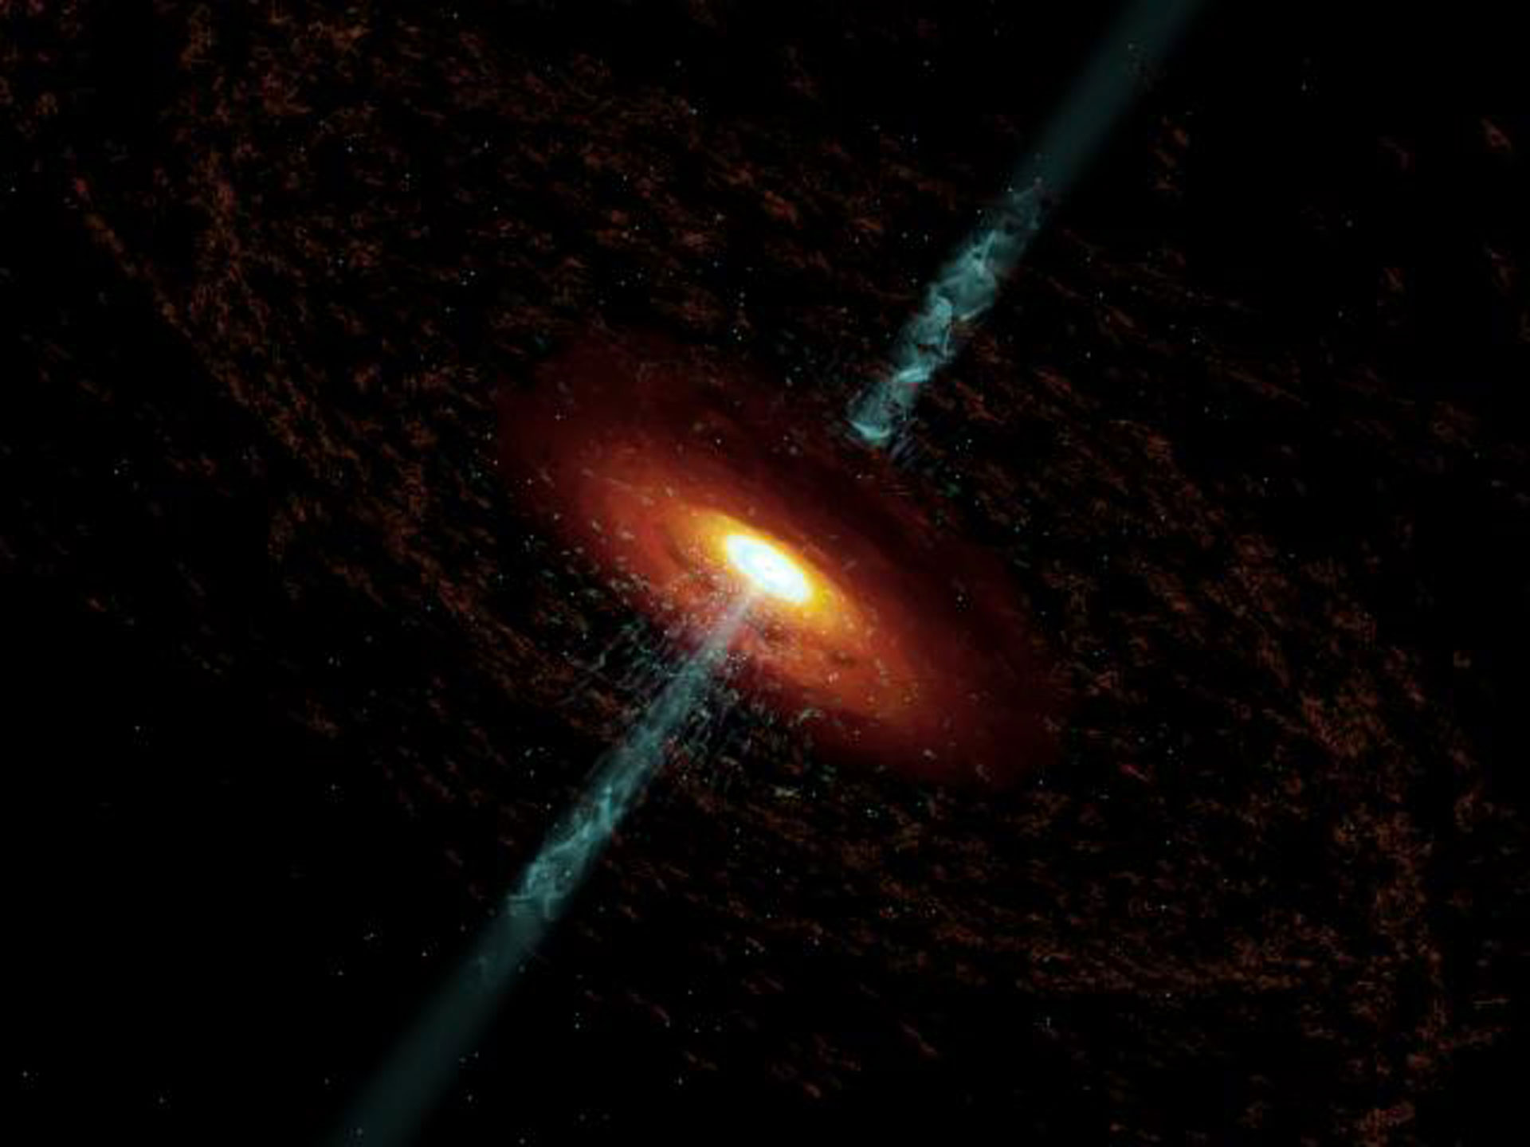


New insights into high-energy emission from kpc-scale extragalactic jets
Agniva Roychowdhury, University of Maryland Baltimore County, USA.
AAPCOS, SINP, Kolkata, 26th January, 2023.
Co-authors: Eileen Meyer (PhD advisor), Markos Georganopoulos

Slide 2
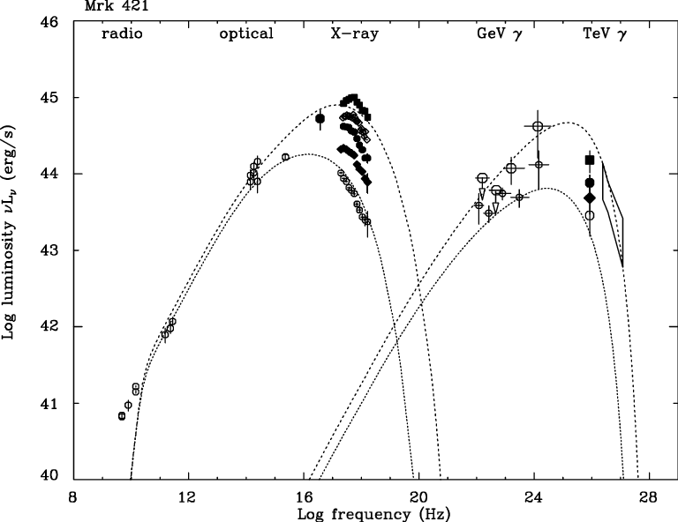
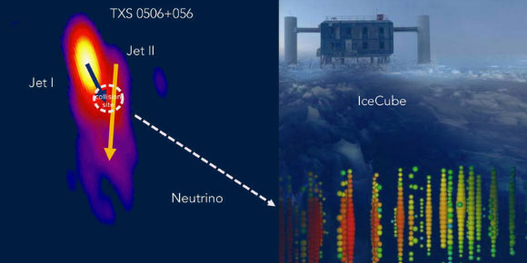
Blazars, neutrinos and cosmic rays
Leptonic synchrotron
Synchrotron self-Compton (SSC)
TXS 0506+056: source of neutrinos → particle acceleration to millions of TeV?
Archetypal blazar Markarian 421
Notes:
and as we know, blazars are a class of active galactic nuclei with a prominent jet pointed close towards our line of sight thereby producing Doppler boosted emission through radio to high-energy gamma-rays. Mrk 421 is a typical blazar characterised by two components in the SED. The low energy spectrum is well understood to be leptonic synchrotron and the high energy is SSC in the core. Although in this specific case SSC is plausible, the origin and location of this high-energy component is not well known for most blazars and there are a number of reasons we care about GeV-TeV emitting extragalactic objects.
for example, detection of neutrinos from blazar TXS 0506 suggests photohadronic radiative processes which in turn implies particle acceleration to millions of TeV, that can can explain origin of UHE CRs.

Slide 3
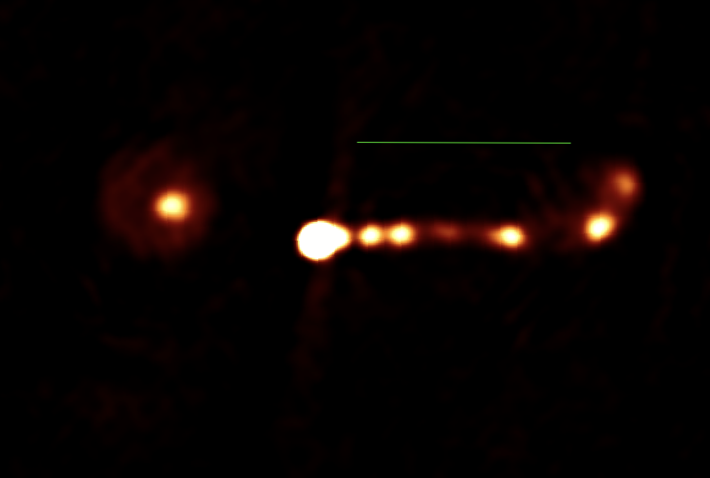
counter-hotspot
core
large-scale or kpc-scale jet
(0.1-100 kpc)
PKS 22090+080 | VLA 15 GHz

Slide 4
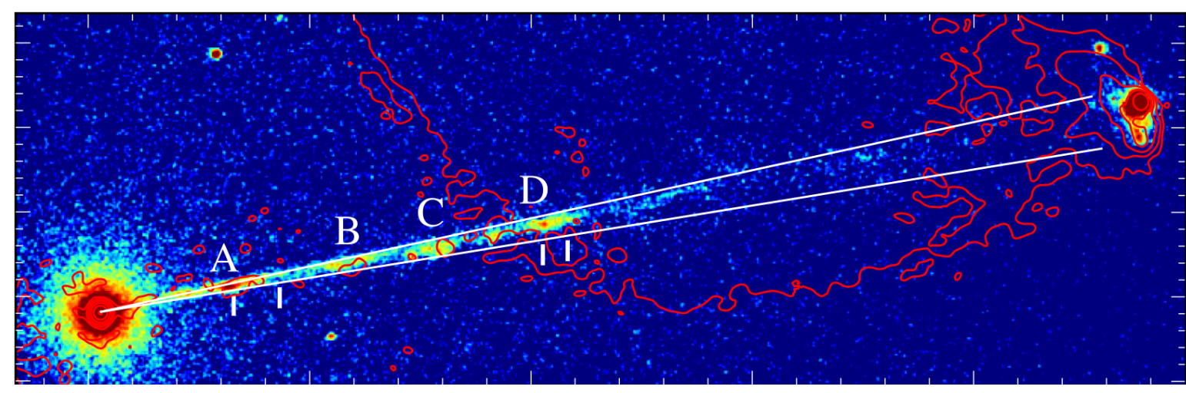
Why do kpc-scale radio jets produce X-rays?
Chandra imaging of Pictor A (Hardcastle+ 2016)
Not the focus of today’s talk. Please see Breiding+ 2022, Meyer+ 2015, 16 and references therein.
Focus : steps to understand SED modelling of large-scale jets.

Slide 5
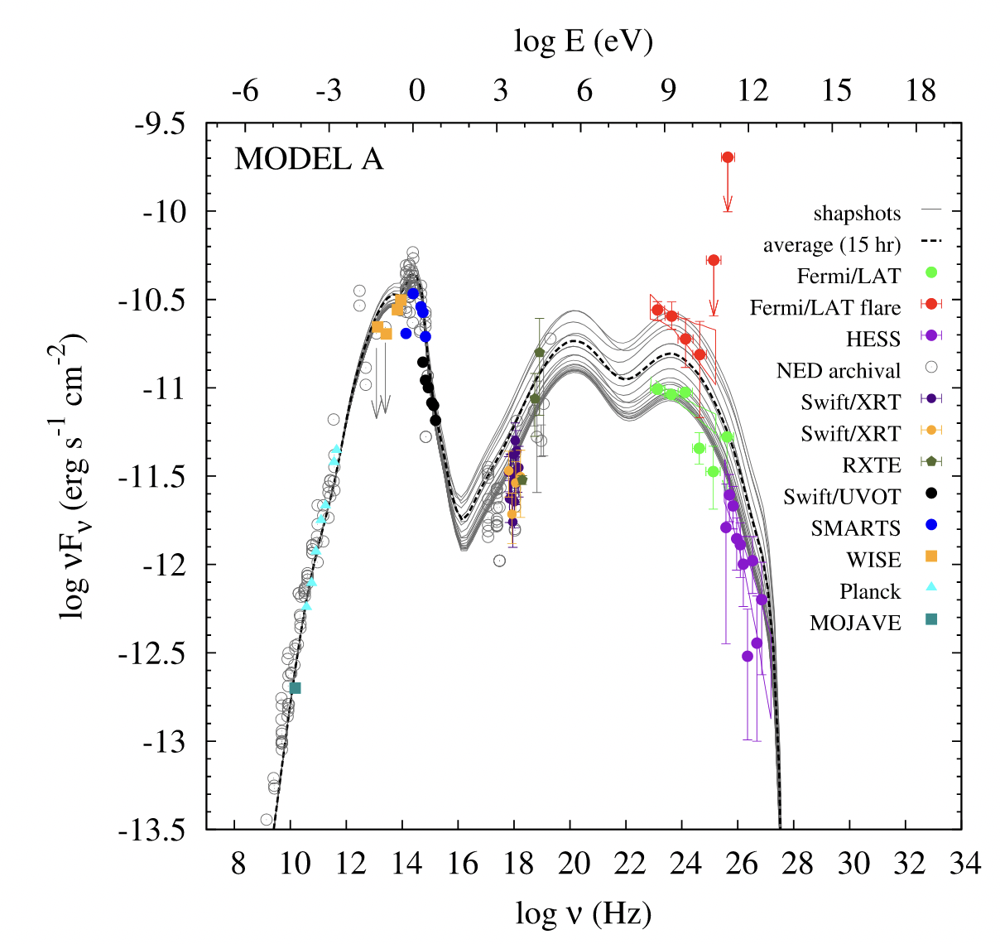
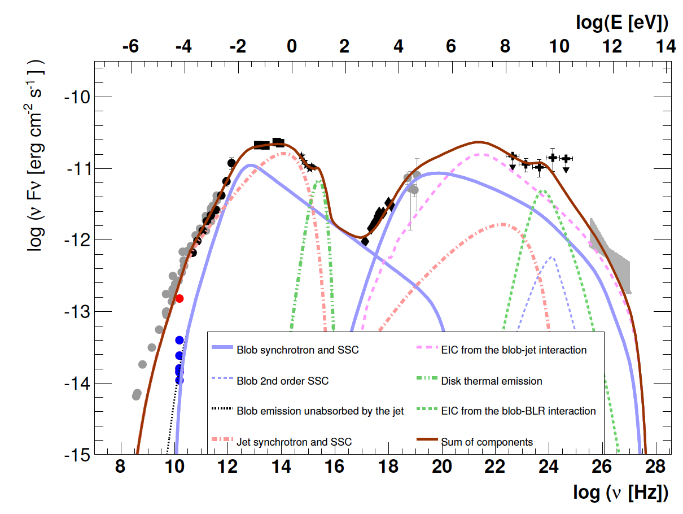
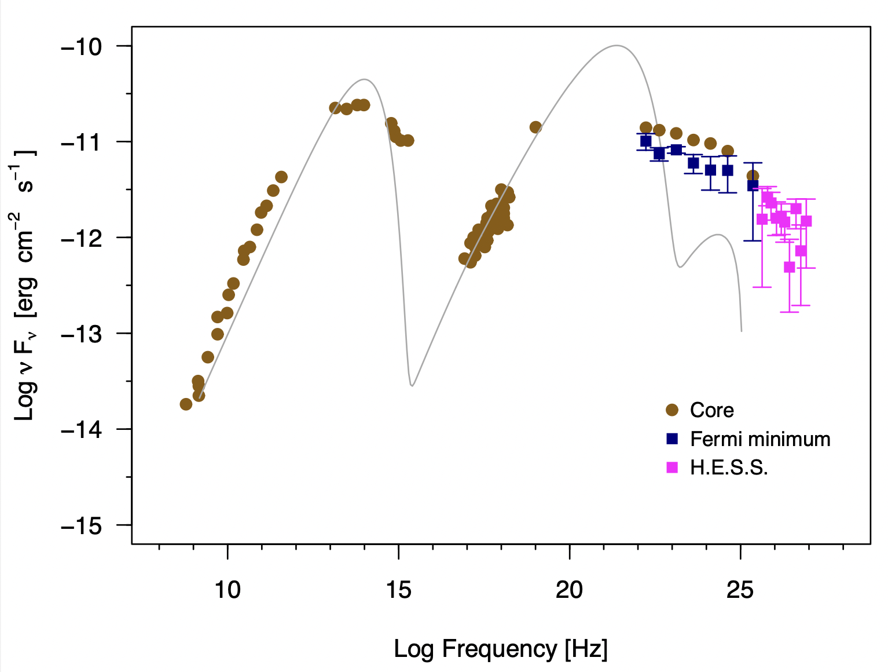
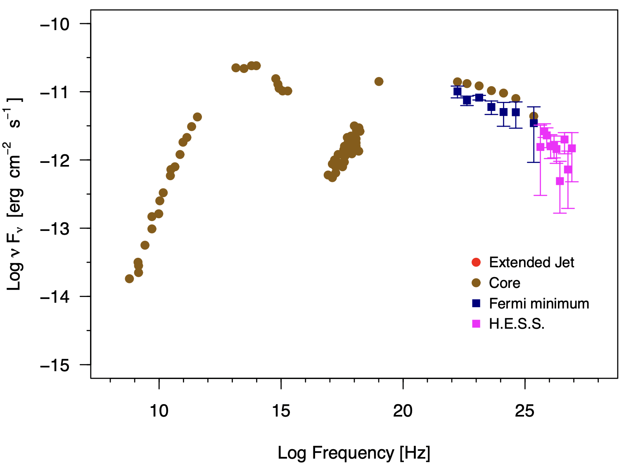
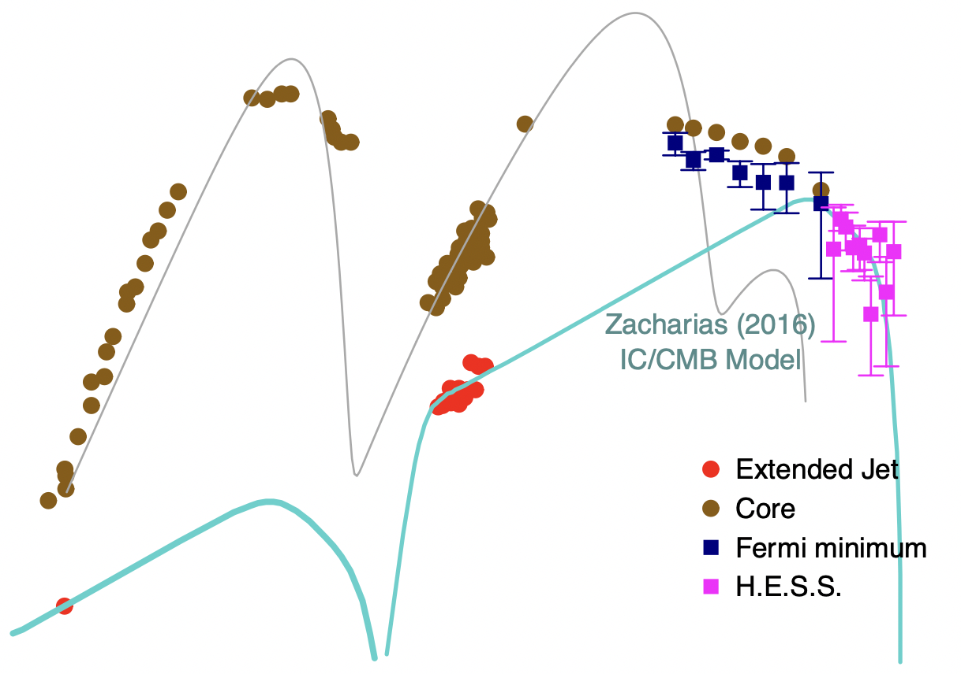
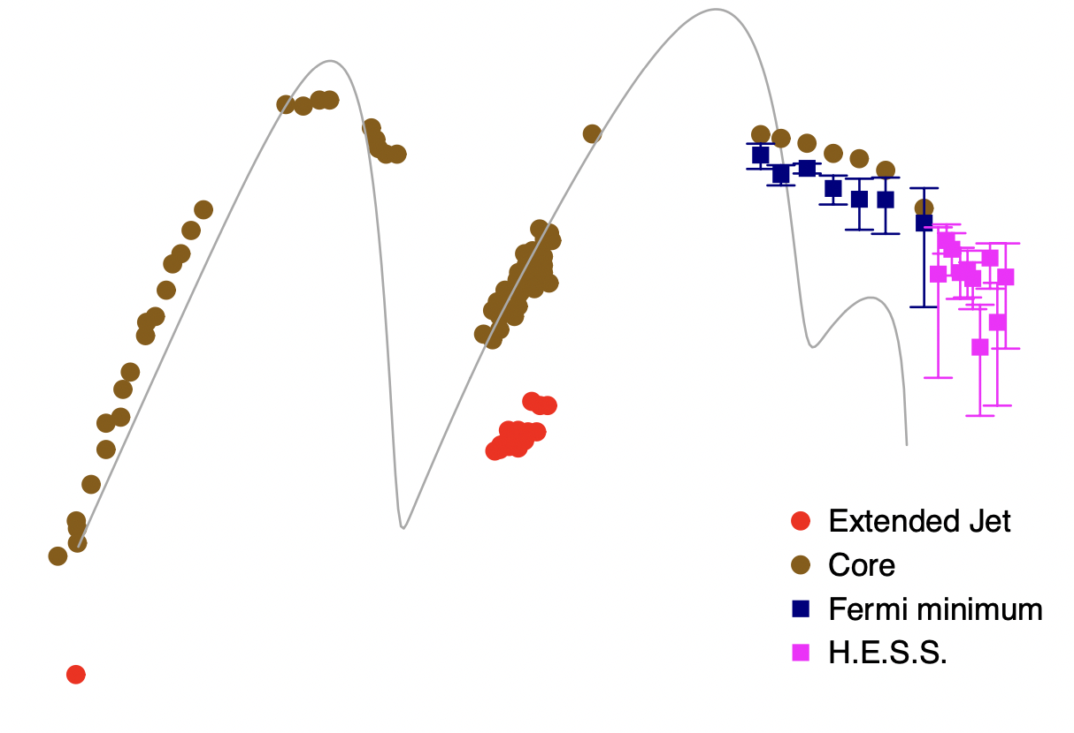
Case I : AP Librae
Origin of VHE emission unknown: one-zone synchrotron self-Compton models not viable.
Zacharias+, Sanchez+ 2016: inverse Compton scattering of Cosmic Microwave Background photons in the kpc-scale jet (“IC/CMB”): multi-TeV electrons, equipartition field and near Eddington jet power.
Hervet+ 2015. pc-scale blob-in-a-jet model: leptonic radiation but super-Eddington jet powers dominated by protons.
Petropoulou+ 2016. Photohadronic processes in the core: 10-100 times Eddington power, radiation dominated by 1000 TeV protons.
Notes:
and we interestingly find that the TeV emission cannot be explained by a simple one-zone SSC model, unlike Mrk 421. hence there have been a number of concerted efforts over the last decade to explain this VHE emission.
now in addition to the core, the object also has a very bright X-ray and radio jet and Zacharias (2016) proposed that
and that actually forms a part of our goal, to understand what exactly may be going on.

Slide 6
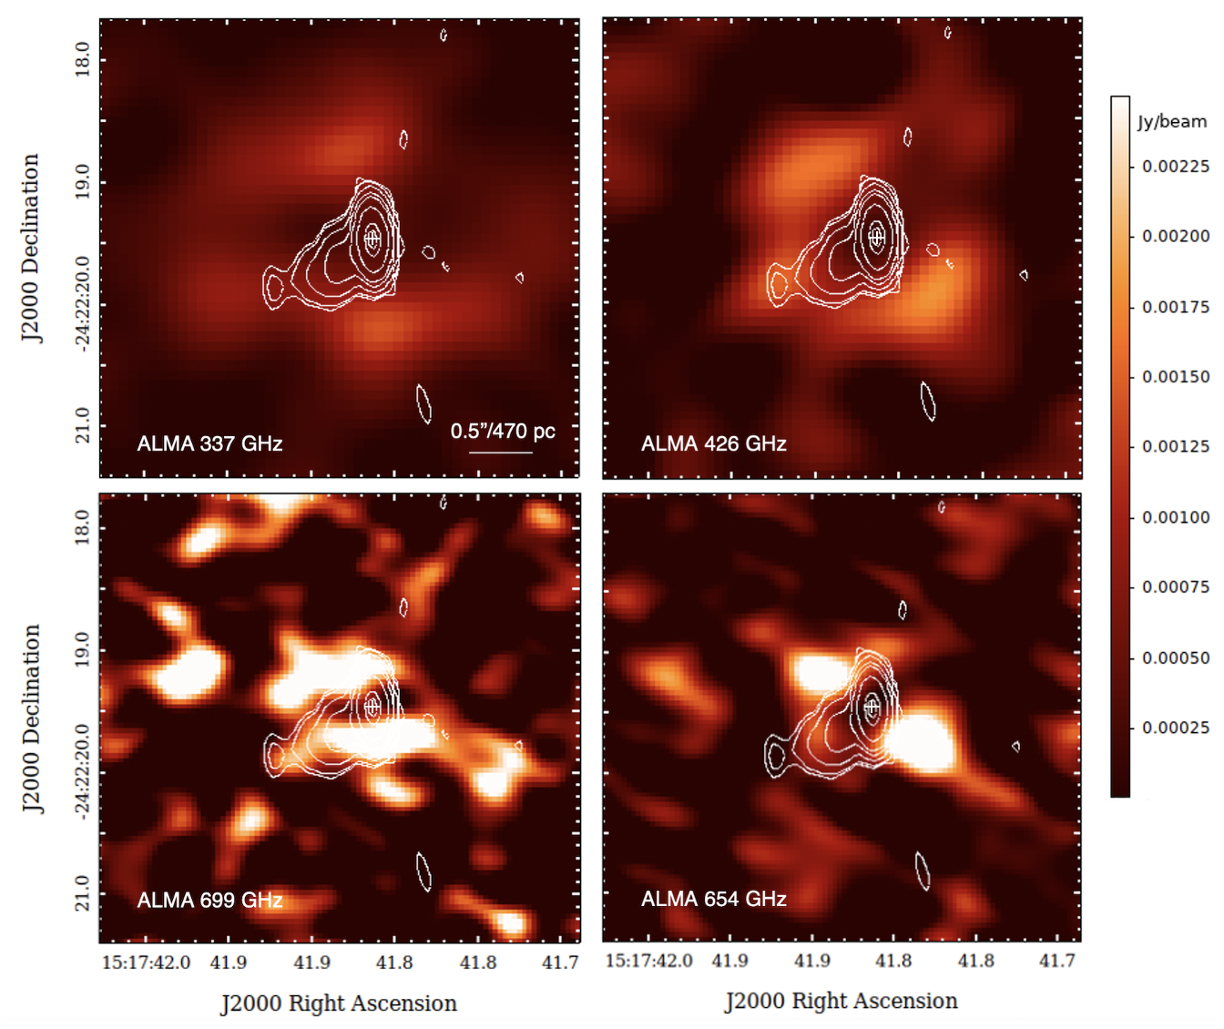
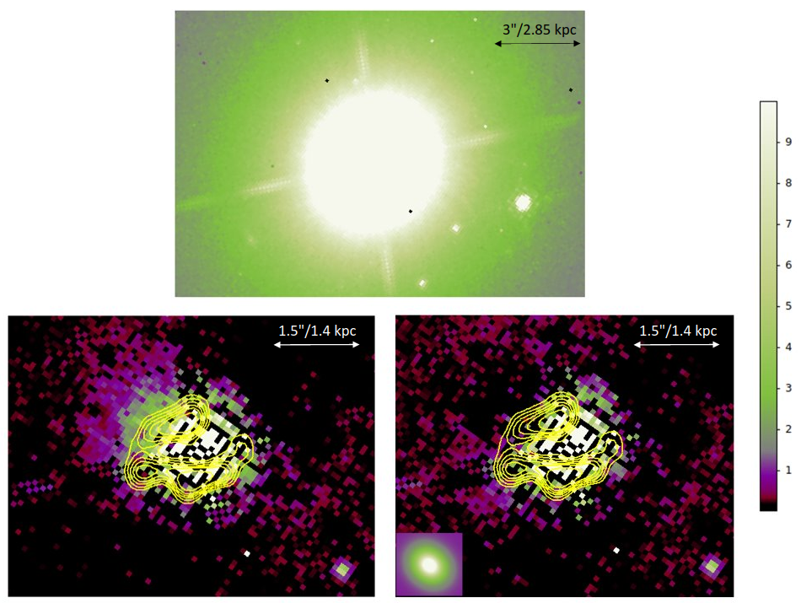
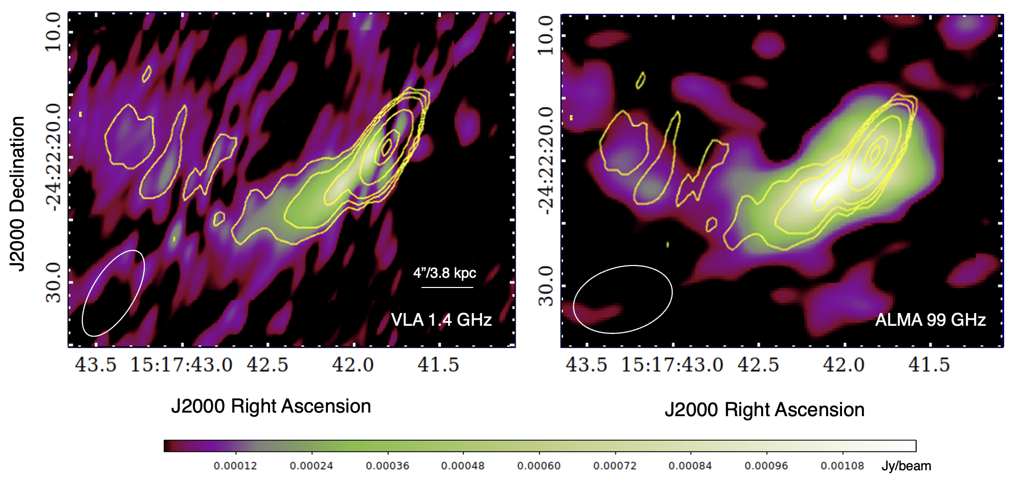
Analyzing radio/sub-mm archival observations
Residual

Slide 7
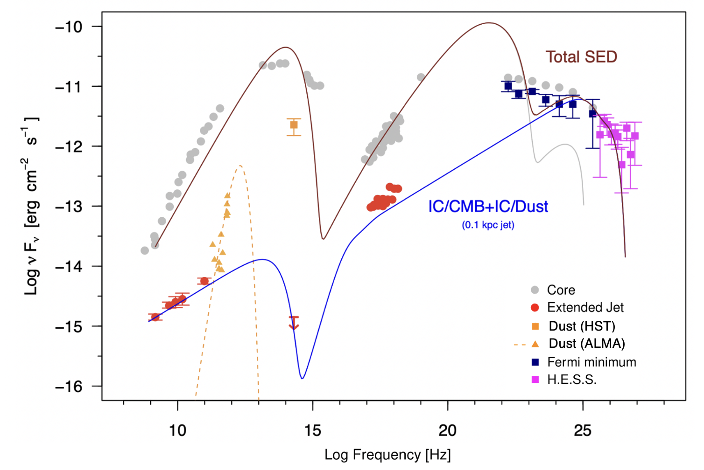
>100 GeV emission: IC/CMB
TeV emission: IC/Dust
Blackbody at 25 K
Projected location of TeV emission : 0.1 kpc
Immune to 𝛾-𝛾 pair production opacity.
Roychowdhury et al., 2022, ApJ, 924, 2
Notes:
Okay, now this spectrum assumes the following morphology with the de-projected
which implies it is immune to ....
which further implies that if and only if our detection is that of a covering dusty disk, TeV emission from the pc-scale core would simply be absorbed by this large-scale dusty torus and hence models that predict pc-scale TeV emission can be ruled out and that is one of the big outcomes of this work.

Slide 8
Where does our model stand?
Plausible explanation of TeV emission is IC/Dust in the >100 pc jet.
Purely leptonic model: but requires continual acceleration through ~ 1 kpc in de-projected length.
Uses the least number of model parameters compared to previous studies.
Max electron energies ~ 100 GeV.
Requires sub-Eddington jet luminosity (lower limit to total jet power).
Magnetic field in the extended jet close to equipartition.

Slide 9
Takeaway (I) :
Large-scale jet SED modelling very non-trivial : multi-wavelength, differing resolutions and visible jet sizes/features.
Consideration of possible unexplored photon fields using all archival observations.
Making sure one-zone models are consistent with the large-scale jet properties : for example, not using a spherical emission region with radius 1 kpc when the jet cross section is much smaller.

Slide 10
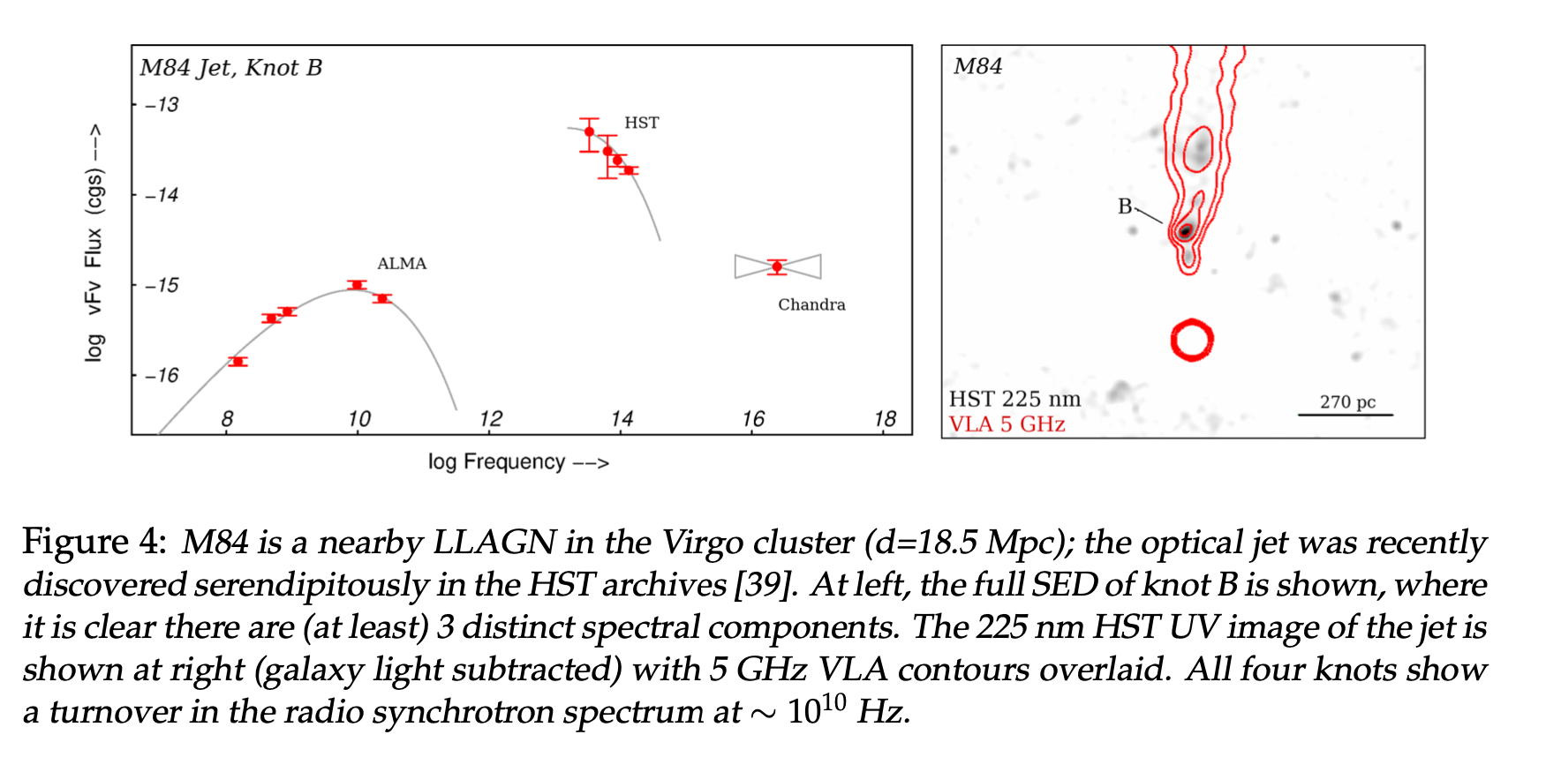
Case II : Multi-spectral component jets

Slide 11
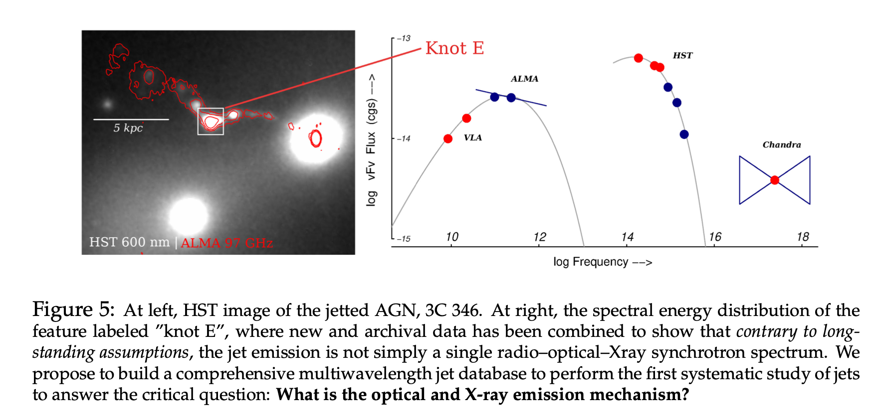
Multi-component SEDs (contd.)

Slide 12
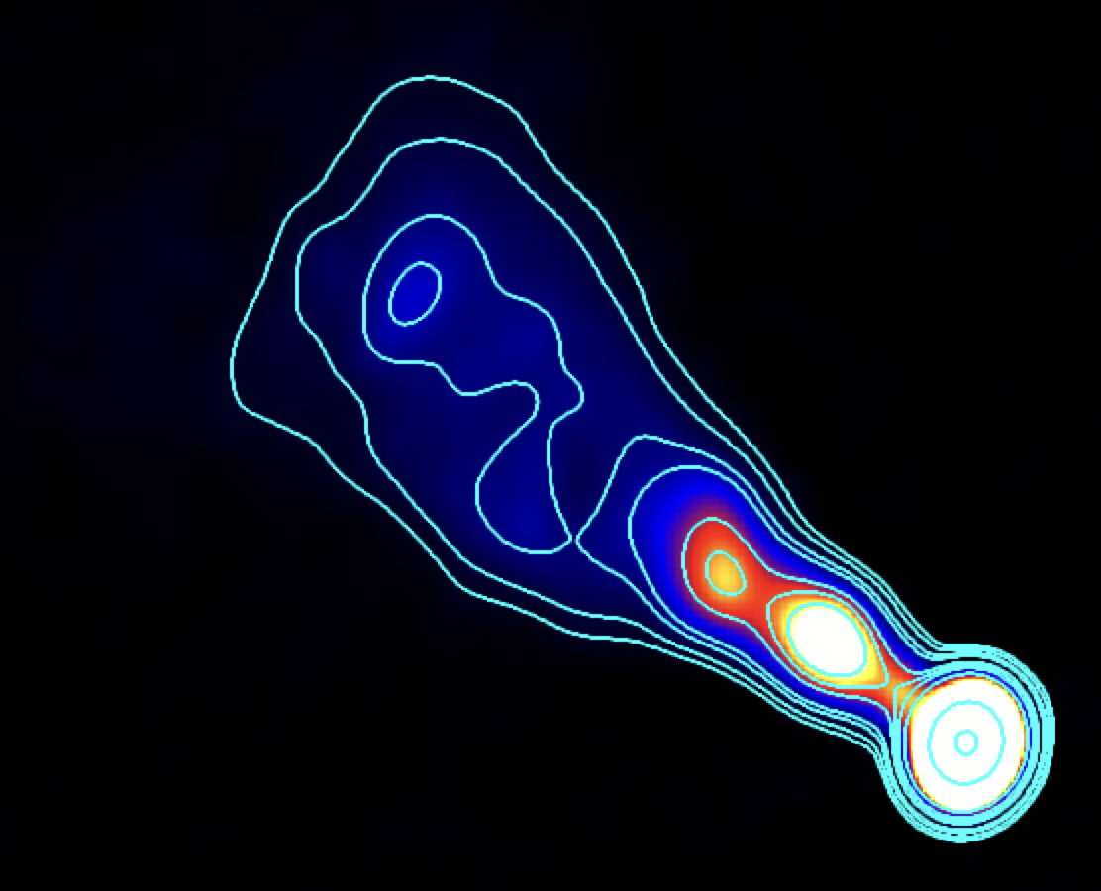
FR-I Radio Galaxy 3C 78 : kpc-scale jet
200 pc/0.35”
22 GHz, VLA, 2019
Diffuse emission
Knot C
Knot B
Knot A

Slide 13
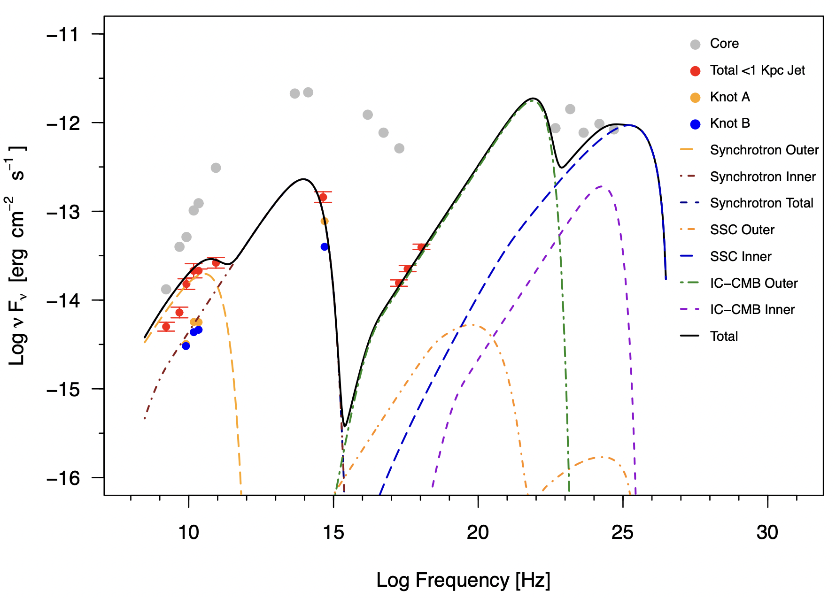
An effective one-zone spectral model for a knot
Inner zone
Outer zone: adiabatically cooled version of the Inner zone
See Rahman, Sahayanathan & Subha, 2022, MNRAS, 515, 1410 for a variant
Roychowdhury+ 2023b (submitted)

Slide 14
Takeaway (II):
Large—scale jets : mystery.
Need detailed future testing with multi-wavelength but similar resolution data.
Need better connection between Lorentz factor observations and SED modelling (Meyer+ 2016, Roychowdhury+ 2023b).
Focus must move away from independent EEDs (for complex spectra)
  Multi-zone models required but with a higher degree of dependence and physical intuition.
  Need more (better?) collaboration between particle acceleration theorists and jet observers.

Slide 16
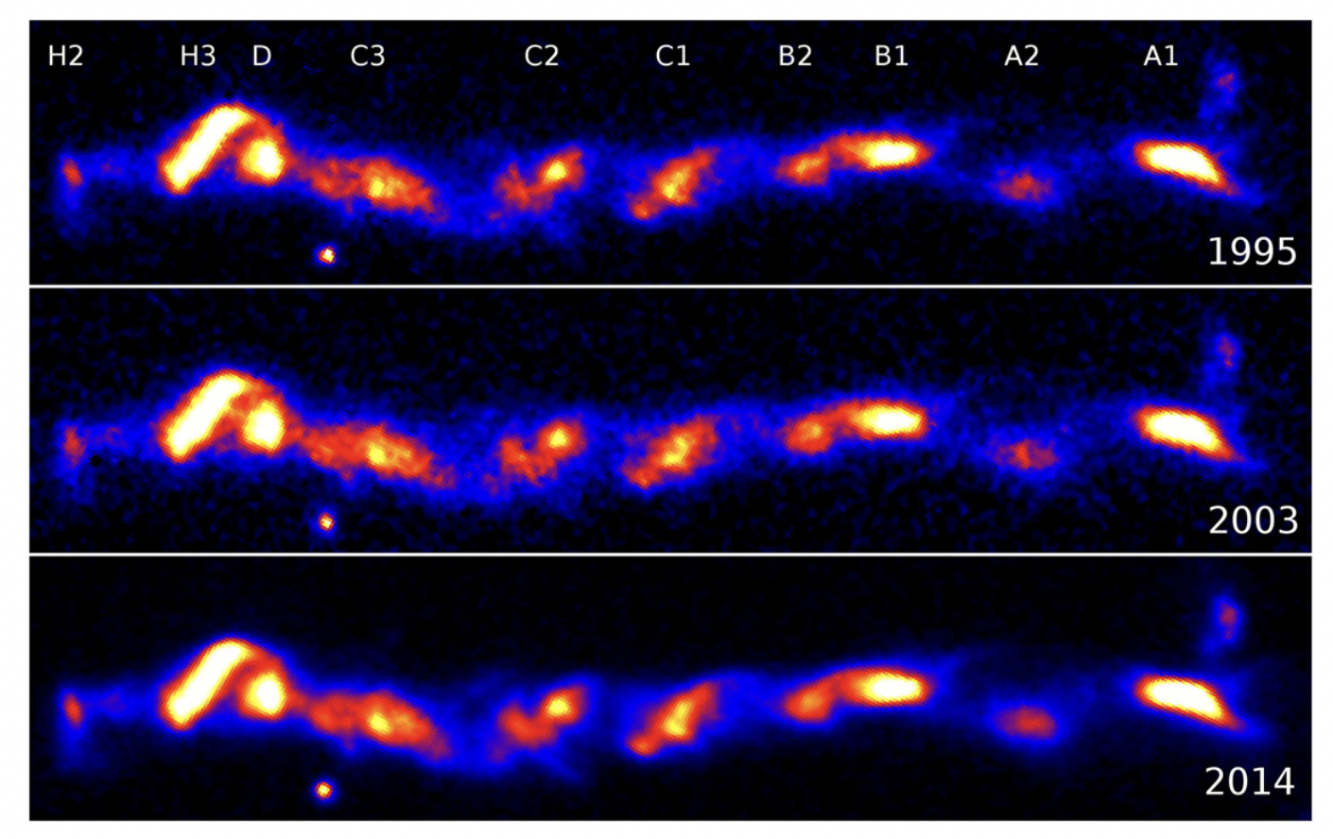
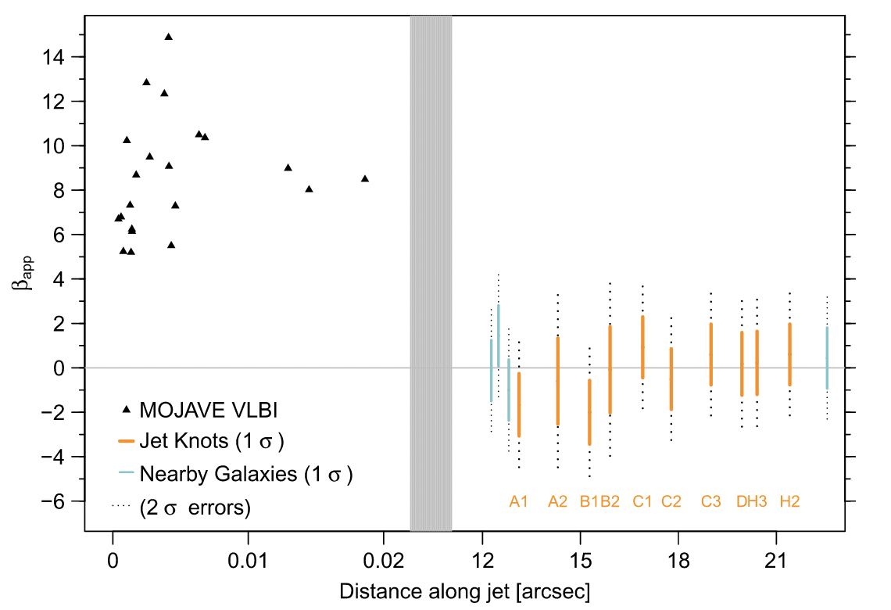
3C 273 and kpc-scale X-ray emission
1.5”/1.3 kpc
𝛤_{mean} < 3, not fast enough for a single-zone IC/CMB knot emission. Meyer+ (2016)

Slide 17


