Slide 1
Setting Initial Conditions for Inflation with
Reaction-Diffusion Equation
Ajit M. Srivastava
Institute of Physics
Bhubaneswar, India
Collaborators: Partha Bagchi, Arpan Das,
Shreyansh S. Dave, Srikumar Sengupta

Slide 2
Outline:
Issue of initial conditions for different inflation models
Natural inflation: requirement for small field over several
Hubble volumes. How natural?
Review of propagating front solutions in reaction-diffusion
equations.
Single domain with reaction-diffusion equation front leading
to inflation: general picture
Results
Conclusions and future directions

Slide 3
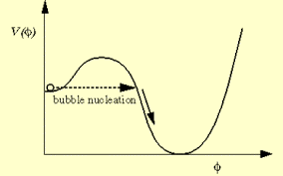
Original: Old Inflation:
Inflation while in the metastable state
Tunnel by bubble nucleation
To end inflation
Problem: Contradictory requirements on nucleation rate
Sufficient inflation requires low nucleation rate
Reheating only possible by bubble collision:
requires large nucleation rate
No overlap for the two requirements

Slide 4
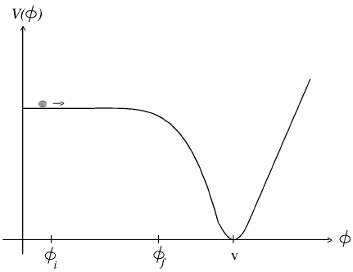
New Inflation
Field equation:
Inflate during slow roll down
Reheat: roll down the slope
and oscillate
Question: Why should field start from very small values?
Note: this potential corresponds to a second order phase transition.
Note: the field always sits at the minimum: continuous change of vev for 2nd order transition.

Slide 5
New Inflation
Thus: Impossible to argue for small
initial field amplitude for this (second
order transition) effective potential.
Need: metastable vacuum
with small barrier:
Field initially localized at 0 (after phase transition), tunnels through the barrier.
Then rolls slowly for inflation

Slide 6
Important point about initial condition for these two
models of inflation:
Required value of field (close to zero) naturally set by initially
Thermal equilibrium stage with restoration of symmetry.
After the transition, φ settles at φ = 0 due to the presence of metastable vacuum.
So, φ = 0 does not require any fine tuning.
For other models, chaotic, natural, initial value of the field
is not set naturally in this manner.
Rather, it is supposed to explore entire allowed (relevant) field values. Inflation occurs wherever the field has correct value.
Important: Correct initial value always refers to the value in
the entire Hubble volume. For randomly varying field one
says that it is the field value averaged over the Hubble volume which should satisfy required initial conditions.
This is an important statement: during initial stages of inflation
This average value should change in the manner of “slow roll”.

Slide 7
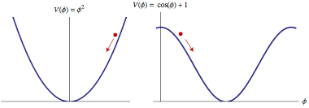
Chaotic inflation and Natural inflation: No fine tuning of
Shape: Require large field amplitudes for slow roll.
Very large roll down time (very flat potential shape), so large
distance to travel (large field amplitude), with low gradient
We consider natural Inflation as example: We will not discuss the
Issue of the viability of the models. Any model having inflaton field
has to address the issue of initial conditions for the field.
Also: our model can be extended to other models of inflation
Potential for natural inflation:
Minimum at φ = π f:
f ~ m_{pl} , Λ ∼ 10¹⁵ GeV

Slide 8
Note: This potential is exactly of the same shape as axion potential for QCD (and also for chiral sigma model in
Low energy effective theory of QCD): Two very different
energy scales arise naturally.
V_{eff}
T > T_{C}
T = 0
Q
φ
P
GUT scale Λ⁴
True vacuum
f ~ m_{pl}
Note: Potential always tilted: Tilt is negligible at energy scales much larger than Λ. Successful inflation requires field
very close to saddle point Q, most importantly: over several
Hubble volumes.

Slide 9
Can one assume that the entire required value of the field spans the Hubble volume?
May be more natural near the Planck scale as all relevant length
Scales (including the Hubble scale) are of same order.
BUT: No reason to expect this when scale of inflation is below the
Planck scale. Then all relevant correlation lengths are much smaller than the Hubble scale. So field must have large variations
Within the entire Hubble volume.
One can say that the relevant thing is the average value of the field over the Hubble volume.
Suppose average value of the field in the Hubble volume is 0.1.
With φ varying randomly over many correlation volumes (domains), this means that many such “domains” will have φ larger
than 0.1.
φ will roll down much faster in those domains. This means that
the average value of φ will increase faster than the roll down time
calculated for the averaged φ itself. So calculation not consistent.

Slide 10
Let us then assume that φ has roughly the required initial value
In the entire Hubble volume
Λ⁴
f ~ m_{pl}
Λ ∼ 10¹⁵ GeV
φ = π f
Natural setting: Thermal initial conditions with T > Λ
(but T much less than m_{pl}). Non-zero probability for
φ_{initial} ∼ 0 (recall, this is a saddle point).
Take conservatively, φ_{initial} ∼ 0.1 (2πf), probability ~ 0.1
We need this to hold for at least several Hubble volumes.
Then only FRW equations are relevant leading to vacuum
Energy dominance for inflation.
Again, conservatively, take only one Hubble volume.

Slide 11
For radiation dominated era down to T ~ Λ , we have:
Η ∼ 1/t , and T ~ t^{-1/2}
So: H⁻¹_{GUT} = H⁻¹_{pl} T²_{pl}/T²_{GUT}
Take thermal correlation length ξ ∼ T⁻¹, then
Η⁻¹_{GUT}/ ξ_{GUT} = (H⁻¹_{pl}/ ξ_{pl} )T_{pl}/T_{GUT}
With all Planck scale quantities of order m_{pl}, and T_{GUT} ~ 10¹⁵ GeV,
Η⁻¹_{GUT}/ ξ_{GUT} = 10⁴
So, each Hubble volume has about 10¹² correlation volumes.
Field not expected to be correlated beyond correlation length.
So, each correlation volume should have independently varying
field magnitude, especially with axionic almost flat potential.

Slide 12
For each correlation volume, required value of φ ∼ 0.1 had
Probability 0.1
So, for the Hubble volume with 10¹² correlation domains, the
Probability that φ ∼ 0.1 in the entire Hubble volume is
(0.1)^{10^12} which is completely negligible.
This is a serious problem in assuming a reasonable initial
Condition for inflation.
One needs to specify the specific conditions under which the
Required initial conditions can arise in any inflation model.
We argue that this can be achieved “naturally” by precisely
invoking (rather than neglecting) the correlation domain structure
of variation of field inside the Hubble volume.
We will not require initial small value of the field over any extended
region, not even the entire correlation volume. It will be very small in a very tiny region inside the correlation domain, and will
be assumed to smoothly change to large value (vev) over the
correlation length.

Slide 13
We use specific features of the reaction-diffusion equation to
address this issue
Reaction-Diffusion equations : Quick review
Diffusion equation:
In 1-d it has solution of the form:
Note: Diffusion equation has no traveling wave solution of the
form u(x-vt).
Modify the equation by introducing “reaction term” f(u).
(used e.g. in the context of biological systems, where the reaction
Term represents interaction of species).
This is the “Reaction-Diffuion equation. It
has traveling wave (and static) solutions,
with appropriate boundary conditions.
Compare with the field equations:
In the high dissipation limit, this is same as the reaction-diffusion Eqn

Slide 14
Nontrivial field evolution with reaction-diffusion equation
For specific boundary conditions:
Take this
potential
With this initial profile for φ
Expected
Evolution: φ
Rolls down to vev = φ₀
Actual evolution
Development of Well formed front which propagates with
definite velocity
Which can be 0
Note: Non-zero vev (and a maximum) necessary for the propagating (or static) front. For the above potential field rolls down quickly

Slide 15
Recall: potential for QCD axion case, or for QCD chiral sigma model:
As mentioned earlier, Natural inflation has the same form of potential
V_{eff}
For QCD chiral sigma model, we had
Studied evolution of a field profile
Interpolating between points Q and P
with dissipative field equations. These
Equations became exactly the same as
specific reaction-diffusion Equation known
as The Newell-Whitehead equation.
One would expect field at point Q to
Quickly roll down to P. However:
T > T_{C}
Q
T = 0
P
True vacuum
well defined front forms and moves inwards, just as the interface moves for a first order phase transition.
Note: no metastable
vacuum here, so no first
Order transition interface

Slide 16
Lessons to learn from this:
Note: the velocity of the front
Depends on the specific profile
(different solutions have different velocities). There are
Also static fronts.
So, in an expanding system
(expanding plasma as for
Heavy-ion collisions, or
Expanding universe), expansion may dominate over
Slow shrinking of domain.
In such a case, domain will actually expand, being stretched by
the expansion, even though energetically it should have shrunk.
For QCD case, we showed that this leads to formation of large DCC domains (disoriented chiral condensate domains).
Its implications for expanding universe are then obvious:

Slide 17
For expanding universe: think of this QCD potential as that for
Natural inflation. Think of the chiral field domain as domain for
Inflaton (axion) field, with zero of the field being at point Q
(large vacuum energy).
V_{eff}
T > T_{C}
Q
T = 0
P
True vacuum
As the domain shrinks slowly (by inward motion of the wall),
or it remains static, it gets stretched by the universe expansion.
If expansion dominates, the domain will become larger, and eventually will dominate the energy in the Hubble volume.
When vacuum energy starts dominating, universe will inflate.
After the domain exits the horizon, inflation will be established.
Small value away from point Q will decide eventual roll down
Of the field and end of inflationary stage.

Slide 18
Natural inflation with reaction-diffusion equation:
Potential:
We take f = m_{pl} , Λ = 10¹⁵ GeV
Field equations for the inflaton:
Scale factor evolution:
Field energy:
  Radiation energy:
  (starting at GUT scale)
  Field profile taken as Tanh (for planar 1-d solution as well as for spherical 3-d solution) interpolating between the minimum of V at φ = π m_{pl} and a point close to the Maximum of V with φ = ε. Our results very insensitive to the initial profile. Even linear segments evolve into smooth profile and lead to inflation.

Slide 19
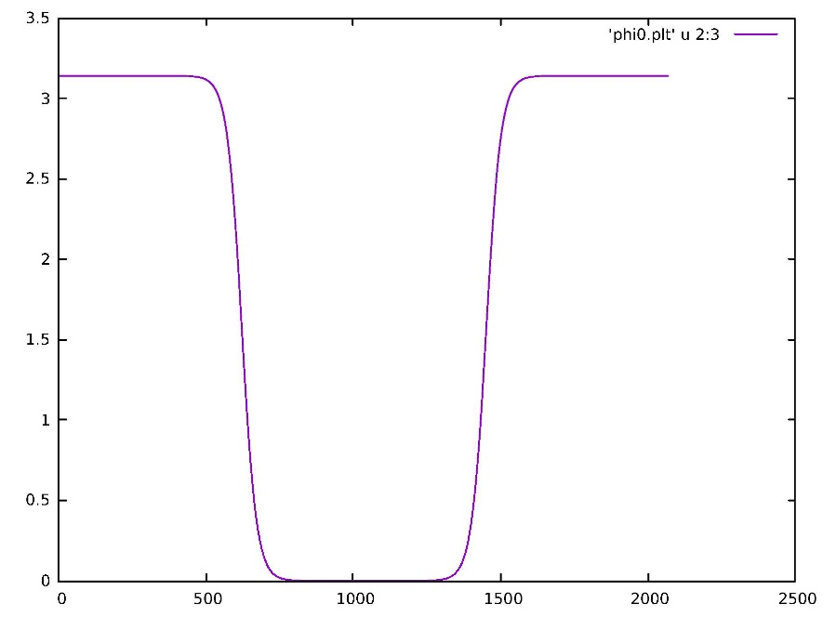
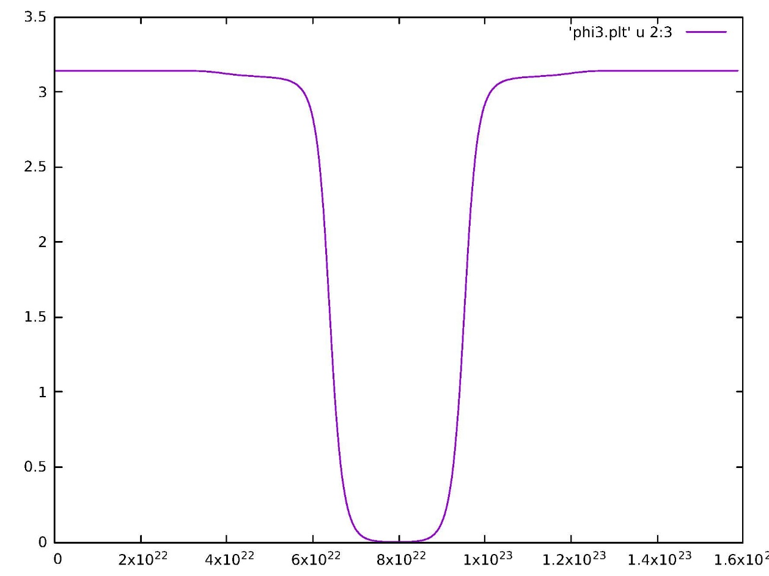
Results:
Initial profile of field in a domain
(lengths in the units of Λ⁻¹, φ in units of f ).
Region of size H⁻¹/2.
Value of φ at domain center is ε ∼ 10⁻⁷
Field profile after 60
e-fold evolution.
Very little change in
the field

Slide 20
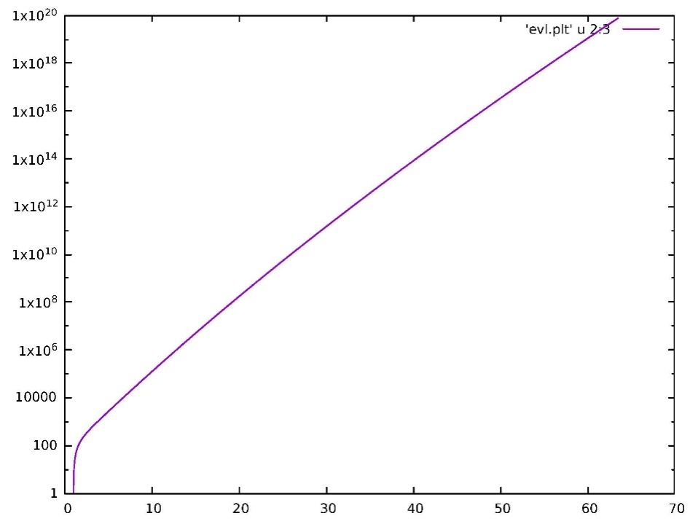
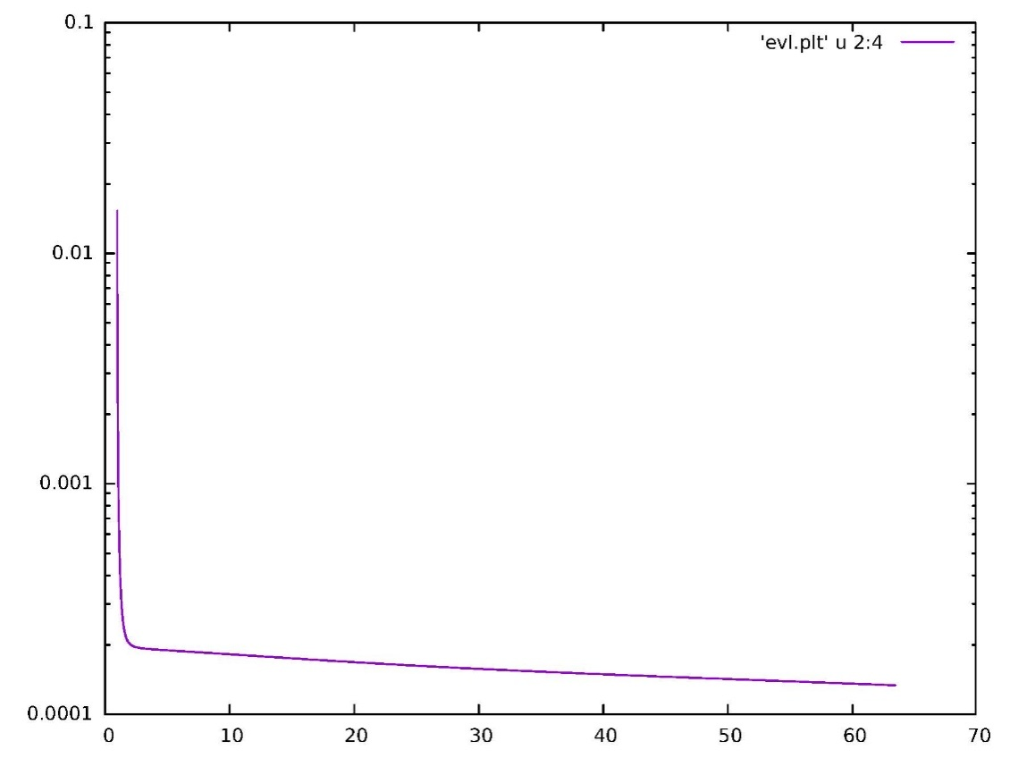
Evolution of scale factor:
Time in units of H⁻¹_{iniial}
Evolution of H:

Slide 21
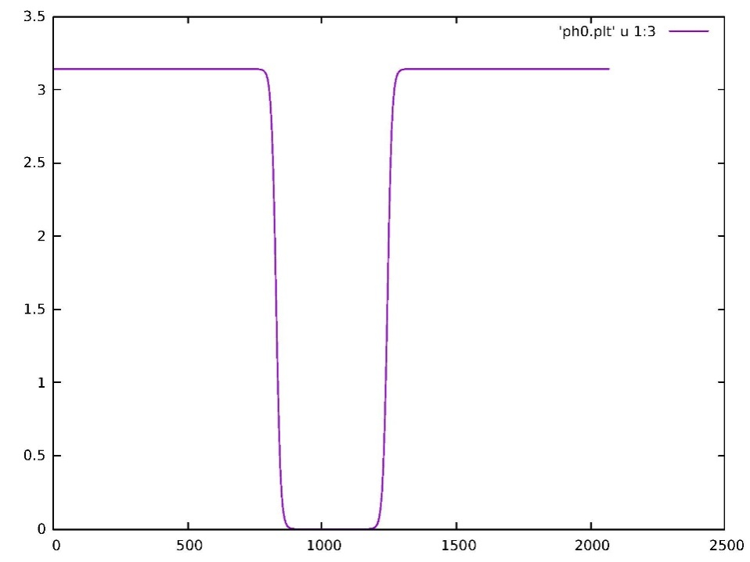
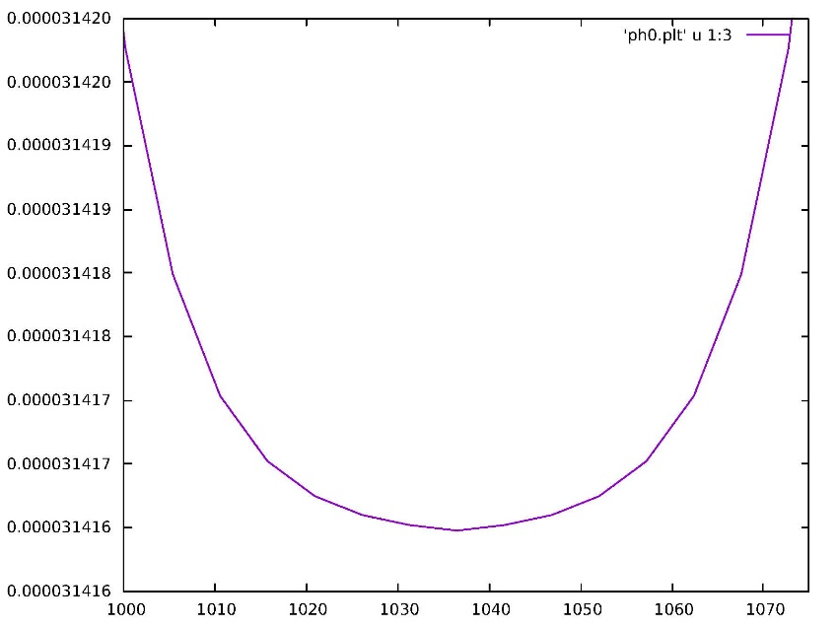
Ending inflation:
Take larger value of φ at domain center : ε ∼ 10⁻⁵
Profile near center: note
it has smooth variation
Domain stretches beyond Hubble size after t ~7 H⁻¹. This is
the stage of entering full inflation.
Field roll down at the center is more rapid here so after 60
e-fold evolution field significantly rolls down.

Slide 22
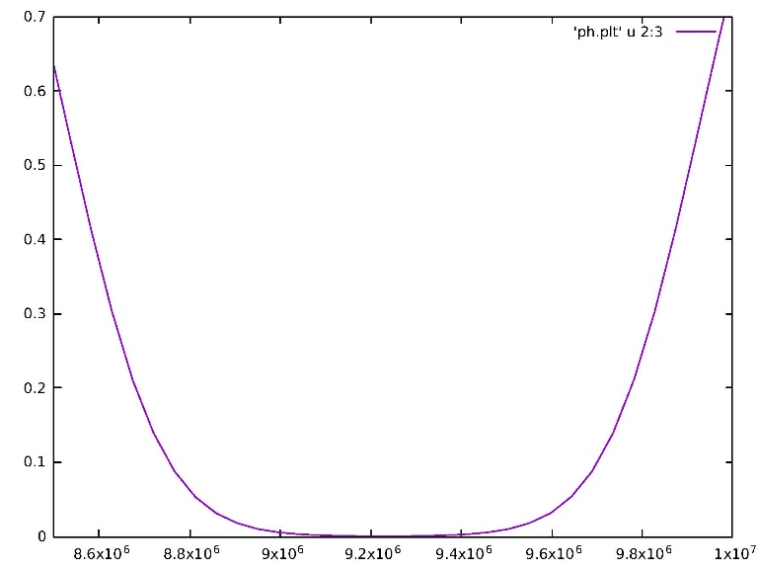
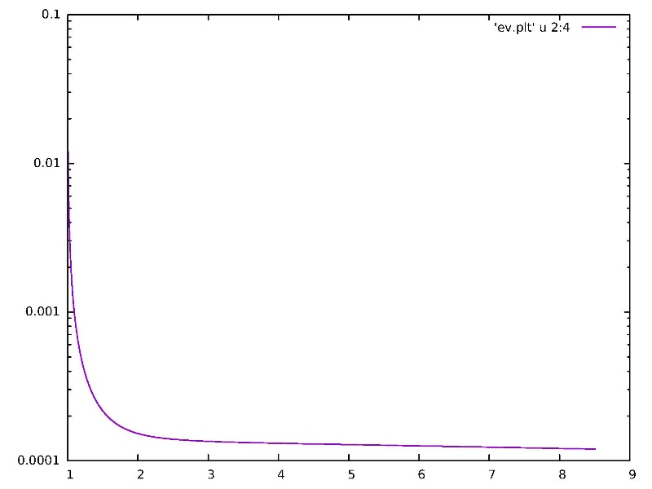
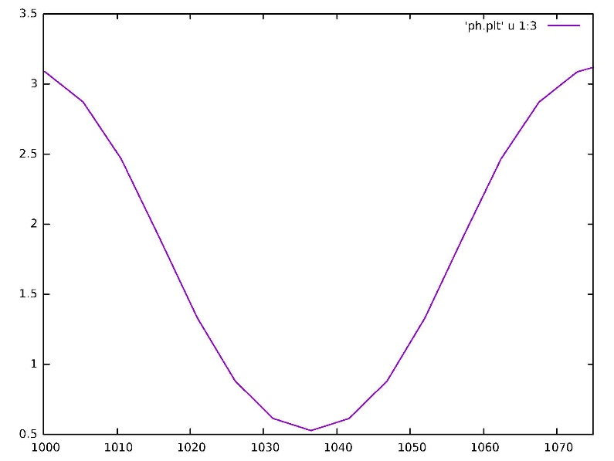
Profile after t ~ 7 H⁻¹. Evolution of H shows domain is superhorizon at this stage
Due to larger ε, field rolls
Down significantly after 60
e-fold evolution ending inflation.
(comoving coordinates)

Slide 23
Main points about the results:
We show that one does not need to assume finely tuned value
Of the field in the entire Hubble volume for inflation.
A single domain, much smaller than the Hubble volume, with field varying smoothly across the domain, can lead to Inflation. This occurs because of special reaction-diffusion equation solutions of
dissipation dominated field equations.
They lead to slowly moving (or static) fronts, instead of rapidly rolling field.
Such smooth field profiles expected with general picture of
Correlation domains. Value close to the top of the potential (saddle point) taken only at one point, then it smoothly changes to the vacuum Value across the domain.
Any Hubble volume with even such domain will have Inflation.

Slide 24
Future directions:
Existence of slowly moving propagating front (instead of rapidly
rolling field) is a general consequence of reaction-diffusion equations.
Also, smoothly varying field profile across a correlation domain needs to be assumed for the beginning of inflation. This can be applied to other models of inflation (which have potentials of correct types).
Warm inflation has extra dissipation, this should lead to closer correspondence with the Reaction-diffusion equation.
Effect of fluctuations etc. has to be studied, especially on the
Propagating front profile and its velocity.
For Reaction-diffusion equations: For different reaction terms
One gets different specific equations with well defined solutions.
(We have shown that, with chiral sigma model potential one gets the
Newell-Whithead equation, while for Polyakov loop potential, one gets the Fitzhugh-Nagumo equation used in population genetics).
What will be the properties of the reaction-diffusion equation with cos(φ) interaction term (as for the Natural inflation case)?

Slide 25
THANKS TO THE ORGANIZERS
FOR A GREAT WORKSHOP

