Slide 1
Large Scale Anisotropy in the Universe
Pankaj Jain
I.I.T. Kanpur

Slide 2
Introduction
Universe is assumed to be homogeneous and isotropic at large distance scales
No preferred position or direction
Cosmological Principle
It is purely an assumption, originally made for simplicity

Slide 3
Cosmological Principle
FRW metric, Big Bang Model
⇒expanding universe

Slide 4
Their exist several observations which appear to violate the Cosmological Principle
Radio polarizations from radio galaxies
Visible polarization from quasars
Cosmic Microwave Background anisotropies
Radio source count and sky brightness
Radio polarization flux
Cluster peculiar velocities?

Slide 5
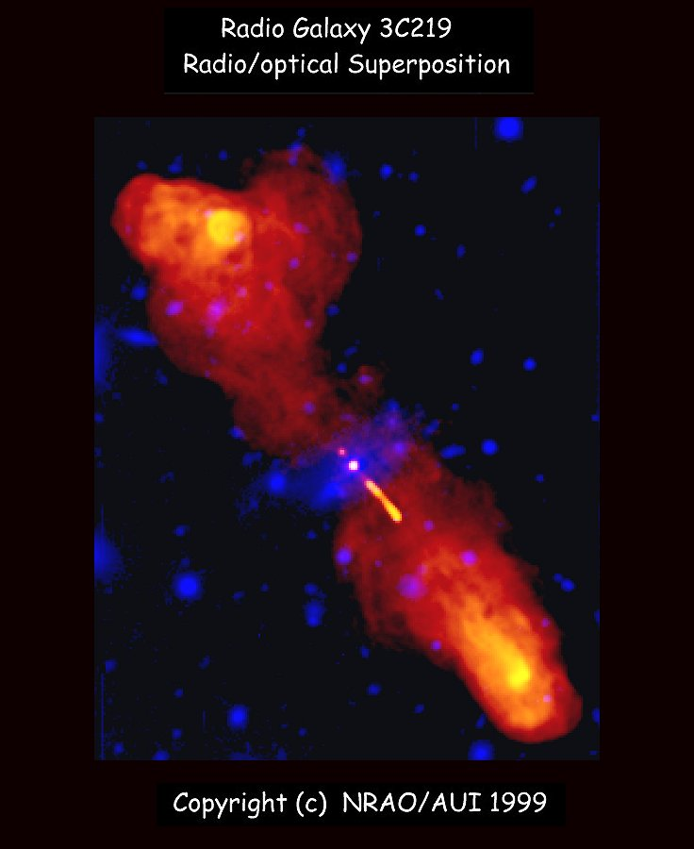
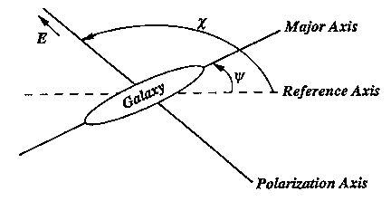
Anisotropy in Radio Polarizations
Radio Polarizations from distant Active Galaxies show a dipole anisotropy
Offset angle β = χ − ψ
θ(λ² ) = χ + (RM) λ²
  RM : Faraday Rotation Measure
  χ = IPA (Polarization at source)

Slide 6
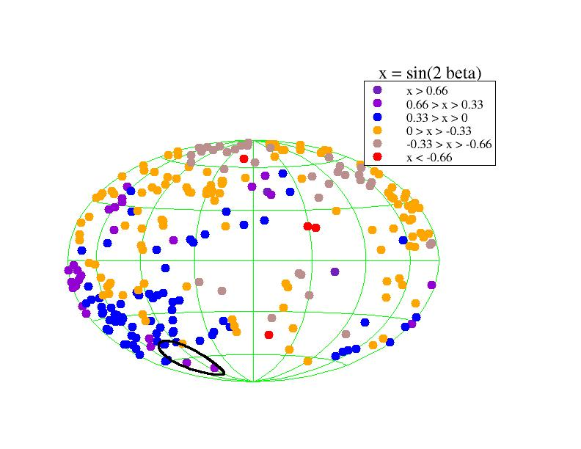
Anisotropy in Radio Polarizations
cut |RM - <RM>| > 6 rad/m²
averaged over a small region
preferred axis points towards Virgo
beta = polarization offset angle
= polarization angle – galaxy alignment angle

Slide 7
Statistical Significance
  Full Data: (332 sources)
  P = 3.5 % (2 sigma)
  Using cut: |RM - <RM>| > 6 (265 sources)
  P = 0.06 % (3.5 sigma)
Birch 1982
Jain, Ralston, 1999
Jain, Sarala, 2003

Slide 8
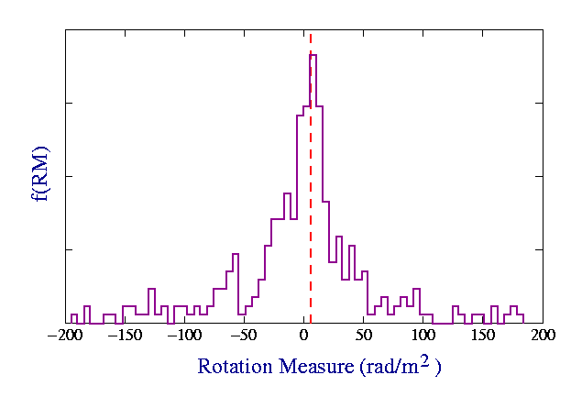
Rotation Measure Cut

Slide 9
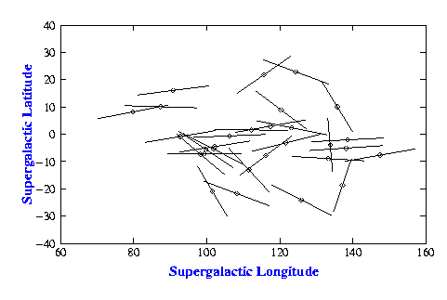
Hutsemékers Effect
Optical Polarizations of QSOs appear to be locally aligned with one another (3-4 sigma)
1<z<2.3
Hutsemekers 1998
A very strong alignment is seen in the direction of Virgo cluster

Slide 10
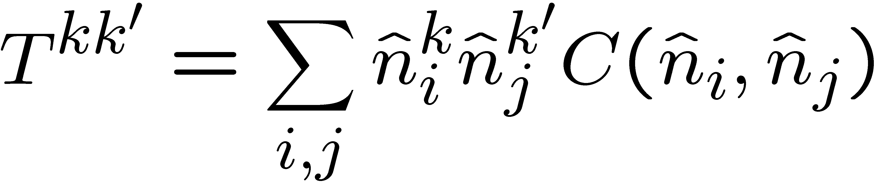
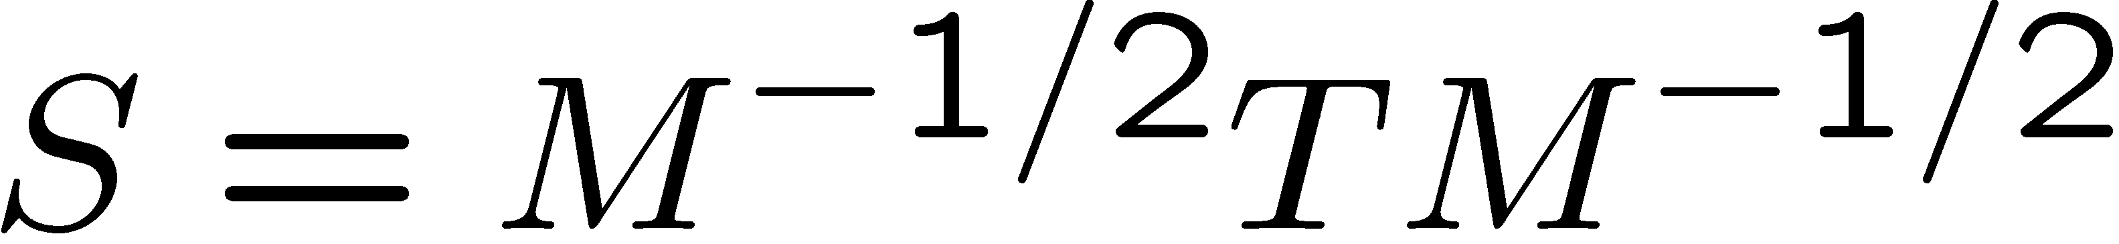
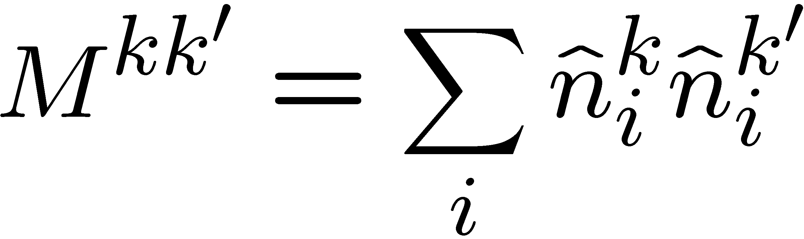
Preferred Axis
Two point correlation
(Jain, Narain and Sarala 2004)
Define the correlation tensor
Define
where
S is a unit matrix for an isotropic uncorrelated sample
is the matrix of sky locations

Slide 11
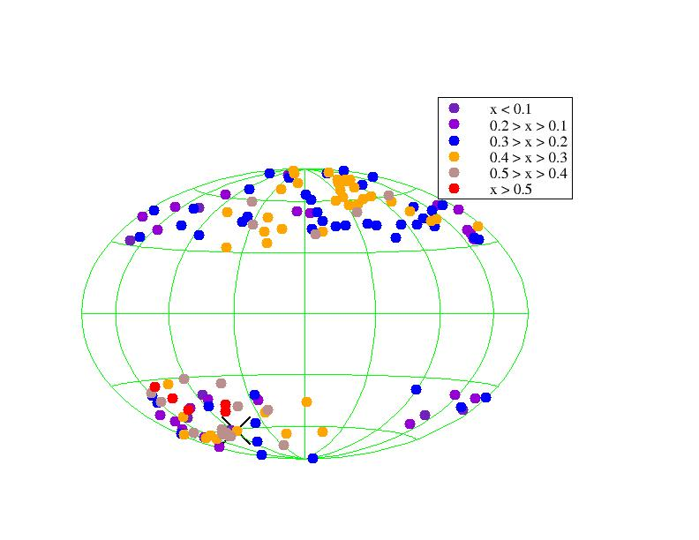
Optical Polarizations
Preferred axis points towards to Virgo
Ralston and Jain, 2004
Degree of Polarization < 2%

Slide 12
Cosmic Microwave Background Radiation (CMBR)
CMBR is highly isotropic
It shows a dipole anisotropy with
This arises due to motion of our galaxy
The higher order multipoles arise due to primordial fluctuations

Slide 13
CMB anisotropies also give an indication of large scale anisotropy
Quadrupole and octopole show a preferred axis pointing towards Virgo
CMB dipole also points towards Virgo
Oliveira-Costa et al 2003
Ralston and Jain, 2004
Schwarz et al 2004

Slide 14
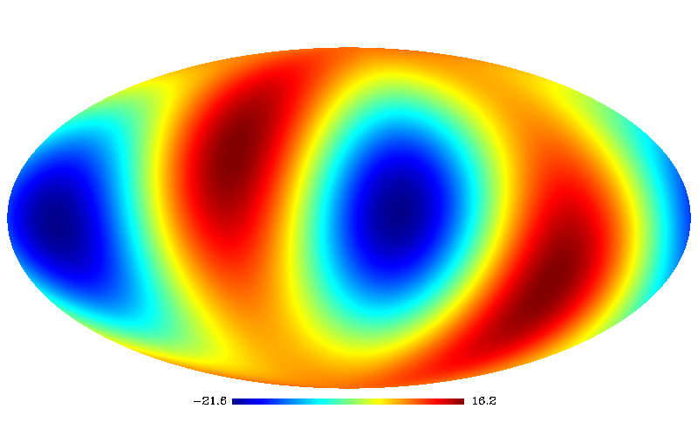
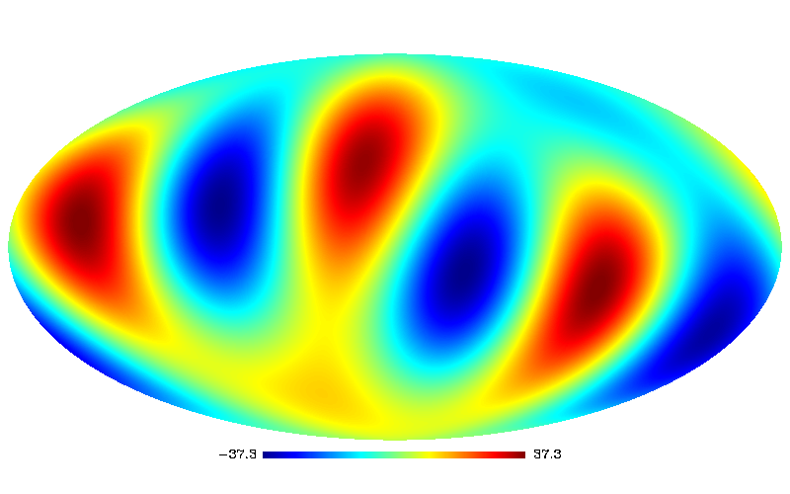
Quadrupole
Sig. of alignment
= 3 - 4 sigma
Octopole

Slide 15
Number count and brightness of radio sources
The observed source count and brightness of radio sources should show a dipole anisotropy due to local motion
Caused by aberration and Doppler effect
Seen in data, direction ∼ CMB dipole
But the amplitude is 2.5 - 4 times larger
(Singal 2011, Tiwari et al 2015)

Slide 16
Radio Data
The signal is seen in all sky radio survey (NVSS) using VLA
Most sources are at high redshift of order 1 but the actual value is not known

Slide 17
Difference in Amplitude
The difference in amplitude arises partially from the method used and the removal of cluster dipole
We use spherical harmonic decomposition which gives a conservative estimate, Singal makes a direct dipole fit to data which gives a larger amplitude

Slide 18
Cluster Dipole
The local sources are not distributed isotropically
We need to remove these sources which will bias the cosmological signal
However analysis of 2MASS survey indicates that this cluster dipole does not converge even up tp distances of 300 Mpc
(Bilicki et al 2011)

Slide 19
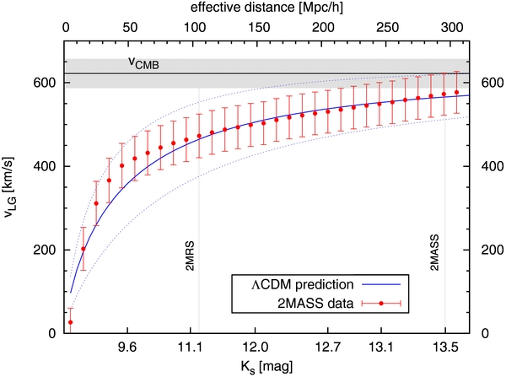
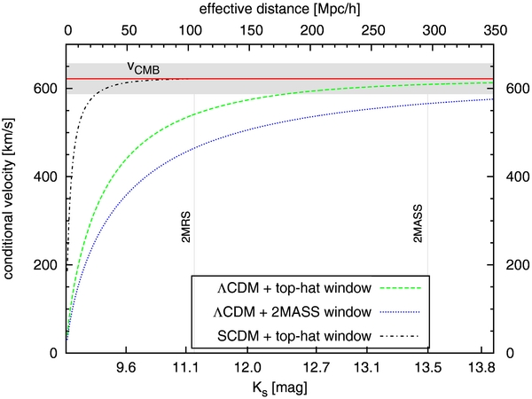

Slide 20
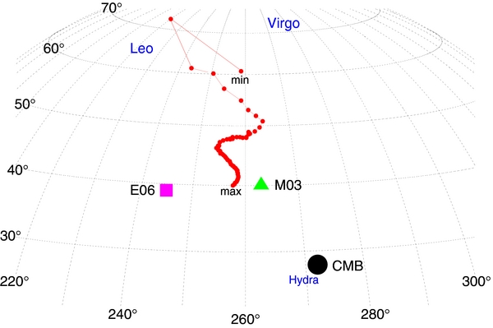
Axis of clustering dipole

Slide 21
Polarization flux weighted number counts
The polarized flux also shows dipole anisotropy, direction ∼ CMB dipole
But the amplitude is 7-8 times larger than expected
(Tiwari and Jain 2014)

Slide 22
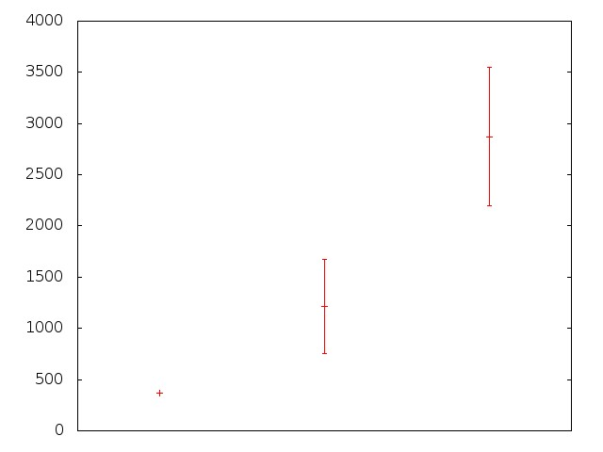
V (Km/s)
Radio
brightness
Radio
polarization
CMB

Slide 23
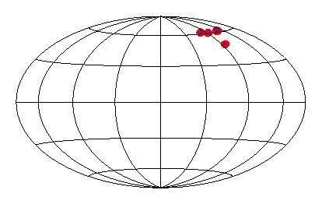
The Virgo Alignment
optical
quadrupole
and octopole
radio
Pol.
dipole
Radio
brightness
Radio
Polarized flux

Slide 24
Other Claims
hemispherical power anisotropy in CMB
A Cold Spot in CMB
Parity asymmetry in CMB?
Parity asymmetry in spiral galaxies?
Large scale coherence in cluster peculiar velocities?
WMAP, PLANCK dismiss some of these

Slide 25
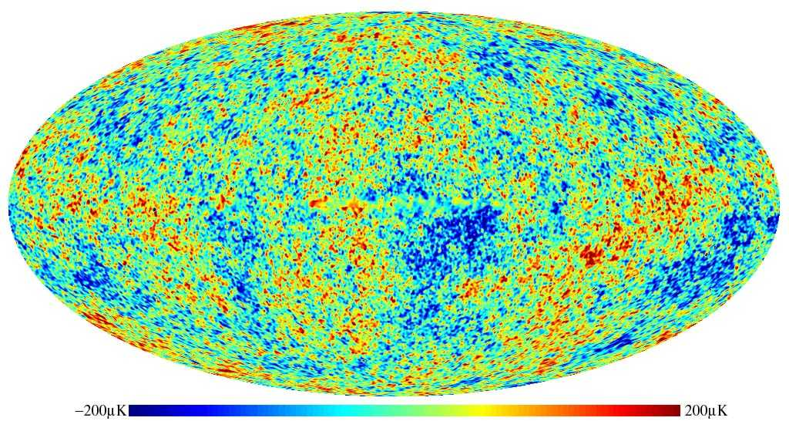

Hemispherical Power anisotropy
Power is different in the two hemispheres
Dipole modulation
A = 0.072±0.022 Eriksen et al 2004

Slide 26
Physical explanations for violation of isotropy
Galactic and/or supercluster foregrounds
Voids in our astrophysical neighbourhood
Anisotropic and/or Inhomogeneous metric
Spontaneous violation of isotropy
Anisotropic inflation, (perhaps due to a vector field)
Background magnetic field
Violation of Lorentz, rotational invariance…

Slide 27
Can we find an explanation within the Big Bang paradigm?

Slide 28
At very early time the Universe may be anisotropic and inhomogeneous
During inflation it becomes isotropic and homogeneous is a very short time
(Wald 1983)

Slide 29
History of time
Anisotropic
inhomogeneous
Isotropic and homogeneous
t=0
Inflation
Radiation
matter
?
Aluri and Jain 2012

Slide 30
Inflation
At very early times Universe is not isotropic
It becomes isotropic very quickly during inflation

Slide 31
Inflation
Perturbations generated during inflation leave the horizon at early times
They re-enter the horizon later during radiation and dark matter dominated phases
These lead to structure formation, CMB anisotropies etc.

Slide 32
Perturbations generated during the early anisotropic and inhomogeneous expansion enter the horizon at late time
⇒Observed signals of anisotropy
may not follow the cosmological principle
Yet, these are consistent with Big Bang paradigm
Aluri and Jain 2012, Rath et al 2013

Slide 33
Proposal
Anisotropic
inhomogeneous
Isotropic and homogeneous
t=0
Inflation
matter
Radiation
perturbations generated during very early anisotropic, inhomogeneous phase can affect observations
these can lead to violations of the cosmological principle
Aluri and Jain 2012, Rath et al 2013

Slide 34
We have explicitly demonstrated this mechanism by considering an anisotropic metric.
The anisotropy is assumed to be small. It decays further during inflation
We predict a late time anisotropy in the Universe
Aluri and Jain 2012, Rath et al 2013

Slide 35
So far we have assumed Lorentz and rotational invariance
However at very early time, when quantum gravity effects are important, these symmetries may be violated
For example, space-time coordinates may not commute at these short length scales

Slide 36
Through loop corrections these can lead to very large violation of Lorentz invariance ⇒ a fine tuning problem
Collins et al 2005

Slide 37
Violation of Lorentz Invariance
SUSY solves this fine tuning problem also
At low energy violation is related to the SUSY breaking scale
Lorentz violation ∝ (M_{SUSY}/M_{PL})²
(Jain and Ralston 2005)

Slide 38
Violation of Lorentz , rotational , invariance is predicted even within the standard framework
It is small only due to SUSY and hence is controlled by SUSY breaking scale.

Slide 39
The lower limit on Lorentz breaking is 1 part in 10³², using M_{SUSY} = 1TeV
Current observations on Lorentz violation limit SUSY breaking scale to be less than 10¹⁰ GeV

Slide 40
Violation of Lorentz Invariance
Quantum gravity might lead to non-commutative space-time
Δx₀ (Δx₁+ Δx₂+ Δx₃) > (λ_{P})²
Δx₁ Δx₂+ Δx₂ Δx₃ + Δx₁ Δx₃ > (λ_{P})²
[x_{μ},x_{ν}] = i θ_{μν}
(Doplicher et al 2003)

Slide 41
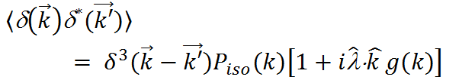


Hemispherical Power anisotropy
Can be explained by the anisotropic primordial power spectrum in a non-commutative space-time
Rath and Jain 2014
Rath, Kothari and Jain,
in preparation
Fit to data ⇒
for k < 60/η₀ and decays for larger k

Slide 42



Hemispherical Power anisotropy
(
,
(
)
,
Alternatively we can explain this in terms of an inhomogeneous model
(
)
,
(
)
Rath and Jain 2014
,
)
= Fourier Transform

Slide 43


Inhomogeneous Model
(
,
(
)
,
(
)
,
(
)
,
)
Rath and Jain 2014

Slide 44


Inhomogeneous Model
g(k) is found to be constant for k < 60/η₀ and decays for larger k

Slide 45
Conclusions
Radio polarization angles
CMB dipole
CMB quadrupole
CMB octopole
Quasar Optical polarizations
Radio source count and brightness
Radio polarization flux
all indicate a preferred direction pointing roughly towards Virgo
⇒ strong evidence that the Universe is anisotropic

Slide 46
Conclusions
The anisotropy may be caused by the pre-inflationary anisotropic, inhomogeneous epoch in the evolution of the Universe
At very early time basic symmetries, Lorentz, rotational invariance may not be respected
Modes generated at such early time can influence observations today
Hence we predict violation of the cosmological principle at late time

Slide 47
Conclusions
The hemispherical anisotropy can be related to the anisotropic primordial power spectrum
However this is possible only within non-commutative geometry
Alternatively this can be explained by an inhomogeneous model

Slide 48
Conclusions
Violation of Lorentz, rotational invariance is expected even within the standard framework,
Controlled by the scale of SUSY breaking

Slide 49
Collaborators
John Ralston
S. Sarala
Sukanta Panda
Rajib Saha
Pramoda Samal
Pavan Aluri
Pranati Rath
Prabhakar Tiwari
Tanmay Mutholkar
Shamik Ghosh
Rahul Kothari

