Slide 1


If the Universe is the answer
what is the question?
Rogerio Rosenfeld
IFT-UNESP
LIneA
Dark Energy Survey collaboration
SILAFAE 2018 – Lima – Peru

Slide 2
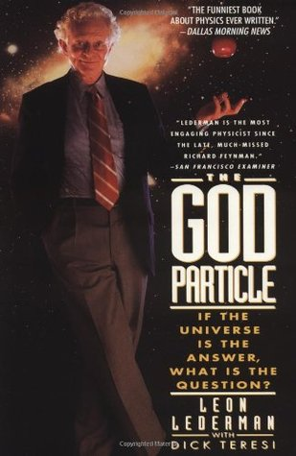
Leon Max Lederman (July 15, 1922 – October 3, 2018)
Started the cosmology group at Fermilab
SDSS and DES

Slide 3
Plan:
0 – Introduction
1– From probes to answers
2 – Perturbations in the Universe
3 – The 3d power spectrum
4 - Baryon acoustic oscillations
5 – Angular power spectrum: theory
6 – Observations: the Dark Energy Survey
7 – DES highlights and challenges
8 – Coda

Slide 4
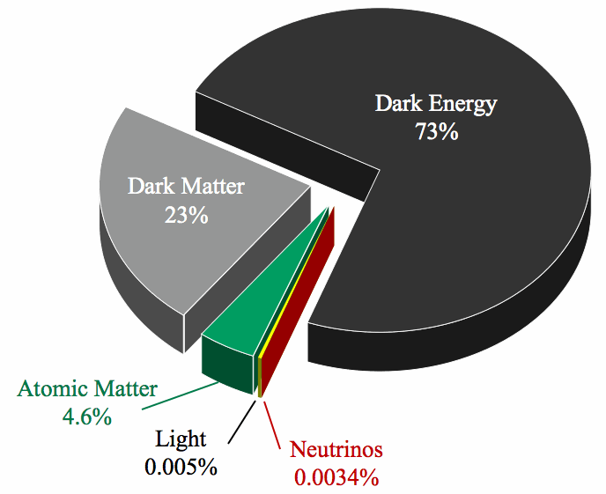
0 – Introduction
We know that we don’t know what 95%
of the universe is made of.
What is dark matter?
Cold, warm, fuzzy, self-interacting...
What is dark energy?
New degree of freedom/MG:
Quintessence, galileon, f(R),
Hordensky, beyond Hordensky,
massive gravity, EFTofDE...
Does it interact with matter?
Does it cluster?
4

Slide 5
Standard Model of Particle Physics works fine but it is unsatisfactory (neutrino masses, dark matter, hierarchy problem, etc). Beyond SM!
Standard Model of Cosmology (ΛCDM) works fine but it is unsatisfatory (value and nature of Λ). Beyond ΛCDM!
Models abound! We have to see what Nature has chosen...

Slide 6
Cosmology has become a data-driven science.
Many probes are used to extract information about cosmology.
Important to combine them to break degeneracies and improve bounds.
t_{U}= (13.799±0.021)x10⁹ years [used to be 10^{9±1} years]

Slide 7
Some cosmological probes
Cosmic Microwave Background (CMB)
Big bang nucleosynthesis (BBN)
Supernovae Ia
Gravitational lensing
Distribution of galaxies (including BAO)
Number count of clusters of galaxies
Large
Surveys

Slide 8
1- From probes to answers
The main goal is to determine what is the best model
that describes our Universe.
Easy steps:
. Pick a probe
. Pick a model
. Compute predictions from the model for a given set of
parameters
. Get some data
. Compare model predictions with data
. Find the best model with the corresponding values of
parameters

Slide 9
Put all steps together in the so-called likelihood function:
Theoretical prediction depends on the model and its parameters.
Observations depend on the experiment.
The covariance matrix basically reflects the uncertainty in the experimental measurement.
Best model: maximize likelihood
Sounds pretty easy!

Slide 10
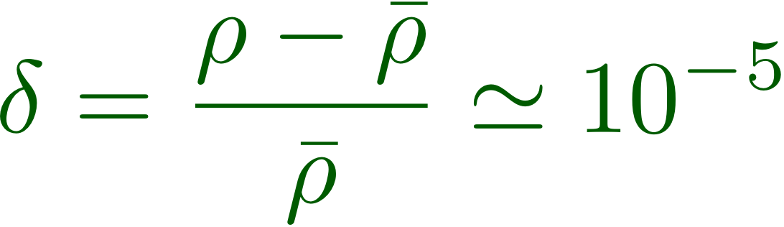
2- Perturbations in the Universe
Inflation generated small density perturbations in the
early Universe.
These perturbations grew with gravity and originated the
structures we now observe.
These early fluctuations were detected for the first time
in the cosmic microwave background (~1991) and are
tiny:

Slide 11
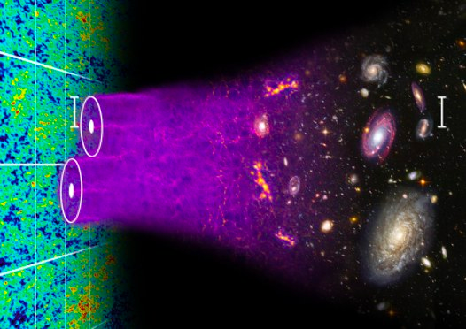
Evolution of perturbations
Illustration by Chris Blake and Sam Moorfield

Slide 12
Evolution of perturbations:
It is not possible to fully describe the non-linear
regime analytically in GR:
large numerical simulations are necessary
(Millenium, MICE, etc…) – and are done using
Newtonian physics. Sometimes only cold dark
matter is considered because it is dominant (and
easy to simulate since it is dissipationless).
Baryons are complicated but essential.
Linear perturbations are much easier to compute.

Slide 13
Semi-analytical methods for nonlinear
evolution of perturbations:
Halo model
EFTofLSS
Resummed perturbation theory
Halo model motivated fits to simulations
(HALOFIT)

Slide 14
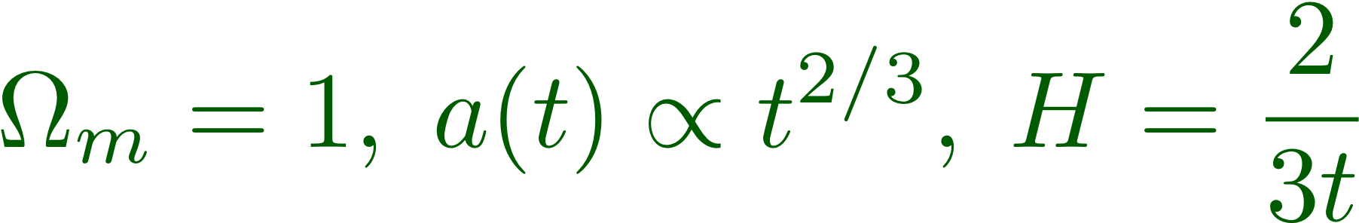
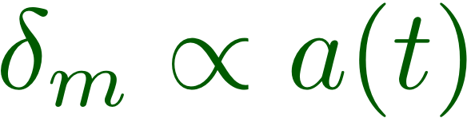

One can show that in a matter dominated universe
the matter density perturbation grows as
and that in a Λ-dominated universe

Slide 15

Dark energy suppresses structure formation
(Weinberg’s anthropic argument)

Slide 16
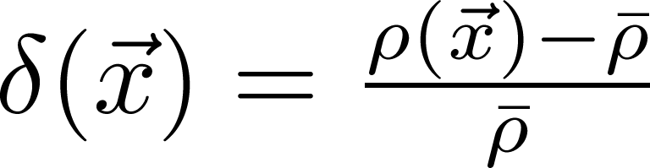
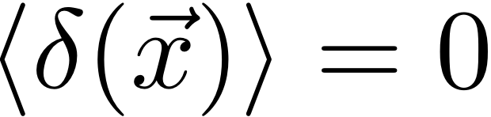
3- The 3d power spectrum
Fluctuations can be described by a density contrast:
Fluctuations are a random gaussian field: characterized
by its moments – 1pt (average), 2pt (variance), 3pt, ...
Two-point spatial
correlation function
...
Homogeneity and isotropy

Slide 17
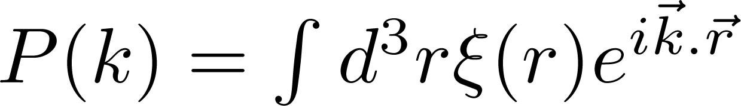
Interpretation of 2 pt. correlation function: excess
(or deficit) of clustering over random at a given scale r
random
One can also define a power spectrum:

Slide 18
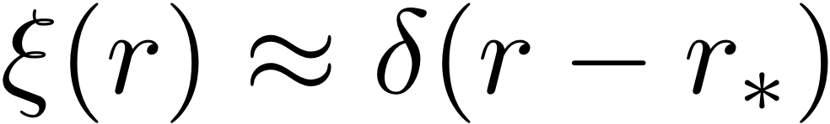
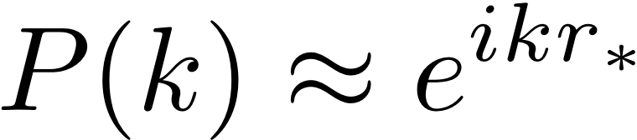
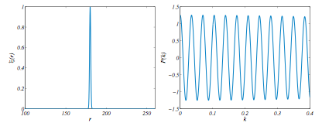
It’s possible to work with either spatial correlation
function or power spectrum – advantages and
disadvantages
Sharp peak in correlation results in oscillations in the
power spectrum

Slide 19
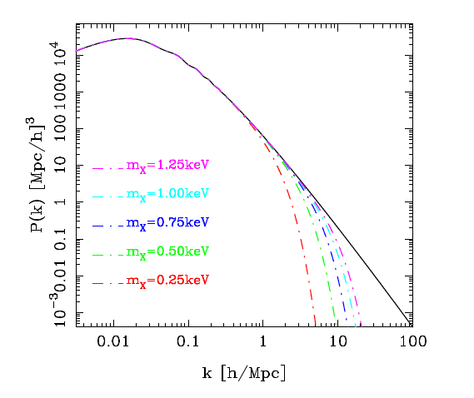
Power spectrum is sensitive to
new physics
Warm dark matter
Linear power spectrum

Slide 20
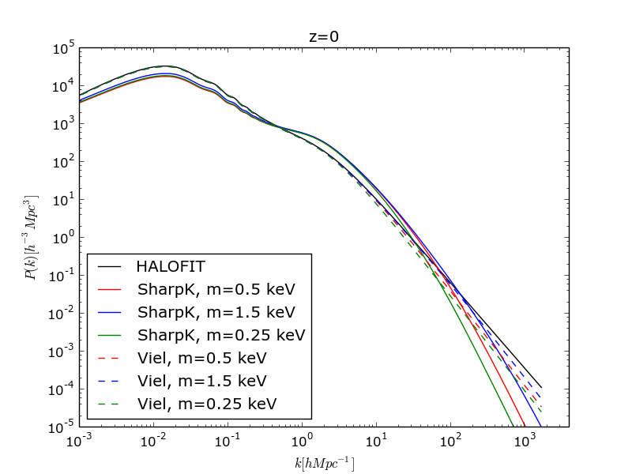
Power spectrum is sensitive to
new physics
Warm dark matter
Non-linear power spectrum
Jéssica Martins

Slide 21
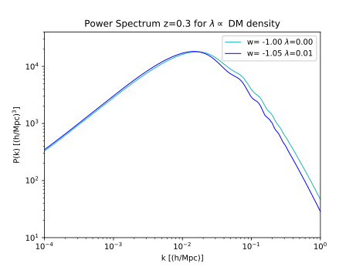
Power spectrum is sensitive to
new physics
Interacting dark matter-dark energy
Linear power spectrum
Andresa Campos

Slide 22
4- Baryon acoustic oscillation
Should a preferred scale emerge in galaxy distribution?
Yes – the sound horizon at decoupling.
Before recombination, baryons and photons were
strongly coupled, forming a single fluid with pressure and
speed. Dark matter, neutrinos and other forms were
decoupled.

Slide 23
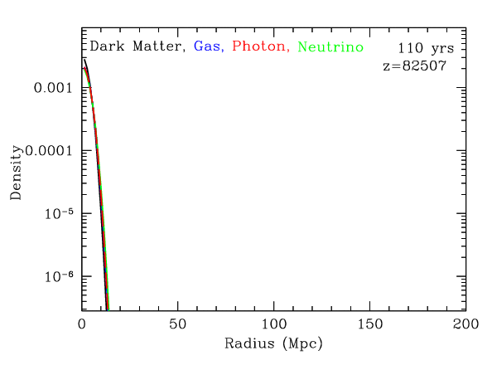
Evolution of one spherical perturbation
^{Eisenstein}

Slide 24
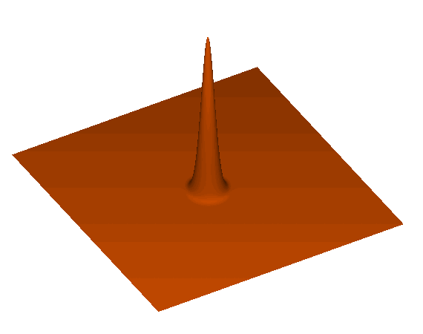
Evolution of one spherical perturbation
^{Eisenstein}

Slide 25
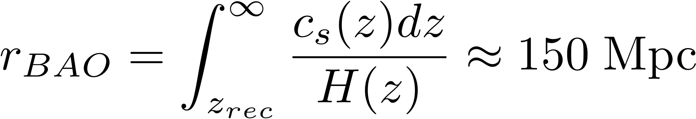
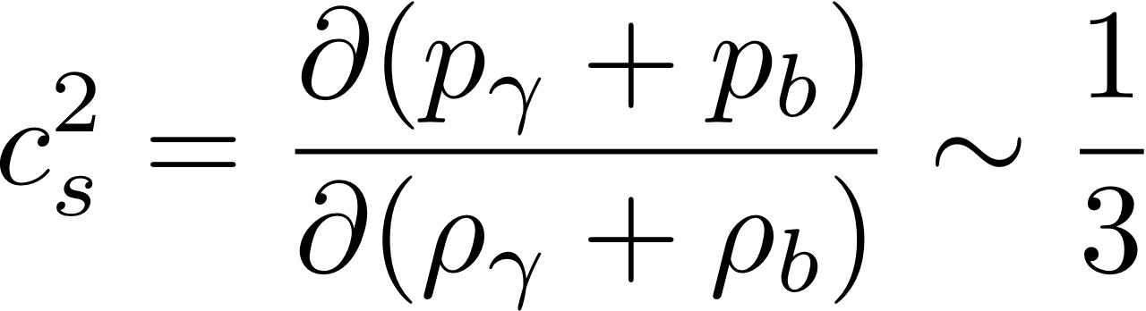
BAO scale
Standard ruler in the sky
Cosmological parameters

Slide 26
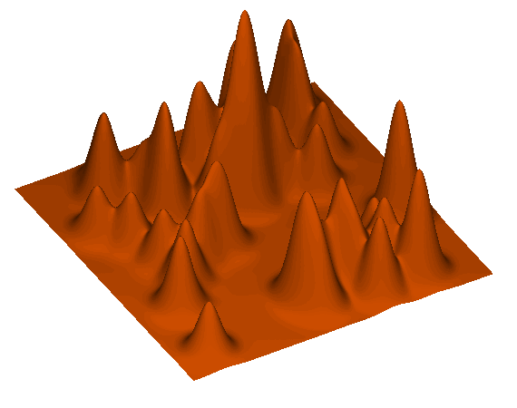
Things are more complicated: superposition of shells
with different locations and different amplitudes
^{Eisenstein}

Slide 27
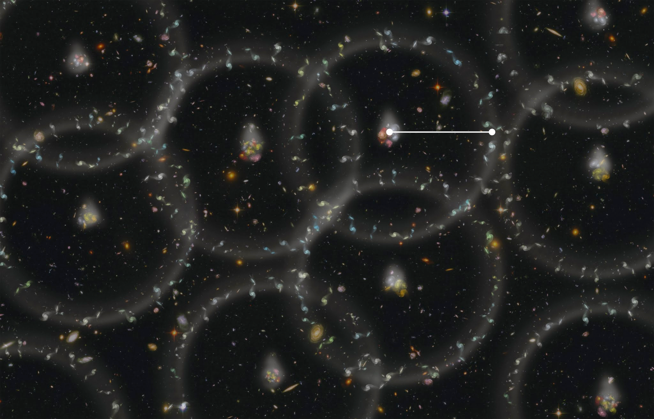
Credit: Zosia Rostomian, Lawrence Berkeley National Laboratory

Slide 28
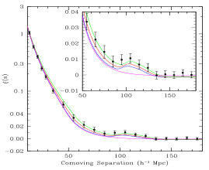
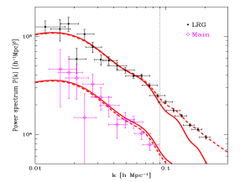
First detection of BAO features with SDSS data
small effect (<few %), difficult measurements
(bump hunting)
^{Eisenstein et al (2005)}
^{Tegmark et al (2006)}
DR3, z ~ 0.35

Slide 29
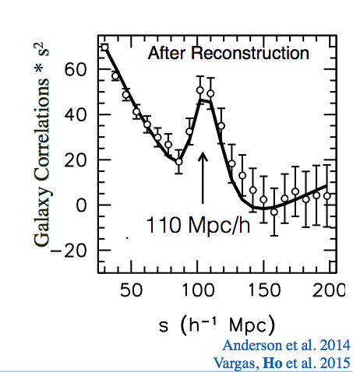
Galaxy 2-point correlation function

Slide 30

5- Angular power spectrum: theory
Some surveys have poor redshift determination and it
is convenient to project the 3d matter density contrast into
spherical shells in a given redshift bin and expand it
in spherical harmonics:
Selection function (given by experiment)

Slide 31



The angular power spectrum C_{l} is defined as:
It is not difficult to show that the angular power spectrum C_{l} is related to the 3d power spectrum by:

Slide 32
Why is it difficult to compute the angular power spectrum in a given model:
. To compute the linear P(k) in a new physics model one has to solve a complicated set of Boltzmann equations (CAMB, CLASS) to evolve an initial P(k)
. Non-linear power spectrum is very difficult to obtain – semi-analytic mthods, simulations, EFT
. One must correct for the so-called redshift space distortions – proper motions of objects
. Redshift measurement has large errors that have to be modelled (photometric redshift)
. Integral in k oscillates wildly (Limber approximation)

Slide 33
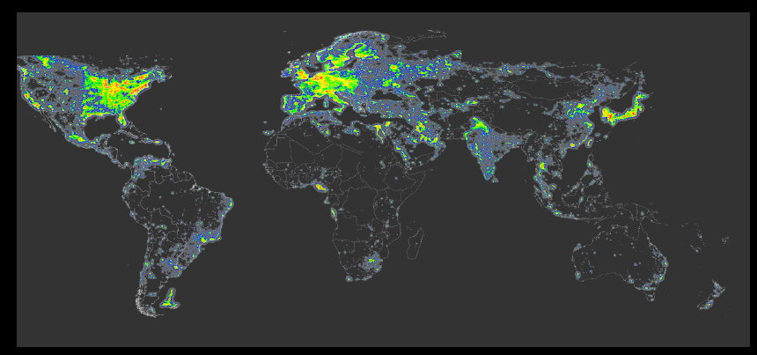
We observe galaxies (baryons) since they emit light.
Baryons are only ~ 15% of the total matter in the Universe!
Galaxies are a biased tracer of the total matter distribution.
DES measures the distribution properties of galaxies.

Slide 34
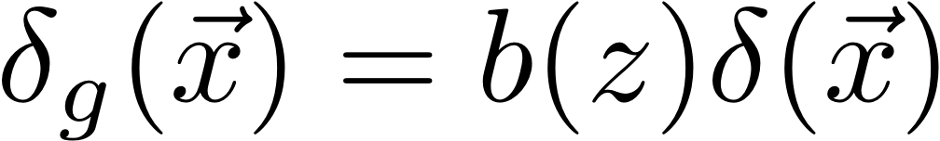
Linear bias model
(relation between galaxy density and dark matter density):
galaxy overdensity
matter overdensity
(theory from a cosmological model)
bias
Linear bias: another free parameter

Slide 35
6- Observations: the case of DES
Large scale galaxy surveys are instrumental for
the determination of best model for the Universe:
SDSS, BOSS, eBOSS
KiDS
DES
PAU, J-PAS
DESI
LSST
Euclid ...

Slide 36
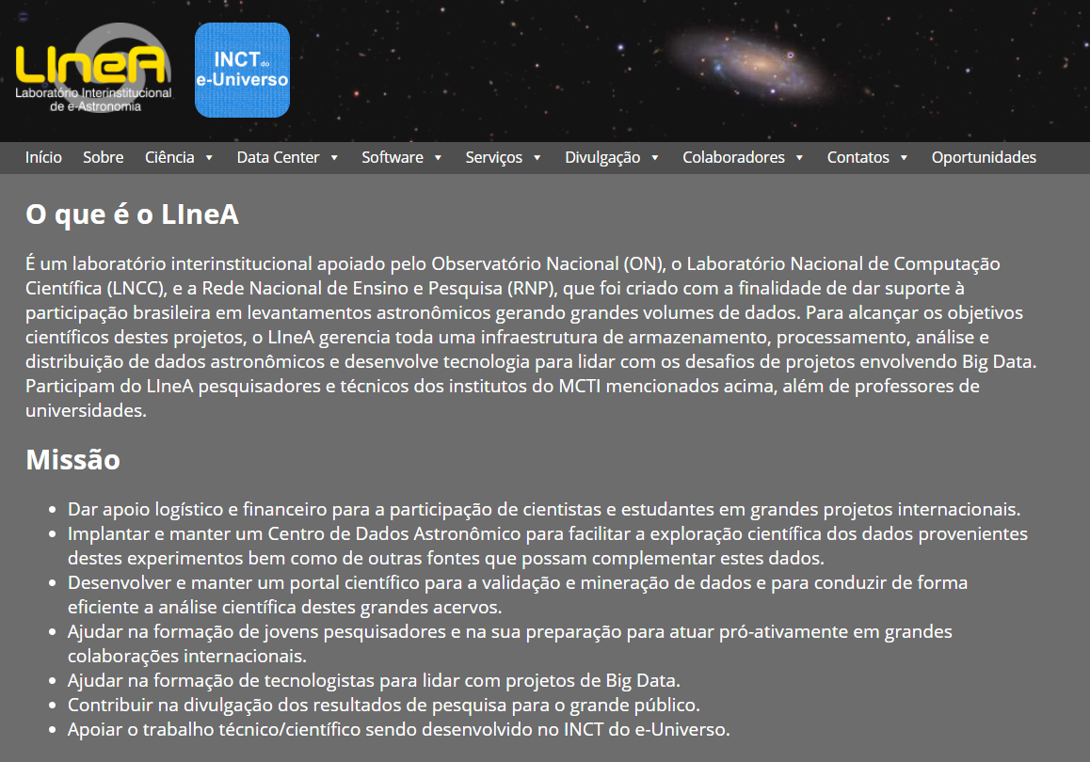
linea.gov.br

Slide 37
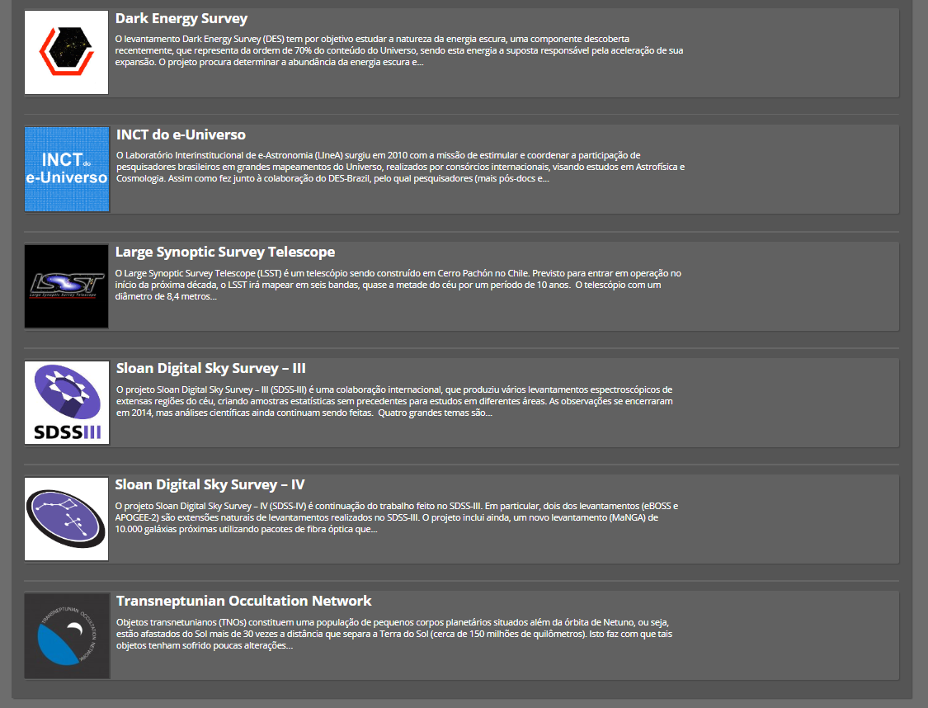

Slide 38
Distribution of galaxies in the universe provide:
information about growth of perturbations (DE/MG)
information about dark matter (hot DM is ruled out)
standard ruler (baryon acoustic oscillation scale)

Slide 39
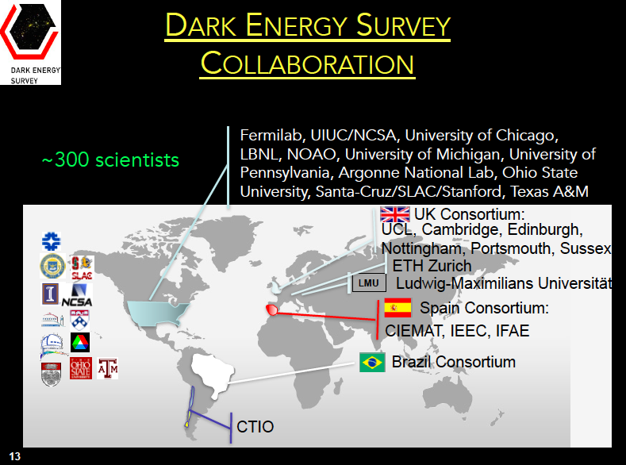
John Peoples - 1st Director
Josh Frieman – 2nd Director
Richard Kron – 3rd Director

Slide 40
DES-Brazil is a LIneA Project
Laboratório Interinstitucional de e-Astronomia (LIneA )
http://www.linea.gov.br
Recently approved INCT of the e-Universe

Slide 41
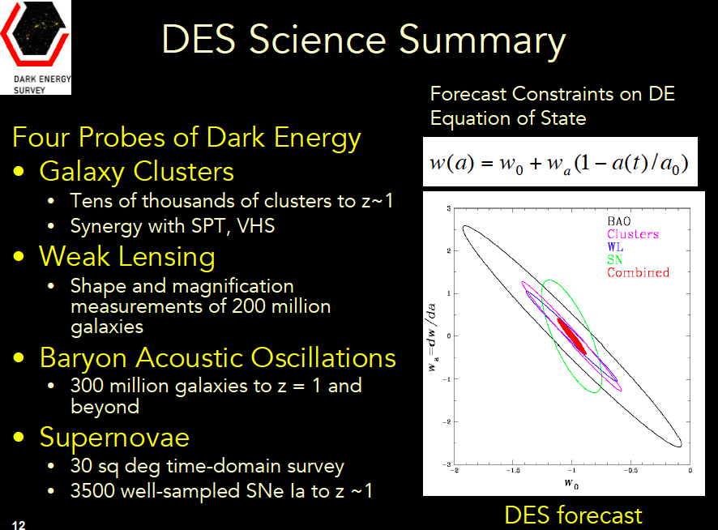

Slide 42
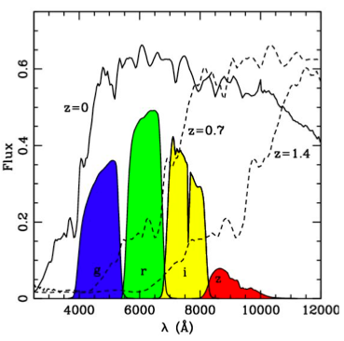
DES Project
Survey of 5000 deg² (~ 1/8 of the sky)
300 millions of galaxies up to z~1.3
(+ 100,000 clusters + 4,000 SN Ia)
Photometric redshift with 5 filters
Blanco telescope (4m, CTIO)
DECam – 62 (+12) CCDs (LBNL) - 570 Megapixels

Slide 43
DES Project Timeline
NOAO Blanco Announcement of Opportunity 2003
DECam R&D 2004-8
Camera construction 2008-11
First light DECam on telescope September 2012
Science Verification (SV) run: Sept. 2012 - Feb. 2013
First Season (Year 1): Aug. 31, 2013 - Feb. 9, 2014
Second Season (Year 2): Aug. 2014 - Feb. 2015
Third Season (Year 3): Aug. 2015 - Feb. 2016
Fourth Season (Year 4) August 2016 – Feb. 2017
Fifth Season (Year 5) August 2017 – Feb. 2018
5 ½ Season – Finishes January 2019
Planned 5 years of 105-nights each

Slide 44
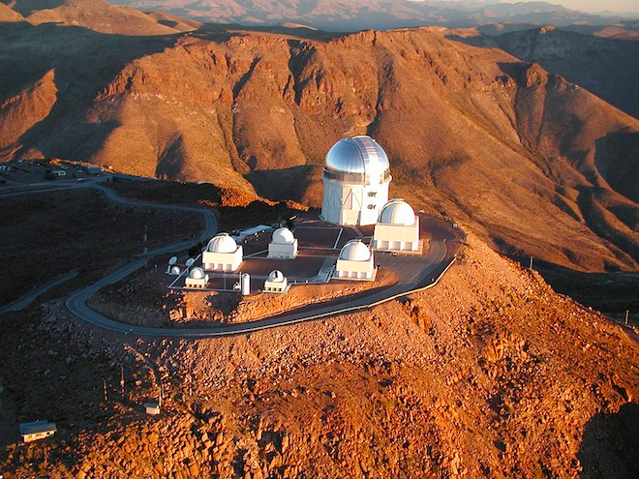
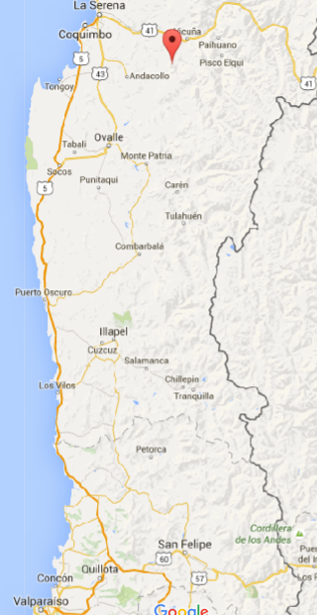
DES site: 4m Blanco telescope at the Cerro Tololo Inter-
American Observatory (CTIO) in Chile

Slide 45
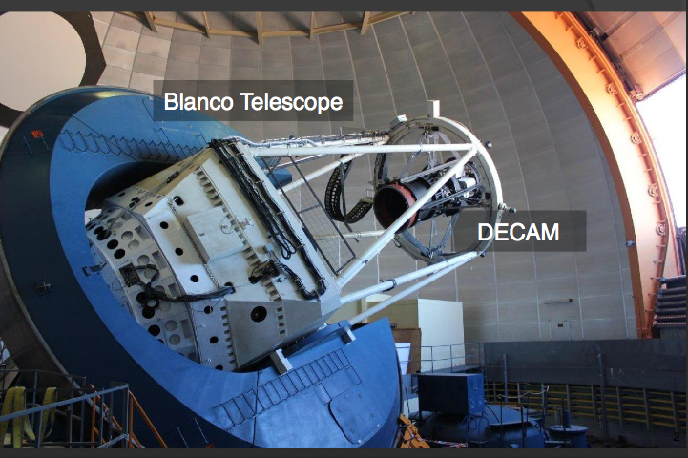
DECam
Able to see light from more than 100,000 galaxies up to 8 billion light-years away in each snapshot. Weighs ~4 tons!

Slide 46
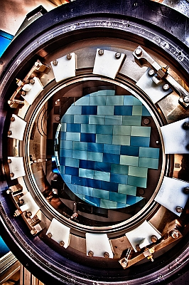
DECam
arXiv:1504.02900

Slide 47
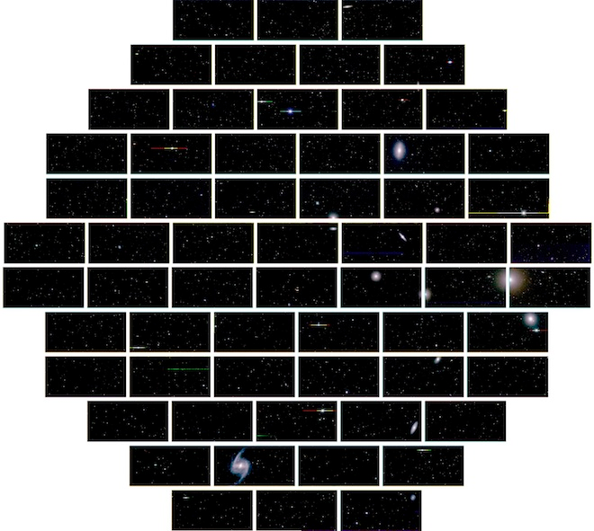
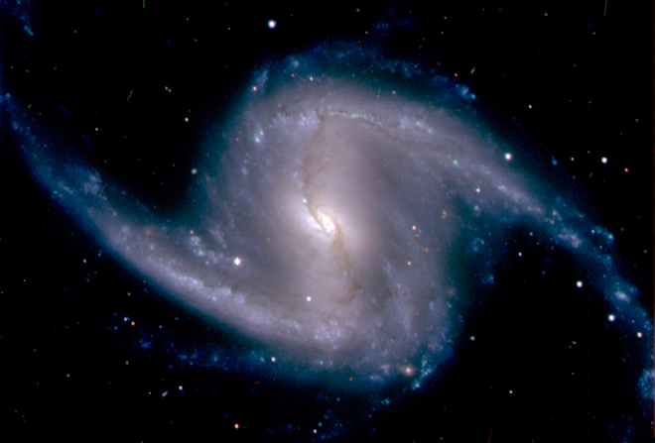
Fornax cluster of galaxies
Barred spiral galaxy NGC 1365 in the Fornax cluster of galaxies

Slide 48
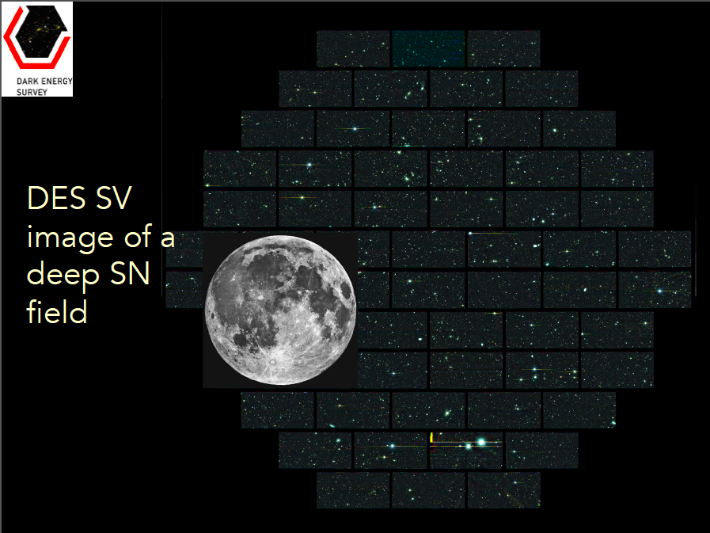
3 deg² field of view

Slide 49
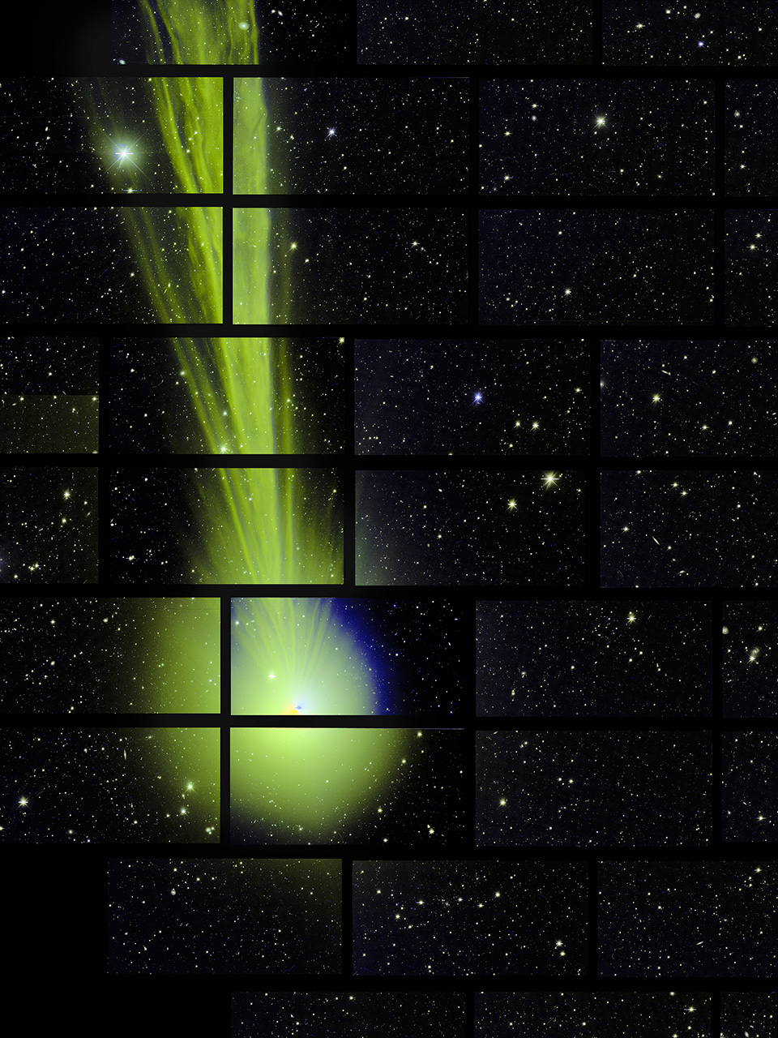
Dark Energy Camera catches breathtaking glimpse of comet Lovejoy
December 27 2014
82 million km away

Slide 50
DES Data Management
Each exposure (in a given filter) generates 500Mb
300 exposures/night – 150 Gb/night
Transferred and processed at NCSA in Urbana

Slide 51
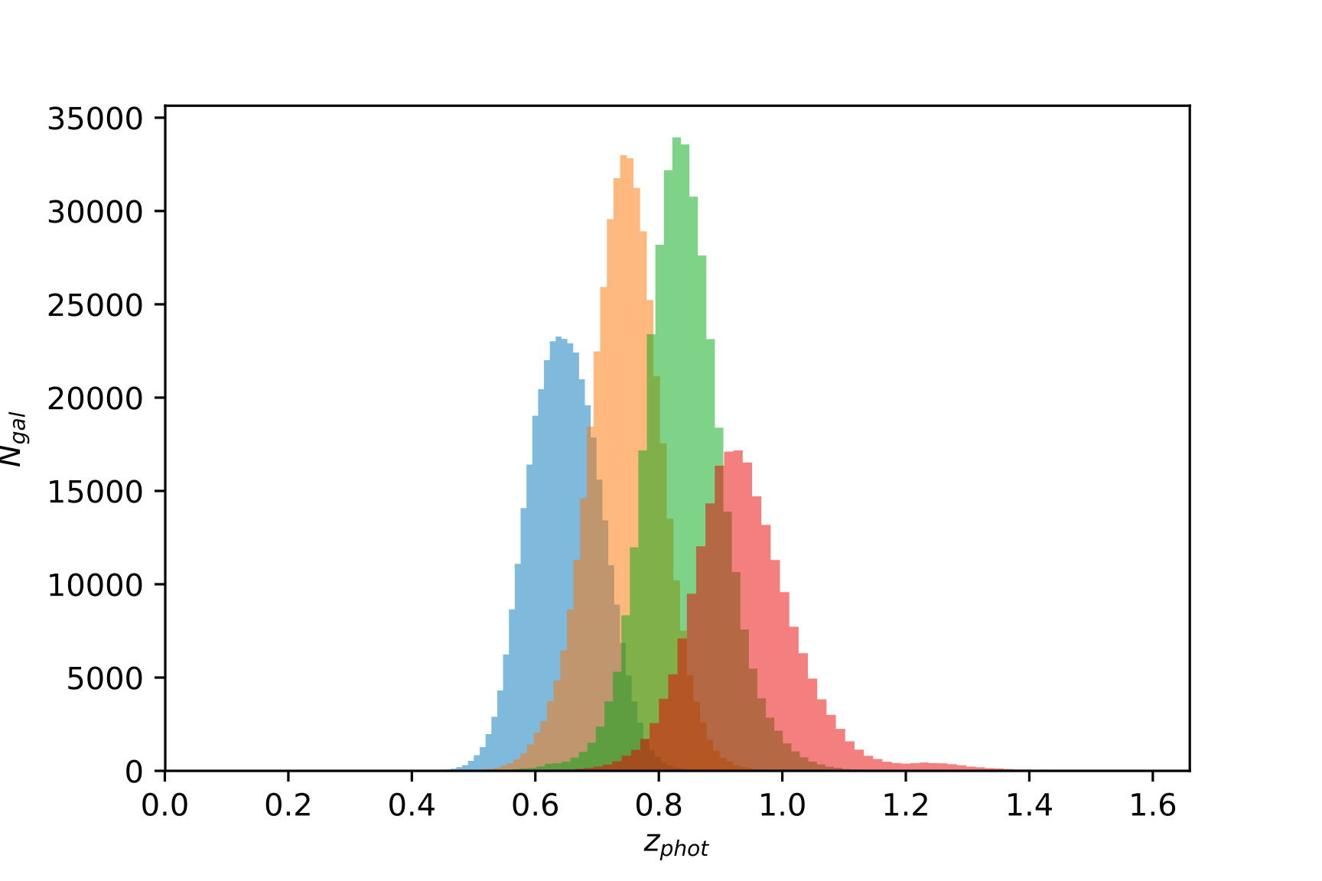
Photometric redshift
Typical photo-z distribution in 4 bins (BPZ) – selection function

Slide 52
Brazilian infrastructure contribution
QuickReduce: software for fast assessment of image
quality at CTIO
The Science Portal: Data Server, Value Added
Catalogs and scientific pipelines
Creating a science-ready catalog is the crux:
selection of objects, photo-z, systematic effects, …

Slide 53
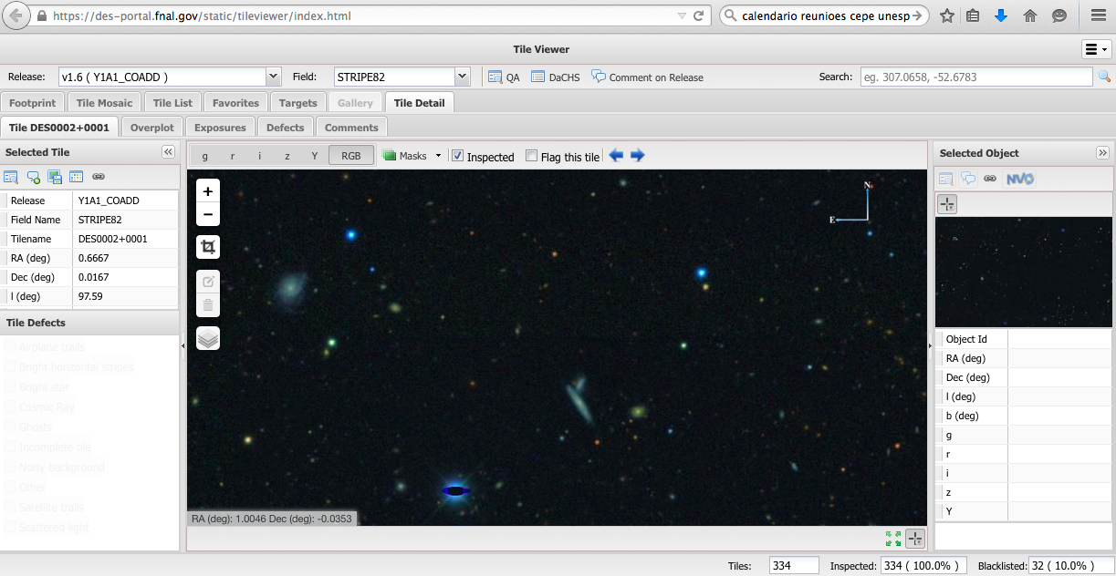

Slide 54
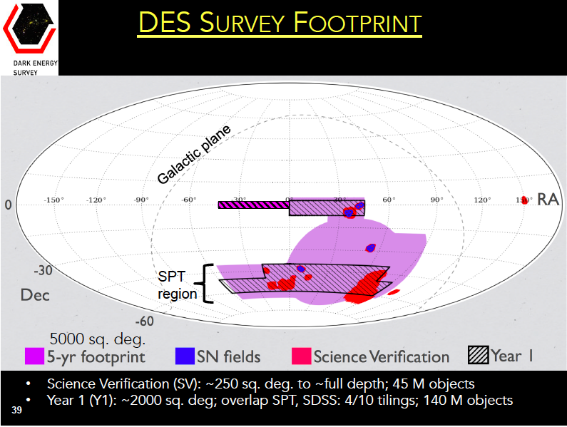

Slide 55
DES Year 1 Galaxy Distribution
SPT
region
SV area
Credit: P. Melchior

Slide 56
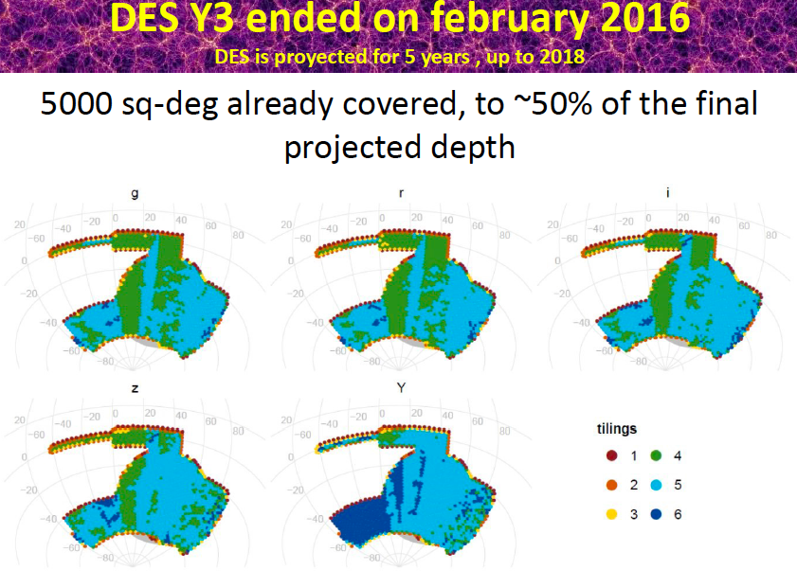

Slide 57
7- DES highlights and challenges
A number of results were already obtained.
I will highlight some but concentrate on these Y1 results:
BAO
Galaxy clustering + weak lensing

Slide 58
64 papers: 26 published and 38 submitted
(not updated)
Produced the largest contiguous mass map of the Universe;
Discovered nearly a score of Milky Way dwarf satellites and other Milky Way structures;
Measured weak lensing cosmic shear, galaxy clustering, and cross-correlations with CMB lensing and with X-ray and SZ-detected clusters;
Measured light curves for large numbers of type Ia supernovae and discovered a number of super-luminous supernovae including the highest-redshift SLSN so far;
Discovered a number of redshift z>6 QSOs;
Discovered a number of strongly lensed galaxies and QSOs;
Discovered a number of interesting objects in the outer Solar System;
Found optical counterparts of GW events – led by a brazilian.

Slide 59
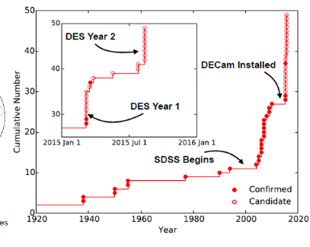
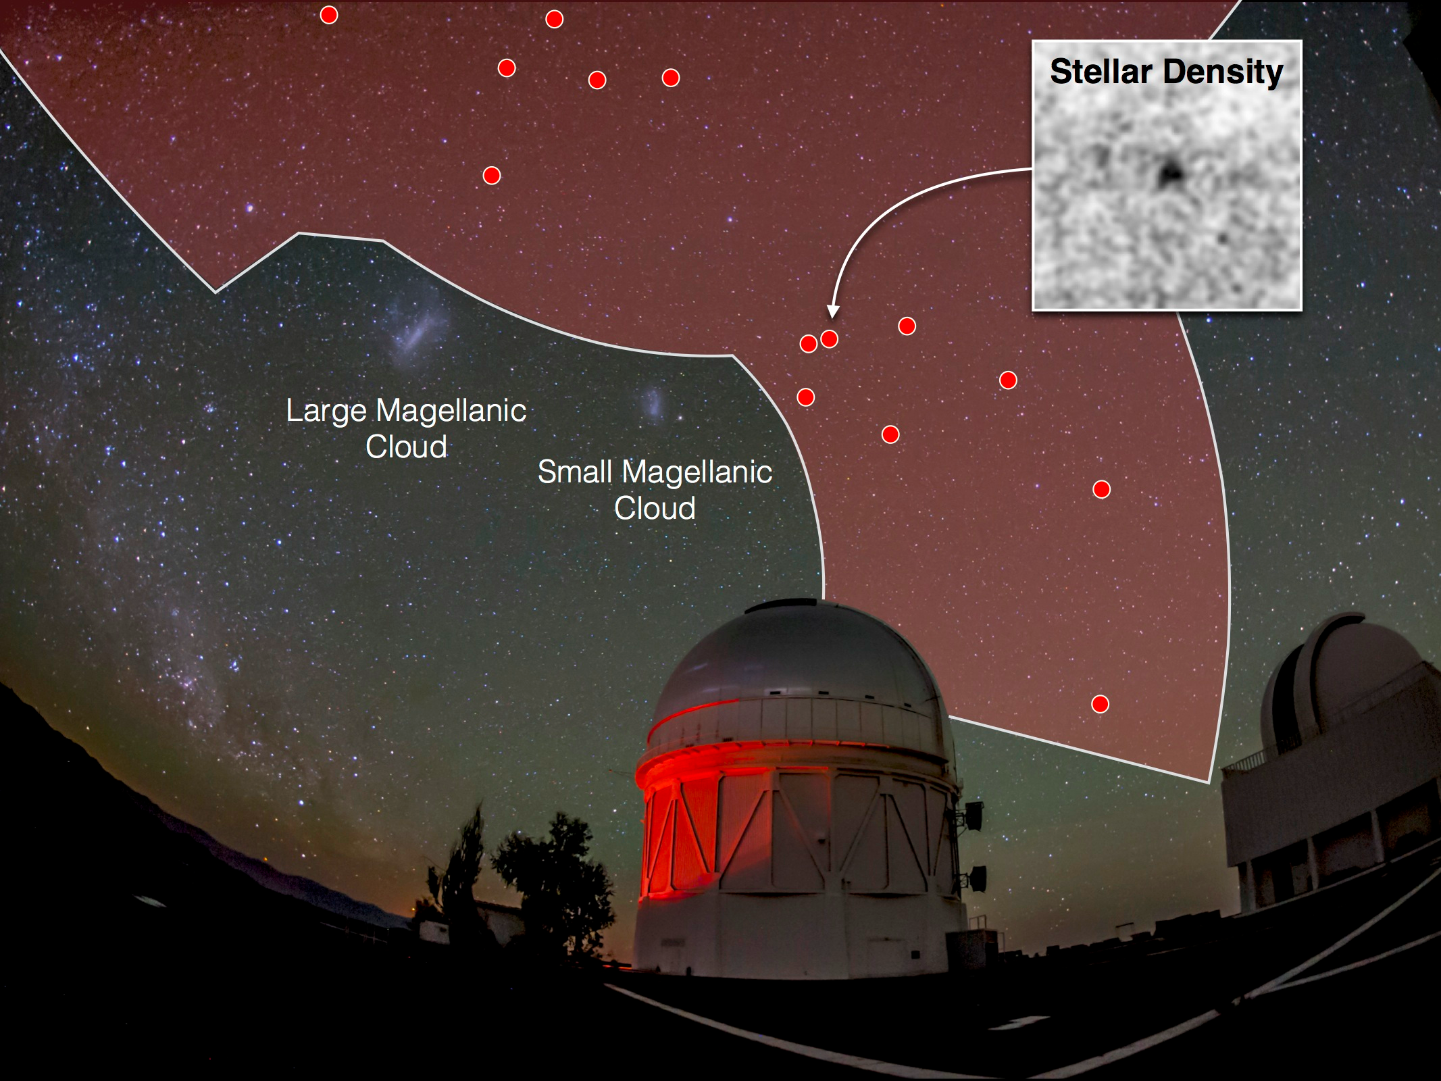
1508.03622
17 new dwarf galaxies discovered by DES!
27 known before DES.
Contribution from B. Santiago’s team
Joint paper with Fermi-LAT
WIMPs with mass<100 GeV are excluded (thermally produced,
model dependent)
1503.02632

Slide 60
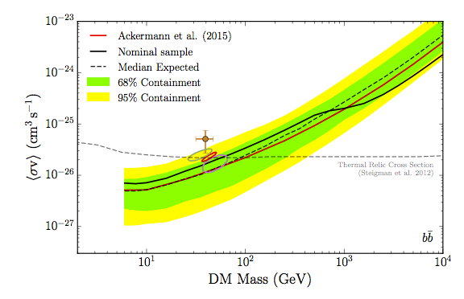
Results from Fermi-LAT & DES using 45 dwarf
Milky Way satellite galaxies (rich in dark matter)
1611.03184

Slide 61
7.1- BAO@DES
BAO main paper: 1712.06209
Three diferente analysis:
Real space angular correlation function
Harmonic space power spectrum – our contribution
Comoving transverse separation
Identify the BAO signature in the DES Y1data, and use it to place constraints on the comoving angular diameter distance to the effective redshift of the sample.

Slide 62
BAO main paper: 1712.06209
Steps:
Determine a sample (catalogue) – based on color and magnitude cuts that optimize the BAO signal
Minimize systematic errors (stellar contamination, seen, etc)
Measure redshift and divide sample into redshift bins
Define (bins in angle, bins in l’s) and measure data vector
Estimate covariance matrix (1800 Halogen mocks)
Show robustness/goodness of measurements

Slide 63
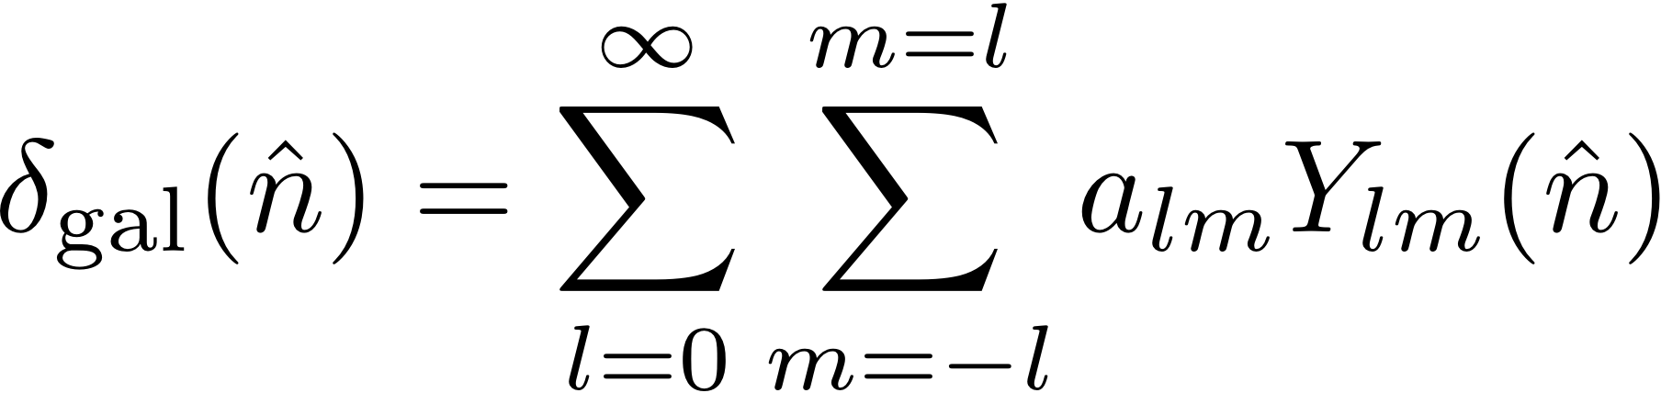
BAO using the angular power spectrum:
Camacho et al 1807.10163
Estimations of the galaxy angular power spectrum.
First decompose the projected 2-dimensional galaxy overdensity in a given redshift bin in spherical harmonics as:

Slide 64
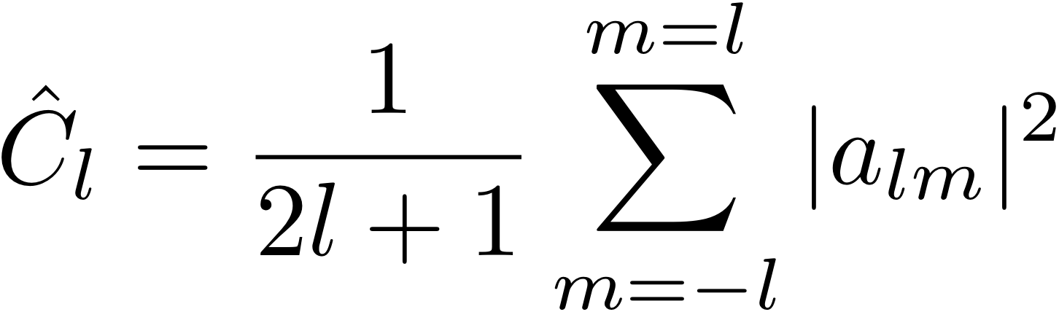
The angular power spectrum C_{l} can be estimated (in full sky) as:
We compute the coefficients a_{lm} from the pixelized density contrast maps using the anafast code contained in HEALPiX.
The measurements must take into account the fact that the survey is not performed in full sky – there is a mask

Slide 65
Mask affects the estimator: we use the so-called pseudo-C_{l} method (developed in CMB)
Mask is provided by the collaboration taking into account data quality and systematic effects (eg airmass).
Effective area of full survey is expected to be 5000 deg²
Y1 ~ 1000 deg²
Covariance matrix estimated from 1800 mocks (but resulted in large chi2) – also estimate theoretically from HALOFIT including mask effects.

Slide 66

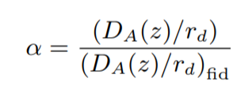
BAO position estimated using a template-based method:
Parameter α determines the shift in the BAO position with respect to a fiducial cosmology:

Slide 67
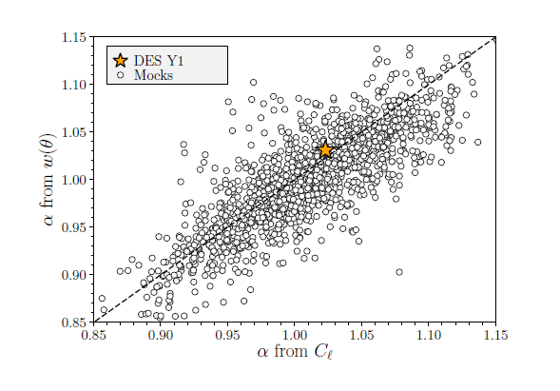

Slide 68


Slide 69
7.2- Main result:
Galaxy clustering + weak lensing
Main paper: 1708.01530
Uses 2 galaxy samples:
“Shape catalogue”: 26M galaxies for cosmic shear measurements (source galaxies) divided into 4 redshift bins
“Position catalogue”: 650,000 luminous red galaxies (lens galaxies) for clustering measurements divided into 5 redshift bins

Slide 70

Redshift distributions of the 2 samples

Slide 71

20
Nuisance
Parameters

Slide 72
Data vectors were defined using scale cuts to mitigate non-linear bias effects.
Uses a theoretical (halo-model based) Covariance Matrix: CosmoLike (457x457) validated with 800 lognormal mocks – our contribution.
2 main parameters were measured: the total matter density and the amplitude of perturbations at a scale of 8 Mpc.
2 models were analyzed: ΛCDM and wCDM

Slide 73

ΛCDM

Slide 74

ΛCDM

Slide 75


wCDM
There goes the Nobel prize... (S. Dodelson)

Slide 76

Beyond wCDM: “Extensions paper” - 1810.02499
Four extensions:
1. Spatial curvature
2. The effective number of neutrinos species
3. Time-varying equation-of-state of dark energy: w(a) = w₀ +(1-a) w_{a}
4. Tests of gravity

Slide 77


Slide 78


Slide 79
7.3- Challenges
Cosmology from cluster counts:
cluster finding algorithms (RedMapper), mass-richness
calibration, etc – coming!
Including cluster counts in a joint analysis: 3x2pt+1
SNIa cosmology just finished:
First Cosmology Results using Type Ia Supernovae from the DES:
Constraints on Cosmological Parameters - 1811.02374
Going to smaller scales:
better modelling of bias and baryons – precision!
Alternative covariances
Check for non-gaussian likelihoods

Slide 80
8 - CODA
Cosmology has become a precision, data driven science
Cosmology tests models of fundamental physics (eg are studying WDM and DM-DE interaction)
New experiments are taking data now and many are planned (DESI, LSST, Euclid, ...)
Y1 DES analysis finished – Y3 under way
It is an exciting time – let’s hope for surprises!

