Slide 1

A Quipu on
Reactor Neutrino Experiments
KT McDonald
Princeton U.
(November 27, 2018)
XII Latin American Symposium on High Energy Physics
Pontificia Universidad Católica del Perú, Lima
http://physics.princeton.edu/~mcdonald/examples/mcdonald_silafae_181127.pdf

Slide 2
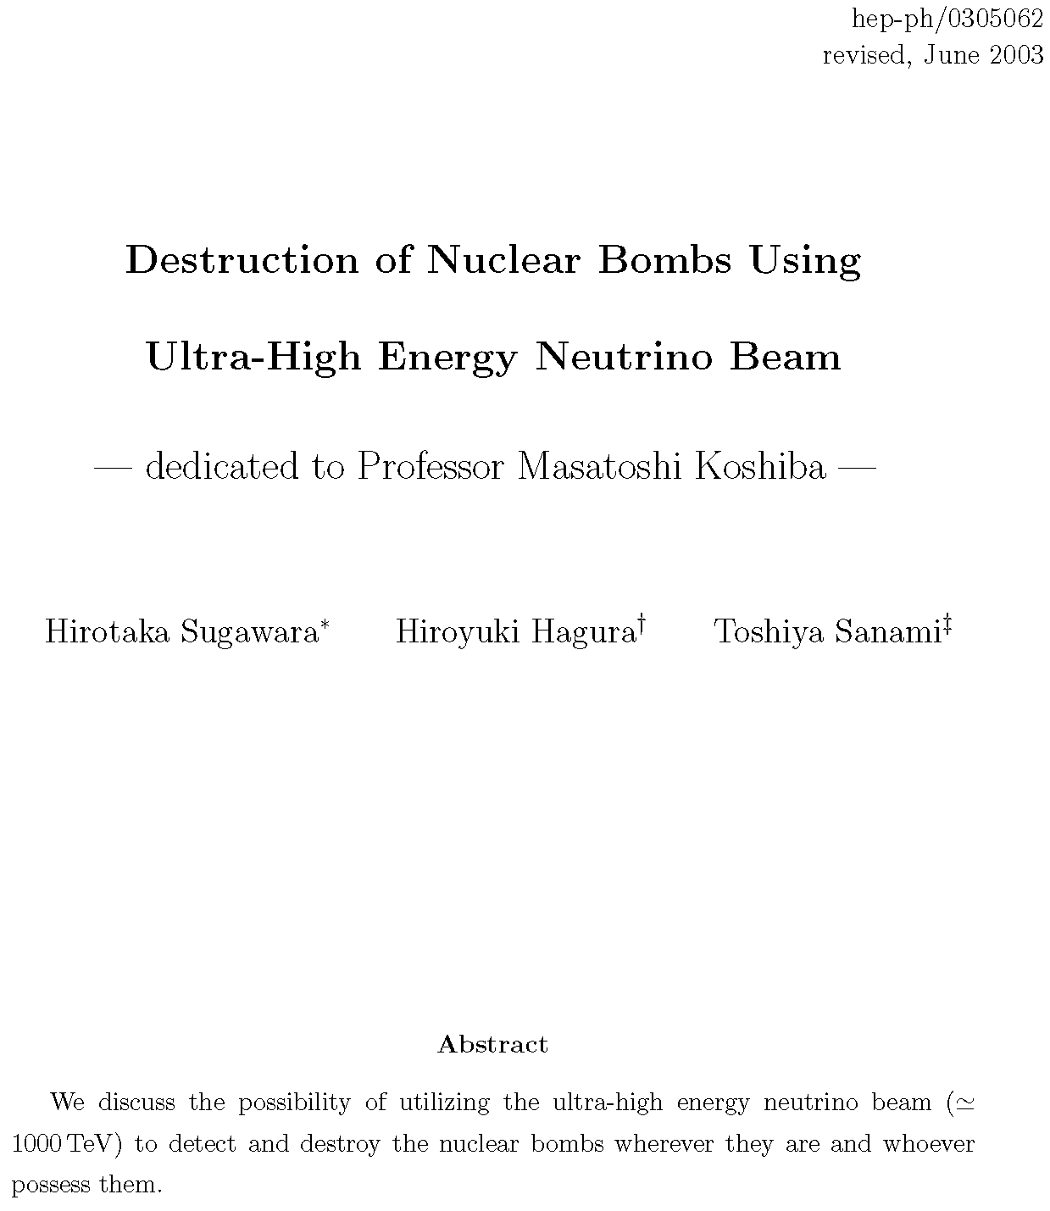
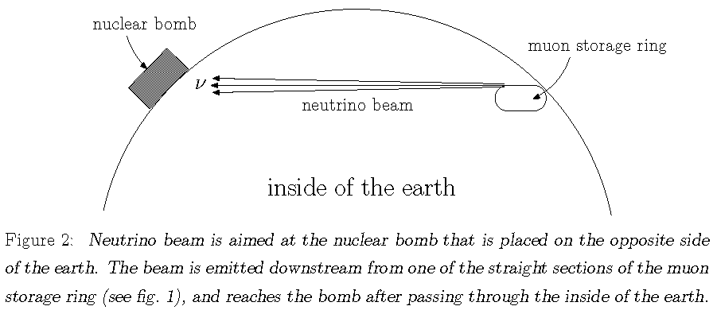
Atom Bombs Produce Neutrinos; Neutrinos Could Destroy Atom Bombs

Slide 3
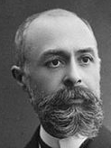
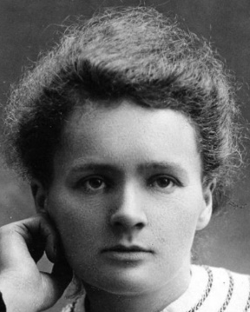
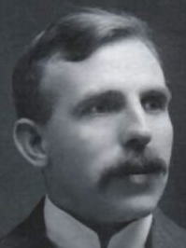
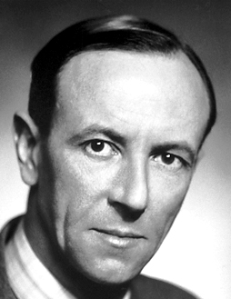
Beta Decay
1896: H. Becquerel discovered that uranium salts can activate photographic film through black paper, as if penetrating rays were emitted. C.R.A.S, 122, 501 (1896)
1897: M. Curie found similar behavior for thorium, and coined the term “radioactivity.” C.R.A.S, 126, 1101 (1898)
E. Branly called a “coherer” of radio waves a “radioconducteur” . Éclair. Élec. 8, 565 (1897)
1898: M. and P. Curie discovered radioactive elements polonium and radium.
C.R.A.S. 127, 1215 (1898)
1899: E. Rutherford showed that radioactive materials have an exponential decay, and that there are 2 types of radioactivity, alpha (not very penetrating) and beta (more penetrating). Phil. Mag. 47, 109 (1899)
1901: Becquerel showed that beta rays are electrons. C.R.A.S, 130, 1583 (1900)
1914: J. Chadwick gave first clear evidence that the energy spectrum of electrons in beta decay is continuous, which implies apparent energy nonconservation.
Work done as a German prisoner of war. Deutsch. Verh. Phys. Ges. 16, 383 (1914)

Slide 4
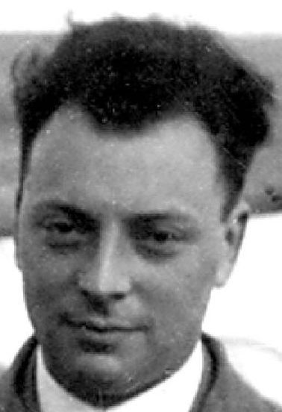
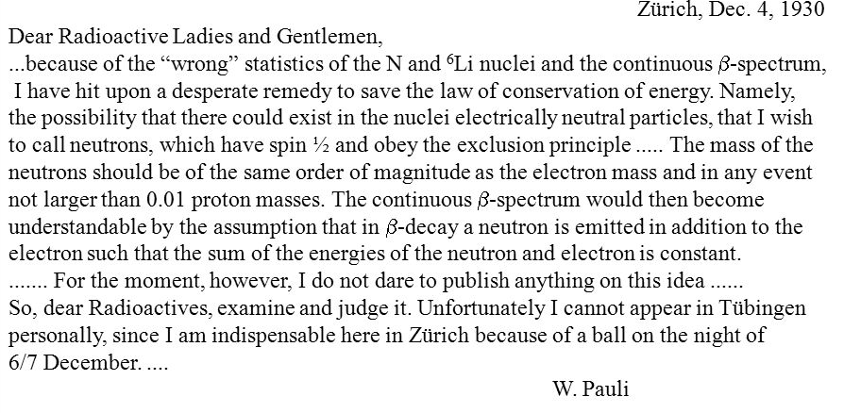
Neutrinos
1930: Pauli noted that if a new particle is produced in beta decay, this would restore conservation of energy, and obey Fermi statistics if the particle has spin ½.
This was the first solution to a problem in particle physics by invention of a new particle. [Astronomy, unexplained perturbations to known planets ⇒ new planet.]

Slide 5
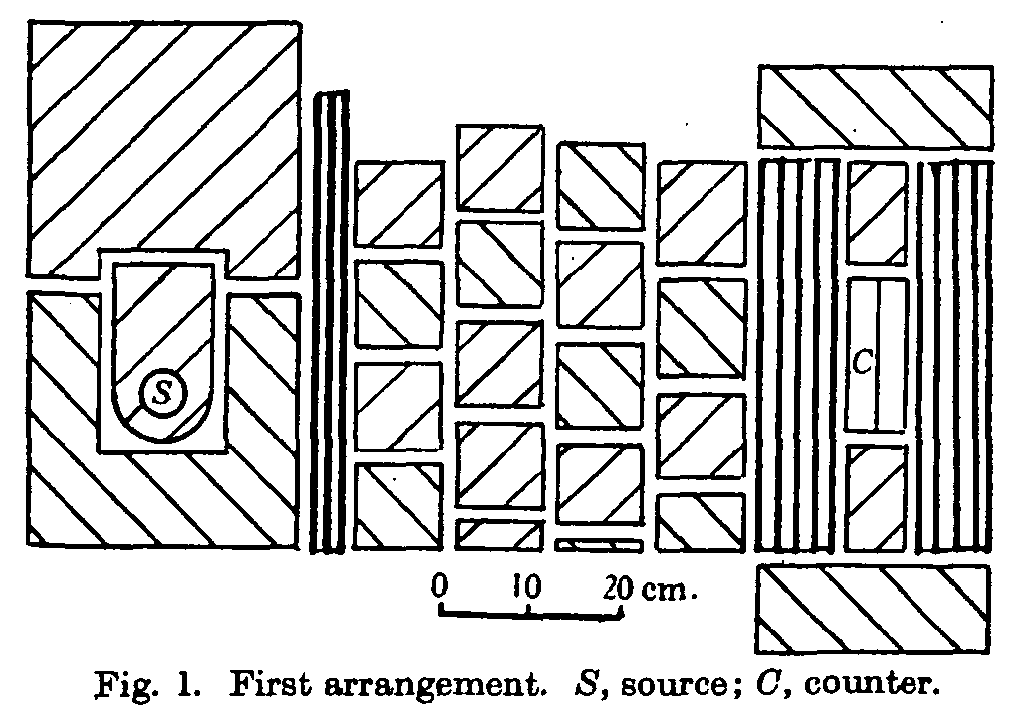
First Attempts to Detect a Neutrino
Bethe and Peierls argued that a spin-1/2 neutrino might have a magnetic moment,
which would cause a small amount of ionization in matter by a penetrating neutrino.
H. Bethe and R. Peierls, Nature, 133, 532 (1934)
Two experiments were performed in 1934 using radium sources and cloud chambers to detect this effect, with negative results.
J. Chadwick and D.E. Lea, Proc. Camb. Phil. Soc. 30, 59 (1934)
M.E. Nahmias, Proc. Camb. Phil. Soc. 31, 99 (1935)
In the Standard Model, the magnetic moment of a neutrino is proportional to its mass,
i.e., extremely small.
K. Fujikawa and R.E. Schrock, Phys. Rev. Lett. 45, 963 (1980)

Slide 6
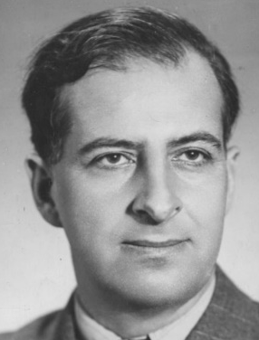

Pontecorvo
1946: Pontecorvo suggested that neutrinos might be observed via inverse beta decay of neutrinos from the Sun, or from a “pile” = nuclear reactor. B. Pontecorvo, Chalk River PD-205 (1946)
In particular, he suggested study of the chlorine reaction:
Pontecorvo proposed to search for neutrinos at a nuclear reactor, although reactors (unlike the Sun) produce antineutrinos!
He was inspired by Majorana’s comment that neutrinos might be their own antiparticles. E. Majorana, Nuovo Cimento 14, 171 (1937)
v + $Cl^{37}→Ar^{37}+e^{− }$

Slide 7
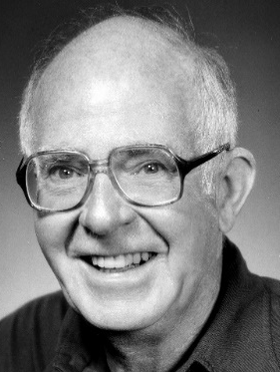
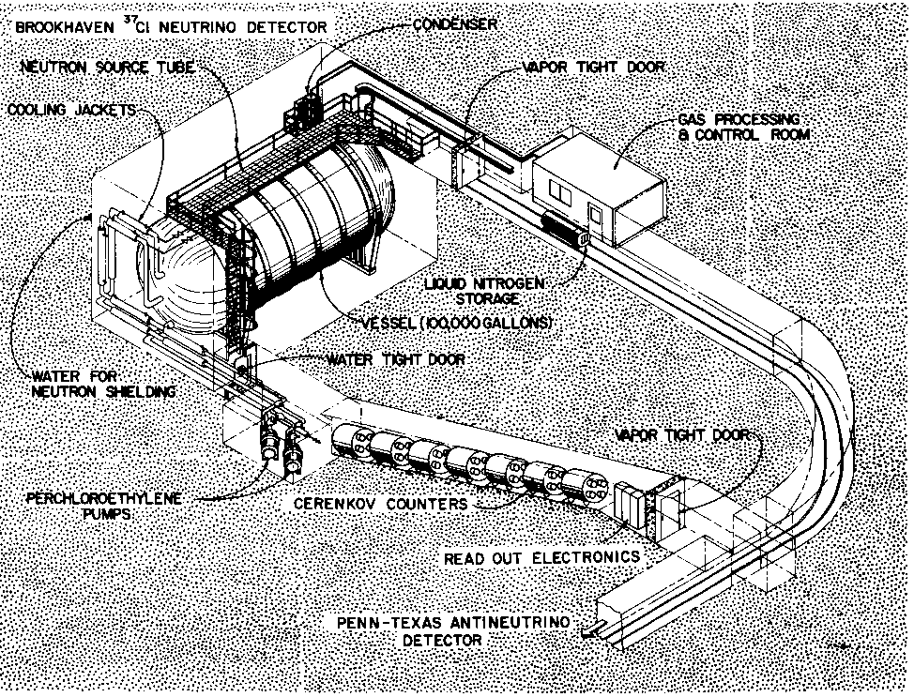

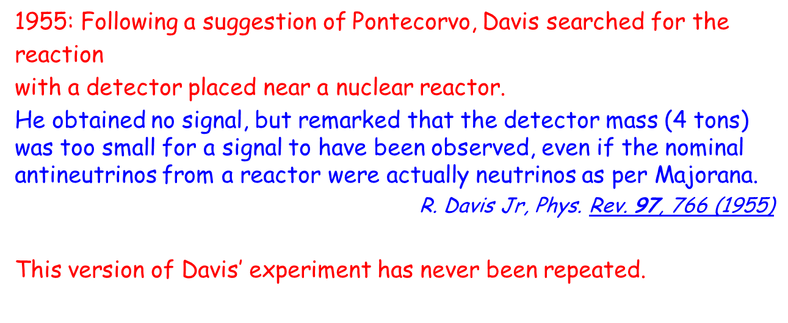
Davis
1955: Following a suggestion of Pontecorvo, Davis searched for the
reaction
with a detector placed near a nuclear reactor.
He obtained no signal, but remarked that the detector mass (4 tons) was too small for a signal to have been observed, even if the nominal antineutrinos from a reactor were actually neutrinos as per Majorana.
R. Davis Jr, Phys. Rev. 97, 766 (1955)
This version of Davis’ experiment has never been repeated.
v + $Cl^{37}→Ar^{37}+e^{− }$
Davis switched his efforts to the detection of solar neutrinos, deep underground and far from any nuclear reactor, with now-famous results: the solar-neutrino “deficit.” Cleveland et al., Ap. J. 496, 505 (1998)

Slide 8
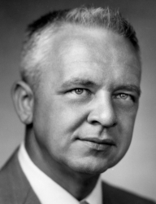
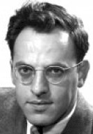
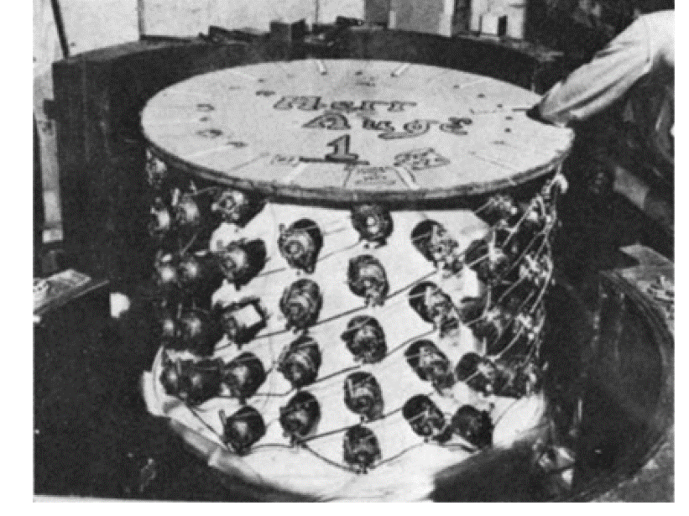



Cowan and Reines
1953: Cowan and Reines noted that a better way to detect reactor antineutrinos (produced via the beta decay )
is via the inverse-beta-decay process, ,
using a liquid-scintillator detector that first observes the positron, and then the delayed capture of the thermalized neutron on a nucleus, with subsequent emission of γ-rays.
F. Reines and C.L. Cowan Jr, Phys. Rev. 90, 492 (1953)
They reported marginal evidence for detection of antineutrinos in 1953, and then more compelling evidence in 1956.
F. Reines and C.L. Cowan Jr, Phys. Rev. 92, 830 (1953)
C.L. Cowan Jr et al., Science 124, 103 (1956)
n $→p e^{− }{\overline{v}}_{e}$
${\overline{v}}_{e}$ p $→n e^{+ }$

Slide 9
Three Generations of Standard-Model Leptons
1936: Muon discovered in cloud chambers.
C.D. Anderson and S.H. Neddermeyer, Phys. Rev. 50, 263 (1936)
J.C. Street and E.C. Stevenson, Phys. Rev. 52, 1003 (1937)
1962: Muon neutrinos observed in spark chambers.
G. Danby et al., Phys. Rev. Lett. 9, 36, (1962)
1975: Tau lepton discovered in a 4π collider detector.
M.L. Perl et al., Phys. Rev. Lett. 35, 1489 (1975)
2001: Tau neutrinos observed in emulsion detectors.
4 events: K. Kodama et al., Phys. Lett. B 504, 218 (2001)
5 events: N. Agafonova et al., Phys. Rev. Lett. 115, 121802 (2015)
Measurement of the “invisible” width of the Z⁰ boson at e⁺e⁻ colliders ⇒ No. of low-mass, Standard-Model neutrinos is 2.984 ± 0.008. Phys. Rep. 427, 257 (2006)

Slide 10
Pontecorvo, Maki, Nakagawa, Sakata
1957: Pontecorvo considered that lepton number might not be conserved, that neutrinos might have nonzero mass, and that they could exhibit vacuum oscillations.
B. Pontecorvo, Sov. Phys. JETP 6, 429 (1957)
1962: Maki, Nakagawa and Sakata considered a triplet model for leptons, that accommodates neutrino mixing. Prog. Theor. Phys. 28, 870 (1962)
These suggestions have defined much of the study of neutrino interactions in last 50 years: Measurement of 3 mass differences, 3 mixing angles, and CP-violation parameter
[1964: CP violation discovered in the neutral-Kaon system.
J.H. Christenson et al., Phys. Rev. Lett. 13, 138 (1964) ]
Initial searches for neutrino oscillations at a nuclear reactor used only a single detector, at a single distance from the reactor, hoping to find a signal for (electron) antineutrinos smaller than that expected for the case of no oscillations.
Perhaps not surprisingly, results from these experiments were negative.
[See also slides 18 and 31-32.]

Slide 11
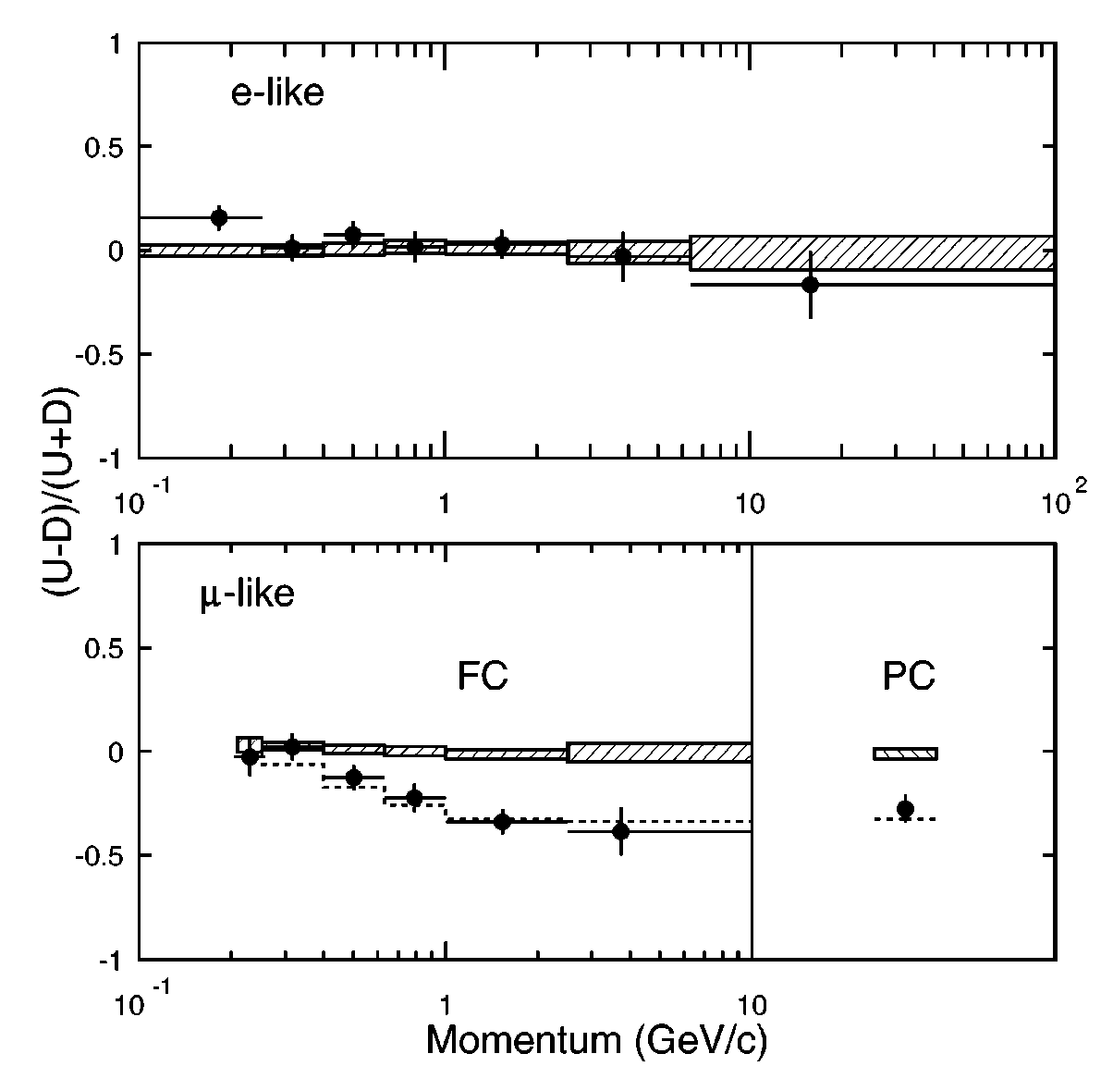
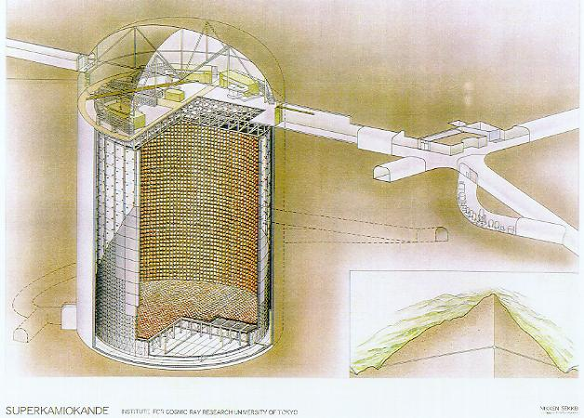
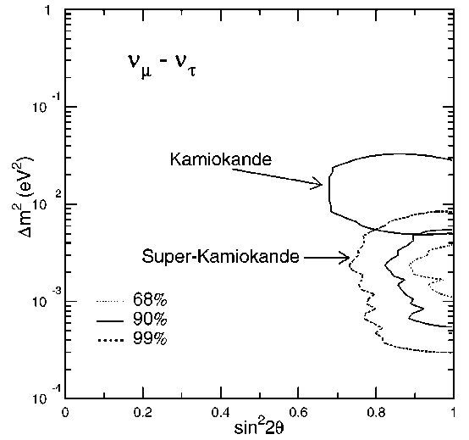
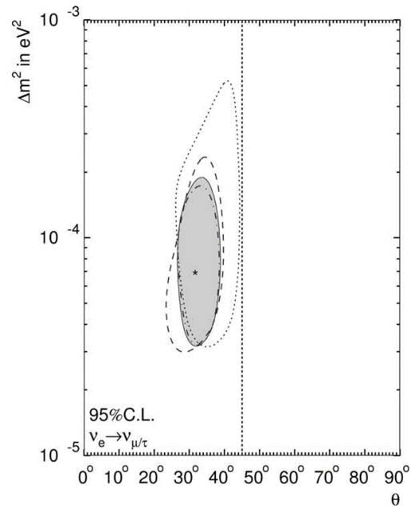
Atmospheric and Solar Neutrino Oscillations
1998: Following hints of atmospheric neutrino oscillations in the Kamiokande expt,
the Super-Kamiokande water-Ĉerenkov detector showed a clear difference in the energy dependence of 0.2-20 GeV electron and muon neutrinos produced in the upper atmosphere. Y. Fukuda et al., Phys. Rev. Lett. 81, 1562 (1998)
2002: By study of 5-20 MeV electron neutrinos, Super-K determined parameters of solar-neutrino mixing. Y. Fukuda et al., Phys. Lett. B 539, 179 (2002)

Slide 12
Do Neutrino Oscillations Conserve Energy?
If neutrinos have mass, they have a rest frame.
If a neutrino oscillates and changes its mass in this rest frame, its mass/energy is not conserved! If a moving neutrino oscillated with fixed momentum, its energy would change, or if fixed energy, its momentum would change.
Is this the way neutrino oscillations work? NO!
Neutrinos are always produced together with some other state X, and if the parent state has definite energy and momentum, then so does the quantum state |ν⟩|X⟩.
If the neutrino is produced in a flavor state, it is a quantum sum of mass states,
|ν_{e}⟩ = a₁ |ν₁⟩ + a₂ |ν₂⟩ + a₃ |ν₃⟩, and the production involves an entangled state,
|ν_{e}⟩ |X⟩ = a₁ |ν₁ |X₁⟩ + a₂ |ν₂⟩ |X₂⟩ + a₃ |ν₃⟩ |X₃⟩.
The sum of the energies and momenta of ν_{i} and X_{i} equals the initial state energy/momentum, while the different ν_{i} (X_{i}) have different energies and momenta.
The coefficients a_{i} can change with time (oscillate), but the energy of ν_{i} does not change with time.
http://physics.princeton.edu/~mcdonald/examples/neutrino_osc.pdf

Slide 13
Can Measurement of X Suppress Neutrino Oscillations?
YES.
If X is measured so well that we can distinguish the different X_{i} from one another, then the neutrino must be observed in the corresponding state ν_{i}.
If the neutrino is observed in a flavor state, the proportions of the 3 possible flavors are just squares of the MNS matrix elements, independent of time/distance.
However, most “observations” of state X do not determine its energy so precisely that the above scenario holds.
Example: In a nuclear beta decay, A → A’ e ν_{e}, the interaction of A’ and e with nearby atoms does not “measure” their energies precisely. Rather, the entanglement of the ν_{e} with A’ and e becomes transferred to neighboring atoms.
Optical experiments with entangled photons illustrate how measurement of the 2nd photon of a pair can affect the quantum interference of the 1st photon.
X.-S. Ma et al., Quantum erasure with causally disconnected choice, Proc. Nat. Acad. Sci. 110, 1221 (2013)

Slide 14
What is Decoherence of Neutrino Oscillations?
Since the different ν_{i} have different energies, they have different velocities, such that their wavepackets no longer overlap at large enough distances, and neutrino oscillation should no longer be observable.
Can this effect ruin a long-baseline neutrino experiment, particularly one like JUNO where it is proposed to observe the ~ 15th oscillation?
NO -- if the detector is “good enough”!
That is, when the neutrinos are observed at some large, fixed distance, and one looks for evidence of oscillations in their energy spectra, if the detector resolution is good enough to resolve the oscillations, this guarantees that the wavepackets of the different ν_{i} still overlap (barely).
On the other hand, if the detector energy resolution is poor, and the oscillations can’t be resolved in the energy spectrum, the different ν_{i} can have very different velocities, and the quantum description of this is that the ν_{i} have “decohered” because their wave packets don’t overlap.
Moral: If you want to see neutrino oscillations, you have to observe them with a “good enough” detector.

Slide 15
Coherence Length
We review the concept of coherence length by consideration of the neutrino types, 1 and 2,
with masses and well defined energies and momenta in the lab frame,
Physical neutrinos are not plane-wave states as above, but are wave packets with a spread of energies with time spread and spatial width
The wave packet decoheres when the packets of types 1 and 2 cease to overlap, i.e., when
C. Giunti, C.W. Kim and U.W. Lee, Phys. Lett. B 421, 237 (1998)
T. Ohlsson, Phys. Lett. B 502, 158 (2001)
M. Beuthe, Phys. Rev. D 66, 013003 (2002)

Slide 16
Oscillation Length
We also remind you of the concept of oscillation length for the case of two neutrino flavors,
and
Suppose have pure flavor state at the origin at

Slide 17
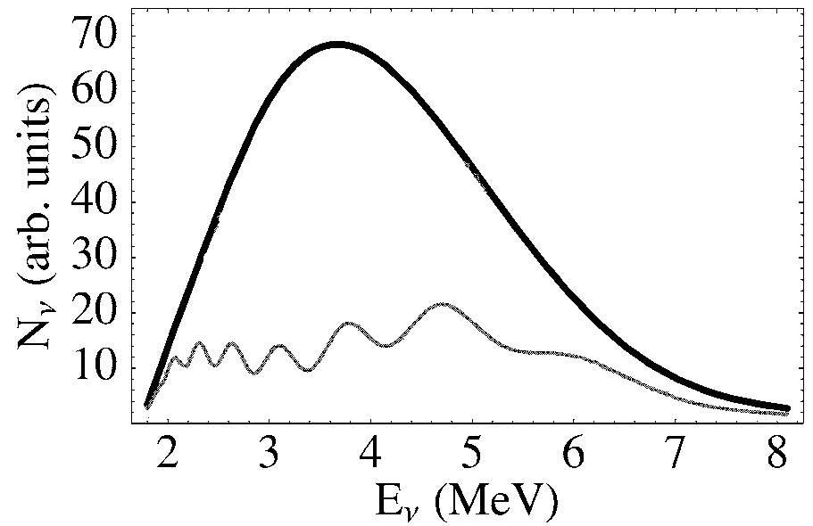
Number of Oscillations in the β-Decay Energy Spectrum
The spatial period of neutrino oscillations at fixed is
The period of oscillations in the neutrino-energy spectrum from β-decay at fixed is
  where is the average neutrino energy.
Thus, at distance the number of oscillations in the energy spectrum, of width is
If no oscillation.
If sin²2θ₁₃ = 0.05.
S.R Petcov and M Piai,
Phys. Lett. B 533, 94 (2002)

Slide 18
(Non)Decoherence in a Reactor-Neutrino Experiment
In neutrino experiments, the detector energy resolution determines in the expression for the coherence length
Some people have difficulty with this factoid, as they suppose that “decoherence” is something that happens before the neutrino is detected. We follow Bohr in noting that the apparatus plays a role in a quantum system. In particular, a neutrino detected with a nominal energy actually has energy in the range which affects the overlap of the wavepackets of different neutrino types when they have arrived at the detector.
Suppose the detector is at distance from a nuclear reactor that produces neutrinos of average energy Then, the neutrino-energy spectrum would show oscillations.
To resolve these oscillations, we need detector energy resolution
And, in this case the coherence length is
Thus, if the detector energy resolution is good enough to resolve the energy oscillations, then the coherence length is automatically long enough to avoid “decoherence.”
Moral: Decoherence is unimportant in a “good enough” neutrino experiment.
http://physics.princeton.edu/~mcdonald/dayabay/decoherence.pdf

Slide 19
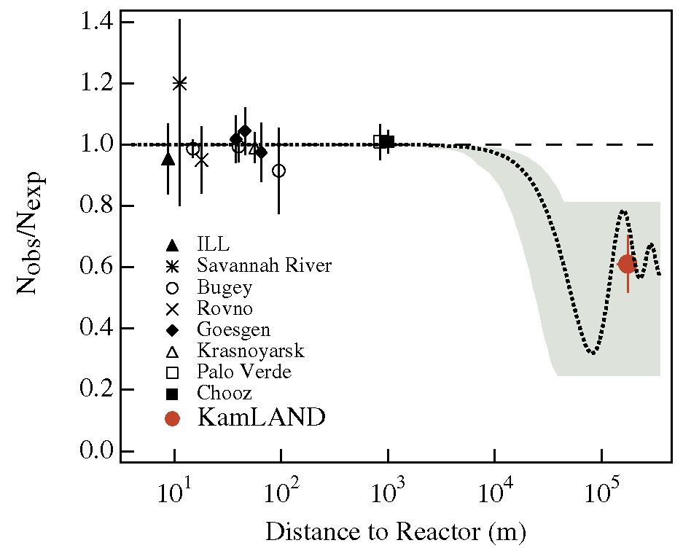
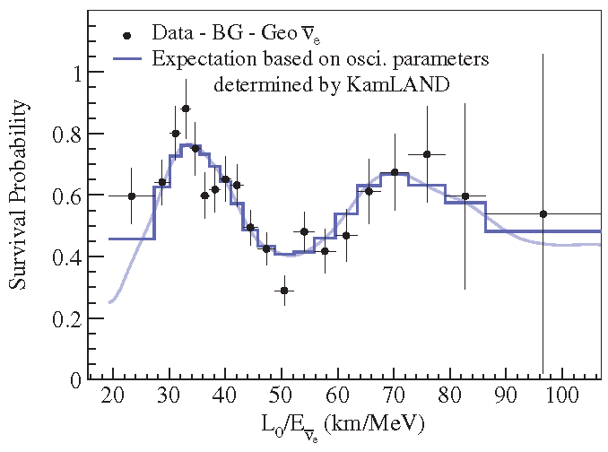
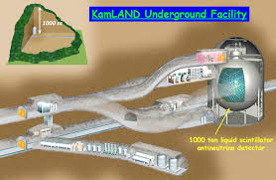
Example: The KamLAND Reactor Neutrino Experiment
In their initial oscillation analysis, the KamLAND experiment ignored the neutrino energy, so that and they could only see an average effect of the first oscillation in K. Eguchi et al., Phys. Rev. Lett. 90, 021902 (2003)
In a later analysis, the neutrino energy was used,
and better evidence for neutrino oscillation was
obtained.
S. Abe et al., Phys. Rev. Lett. 100, 221803 (2008)

Slide 20
Effect of Source Size
Neutrinos from sources at different distances are not coherent with one another, when source size ≥ oscillation length (as for solar neutrinos and supernovae).
If the neutrino source is large compared to an oscillation length, the evidence for neutrino oscillations in a detector will be “washed out.”
This is not strictly an effect of decoherence, in that neutrinos produced in different primary interactions do not interfere with one another.
For solar-neutrino oscillations, the solar-neutrino “deficit.” B.T. Cleveland et al., Ap. J. 496, 505 (1998)
J.N. Bahcall, M.H. Pinsonneault and S. Basu, Ap. J. 555, 990 (2001)
In a later analysis, the neutrino energy was used, and better evidence for neutrino oscillation was obtained.

Slide 21
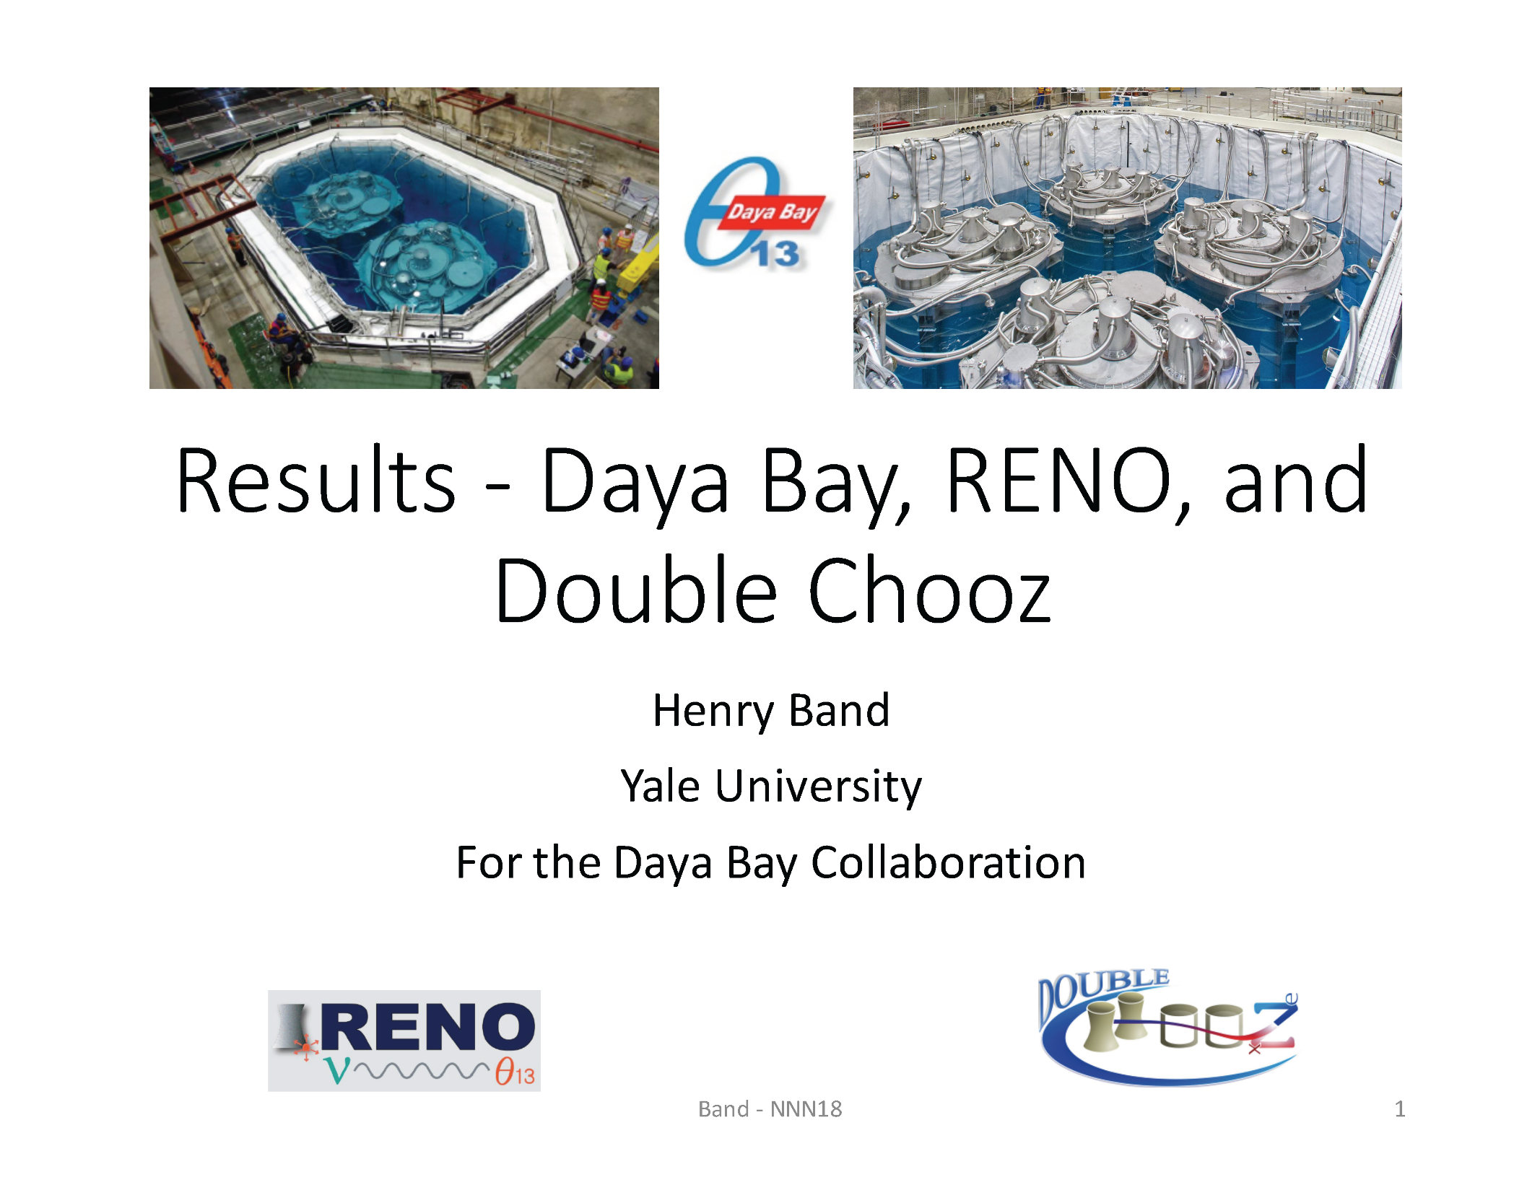
Extracts from
https://meetings.triumf.ca/indico/event/27/session/5/contribution/13/material/slides/0.pdf

Slide 22
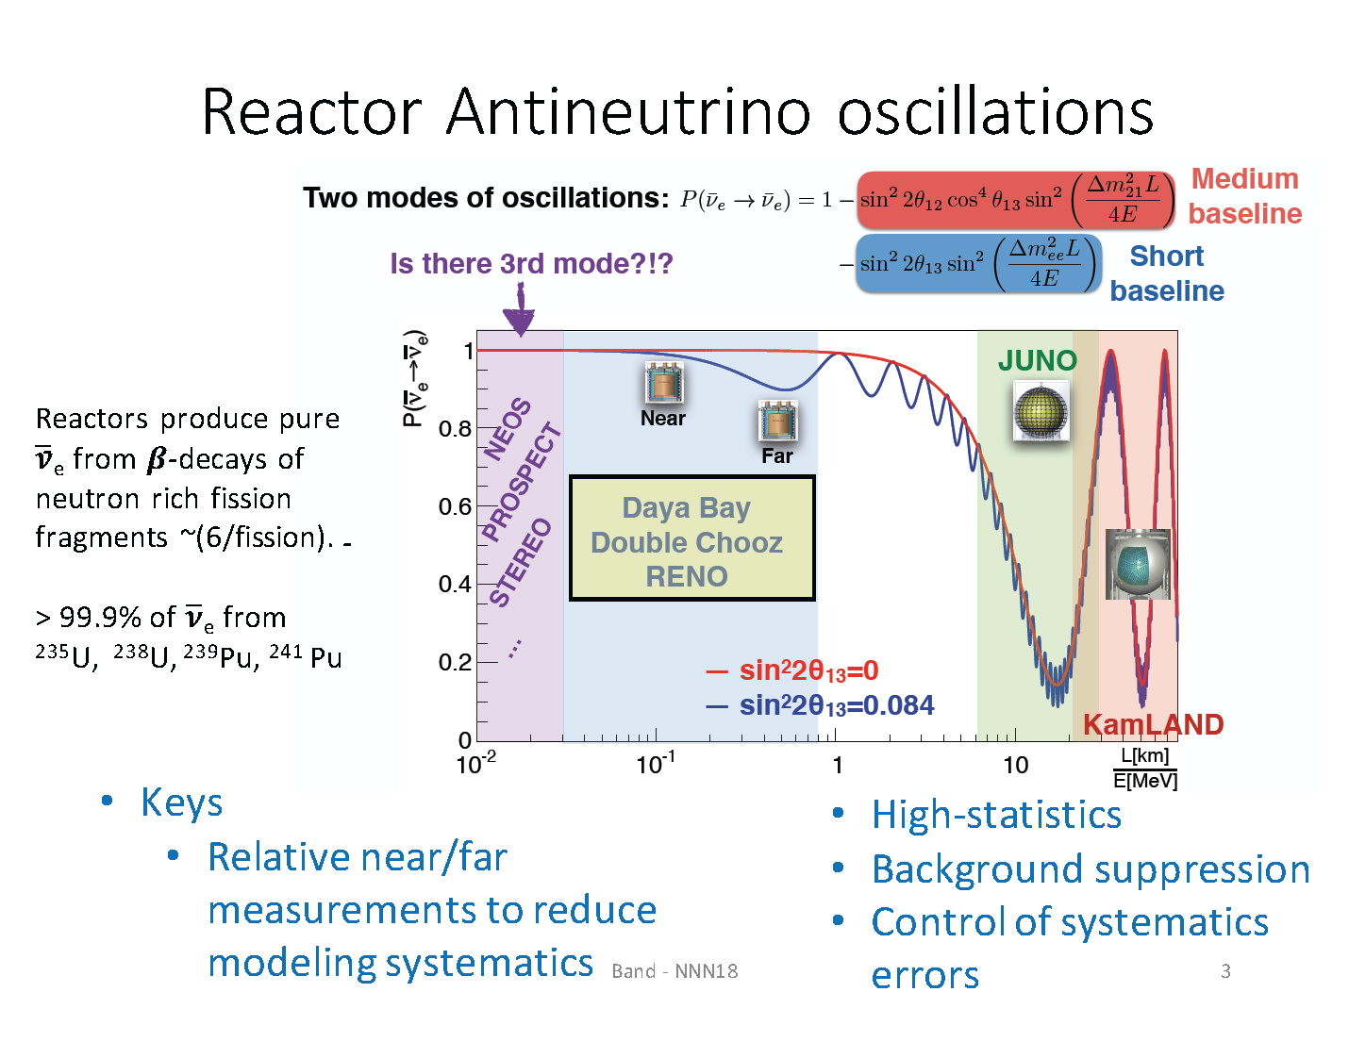
Solar neutrino oscillation
oscillations

Slide 23
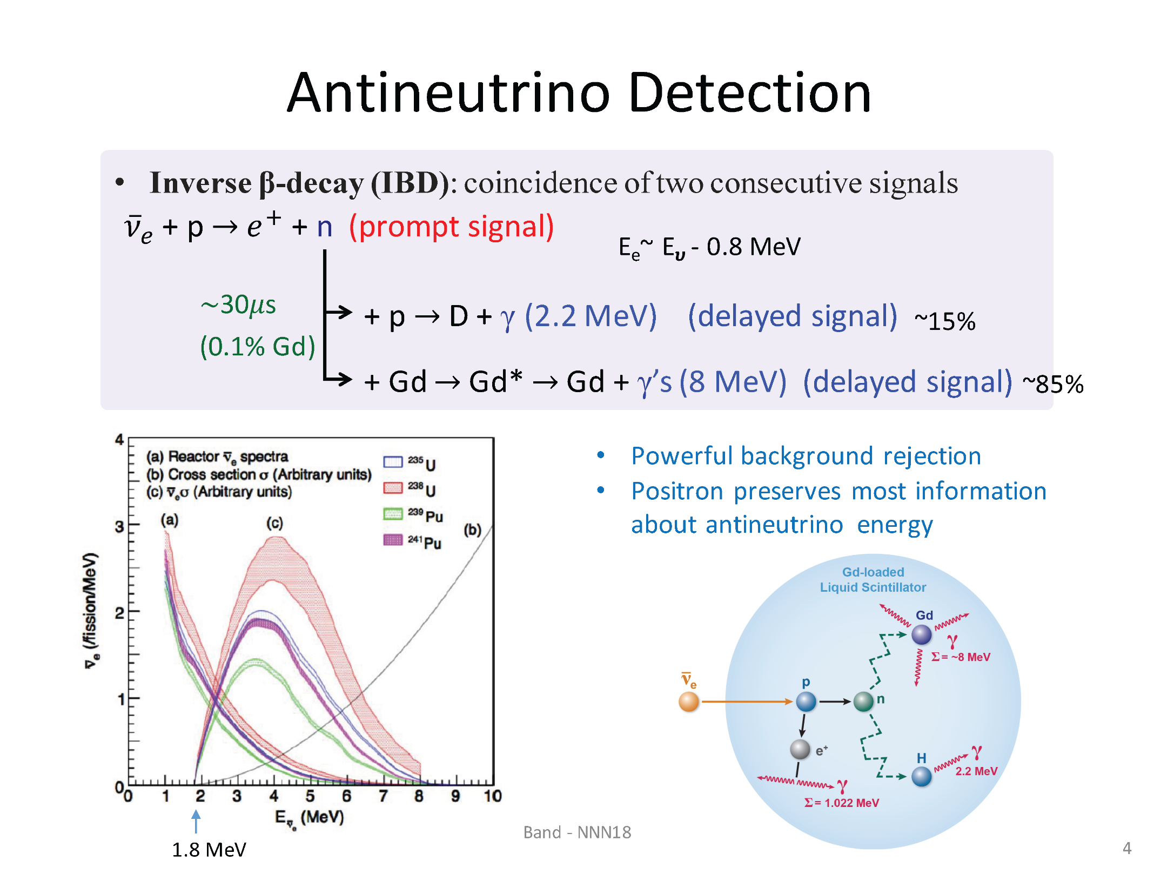

Slide 24
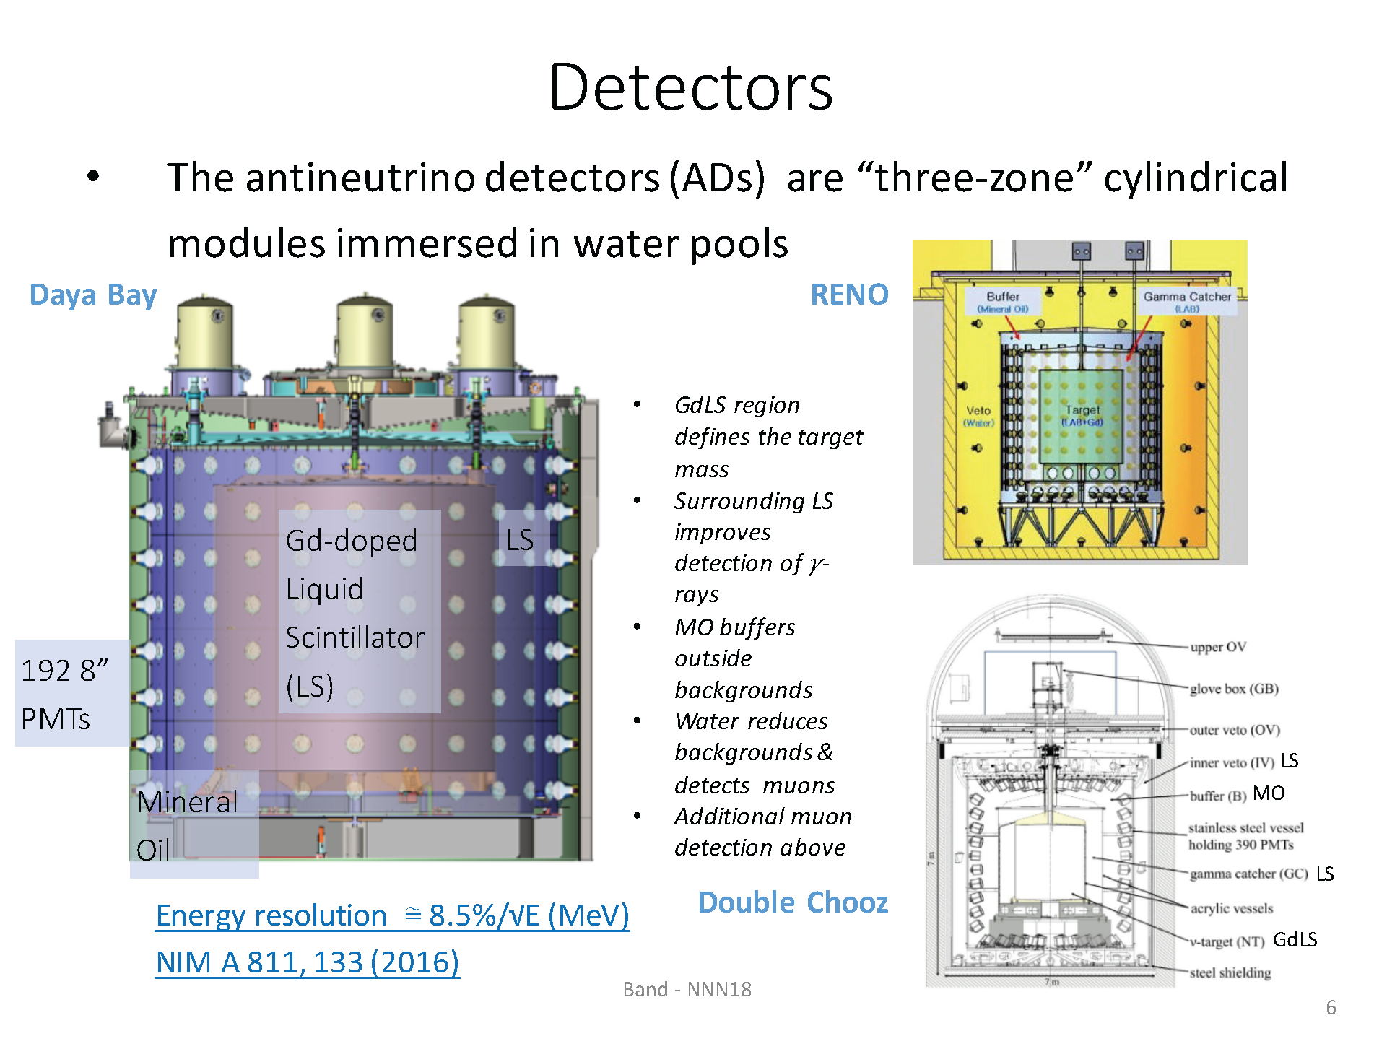
+1%

Slide 25
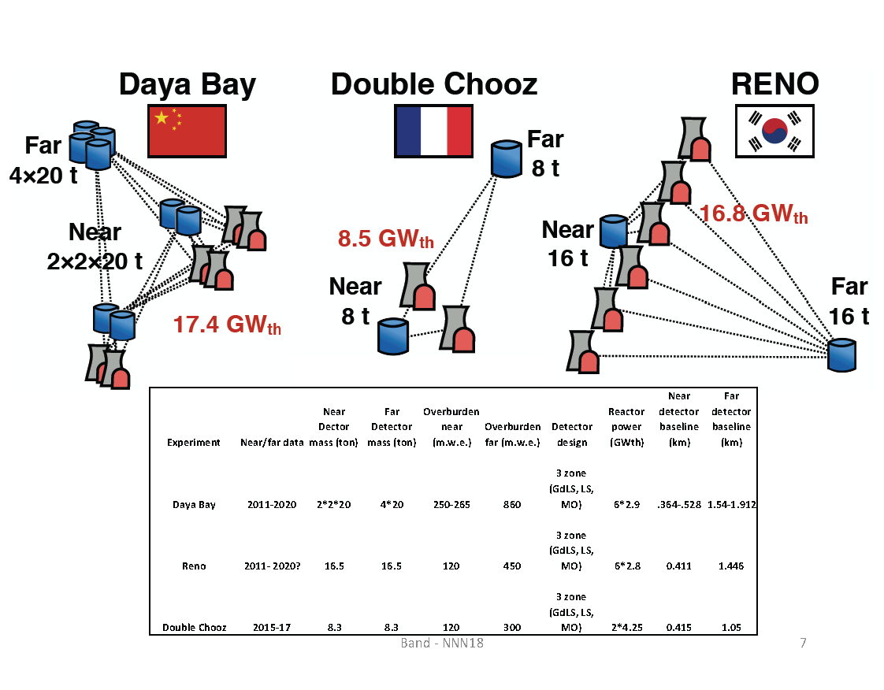

Slide 26
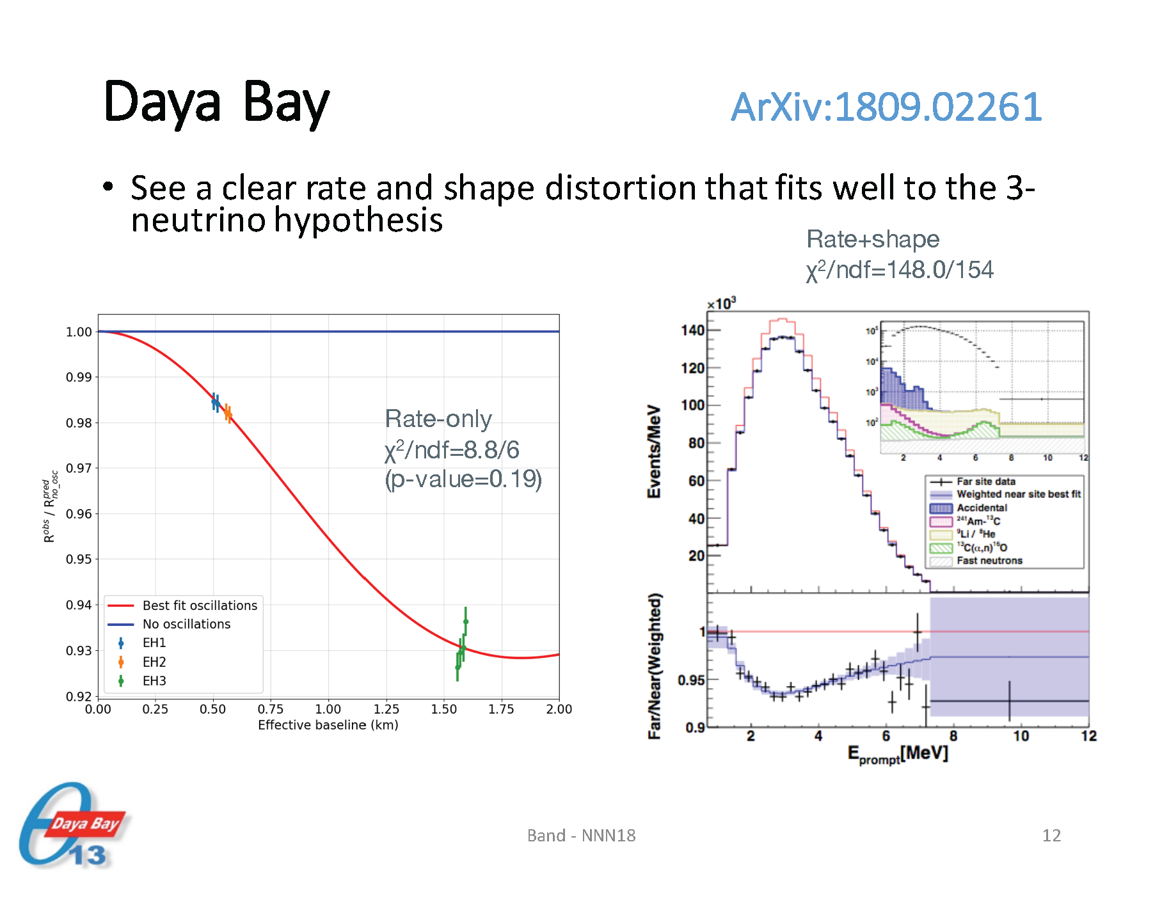
Sum over all energies

Slide 27
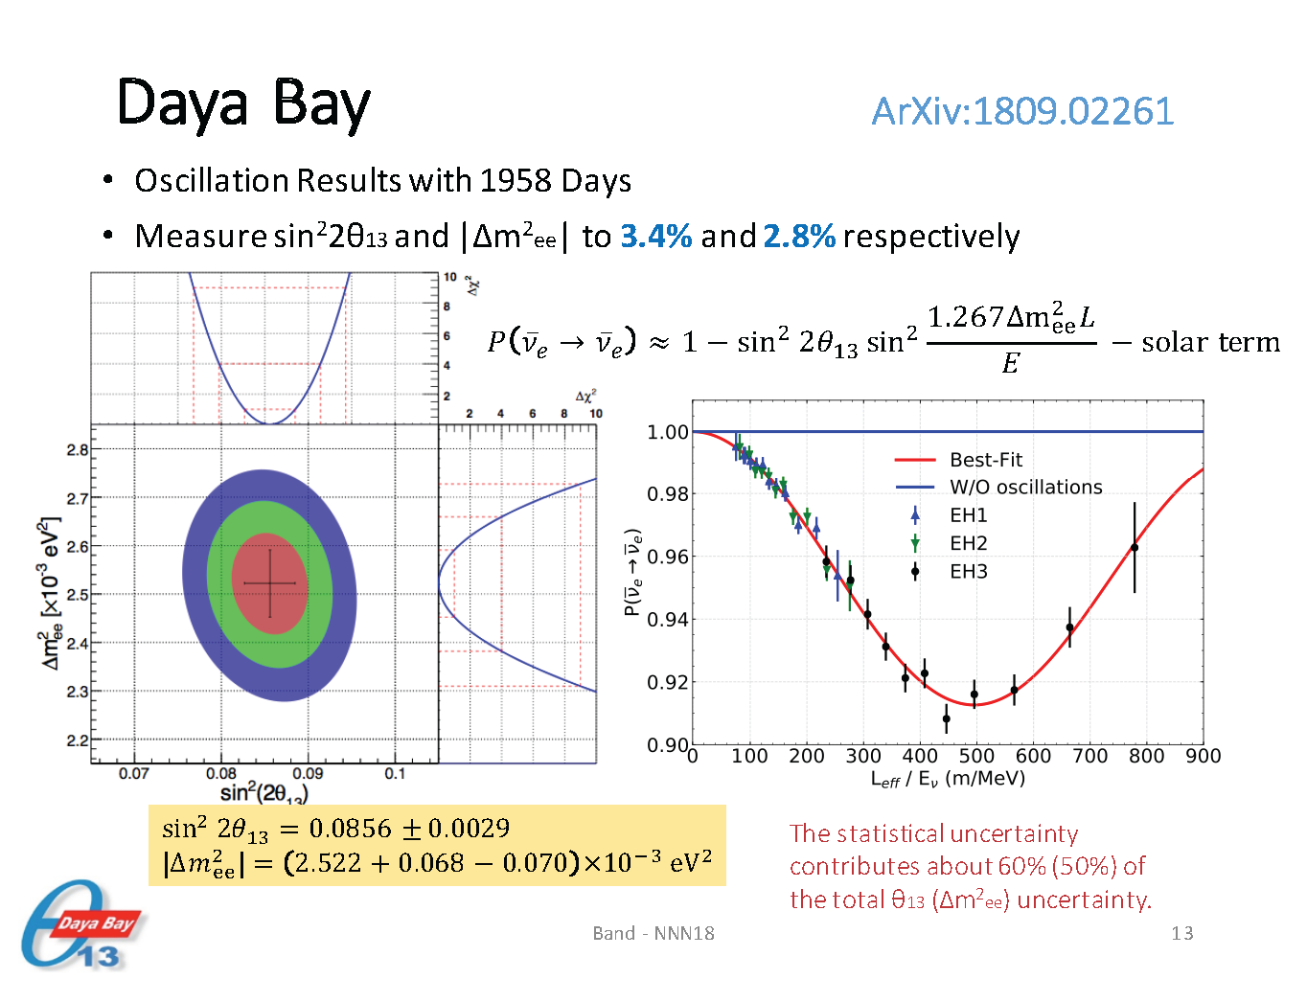
A small variant of

Slide 28
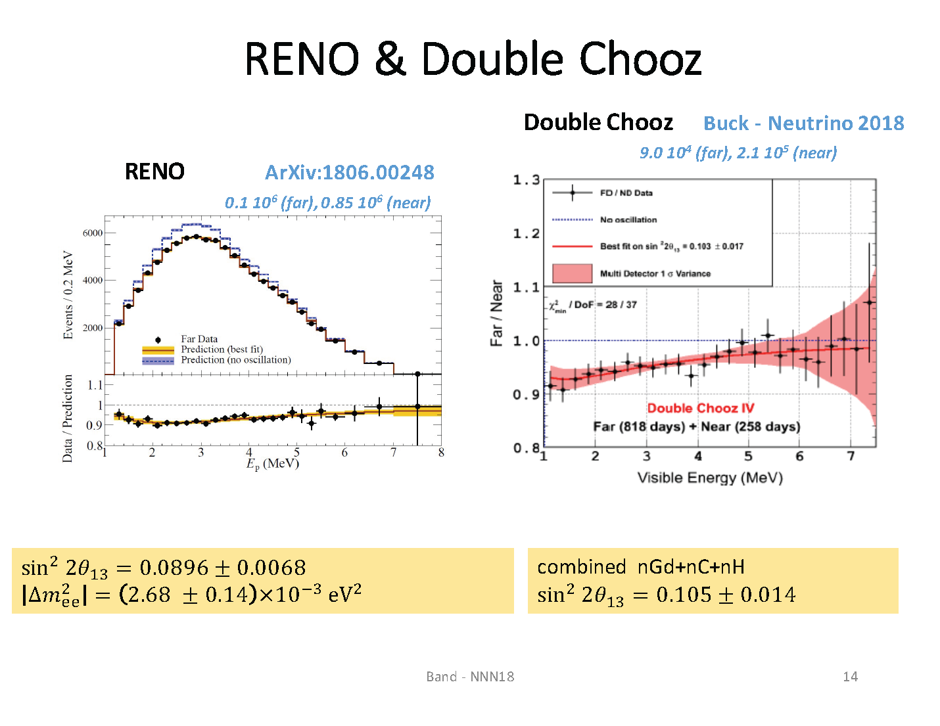

Slide 29
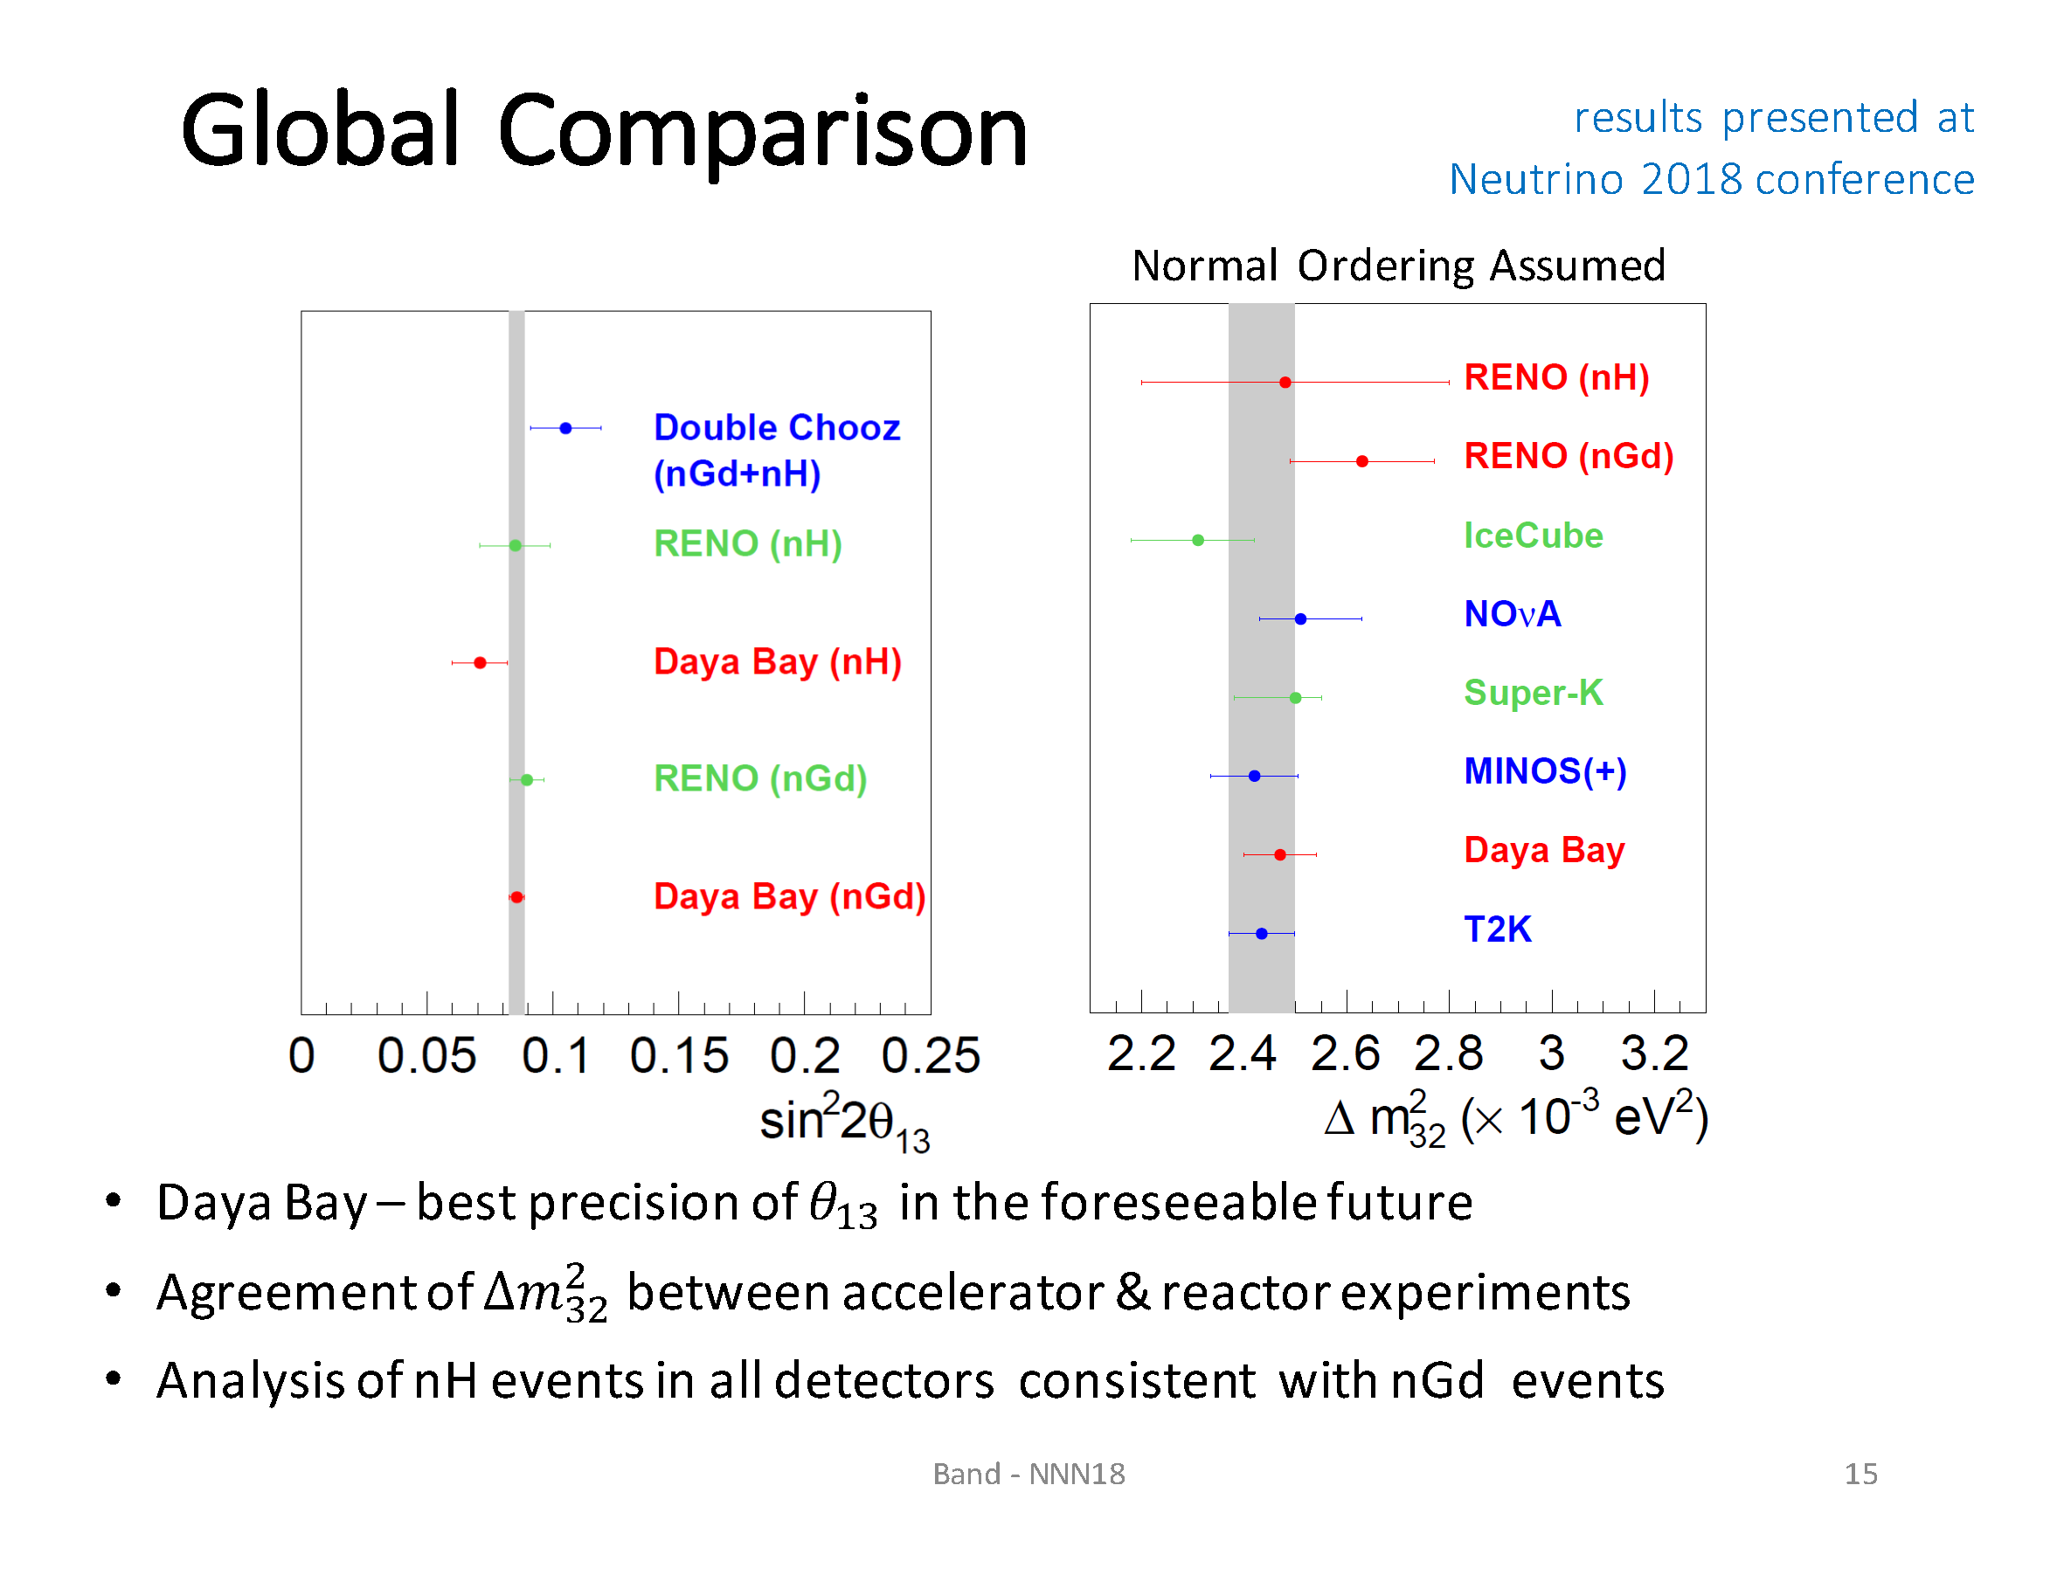

Slide 30
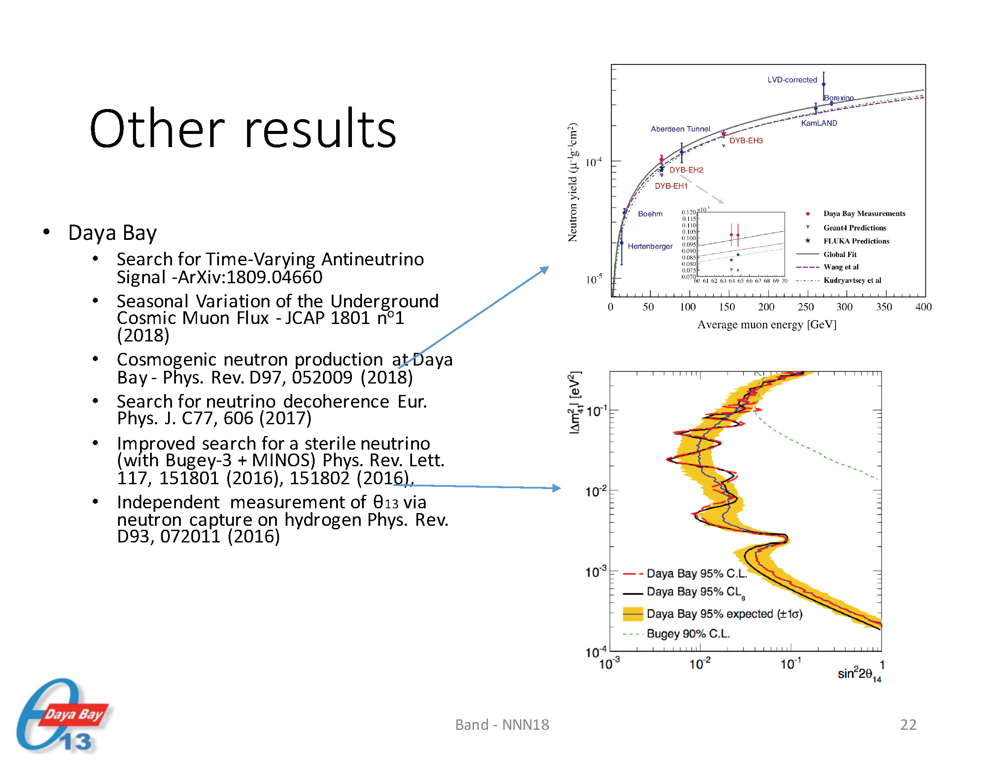

Slide 31
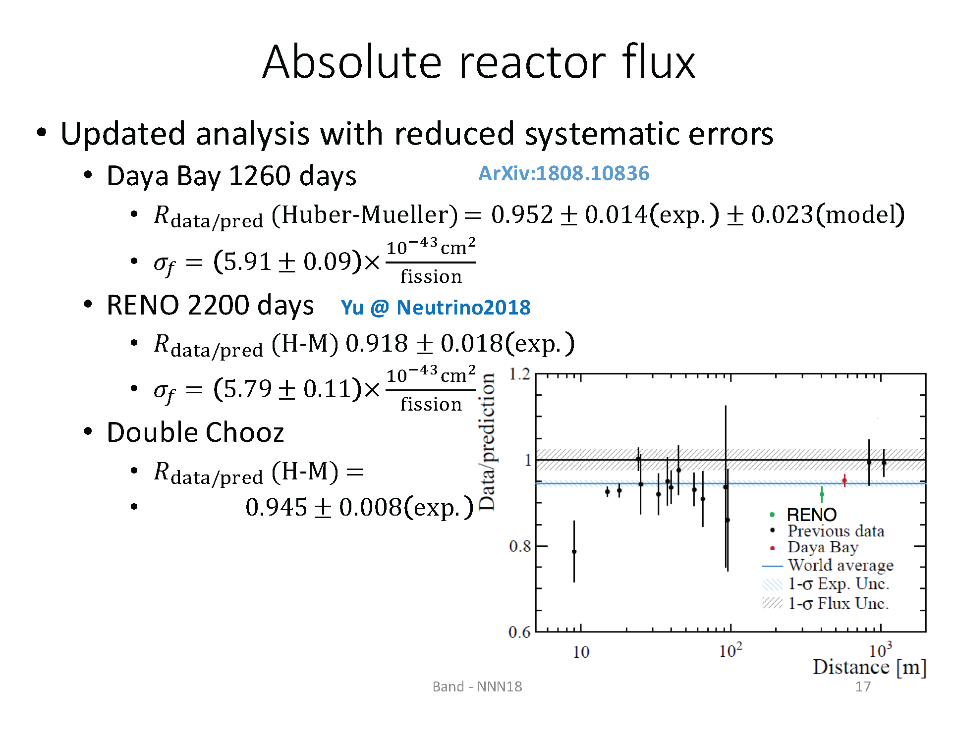
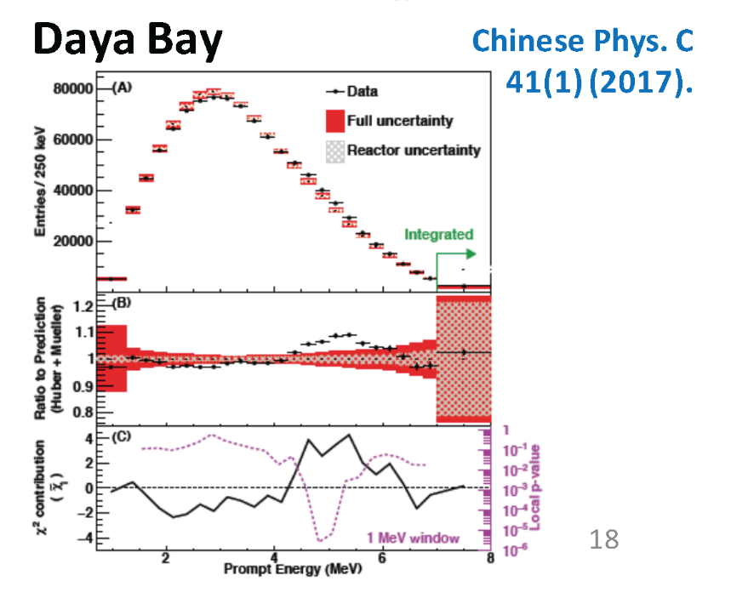
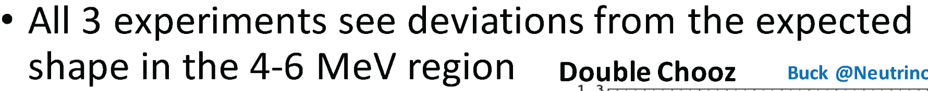
Reactor models still not
sufficiently accurate.
P. Huber, Phys. Rev. C 84, 024617 (2011)
T.A. Mueller et al., Phys. Rev. C 84, 054615 (2011)

Slide 32
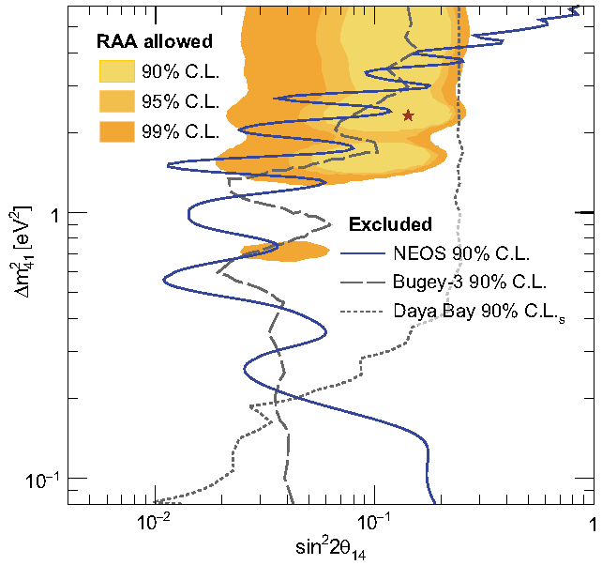
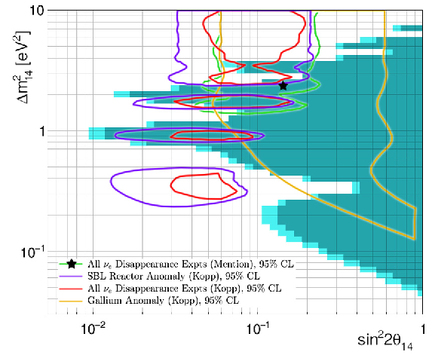
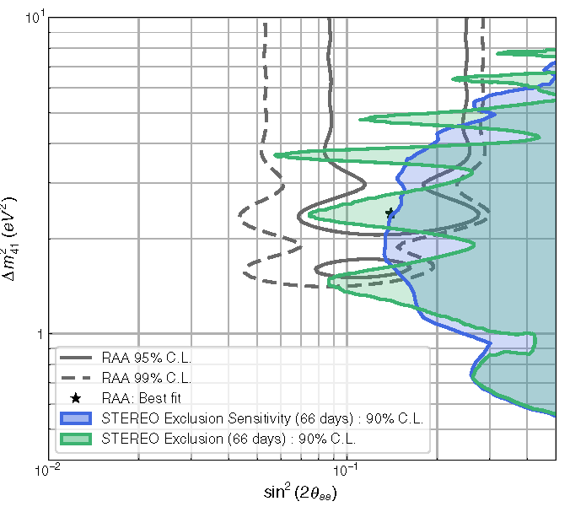
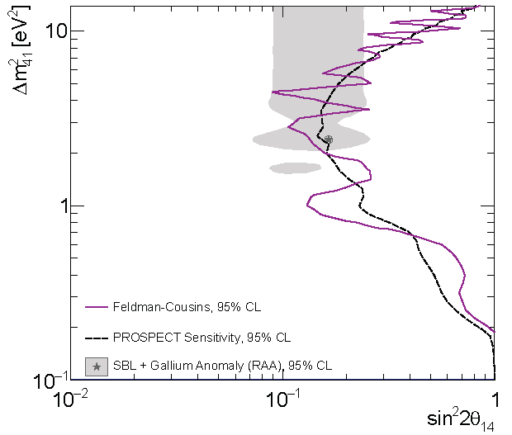
Recent, Very Short Baseline Experiments (≈ 10 m)
Inspired by the claimed “reactor anomaly”, perhaps due to a 4th, light, sterile neutrino
Mention et al.,
Phys. Rev. D 83, 073006 (2011)
“You can’t prove a negative.”
NEOS
DANSS
Ko et al., Phys. Rev. Lett. 118, 121802, (2017)
Alexseev et al., Phys. Lett. B 787, 56, (2018)
Almazán et al., Phys. Rev. Lett. 121, 161801, (2018) Ashenfelter et al., 1806.02784
STEREO
PROSPECT

Slide 33
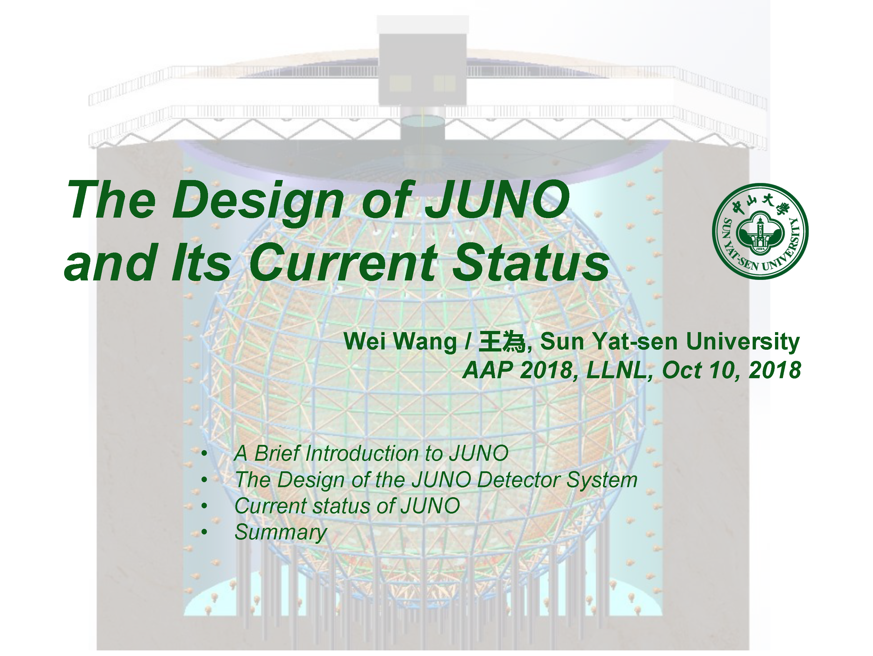
Extracts from
https://neutrinos.llnl.gov/content/assets/docs/workshops/2018/AAP2018-JUNO-Wang.pdf

Slide 34
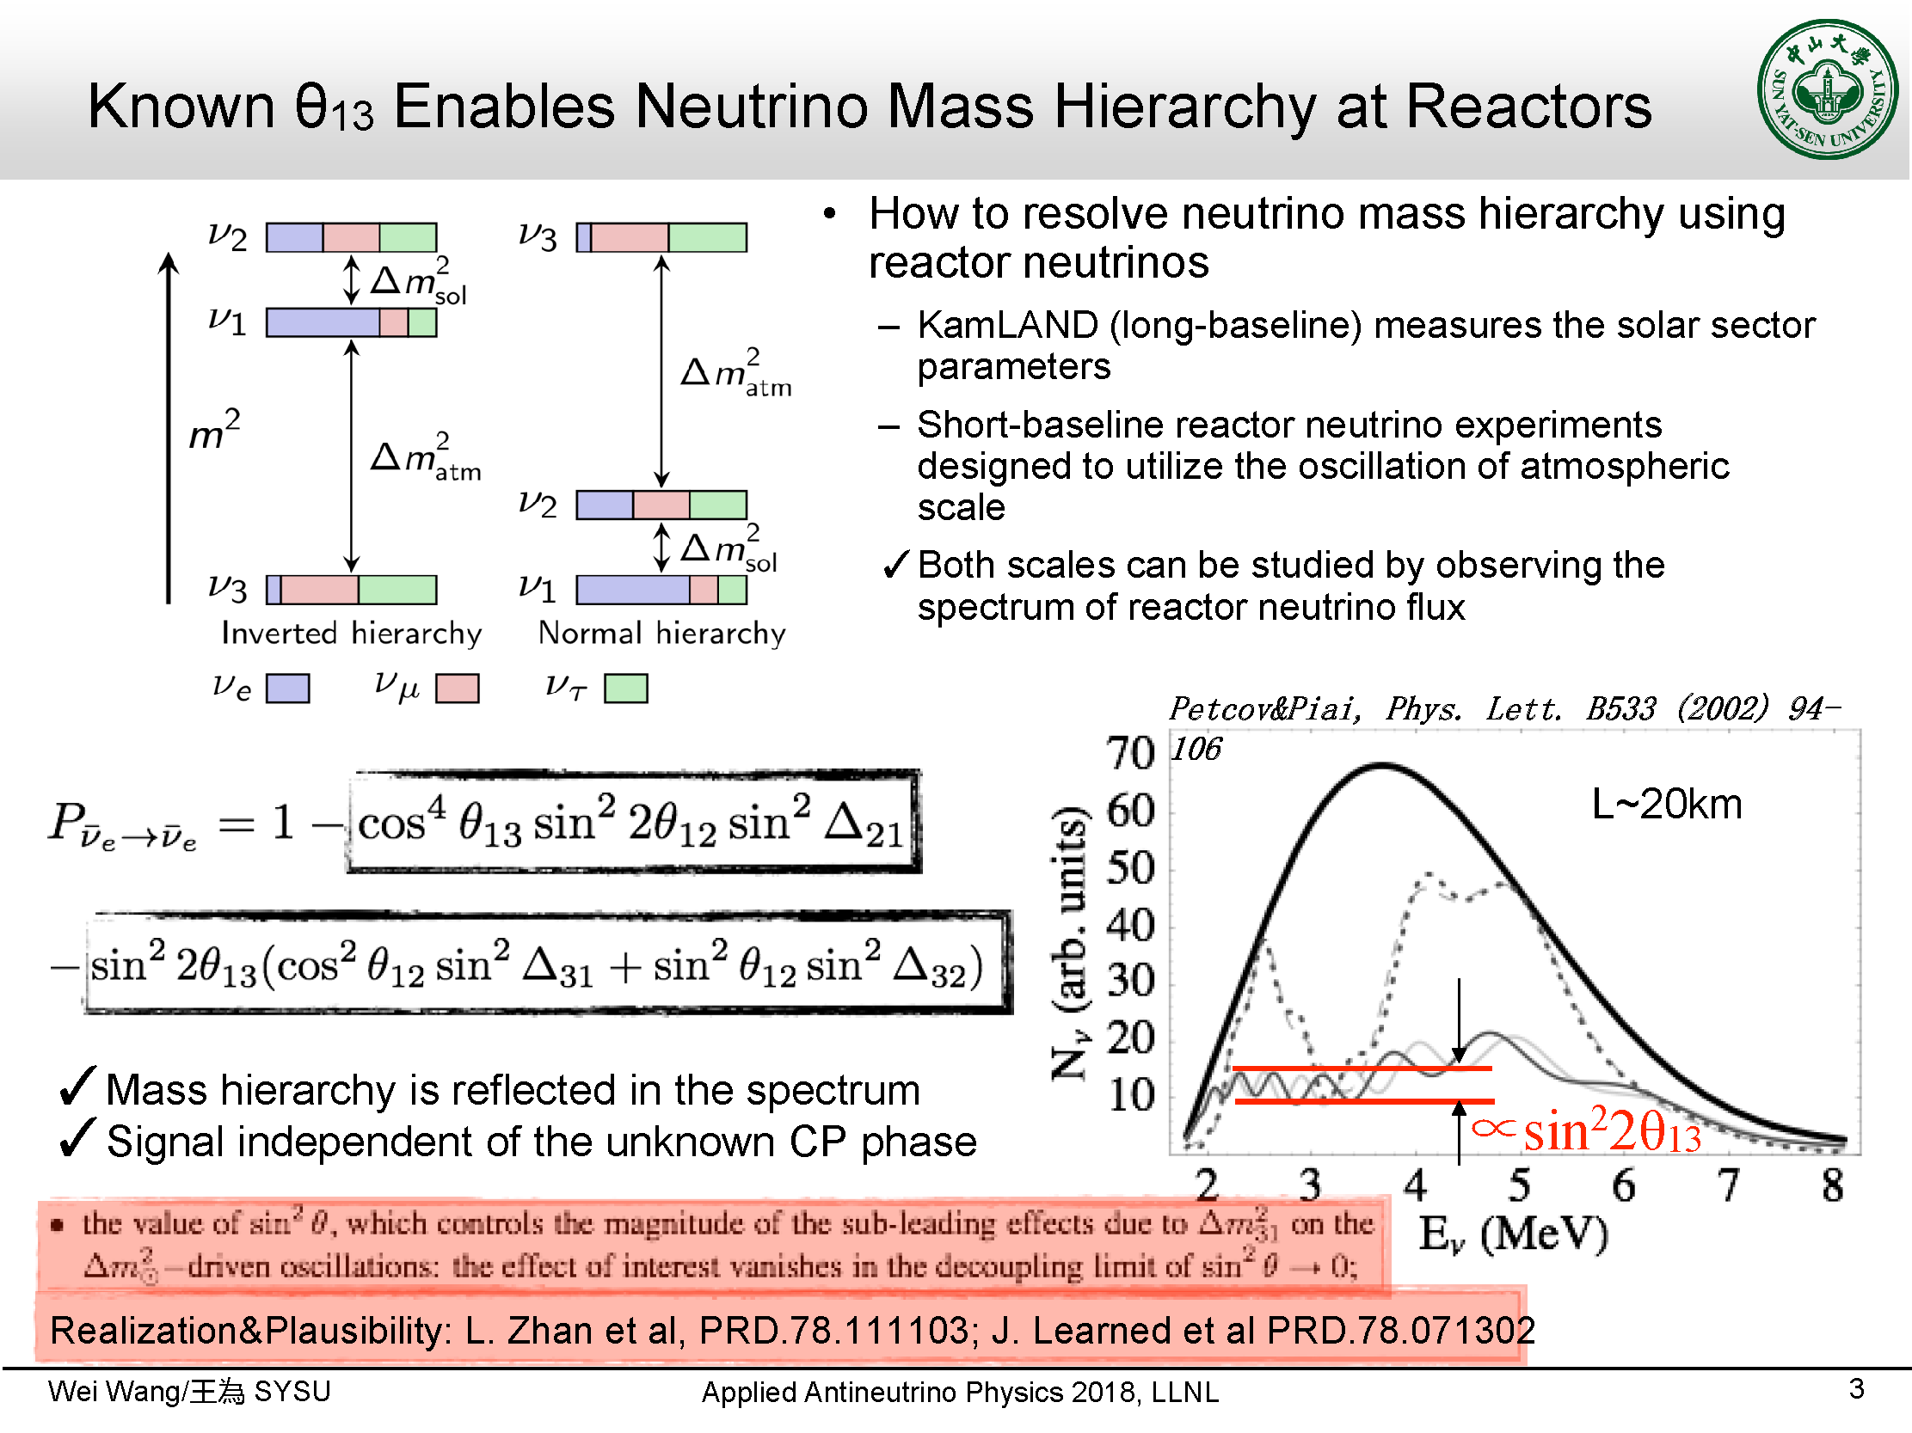
S.R Petcov and M Piai, Phys. Lett. B 533, 94 (2002)
S.R Petcov and M Piai, Phys. Lett. B 533, 94 (2002)
Sign known by definition
Assumed sin²2θ₁₃ = 0.05.
Signs to be measured

Slide 35
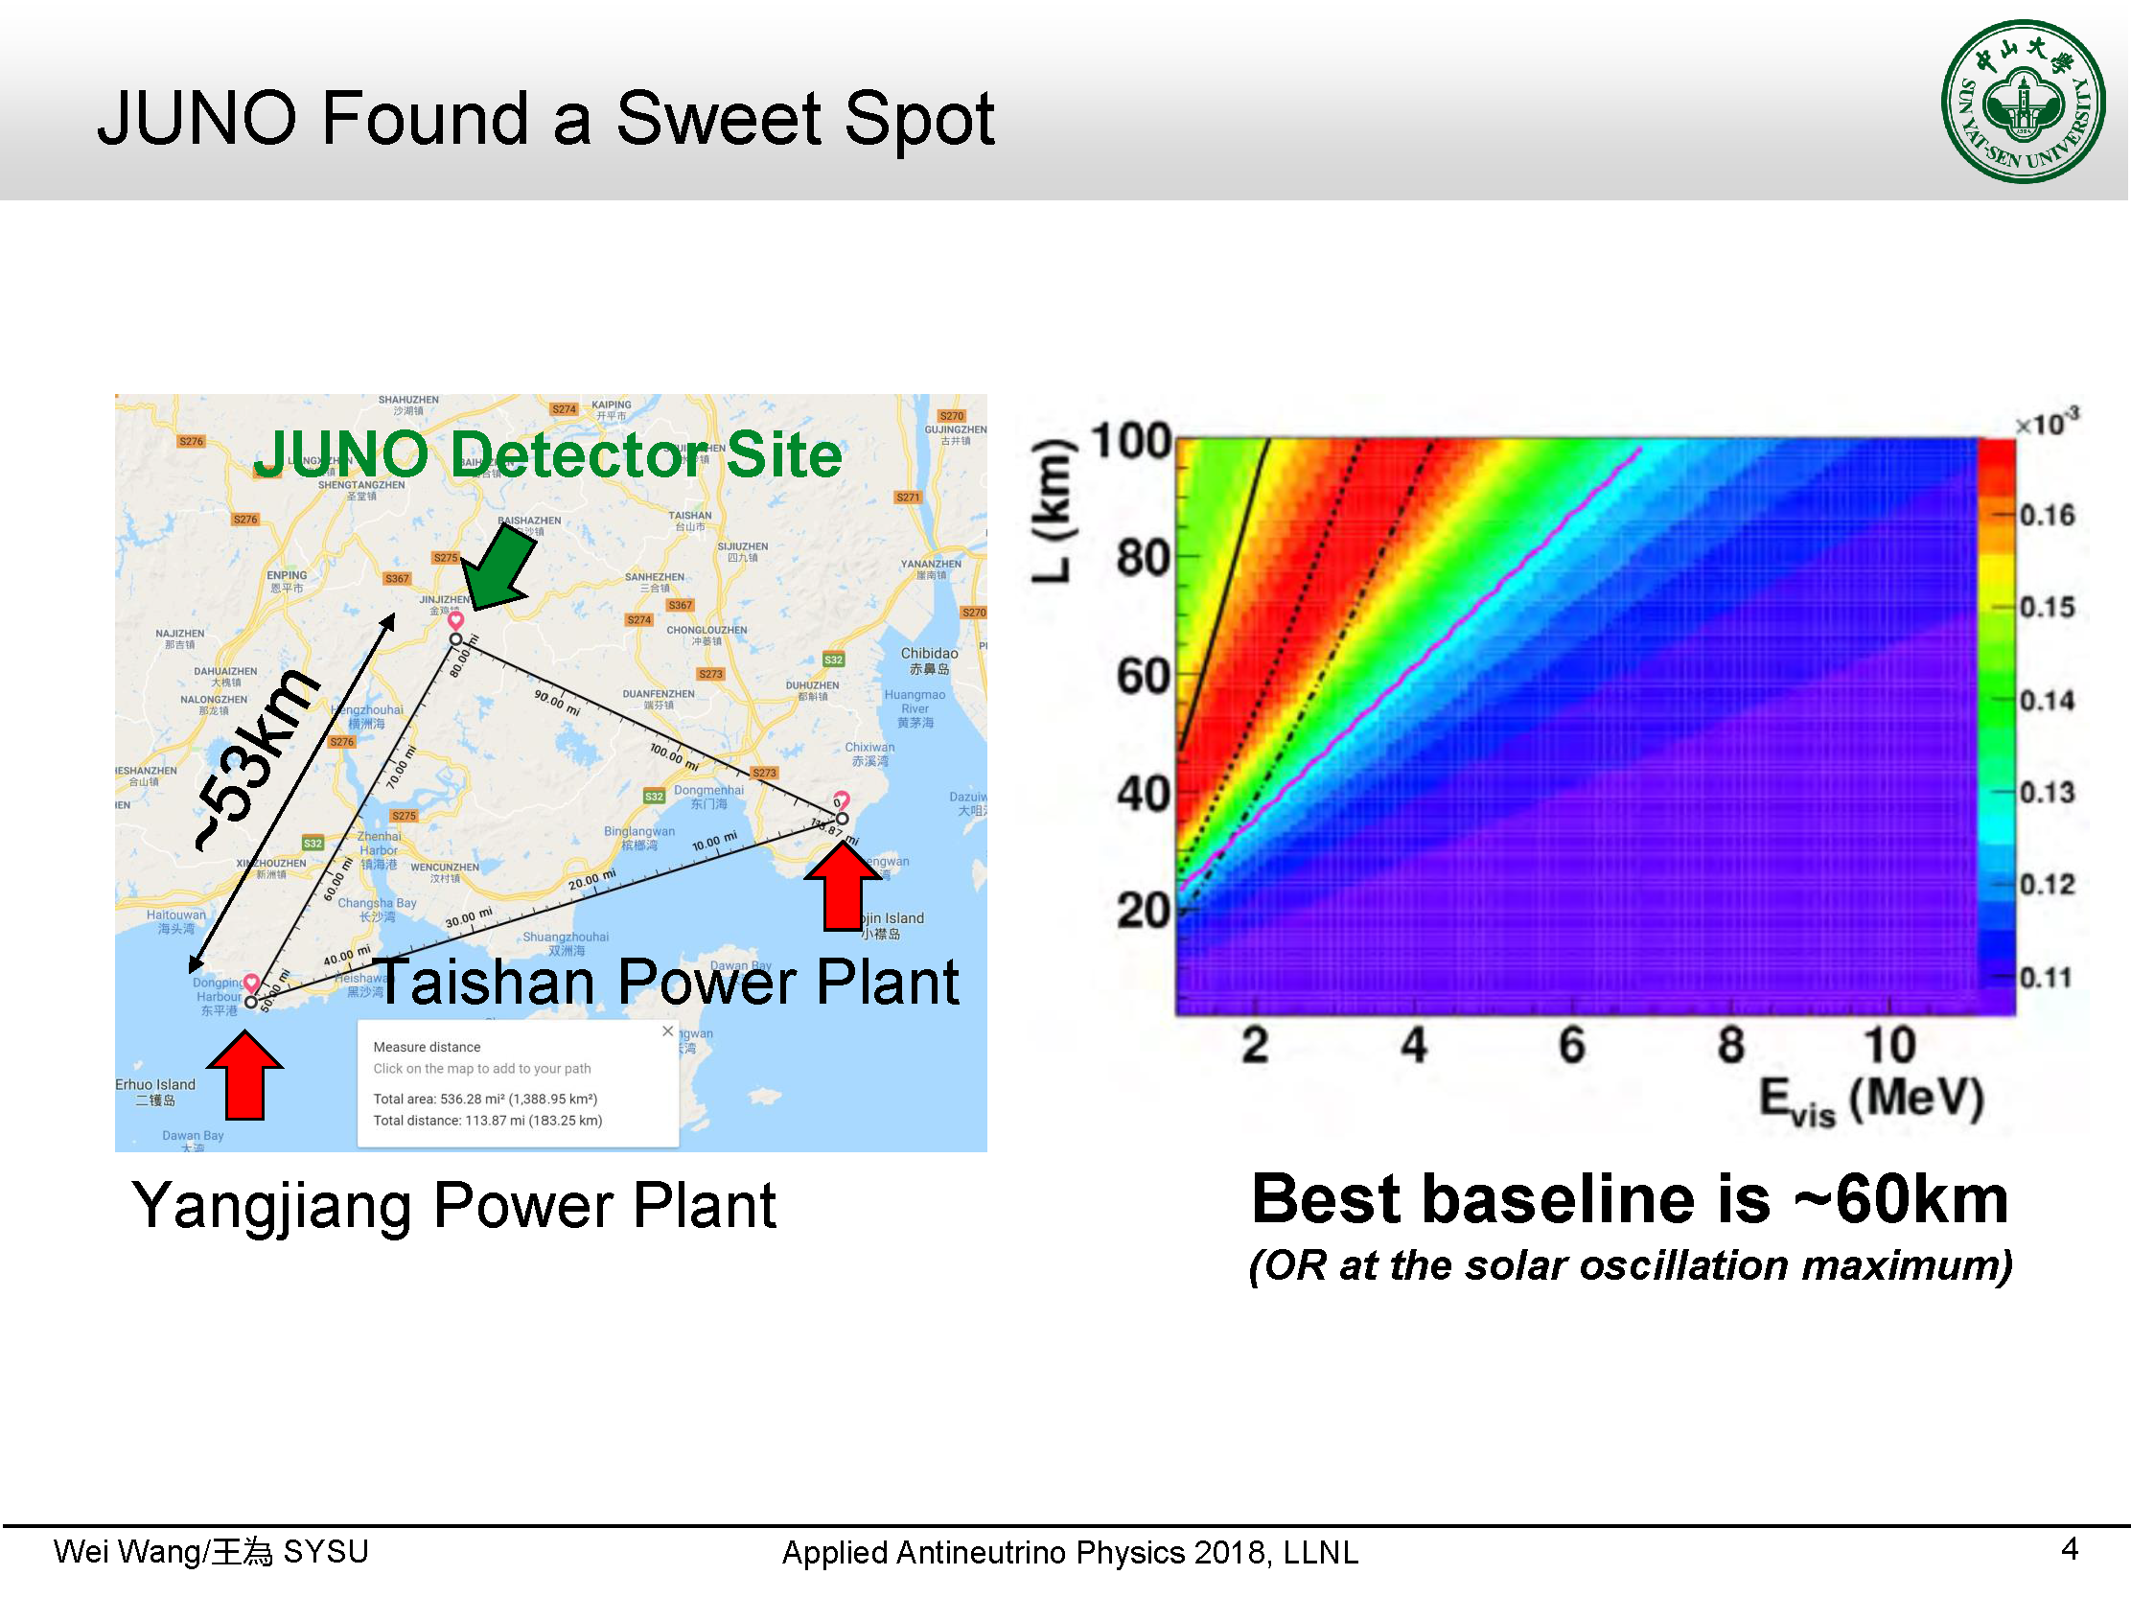
Solar neutrino
oscillation
oscillations

Slide 36
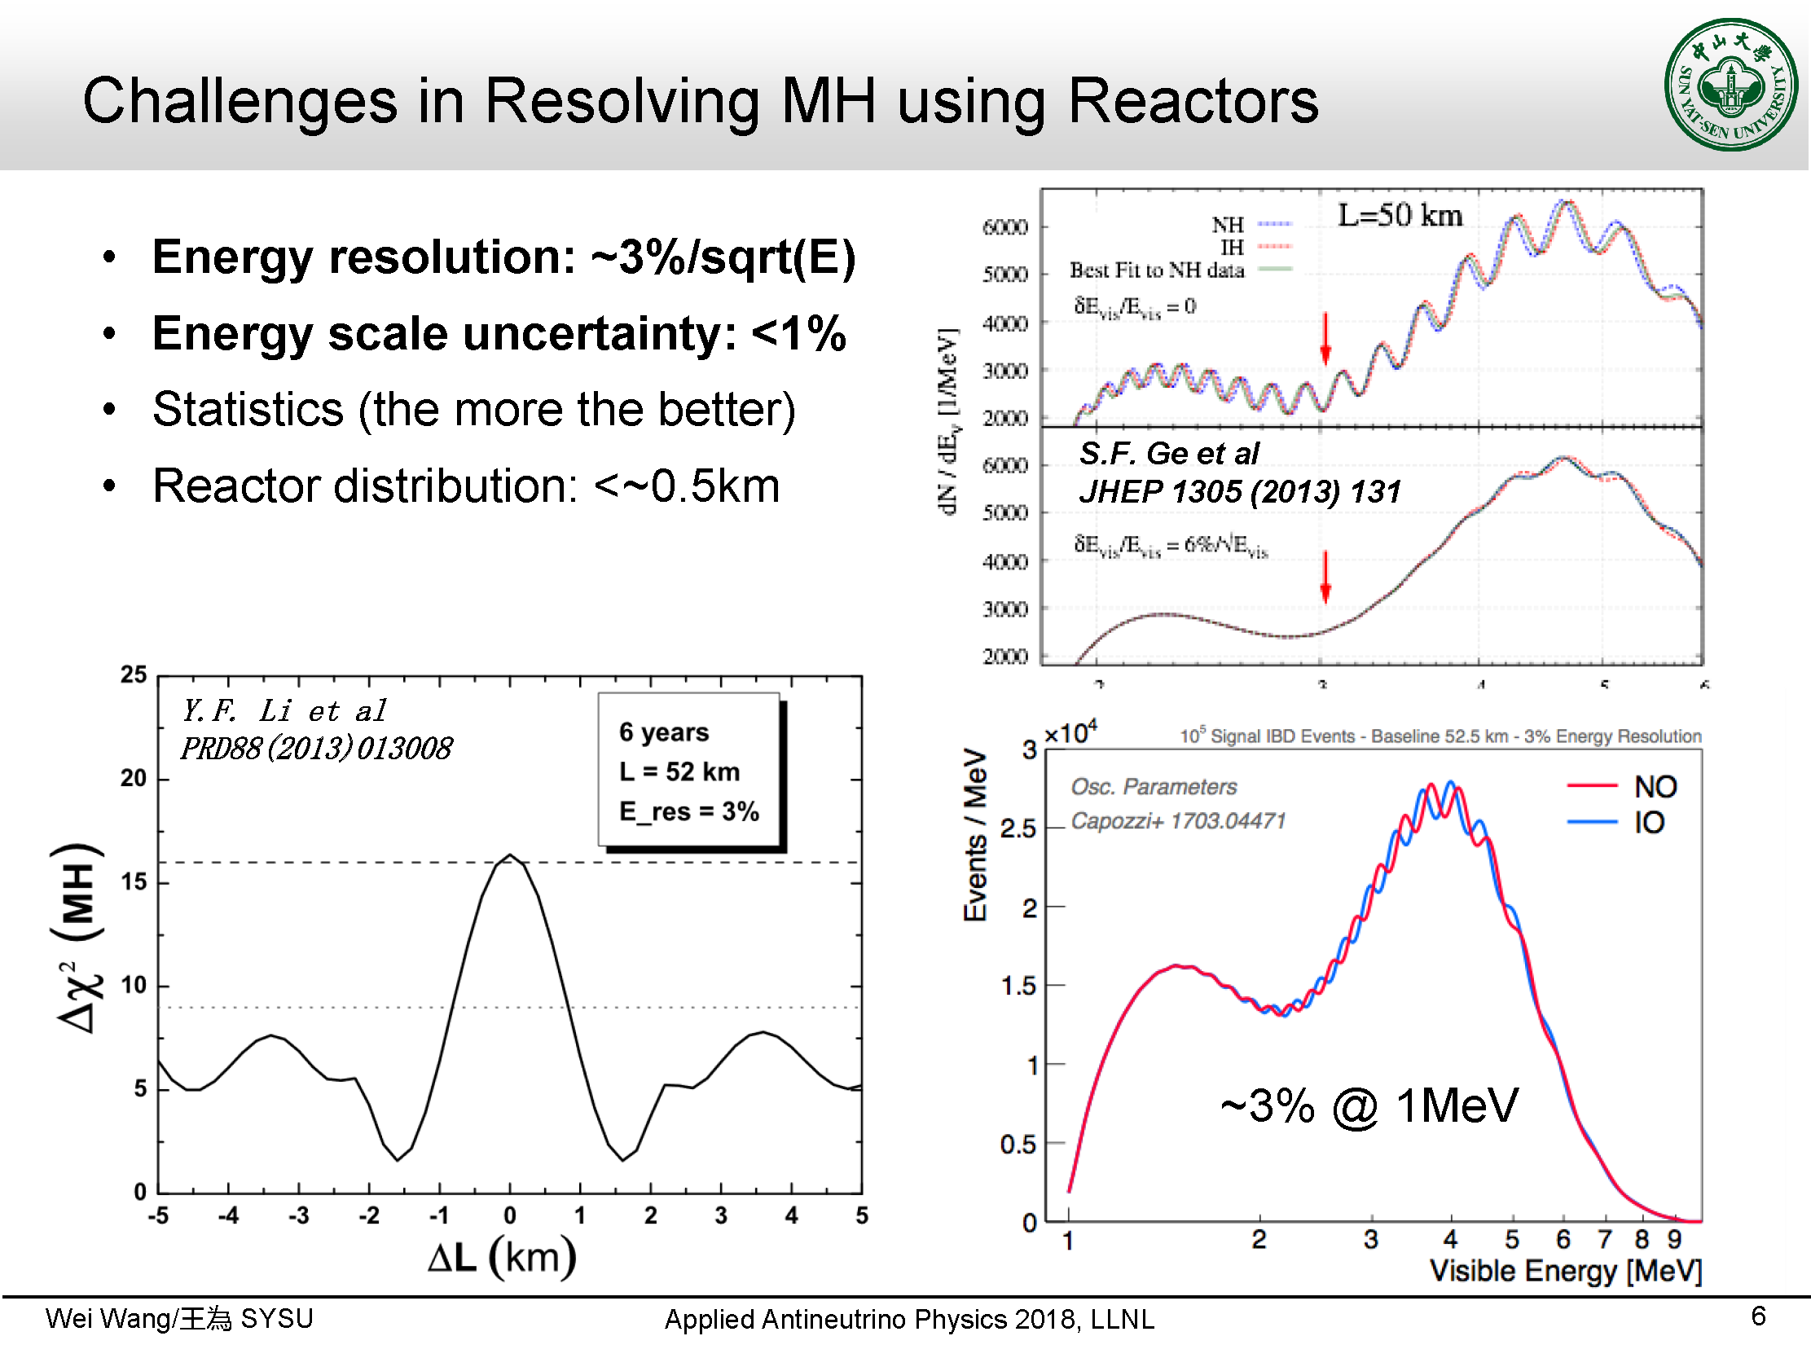

Slide 37
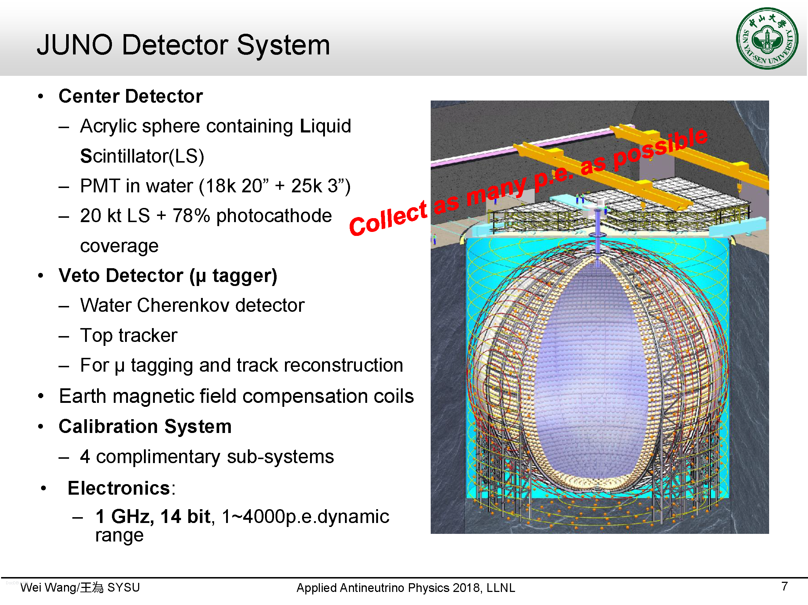

Slide 38
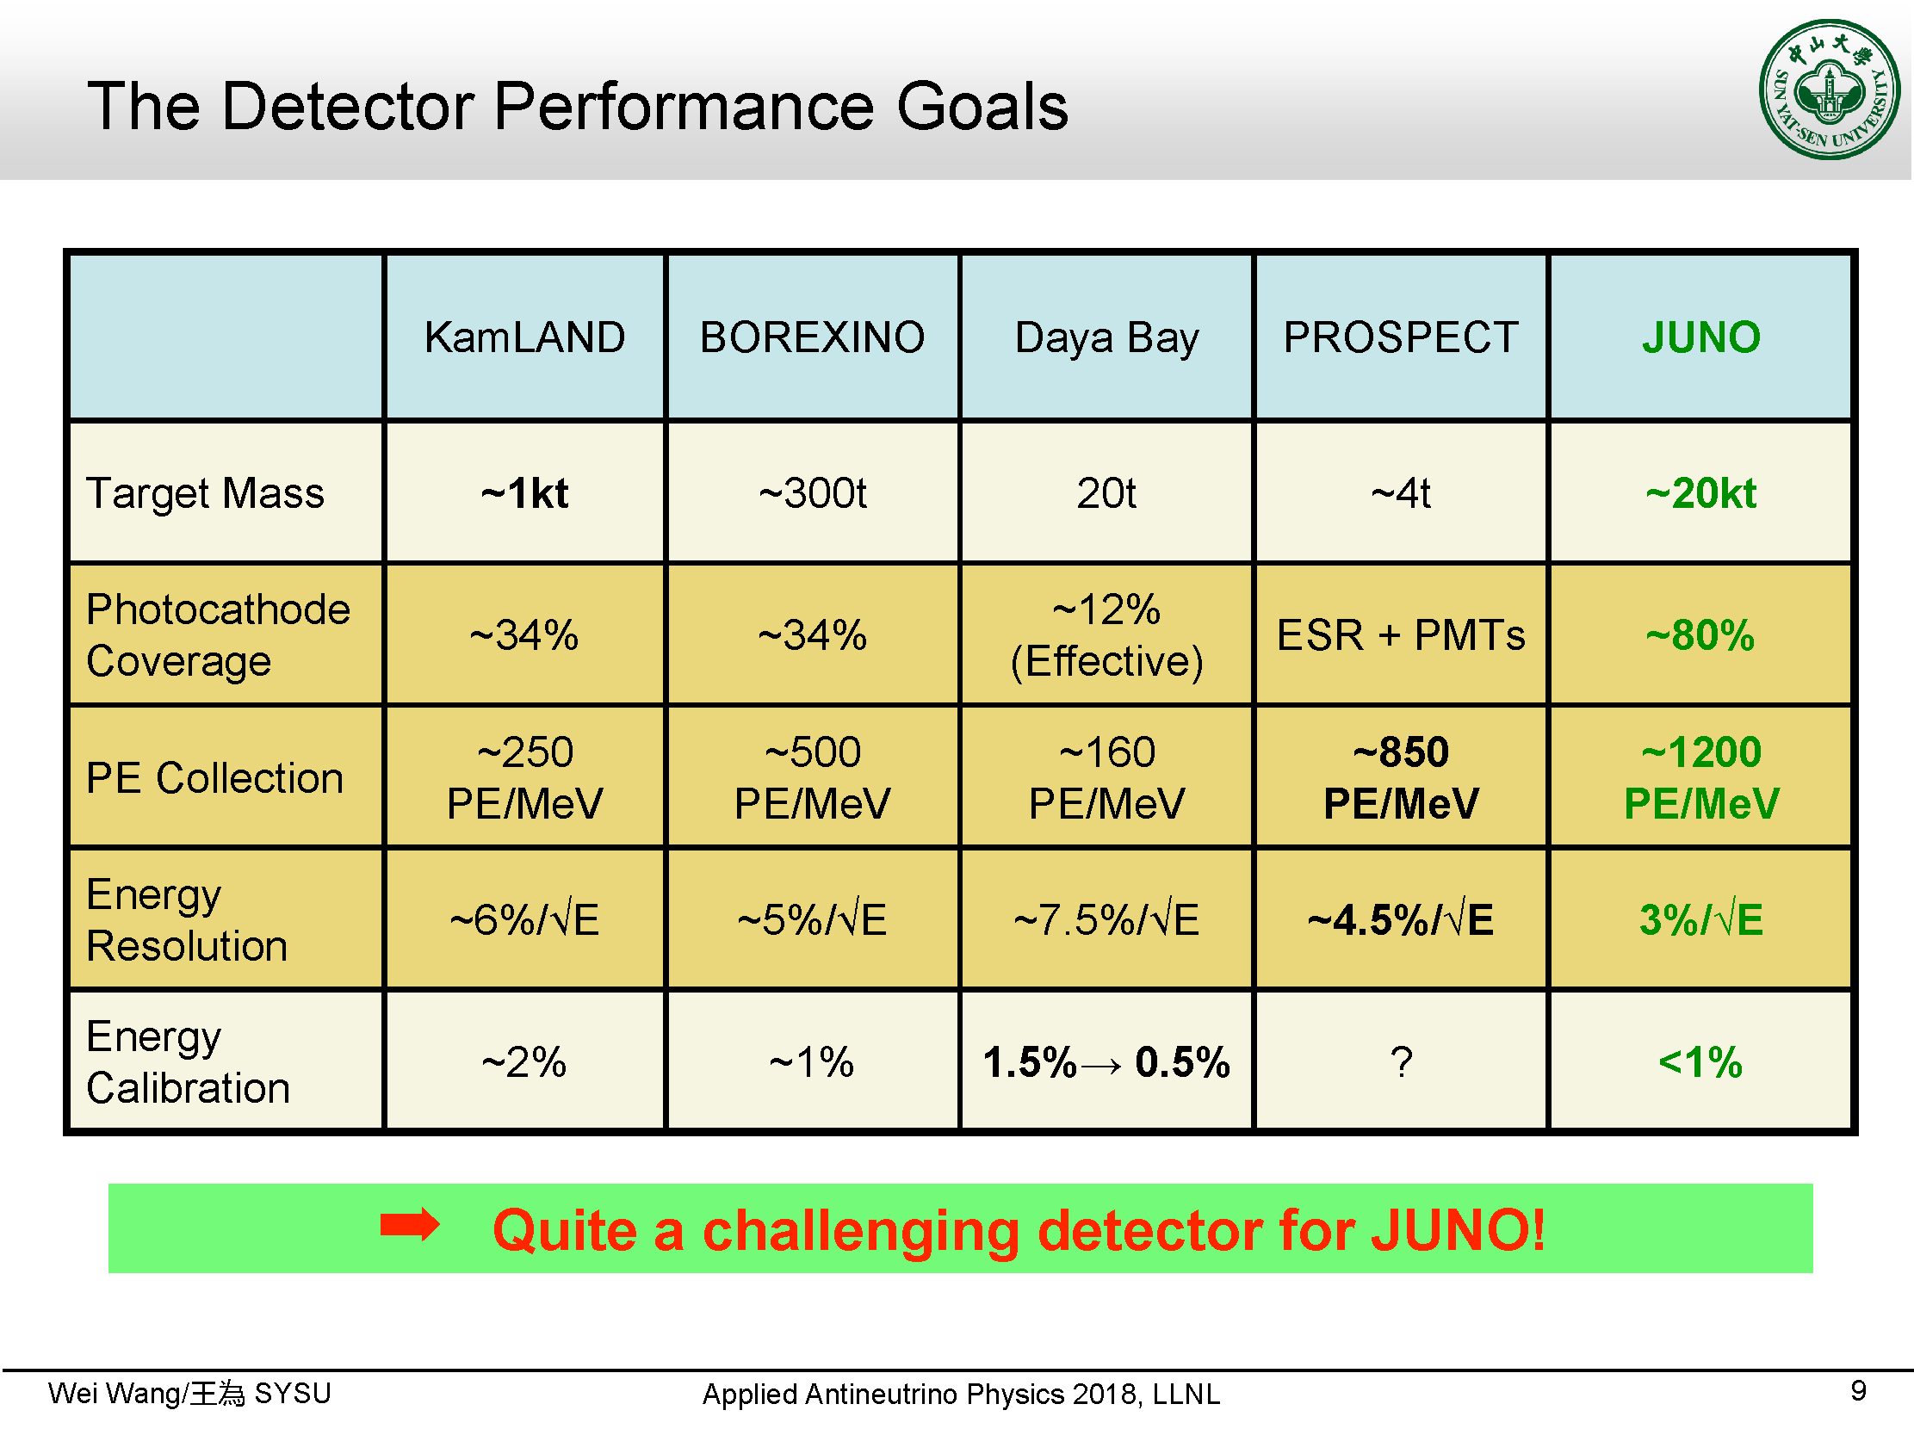

Slide 39
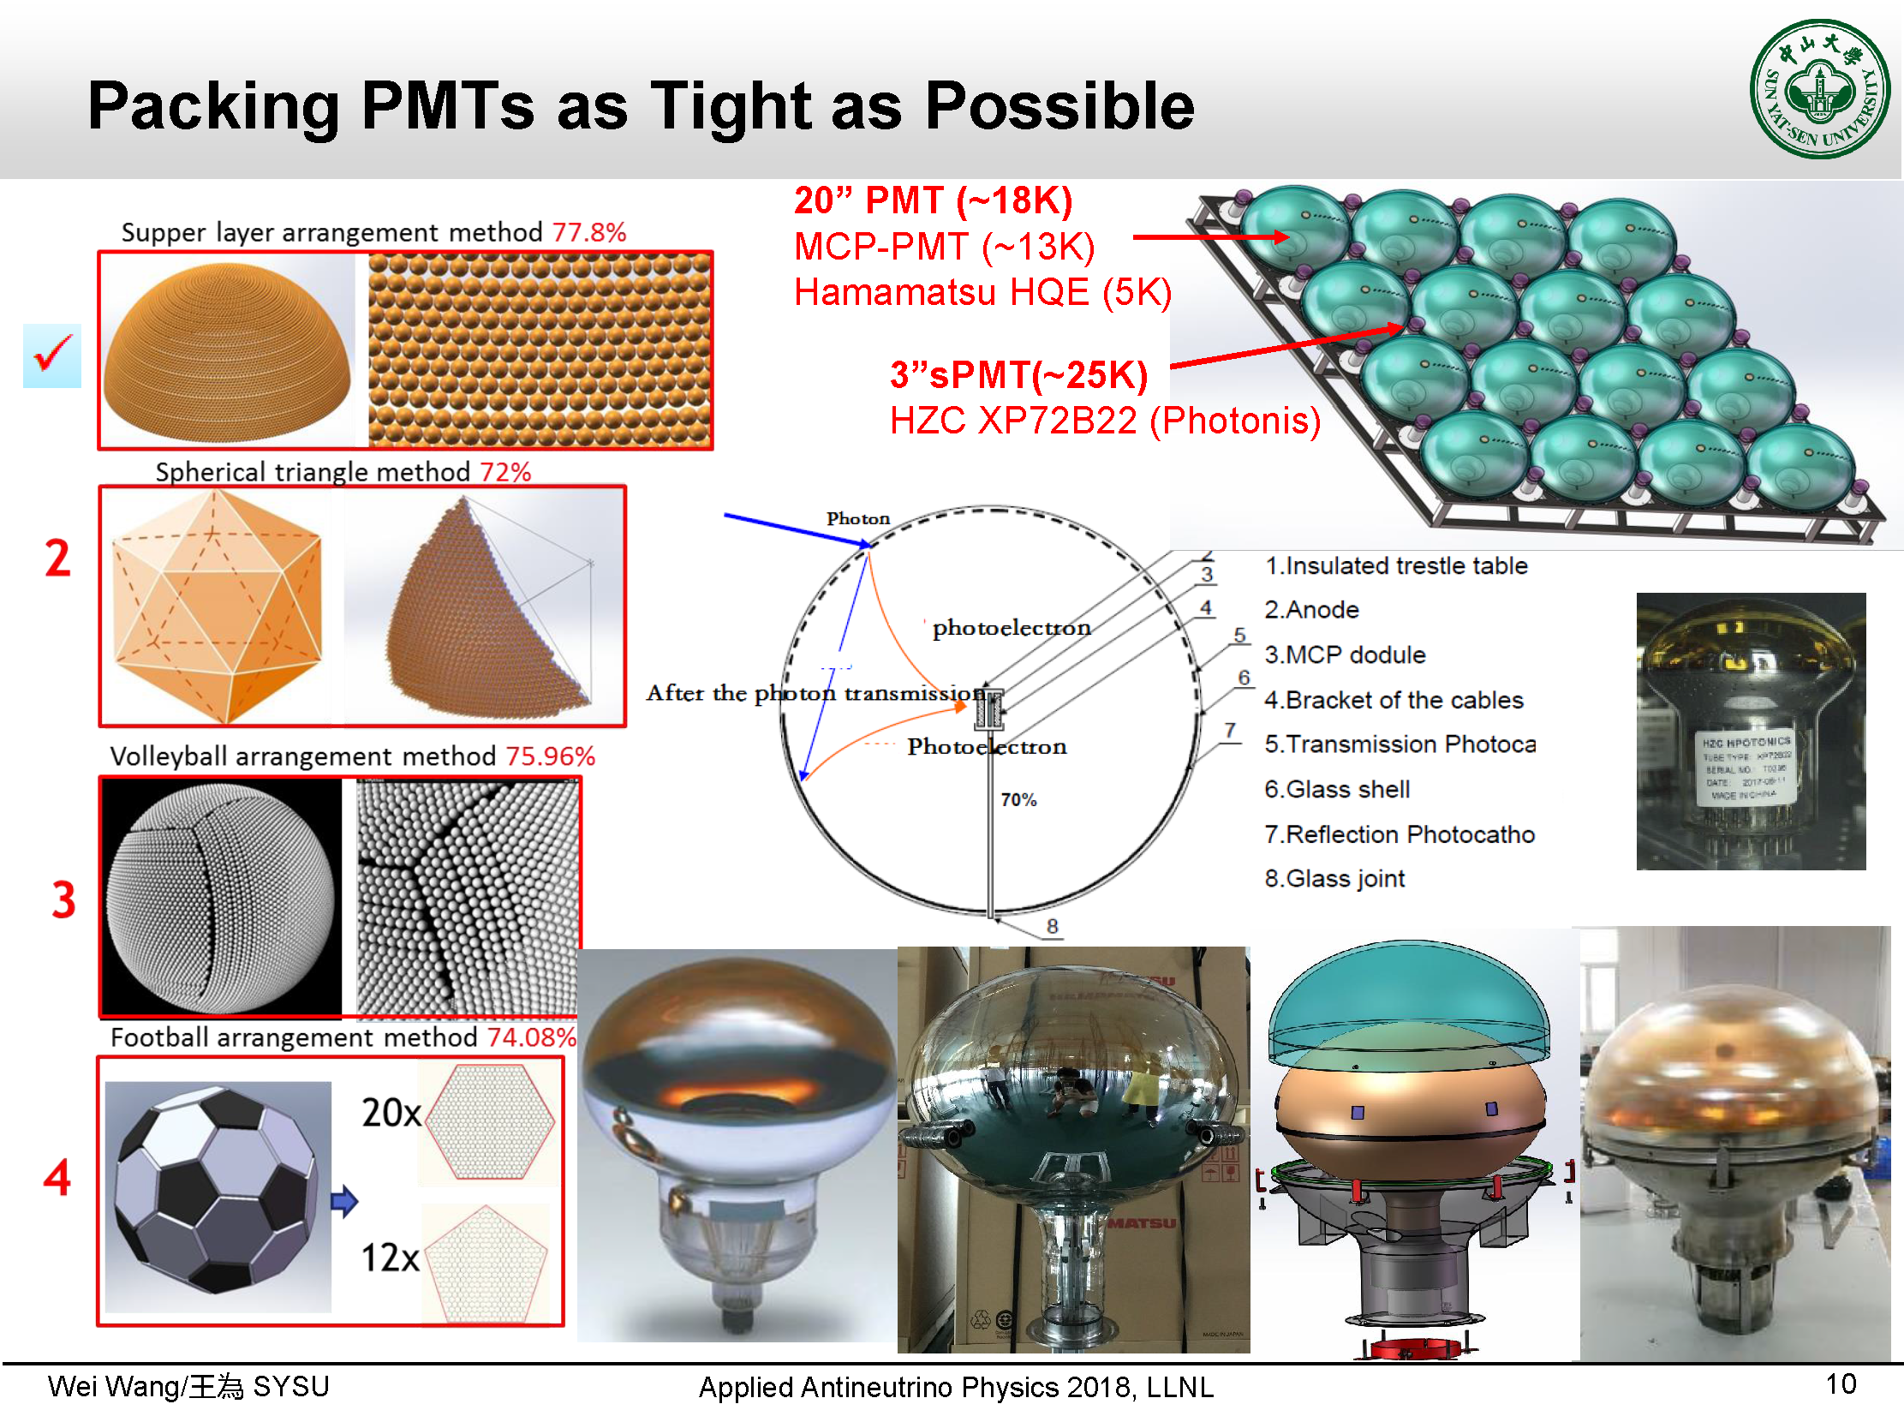

Slide 40
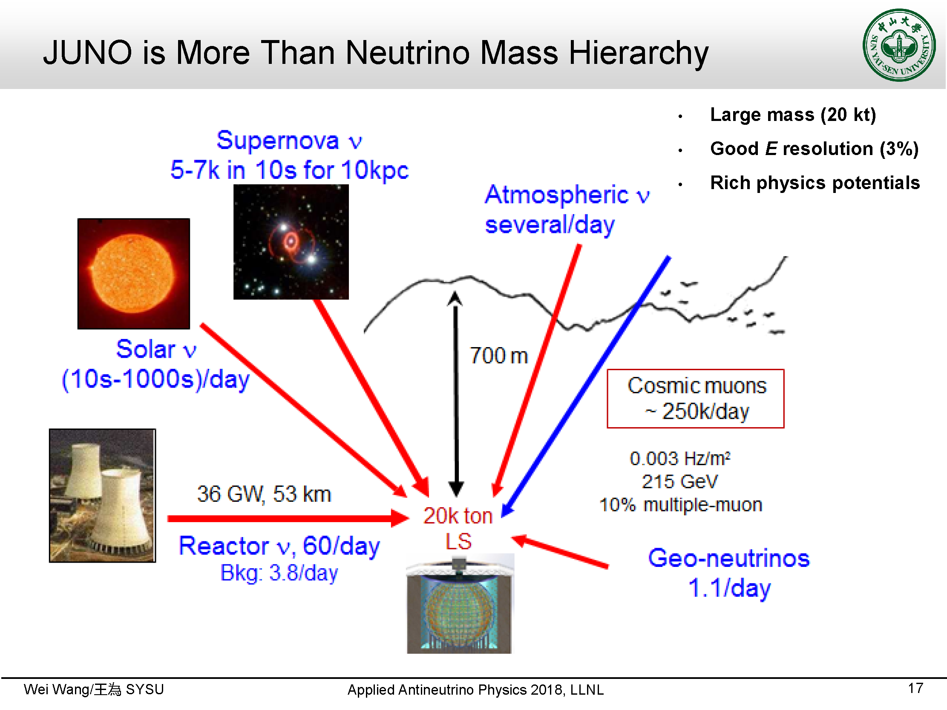

Slide 41
