Slide 1
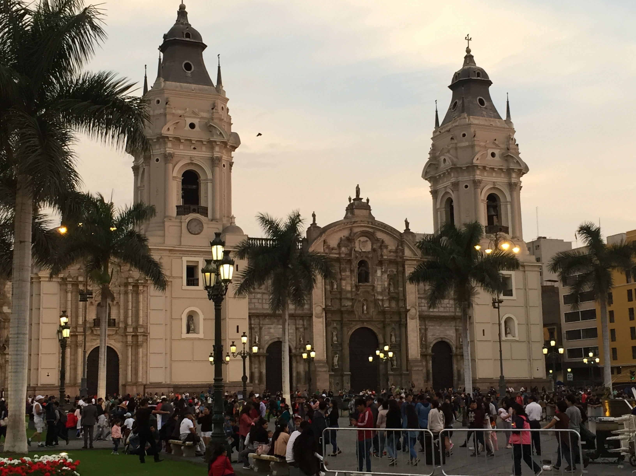
Neutrino theory = Neutrino physics viewed by a theoretician
Hisakazu Minakata IFT UAM/CSIC, Madrid → where??

Slide 2
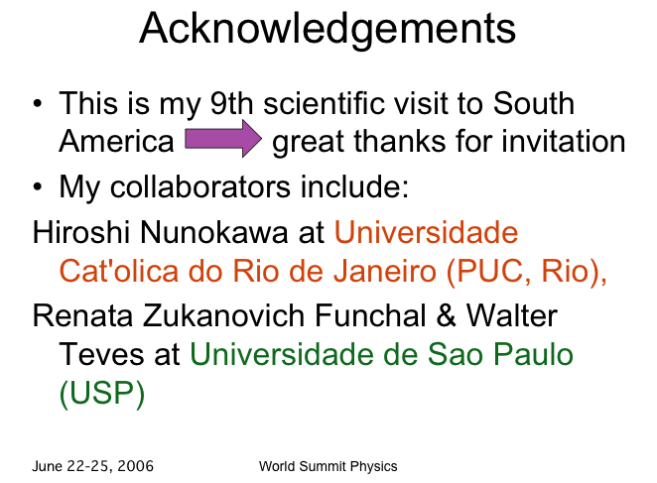
My career in Latin America
Since Feb 2013, Rio de Janeiro (6 meses), Sao Paulo (32 meses), Yachay Tech (Ecuador, 14 meses) ~ 4.5 años
Galapagos!! in 2006

Slide 3

neutrino physics as interdisciplinary field
Really enjoyable field!

Slide 4
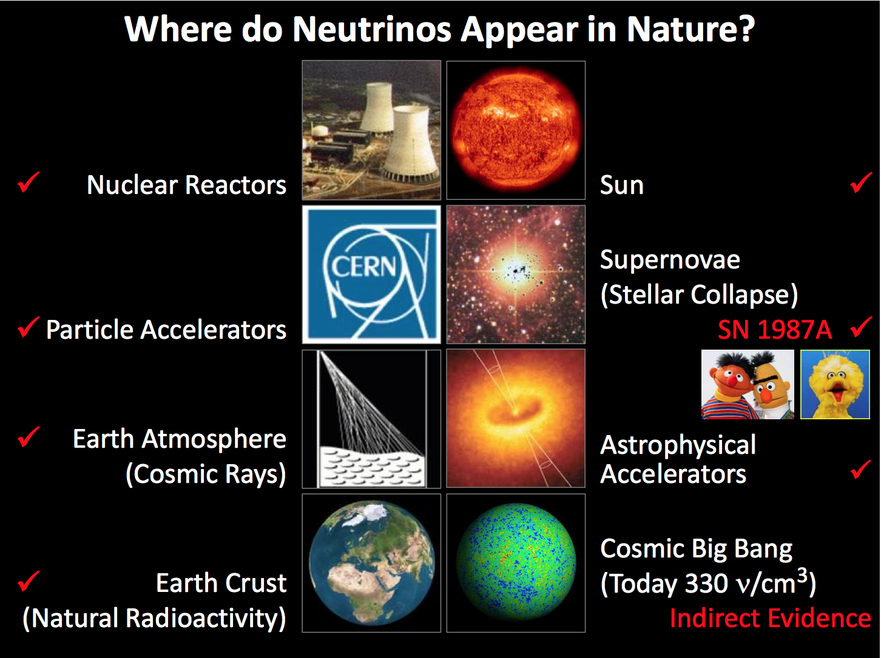
Georg Raffelt, Physics Colloquium, Stockholm, 24 April 2014

Slide 5
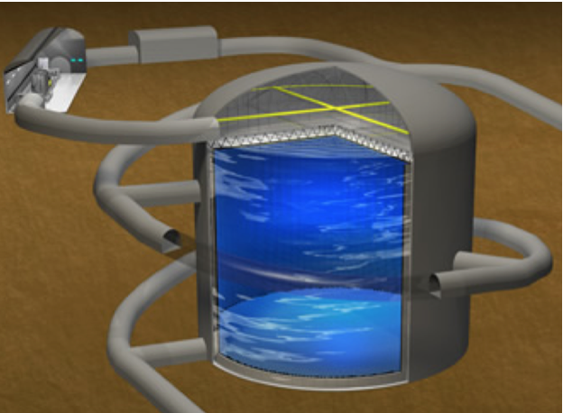
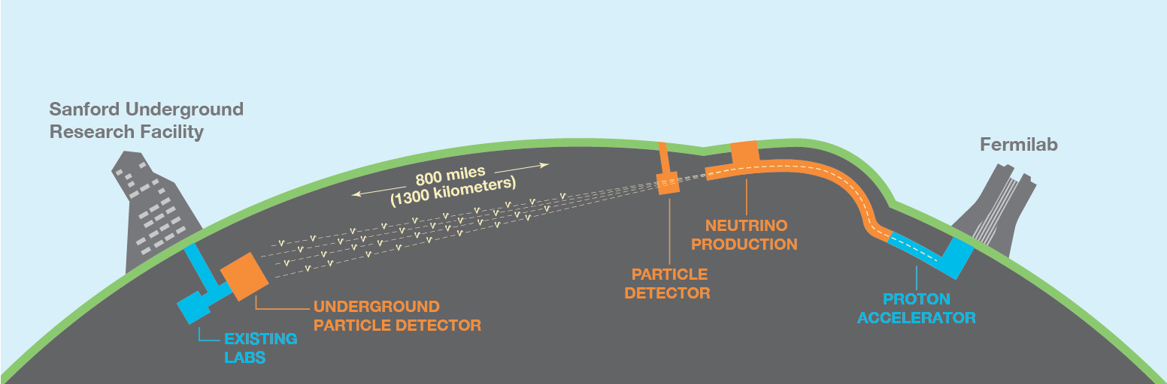
Experimental nu is moving!!
Hyper-K → Start construction in 2020!
DUNE → DOE Stage 3 approval

Slide 6
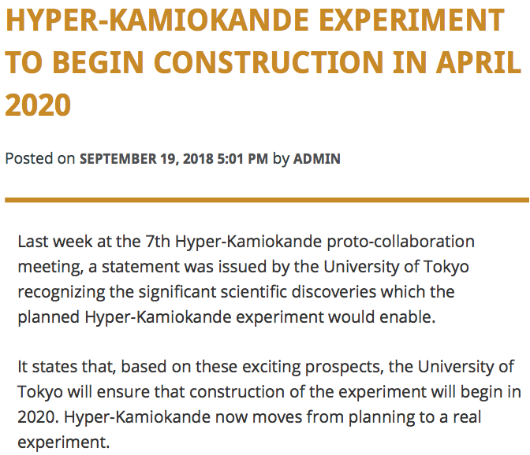
Experimental nu is moving!!
Hyper-K → Start construction in 2020!
DUNE → DOE Stage 3 approval

Slide 7
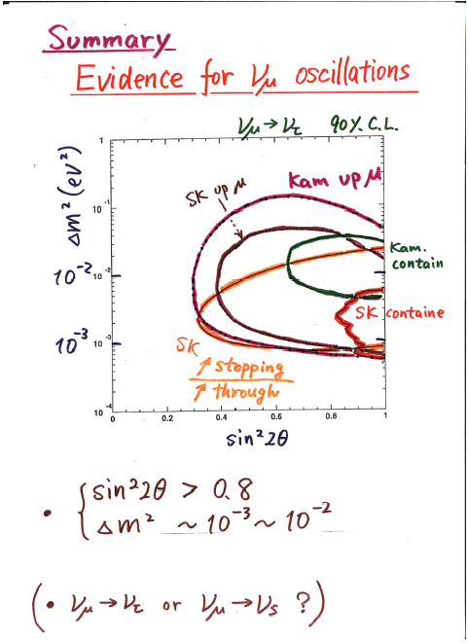
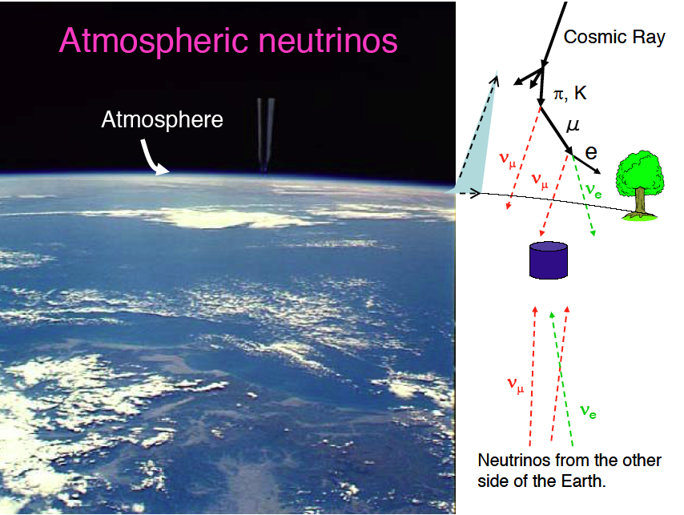
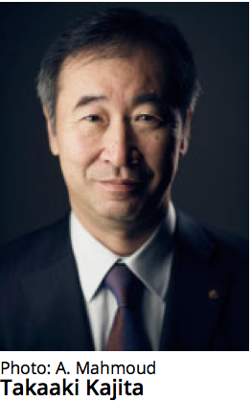
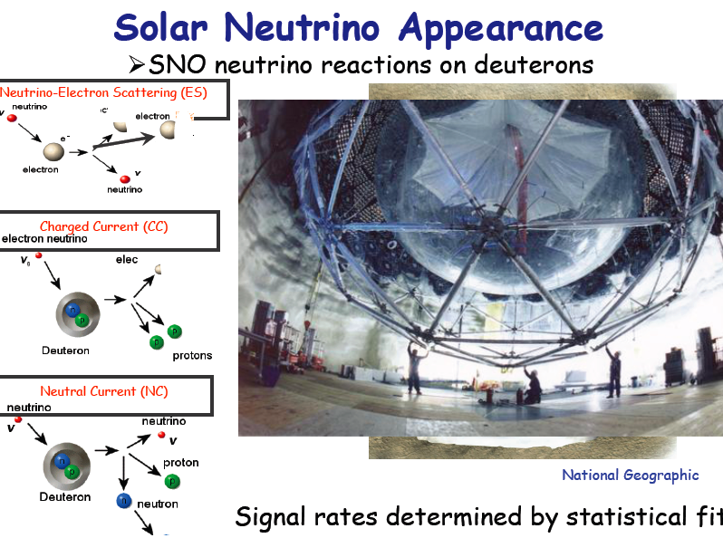
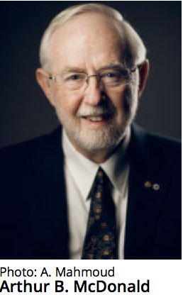
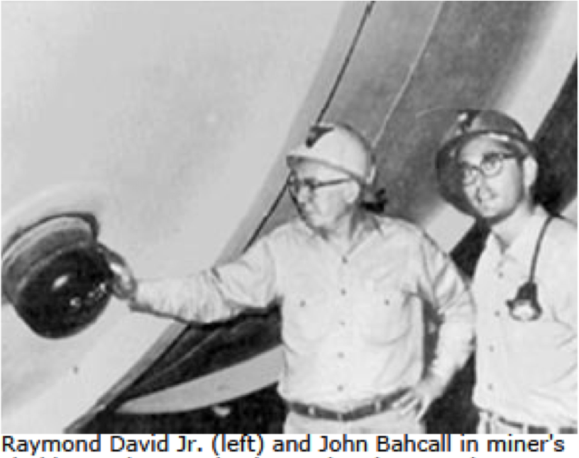
Long discovery phase finally ended

Slide 8

3 flavor neutrino mixing established

Slide 9
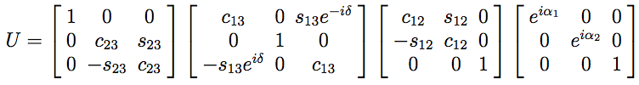
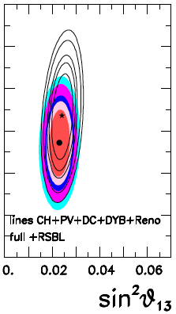
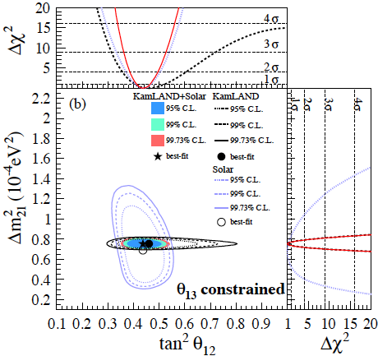
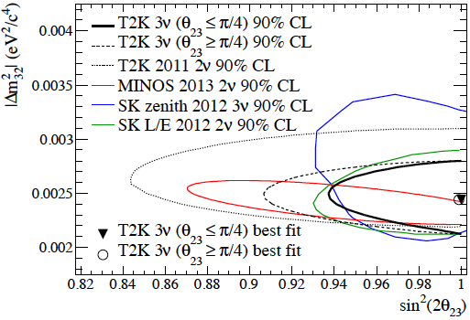
All the angles are measured ! lepton CP phase δ left (1998-2012)
ν_{α}=U_{αi} ν_{i}
SK-atm+MINOS+T2K
T2K-MINOS-DC-DB-RENO
solar+KamLAND

Slide 10
All three angles are measured: Random angles?
θ₂₃ ~ 45 degree
θ₁₂ ~ 33 degree
θ₁₃ ~ 8 degree
What do they mean?
Quark mixing:
angles are tiny except for θ_{Cabibbo} = 13 deg.

Slide 11
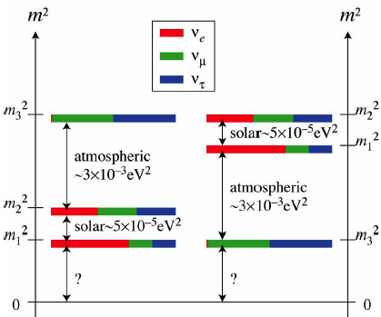


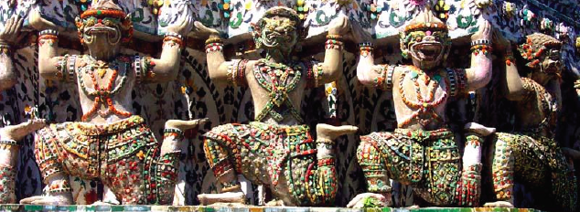
Yet, we still don’t know CP, ν mass pattern & absolute mass scale
← Cosmology helps → Planck 2018 !!
Normal
Inverted

Slide 12

CP and mass ordering: Are we started to know the answer?

Slide 13
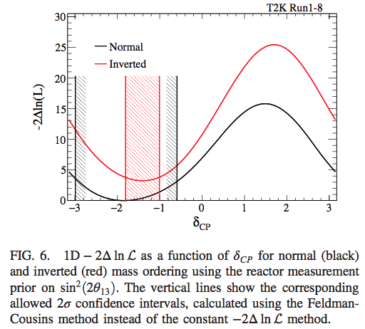
δ =~ 3π/2 preferred (T2K)
~2 σ exclusion of CPC !
T2K II (proposed, run until 2026) they could see CPV at ~3 σ (expected for ~15x10²¹ POT)

Slide 14
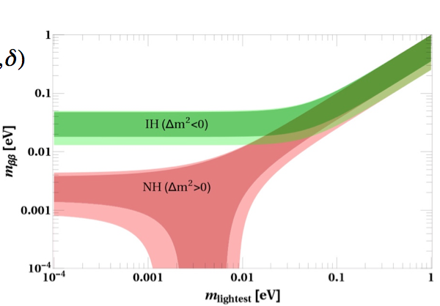
Apparently, normal ordering preferred !
A global analysis says normal ordering preferred at 3 σ level!
Bari group analysis: arXiv:1804.09678
Main additional contribution from Super-K atmospheric →
Immediate question: If normal, how we could attack ββ decay??

Slide 15
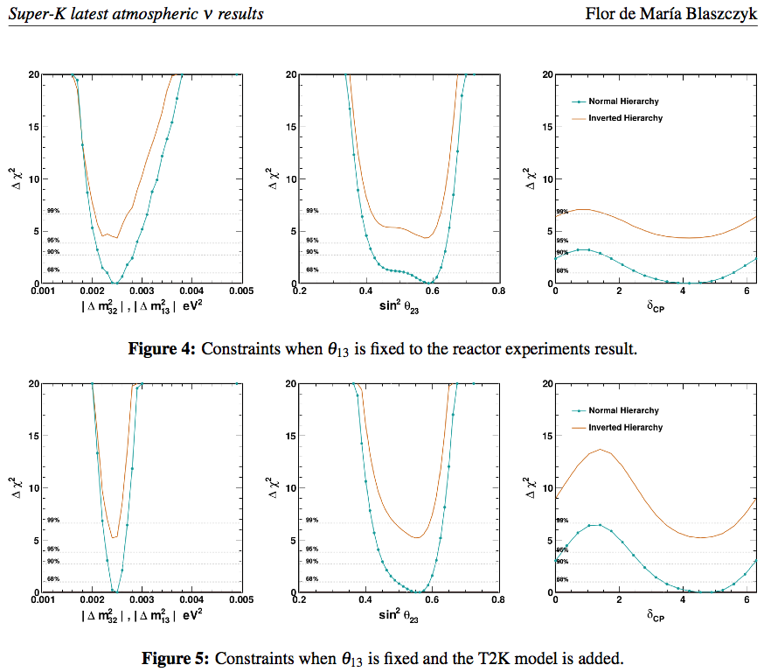
Super-K (+T2K, reactor)
SK only
θ₂₃ 2nd octant!
T2K added

Slide 16

So, Things started to converge !!?

Slide 17

If so, it’s a great news for NOvA!

Slide 18
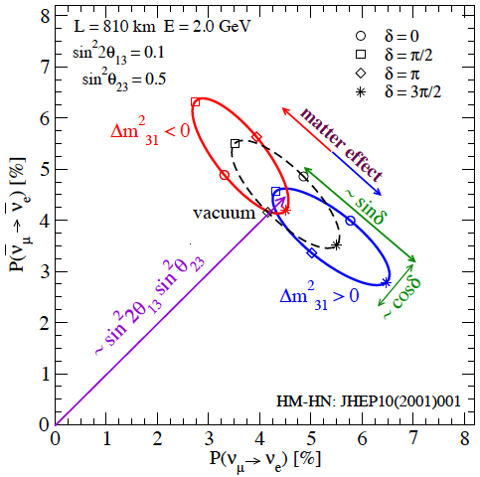
δ=3π/2 (or –π/2) implies that we are at the tip of the ellipse the best case for NOvA
P-\bar{P} bi-probability diagram, proposed by HM-H.Nunokawa, JHEP 2001
Sign of Δm²₃₁ distinguishes normal vs inverted mass ordering
δ and sign Δm²₃₁ couple because (Δm²₃₁ → − Δm²₃₁ , δ →π-δ) symmetry in vacuum (JHEP 2001)

Slide 19

Next generation experiments

Slide 20
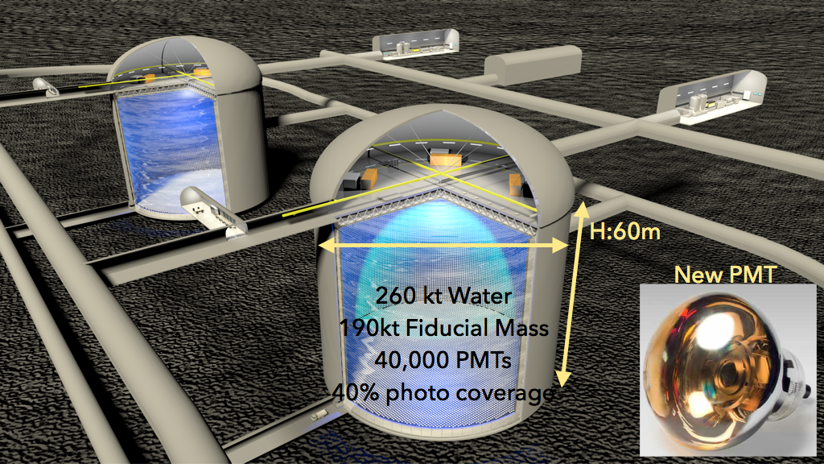
Hyper-Kamiokande
HK will start construction in 2020!
D:74m

Slide 21
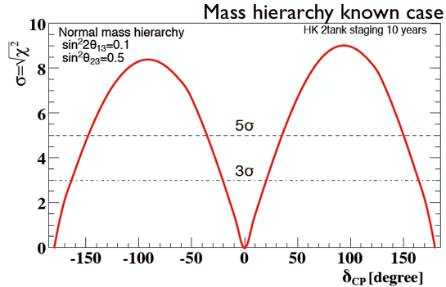
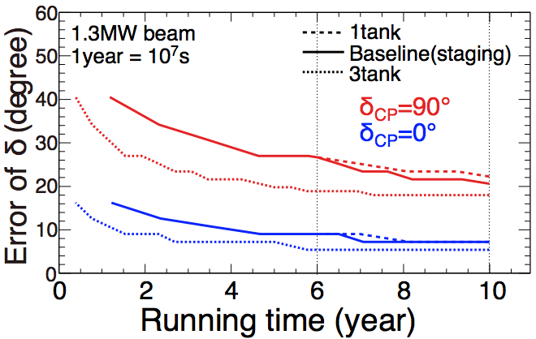
Sensitivity to CP phase
If CP is known to 3 σ, HK (or next generation machines) may have to have capability to measure something else → proton decay

Slide 22
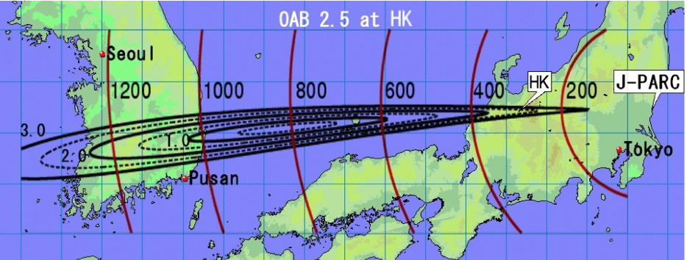
Ishitsuka-Kajita-HM-Nunokawa, PRD 2005, 2007
We discussed T2KK > 10 years ago, now revived as “T2HKK”

Slide 23
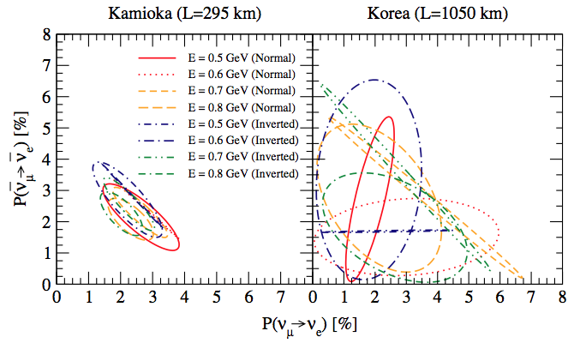
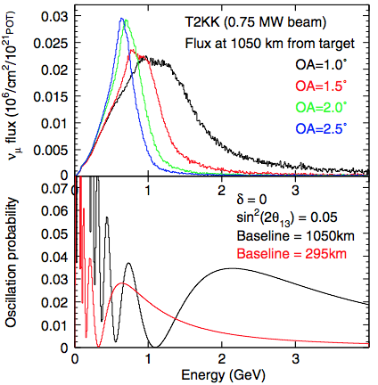
T2KK (or T2HKK)
Dufour et al PRD 2010
E dependence far more dynamic at 2nd oscillation maximum
Ishitsuka-Kajita-HM-Nunokawa, PRD 2005, 2007

Slide 24
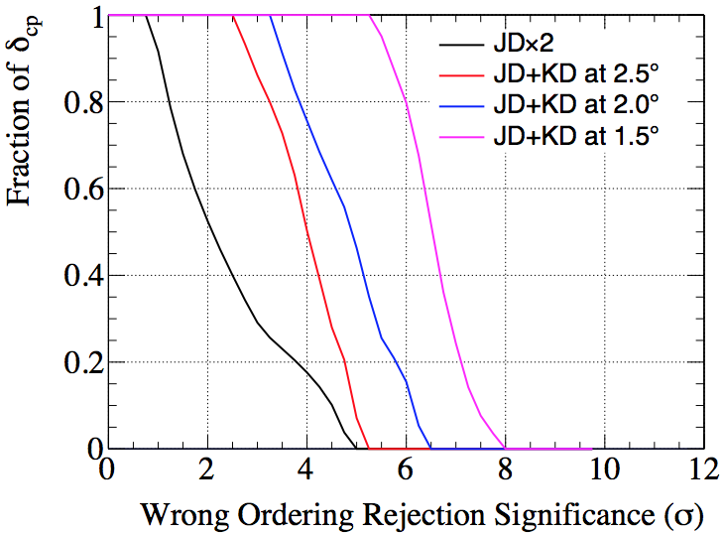
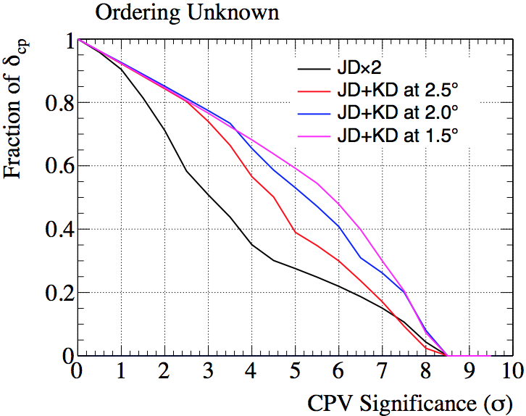
T2HKK: Mass ordering and CP sensitivities
T2HKK White paper arXiv 1611.06118

Slide 25
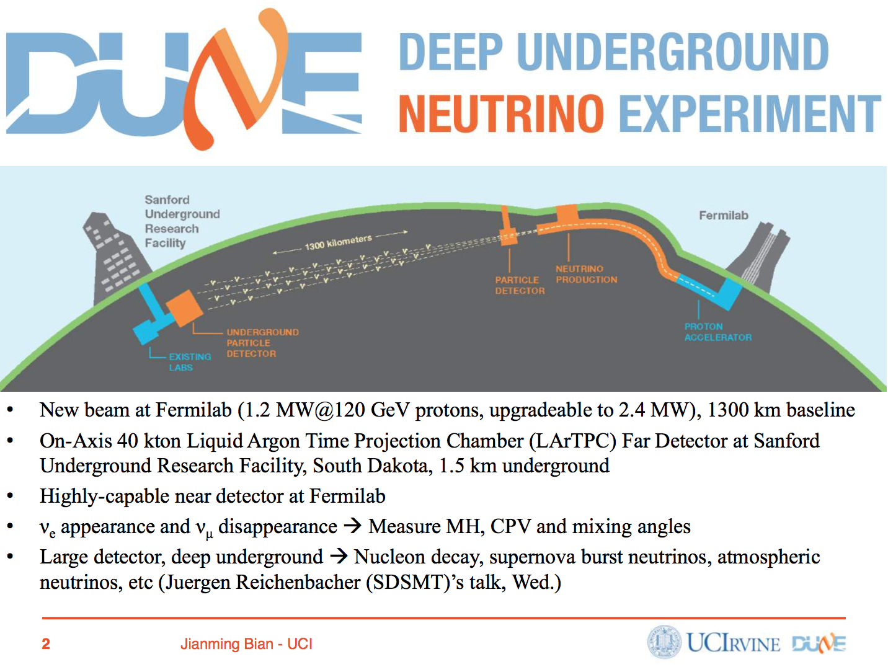

Slide 26
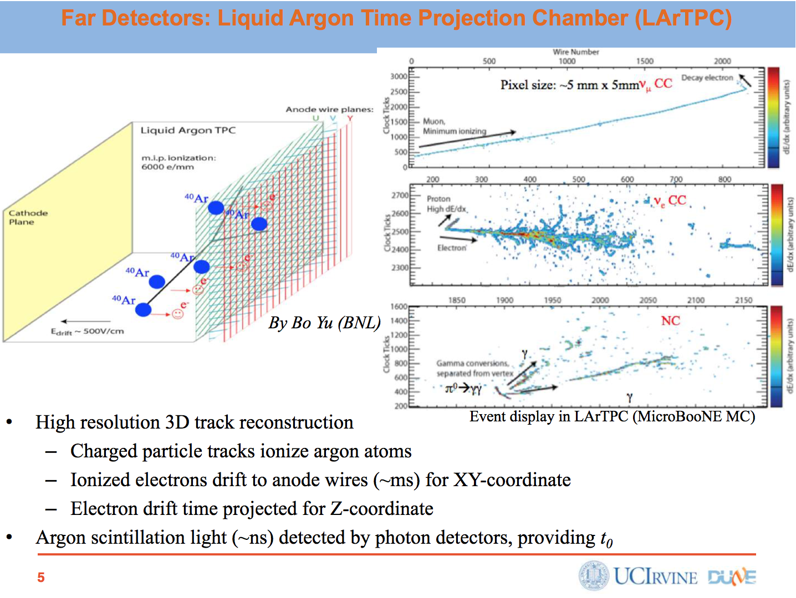

Slide 27
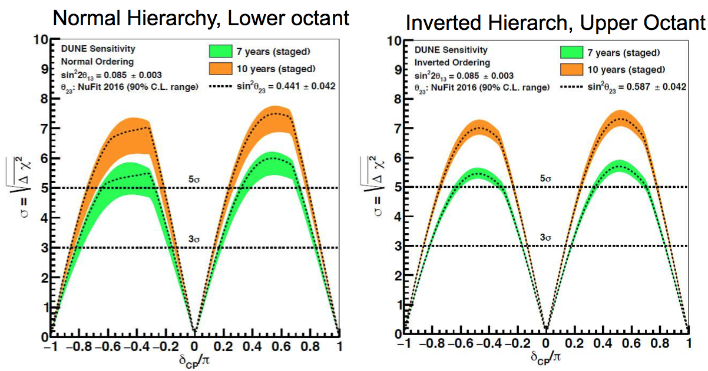
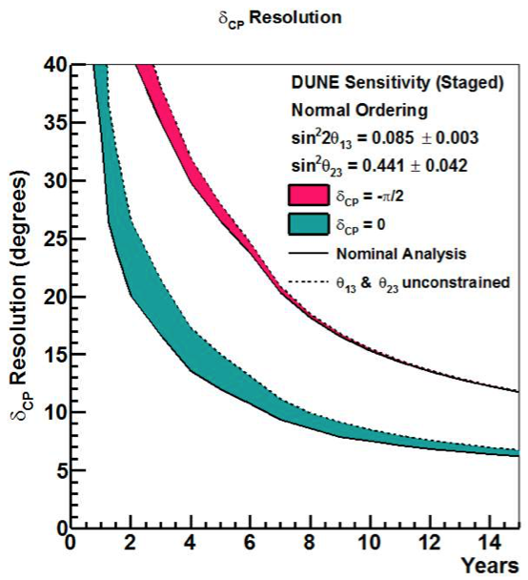
DUNE: CP sensitivity

Slide 28
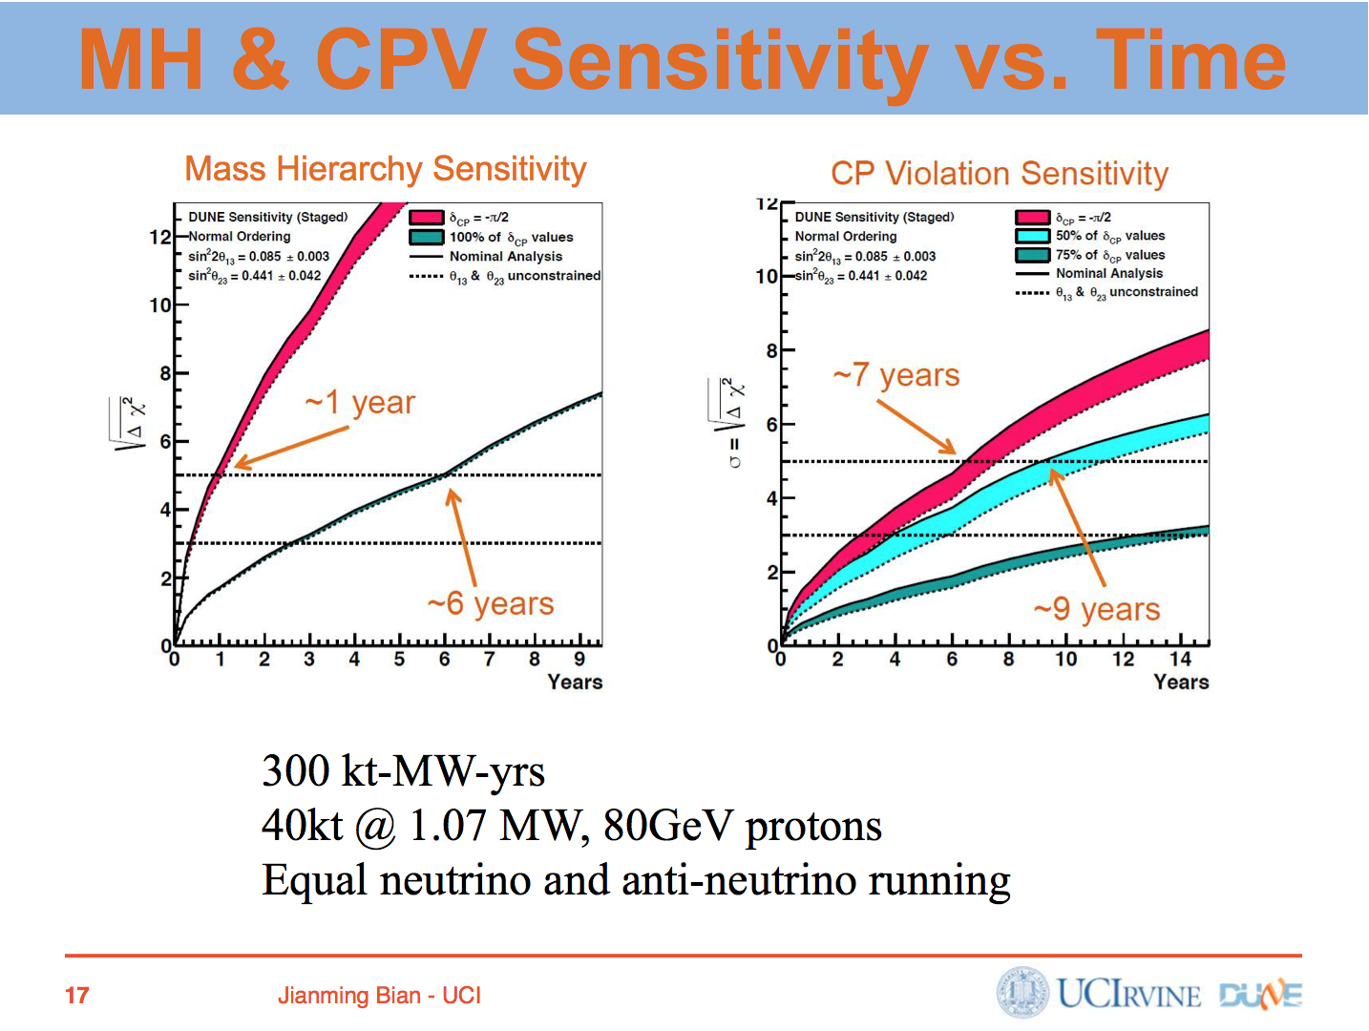

Slide 29

JUNO: exploring 12 sector & mass ordering

Slide 30
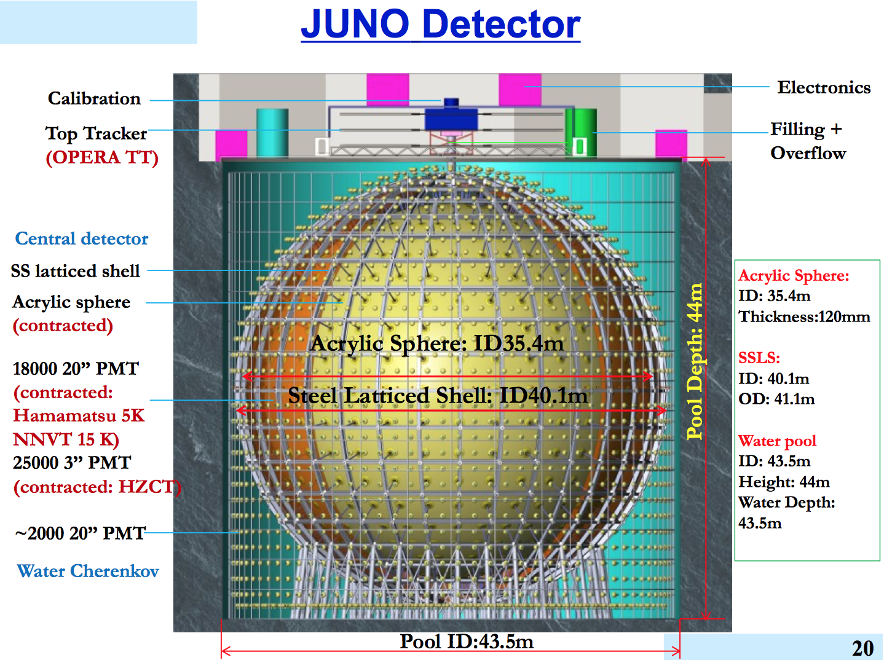
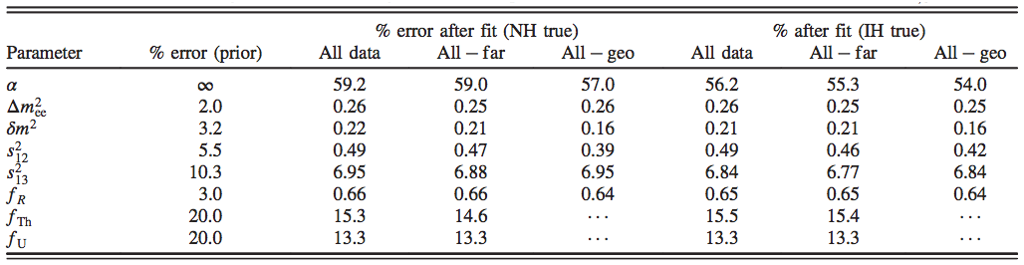
20 kt Liquid Scintillator Detector
Capozzi et al PRD2014

Slide 31
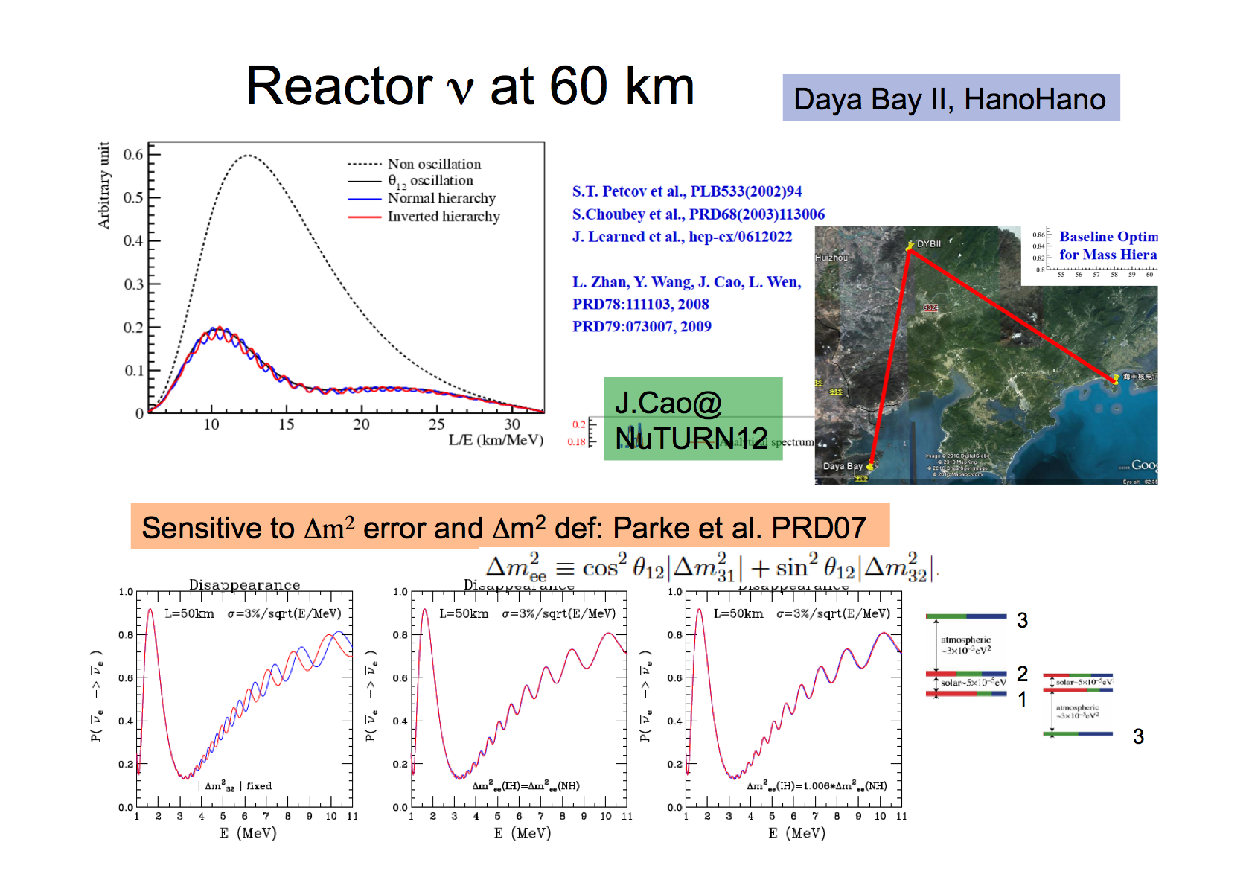
Mass ordering in JUNO: highly debated subject
My slide in Neutrino 2012@Kyoto

Slide 32

Anomaly? Sterile ν?

Slide 33
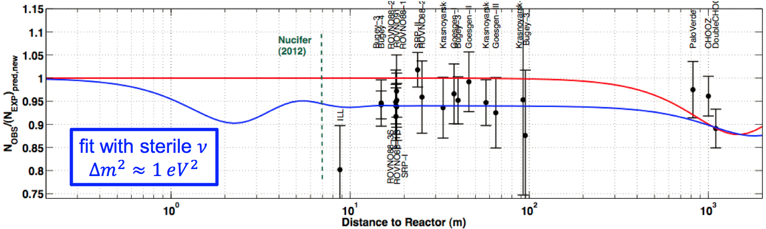
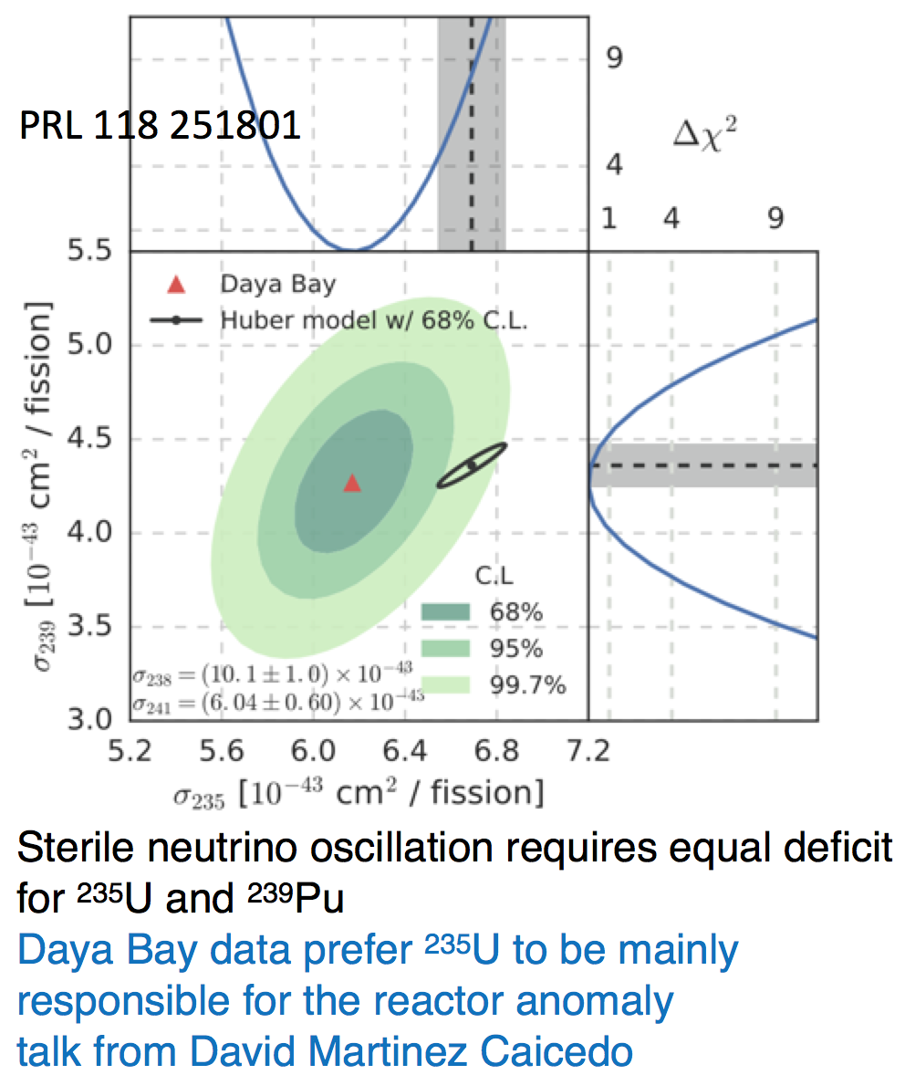
Reactor anomaly?
Reactor neutrino anomaly?
Calculated nu flux ~3-5% higher than measured
Sterile nu?
But the discrepancy is in ²³⁵U, not in ²³⁹Pu (Daya Bay)

Slide 34
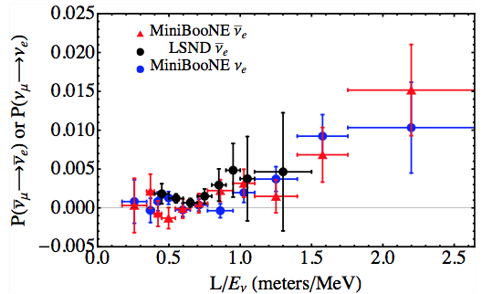
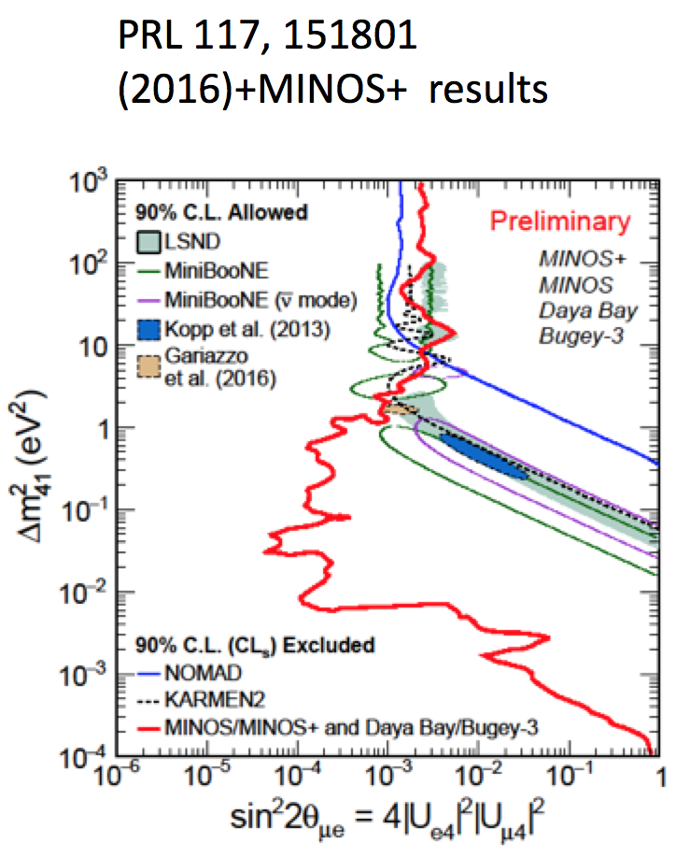
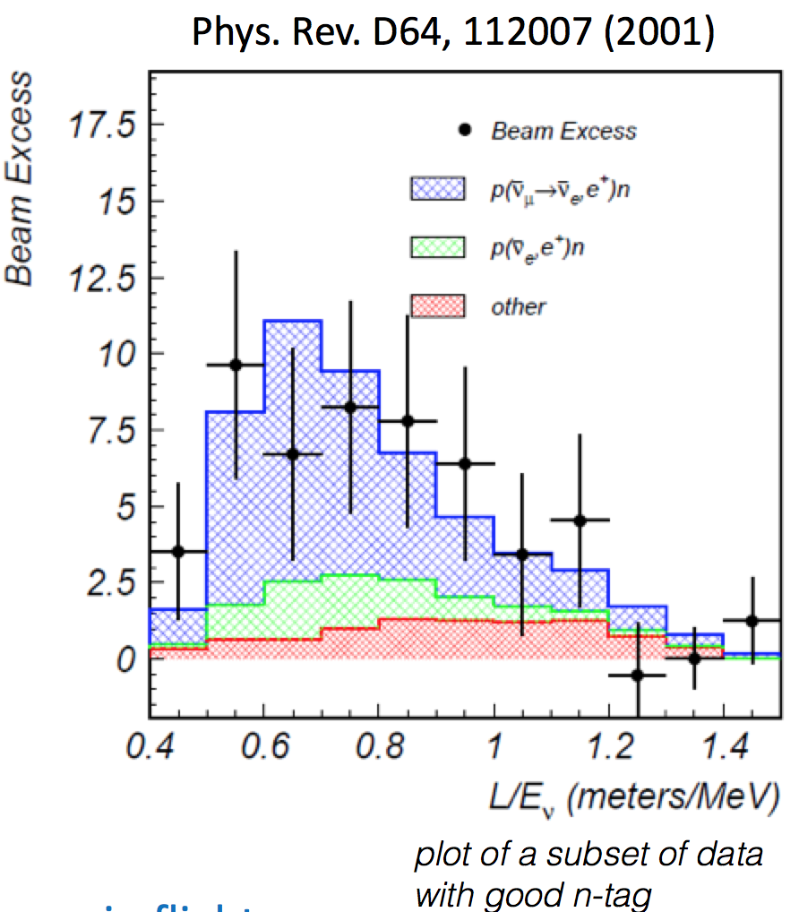
LSND-MiniBooNE anomaly
Diwan@WIN2017

Slide 35
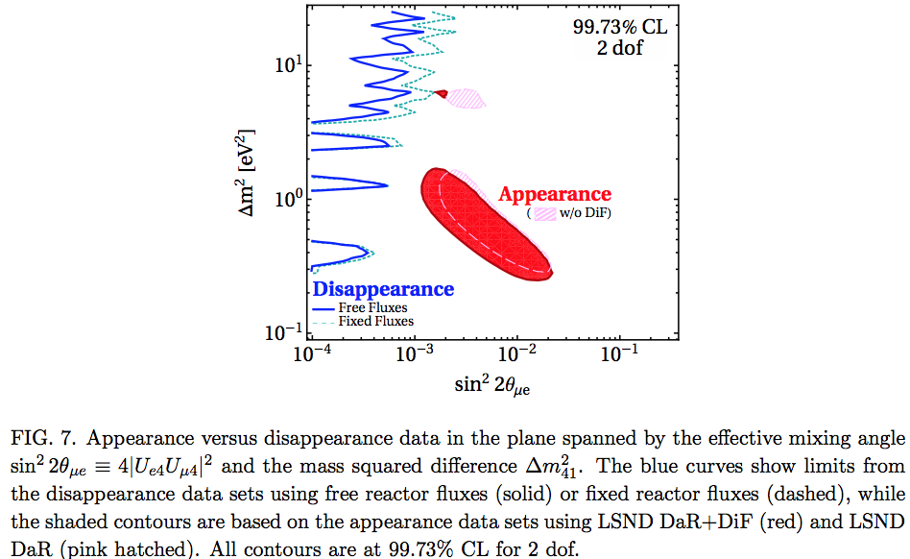
Tension between appearance and disappearance
M. Dentler et al 1803.10661

Slide 36
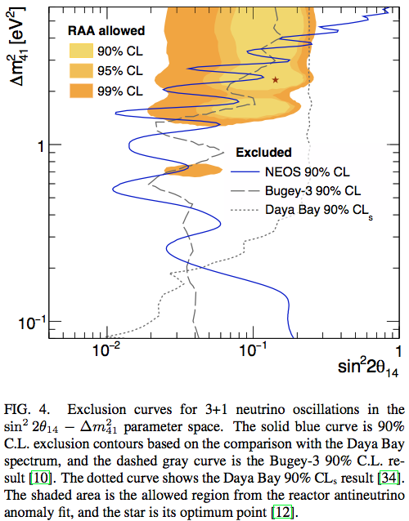
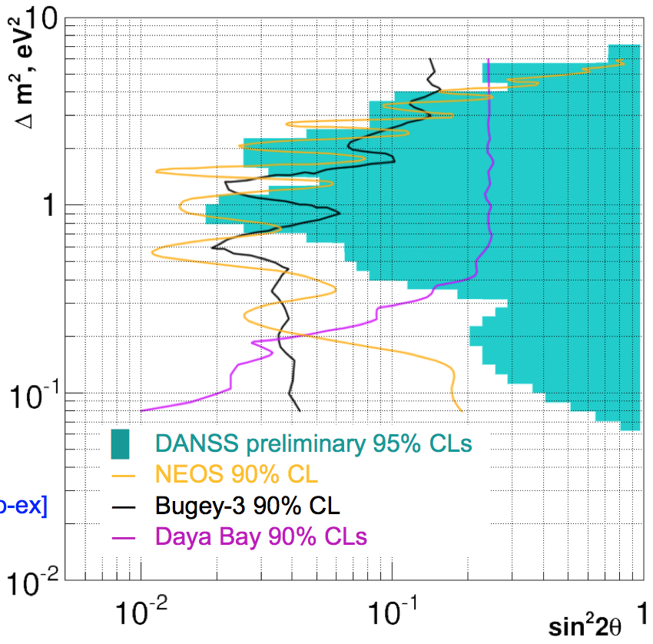
SBL experiments ongoing
DANSS (Russia)
NEOS (Korea)

Slide 37
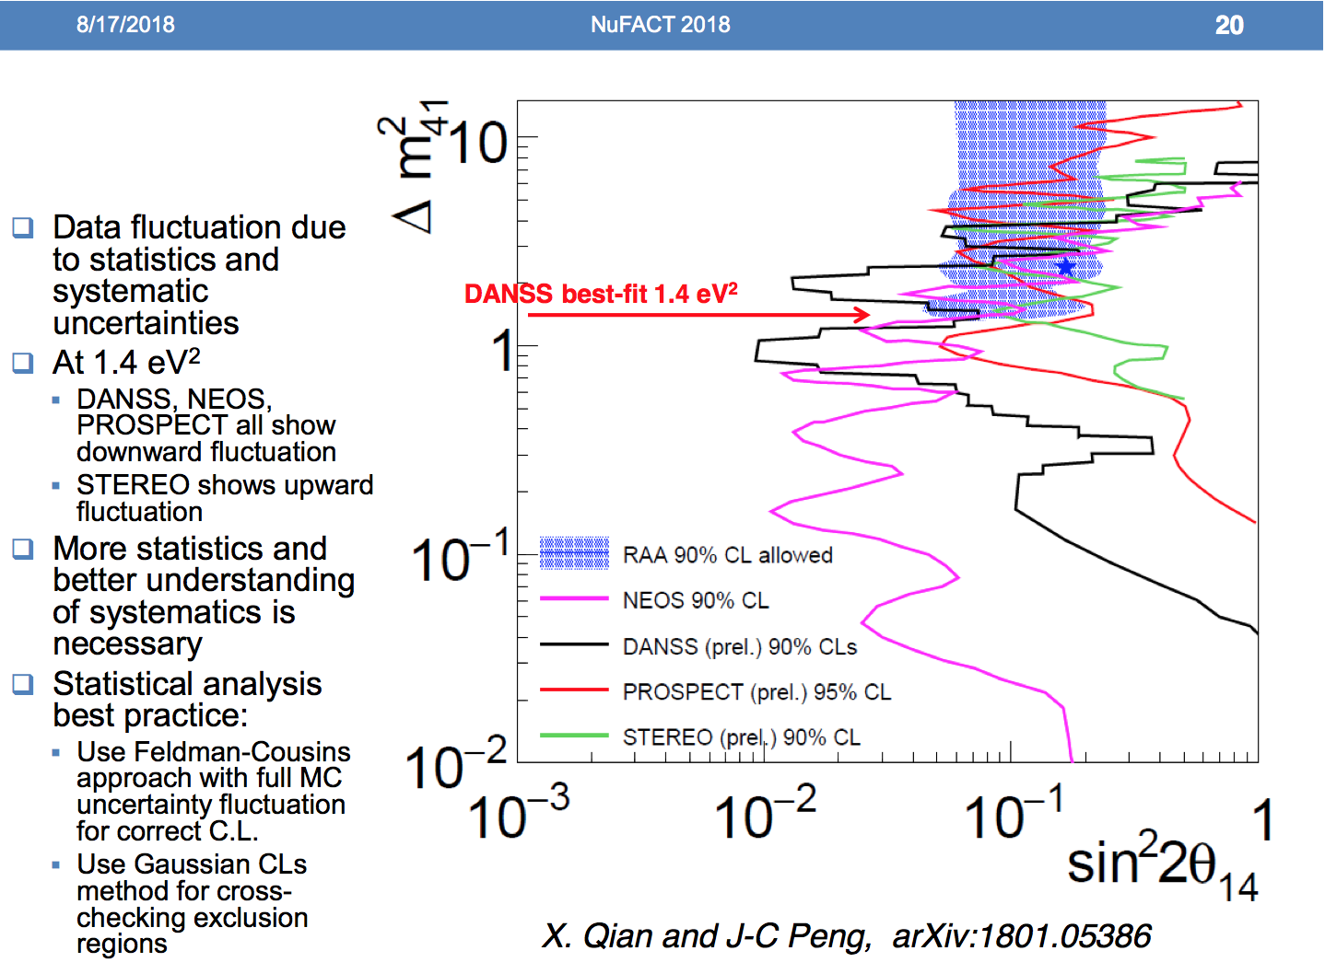
Chao Zhang Nufact2018

Slide 38

We want to hear definitive result!

Slide 39
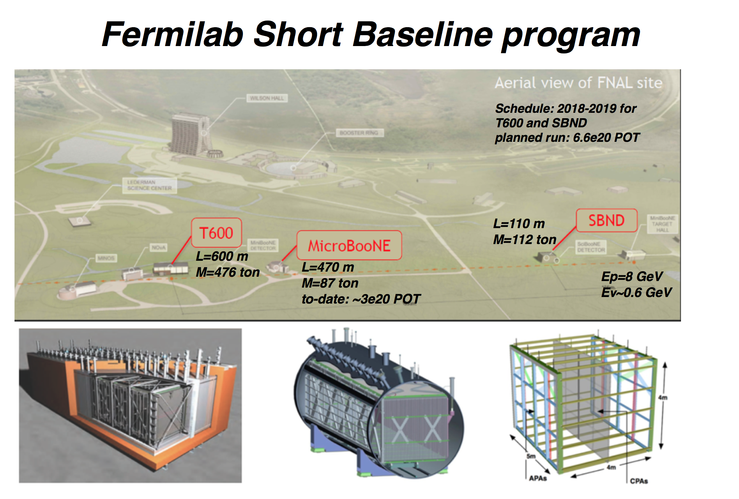
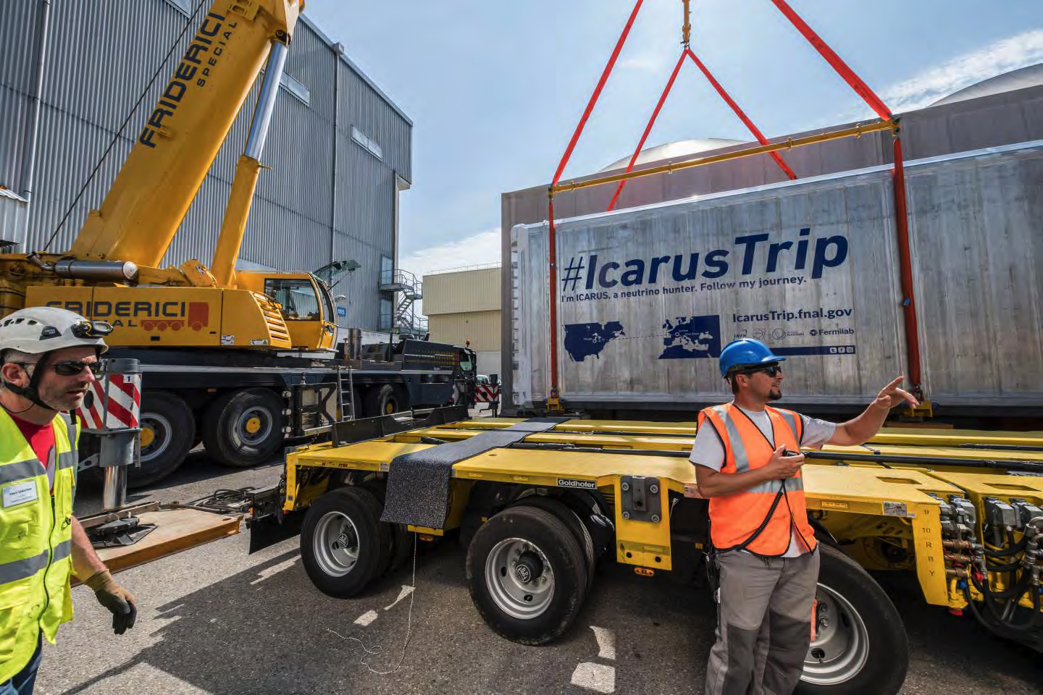
Puzzle lasted for ~20 years!
LSND paper → 2001
LIGO started observation in 2002 !!

Slide 40
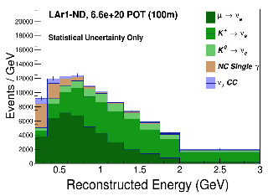



Fermilab SBL program: 5σ coverage!
LiqAr ND
MicroBooNE
ICARUS T600
arXiv: 1503.01520

Slide 41

Astrophysical neutrinos
Neutrino is moving !!

Slide 42


IceCube discovered astrophysical neutrinos!

Slide 43

Carlos Argüelles @ Nufact 2018

Slide 44
IceCube discovered the source!

Slide 45

IceCube-170922A from blazar TXS 0506+056
E~290 TeV

Slide 46


blazar TXS 0506+056
MAGIC and FERMI saw the rise

Slide 47

Multi-wavelength observations of TXS 0506+056

Slide 48

neutrino follows gravitational wave in multi-messenger astronomy
We live in the new era of astronomy !!

Slide 49

Physics of neutrino mass

Slide 50


If I ask the question “what is the origin of nu mass?”
Varying mechanisms proposed
Majority would agree with Weinberg’s dimension 5 operator (1/M_{NP}) φφνν
But what is inside??

Slide 51

“multi-messenger approach” in nu theory?
TeV scale seesaw + small nu mass radiative nu masses Z₂ symmetry (no tree mass) stability of dark matter
Ma, Krauss etal, Aoki etal, Kanemura etal, many references..
Low mass minimal seesaw model, testable by SHiP, leptogenesis, ββ decay etc
P. Hernandez et al, (using Pilaftsis-Underwood) + ……..
→ generically leads to testable models in collider, ββ decay, leptogenesis, lepton flavor violation, precision measurement etc.

Slide 52


νMSM by Asaka, Shaposhnikov et al
Sterile neutrino DM populated through mixing with active nu
Successful leptogenesis etc
Constrained by NuSTAR
Kenny Ng, IPMU seminar Nov 2018

Slide 53

What is next? (or toward the end?)

Slide 54
What is next?
Suppose in some day we come to know lepton CP phase and the neutrino mass ordering
Then, the question is “what is next?”, or could be “what is the last?”
Certainly we will definitely have high precision measurement of the mixing parameters
Paradigm Test ! Prove that 3 nu mixing is our world
e.g. by JUNO!

Slide 55
In what circumstance, do we have unitarity test ?
We don’t know what is NP that causes UV
Yet, we want to test unitarity
If we know what is NP, we don’t need “unitarity test”. We can just go to the model of NP to confront it to experiments!
The only way we could pursue is to prepare (as much as) model-independent framework for unitarity test ← “CKM triangle” difficult..

Slide 56
High-energy vs. Low-energy unitarity violation
Feature of unitarity violation different for
High-energy (E >> M_{W}) unitarity violation vs.
Low-energy (E << M_{W}) unitarity violation
For Low-E UV: probability leakage to “sterile” sector small but observable effect
High-E UV: “model-independent” framework by integrated out NP sector, but no systematic way for Low-E UV →
New trial by C-S. Fong, HM, H. Nunokawa, arXiv: 1609.08623, 1712.02798

Slide 57
High- vs low-scale unitarity violation: more generic differences
High-scale UV >> m_{W}
Low-scale UV << m_{W}
lepton flavor universality: NO
zero distance neutrino flavor transition: YES
Kinematical effect of sterile nu emission: YES (if kinematically allowed)
lepton flavor universality: YES
zero distance neutrino flavor transition: NO
Kinematical effect of sterile nu emission: YES

Slide 58


Parametrizing non-unitarity: alpha parametrization →
Escrihuela etal PRD2015 (Valencia group)
Then, NP parameter α is universally correlated with SM parameter δ !!
Ivan Martinez-Soler, HM, arXiv:1806.10152
Framework of UV itself knows how NP is related with SM
UV is better defined framework than “NSI put in by hand” approach

Slide 59
Conclusion
Tried to review neutrinos in interdisciplinary field
We started to see convergence: CP phase ~ 3π/2, normal mass ordering (2nd octant of θ₂₃?)
Nu is moving #1: 2 big projects, T2HK (Japan) and DUNE (US) are going to happen
Nu is moving #2: birth of multi-messenger neutrino astronomy
Theoretical “multi-messenger” approach described
How to close the neutrino story? 3 ν paradigm test

Slide 60
Conclusion continued
LSND-MiniBooNE anomaly + reactor neutrino anomaly hints for sterile neutrinos?
Waiting for the definitive answer (anomaly ~20 years old..)
Fermilab short baseline program
0ν double beta decay must be discussed (important subject but not discussed)…..as a mean to determine Majorana vs Dirac neutrinos
Absolute nu mass (KATRIN+Planck) too….

Slide 61

Backup slides

Slide 62

Majorana vs. Dirac neutrinos

Slide 63


Slide 64



Observable: 0ν DBD half life

Slide 65

Currently, Xe constraint seems the strongest

Slide 66








Many double beta decay experiments are either ongoing or coming

Slide 67
If 0ν DBD is discovered ..
If 0ν DBD is discovered what that means?
Neutrinos are Majorana particle
Lepton number is violated by 2 units
(1/M_{NP}) φφνν (=Majorana mass) favored but not proven

