Slide 1


Traversable Wormholes in AdS
Vargas
Facultad de Ciencias Físicas
UNMSM
XII SILAFAE
PUCP LIMA, PERU
November 26 – 30, 2018

Slide 2
Outline
I. Introduction
II. Traversable wormholes via a double trace deformation
III. Final Comments

Slide 3
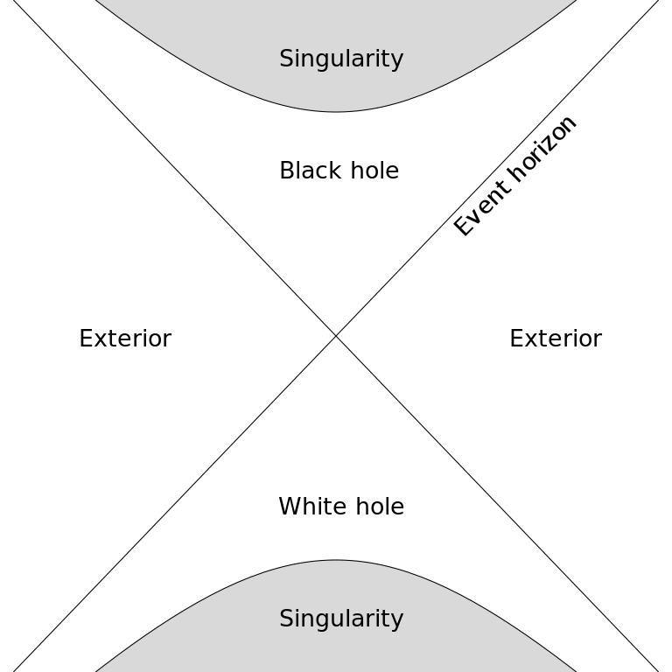

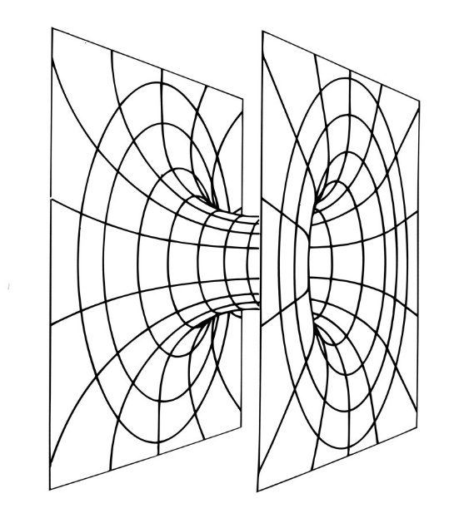
I. Introduction
Wormhole is a vacuum solution of Einstein’s equation
On a time-slice, two interiors of black holes are connected via
a tube or “throat” called Einstein-Rosen bridge.
The Maximally Extended Schwarzschild Solution in Kruskal
coordinates is:

Slide 4
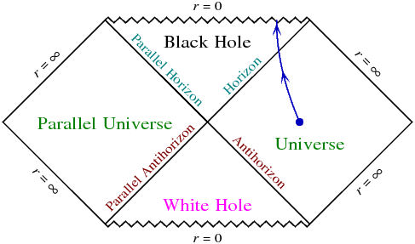
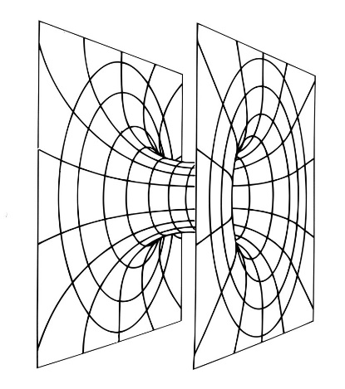
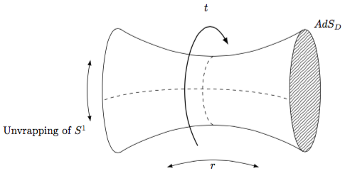
The Penrose diagram of the Maximally Extended
Schwarzschild Solution is
Anti-de Sitter space is a solution of Einstein’s equation with
negative cosmological constantan

Slide 5
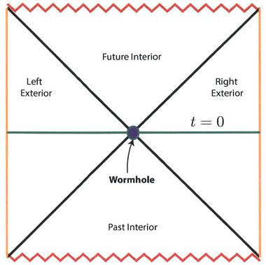
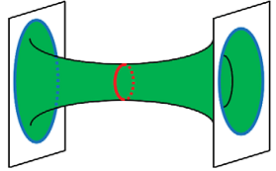
The Penrose diagram of the eternal Anti-de Sitter space in
Kruskal coordinates is:

Slide 6
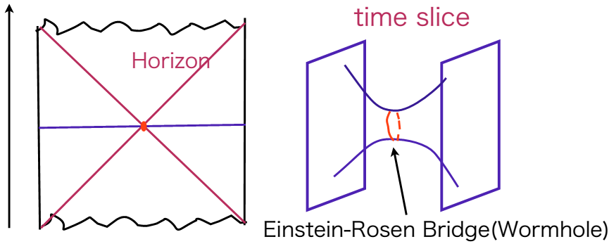
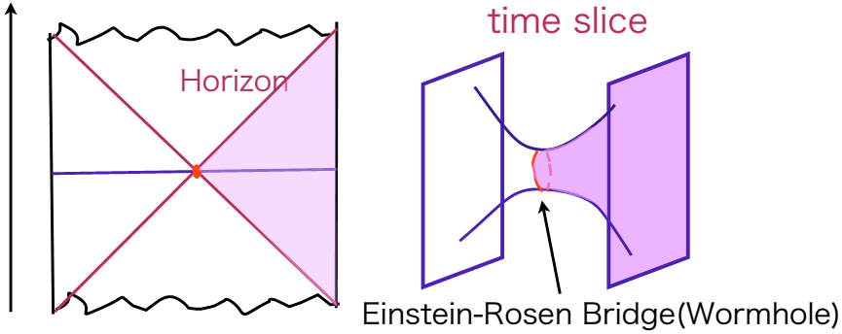
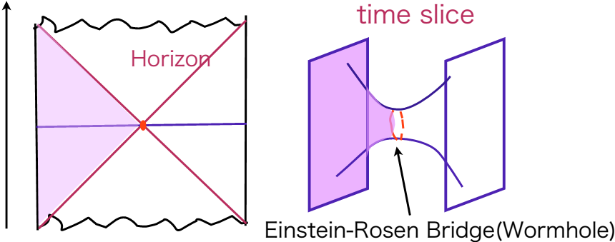
Borrowed from T. Numasawa

Slide 7
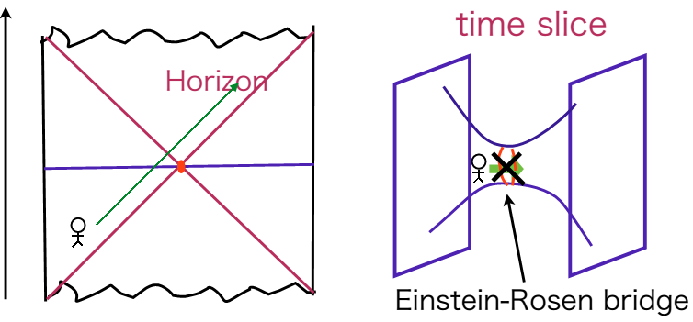
Since the Einstein-Rosen bridge is instable an we can not go
to the other side.
Traversable wormhole: usually require an exotic matter which
violates the Average Null Energy Condition (ANEC).

Slide 8
The ANEC states that along a given infinite null geodesic, the
integral of the null component of the stress energy is
nonnegative:
-is the expectation value of the renormalized stress-energy
tensor
- vector pointing along the direction of the null geodesic
λ -is an affine parameter along the null geodesic
ANEC in GR ensures that gravity is an attractive force
In quantum level ANEC can be violated.
For all traversable wormhole it is necessary the violation of ANEC. Morris, Thorne, Yurtsever 88

Slide 9
II. Traversable wormhole via double trace deformation
Gao-Jefferis-Wall, 16
The Thermofield Double State (TFD)
The thermofield double state is an entangled state in the tensor product of two identical “left” and “right” CFTs:
where β is the inverse temperature
sum is over energy eigenstates.
where Z is the partition function

Slide 10
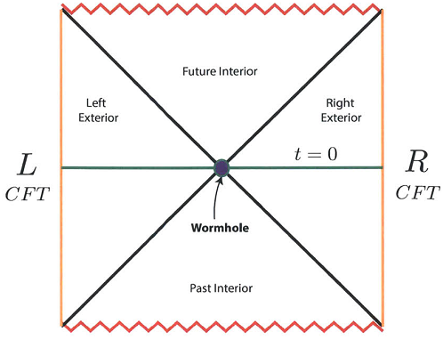
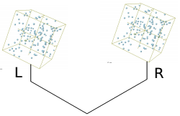
Assuming the AdS/CFT correspondence TFD is holographically
dual to an eternal two-sided AdS black hole.
Start with the eternal AdS black hole, dual to the thermofield
double state in the decoupled product of two
CFTs.
Israel, Maldacena

Slide 11


Gao, Jafferis and Wall showed that a wormhole in the eternal
AdS black hole scenario can be made traversable by turning
on a coupling between the left and right boundaries of form
is a small deformation.
is a scalar operator of dimension living in
the Left/Right CFT, dual to a bulk scalar field with mass m.

Slide 12

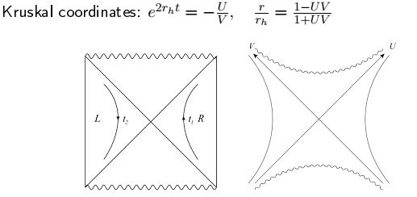

BTZ black hole Bañados, Teitelboim Zanalli 92
The bulk stress tensor associated to the scalar field is
They considered correlation function

Slide 13


First order in contribution in h
Bulk to boundary propagator
The stress tensor
The linearized Einstein equation for the UU component for
the fluctuations evaluated at V=0 gives

Slide 14

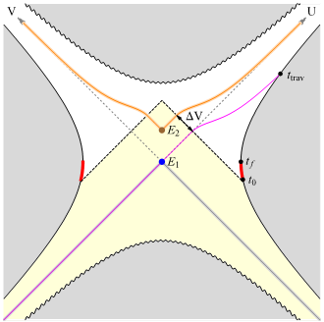

The null geodesics at the horizon caused by the interaction is

Slide 15
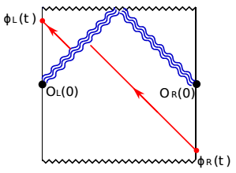
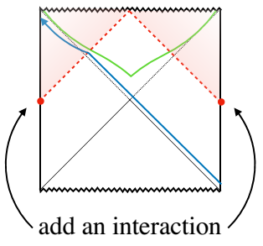

Slide 16
III. Final Comments
Rotaing E. Caceres, A. Misobuchi
Charged
In collaboration with: E. Caceres, C. Rivera and A. Misobuchi

Slide 17

Muchas Gracias !

