Slide 1
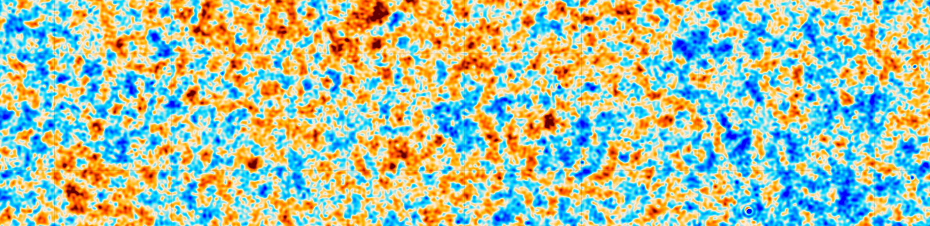

COSMIC ALP STRINGS
LOOKING FOR
IN CMB DATA
Ray Hagimoto
Notes:
Tie into other talk; here we’re looking at another phenomenological implication of axion strings

Slide 2






arXiv:2208.08391
[Published in JCAP 2022]
Searching for axion-like particles through CMB birefringence from string-wall networks
Mudit Jain, Ray Hagimoto, Andrew J. Long, Mustafa A. Amin

Slide 3
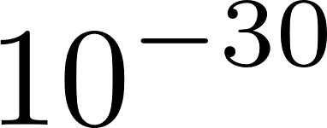
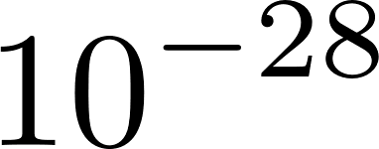
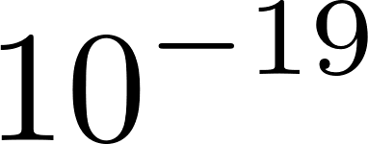
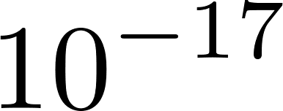
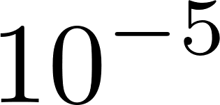
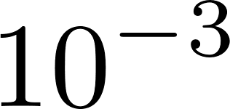

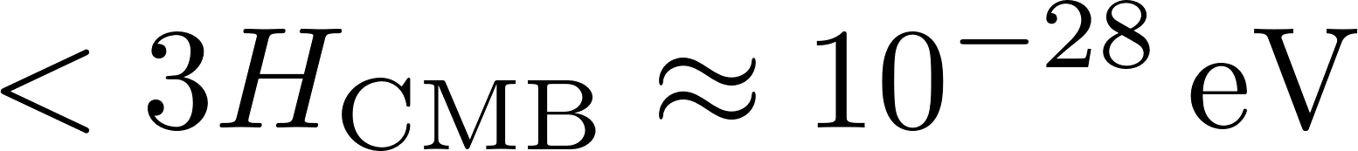
Which ALPs are we considering?
Introduction
Axion mass
dark matter
QCD axion
axion strings
This talk: axion mass
Notes:
Mention that strings are very thin (10^-30 m, for example)
Cut it down and tie to the plenary?

Slide 4
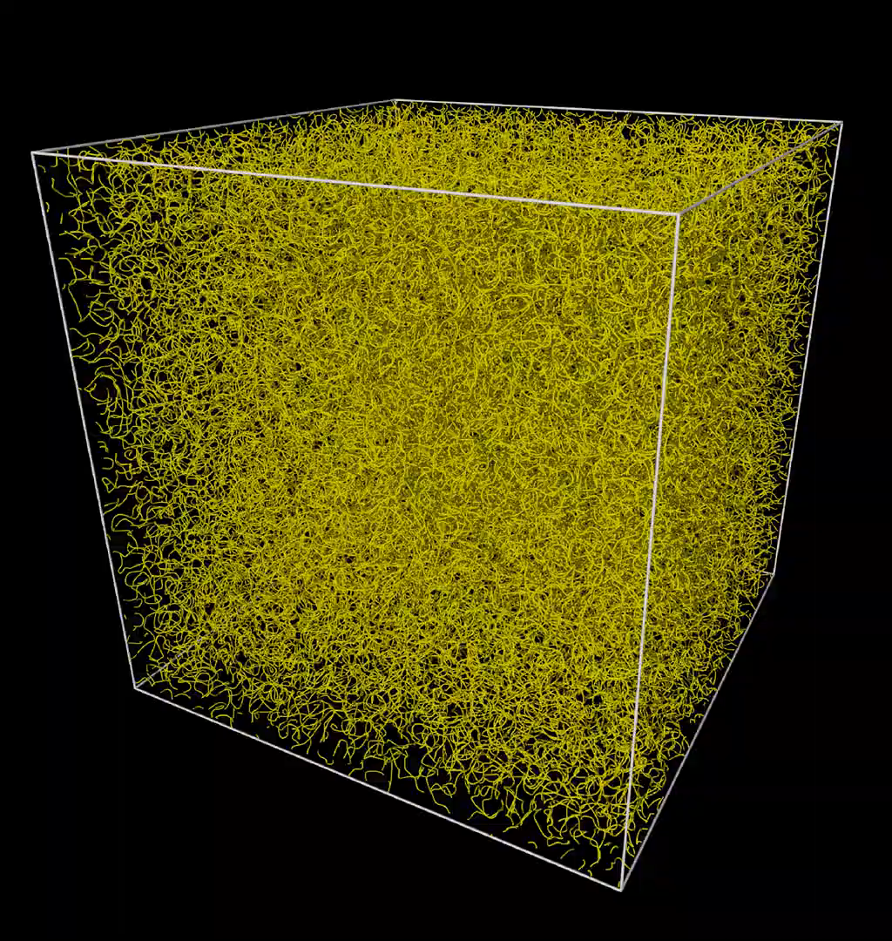
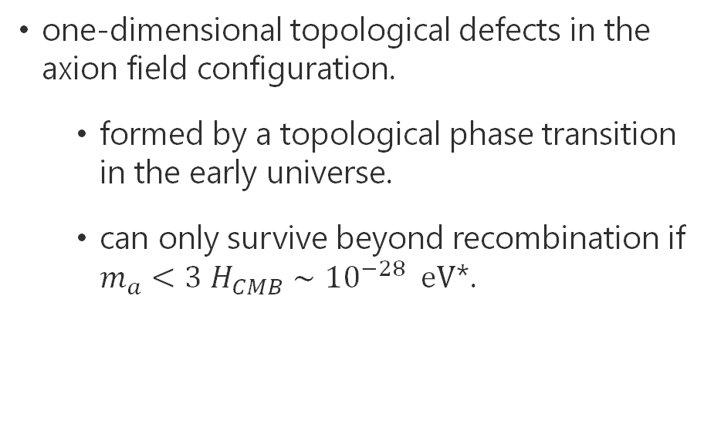
Axion strings
Introduction
Axion mass
Axion strings
one-dimensional topological defects in the axion field configuration.
  formed by a topological phase transition in the early universe.
  can only survive beyond recombination if $m_{a}<3 H_{CMB}∼{10}^{−28} eV$*.
M. Buschmann et. al. (arXiv:2108.05368)
* For dark matter axions $m_{a}>{10}^{−19} eV$ so the “hyperlight” axions we consider cannot make up a significant fraction of DM.
Notes:
What observations constrain axion mass to be greater than 10^-19 eV for dark matter?
“As a visual aid here is a simulation of a string network taken from Buschmann et. al. 2021”

Slide 5
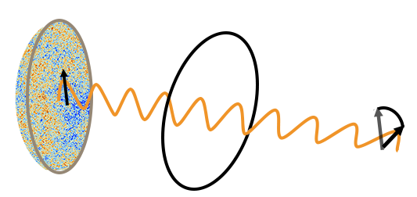
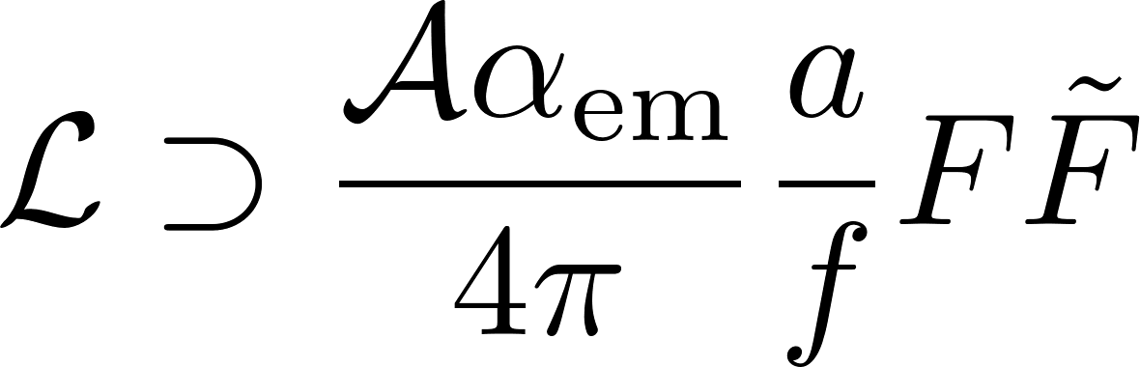

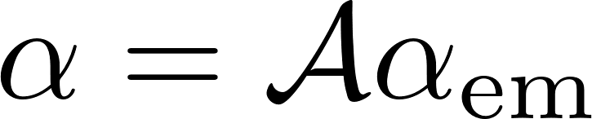


Cosmic birefringence
Introduction
Axion mass
Axion strings
Cosmic birefringence
CMB $γ$
Axion string loop
Rotated CMB $γ$
Agrawal, Hook, and Huang (arXiv:1912.02823)
Notes:
\mathcal A = the anomaly coefficient for the mixed anomaly between EM and the continuous shift symmetry of the axion.
\mathcal A =is not renormalized. Therefore intervening physics between the high energy and low energy scales
This mplies eV cross-correlations

Slide 6
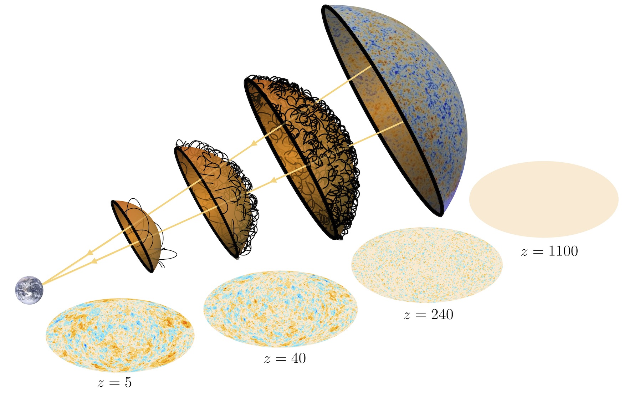




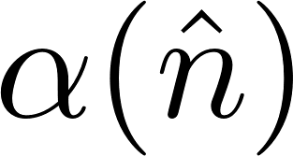
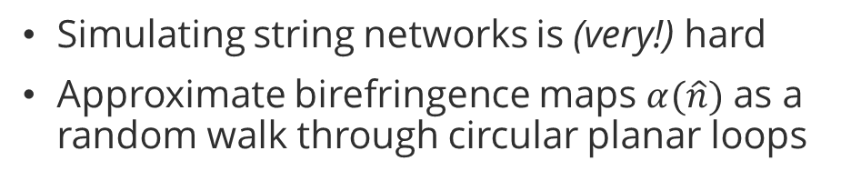
The Loop Crossing Model
Introduction
Axion mass
Axion strings
Cosmic birefringence
Methodology
Loop crossing model
Simulating string networks is (very!) hard
Approximate birefringence maps $α(\hat{n})$ as a random walk through circular planar loops
Model parameters:
= EM anomaly
= loop radius
= # of loops
= axion mass
Jain, Amin, Long, RH (arXiv:2103.10962, arXiv:2208.08391)

Slide 7
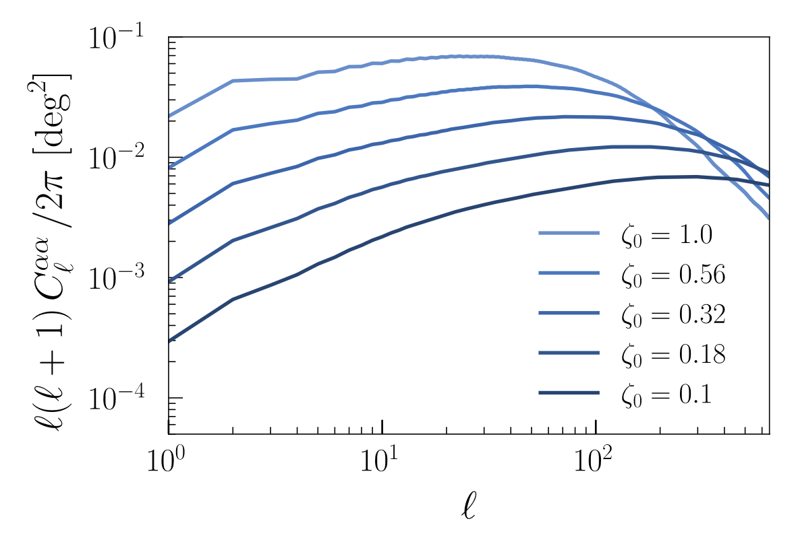

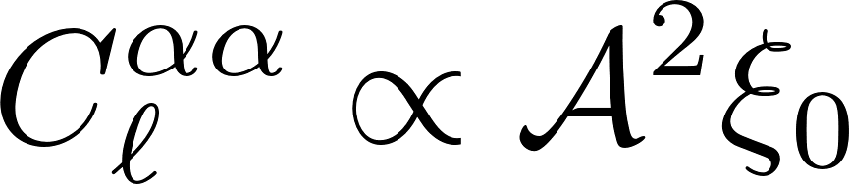

The Signal
Introduction
Axion mass
Axion strings
Cosmic birefringence
Methodology
Loop crossing model
The signal
Calculate the power spectrum of $α(\hat{n})$ maps in the loop crossing model.
Can compare this to measurements!
= loop radius
= # of loops

Slide 8
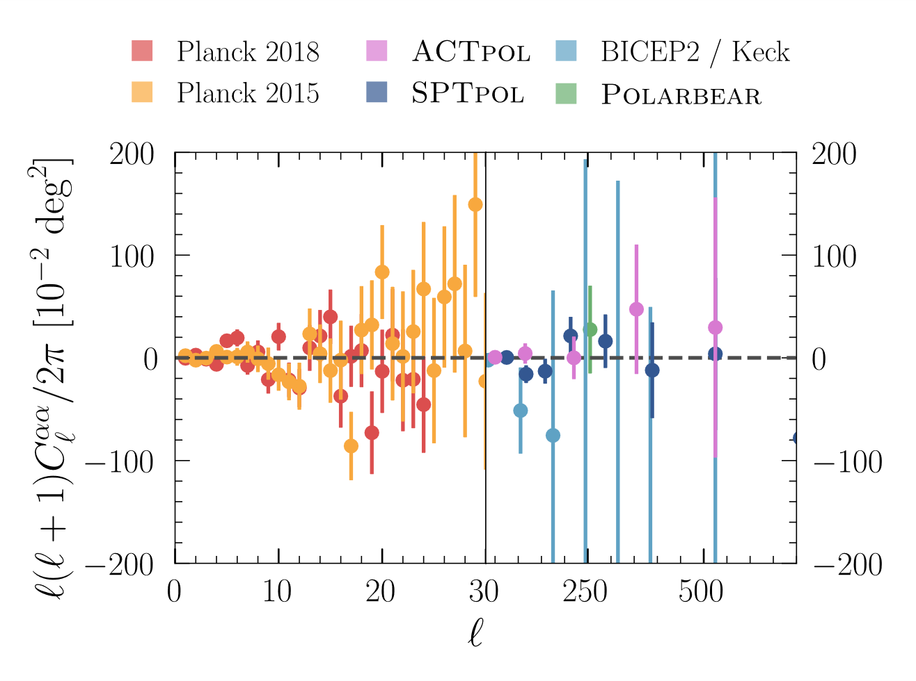

Cosmic birefringence measurements
Introduction
Axion mass
Axion strings
Cosmic birefringence
Methodology
Loop crossing model
The signal
The data
Anisotropic birefringence
Isotropic birefringence
$$α={{0.342}^{∘}}_{−{0.091}^{∘}}^{+{0.094}^{∘}}$$
Eskilt and Komatsu 2022
Palazuelos et. al. 2022
Minami and Komatsu 2018
Notes:
Takeaway
Left: no evidence for anisotropic birefringence
Right: 3-sigma evidence for isotropic birefringence

Slide 9
Can axions explain isotropic and anisotropic birefringence data?
2. What constraints are obtained from anisotropic birefringence?

Slide 10
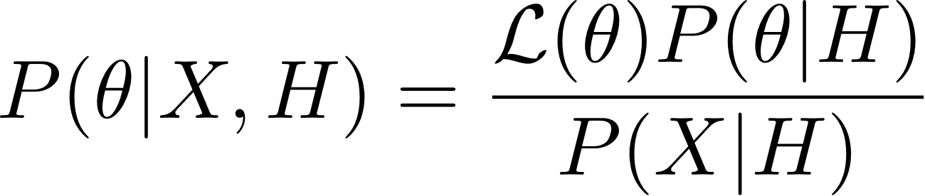
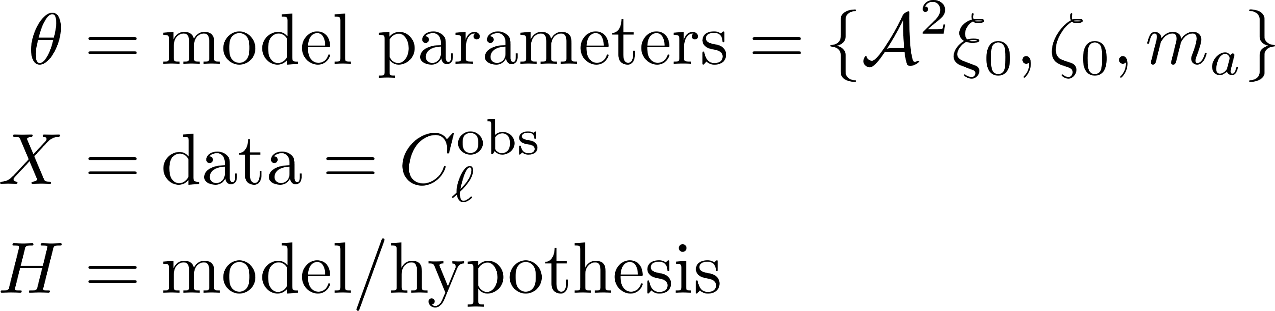
Bayesian inference
Introduction
Axion mass
Axion strings
Cosmic birefringence
Methodology
Loop crossing model
The signal
The data
Bayesian inference
likelihood
prior
posterior
“which parameters are most
favoured?”
evidence
amplitude radius mass

Slide 11
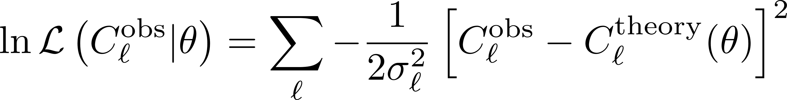
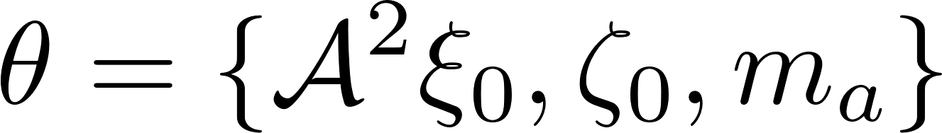
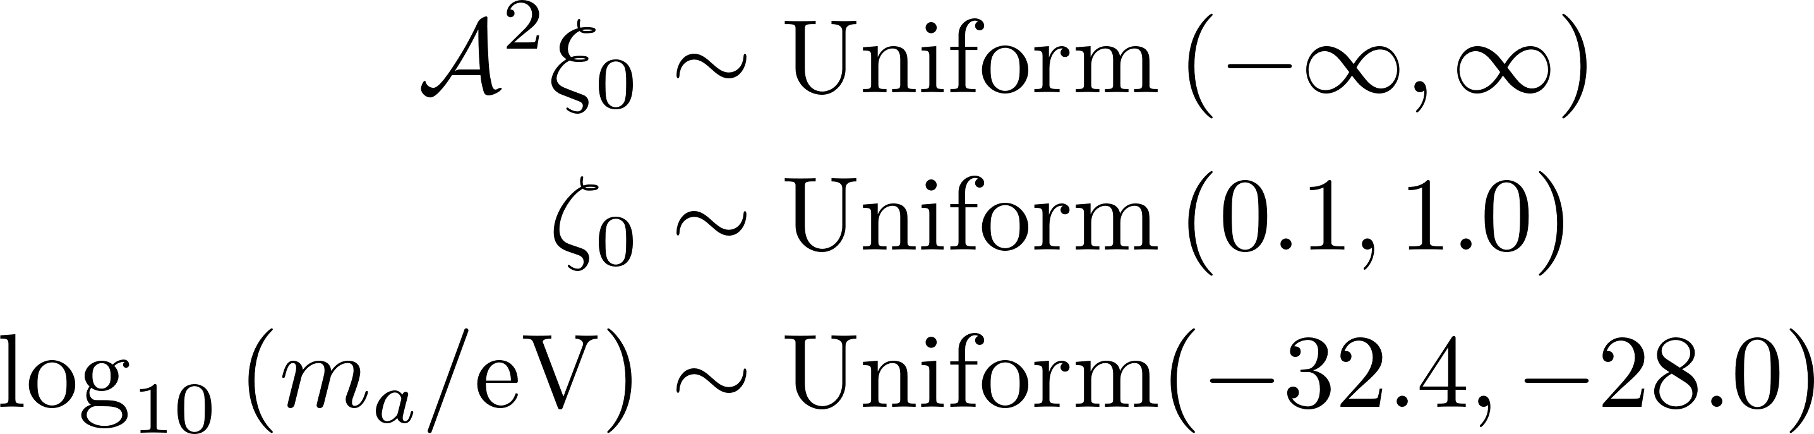
Bayesian inference
Introduction
Axion mass
Axion strings
Cosmic birefringence
Methodology
Loop crossing model
The signal
The data
Bayesian inference
Likelihood
Priors
We sampled the posterior using MCMC methods
Obtained parameter constraints

Slide 12
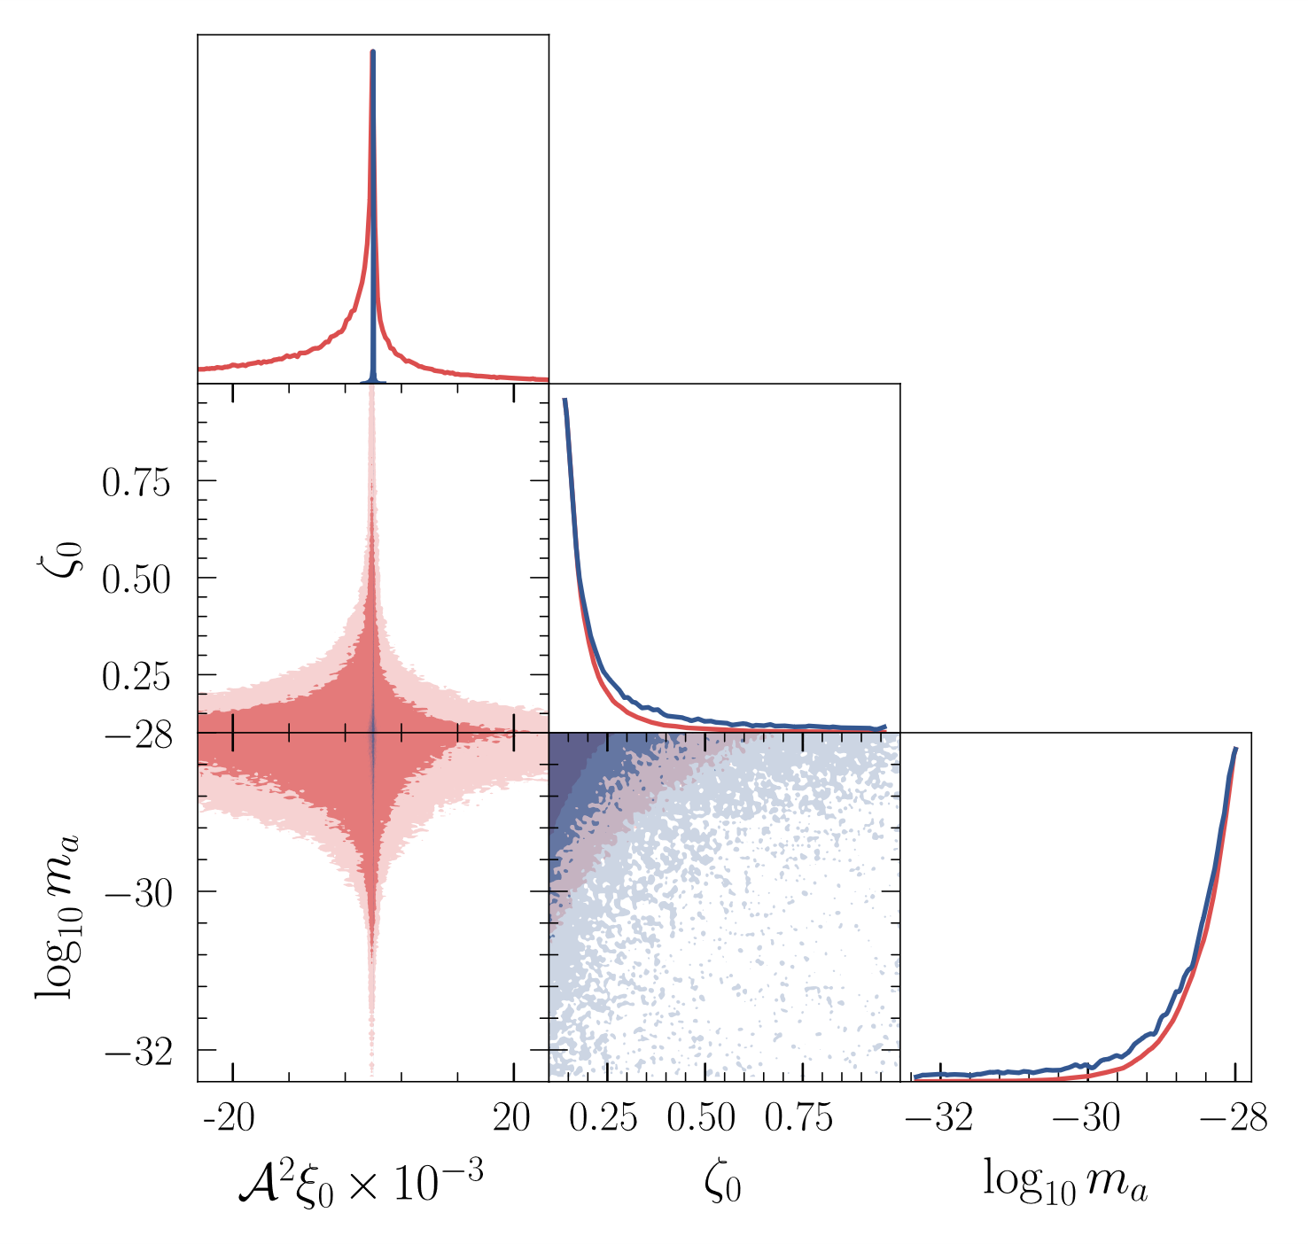

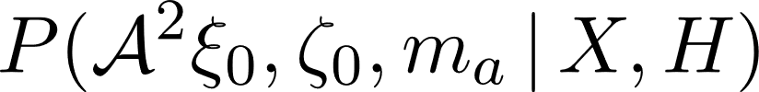






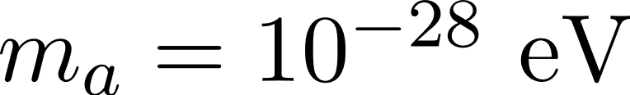
Planck, SPTpol posteriors with 68% and 95% CL contours
Introduction
Axion mass
Axion strings
Cosmic birefringence
Methodology
Loop crossing model
The signal
The data
Bayesian inference
Results
Planck and SPTpol
95% CL constraints on
Degeneracy direction at
Marginal posterior peaks at
upper bound
(consistent with no signal)
Model parameters:
= loop radius (in units of Hubble length)
= effective # of loops in Hubble vol.

Slide 13
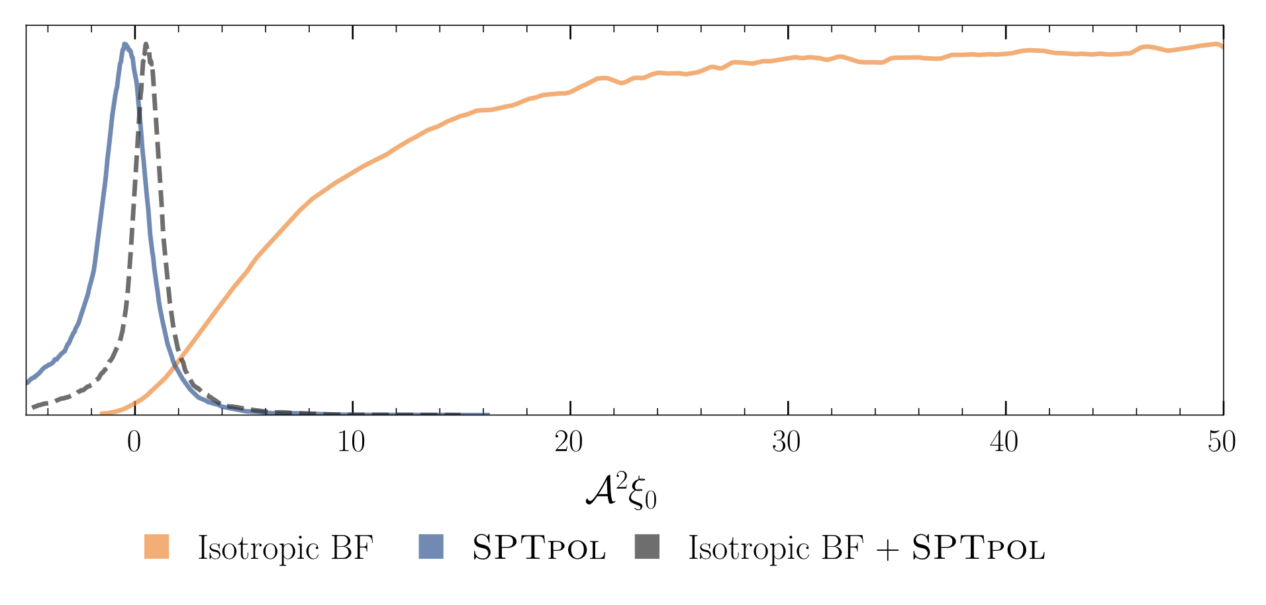
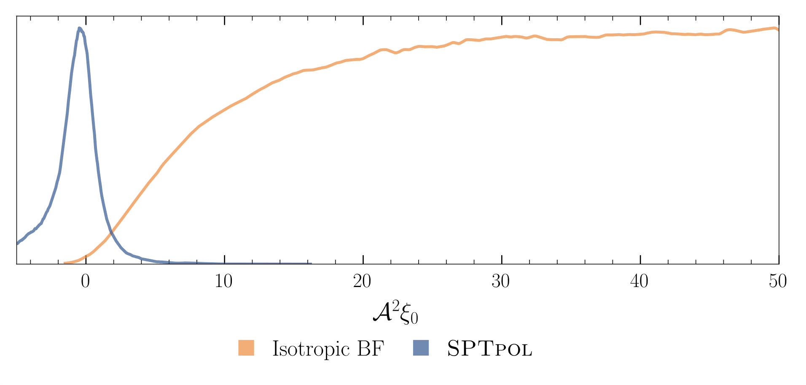

What about isotropic birefringence?
Introduction
Axion mass
Axion strings
Cosmic birefringence
Methodology
Loop crossing model
The signal
The data
Bayesian inference
Results
Planck and SPTpol
Isotropic birefringence
($α={{0.342}^{∘}}_{−{0.091}^{∘}}^{+{0.094}^{∘}}$)
Conclusion: The detection of isotropic bir. + the non-detection of anisotropic bir.
is difficult to explain with axion-strings.

Slide 14

Summary
Introduction
Axion mass
Axion strings
Cosmic birefringence
Methodology
Loop crossing model
The signal
The data
Bayesian inference
Results
Planck and SPTpol
Isotropic birefringence
Summary
Ultralight axions ($m_{a}{<10}^{−28} eV$) can form long-lived string networks and may rotate CMB photon polarization (cosmic birefringence.)
We used Bayesian methods to obtain constraints on axion string network parameters
We found that if axion strings can explain the detection of isotropic birefringence, then it is difficult for them to explain the absence of anisotropic birefringence.
Next steps
Study non-Gaussianity
Look for evidence of more ‘realistic’ axion network models
Ray-tracing of photons through axion network

Slide 15
DISTINGUISHING SOURCES OF B-MODES
Introduction
CMB & BSM physics
What is an axion string?
Cosmic birefringence
Axion signal
Birefringence data
Other sources of B-modes include:
Weak gravitational lensing
Leads to parity-conserving correlators; hence distinguishable from axion birefringence.
Primordial gravitational waves
In most models, PGWs conserve parity. However, even in models which induce parity-violating correlations. In this case the scale-dependence of correlators, and higher-order correlators could distinguish sources.
Faraday rotation
This effect is frequency-dependent, whereas axion birefringence is not.
Bayesian Inference
Bayes’ Theorem
Likelihoods & priors
Results
Planck 2018, SPTpol
Iso. bir. + SPTpol
Summary

Slide 16



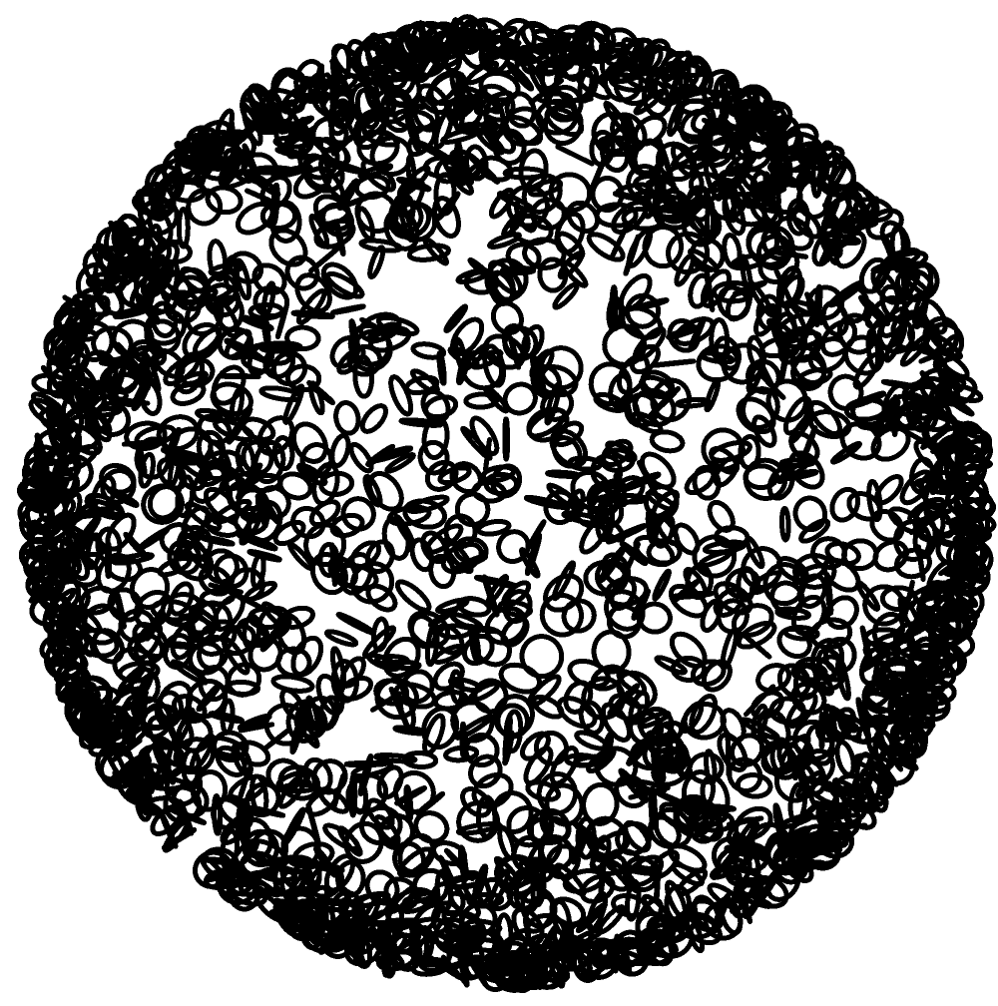
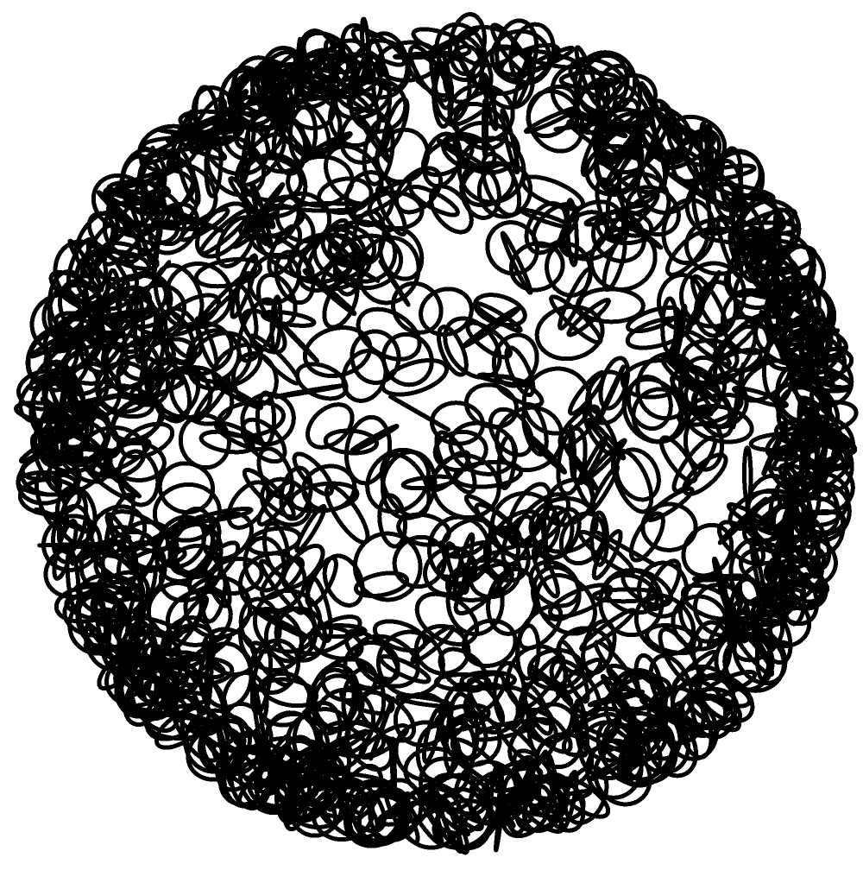
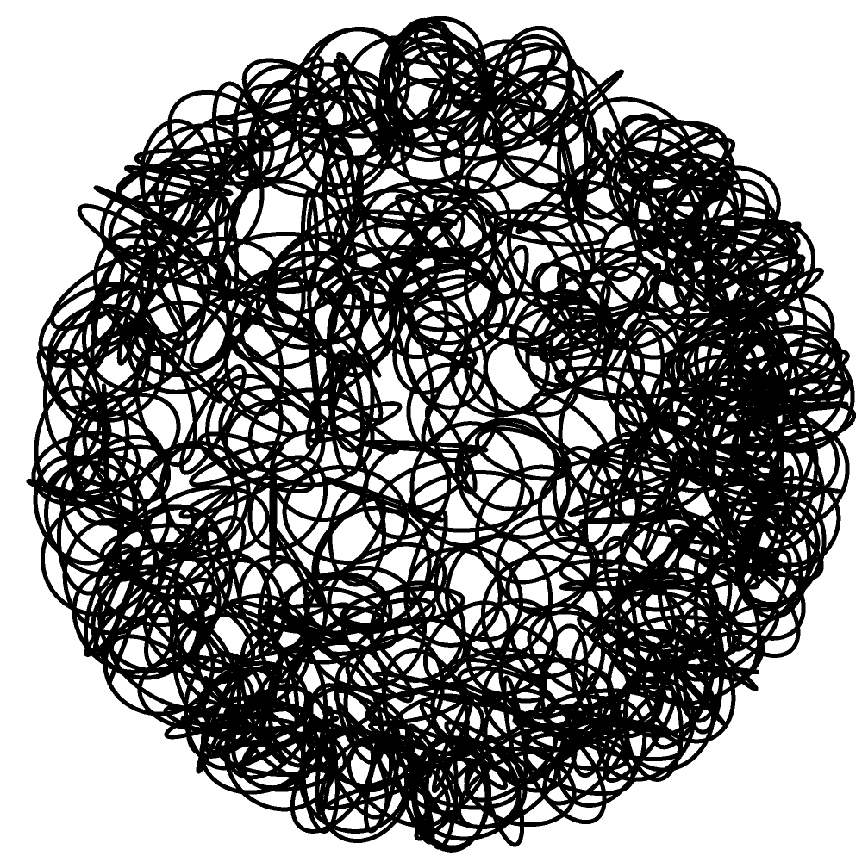


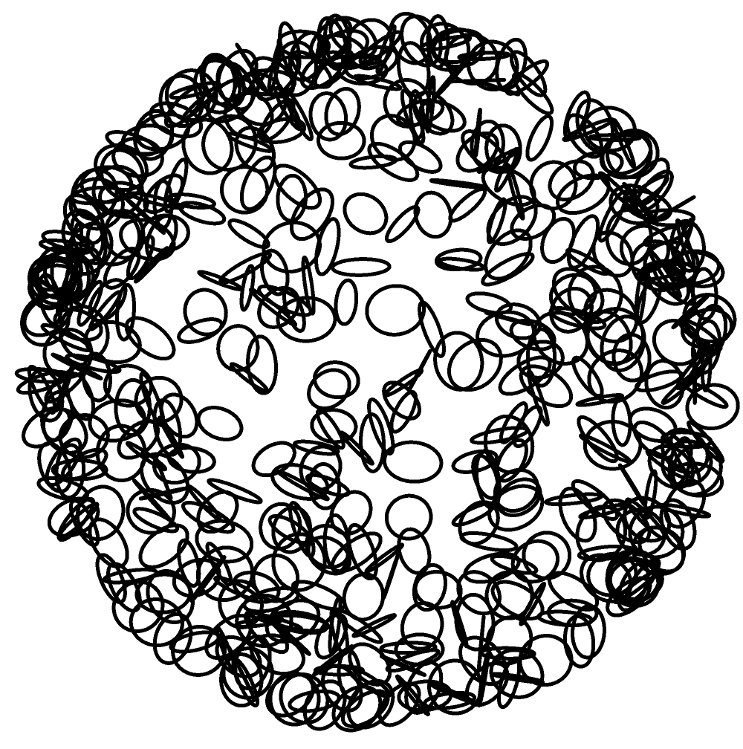
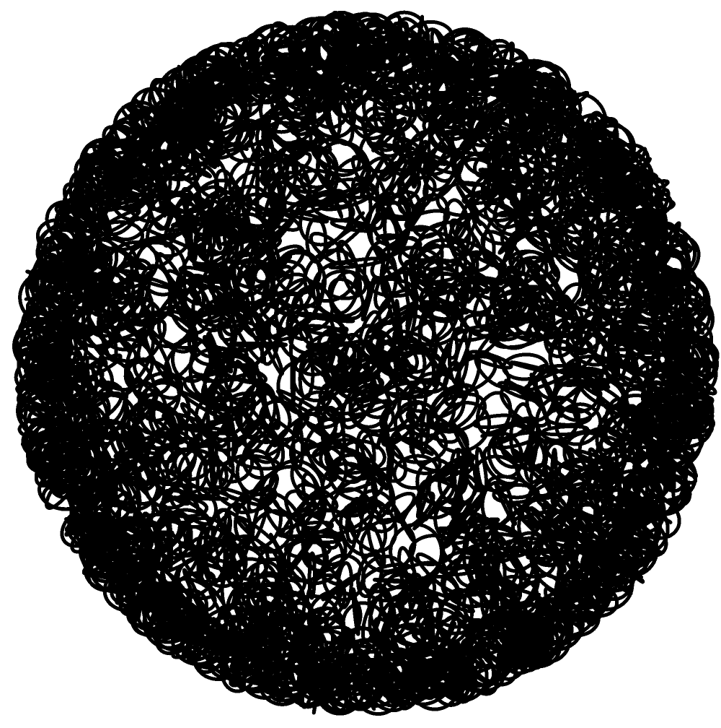
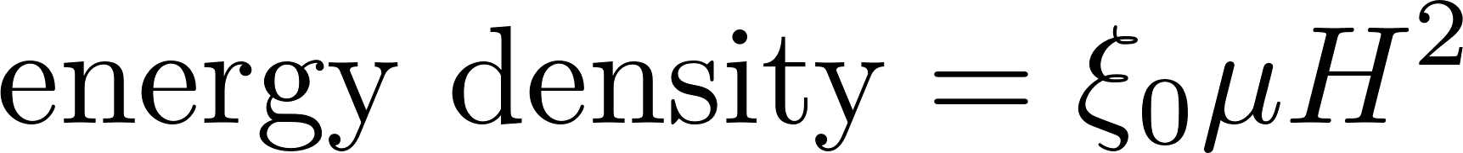
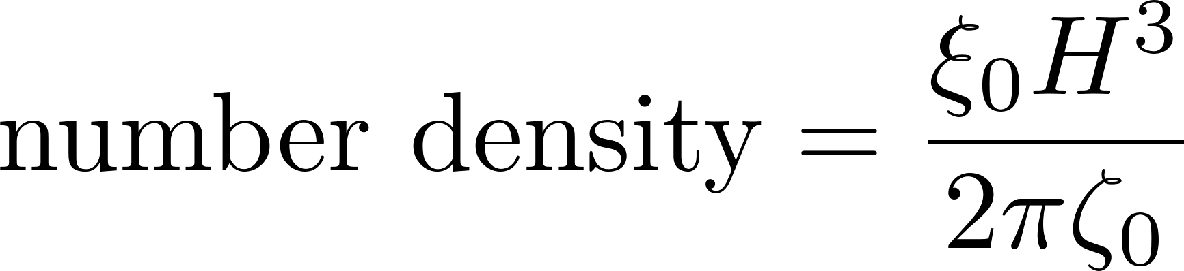
Model parameters

Slide 17
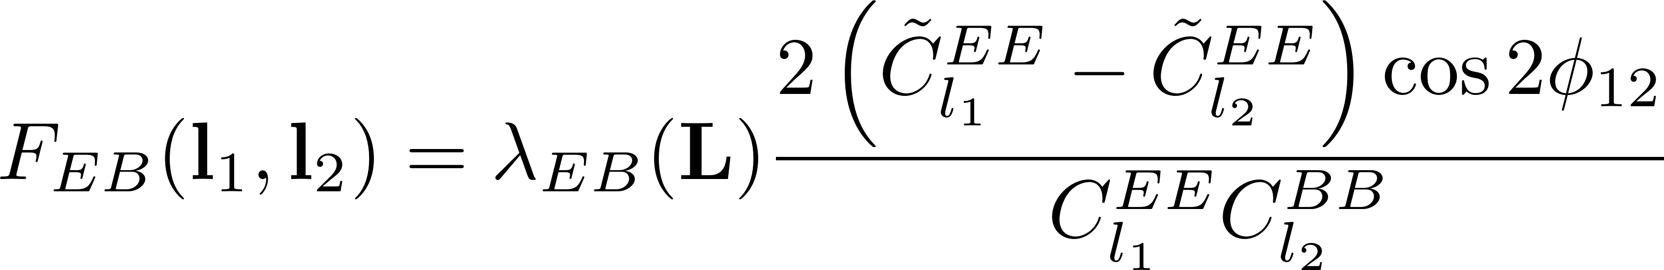
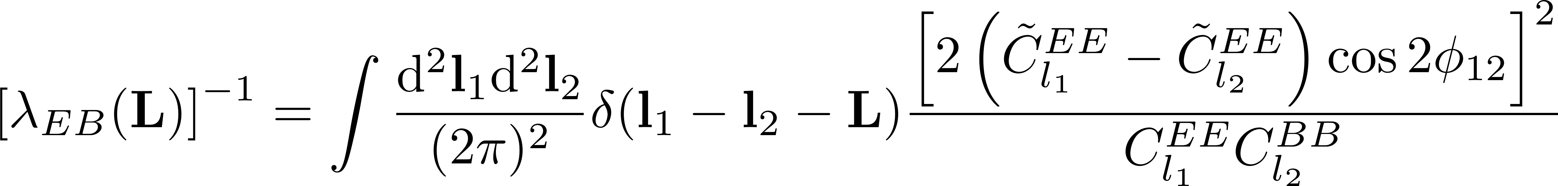

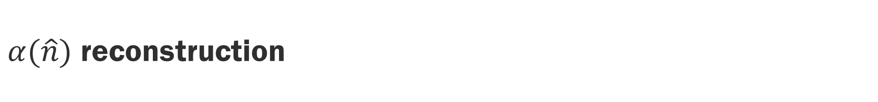
$α(\hat{n})$ reconstruction
E.g. can estimate using $E$ and $B$-mode measurements
(tildes denote primordial quantities (before birefringence)
Yin, Dai, Ferraro (arXiv:2111.12741)
17

Slide 18
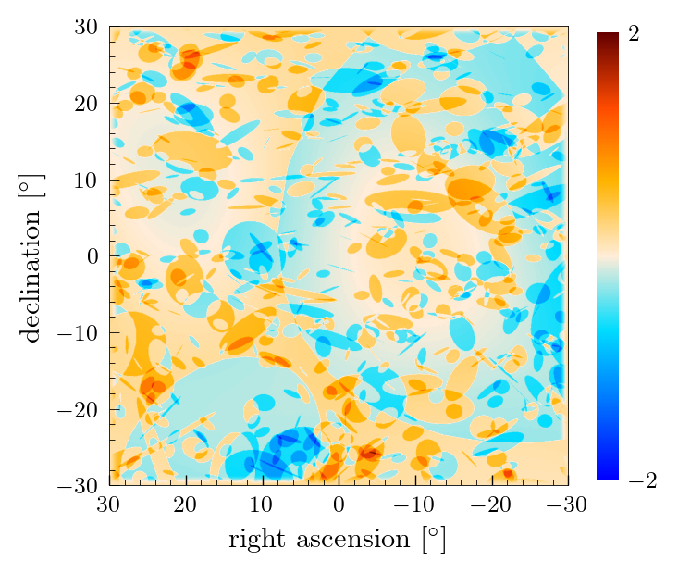
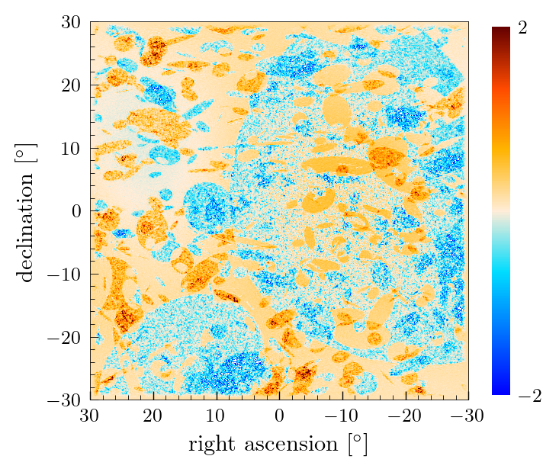
$α(\hat{n})$ reconstruction

Slide 19
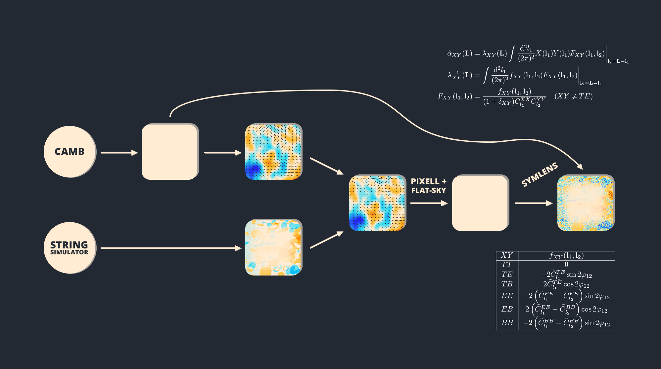
















QUADRATIC ESTIMATOR PIPELINE
PRIMORDIAL $T, Q, U$
$$C_{ℓ}^{TT}$$
$$C_{ℓ}^{TB}$$
$$C_{ℓ}^{TE}$$
$$C_{ℓ}^{EB}$$
$$C_{ℓ}^{EE}$$
$$C_{ℓ}^{BB}$$
ROTATED $T, Q, U$
$${\tilde{C}}_{ℓ}^{TT}$$
$${\tilde{C}}_{ℓ}^{TB}$$
$${\tilde{C}}_{ℓ}^{TE}$$
$${\hat{α}}_{XY}(L)$$
$${\tilde{C}}_{ℓ}^{EB}$$
$${\tilde{C}}_{ℓ}^{EE}$$
$${\tilde{C}}_{ℓ}^{BB}$$
$$α(\hat{n})$$

Slide 20
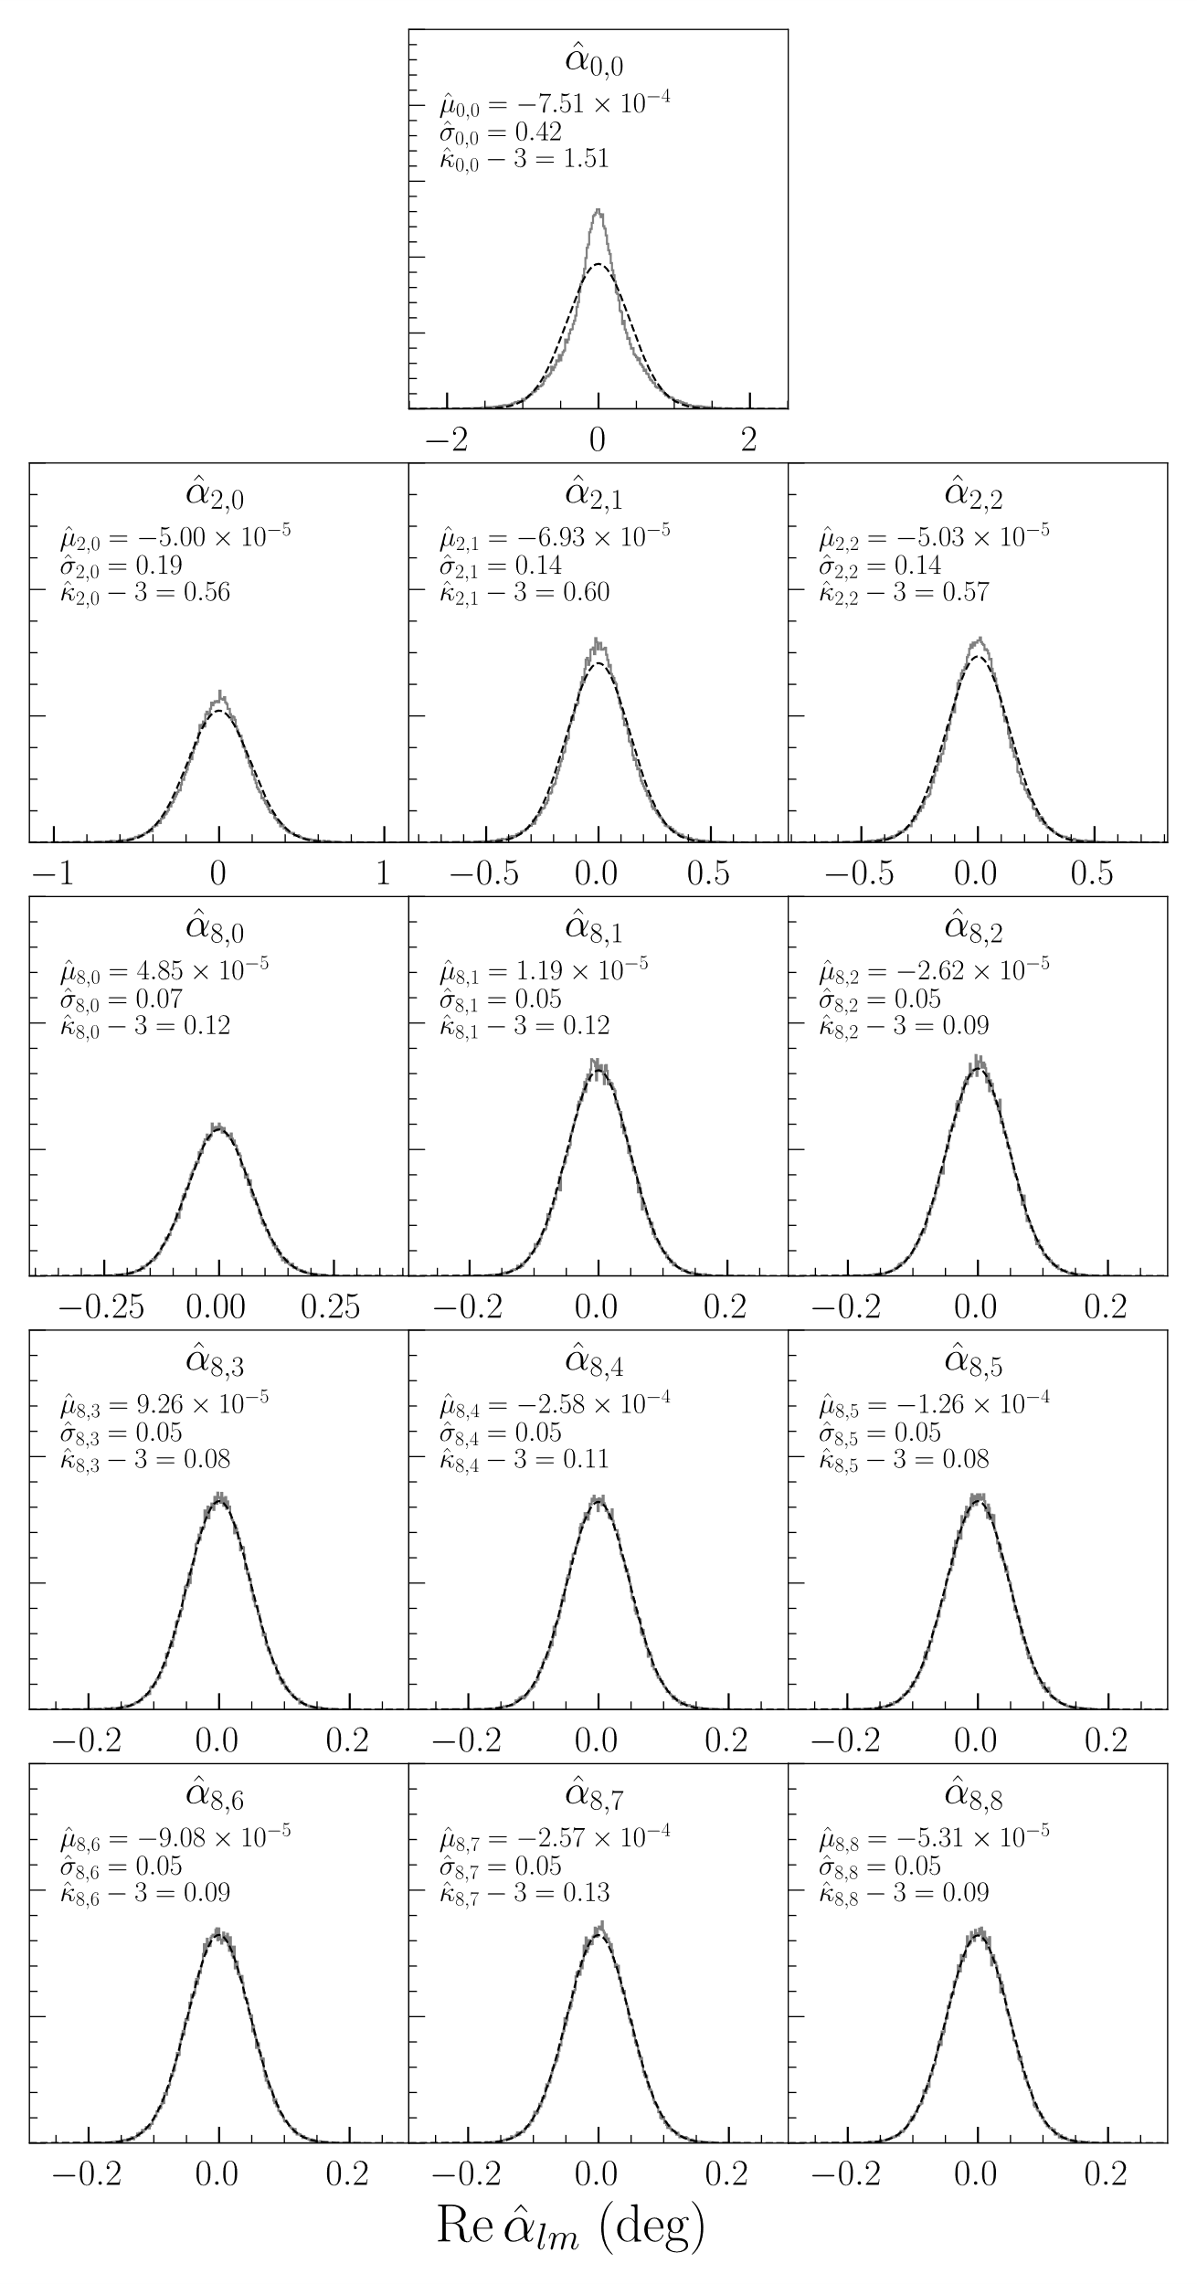
Non-gaussianity

