Slide 1

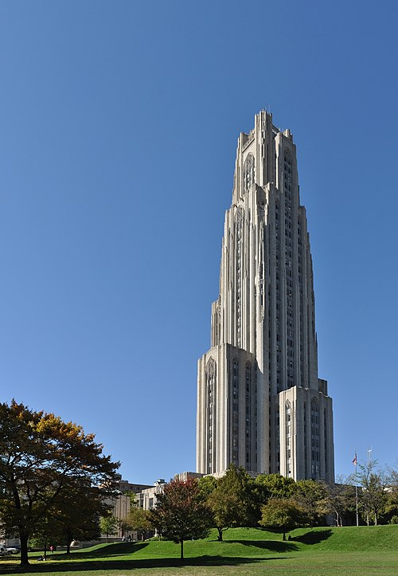



Perspective on Flavor Physics
May 9, 2023, PHENO @ U. Pittsburgh

Slide 2
Outline
0. Backdrop
“charge” & quotes
I. A Cry in the Wilderness
Caution on B-anomalies @ 2018 Rencontres du Vietnam
II. Response(s) to R_{K}(*) Disappearance
some fun
& Zip thru “my view for BSM”
III. Rehab of H⁺ for R_{D}(*) in G2HDM
not necessary
(w/o Z₂)
IV. G2HDM as Next New P hysics?

Slide 3
0. Backdrop
“the Charge”
“Seeing the K/D anomalies come and go, that has caused a lot of excitement as well as some confusion. Would you be willing to offer your perspectives on the current stand of flavor physics, of course in connection with your view for BSM.”
“Just, please try to engage
a broader audience.”
12/20 Nature News (LHCb Seminar @ CERN)
Although the latest result had been rumoured for months, its confirmation comes as a surprise, says Gino Isidori, a theoretical physicist at the University of Zurich who was at the CERN talk, because a coherent picture seemed to be emerging from related anomalies. This could have pointed to the existence of previously unseen elementary particles that affect the decay of B mesons. Isidori gives the LHCb collaboration credit for being “honest” in admitting that its previous analyses had problems, but he regrets that it took so long for the collaboration to find the issues.
M. Mangano (“the diplomat”), 12/20 CERN Courier
“That such anomalies could have been real shows how little we know about the deep origin of flavour symmetries and their relation with the Higgs, and highlights the key role of experimental guidance. ... The latest LHCb findings take nothing away from our mission to push further the boundary of our knowledge, and the search for anomalies goes on!”

Slide 4
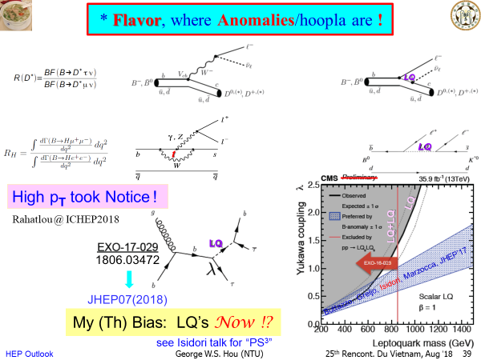

I. A Cry in the Wilderness
Hiller & Krüger 2004
LeptoQuark
Rencontres du
Vietnam, 2018
“Pati-Salam³”

Slide 5
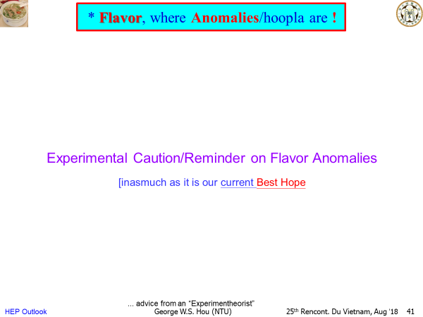
A Cry in the Wilderness

Slide 6
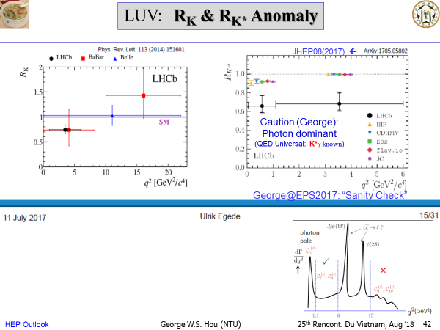
A Cry in the Wilderness
Seemingly
Impressive
@ EPS-HEP 2017
George @ EPS2017, Venezia
“I’ll betcha the plan was to demonstrate
Universal behavior for low bin, making
high bin, together with R_{K}, convincing!”
But …

Slide 7

A Cry in the Wilderness
real?
@ EPS-HEP 2017
R_{K} ~ 0.745 @ ‒ 2.6σ, 1.0 ‒ 6.0 GeV²
R_{K*} ~ 0.66 @ ‒ 2.2σ, 0.045 ‒ 1.1 GeV²
R_{K*} ~ 0.69 @ ‒ 2.4σ, 1.1 ‒ 6.0 GeV²
“Systematic
effect?”
Occam’s razor
A Simpler, Common Cause !?

Slide 8
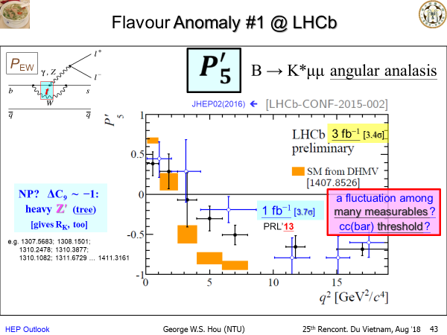
A Cry in the Wilderness
Will see …
Not Good, Not Bad … Not Too Good …
Significance did not improve. [3.7σ → 3.4σ]

Slide 9
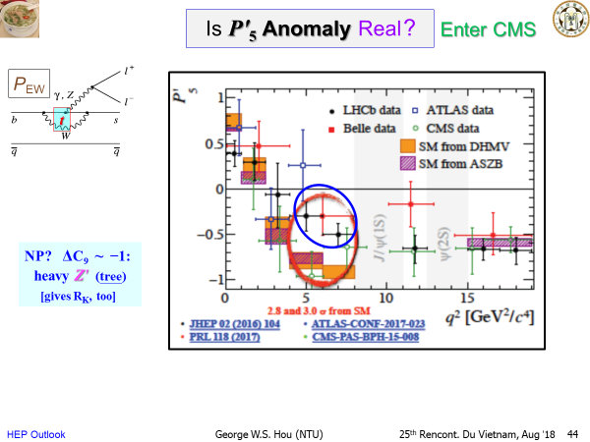
A Cry in the Wilderness
Consistent
w/ SM !
1710.02846 (PLB’18)

Slide 10
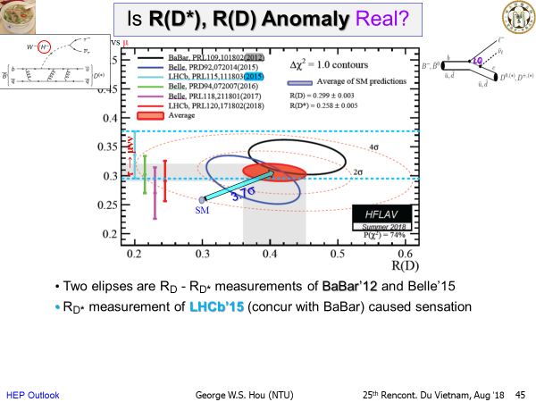
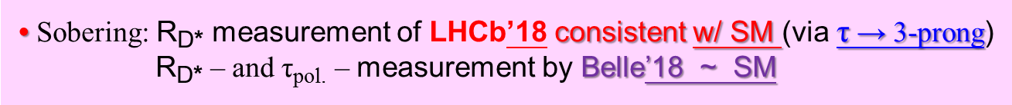
A Cry in the Wilderness
Theorists
went
wild !
τ → πππν

Slide 11
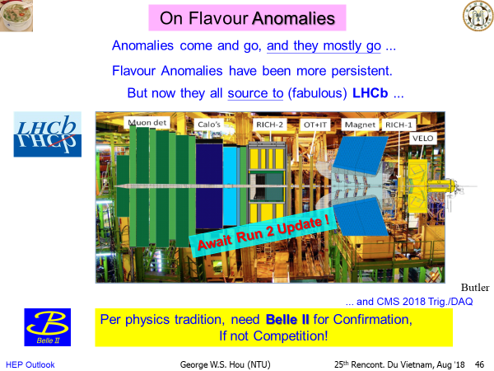
A Cry in the Wilderness
Rencontres du
Vietnam, 2018
Until 12/20 talk by Renato Quagliani at CERN

Slide 12
R_{K}, R_{K*} Evaporated
Isidori:
“Not all is lost.”
But Not Gone.
3.2σ
Belle II

Slide 13
II. Response(s) to R_{K}(*) Disappearance
(1) Hadronic Effect
been saying
so for ages
hadronic
rescattering
2212.10516 (12/20)
cuts

Slide 14
Response(s) to R_{K}(*) Disappearance
(2) “Die-Hard”
Add
CPV-LUV
Enlarged Space !
despite
R_{K}(*) = 1
2303.08764

Slide 15
Response(s) to R_{K}(*) Disappearance
(3) Defiant
Also Greljo et al., 2212.10497 (12/20)
2211.11766 [v4]

Slide 16
Response(s) to R_{K}(*) Disappearance
(4) LUV gauge int.
But I’ll follow
a different path.
Gino means it.
UV completion
2303.01520v3

Slide 17

Response(s) to R_{K}(*) Disappearance
(5) Everything
Everywhere
All at Once
Learn all the Anomalies here, if that’s your creed.
8th Symposium on Prospects in the Physics of Discrete Symmetries (DISCRETE 2022)
7-11 November 2022
Baden-Baden, Germany
2304.01694

Slide 18
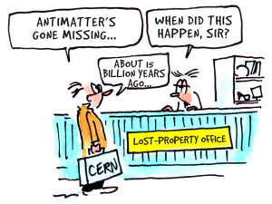


Whither Extra Yukawas?
Known CPV in CKM ➔ Yukawa’s. Extra Yukawa’s ?
my view for BSM
Jarlskog Invariant way too small !
Killed by Z₂ (Glashow-Weinberg 1977)
Natural Flavor Conservation (NFC)
Baryon
Asymmetry
of
Universe
2012⁺: One Higgs ➔ 2nd Higgs
Highly Plausible !
PLB’13
PLB’92
1% Still Possible !!
c_{γ}
Before Top Quark was Discovered: WSH, PLB’92 (PSI-PR-91-34)
An Experimental Issue
ρ_{cc} ρ_{ct}
ρ_{tc} ρ_{tt}
H⁺
H + i A
FCNH modulated by h‒H mixing
→ Alignment overtakes Glashow-Weinberg NFC
Extra Yukawas
c_{γ} small

Slide 19
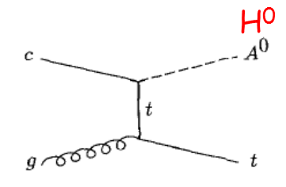
* top-Higgs? → “Flavored” Higgs → SM2 (?)
2HDM (w/o Z₂)
EW BaryoGenesis
• EWBG Remarkably Efficient w/
N.B. O(1) modulo flavor org. (of SM): much smaller Yuk. involving lower gen.
Fuyuto, WSH, Senaha, 5’17 (PLB’18)
Higgs quartics η_{i}
New Yukawa ρ_{tt} [and ρ_{tc}
O(1)
•
Much New FPCP Pheno
most modulo c_{γ} a better substitute for NFC
• Approx. Alignment for O(1) Higgs quartics
- mild tuning (1/4) ➔ Extreme Alignment
- mild Alignment (c_{γ} = ‒ 0.2) ➔ lower m_{h} by level repulsion
- sub-TeV H⁰, A⁰, H⁺ preferred ➔ rethink LHC Search
← w/o or w/ Z₂ !
WSH, Kikuchi, 6’17 (EPL’18)
H⁺
H + i A
ρ_{tc}
Discover @ LHC !?
- NOT SUSY !
- Touch EWBG ! [need CPV probe
- Another Energy Layer guaranteed ! [by Landau pole
cg → tH⁰/A⁰ → ttc(bar), ttt(bar)
Kohda, Modak, WSH, 10’17 (PLB’18)

Slide 20
III. Rehab of H⁺ for R_{D}(*) in G2HDM
G2HDM = General 2HDM = 2HDM w/o Z₂
So has extra Yukawa
3.2σ
Isidori:
“Not all is lost.”
Not Gone

Slide 21
Rehab of H⁺ for R_{D}(*) in G2HDM
not necessary
“G2HDM” offered some earliest explanation:
e.g. Crivellin, Greub, Kokulu, PRD’12
Celis, Jung, Li & Pich, JHEP’13
G2HDM = General 2HDM = 2HDM w/o Z₂
So has extra Yukawa
See e.g. also 2202.10468, 2302.08935
but ruled out by B_{c} lifetime argument:
Alonso, Grinstein, Martin Camalich, PRL’17.
2201.06565 (PRD’22)
1612.06676 (PRL’17): BR(B_{c} → τν) < 30%
1708.04072 (PRD’17): BR(B_{c} → τν) < 10%
1811.09603 (PRD’19): BR(B_{c} → τν) < 60%
(Blanke et al.)
→ 1708. underestimate m_{c} uncertainty and
b → B_{c} fragmentation;
2105.02988 (JHEP’21) affirm (63%).
(Aebischer-Grinstein)
2212.07233 (PRD’23)
These two papers use over-simplified, unrealistic
extra Yukawa matrices, but illustrates G2HDM is
Rehabilitated for R_{D}(*).
Exp’t may further evolve.
N.B. Please let Nature decide on ρ_{ij} values.

Slide 22
IV. G2HDM (w/o Z₂) as Next New P hysics?
“Just, please try to engage
a broader audience.”
Glimpse from a TW Flagship Project
Flavor, Mass, Higgs
Heavens & Earth: EWBG & eEDM
2017 a Good Year
→ Fruition in 2023 …
New Higgs/Flavor Era

Slide 23
Glimpse from a TW Flagship Project
Report at ASP Annual Meeting
Quite
Hear all
about it !
Really
Chin.J.Phys.
ASP = Academic
Summit Project
4

Slide 24
“Flavor ”
m_{e}
ASP Origins

Slide 25
“Flavor ”
m_{e}
G
Goldstone
Boson
(“eaten”)

Slide 26
JHEP’21
g ≃ 2m_{V}/υ
ca. 2015
λ_{f} ≃ √2 m_{f} /υ
t/b/τ: 2018
μ: 2020
Fantastic !
m_{e}?

Slide 27
B illions
&
billions of stars …
all burning protons
le Raison d'être
Where have all the Antimatter Gone?
BAU: an issue as Big as the Universe.
JILA ’22

Slide 28
Our Life & Times
h(125) ✔ New Physics ✘
EWBG ought to be pursued while LHC is still running!
No SUSY , No Nothin’ !
Beyond CKM CPV
EW BaryoGenesis (EWBG)
- more testable -
tension
LHC
- N o N ew P hysics -
Fuyuto, WSH, Senaha, PRD 101 (2020) 011901(R)
tension
competition
JILA’22
0.41
e EDM: ACME14 → ACME18
- L.E. Precision Frontier -
|d_{e}| < 1.1 x 10^{‒29} e cm
A Natural Cancellation Mechanism !
4

Slide 29
Zooming in …
ad hoc
so, the ρ_{ij}s
G2HDM
forward looking NSTC !
Thanks.
TW Funding
Agency
4

Slide 30

First
Fruit
ρ_{tc} c_{γ}
“alignment”
c_{γ} small
c_{γ}: h-H mixing
h
emergent
Extra Higgs Doublet w/
Extra Yukawa Couplings
Extra Quartic Couplings
c
H⁺
H + i A
General 2HDM
Before Top Quark was Discovered: WSH, PLB’92 (PSI-PR-91-34)
Correction on formulation with “SM”-like Higgs h: Chen, WSH, Kao, Kohda, PLB’13
NTUCMS Group
World Best Bound:
t → ch < 0.00073

Slide 31
Explaining
BAU
H⁺
H + i A
Fit for LHC
Production
Processes
unsuppressed
by alignment
ρ_{tc}
ATLAS-CONF-2022-039 (ICHEP)
Search Started 2/2020.
Fruition 2023 !
Can’t tell you …
4

Slide 32
2nd ASP 8/2021 – 7/2026
Finite Chance for Discovery !
Extra Higgs Doublet w/
Extra Yukawa Couplings
& Extra Quartic Couplings
Decadal Mission of New Higgs/Flavor Era
54 extra flavor param.
& 7 add’l Higgs param.
TeV
CMS: H, A, H⁺ search @ LHC
Belle II: τ → μγ; B → μν, τν; ττ, τμ
CMS: B_{s,d} → μμ
Lattice: Higgs Potential
Steering: Pheno 粒子現象學
Kai-Feng (Jack) Chen
Paoti Chang
Sub-TeV
1st EWPT
David C.J. Lin
(NYCU)
υ
Landau Pole
Alex Pomarol
Wish us Luck !

Slide 33
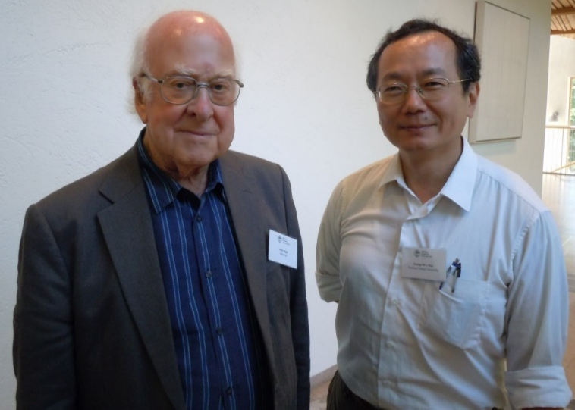
Up to Nature whether our “ Wish for Discovery ” is Granted … or Not …
Thank You !
a Higgs, and a 2nd Higgs ...

Slide 34
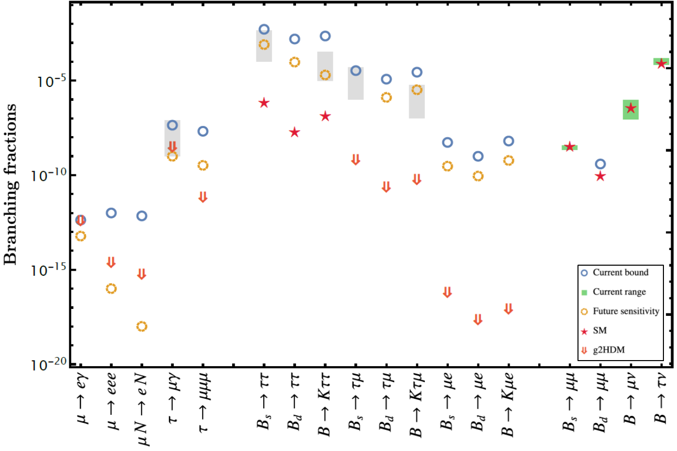
Glimpse of coming New Flavor Era in G2HDM
μ & τFV (Flav.Viol.)
in B decay
~ eEDM diagrams
5 Grey boxes: Astounding BSM via
“LQ ” from B-Anom.
R_{K}, R_{K*} nullified
g2HDM-SM interference
ρ_{μe}
LHCb
LHCb
What hides H, A, H⁺ effects so well from our view ?
PRD’20
“Know” SM Hierarchy !
eEDM
cancel.
b → sγ
2302.08847
Much more promising if
muon g-2 is harbinger
general 2HDM
WSH&Kumar, PRD’20
Belle II
EPJC’21
Belle II
LHCb
Belle/II
CMS

