Slide 1



Neutron Star Heating with Inelastic Dark Matter
Mehrdad Phoroutan-Mehr
Based on:
Gerardo Alvarez, Aniket Joglekar, Mehrdad Phoroutan-Mehr, Hai-Bo Yu, arxiv: 2301.08767 (PRD)

Slide 2
Outline
Introduction
Dark Matter Capture in Neutron Stars
Results

Slide 3
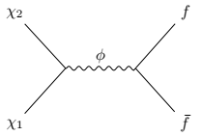
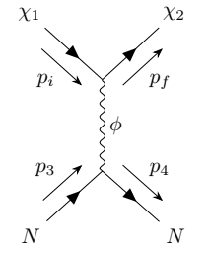
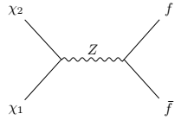
Theory of Inelastic Dark Matter Physics
time
Two species of dark matter particles with a mass gap.
It carries its own force.
Its mediator couples to the standard model particles.
This model predicts novel phenomenology, coannihilation in the early universe, and unusual spectrum in dark matter direct detection.
time
coannihilation
time
Scattering
coannihilation

Slide 4
As astrophysical objects move within the DM halo, they sweep DM particles along their path.
Gravitational forces accelerate DM particles toward these objects.
If the particles lose enough kinetic energy, they become captured.
The captured DM particles can contribute to neutrino emission, leading to the formation of black holes within the objects, and increasing their temperatures.
The temperature increase occurs through the deposition of DM kinetic energy into the objects and via DM annihilation.
Neutron stars could accelerate DM particles to relativistic velocities. They could deposit their kinetic energy into neutron stars and heat them up.
Neutron stars are an ideal target for studying inelastic DM because they can accelerate infalling DM to relativistic velocities.
Astrophysical Objects Can Capture Dark Matter

Slide 5
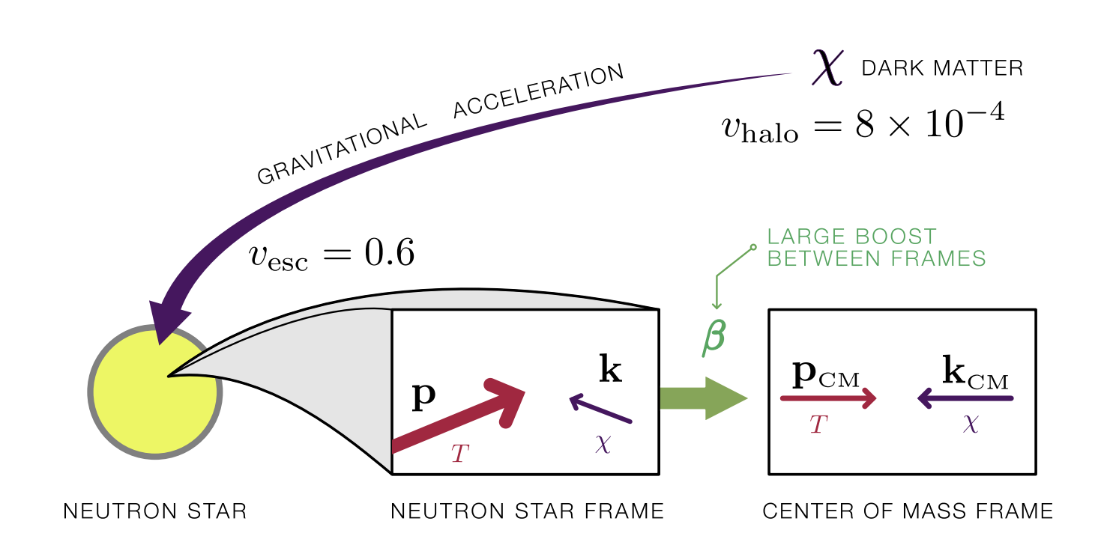





Temperature Estimation
Joglekar, Raj, Tanedo, Yu 2020

Slide 6
The study of neutron star capture is complicated
The scattering is inelastic.
The electron targets are ultra-relativistic, while the infalling DM is relativistic.
The target rest frame is different from the neutron star rest frame.
The mass of the electron is less than the Fermi momentum.

Slide 7
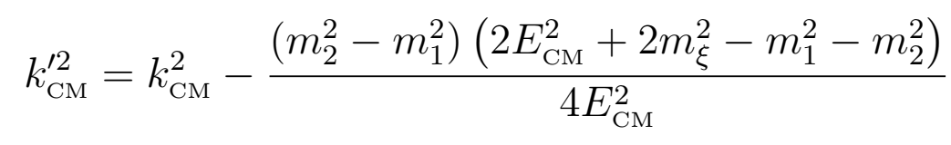
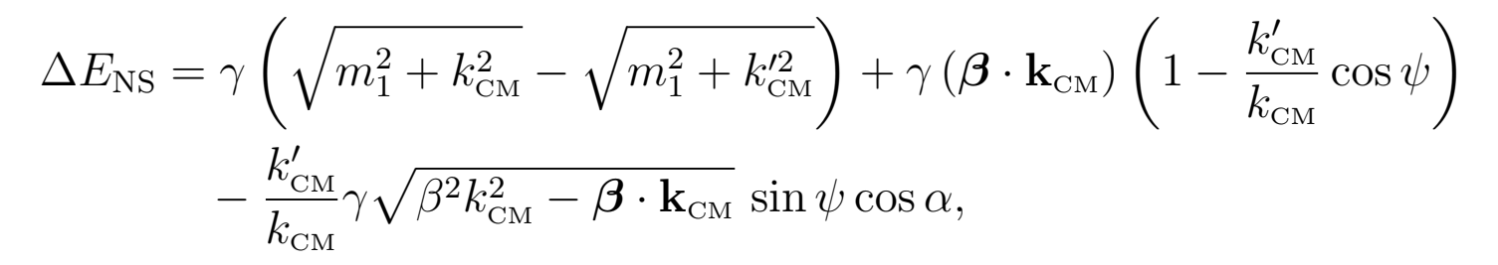












Mas Gap

Slide 8


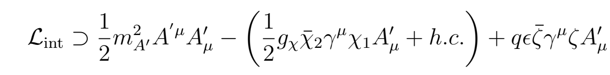
Capture Probability
Number of Scattering
Particle Model
Fermi Energy Condition
Escape Condition
Effective Vector-Vector Operator
Models
Vector Mediator
Kinetic Mixing Model

Slide 9
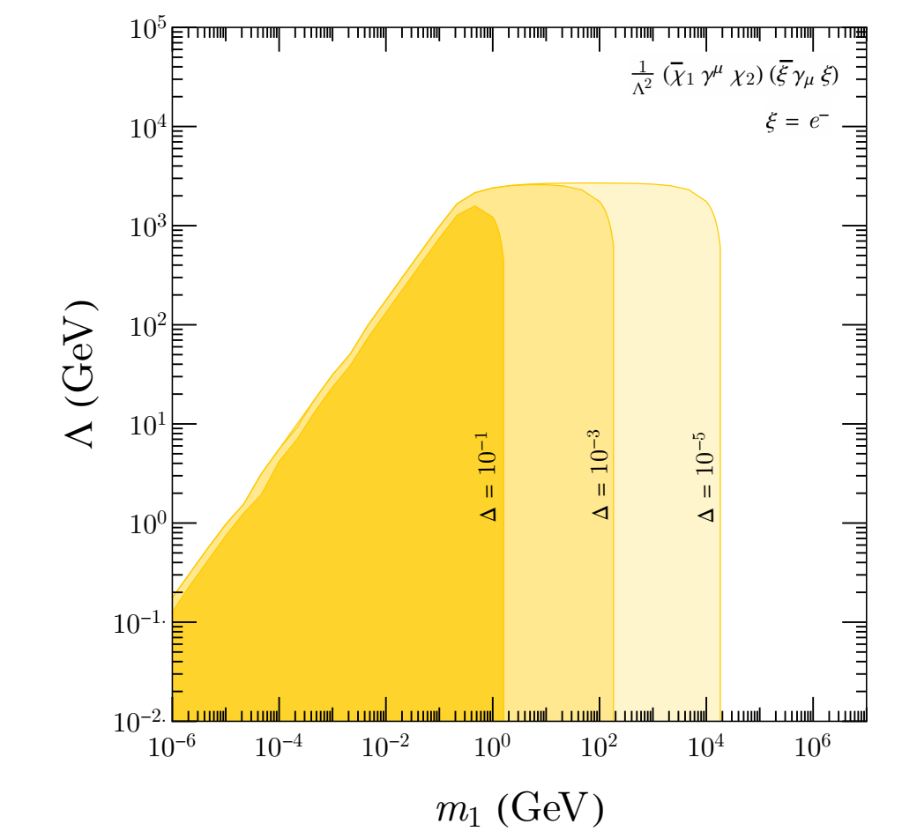
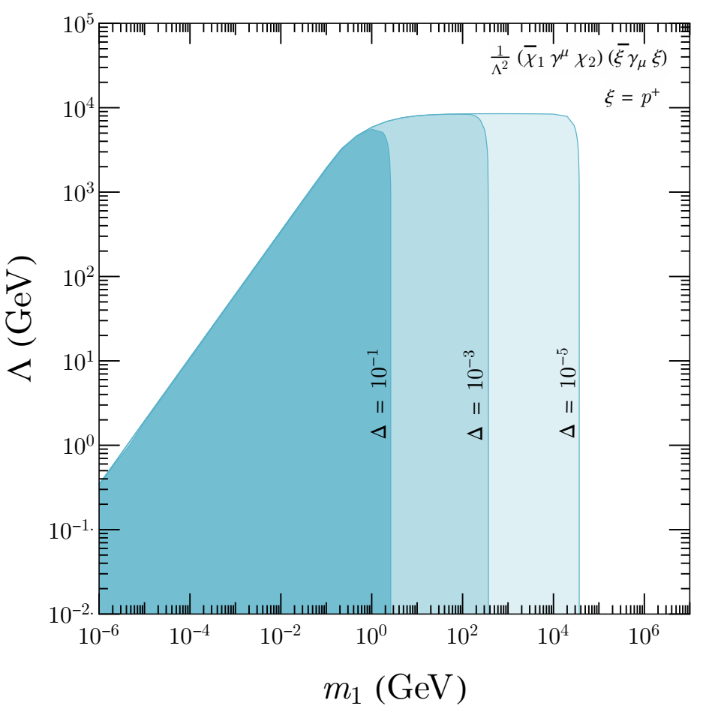

Effective Vector-Vector Operator

Slide 10
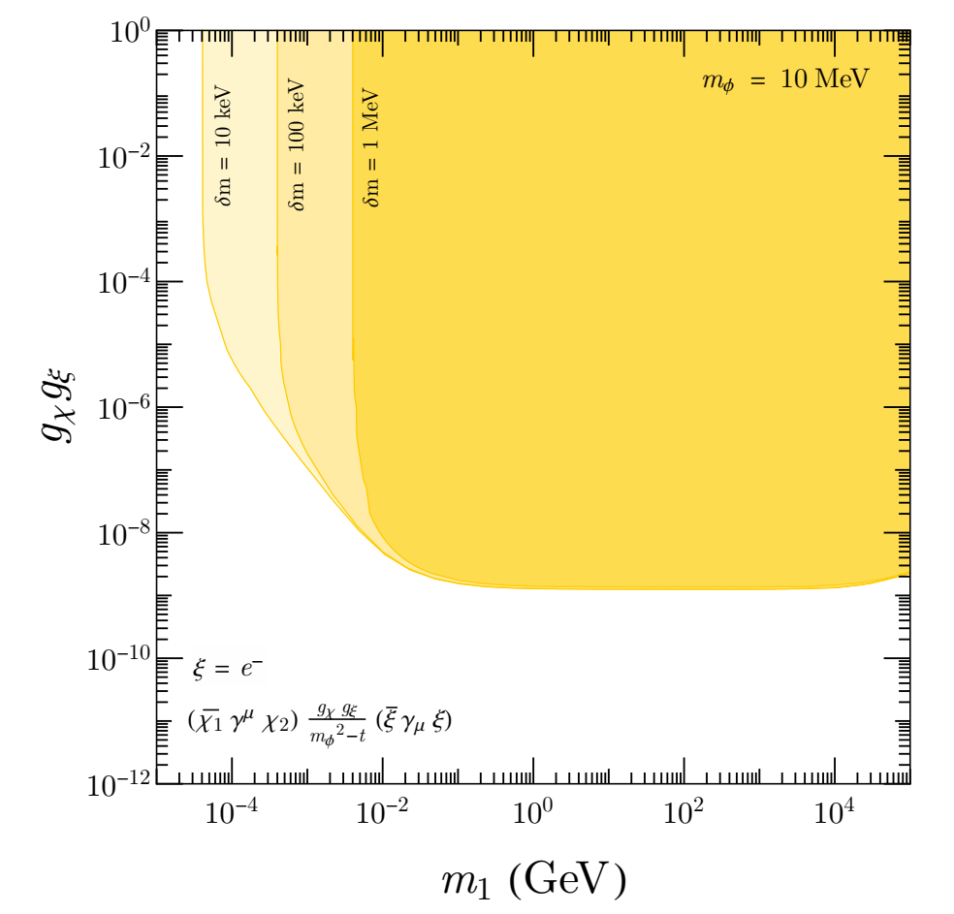
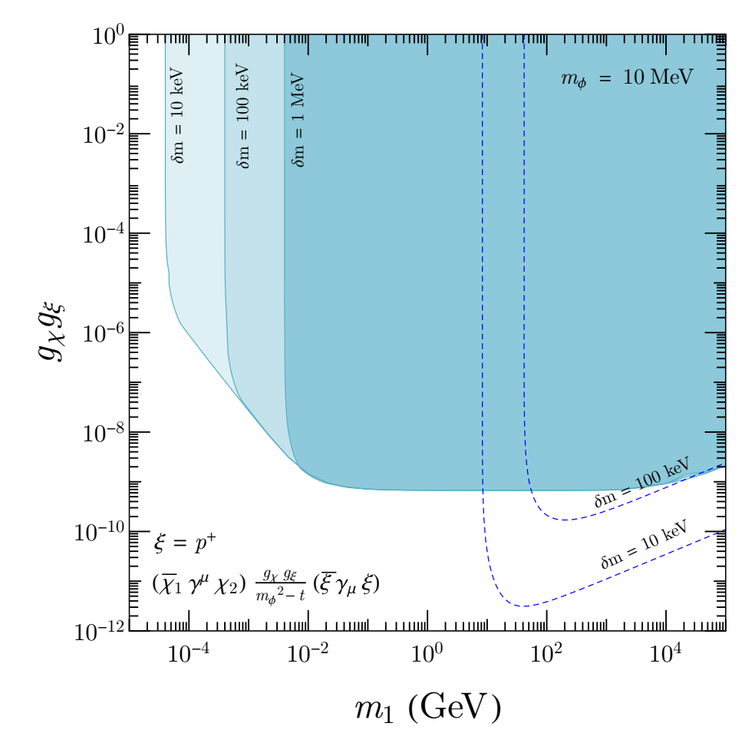
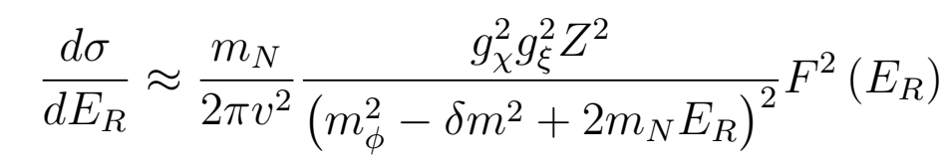
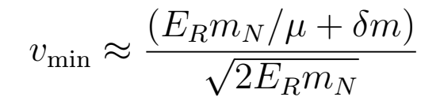
Vector Mediator

Slide 11
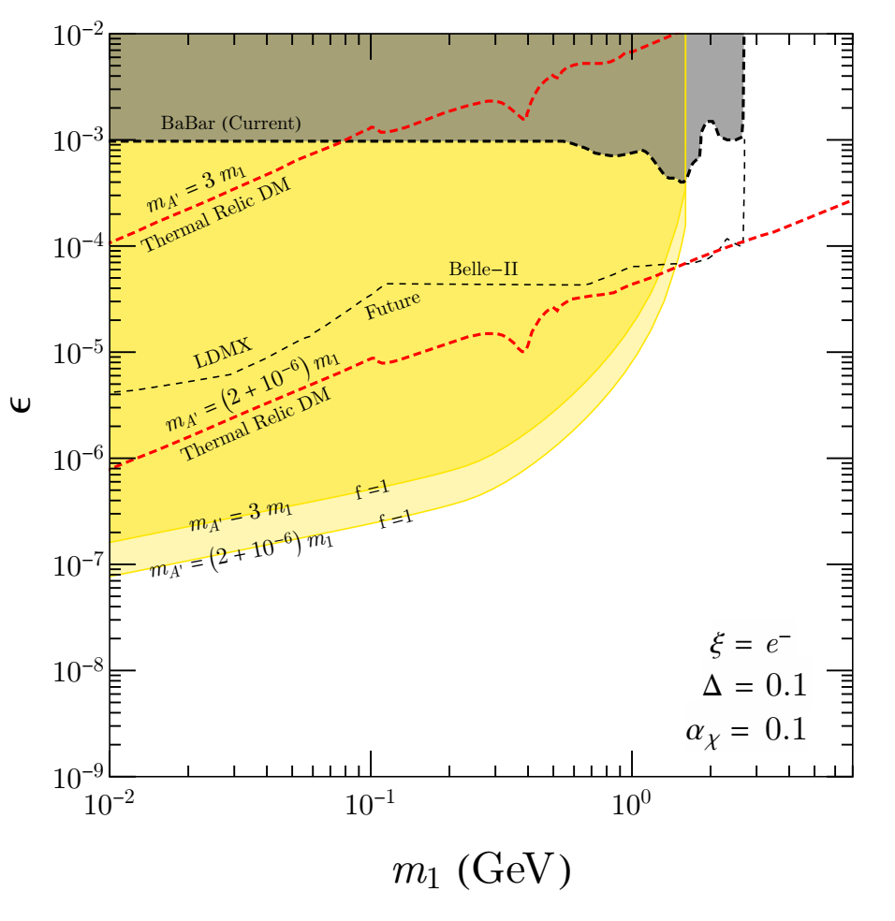
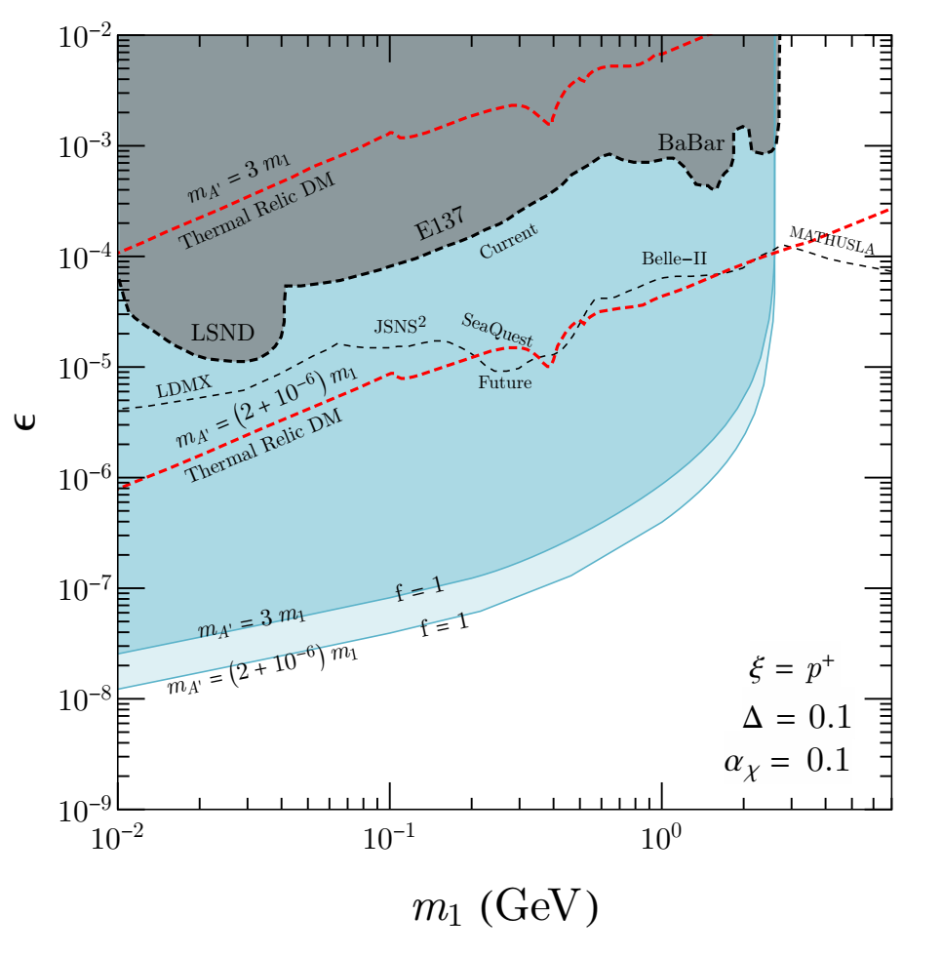


Kinetic Mixing Model

Slide 12
Summary and Outlook
The capture of relativistic Dark Matter by ultra-relativistic electrons in neutron stars requires a somewhat complicated formalism.
Neutron stars are highly efficient targets for studying inelastic dark matter.
The bounds on parameter space provided by neutron stars are stronger than those from direct detection, relic abundance, and accelerator experiments.

Slide 13
Thank You

