Slide 1


Molecular Migdal Effects
Ian Harris
University of Illinois at Urbana-Champaign
May 8, 2023
Yoni Kahn, Carlos Blanco, Jésus Pérez Ríos, Benjamin Lillard
arXiv: 2208.09002, PRD 106, 115015
Yoni Kahn, Carlos Blanco, Anirudh Prabhu
arXiv: 23xx.xxxxx

Slide 2
Outline
Introduction
Migdal Effect
Diatomic Molecules
  Excitation
  Ionization
Results

Slide 3
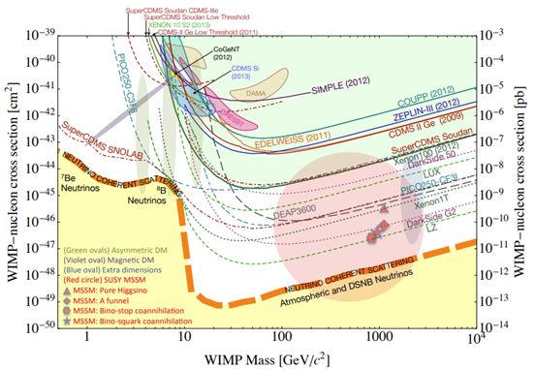
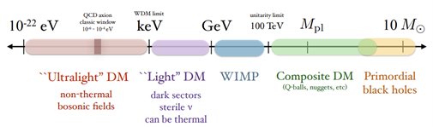
Dark Matter
27% of the universe
(Very) wide range of masses predicted¹:
Shifting focus from WIMPs to Light DM²
¹Lin; arXiv:1904.07915v1
²Bauer and Plehn; arXiv:1705.01987v2

Slide 4
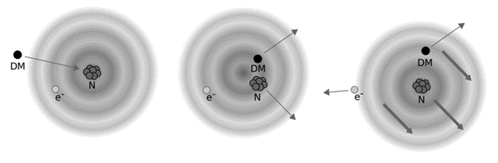
Migdal Effect
Particle-nucleus scattering
  Momentum transfer displaces nucleus, induces electron transition probability
Electron can be emitted or transition to a higher energy state
  (Usually) need to determine initial, final wavefunctions
³Dolan, Kahlhoefer, McCabe; arXiv:1711.09906v2

Slide 5
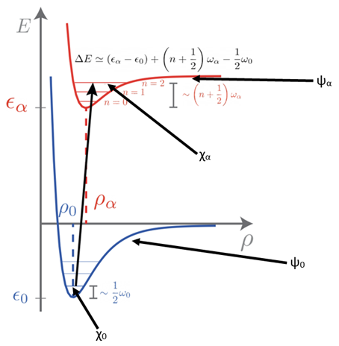
Born-Oppenheimer Approximation

Slide 6
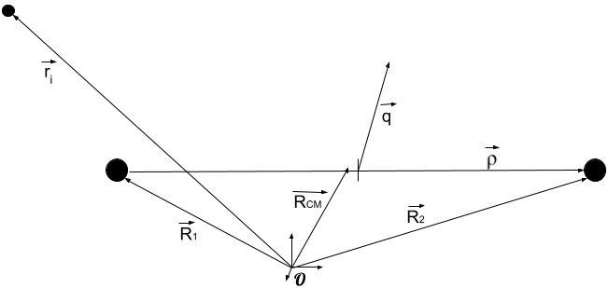
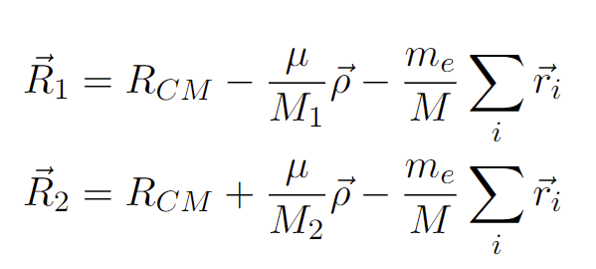
Center of Mass Recoil
(1)
(2)

Slide 7
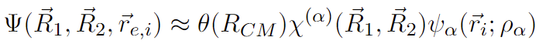
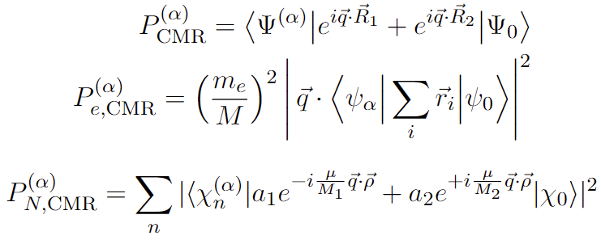
Center of Mass Recoil (cont.)
Born-Oppenheimer approximation:
Electronic, nuclear transition amplitudes:
(3)
(4)
(5)

Slide 8
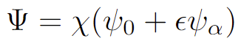
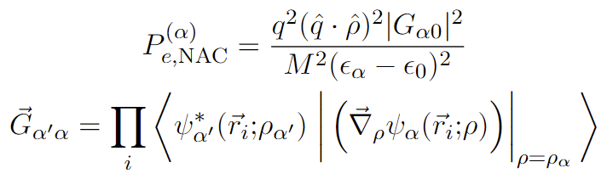
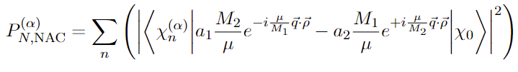
Non-Adiabatic Coupling
Terms beyond Born-Oppenheimer treated as perturbations³
Electronic transition probabilities given as:
Nuclear transition probabilities given as:
(6)
(7)
(8)
(9)
³Lovesey, Bowman, Johnson; Z. Phys. B - Condensed Matter 47, 137-147 (1982)

Slide 9
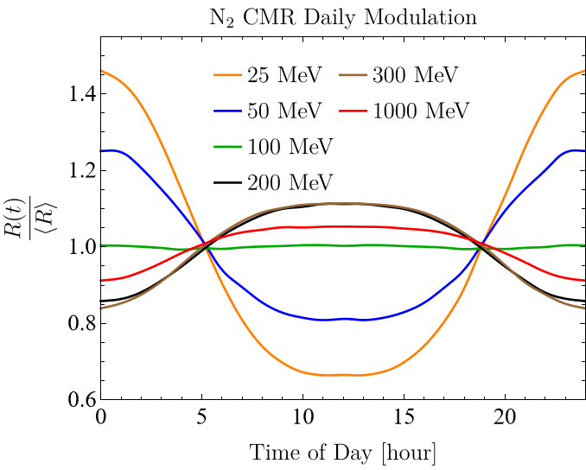
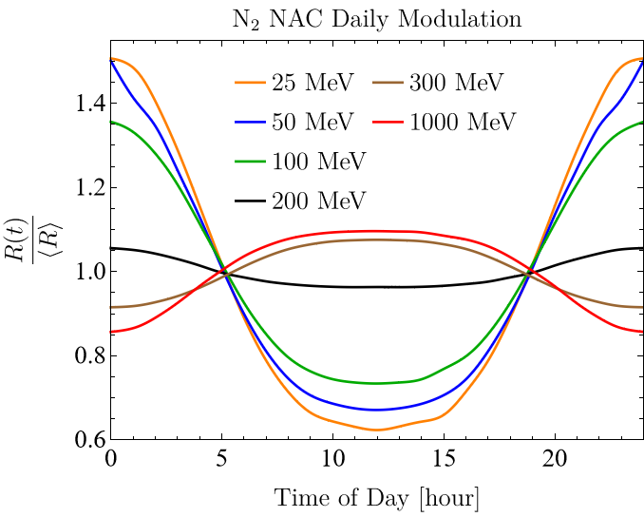
Daily Modulation
Standard Halo Model (SHM) ansatz for DM velocity distribution⁴
⁴Evans, O’Hare, McCabe; arXiv:1810.11468v2

Slide 10
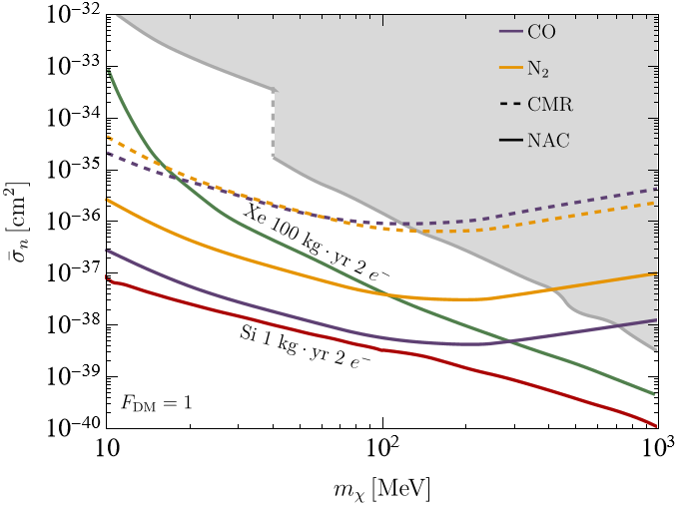
Sensitivity
Comparable sensitivity to semiconductors

Slide 11
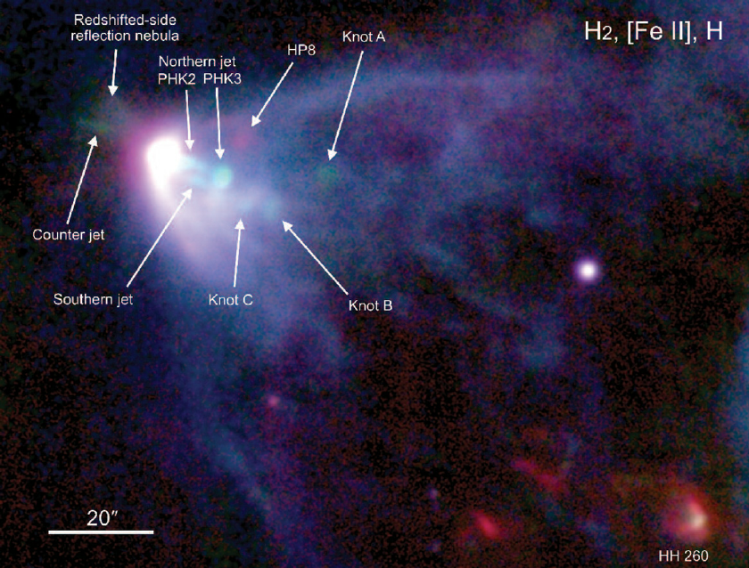
H₂ Molecular Clouds
Optically dense MCs are ionized by cosmic rays and potentially DM
L1551-IR MC chosen to minimize background⁵
⁵Blanco, Prabhu; arXiv:2211.05787
Hayashi, Pyo; DOI:10.1088/0004-637X/694/1/582

Slide 12
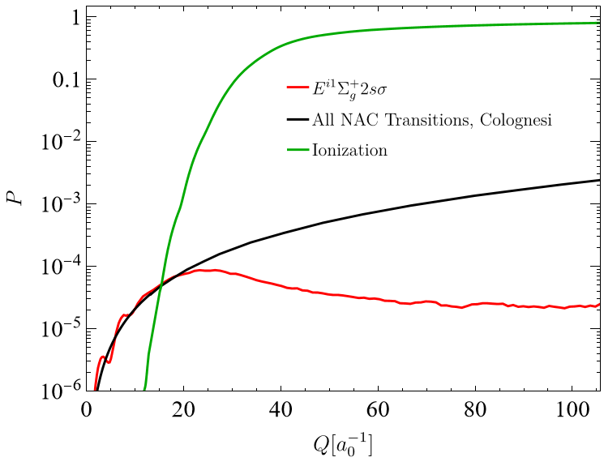
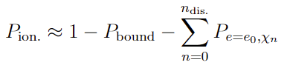
NAC Excitation vs. Ionization
Inclusive probability of ionization:
Ionization >> NAC >> CMR⁶
(10)
⁶Colognesi; doi:10.1016/j.physb.2004.12.036

Slide 13
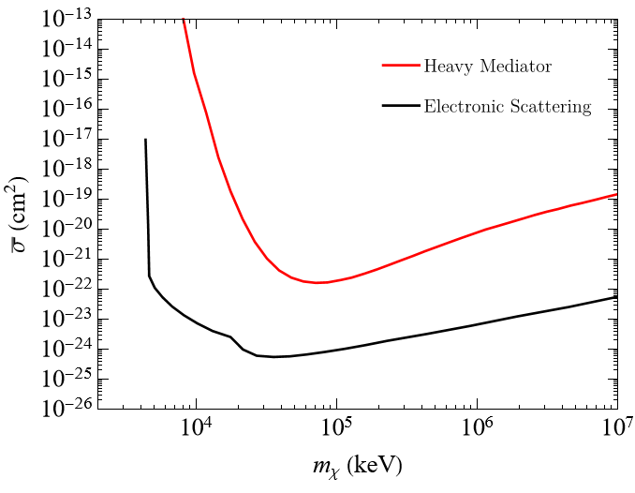
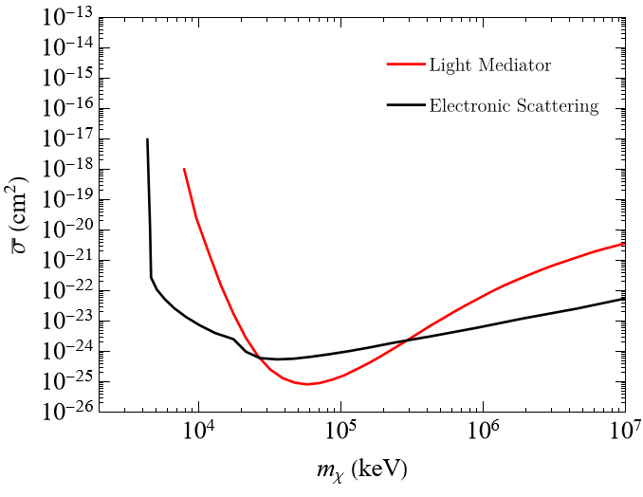
(Preliminary) Sensitivity
Can still be sensitive to a small subcomponent of DM, f_{χ} ≲ 0.4%

Slide 14
Summary
The Migdal effect can be used to study light DM scattering with nuclei
Daily modulation in anisotropic systems can help distinguish signal from background
Two different excitation effects, ionization can occur in molecules
Future studies of terrestrial detector molecules could improve bounds on light DM
Ionization in molecular clouds could probe fractional subcomponent of DM

Slide 15
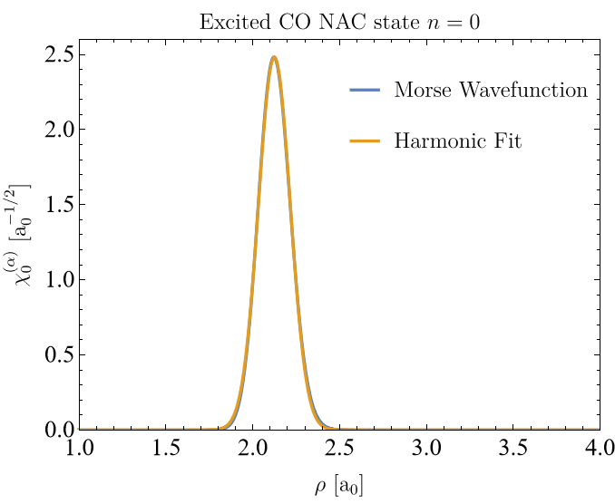
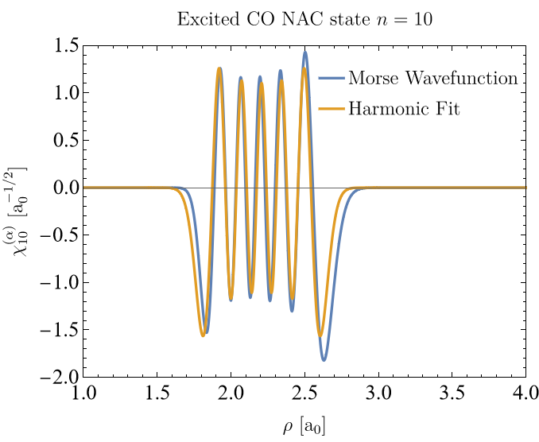
Backup
Closed form solution for harmonic nuclear matrix elements
Use Morse energies to fit harmonic wavefunction

Slide 16
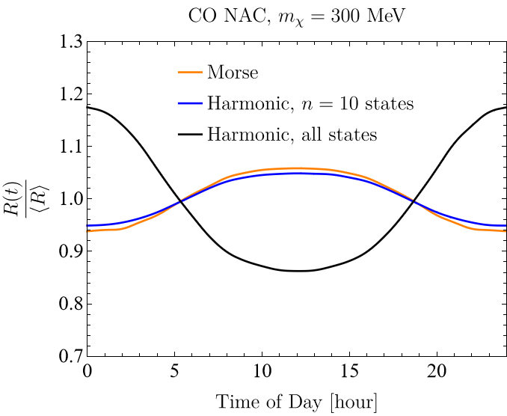
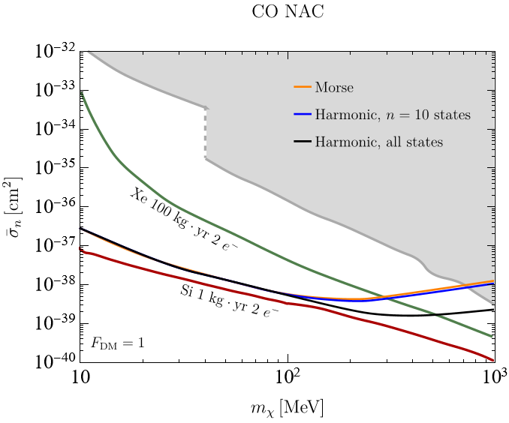
Backup
Lose accuracy at higher masses

Slide 17
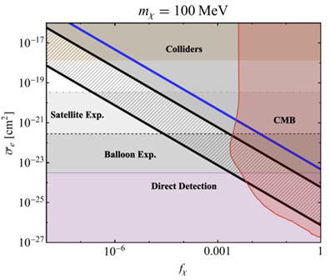
Backup
Projected sensitivities can still probe unexplored areas of parameter space:
Blanco, Prabhu; arXiv:2211.05787

Slide 18
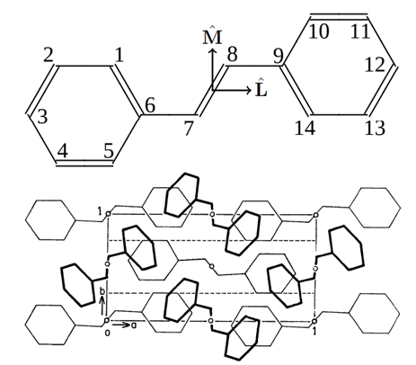
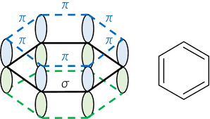
Backup
T-stilbene has eV-range electronic transitions and scintillates!
arXiv:2103.08601v2

