Slide 1


An Analytic Approach to Light Dark Matter Propagation
Based on arXiv:2301.07728
Christopher Cappiello
Phenomenology Symposium 2023
May 8th, 2023

Slide 2
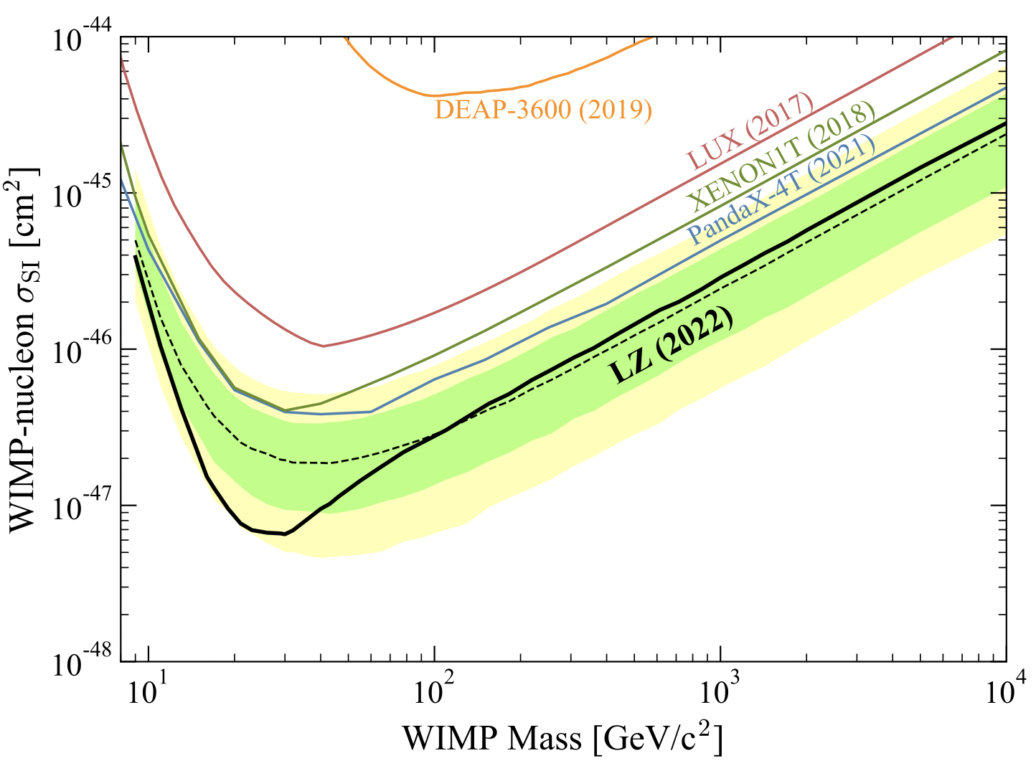
Direct Detection Limits
arXiv:2207.03764

Slide 3
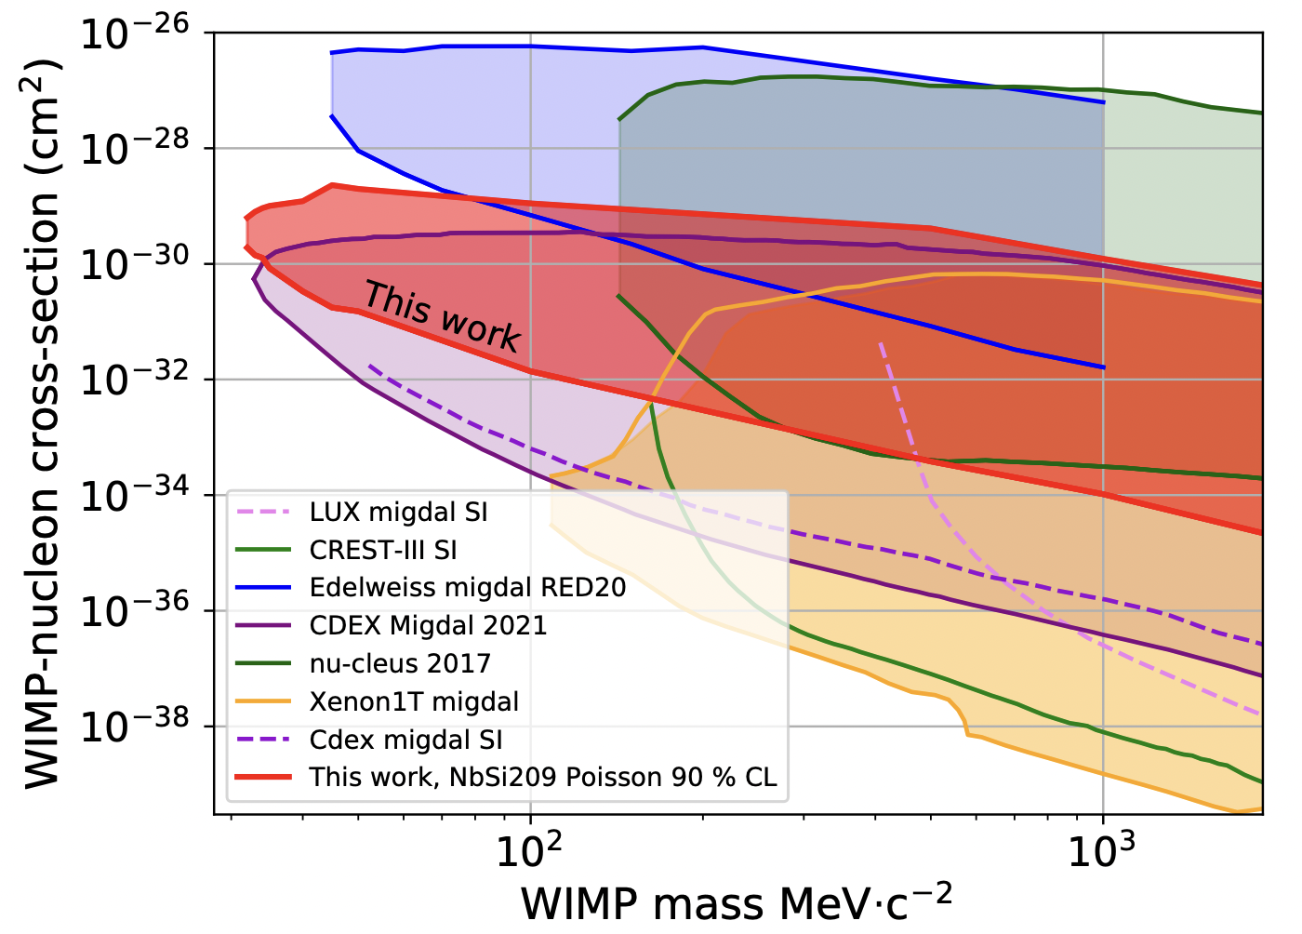
Direct Detection Limits
arXiv:2207.03764
arXiv:2203.03993 (Edelweiss)

Slide 4
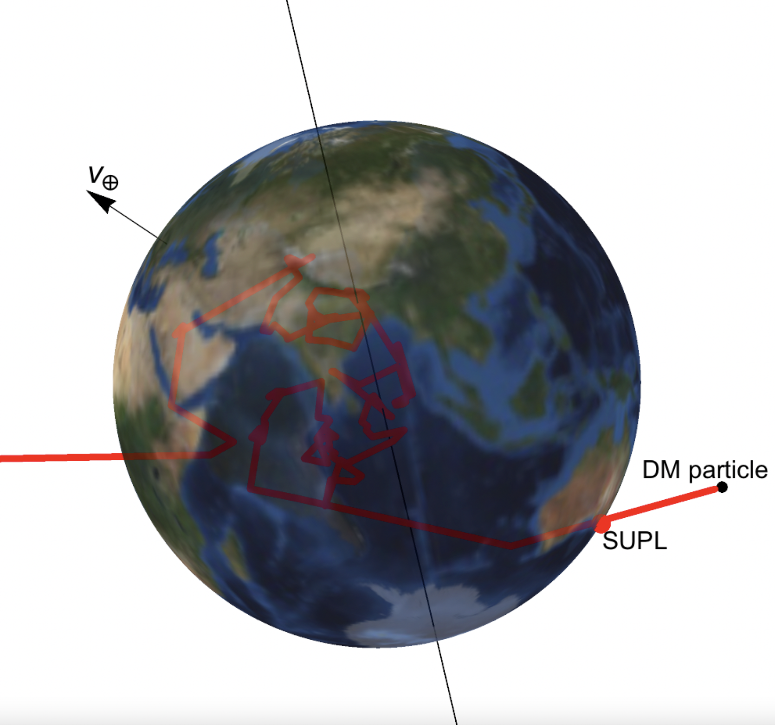
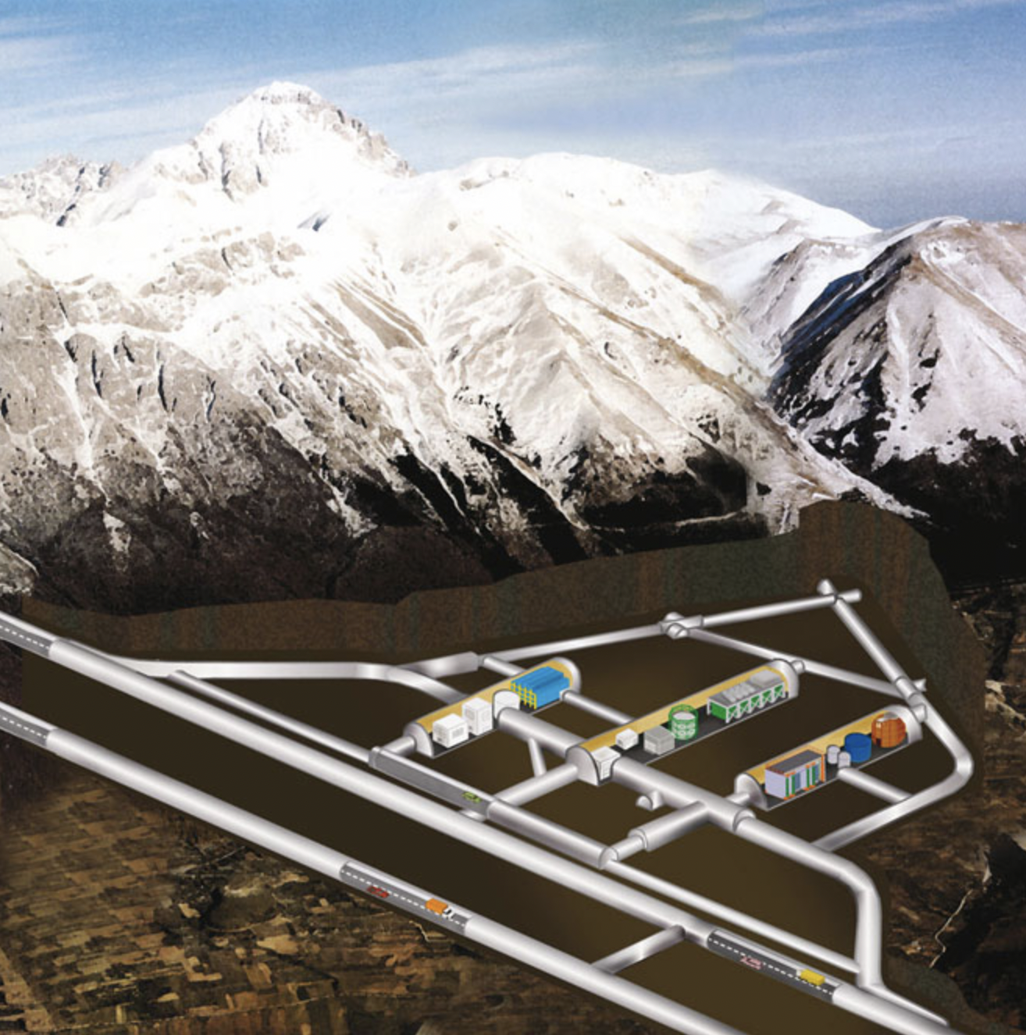
Monte Carlo vs. Straight Line
timonemken.com/code, arXiv:1706.02249
https://www.appec.org

Slide 5
Direct Detection Limits
arXiv:2207.03764
arXiv:2203.03993 (Edelweiss)

Slide 6
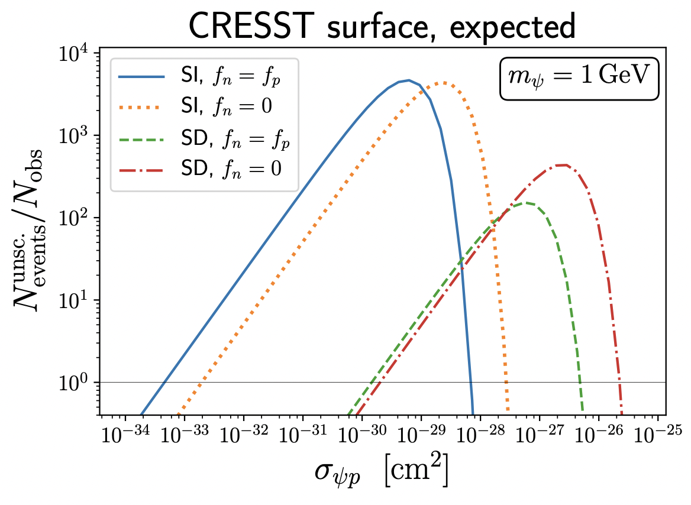

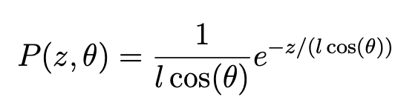
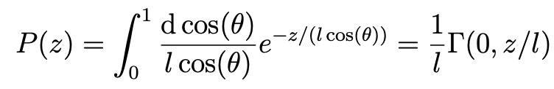
Probability of Not Scattering
We want an alternative to both Monte Carlo and straight-line approaches
Hooper & Mcdermott (left):
Compute fraction of dark matter reaching CRESST surface detector without scattering
arXiv:1802.03025

Slide 7
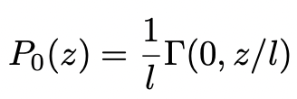
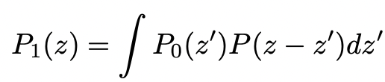
What about scattering?

Slide 8
What about scattering?
Assume isotropic scattering

Slide 9
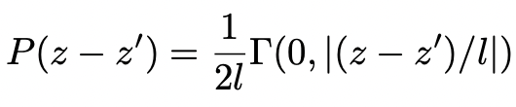
What about scattering?

Slide 10
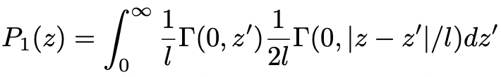
What about scattering?

Slide 11
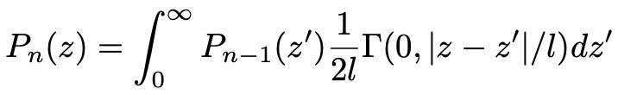
What about scattering?
This process is iterative!
Can compute probabilities through n scatterings

Slide 12
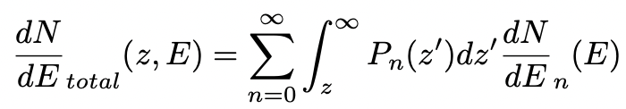
What about scattering?
This process is iterative!
Can compute probabilities through n scatterings

Slide 13
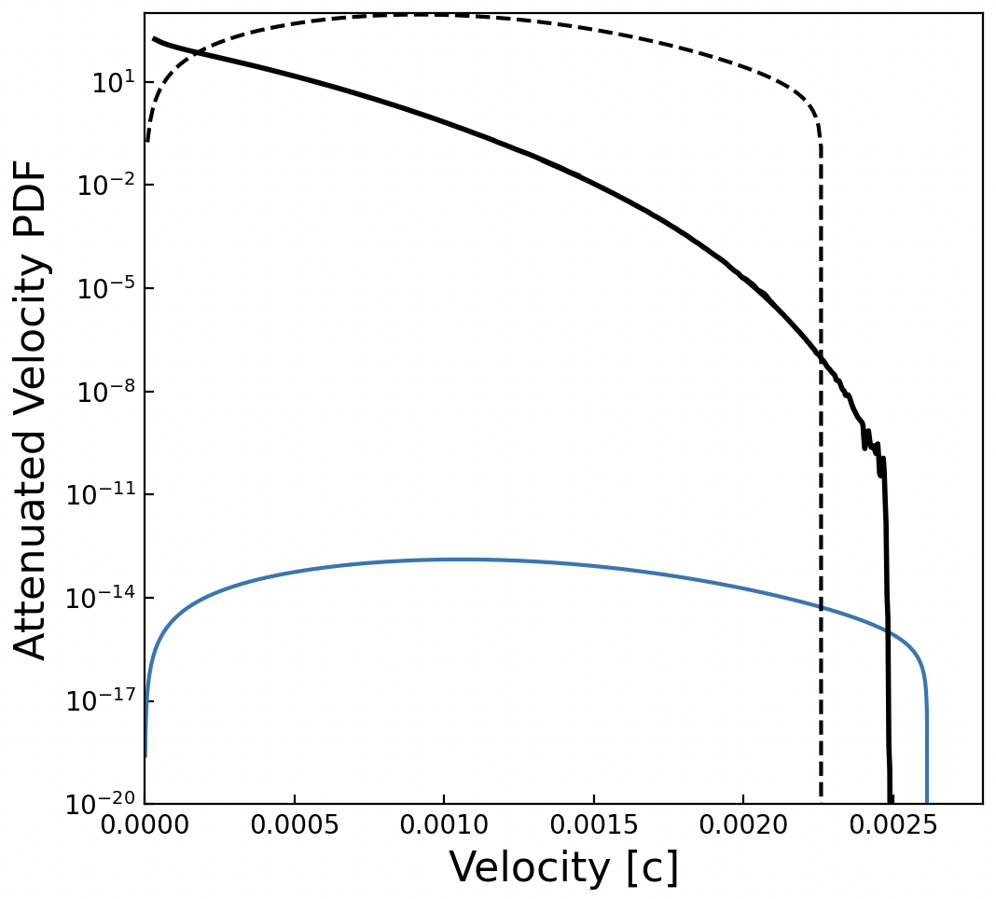
Velocity Distribution
M_{X} = 100 MeV
σ_{XN} = 5*10⁻³⁰ cm²
Depth = 1400 m

Slide 14
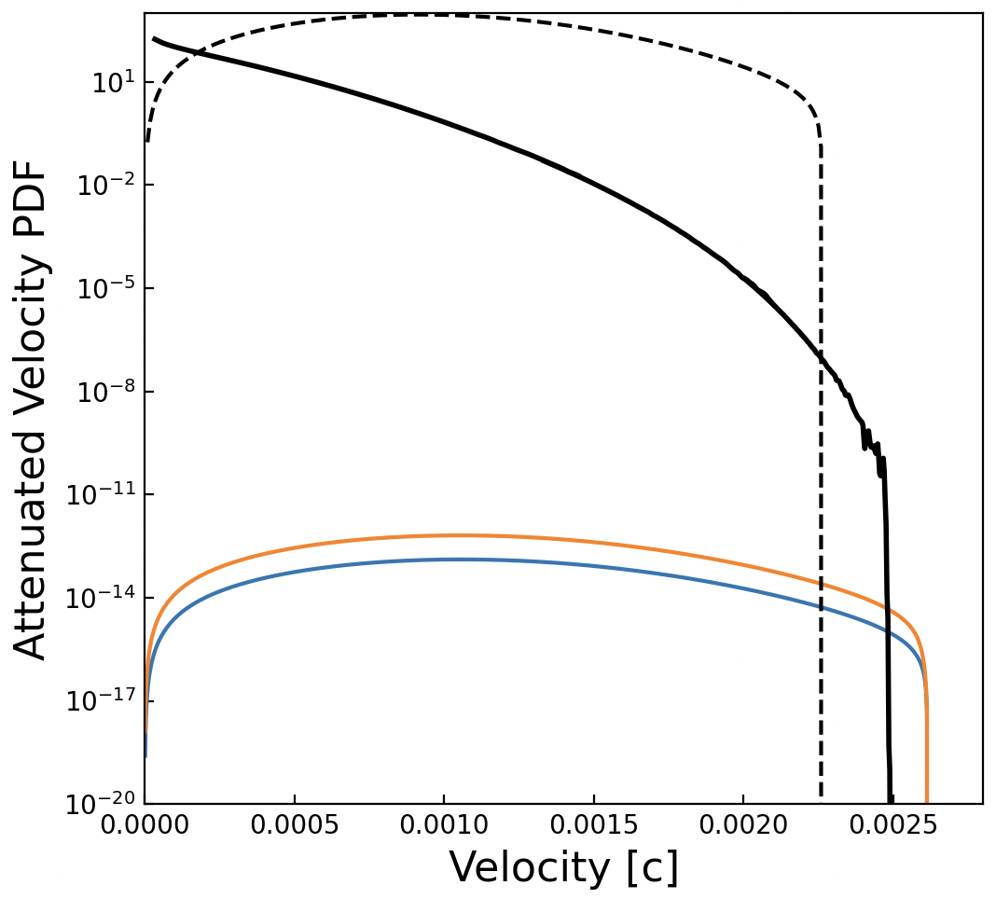
Velocity Distribution
M_{X} = 100 MeV
σ_{XN} = 5*10⁻³⁰ cm²
Depth = 1400 m

Slide 15
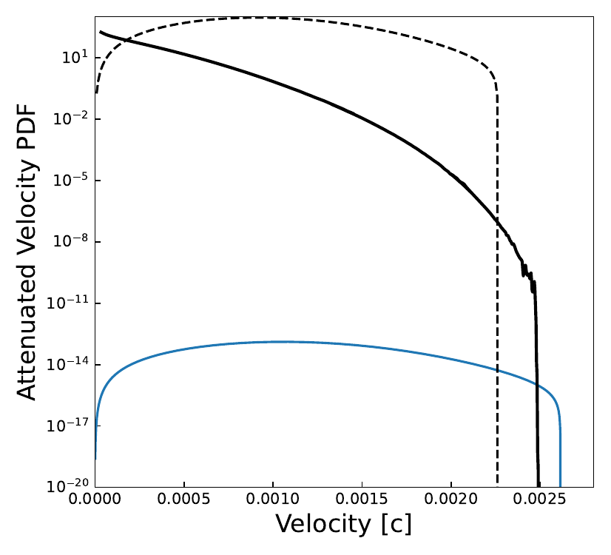
Velocity Distribution
M_{X} = 100 MeV
σ_{XN} = 5*10⁻³⁰ cm²
Depth = 1400 m

Slide 16
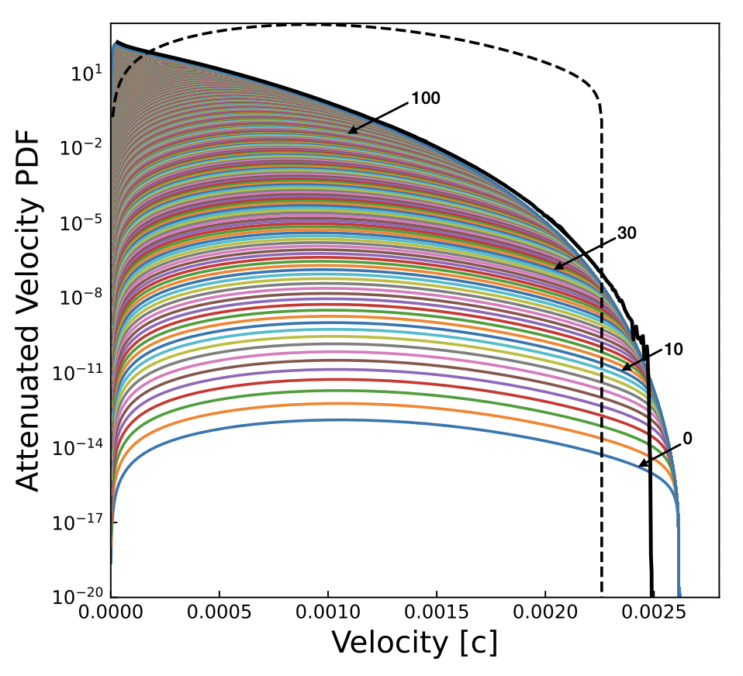
Velocity Distribution
M_{X} = 100 MeV
σ_{XN} = 5*10⁻³⁰ cm²
Depth = 1400 m

Slide 17
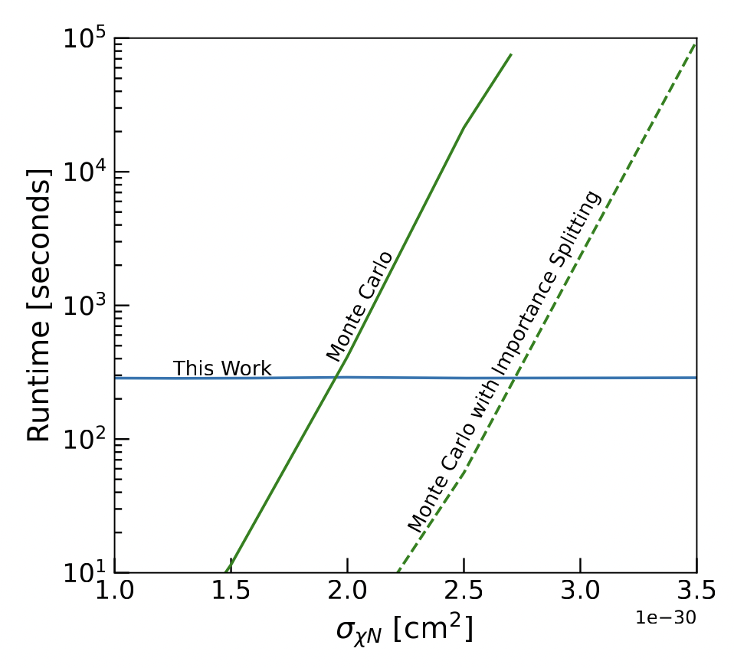
Runtime Comparison
M_{X} = 200 MeV
Depth = 1400 m

Slide 18
Attenuation: Straight Line Approximation
arXiv:2203.03993 (EDELWEISS)

Slide 19
Runtime Comparison
M_{X} = 200 MeV
Depth = 1400 m

Slide 20
Thank you!
Many thanks to Timon Emken for details on the DaMaSCUS Monte Carlo code
Thank you to Ivan Esteban for suggestions on speeding up integration
Code Publicly Available: https://github.com/ccapp413/DMpropPublic

Slide 21
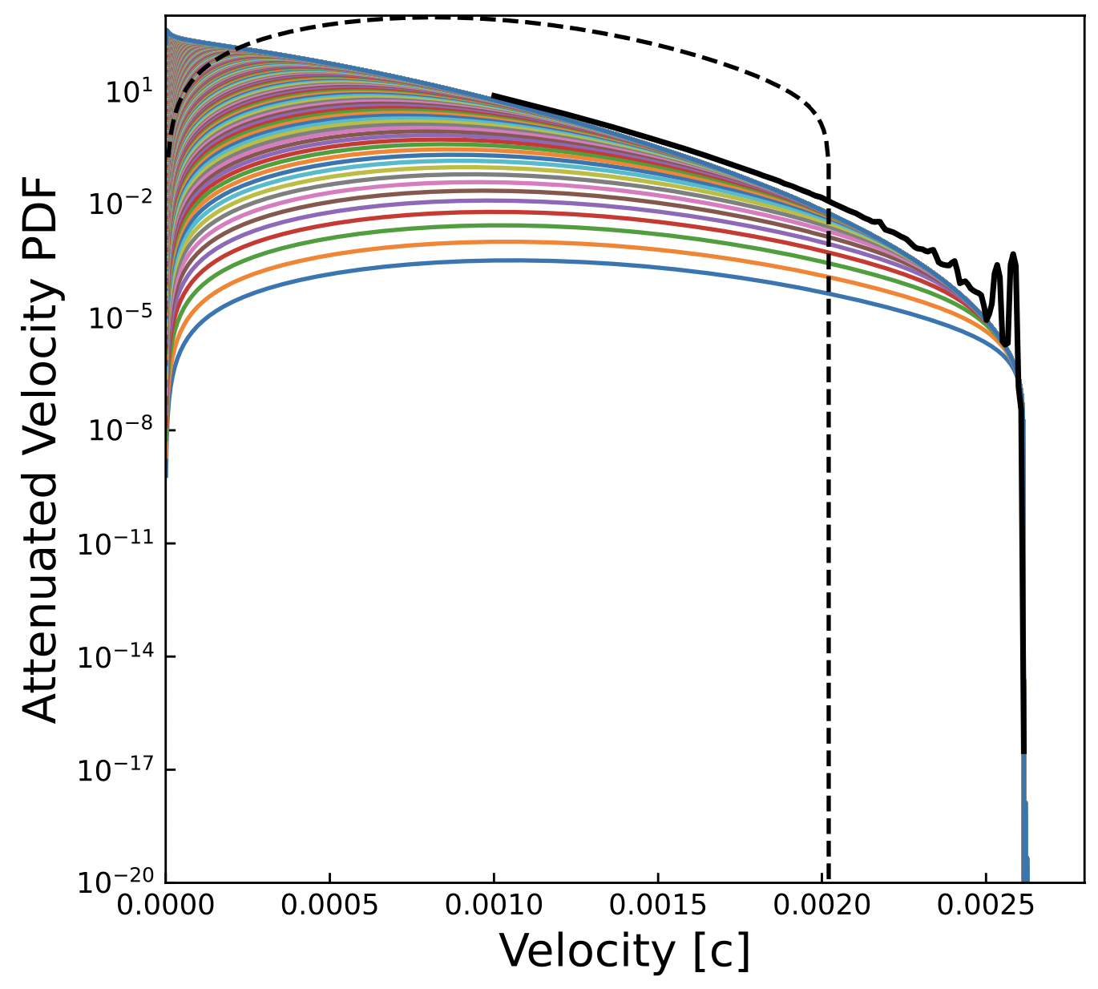
Backup: 500 MeV, 10⁻³⁰ cm²

