Slide 1
Variant Nelson-Barr Mechanism with MFV
George N. Wojcik- UW Madison
Based on 2212.07459 (JHEP 04 (2023) 063) with Y. Bai
PHENO – May, 9 2023

Slide 2
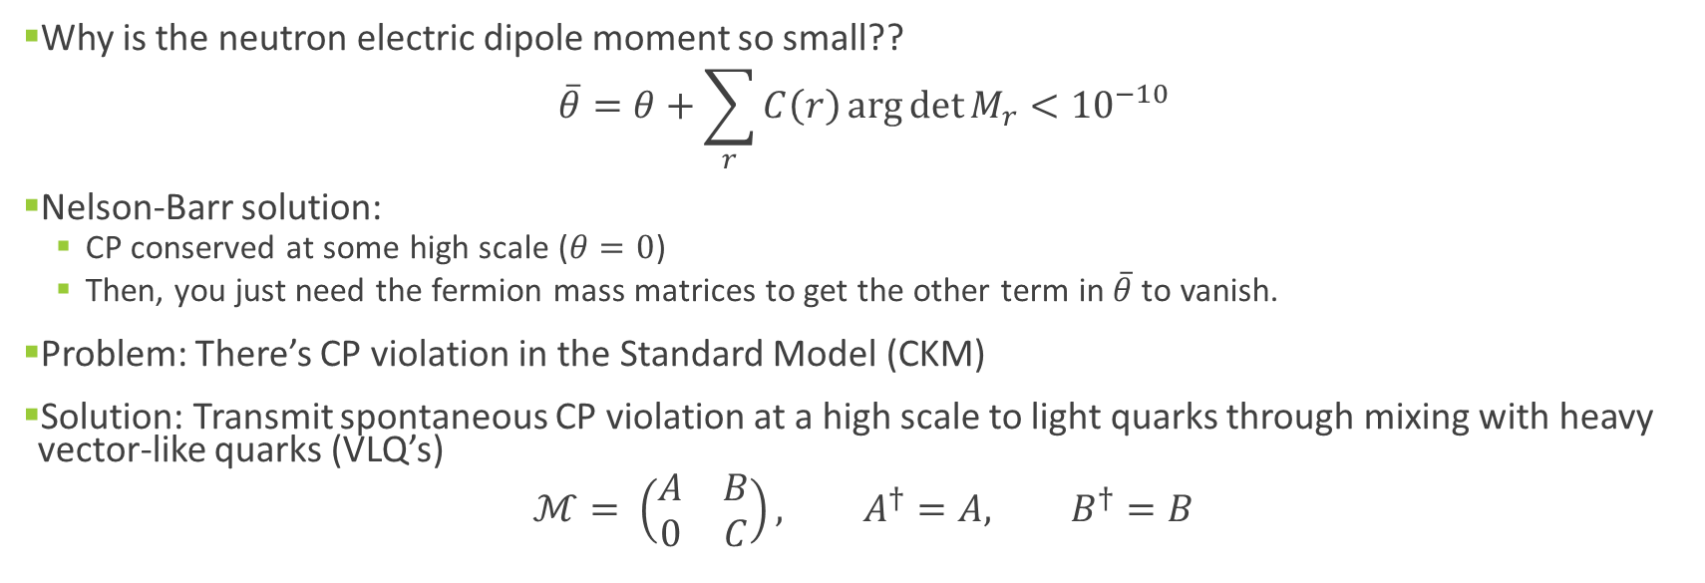
Strong CP Problem and Nelson-Barr
Why is the neutron electric dipole moment so small??
$$\overline{θ}=θ+\sum_{r}{C\left(r\right)\arg{\det{M_{r}}}}<{10}^{−10}$$
Nelson-Barr solution:
  CP conserved at some high scale ($θ=0$)
  Then, you just need the fermion mass matrices to get the other term in $\overline{θ}$ to vanish.
Problem: There’s CP violation in the Standard Model (CKM)
Solution: Transmit spontaneous CP violation at a high scale to light quarks through mixing with heavy vector-like quarks (VLQ’s)
$$ℳ= \left(\begin{matrix}A & B \\ 0 & C\end{matrix}\right), A^{†}=A, B^{†}=B$$

Slide 3
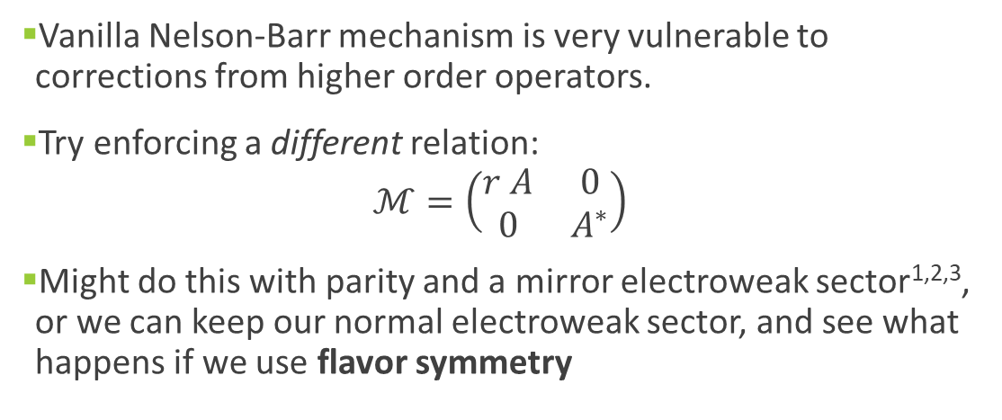
Nelson-Barr and Quality
Vanilla Nelson-Barr mechanism is very vulnerable to corrections from higher order operators.
Try enforcing a different relation:
$$ℳ=\left(\begin{matrix}r A & 0 \\ 0 & A^{∗}\end{matrix}\right)$$
Might do this with parity and a mirror electroweak sector^{1,2,3}, or we can keep our normal electroweak sector, and see what happens if we use flavor symmetry

Slide 4
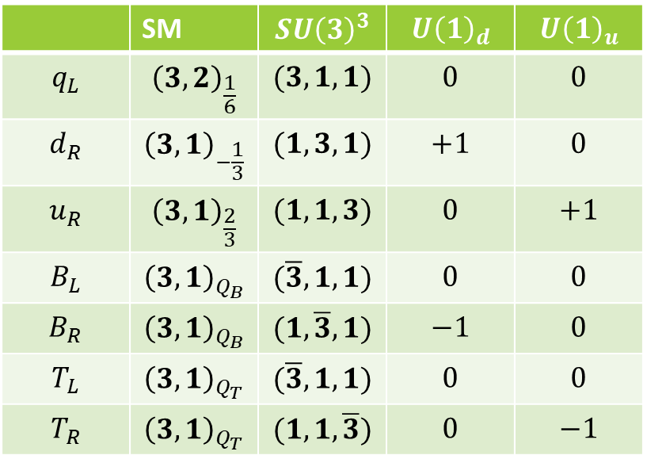

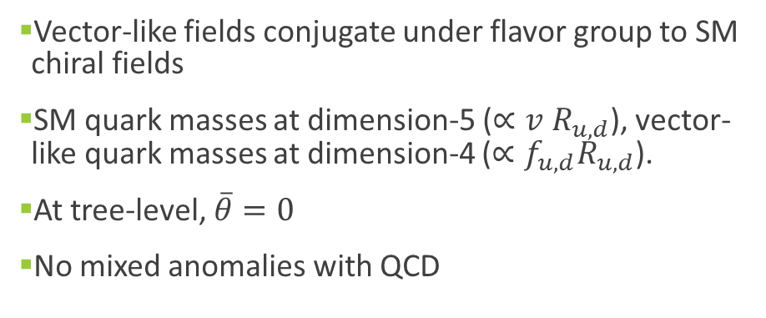
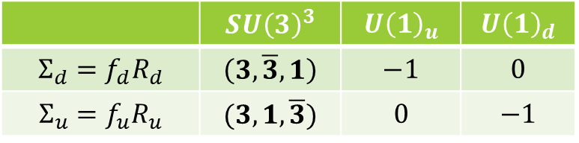
MFV Nelson-Barr
$$SU{\left(3\right)}_{q_{L}}×SU{\left(3\right)}_{d_{R}}×SU{\left(3\right)}_{u_{R}}×U{\left(1\right)}_{u}×U{\left(1\right)}_{d}$$
 | SM | $$SU{\left(3\right)}^{3}$$ | $$U{\left(1\right)}_{d}$$ | $$U{\left(1\right)}_{u}$$
$$q_{L}$$ | $${\left(3,2\right)}_{\frac{1}{6}}$$ | $$(3,1, 1)$$ | $$0$$ | $$0$$
$$d_{R}$$ | $${\left(3,1\right)}_{−\frac{1}{3}}$$ | $$(1,3,1)$$ | $$+1$$ | $$0$$
$$u_{R}$$ | $${\left(3,1\right)}_{\frac{2}{3}}$$ | $$(1,1,3)$$ | $$0$$ | $$+1$$
$$B_{L}$$ | $${\left(3,1\right)}_{Q_{B}}$$ | $$(\overline{3}, 1,1)$$ | $$0$$ | $$0$$
$$B_{R}$$ | $${\left(3,1\right)}_{Q_{B}}$$ | $$(1,\overline{3}, 1)$$ | $$−1$$ | $$0$$
$$T_{L}$$ | $${\left(3,1\right)}_{Q_{T}}$$ | $$(\overline{3},1,1)$$ | $$0$$ | $$0$$
$$T_{R}$$ | $${\left(3,1\right)}_{Q_{T}}$$ | $$(1,1,\overline{3})$$ | $$0$$ | $$−1$$
 | $$SU{\left(3\right)}^{3}$$ | $$U{\left(1\right)}_{u}$$ | $$U{\left(1\right)}_{d}$$
$$Σ_{d}=f_{d}R_{d}$$ | $$\left(3, \overline{3},1\right)$$ | $$−1$$ | $$0$$
$$Σ_{u}=f_{u}R_{u}$$ | $$(3,1,\overline{3})$$ | $$0$$ | $$−1$$
Vector-like fields conjugate under flavor group to SM chiral fields
SM quark masses at dimension-5 ($∝v R_{u,d}$), vector-like quark masses at dimension-4 ($∝f_{u, d}R_{u, d}$).
At tree-level, $\overline{θ}=0$
No mixed anomalies with QCD

Slide 5

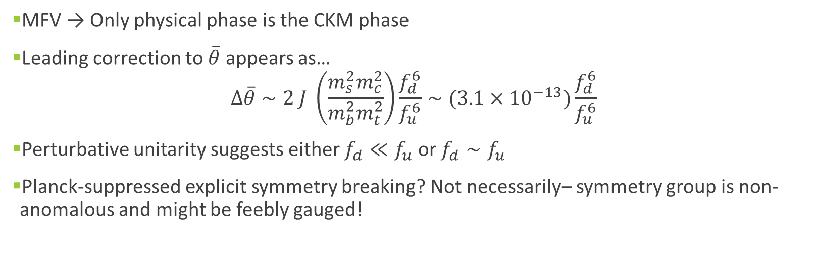
Higher-Dimensional Corrections
$$ℳ^{u}= \left(\begin{matrix}\frac{y_{u }v}{\sqrt{2}}R_{u} & 0 \\ 0 & f_{u}R_{u}^{∗}\end{matrix}\right), ℳ^{d}= \left(\begin{matrix}\frac{y_{d} v}{\sqrt{2}}R_{d} & 0 \\ 0 & f_{d}R_{d}^{∗}\end{matrix}\right)$$
MFV → Only physical phase is the CKM phase
Leading correction to $\overline{θ}$ appears as…
$$Δ\overline{θ}∼2 J \left(\frac{m_{s}^{2}m_{c}^{2}}{m_{b}^{2}m_{t}^{2}}\right)\frac{f_{d}^{6}}{f_{u}^{6}}∼(3.1×{10}^{−13})\frac{f_{d}^{6}}{f_{u}^{6}}$$
Perturbative unitarity suggests either $f_{d}≪f_{u}$ or $f_{d}∼f_{u}$
Planck-suppressed explicit symmetry breaking? Not necessarily– symmetry group is non-anomalous and might be feebly gauged!

Slide 6
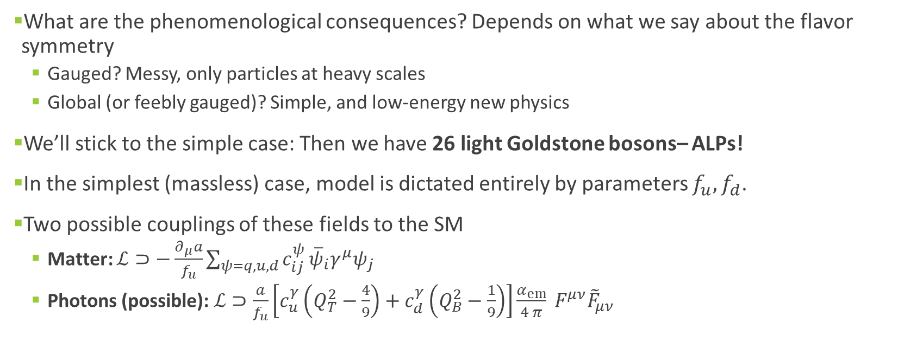
Phenomenology– Goldstone Bosons
What are the phenomenological consequences? Depends on what we say about the flavor symmetry
  Gauged? Messy, only particles at heavy scales
  Global (or feebly gauged)? Simple, and low-energy new physics
We’ll stick to the simple case: Then we have 26 light Goldstone bosons– ALPs!
In the simplest (massless) case, model is dictated entirely by parameters $f_{u}, f_{d}$.
Two possible couplings of these fields to the SM
  Matter: $ℒ⊃−\frac{∂_{μ}a}{f_{u}}\sum_{ψ=q,u, d}{c_{ij}^{ψ}}{\overline{ψ}}_{i}γ^{μ}ψ_{j}$
  Photons (possible): $ℒ⊃\frac{a}{f_{u}}\left[c_{u}^{γ}\left(Q_{T}^{2}−\frac{4}{9}\right)+c_{d}^{γ}\left(Q_{B}^{2}−\frac{1}{9}\right)\right]\frac{α_{em}}{4 π} F^{μν}{\tilde{F}}_{μν}$

Slide 7
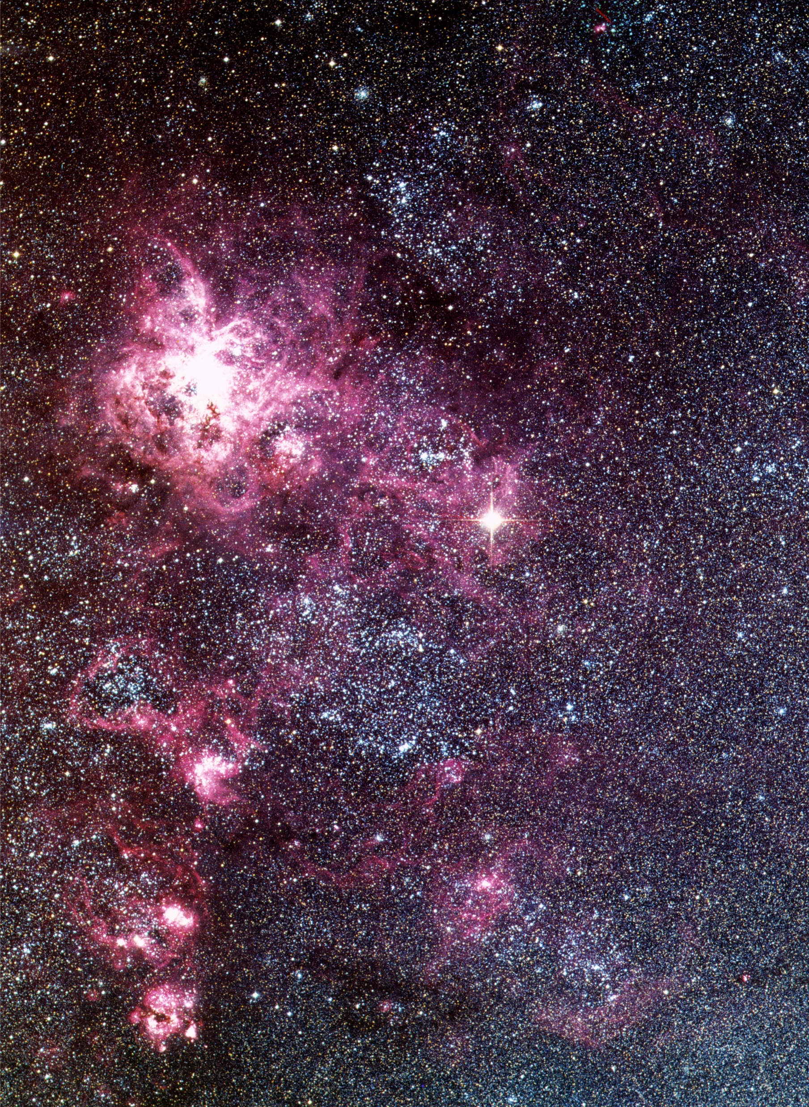
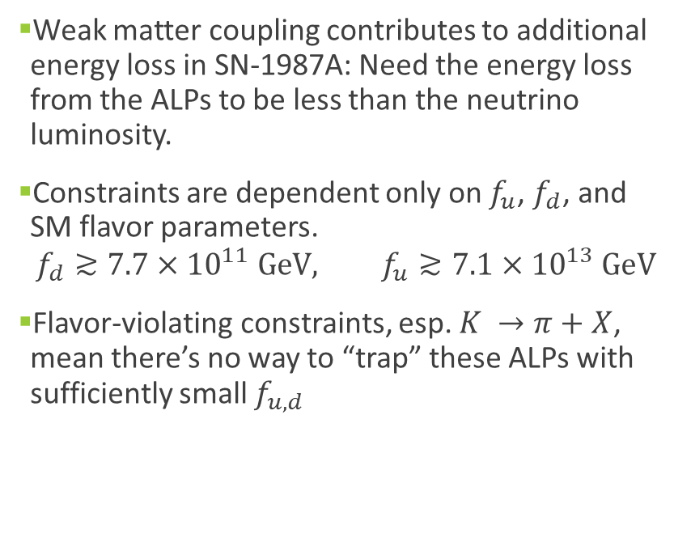
Phenomenology: Nucleon Coupling
Weak matter coupling contributes to additional energy loss in SN-1987A: Need the energy loss from the ALPs to be less than the neutrino luminosity.
Constraints are dependent only on $f_{u}$, $f_{d}$, and SM flavor parameters.
$$f_{d}≳7.7×{10}^{11} GeV, f_{u}≳7.1×{10}^{13} GeV$$
Flavor-violating constraints, esp. $K →π+X$, mean there’s no way to “trap” these ALPs with sufficiently small $f_{u,d}$
Photo: ESO

Slide 8
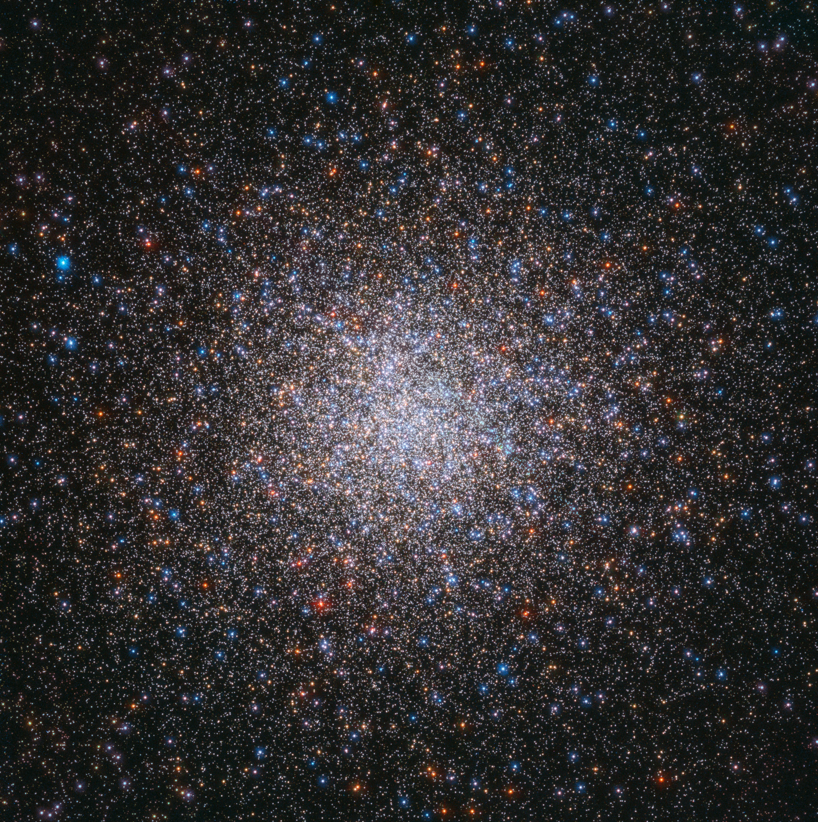
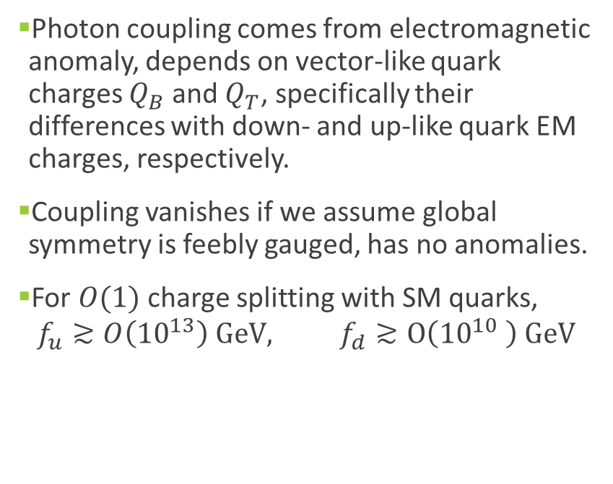
Phenomenology: Photon Coupling
Photon coupling comes from electromagnetic anomaly, depends on vector-like quark charges $Q_{B}$ and $Q_{T}$, specifically their differences with down- and up-like quark EM charges, respectively.
Coupling vanishes if we assume global symmetry is feebly gauged, has no anomalies.
For $O(1)$ charge splitting with SM quarks,
$$f_{u}≳O\left({10}^{13}\right) GeV, f_{d}≳O\left({10}^{10} \right) GeV$$
Photo: ESA/Hubble

Slide 9
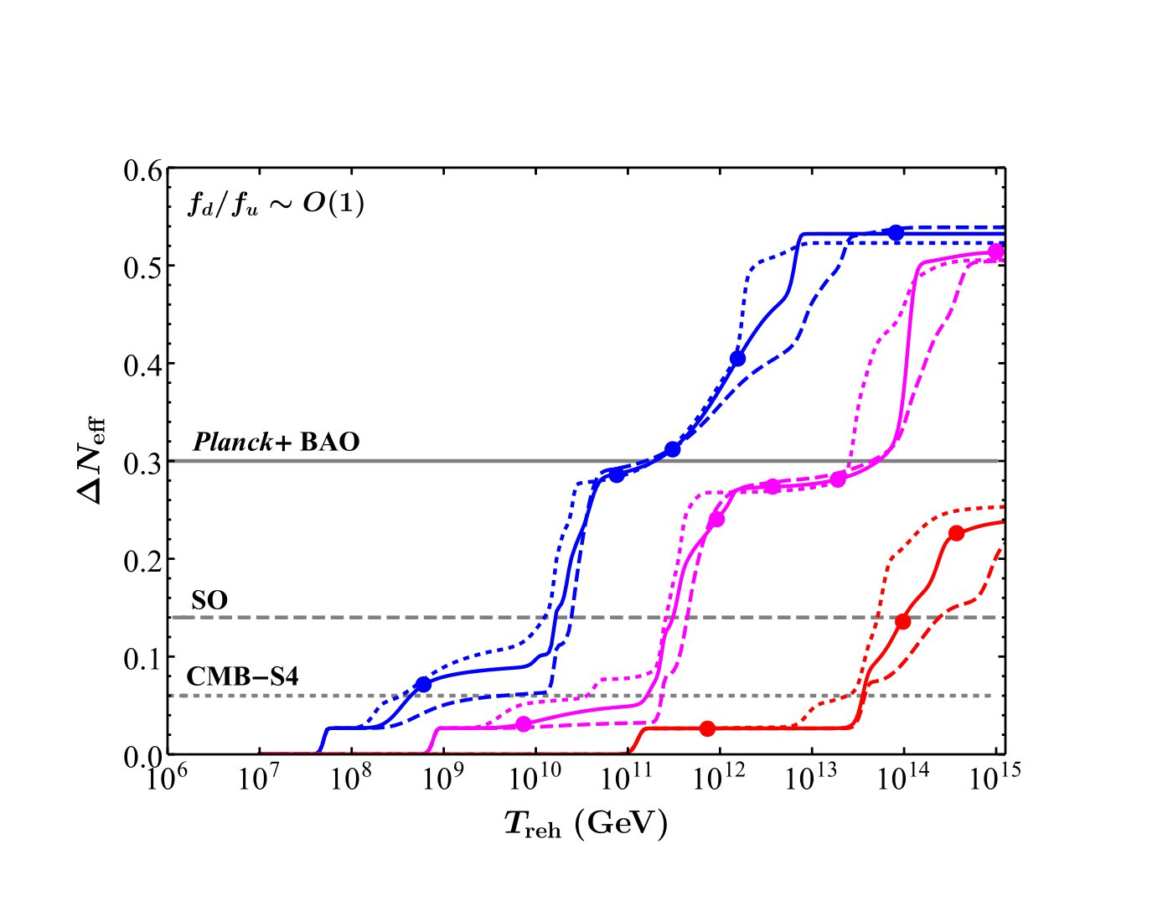
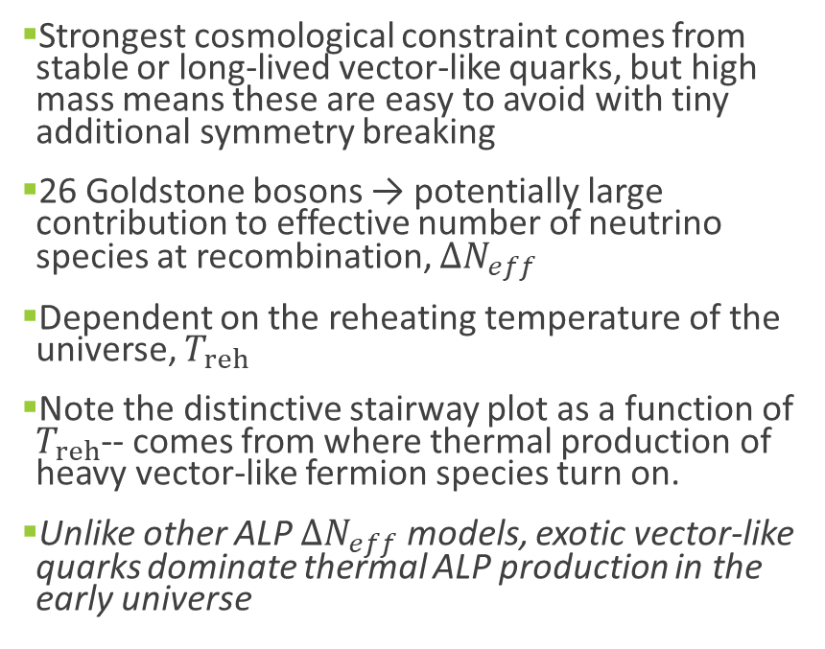
Phenomenology: Flavor Stairway
Strongest cosmological constraint comes from stable or long-lived vector-like quarks, but high mass means these are easy to avoid with tiny additional symmetry breaking
26 Goldstone bosons → potentially large contribution to effective number of neutrino species at recombination, $ΔN_{eff}$
Dependent on the reheating temperature of the universe, $T_{reh}$
Note the distinctive stairway plot as a function of $T_{reh}$-- comes from where thermal production of heavy vector-like fermion species turn on.
Unlike other ALP $ΔN_{eff}$ models, exotic vector-like quarks dominate thermal ALP production in the early universe

Slide 10
Conclusions
We presented a mechanism for solving the strong CP problem based on a large flavor symmetry
Vector-like quarks are unobservably heavy, but there are ample signatures for the lighter Goldstone bosons
MFV is just the first example that comes to mind, but the pheno is distinctive and many characteristics likely carry over to other constructions:
  Large flavor symmetry with parameters dictated mostly by SM flavor structure
  Large number of Goldstone bosons
  ALP cosmology dominated by vector-like quarks

Slide 11
Thank You!

