Slide 1




Probing the Sun for BSM
Physics Using RHESSI
Presenter: R. Andrew Gustafson¹
Co-Authors: Ryan Plestid^{2,3,4}, Ian Shoemaker¹
1. Center for Neutrino Physics, Virginia Tech
2. Department of Physics and Astronomy, University of Kentucky
3. Theoretical Physics Department, Fermilab
4.Walter Burke Institute of Theoretical Physics, Caltech

Slide 2
Where is Physics Beyond the Standard Model (BSM)?

Slide 3

Where is Physics Beyond the Standard Model (BSM)?

Slide 4
Where is Physics Beyond the Standard Model (BSM)?
It does not interact with Standard Model (SM) physics in an appreciable way.
BSM physics could be
Rare
Weak coupling w/ SM
Too heavy to probe

Slide 5
Where is Physics Beyond the Standard Model (BSM)?
It does not interact with Standard Model (SM) physics in an appreciable way.
Long Lived Particles
BSM physics could be
Rare
Weak coupling w/ SM
Too heavy to probe

Slide 6
Outline
Long-Lived Particles Overview
RHESSI
Models Considered
Future Improvements

Slide 7
What are Long-Lived Particles (LLPs)?
Unstable
Travel macroscopic distances before decaying
Produced on-shell (real)

Slide 8
What are Long-Lived Particles (LLPs)?
Unstable
Travel macroscopic distances before decaying
Produced on-shell (real)
SM (DM)
SM (DM)

Slide 9

What are Long-Lived Particles (LLPs)?
Unstable
Travel macroscopic distances before decaying
Produced on-shell (real)
SM (DM)
LLP
SM (DM)
$$λ$$

Slide 10
What are Long-Lived Particles (LLPs)?
Unstable
Travel macroscopic distances before decaying
Produced on-shell (real)
SM (DM)
SM (DM)
LLP
SM (DM)
$$λ$$
SM (DM)

Slide 11
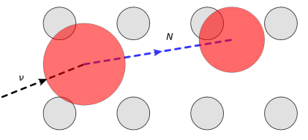

Where to Search for LLPs
Large Volume Detectors
$$λ<L_{det}$$
[1]Coloma, P., Machado, P. A., Martinez-Soler, I., & Shoemaker, I. M. (2017).

Slide 12
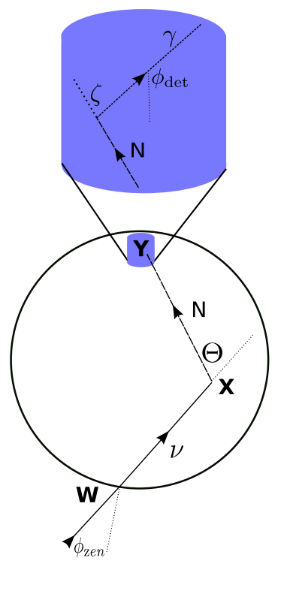

Where to Search for LLPs
Earth
$$L_{det}≪ λ≪R_{⨁}$$
Large Volume Detectors
$$λ<L_{det}$$
[1] Coloma, P., Machado, P. A., Martinez-Soler, I., & Shoemaker, I. M. (2017).
[2] Gustafson, R. A., Plestid, R., & Shoemaker, I. M. (2022)

Slide 13
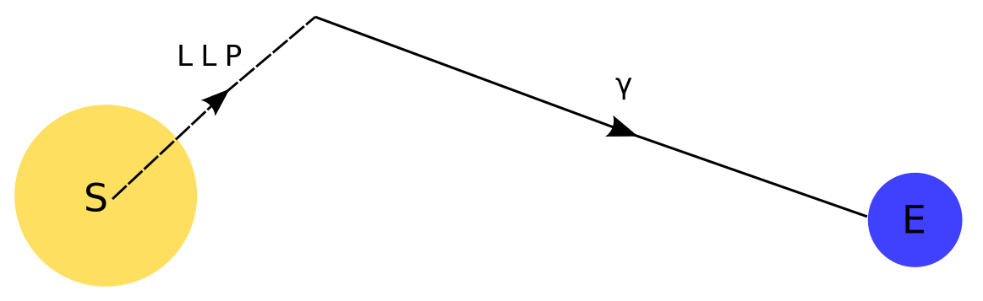

Where to Search for LLPs
Earth
$$L_{det}≪ λ≪R_{⨁}$$
Large Volume Detectors
$$λ<L_{det}$$
Sun
$$R_{⊙}≪λ≪d_{⊙}$$
[1] Coloma, P., Machado, P. A., Martinez-Soler, I., & Shoemaker, I. M. (2017).
[2] Gustafson, R. A., Plestid, R., & Shoemaker, I. M. (2022)

Slide 14
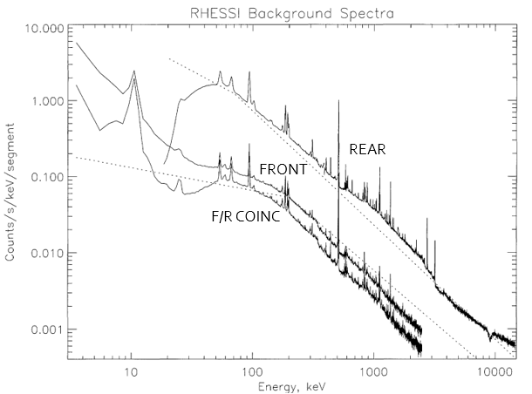
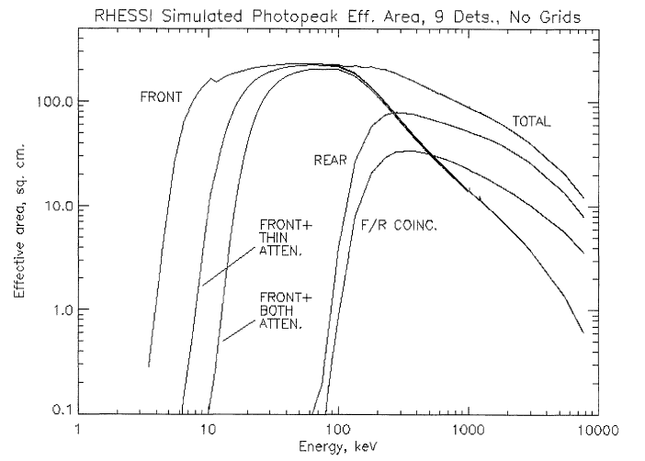
RHESSI- Reuven Ramaty High-Energy Solar Spectroscopic Imager
[3] Smith, D. M., Lin, R. P., Turin, P., Curtis, D. W., Primbsch, J. H., Campbell, R. D., ... & Schwartz, R. (2003).
Notes:
From top to bottom, it is Rear, Front, Front-Rear Anti-Coincidence

Slide 15
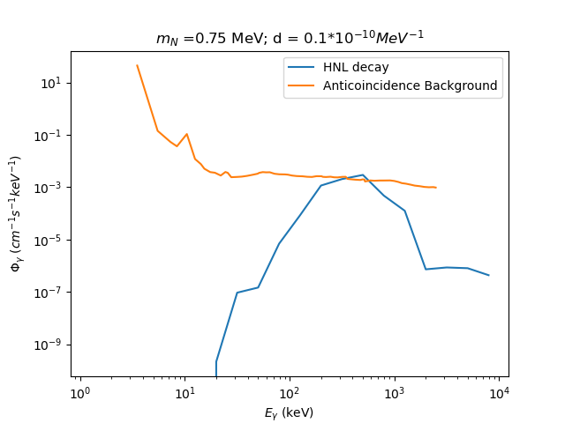
RHESSI (cont)
To obtain the background flux, we multiply a smoothed background count by the effective area.
Note: A more formal analysis would work the other way; taking the flux and transforming it into a RHESSI count.

Slide 16
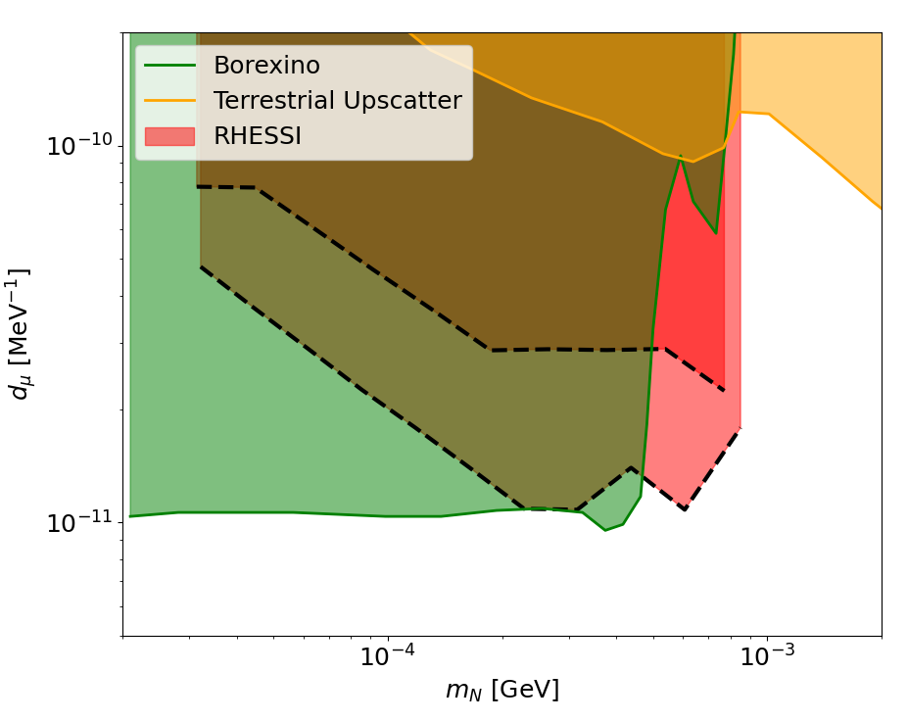
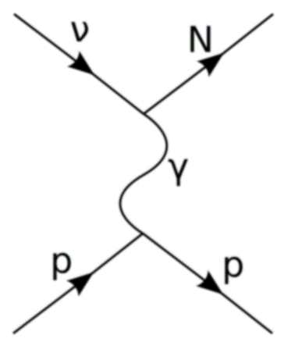
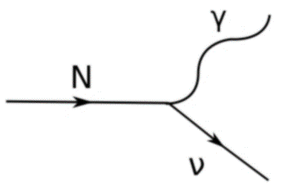

Transition Dipole Model
Production
Parameters:
$d$ (Transition dipole strength)
$m_{N}$ (HNL Mass)
Decay
CMB+BBN- [4] Magill, G., Plestid, R., Pospelov, M., & Tsai, Y. D. (2018).
Borexino + 1987A – [5] Brdar, V., Greljo, A., Kopp, J., & Opferkuch, T. (2021).
Borexino – [6] "Comprehensive measurement of pp-chain solar neutrinos." Nature 562, no. 7728 (2018): 505-510.
Terrestrial Upscattering – [7] Plestid, R. (2021).

Slide 17
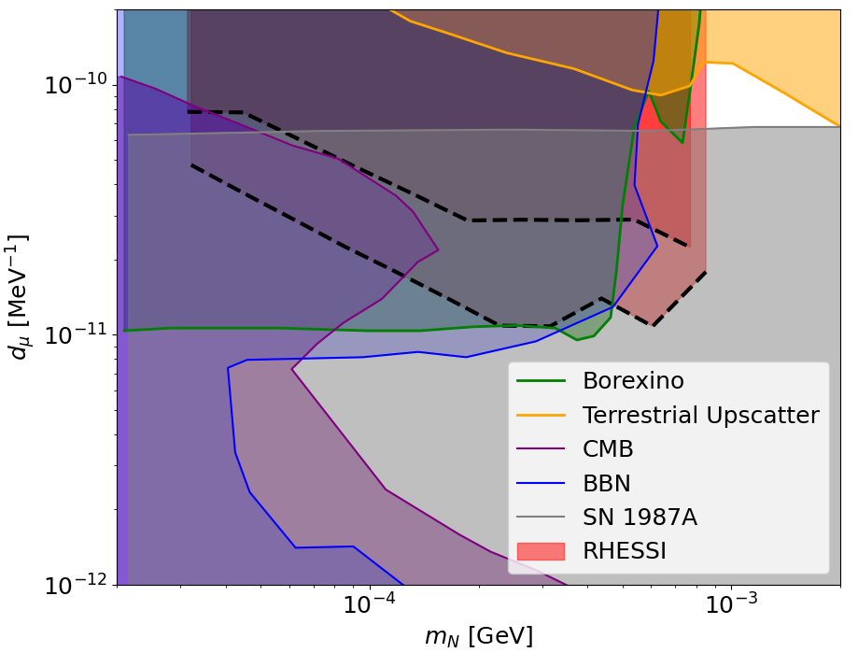

Transition Dipole Model
Production
Parameters:
$d$ (Transition dipole strength)
$m_{N}$ (HNL Mass)
Decay
CMB+BBN- [4] Magill, G., Plestid, R., Pospelov, M., & Tsai, Y. D. (2018).
Borexino + 1987A – [5] Brdar, V., Greljo, A., Kopp, J., & Opferkuch, T. (2021).
Borexino – [6] "Comprehensive measurement of pp-chain solar neutrinos." Nature 562, no. 7728 (2018): 505-510.
Terrestrial Upscattering – [7] Plestid, R. (2021).

Slide 18
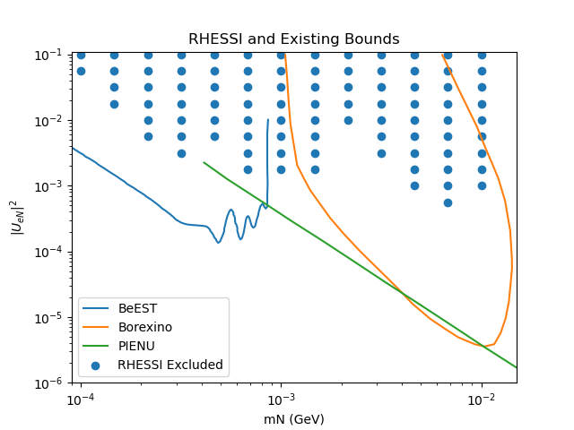
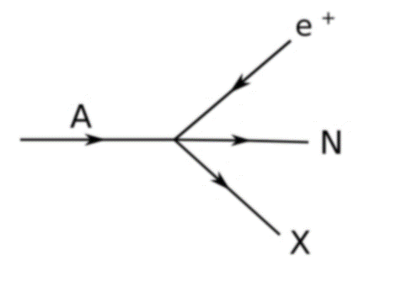
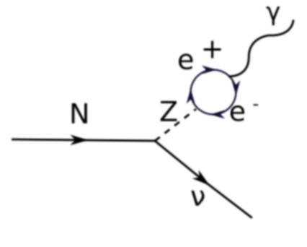

Mass Mixing Model
Production
Parameters:
$U_{eN}$ (HNL-electron neutrino coupling)
$m_{N}$ (HNL mass)
Decay
PIENU- [8] Bryman, D. A., & Shrock, R. (2019).
BeEST- [9] Friedrich, S., Kim, G. B., Bray, C., Cantor, R., Dilling, J., Fretwell, S., ... & Leach, K. G. (2021). Bellini, G., Benziger, J., Bick, D., Bonfini, G., Bravo, Borexino- [10] D., Avanzini, M. B., ... & Borexino Collaboration. (2013).

Slide 19
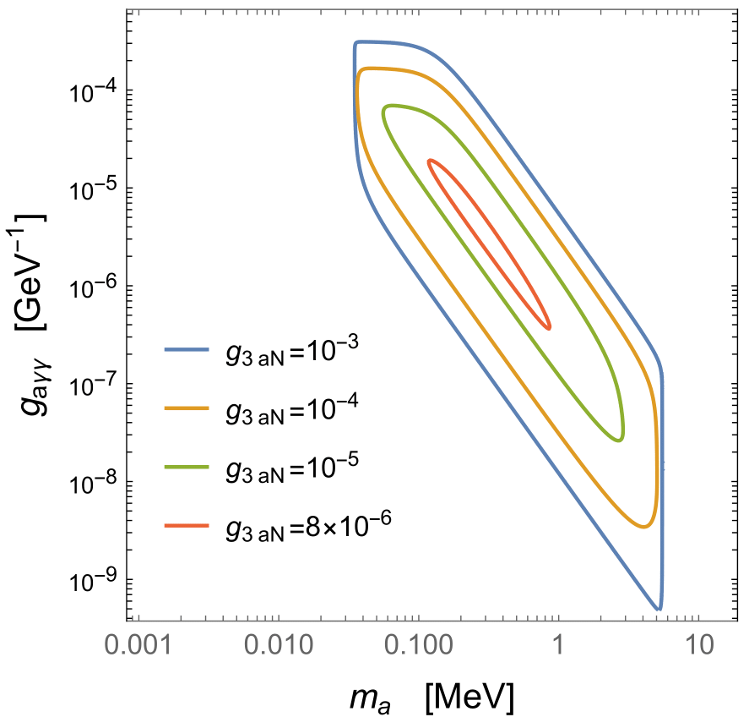
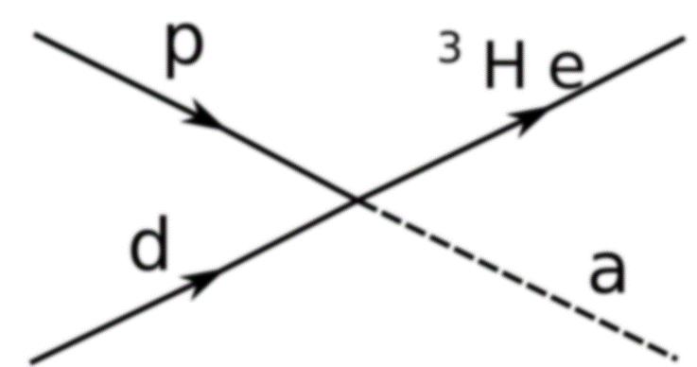
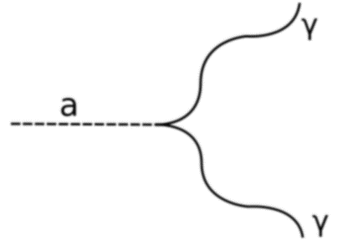

Solar Axion
Parameters:
$g_{3aN}$ (isovector coupling of axions to nucleons)
$g_{aγγ}$ (coupling of axions to photons)
$m_{a}$ (axion mass)
Production
Decay

Slide 20
Further Improvements
Currently, we have no model for the solar background, so we place bounds where the BSM flux exceeds the observed flux. If we had a background model, then our exclusion could improve with exposure.
We do not currently consider the angular distribution of the BSM flux. Doing so could reduce our background (we could see a “halo” of light from decays around the Sun).

Slide 21
References
[1] Coloma, P., Machado, P. A., Martinez-Soler, I., & Shoemaker, I. M. (2017). Double-cascade events from new physics in IceCube. Physical Review Letters, 119(20), 201804
[2] Gustafson, R. A., Plestid, R., & Shoemaker, I. M. (2022). Neutrino portals, terrestrial upscattering, and atmospheric neutrinos. Physical Review D, 106(9), 095037.
[3] Smith, D. M., Lin, R. P., Turin, P., Curtis, D. W., Primbsch, J. H., Campbell, R. D., ... & Schwartz, R. (2003). The RHESSI spectrometer. The Reuven Ramaty High-Energy Solar Spectroscopic Imager (RHESSI) Mission Description and Early Results, 33-60.
[4] Magill, G., Plestid, R., Pospelov, M., & Tsai, Y. D. (2018). Dipole portal to heavy neutral leptons. Physical Review D, 98(11), 115015.
[5] Brdar, V., Greljo, A., Kopp, J., & Opferkuch, T. (2021). The neutrino magnetic moment portal: cosmology, astrophysics, and direct detection. Journal of Cosmology and Astroparticle Physics, 2021(01), 039.
[6] "Comprehensive measurement of pp-chain solar neutrinos." Nature 562, no. 7728 (2018): 505-510.
[7] Plestid, R. (2021). Luminous solar neutrinos. I. Dipole portals. Physical Review D, 104(7), 075027.
[8] Bryman, D. A., & Shrock, R. (2019). Improved constraints on sterile neutrinos in the MeV to GeV mass range. Physical Review D, 100(5), 053006.
[9] BeEST- Friedrich, S., Kim, G. B., Bray, C., Cantor, R., Dilling, J., Fretwell, S., ... & Leach, K. G. (2021). Limits on the Existence of sub-MeV Sterile Neutrinos from the Decay of Be 7 in Superconducting Quantum Sensors. Physical Review Letters, 126(2), 021803.
[10] Bellini, G., Benziger, J., Bick, D., Bonfini, G., Bravo, D., Avanzini, M. B., ... & Borexino Collaboration. (2013). New limits on heavy sterile neutrino mixing in B 8 decay obtained with the Borexino detector. Physical Review D, 88(7), 072010.

Slide 22
Thank You!
Questions?

Slide 23

Extra Slide 1: Theory Equations
Dipole Lagrangian
$$L_{int}=\sum_{a}{d_{a}F^{μν}\overline{N}σ_{μν}P_{L}ν_{a}}$$
Mass-Mixing Portal
$$ν_{e}=U_{eN}N+ \sum_{i=1}^{3}{U_{ei}ν_{i}}$$

Slide 24

Extra Slide 2: Flux Calculations
Photon Flux from HNL Flux
$$Φ_{γ}=Φ_{N}\left[\exp\left(−\frac{R_{⊙}}{λ}\right)−\exp\left(−\frac{d_{⊙}}{λ}\right)\right]$$
Mass-Mixing HNL Flux
$$Φ_{N}=Φ_{ν}{\left|U_{eN}\right|}^{2}\sqrt{1−m_{N}^{2}/E_{N}^{2}}$$
Photon Flux for Axions
$$Φ_{γ}=Φ_{ν}^{pp}{\left|g_{3an}\right|}^{2}{\left[\frac{p_{a}}{p_{γ}}\right]}^{2}\left[\exp\left(−\frac{R_{⊙}}{l_{abs}}\right)−\exp\left(−\frac{d_{⊙}}{λ}\right)\right]$$
Where $l_{abs}^{−1}=λ^{−1}+l_{scatter}^{−1}$

