Slide 1


A phenomenological study of higgs jets at a muon collider
JAY DESAI
ADVISOR:
GEORGE STERMAN

Slide 2
outline
Muon colliders
Vector boson Fusion and collinear factorization
Super-renormalizable splitting
QCD di-jet events
Comparison plots

Slide 3
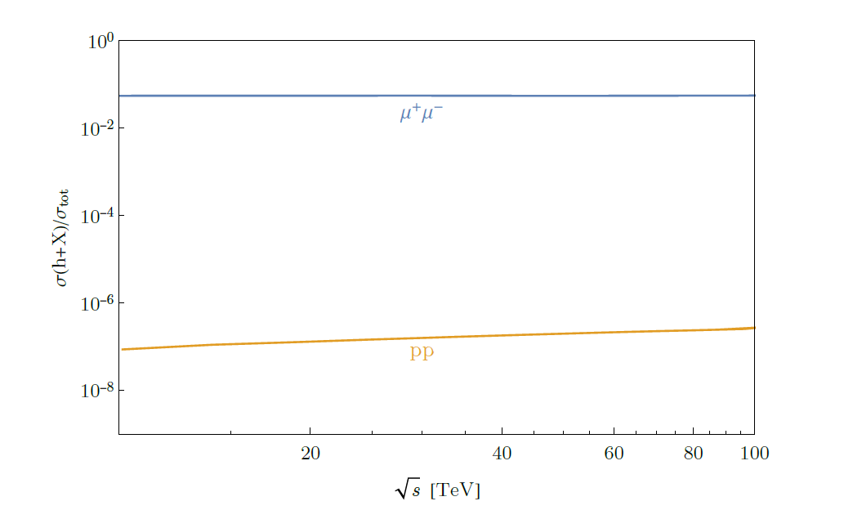
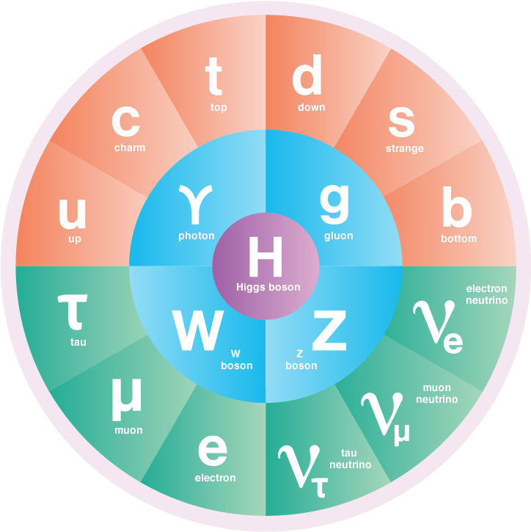
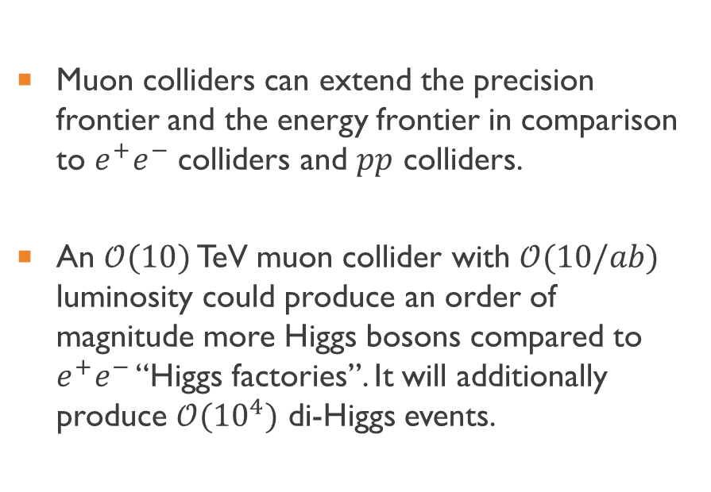
Case for a muon collider
Muon colliders can extend the precision frontier and the energy frontier in comparison to $e^{+}e^{−}$ colliders and $pp$ colliders.
An $𝒪(10)$ TeV muon collider with $𝒪(10/ab)$ luminosity could produce an order of magnitude more Higgs bosons compared to $e^{+}e^{−}$ “Higgs factories”. It will additionally produce $𝒪({10}^{4})$ di-Higgs events.
Higgs production as a fraction of “total” cross-section
image ref: Symmetry Magazine
ref: The Muon Smasher’s Guide
Notes:
Now, we know that Standard Model has been one of the most successful theory in Physics. And, I don’t need to explain the importance of the Higgs boson, in this conference, as it has been very pivotal for the successes of the SM
So, understanding its properties is of significant importance. There are many proposals for Future colliders that could potentially achieve that. One of them is the Muon collider.
While these numbers are low compared to an$𝒪(100)$ TeV $pp$ collider, muon colliders provide a cleaner environment for analysis.
. For muC, higgs production is the LO mu+mu- to h, and total cross-section is single electroweak boson production, dominated by VBF. For pp colliders, higgs production is N3LO cross-section gg->h. while the total cross-section is pp->bb(bar).

Slide 4
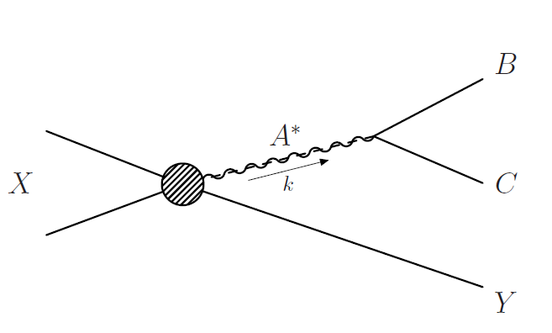
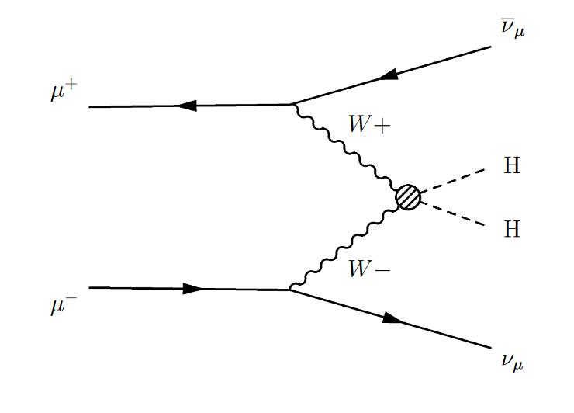

Vector-boson fusion &
Collinear factorization
Vector boson fusion provides a dominant channel.
We consider collinear factorization in final state splittings for High-energy electroweak processes.
If the daughter particles B and C are approximately collinear to the offshell parent particle A*, we have
$dσ_{Y,BC}≃dσ_{Y,A^{∗} }×dP_{A^{∗}→B+C}$
To compute the hard cross-section, we convolute the partonic cross-section with the W-boson PDFs.
ref: T. Han et.al. arXiv:1611.00788v2
Cuomo et. al. arXiv:1911.12366v2
ref: T. Han et.al. arXiv:2007.14300v3
Notes:
For Muon collider, VBF provides ..
We look at the hard process W+ W- to HH to study the phenomenon that we are interested.
Where, a an offshell A* splits into two daughter particles B and C. If they are approximately collinear , the cross-section factorizes as shown. We can compute the hard cross-section separately, which for our case will be computing the partonic cross-section W+W- to HH that is convoluted with the W-boson PDFs for high-energy muons.
Assuming collinear factorization holds true at high energies, we can compute the hard cross-section separately

Slide 5
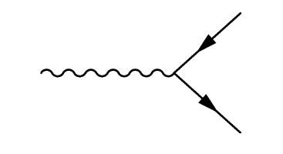
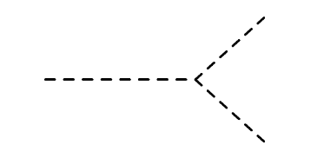
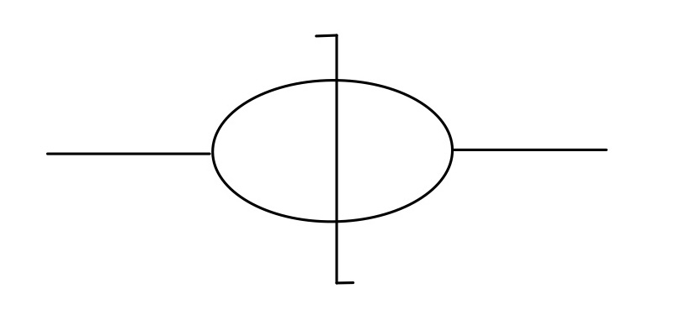

Super-renormalizable splitting
All gauge and Yukawa splittings in the unbroken electroweak theory scale as $dk_{T}^{2}/k_{T}^{2}$, so typical splittings in the broken theory scale the same way.
After SSB, we also have ‘super-renormalizable’ splittings (or ultra-collinear) in the broken theory that scale as $m^{2}dk_{T}^{2}/k_{T}^{4}$
In particular, we look at $h→hh$ splitting. We can calculate the jet function cross-section for the process with an offshell initial Higgs at an observed invariant jet mass $m$
${ J}_{H}(m^{2})=\frac{λ^{2}v^{2}}{16π}\frac{\sqrt{1−\frac{4m_{h}^{2}}{m^{2}}}}{ {\left(m^{2}−m_{h}^{2}\right)}^{2}}$
ref: T. Han et.al. arXiv:1611.00788v2
Notes:
For the splitting probabilities, once we integrate out the azimuthal orientation, the splitting kinematics can be parametrized with two variables: a dimensionful scale (k_T) and a dimensionless scaling variable z.
While because of SSB, we have a new type of splittings known as ultra-collinear splittings in the reference we mentioned below. They exhibit an interesting property for final state Higgs jets as we will see.
In particular, we look at h->hh splitting that is a ‘super-renormalizable’ splitting. We calculate the jet-function cross-section for the process with an offshell initial Higgs that splits into two on-shell Higgs at an observed invariant jet mass m. These ‘super-renormalizable’ jets would be interesting to observe in a high-energy muon collider.

Slide 6
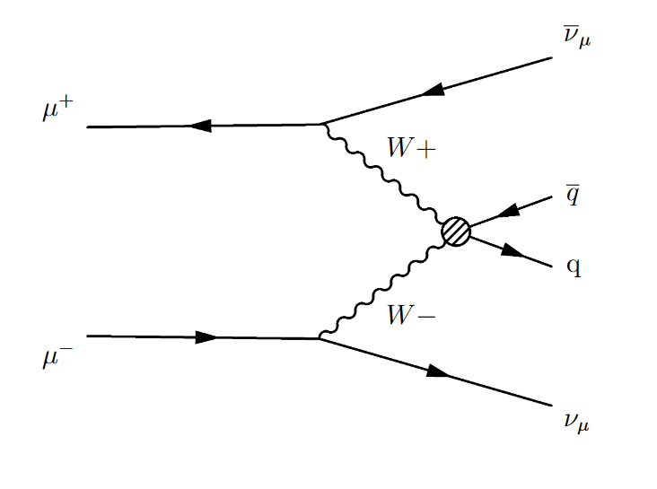
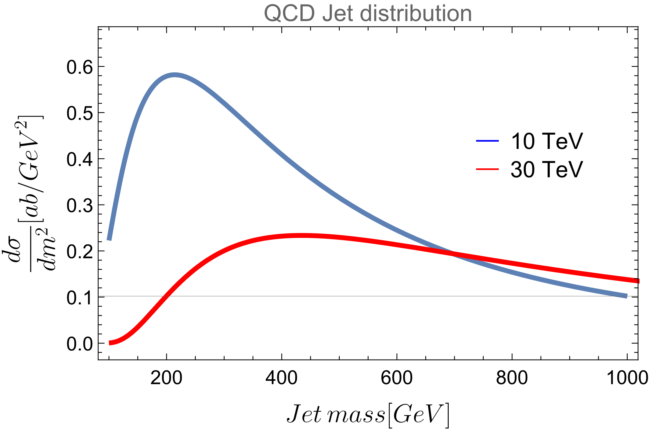
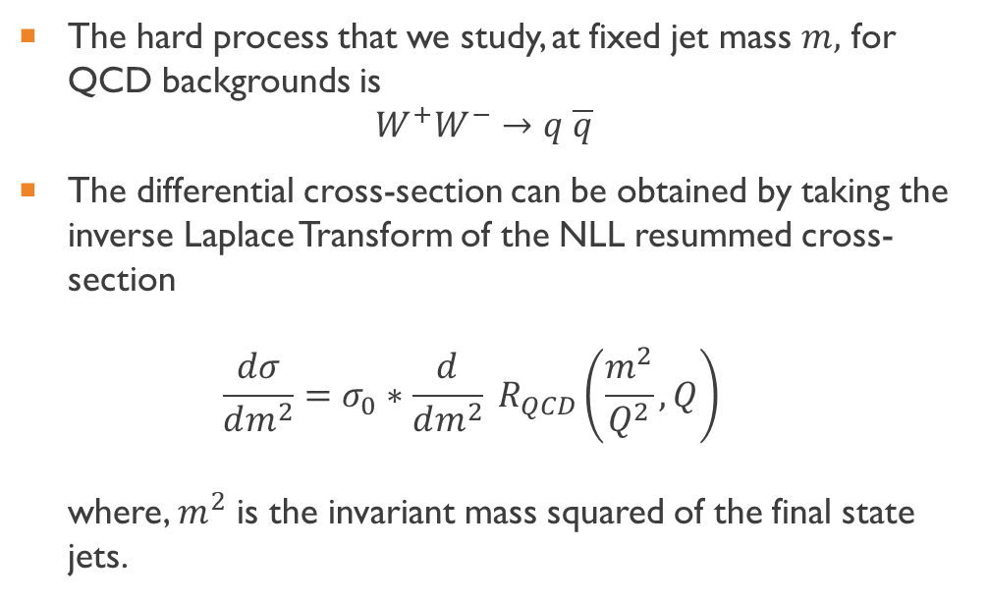
Qcd background
The hard process that we study, at fixed jet mass $m,$ for QCD backgrounds is
$W^{+}W^{−}→q \overline{q}$
The differential cross-section can be obtained by taking the inverse Laplace Transform of the NLL resummed cross-section
$\frac{dσ}{dm^{2}}=σ_{0}∗\frac{d}{dm^{2}} R_{QCD}\left(\frac{m^{2}}{Q^{2}},Q\right)$
where, $m^{2}$ is the invariant mass squared of the final state jets.
ref: C. Berger, G. Sterman arXiv:hep-ph/0307394v2
S. Catani et.al Nuclear Physics B, Volume 407, Issue 1, 1993, Pages 3-42, ISSN 0550-3213
Notes:
We compare it with QCD background. The dominant channel will be VBF and the hard process …
We calculate the hard cross- section in a similar way where we take the partonic cross-section and convolute it with the W-boson PDFs for high-energy muons.
The NLL resumed cross-section exponent is well-understood object in QCD. The resummation for e+e- annihilation was calculated in the paper by Catani and others, while the reference above does the calculation for a thrust-like event shape variable, angularity that is infrared-safe. We can use that integrated cross-section for mu+mu- processes as it will only differ by mass effects.
Here, R is the integrated cross-section and one uses an infrared safe event-shape variable, thrust for the calculation.
We show the plots of the QCD background jet distribution as a function of the jet invariant mass.
Further explanation that gives us this distribution is given in my backup slides.

Slide 7
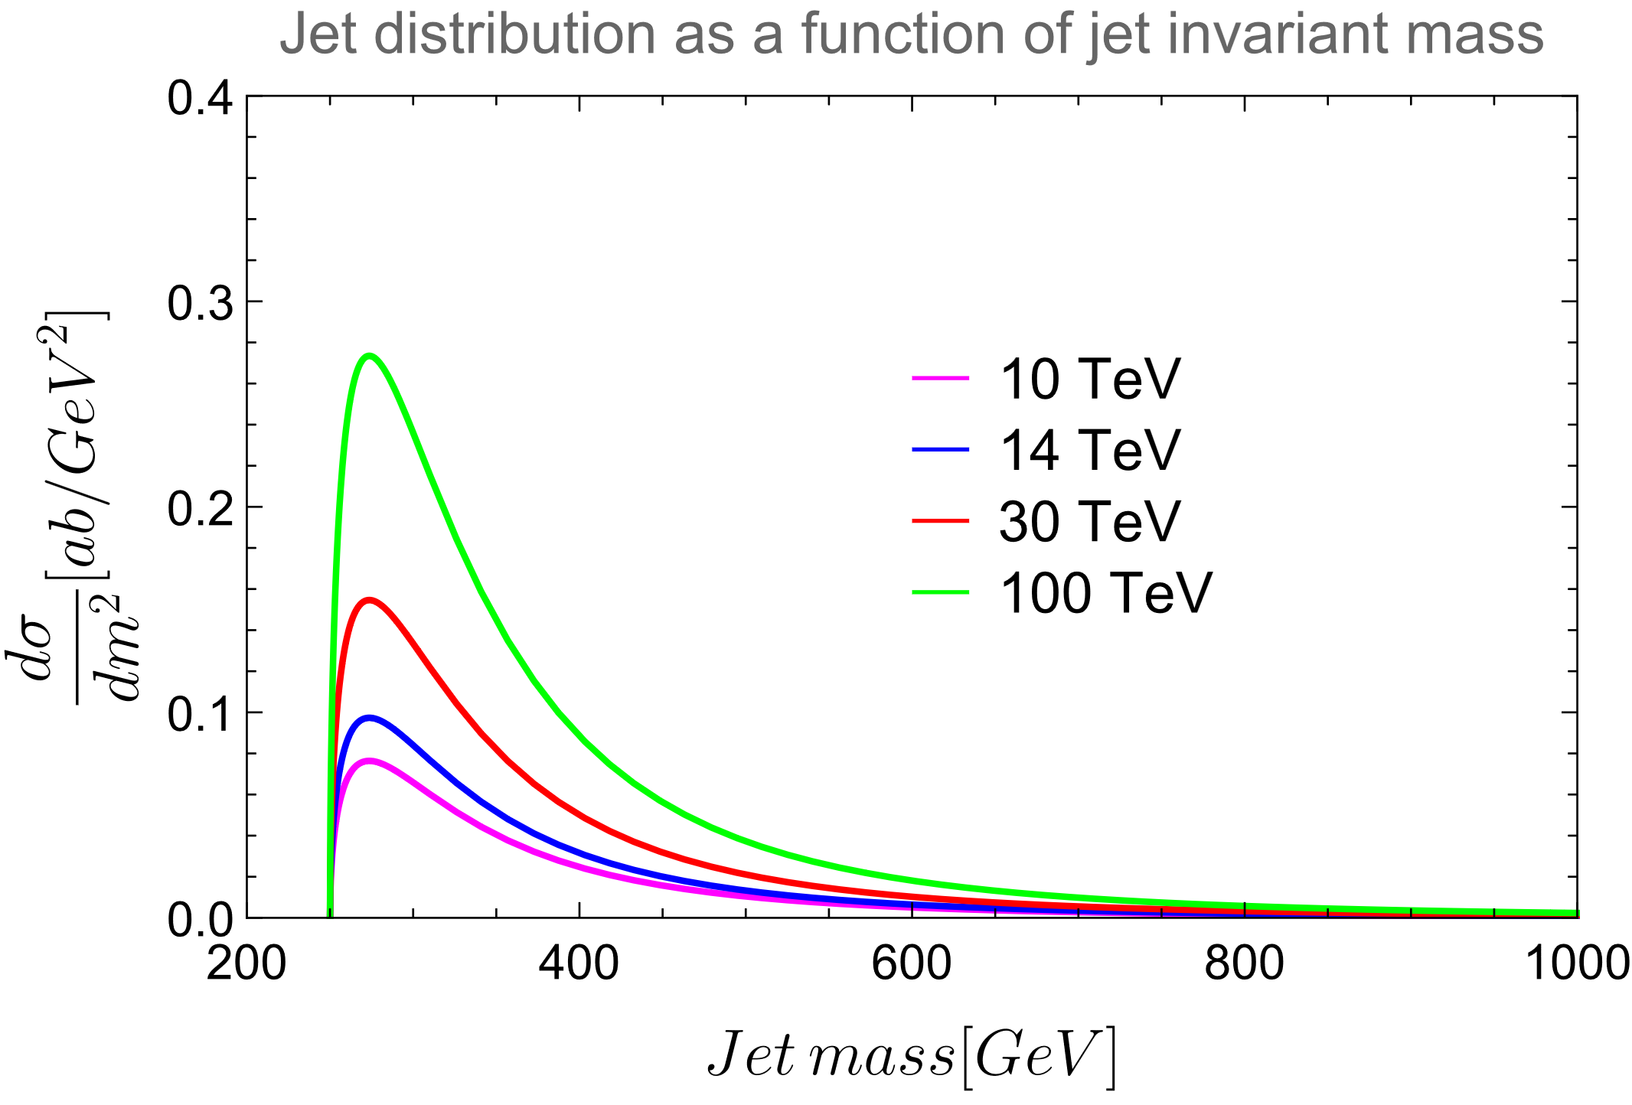
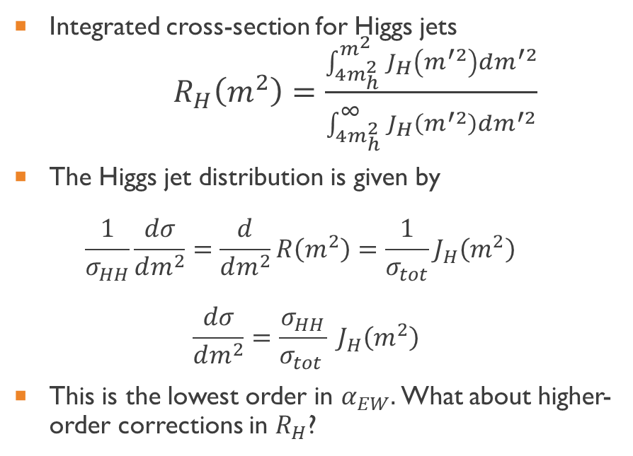
Super-renormalizable HIGGS Jet distribution
Integrated cross-section for Higgs jets
$R_{H}\left(m^{2}\right)=\frac{\int_{4m_{h}^{2}}^{m^{2}}{J_{H}\left(m^{′2}\right)dm^{′2}}}{\int_{4m_{h}^{2}}^{∞^{}}{J_{H}\left(m^{′2}\right)dm^{′2}}}$
The Higgs jet distribution is given by
$\frac{1}{σ_{HH}}\frac{dσ}{dm^{2}}=\frac{d}{dm^{2}}R\left(m^{2}\right)=\frac{1}{σ_{tot}}J_{H}\left(m^{2}\right)$
$\frac{dσ}{dm^{2}}=\frac{σ_{HH}}{σ_{tot }} J_{H}\left(m^{2}\right)$
This is the lowest order in $α_{EW}.$What about higher-order corrections in $R_{H}$?
Notes:
Now, we calculate the differential cross-section distribution for “super-renormalizable” jets from the Jet function we calculated by using the Integrated cross-section.
It will be scaled to the Hard cross-section of mu+mu- to HH via VBF.
These jets have the property that even at different cms, they peak slightly above 2 m_H. As, we go to higher energies, the peak doesn’t shift to a higher invariant jet mass.

Slide 8
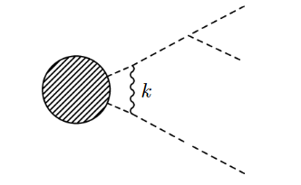
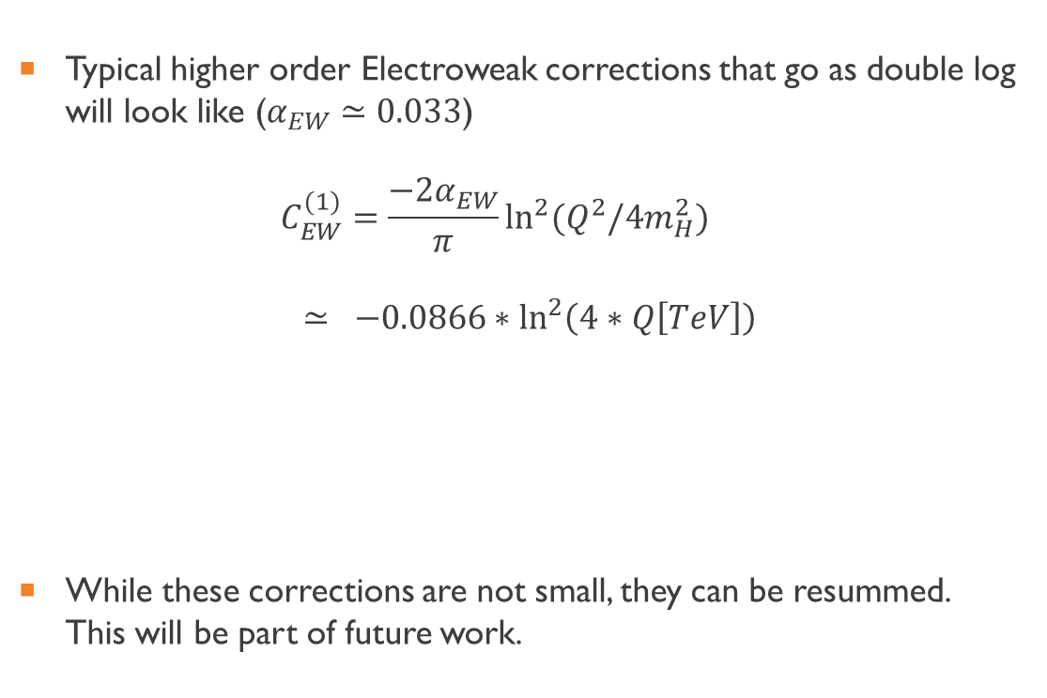

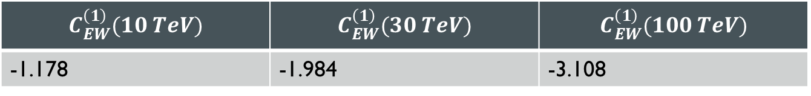
Electro-weak corrections
Typical higher order Electroweak corrections that go as double log will look like ($α_{EW}≃0.033$)
$C_{EW}^{(1)}=\frac{−2α_{EW}}{π}\ln^{2}{(Q^{2}/4m_{H}^{2})}$
$≃ −0.0866∗\ln^{2}\left(4∗Q\left[TeV\right]\right)$
While these corrections are not small, they can be resummed. This will be part of future work.
$$4m_{H}^{2}≪k_{⊥}^{2}≪Q^{2}$$
$$C_{EW}^{\left(1\right)}(10 TeV)$$ | $$C_{EW}^{\left(1\right)}(30 TeV)$$ | $$C_{EW}^{\left(1\right)}(100 TeV)$$
-1.178 | -1.984 | -3.108
Notes:
Typical higher-order electroweak corrections
These will have a double log structure. In the infrared they will be regulated by 2*m_H as we want two on-shell Higgs in the final state splittings.
These corrections are not small, but they can be resummed. But, they will give us Sudakov suppression but not change the qualitative picture.
This jet will be a sub-jet in that process and one would need experimental techniques to separate out Electro-weak background.

Slide 9
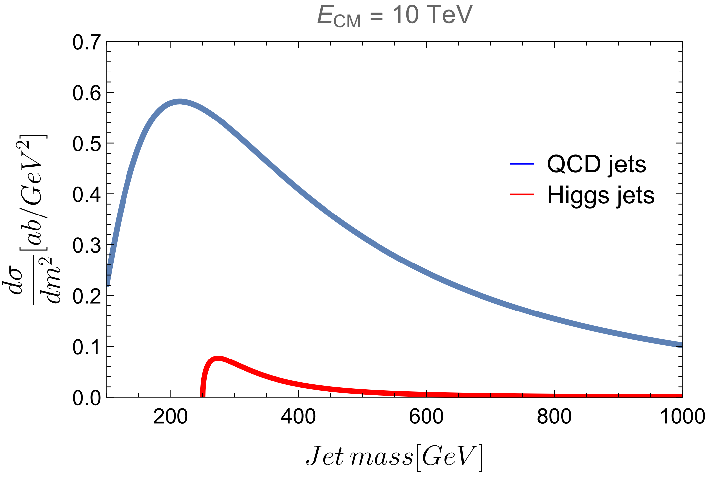
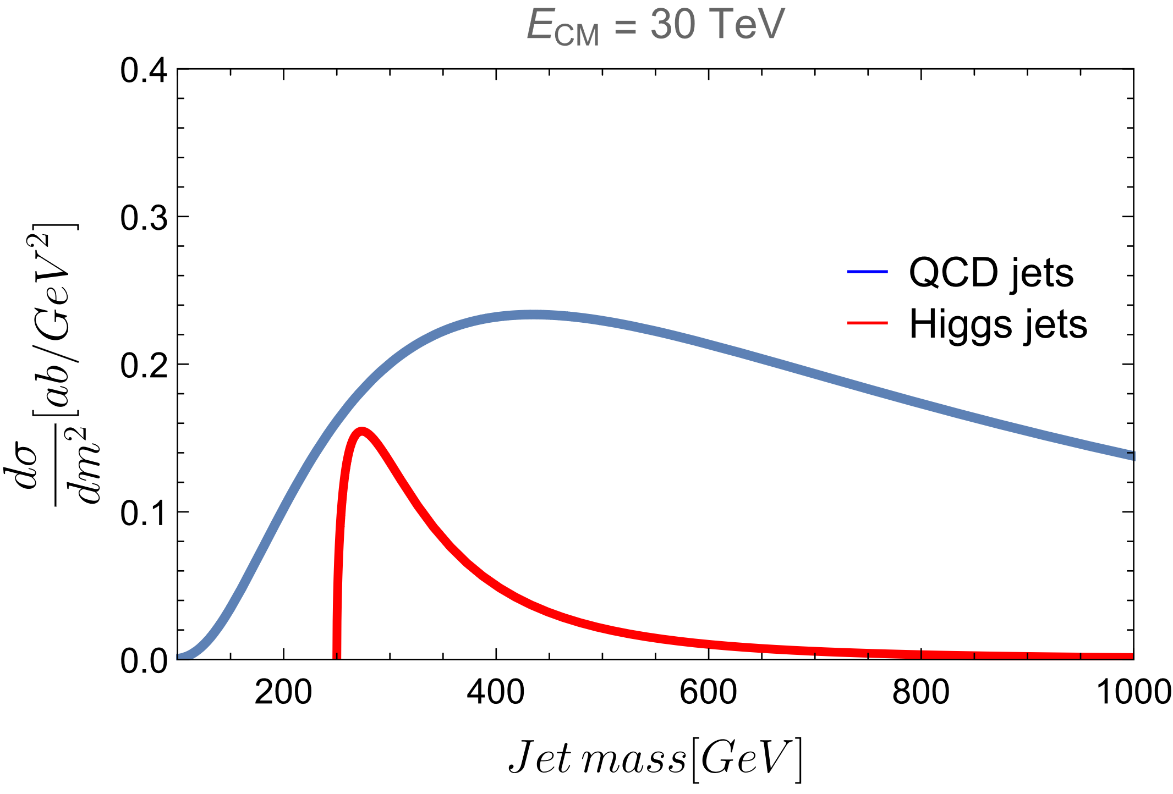
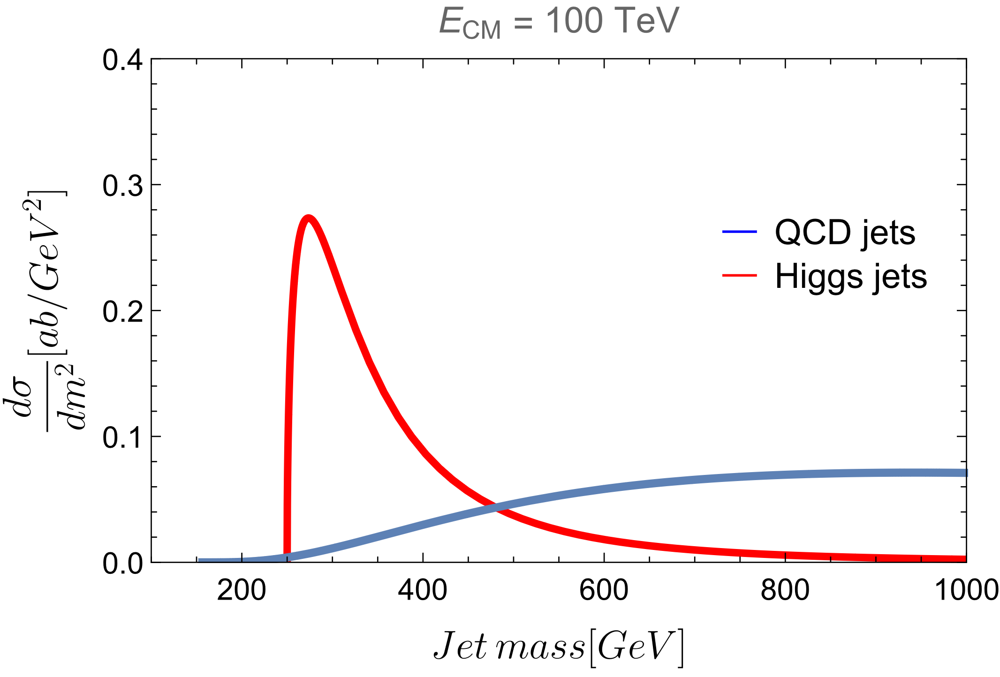



Comparison plots
$$C_{EW}^{\left(1\right)} \left(10 TeV\right)=−1.178$$
$$C_{EW}^{\left(1\right)} \left(30 TeV\right)=−1.984$$
$$C_{EW}^{\left(1\right)} \left(100 TeV\right)=−3.108$$
Notes:
We see that the QCD jets have a tendency that their peak shifts towards higher invariant jet mass. In the case of very high energy of 100 TeV, we have a very distinct signal and the background is completely shifted to higher invariant jet mass. But, even at low cms, we see that there is a potential for observing a unique kind of jet. These jets have their peaks slightly above 2*m_H even for very high energies. The higher order EW corrections are not small, but they can be resummed, but they won’t change this qualitative feature. Namely, these super-renormalizable Higgs jets won’t spread due to corrections in invariant mass. They fall of as 1/m^4. This will be a part of the future work.
This jet could be a sub-jet in a larger electroweak jet and one would need experimental techniques to separate out Electro-weak background.

Slide 10
conclusions
We calculated the “Super-renormalizable” Higgs jet distribution at lowest order in the Jet function and the Hard cross section.
We showed that at higher center of mass energies, the Higgs jet distribution shows a distinctive peak compared to QCD background jets.
The higher order EW corrections, albeit not small, can be handled via resummation. They will give us Sudakov suppression but won’t change the qualitative picture.
Muon collider could provide an interesting opportunity to observe these jets with applications to test BSM physics.
Notes:
There is a unique
Potential BSM models with such similar triple coupling of scalars could also enhance the cross-section peak for these types of jets and this could be an interesting channel to test those models.
Hadron colliders have backgrounds that scale with collider energy. Sensitivity to triple-Higgs coupling of SM can be matched by an O(10) TeV muon collider.

Slide 11
Works cited
Carola F. Berger and George Sterman JHEP09(2003)058, “Scaling rule for nonperturbative radiation in a class of event shapes”
Tao Han, Yang Ma, and Keping Xie Phys. Rev. D 103, L031301, “High energy leptonic collisions and electroweak parton distribution functions”
Chen, J., Han, T. & Tweedie, B. Electroweak splitting functions and high energy showering. J. High Energ. Phys. 2017, 93 (2017). https://doi.org/10.1007/JHEP11(2017)093
S. Catani, L. Trentadue, G. Turnock, B.R. Webber, “Resummation of large logarithms in e+e− event shape distributions”, Nuclear Physics B, 1993, ISSN 0550-3213,
https://arxiv.org/abs/2103.14043, “The Muon Smasher’s Guide”
G. Cuomo, L. Vecchi, A. Wulzer, Goldstone equivalence and high energy electroweak physics, SciPost Phys. 8 (5) (2020) 078, http://dx.doi.org/10.21468/SciPostPhys.8.5.078, arXiv:1911.12366

Slide 12
Thank you for listening
Any Questions or Comments?

Slide 14
BACKUP SLIDES

Slide 15
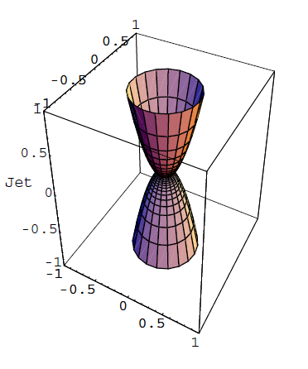

Qcd background
ALTERNATE
For a fixed jet mass, $m$, we consider a well-known infrared safe event shape variable, Thrust.
$1−\frac{m^{2}}{Q^{2}}≃1−τ≡T\left(N\right)=\max_{\hat{n}}{\frac{\sum_{i}{\left|\vec{p_{i}}. \hat{n}\right|}}{\sum_{j}{\left|\vec{p_{j}}\right|}}}$
The differential cross-section for such di-jet events at fixed values of $τ$ is given by
$\frac{dσ(τ,Q)}{dτ}=\frac{1}{2Q^{2}} \sum_{N}{{\left|M\left(N\right)\right|}^{2} δ(τ −τ(N))}$
We work with the integrated cross-section or Radiator calculated for the $e^{+}e^{−}$ annihilation
$R\left(τ,Q\right)=\frac{1}{σ_{tot}}\int_{0}^{τ}{dτ′ \frac{dσ\left(τ′,Q\right)}{dτ′}}$
ref: https://arxiv.org/abs/hep-ph/0307394v2
ref: S. Catani et.al Nuclear Physics B, Volume 407, Issue 1, 1993, Pages 3-42, ISSN 0550-3213
Notes:
Now, we compare this to QCD Background di-jet events.
In the limit, tau<<1, we have di-jet events.
To calculate the differential cross-section, we first go to the Laplace transform space to perform the Resummation and obtain the Next to leading log resummed exponent in the moment space.

Slide 16
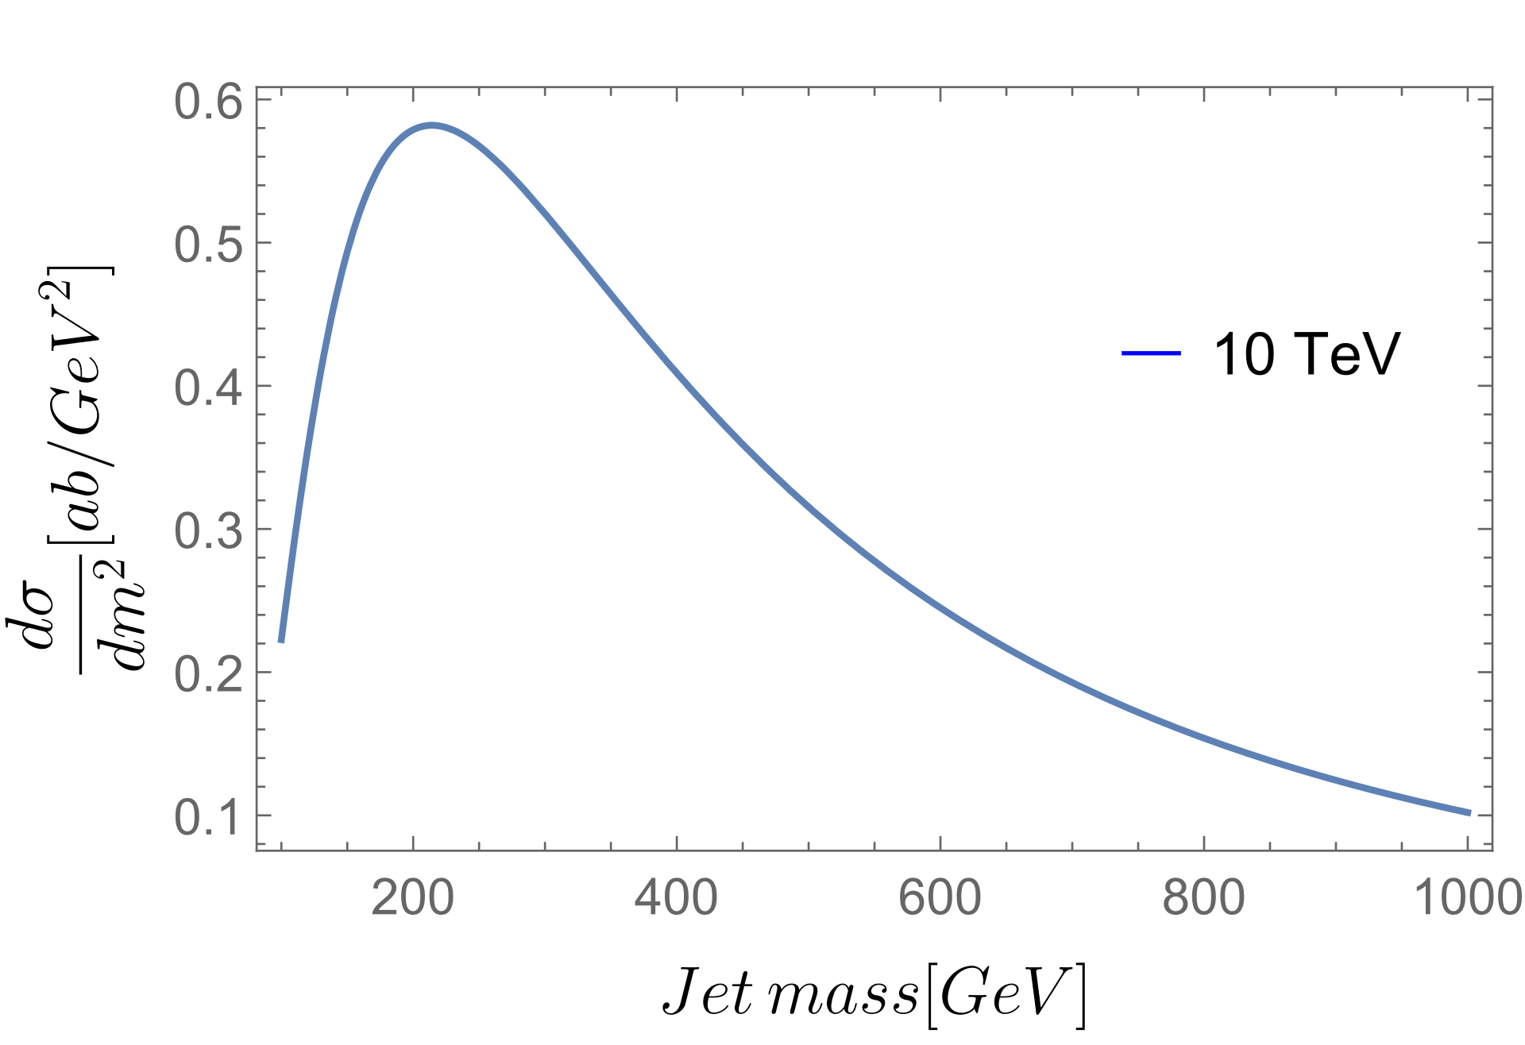
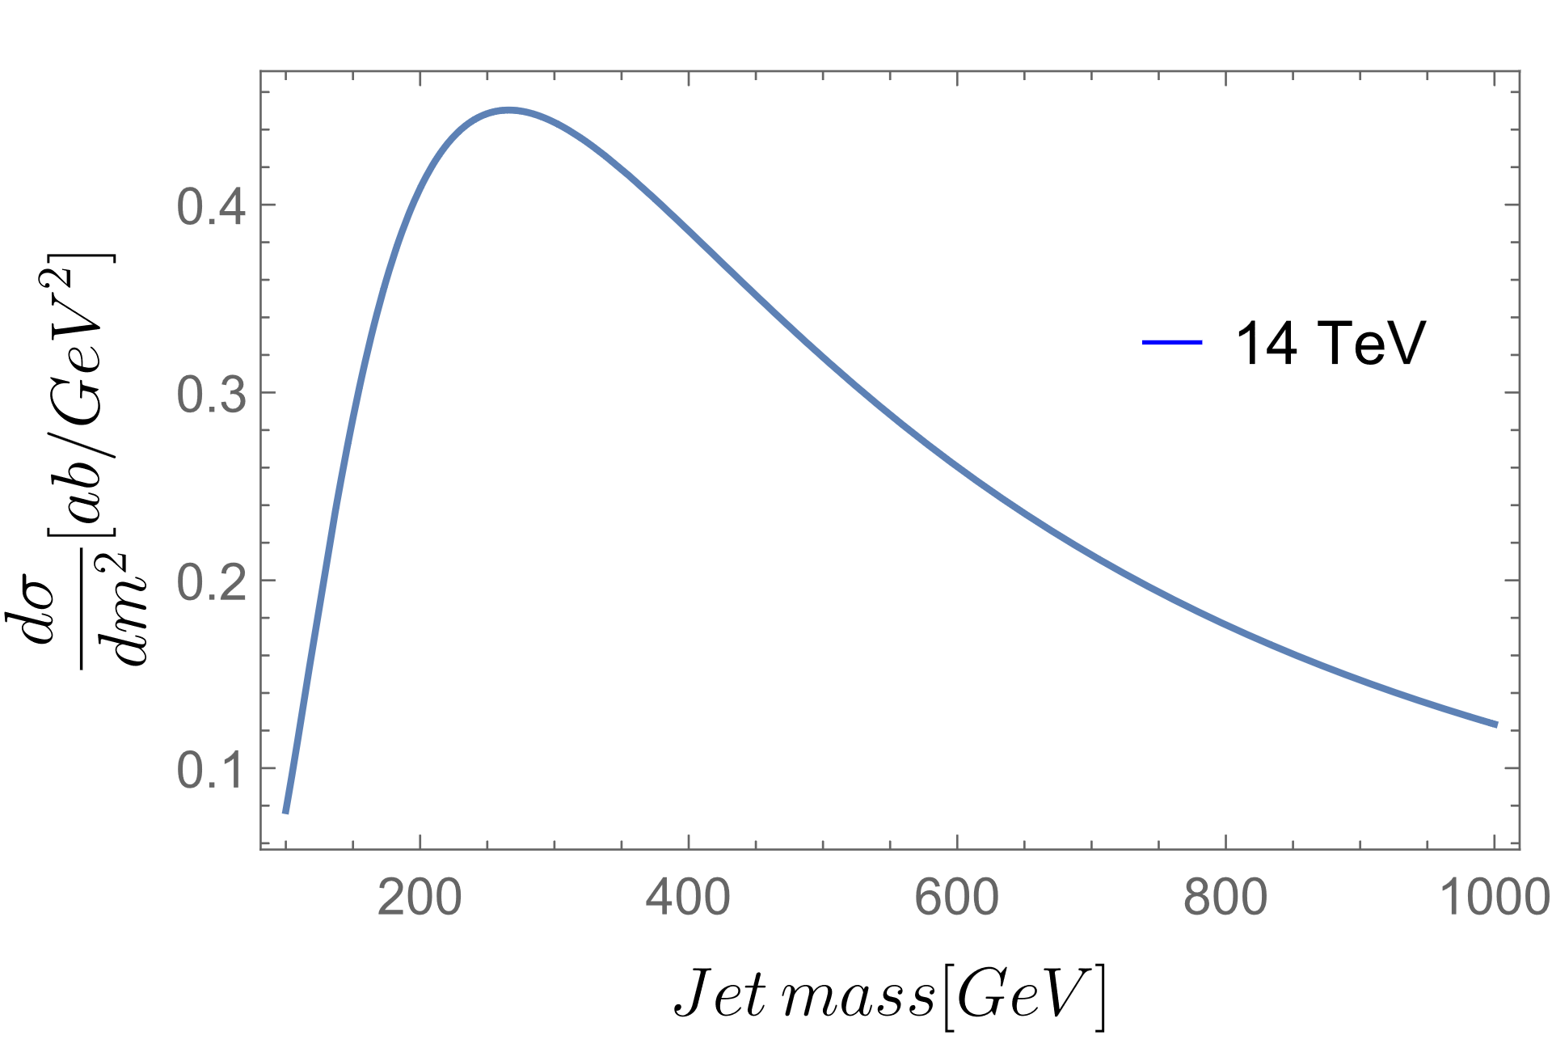

Qcd background
The differential cross-section can be obtained by taking the inverse Laplace Transform of the NLL resummed exponent to get the Radiator.
$\frac{1}{σ_{tot}}\frac{dσ\left(τ,Q\right)}{dτ}=\frac{1}{τ}\frac{d}{d lnτ} R(τ,Q)$
Using $τ=m^{2}/Q^{2}$, we calculate $dσ/dm^{2}$
The hard process that we study, at fixed jet mass $m,$ for QCD backgrounds is
$W^{+}W^{−}→q \overline{q}$
ref: https://arxiv.org/abs/hep-ph/0307394v2
ref: S. Catani et.al Nuclear Physics B, Volume 407, Issue 1, 1993, Pages 3-42, ISSN 0550-3213
Notes:
Here m^2 is the invariant mass squared of the final state jets.
The resummation for e+e- annihilation was calculated in the paper by Catani and others, while the reference above does the calculation for a thrust-like event shape variable, angularity. We can use that integrated cross-section for mu+mu- processes as it will only differ by mass effects. The dominant channel will be VBF and the hard process …
Now, the explicit form of the Radiator that gives us this distribution is given in my backup slides.

Slide 17
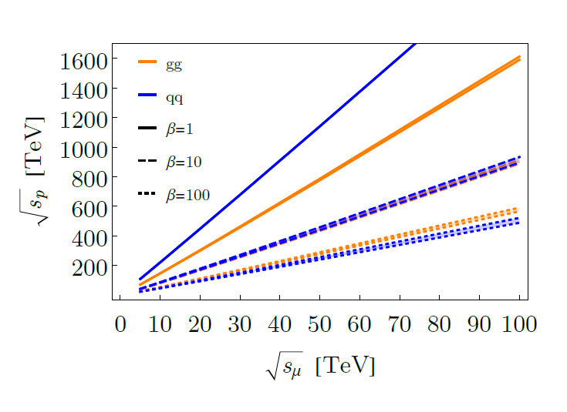
Muon collider
Equivalent cross-section at pp collider v/s muon collider
Higgs production as a fraction of “total” cross-section
image ref: The Muon Smasher’s Guide
Notes:
On the right, we have ratio of higgs production to total cross-section. For muC, higgs production is the LO mu+mu- to h, and total cross-section is single electroweak boson production, dominated by VBF. For pp colliders, higgs production is N3LO cross-section gg->h. while the total cross-section is pp->bb(bar).

Slide 18
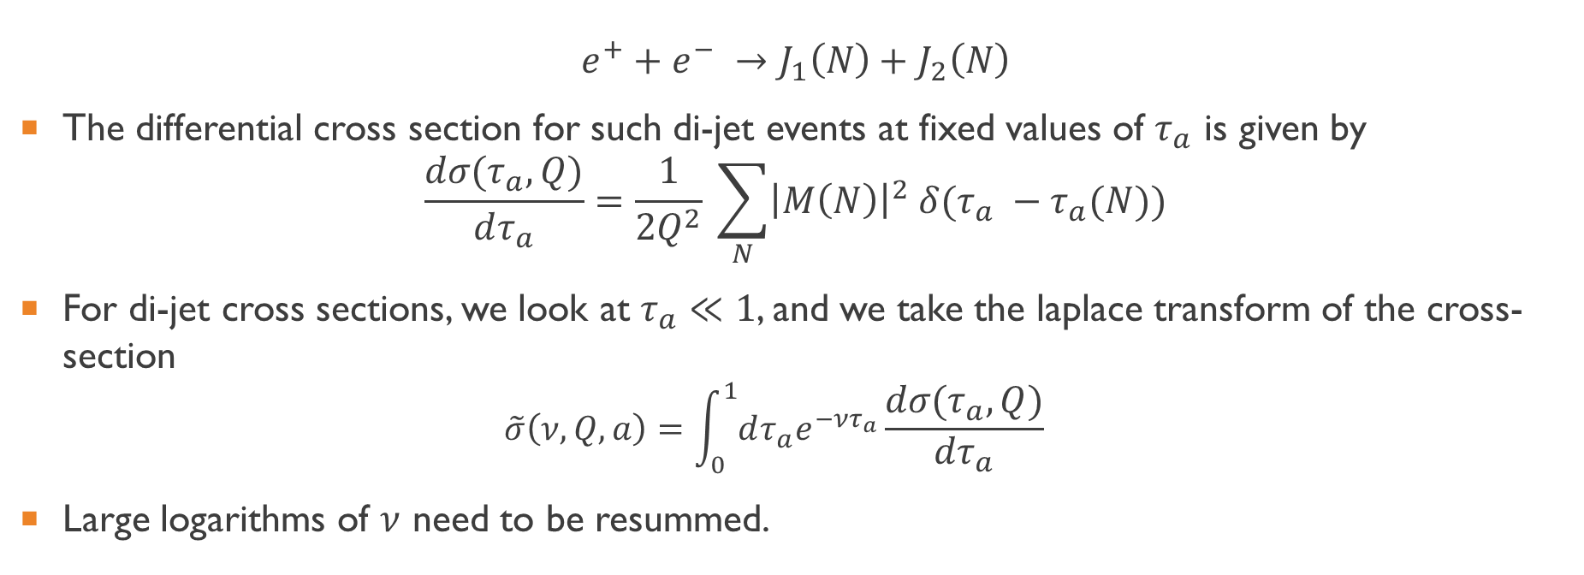
Di-jet cross section
$$e^{+}+e^{−} →J_{1}\left(N\right)+J_{2}\left(N\right)$$
The differential cross section for such di-jet events at fixed values of $τ_{a}$ is given by
$\frac{dσ(τ_{a},Q)}{dτ_{a}}=\frac{1}{2Q^{2}} \sum_{N}{{\left|M\left(N\right)\right|}^{2} δ(τ_{a} −τ_{a}(N))}$
For di-jet cross sections, we look at $τ_{a}≪1$, and we take the laplace transform of the cross-section
$\tilde{σ}\left(ν, Q, a\right)=\int_{0}^{1}{dτ_{a}e^{−ντ_{a}}}\frac{dσ(τ_{a},Q)}{dτ_{a}}$
Large logarithms of $ν$ need to be resummed.
Notes:
We sum over all final states N that contribute to the weighted event, and M(N) is the corresponding amplitude.
For small tau_a, the cross-section has corrections in ln(1/tau_a)

Slide 19

Resummed cross-section at NLL
The Next-to-leading-log (NLL) resummed cross-section for $a<1$ in moment space, can be written as
$\frac{1}{σ_{tot}} \tilde{σ}\left(ν, Q, a\right)=\exp{\{2\int_{0}^{1}{\begin{aligned} \\ \\ \\ \frac{du}{u}[\int_{u^{2}Q^{2}}^{uQ^{2}}{\frac{dp_{T}^{2}}{p_{T}^{2}}A\left(α_{s}\left(p_{T}\right)\right)\left(e^{−u^{1−a}ν{\left(p_{T}/Q\right)}^{a}}−1\right)} \\ +\frac{1}{2}B(α_{s}(Q√u))(e^{−u{\left(ν/2\right)}^{\frac{2}{2−a}}}−1)]\}\end{aligned}}}$
$≡{\left[𝒥\left(ν, Q,a\right)\right]}^{2}$
Notes:
The resummed cross-section in transform space was calculated for the thrust variable in the paper by Catani, et.al. This resummation for the generalized weight function with ‘angularity’ is performed in the paper by Sterman and Berger.

Slide 20

Resummed cross-section at NLL
The resummation is in terms of anomalous dimensions $A\left(α_{s}\right)$ and $B(α_{s})$ which have finite expressions in the running coupling,
$A\left(α_{s}\right)=\sum_{n=1}^{∞}{A^{\left(n\right)}{\left(\frac{α_{s}}{π}\right)}^{n}}$
The coefficients of the perturbative expansion are well known at NLL,
$A^{(1)}=C_{F}, B^{(1)}=−\frac{3}{2}C_{F}$
$A^{(2)}=\frac{1}{2}C_{F}[C_{A}\left(\frac{67}{18}−\frac{π^{2}}{6}\right)−\frac{10}{9}T_{F}N_{f}]$
Notes:
The resummed cross-section is ambiguous, because of the singularity of the perturbative running coupling. We re-express the running coupling in terms of the coupling at a hard scale, to perform the inversion.
Anomalous dimensions come from the Renormalization group flow equations or the evolution equations of the Hard, soft and Jet functions one uses when performing the resummation.

Slide 21

Radiator
We work with integrated cross-section or the Radiator
$R\left(τ_{a},Q\right)=\frac{1}{σ_{tot}}\int_{0}^{τ_{a}}{dτ_{a}^{′} \frac{dσ\left(τ_{a}^{′},Q\right)}{dτ_{a}^{′}}}$
The Radiator can be directly calculated from the jet function $𝒥\left(ν,Q,a\right)$ in transform space by
$R\left(τ_{a},Q\right)=\frac{1}{2πi}{{\int_{C}{\frac{dν}{ν}e^{ντ_{a}}}[𝒥{\left(ν,Q,a\right)]}^{2}}^{}}^{}$
$$R\left(τ_{a},Q\right)=\frac{\exp\left\{2\ln\left(\frac{1}{τ_{a}}\right)g_{1}\left(x,a\right)+2g_{2}\left(x,a\right)+2\left(2−a\right)x^{2}\ln\left(\frac{2μ}{Q}\right)g_{1}^{′}\left(x,a\right)\right\}}{Γ\left[1−2g_{1}\left(x,a\right)−2xg_{1}^{′}\left(x,a\right)\right]}$$
Notes:
The resummed cross-section is ambiguous, because of the singularity of the perturbative running coupling. We re-express the running coupling in terms of the coupling at a hard scale, to perform the inversion.
Anomalous dimensions come from the Renormalization group flow equations or the evolution equations of the Hard, soft and Jet functions one uses when performing the resummation.

Slide 22
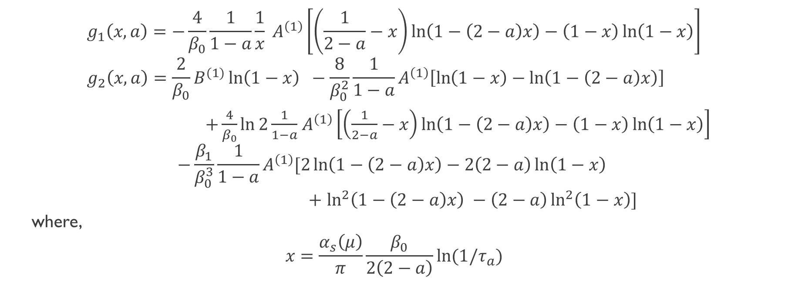
radiator
$$g_{1}\left(x,a\right)=−\frac{4}{β_{0}}\frac{1}{1−a}\frac{1}{x} A^{\left(1\right)}\left[\left(\frac{1}{2−a}−x\right)\ln\left(1−\left(2−a\right)x\right)−\left(1−x\right)\ln\left(1−x\right)\right] \\ g_{2}\left(x,a\right)=\frac{2}{β_{0}}B^{(1)}\ln\left(1−x\right) −\frac{8}{β_{0}^{2}}\frac{1}{1−a}A^{\left(1\right)}\left[\ln\left(1−x\right)−\ln\left(1−\left(2−a\right)x\right)\right]$$
$+\frac{4}{β_{0}}\ln{2\frac{1}{1−a}}$ $A^{\left(1\right)}\left[\left(\frac{1}{2−a}−x\right)\ln\left(1−\left(2−a\right)x\right)−\left(1−x\right)\ln\left(1−x\right)\right]$
$$−\frac{β_{1}}{β_{0}^{3}}\frac{1}{1−a}A^{\left(1\right)}[2\ln\left(1−\left(2−a\right)x\right)−2\left(2−a\right)\ln\left(1−x\right)$$
$+$ $\ln^{2}\left(1−\left(2−a\right)x\right) −\left(2−a\right)\ln^{2}\left(1−x\right)]$
where,
$$x=\frac{α_{s}\left(μ\right)}{π}\frac{β_{0}}{2\left(2−a\right)}\ln{(1/τ_{a})}$$

Slide 23
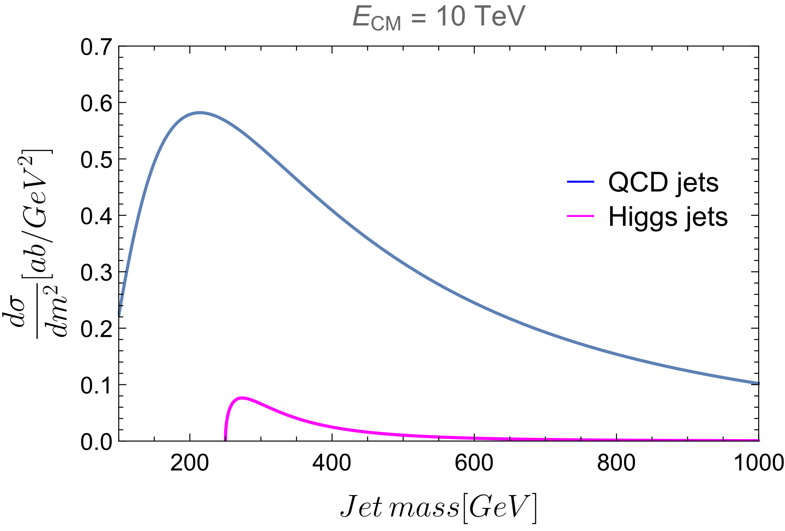
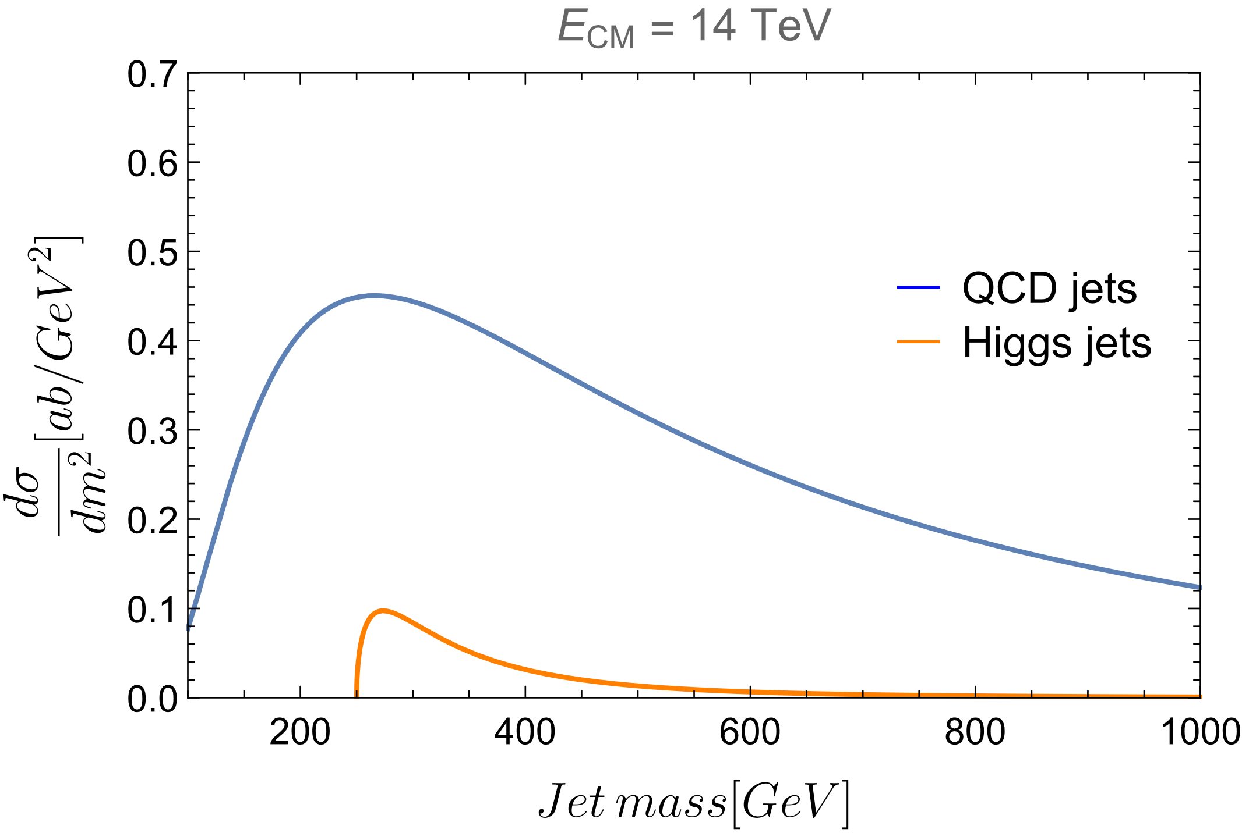
Comparison plots
Notes:
At lower energies, even though we have a small peak, we can still see the properties of the Higgs jets to fall of as 1/m^4. We can observe that if we good experimental techniques to identify a Higgs jet from quark jets.

