Slide 1
Exploring CP Violation in the Higgs Sector Through Higgs Boson Production in Association of Three Jets
Dr. Terrance Figy
Associate Professor
Department of Mathematics, Statistics, and Physics
Wichita State University
Phenomenology 2023 Symposium
May 9, 2023

Slide 2
References and Collaborators
Higgs boson CP-properties of the gluonic contributions in Higgs plus three jet production via gluon fusion at the LHC
CP-violating Higgs boson production in association with three jets via gluon fusion
Azimuthal angle correlations for Higgs boson plus multi-jet events
Collaborators: Francisco Campanario and Michael Kubocz

Slide 3




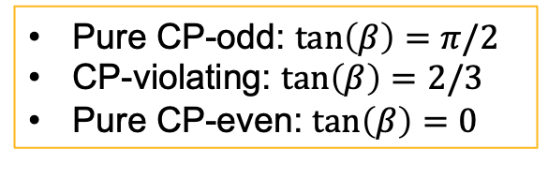
Model Setup
Pure CP-odd: $\tan\left(β\right)=π/2$
CP-violating: $\tan\left(β\right)=2/3$
Pure CP-even: $\tan\left(β\right)=0$
Type-II Two Higgs Double Model

Slide 4
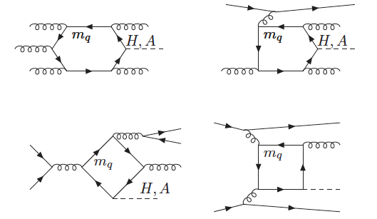

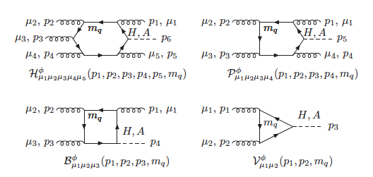
Feynman Diagrams (Yes, we still use them.)
The gluonic contributions were computed by Campanario and Kubocz. New: quark gluon, quark quark channels.

Slide 5





Input Parameters and Selection Cuts
VBNLO 3.0
MMHT2014nlo68lo parton distributions functions
Kt-jet with p=-1
$α_{s}(m_{Z})$ =0.130
Collider Energies: 13 TeV
27 TeV

Slide 6
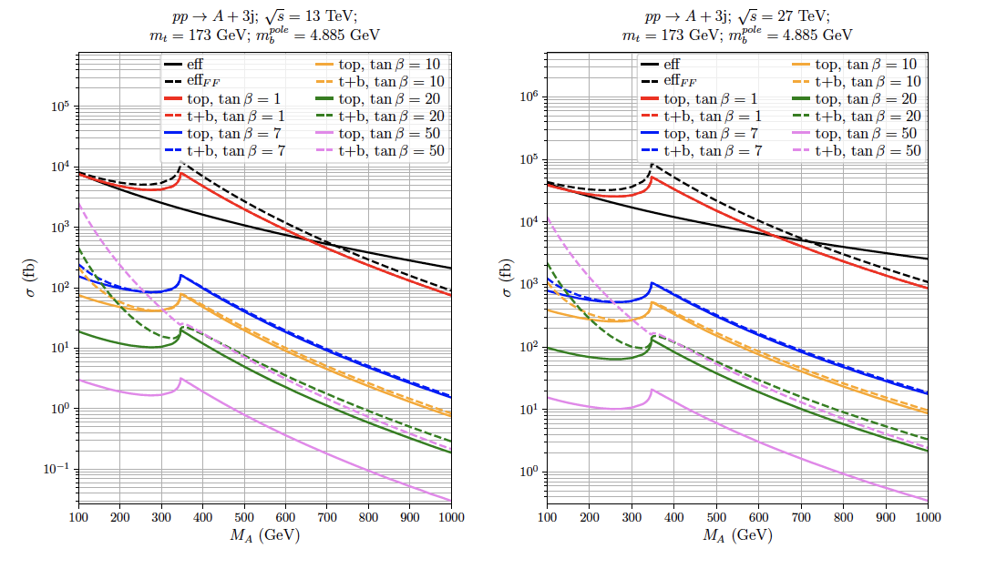
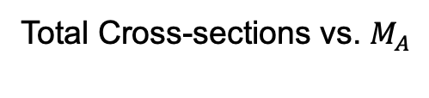
Parametric Dependence (Pure CP-odd)
Total Cross-sections vs. $M_{A}$

Slide 7
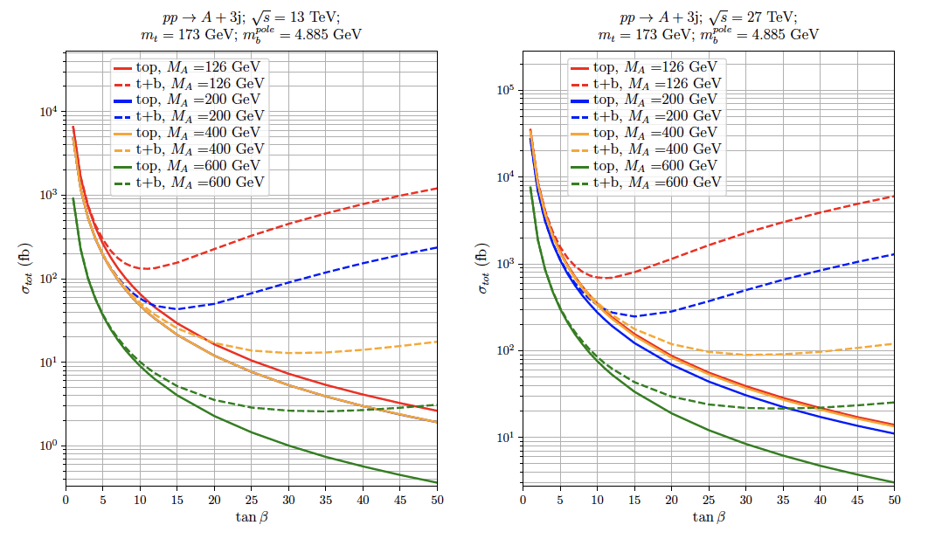

Parametric Dependence (Pure CP-odd)
Total cross-sections vs. $\tan\left(β\right)$

Slide 8
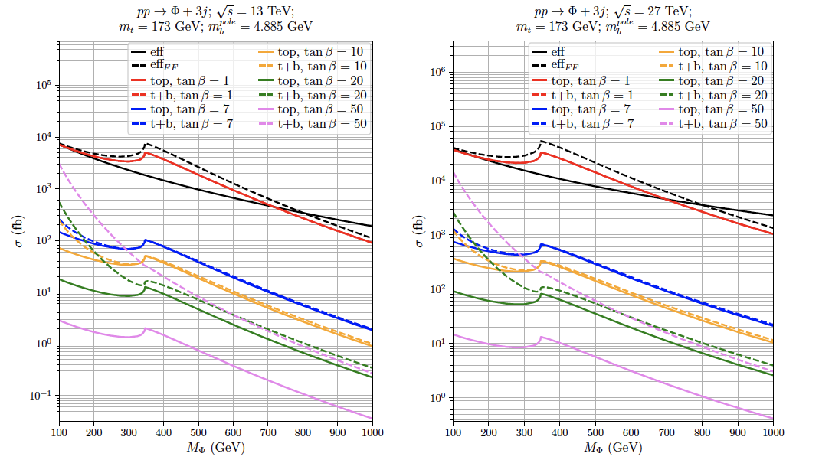

Parametric Dependence (CP-violating)
Total cross-sections vs. $M_{Φ}$

Slide 9
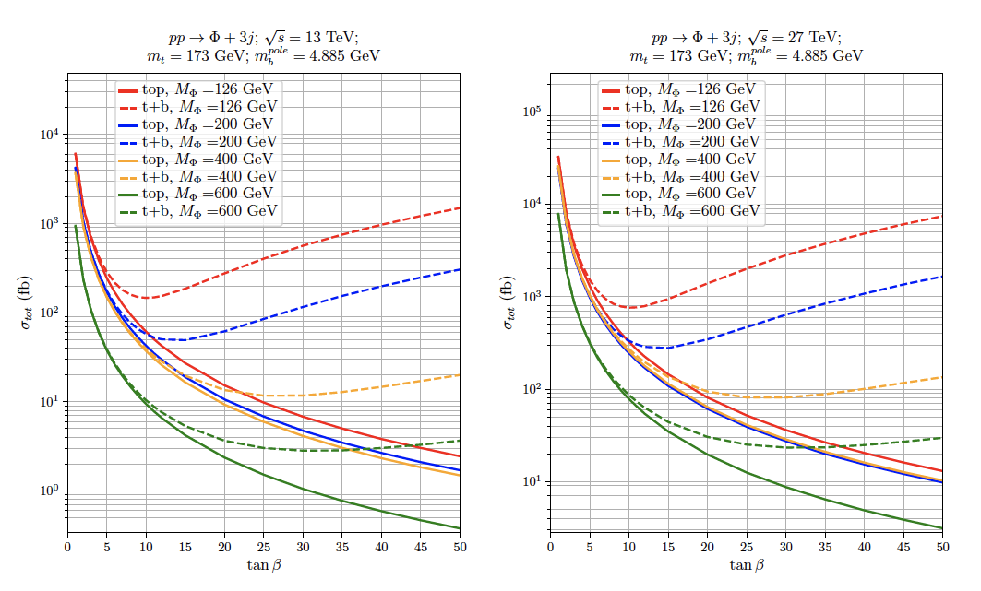
Parametric Dependence (CP-violating)
Total cross-sections vs. $\tan\left(β\right)$

Slide 10
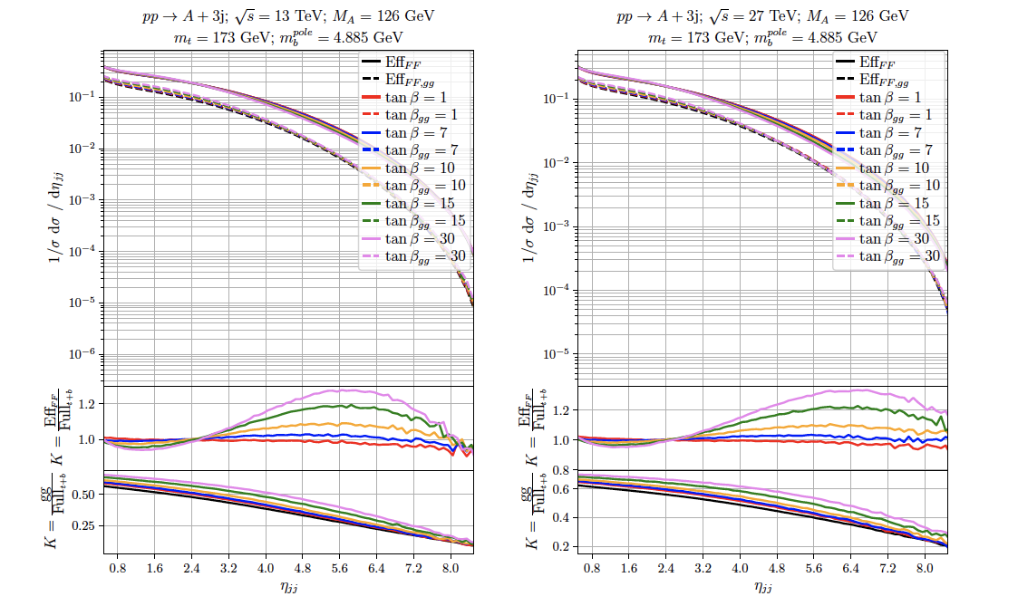
Rapidity Separation (Pure CP-odd)
Rapidity separation of leading two jets

Slide 11
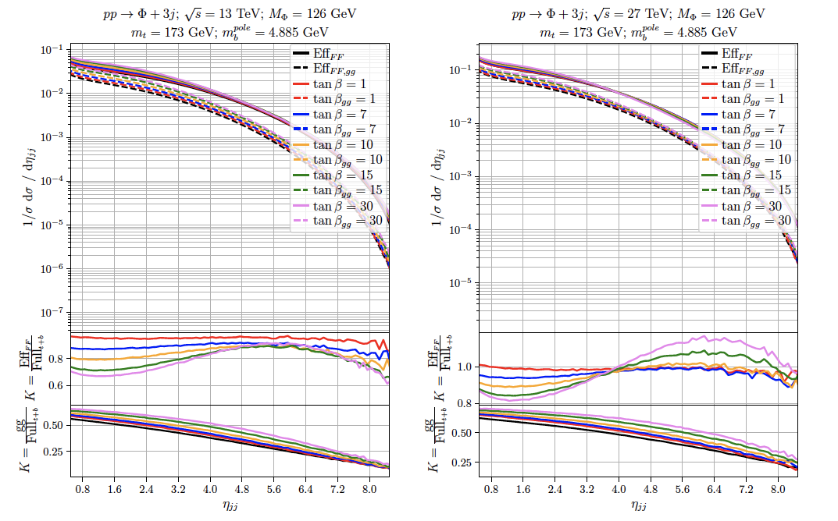
Rapidity Separation (CP-violating)
Rapidity separation of leading two jets

Slide 12
Azimuthal Angle Correlations: $φ_{jj}=φ_{f}−φ_{b}$
The sharp peak is due to the jet radius. The extra radiation decorrelates the two hard jets. However, this can be fixed.

Slide 13
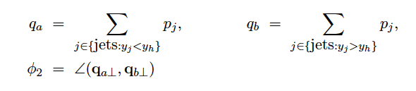
Azimuthal Angle Correlations
https://doi.org/10.1007/JHEP06(2010)091 [Arnold, Andersen, and Zeppenfeld]

Slide 14
Azimuthal Angle Correlations (Pure CP-odd)

Slide 15
Azimuthal Angle Correlations (CP-violating)

Slide 16
Concluding Remarks
We have implemented the remaining subprocesses into VBFNLO for Higgs boson production in association of three jets.
We can generate prediction the include finite top and bottom mass effects (i.e. full loops) and we can operate in the Higgs effective theory (heavy top limit).
We can simulate pure CP-odd, -even, -violating with finite top and bottom mases running in loops for Higgs boson production in association of three jet.

Slide 17
Auxiliary Slides

Slide 18
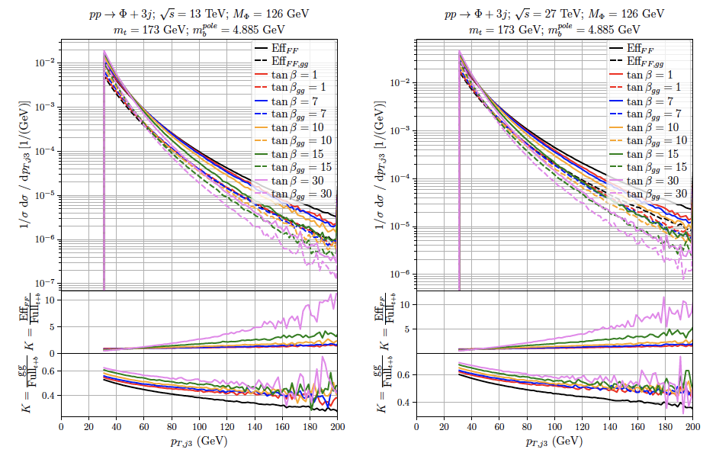
Transverse Momentum of Third Jet (CP-violating)

Slide 19
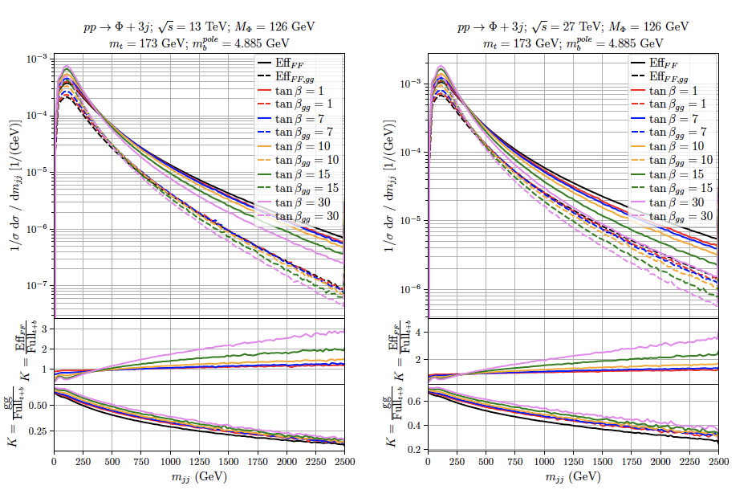
Invariant Mass of Leading Two Jets (CP-violating)
Invariant mass of leading two jets

Slide 20

Azimuthal Angle Correlations (Rapidity Gap)
$$Δη_{j1j2}>3$$
The rapidity gap essentially promotes t-channel exchange graphs.

