Slide 1
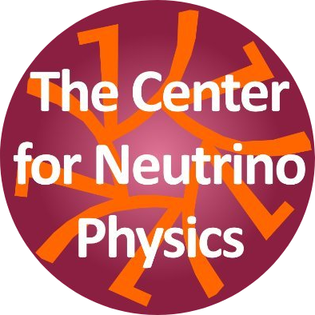

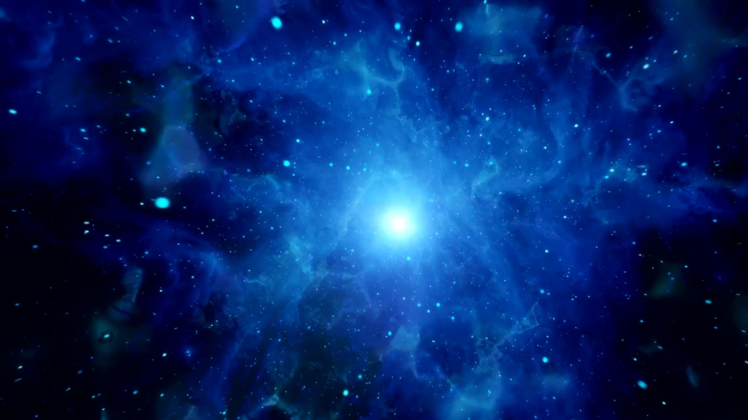
Low Energy Supernova bounds on Sterile Neutrinos
Garv Chauhan
Center for Neutrino Physics, Department of Physics, Virginia Tech
in collaboration with P. Huber, S. Horiuchi, I. M. Shoemaker (arXiv : 2305.abcde)
PHENO 2023
University of Pittsburgh
May 9

Slide 2
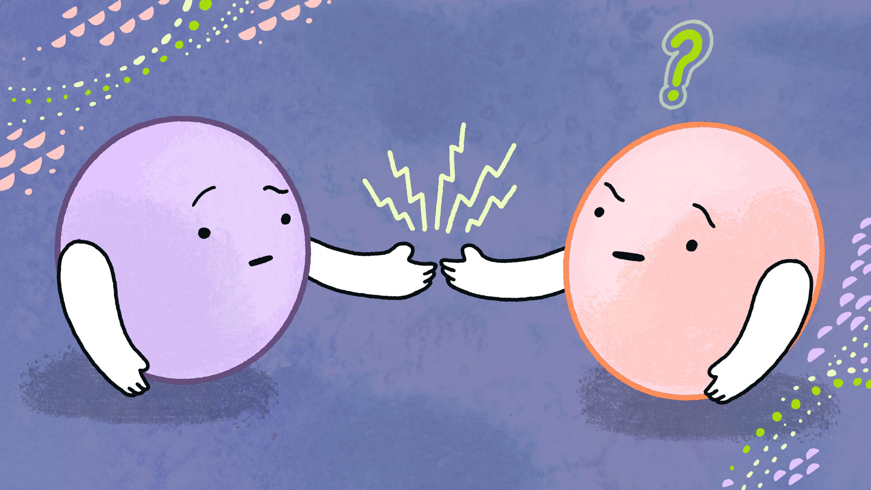

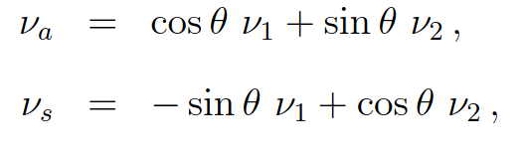
Sterile Neutrino
Motivated class of BSM candidates : neutrino mass mechanisms, dark matter and baryon asymmetry generation.
Sterile neutrinos have been suggested as solutions of various anomalies in neutrino experiments.
An interesting question : which values of masses and mixing angles can be excluded by
direct experiments, cosmology and astrophysics.
We assume that the sterile mixes dominantly with one flavor i.e

Slide 3
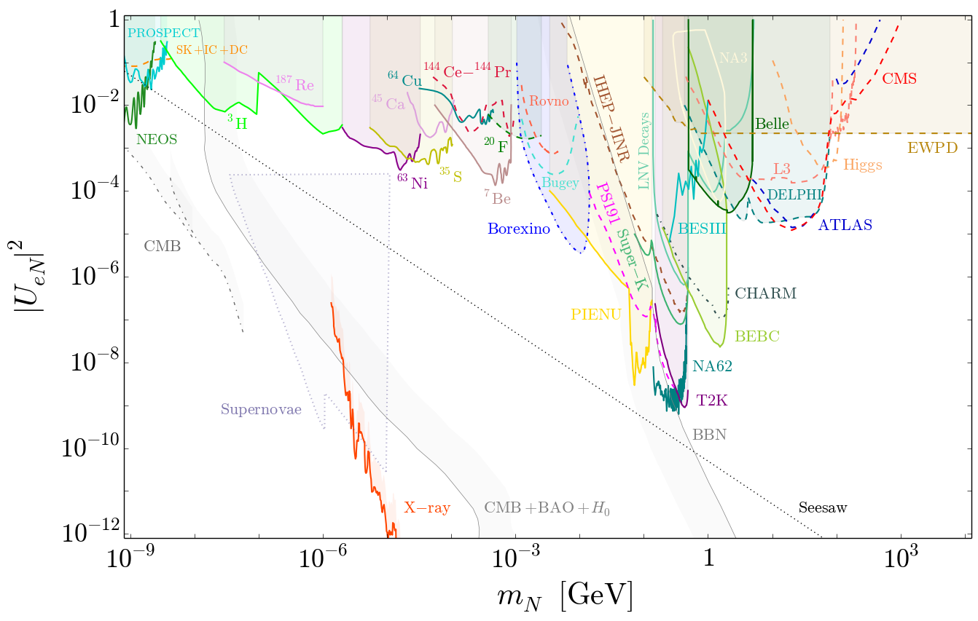
[Bolton, Deppisch, Dev (JHEP ’20)][Atre, Han, Pascoli, Zhang (JHEP ’09); Deppisch, Dev, Pilaftsis (NJP ’15); de Gouvea, Kobach (PRD ’16); Drewes, Garbrecht (NPB ’17)]

Slide 4
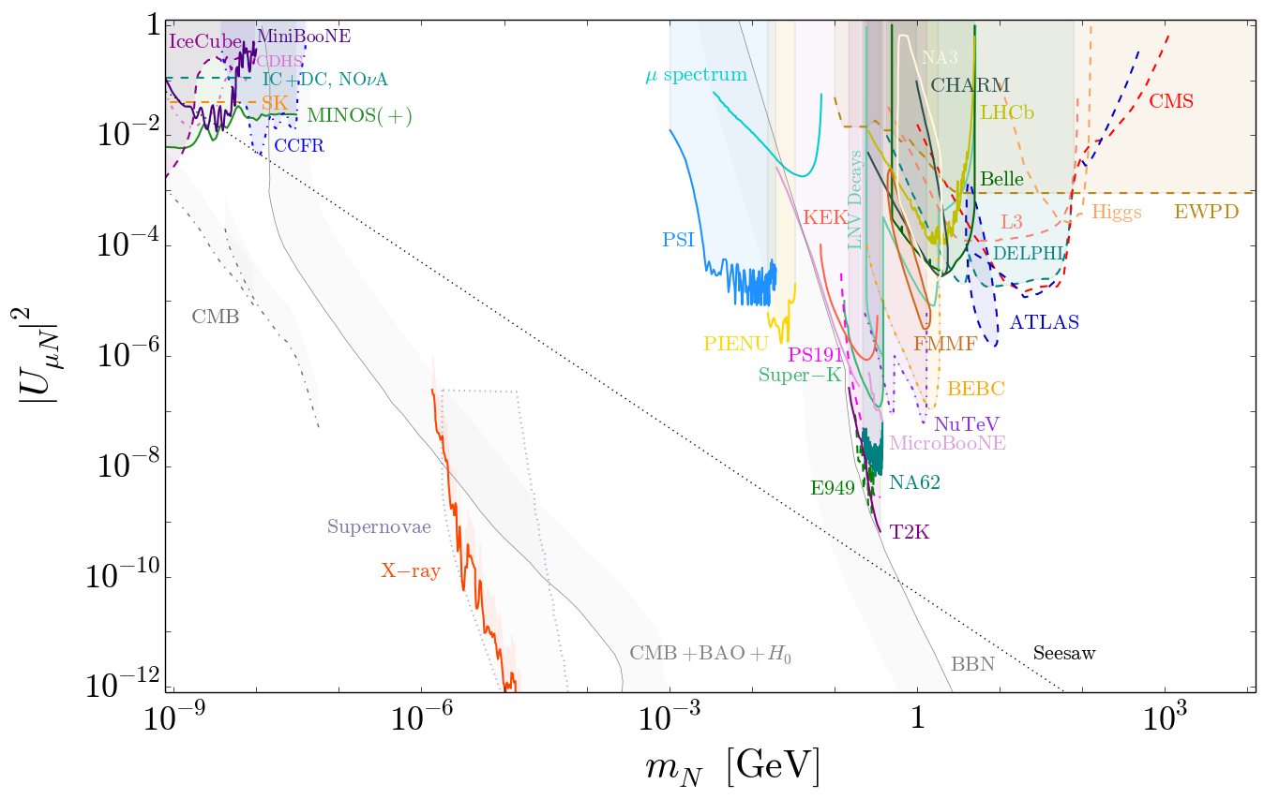
[Bolton, Deppisch, Dev (JHEP ’20)][Atre, Han, Pascoli, Zhang (JHEP ’09); Deppisch, Dev, Pilaftsis (NJP ’15); de Gouvea, Kobach (PRD ’16); Drewes, Garbrecht (NPB ’17)]

Slide 5
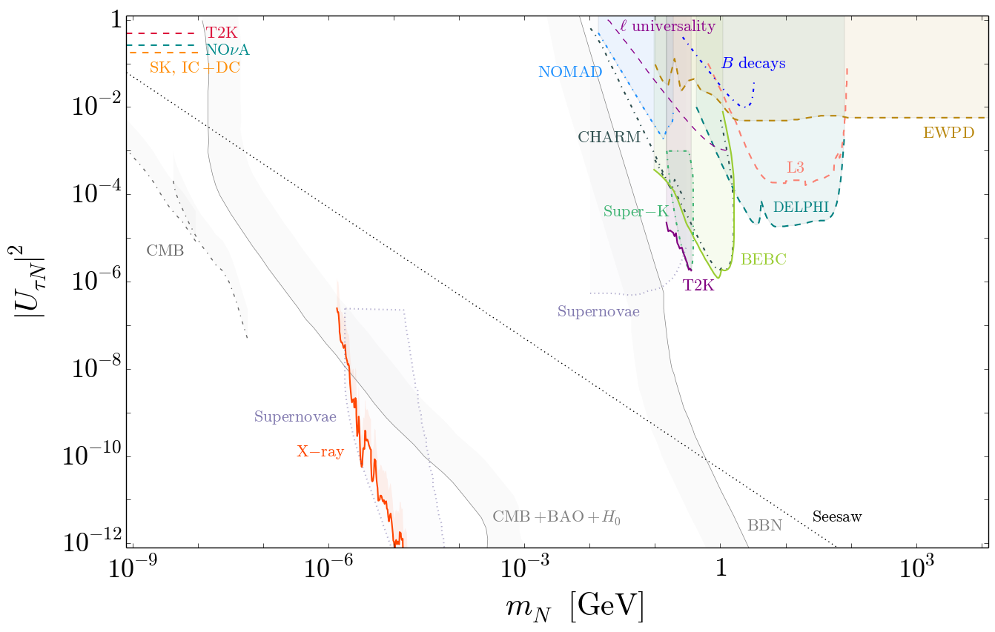
[Bolton, Deppisch, Dev (JHEP ’20)][Atre, Han, Pascoli, Zhang (JHEP ’09); Deppisch, Dev, Pilaftsis (NJP ’15); de Gouvea, Kobach (PRD ’16); Drewes, Garbrecht (NPB ’17)]

Slide 6
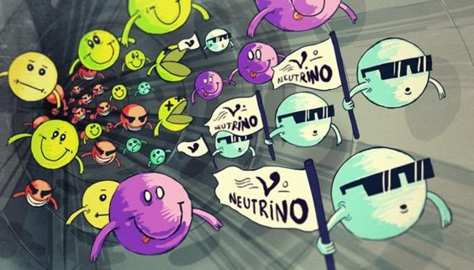

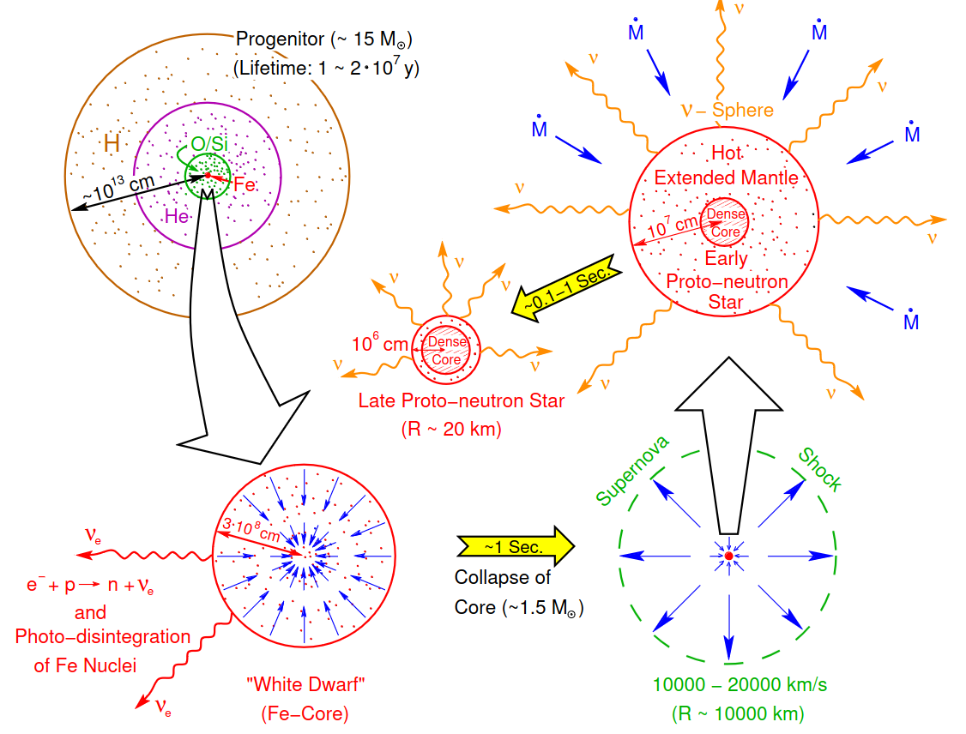


Supernova : factory
Core-collapse supernovae represent the most powerful sources of neutrinos in the Universe.
during the explosion, (anti)neutrinos of all the flavors are emitted with average E ∼ 15 MeV.
Can be used to probe fundamental properties of neutrinos and even …..
emission of exotic BSM particles!
[Burrows, 1990b]

Slide 7
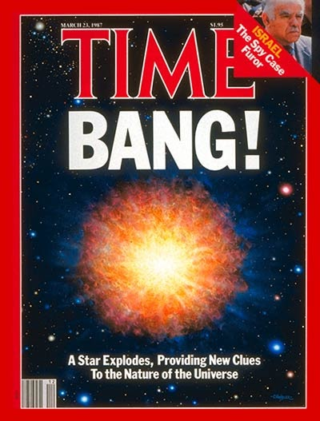
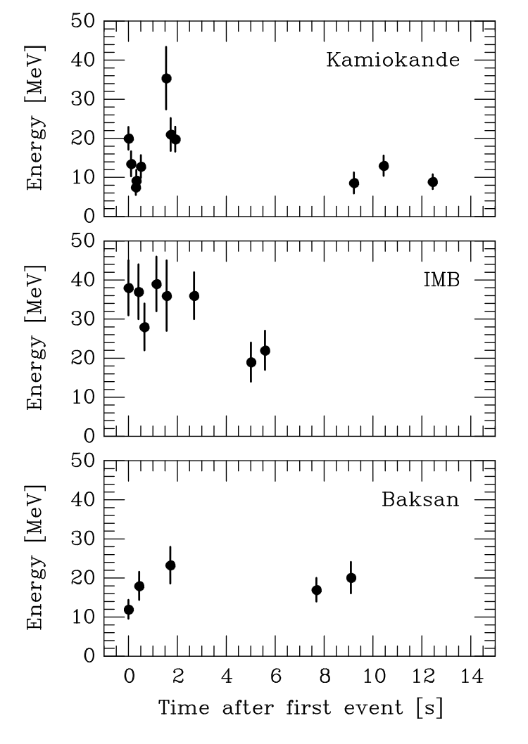
Energy Loss SN1987A
Light BSM particles produced in the SN core would constitute a novel
channel of energy loss, shortening the duration of the neutrino burst.
SN 1987A neutrino signal ∼ 10 s, as expected from standard
SN cooling scenario, excludes an additional energy drain associated with exotic particles
Constrain sterile states mixing with the active ones.
typical temperature T ∼ 30 MeV in the SN core, heavy sterile neutrinos might still be produced by the mixing with the active ones, suffering only a moderate suppression due to the Boltzmann factor.
[Janka 1702.08713, Raffelt ]

Slide 8
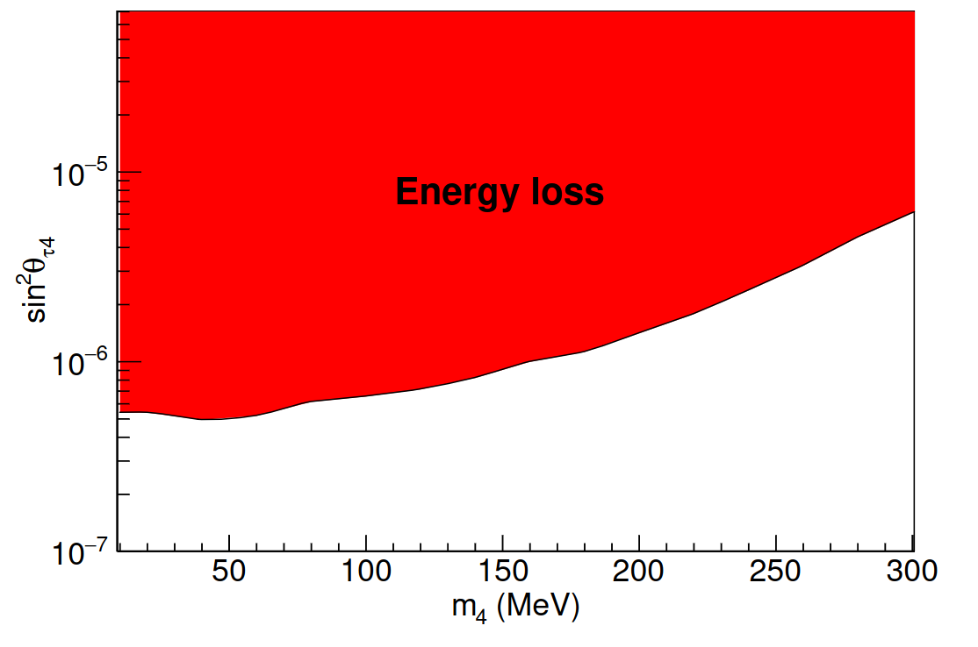
Energy Loss SN1987A
Observations constrain energy-loss rate per unit mass total luminosity bounds on active-sterile mixing
Mastrotaro, Mirizzi, Serpico, Esmaili JCAP 01 (2020)

Slide 9
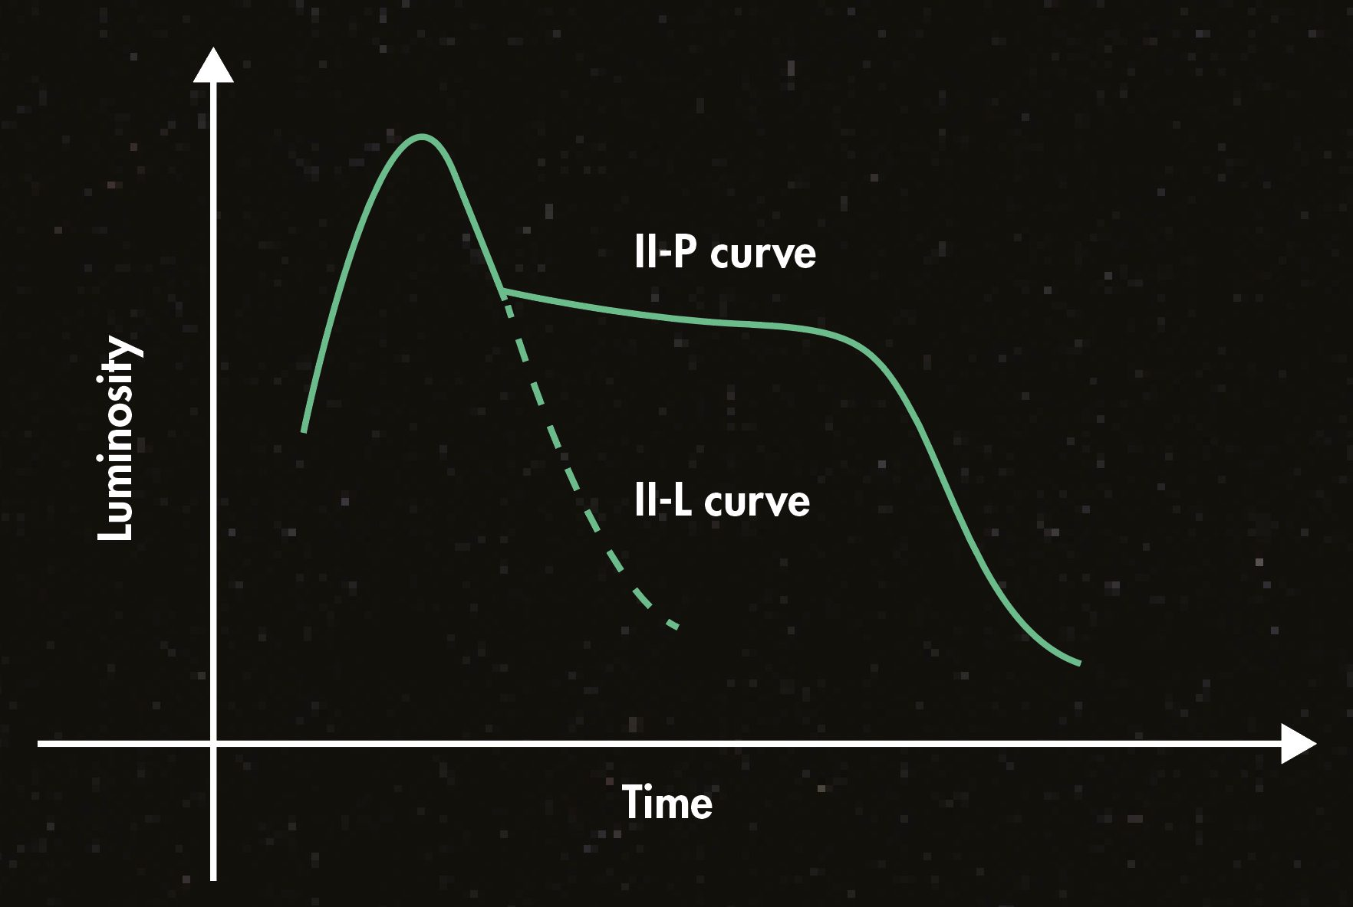
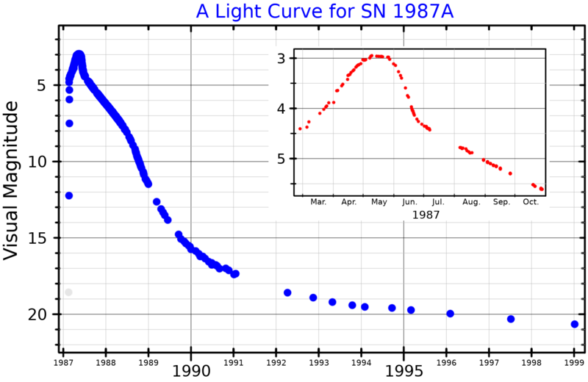
Low-energy SN : IIP or not IIP
There is a separate class of core-collapse SN with low-explosion energies : underluminous SN IIP
Based on the presence of characteristic plateau shape in their light curves , are termed SN IIP.
The brightness and duration of the plateau is determined mainly by the explosion energy, ejecta mass, nickel mass and progenitor radius.
Therefore, the explosion energy can be inferred given the spectrum and the light curves.

Slide 10
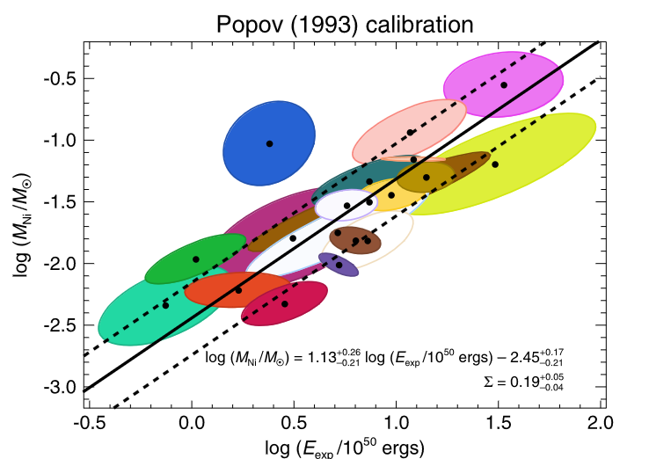

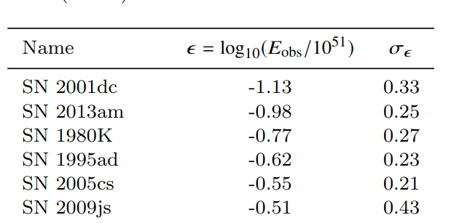

Low-energy SN
(Pejcha:2015 ,Muller:2017) use the fitting formulae and statistical inference along with quantifying the uncertanities, to infer the most likely explosion energy.
The inferred explosion energy ranges from
These reconstructed energies are in good agreement with expectations from the simulated low-energy SN.
But the sterile neutrinos produced in the core can deposit energies of a similar magnitude, and hence can be constrained from the observations of these low-energy SN
Muller,Prieto,Pejcha,Clocchiatti Astrophys.J. 841 (2017), Murphy,Mabanta,Dolence MNRAS 489(2019)
Caputo, Janka, Raffelt, Vitagliano PRL 128(2022)

Slide 11

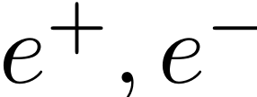
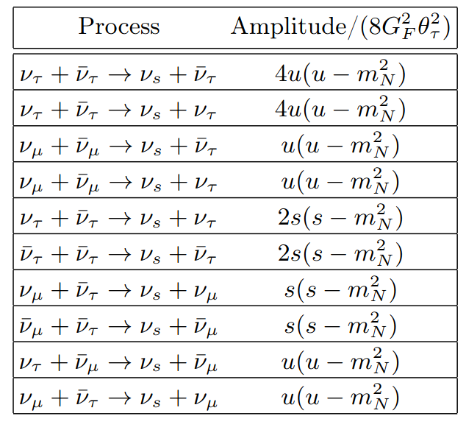
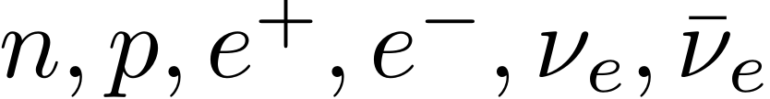
Sterile neutrino production
In a SN core, sterile neutrino can be produced by ddd d or neutrino pair annihilation and the inelastic scattering of (anti-) neutrinos.
But are degenerate in the hot proto-neutron star core,
Pauli-blocking will render pair-annihilation and inelastic scattering on the non-degenerate neutrino species, the dominant processes for sterile production.
Fuller,Kusenko,Petraki PLB 670(2009)

Slide 12
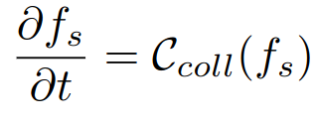
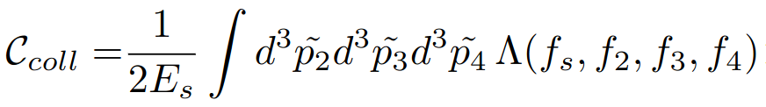
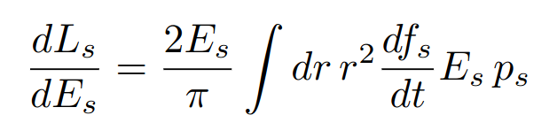
Boltzmann Transport
The evolution of sterile neutrino abundances is governed by the Boltzmann transport equation.
Assuming the medium is homogeneous and isotropic. This implies that the change in phase-space density will only be affected by the scatterings/pair-annihilation processes in the SN core.
Mastrotaro, Mirizzi, Serpico, Esmaili JCAP 01 (2020)

Slide 13


Energy Deposition
The sterile neutrino produced in SN core, decays outside the core but inside the mantle region, depositing energy into the SN envelope.
Caputo, Janka, Raffelt, Vitagliano PRL 128(2022)
For reference model, we use Garching group's SFHo-18.8 muonic model.
Peak Temps. : 30-40 MeV
Final NS mass :
Mirizzi, Tamborra, Janka, Saviano, Scholberg, Bollig RNC 39(2016), Bollig,Janka,Lohs,PInedo,Horowitz,Melson PRL 119(2017)

Slide 14
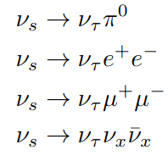

Energy Deposition
For mass range of interest and mixing only with , the charged-current processes are kinematically forbidden.
Only the visible decay modes deposit their energy, determined by
Atre,Han,Pascoli, Zhang JHEP 05(2009), Gorbunov,Shaposhnikov JHEP 10(2007)

Slide 15
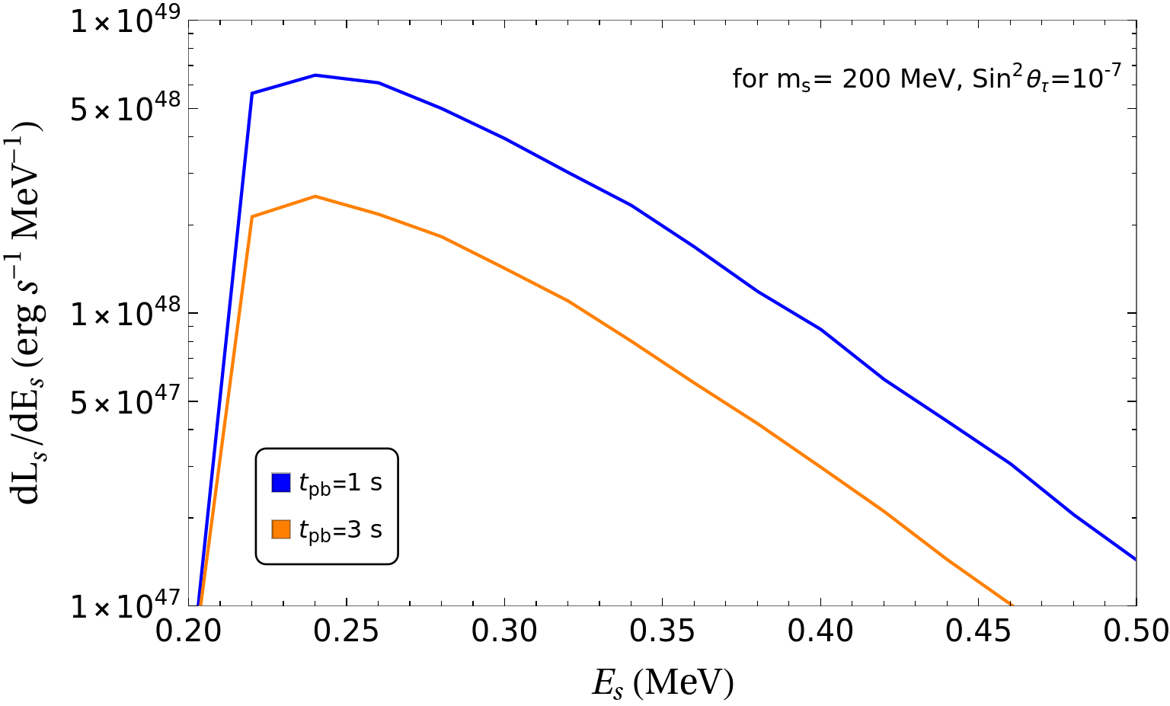
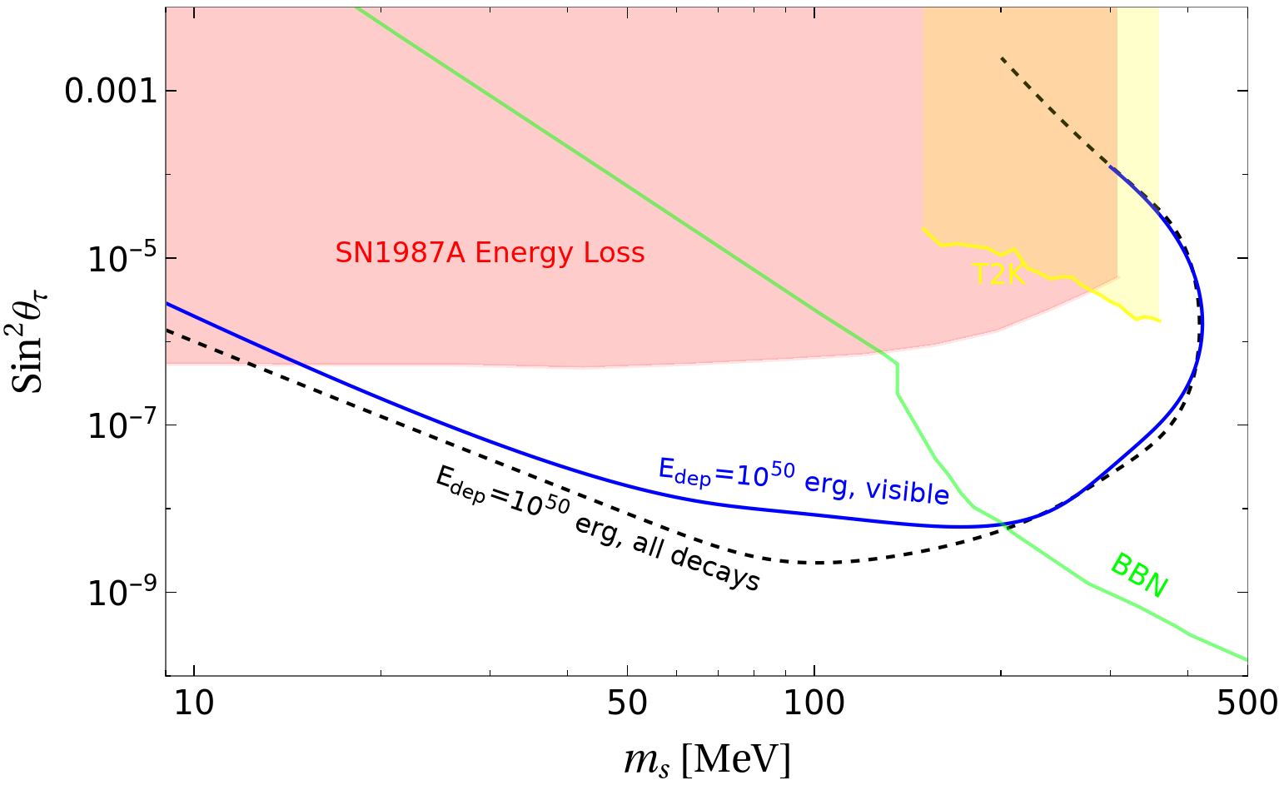
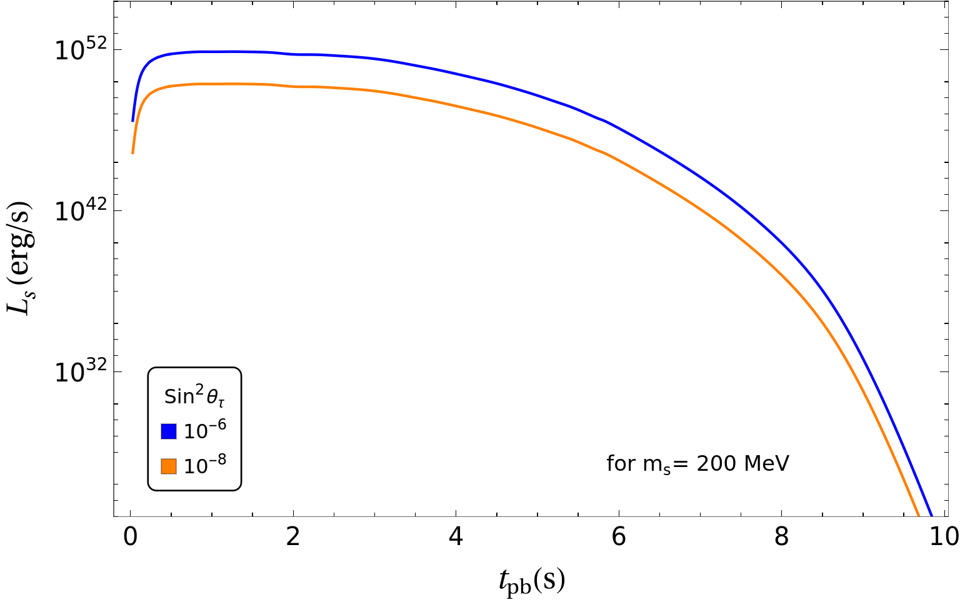
Results
GC, Huber, Horiuchi, Shoemaker (arXiv : 2305.abcde)

Slide 16
Results

Slide 17
Summary
Sterile neutrinos can be produced through mixing with active neutrinos in the hot and dense core of a collapsing supernova (SN).
We discuss a novel bound from energy deposition through the decays of sterile neutrinos inside the SN envelope.
Using observed SN IIP population with low-ejecta velocities, this energy deposition is constrained
for masses 10-400 MeV stringent constraints on tau mixing, 2-3 orders of magnitude lower than those from current constraints

