Slide 1

Asymptotically safe dark matter with gauged baryon number
Christopher D. Carone, Noah L. Donald, Mikkie R. Musser, Jens Boos
Phys. Rev. D 106, no. 3, 035015 (2022)
Phys. Rev. D 107, no. 3, 035018 (2023)
Email: nldonald@wm.edu

Slide 2

Asymptotic Safety and Quantum Field Theory
Asymptotic safety is a framework that can reduce the number of free parameters in a model to only those that can be extrapolated to arbitrarily high energy scales
Renormalization Group Equations (RGEs) govern the dependence of couplings on energy scale
A theory is asymptotically safe if one or more couplings in the theory flow to non-trivial ultraviolet fixed points and all others flow to zero
$$\frac{dg}{dlog⁡(μ)}≡β\left(g\right)≡\sum_{l=1}^{∞}{\frac{1}{{\left(4π\right)}^{2l}}β^{\left(l\right)}(g)}$$

Slide 3
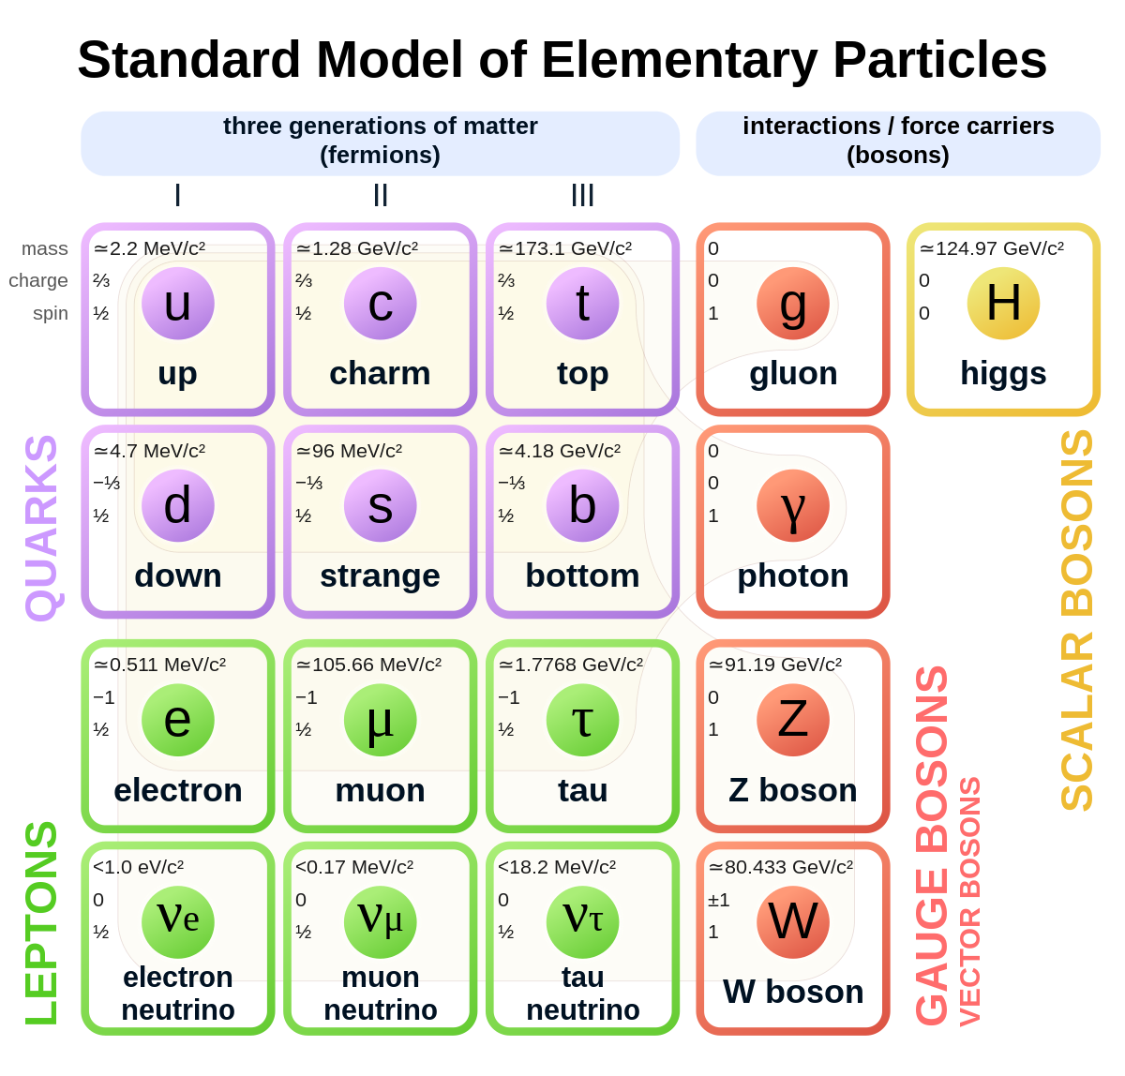
Why Extend the Standard Model?
The hypercharge gauge coupling has a Landau pole (blows up at some scale)
No dark matter candidate
Assuring proton stability if quantum gravitational effects violate global symmetries
Idea: Change the baryon number symmetry from a global symmetry to a gauge symmetry
© Users: MissMJ, Cush, minor edit by Acrux13/Wikimedia Commons/CC-BY-SA-3.0/GFDL

Slide 4
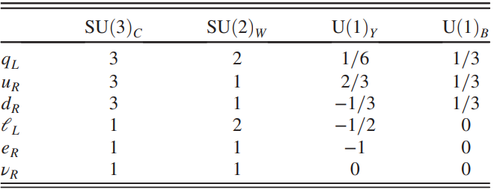
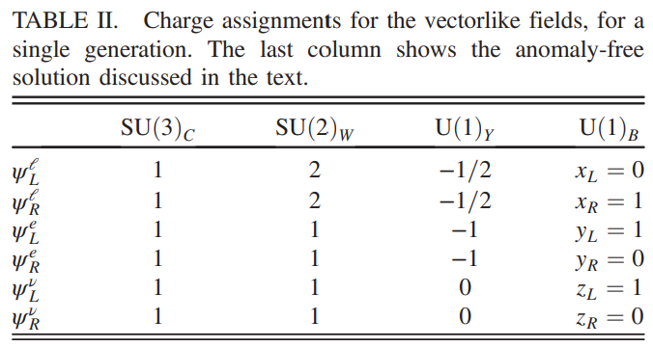

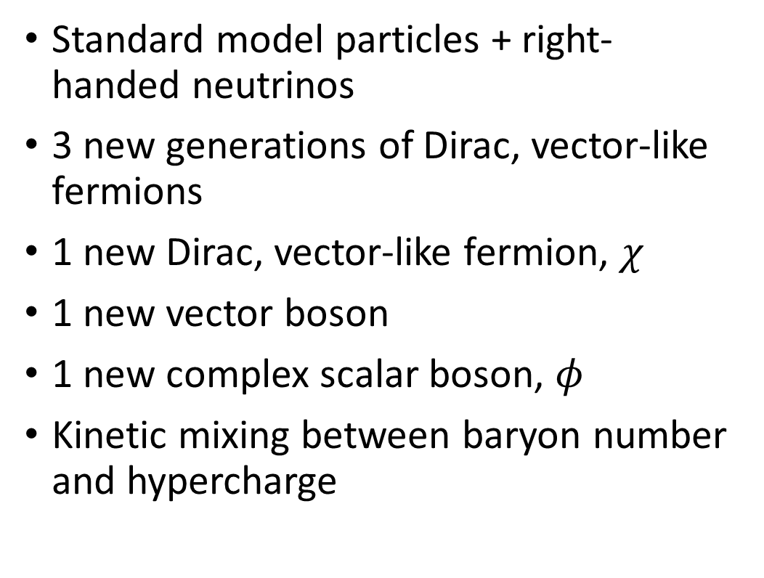
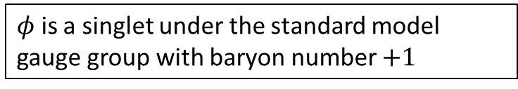
A Gauged Baryon Number Model
Standard model particles + right-handed neutrinos
3 new generations of Dirac, vector-like fermions
1 new Dirac, vector-like fermion, $χ$
1 new vector boson
1 new complex scalar boson, $φ$
Kinetic mixing between baryon number and hypercharge
$φ$ is a singlet under the standard model gauge group with baryon number $+1$

Slide 5
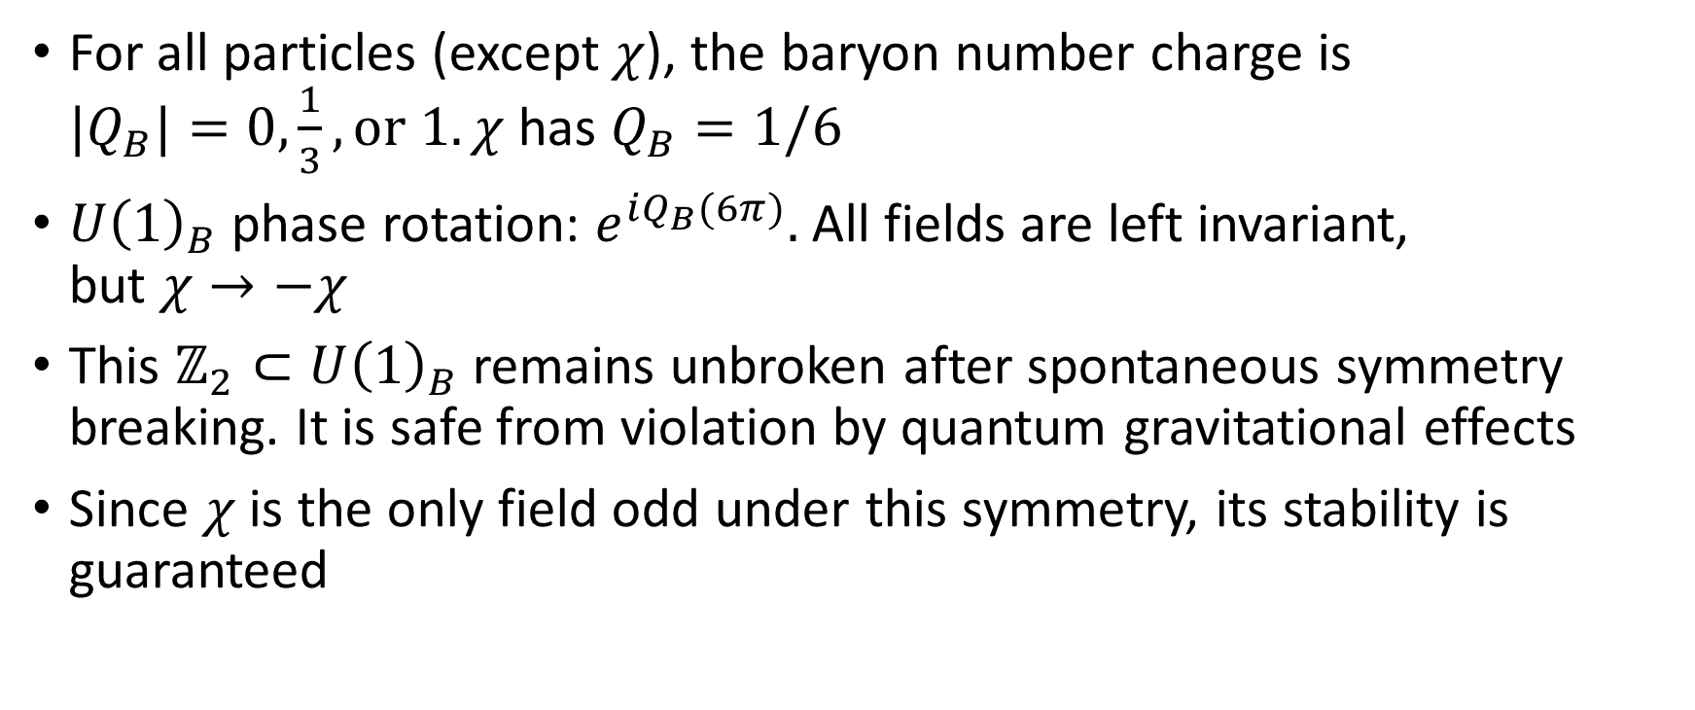
Dark Matter Stability
For all particles (except $χ$), the baryon number charge is ${|Q}_{B}|=0,\frac{1}{3}, or 1. χ$ has $Q_{B}=1/6$
$U{\left(1\right)}_{B}$ phase rotation: $e^{iQ_{B}(6π)}.$ All fields are left invariant, but $χ→−χ$
This $ℤ_{2}⊂U{\left(1\right)}_{B}$ remains unbroken after spontaneous symmetry breaking. It is safe from violation by quantum gravitational effects
Since $χ$ is the only field odd under this symmetry, its stability is guaranteed

Slide 6
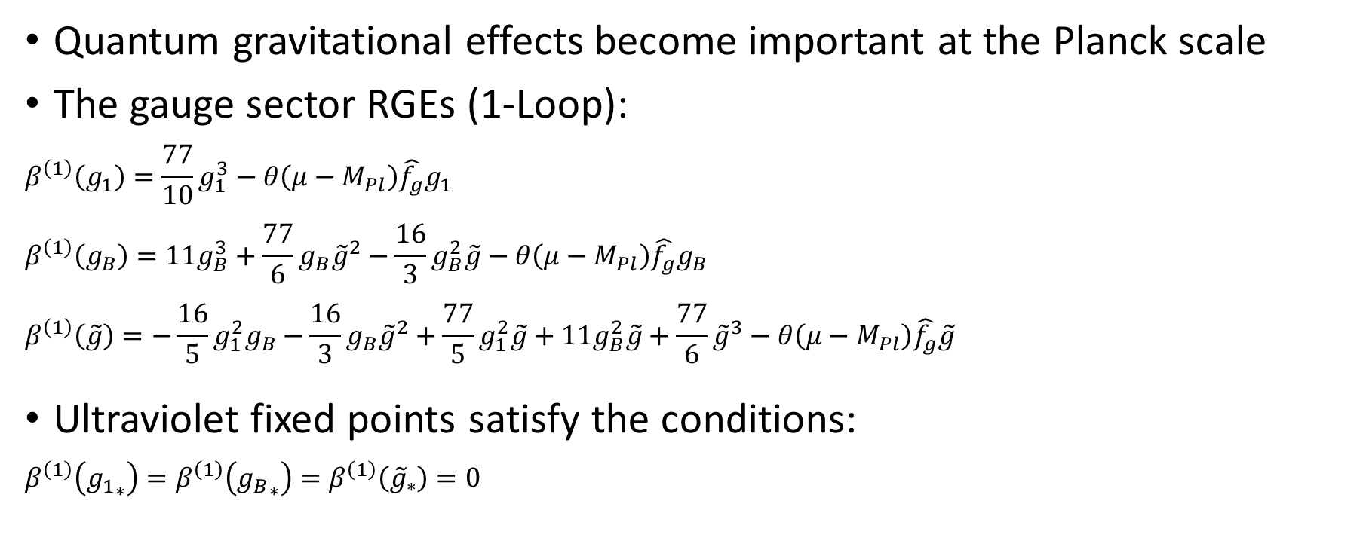
Renormalization Group Equations
Quantum gravitational effects become important at the Planck scale
The gauge sector RGEs (1-Loop):
$$β^{\left(1\right)}\left(g_{1}\right)=\frac{77}{10}g_{1}^{3}−θ\left(μ−M_{Pl}\right)\hat{f_{g}}g_{1}$$
$$β^{\left(1\right)}\left(g_{B}\right)=11g_{B}^{3}+\frac{77}{6}g_{B}{\tilde{g}}^{2}−\frac{16}{3}g_{B}^{2}\tilde{g}−θ\left(μ−M_{Pl}\right)\hat{f_{g}}g_{B}$$
$$β^{\left(1\right)}\left(\tilde{g}\right)=−\frac{16}{5}g_{1}^{2}g_{B}−\frac{16}{3}g_{B}{\tilde{g}}^{2}+\frac{77}{5}g_{1}^{2}\tilde{g}+11g_{B}^{2}\tilde{g}+\frac{77}{6}{\tilde{g}}^{3}−θ\left(μ−M_{Pl}\right)\hat{f_{g}}\tilde{g}$$
Ultraviolet fixed points satisfy the conditions:
$$β^{\left(1\right)}\left({g_{1}}_{∗}\right)=β^{\left(1\right)}\left({g_{B}}_{∗}\right)=β^{\left(1\right)}\left({\tilde{g}}_{∗}\right)=0$$

Slide 7
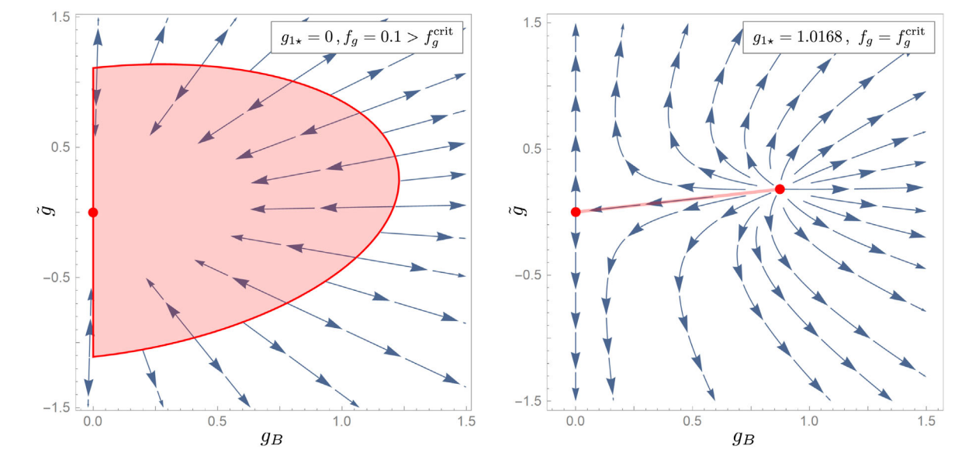
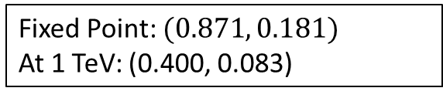
Ultraviolet Fixed Points in the Model
Benchmark Fixed Point: (0.202, 1.136)
At 1 TeV: (0.200, 0.150)
Fixed Point: (0,0)
At 1 TeV: (0.200,0.041)
Fixed Point: $(0.871, 0.181)$
At 1 TeV: (0.400, 0.083)
ii
ib
ia

Slide 8
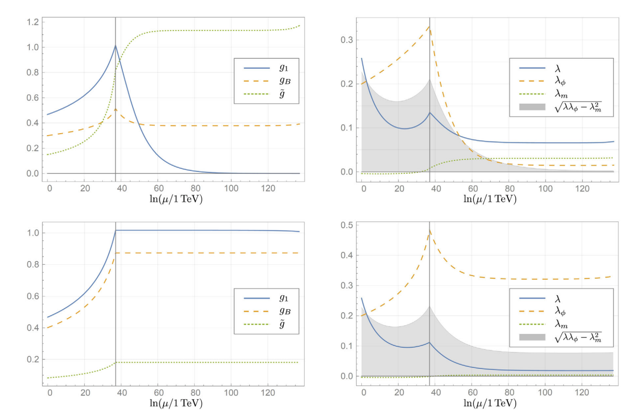

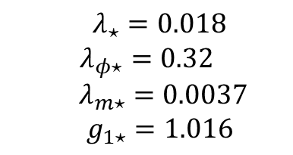
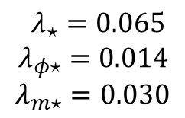

Evolution of Couplings
trivial $g_{1}$fixed point
$λ_{⋆}=0.065$
$λ_{φ⋆}=0.014$
$$λ_{m⋆}=0.030$$
Interacting $g_{1}$fixed point
$λ_{⋆}=0.018$
$$λ_{φ⋆}=0.32$$
$λ_{m⋆}=0.0037$
$g_{1⋆}=1.016$

Slide 9
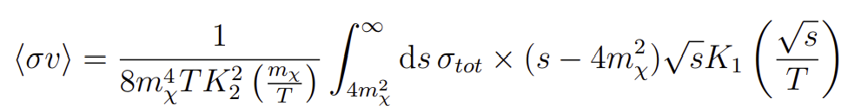
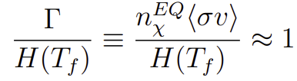
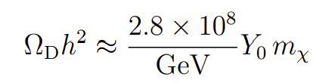
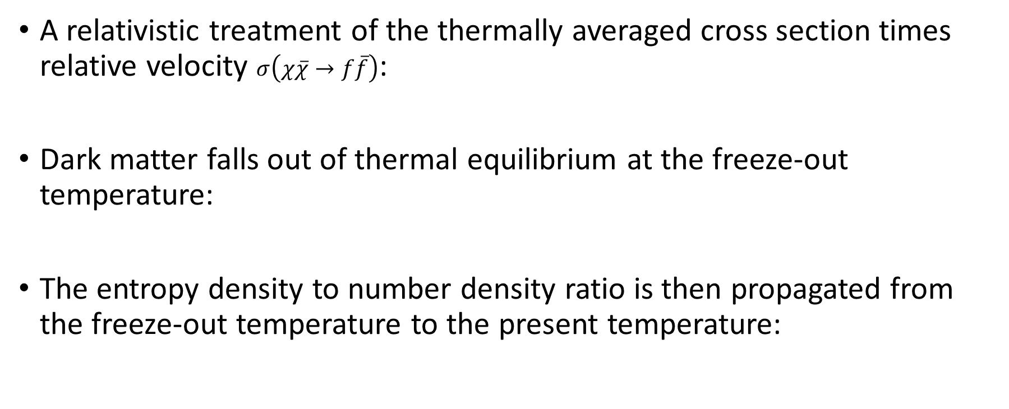
Dark Matter Relic Density
A relativistic treatment of the thermally averaged cross section times relative velocity $σ\left(χ\overline{χ}→f\overline{f}\right)$:
Dark matter falls out of thermal equilibrium at the freeze-out temperature:
The entropy density to number density ratio is then propagated from the freeze-out temperature to the present temperature:

Slide 10
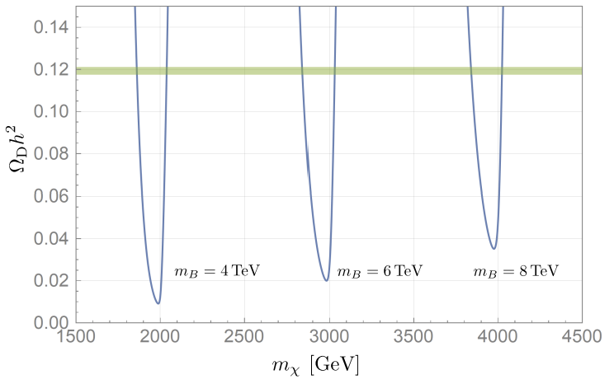
Dark Matter Relic Density
(Planck measurement)

Slide 11
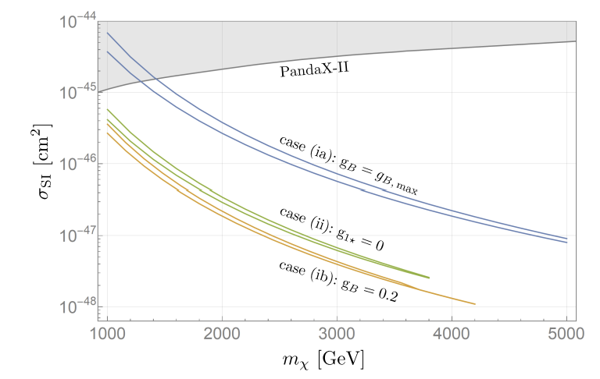
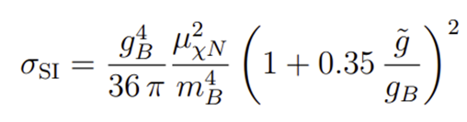

Direct Detection
$m_{B}=m_{B}\left(m_{χ}\right)$ fixed by the observed relic density within two standard deviations

Slide 12
Conclusions
Gravitational corrections above the Planck scale allow for different fixed-point scenarios in the theory. Requiring asymptotic safety constrains the model’s couplings, including the kinetic mixing parameter, and yields a more predictive theory
The model includes a stable TeV scale dark matter candidate
These models can predict the observed relic density while also remain consistent with direct detection experiments

Slide 13
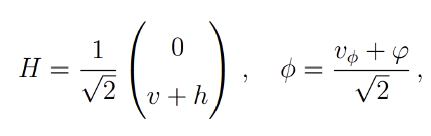
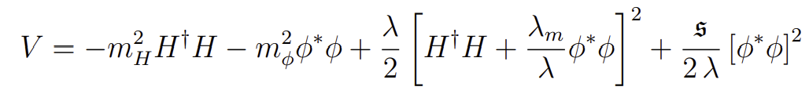
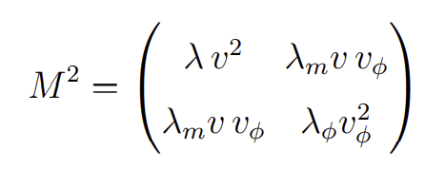
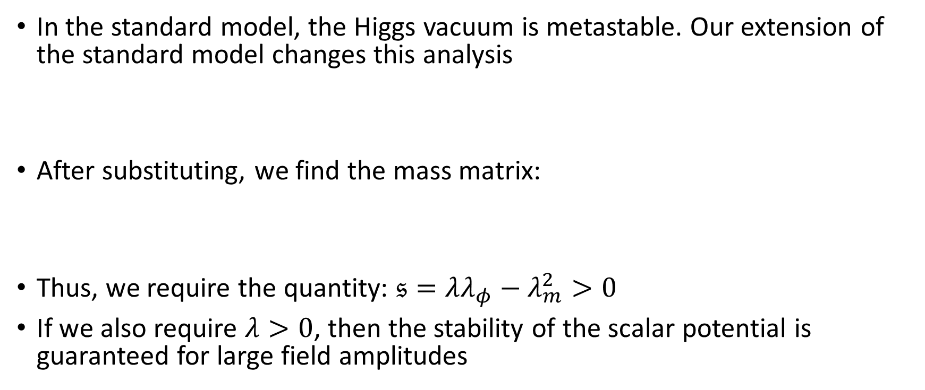
Stability in the Higgs Sector
In the standard model, the Higgs vacuum is metastable. Our extension of the standard model changes this analysis
After substituting, we find the mass matrix:
Thus, we require the quantity: $𝔰=λλ_{φ}−λ_{m}^{2}>0$
If we also require $λ>0$, then the stability of the scalar potential is guaranteed for large field amplitudes

Slide 14
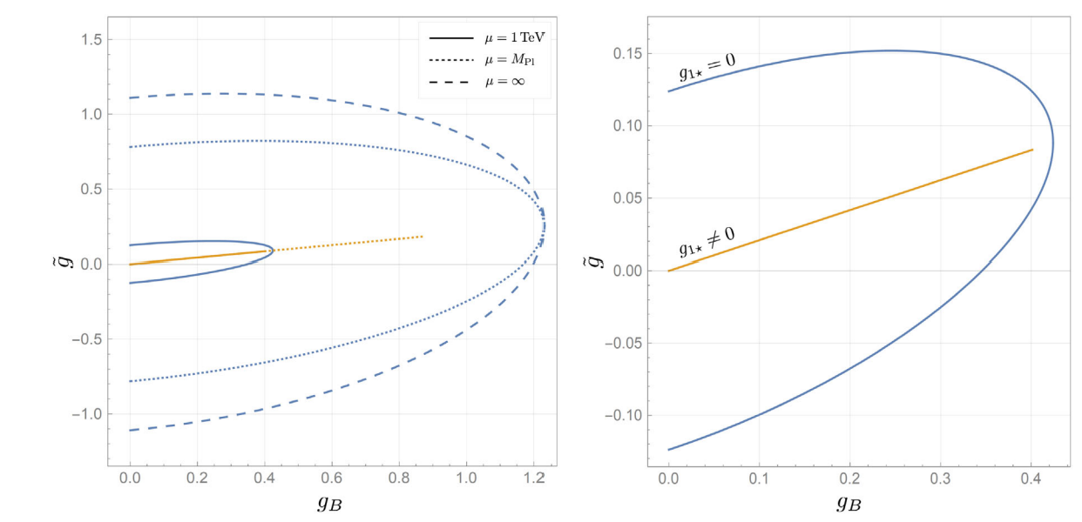
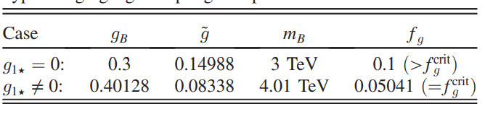
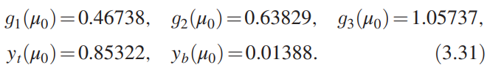










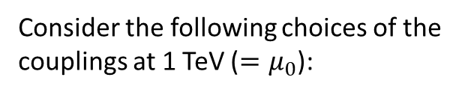

Couplings and Asymptotic Safety
Consider the following choices of the couplings at 1 TeV ($=μ_{0}$):
Measured values of standard model couplings
$$⟹$$
$$⟹$$
$$m_{φ}=$$

Slide 15
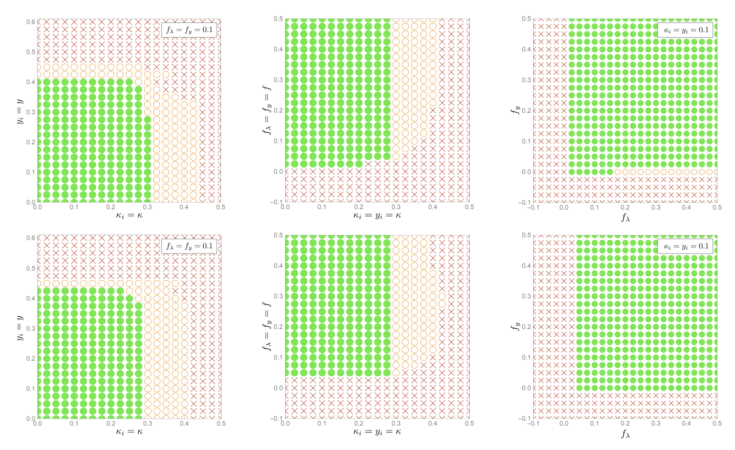
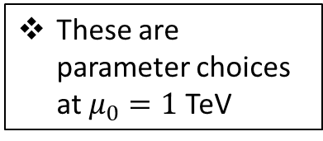
Exploring the Parameter Space
Gaussian Fixed Point
These are parameter choices at $μ_{0}=1$ TeV
Interacting Fixed Point

Slide 16
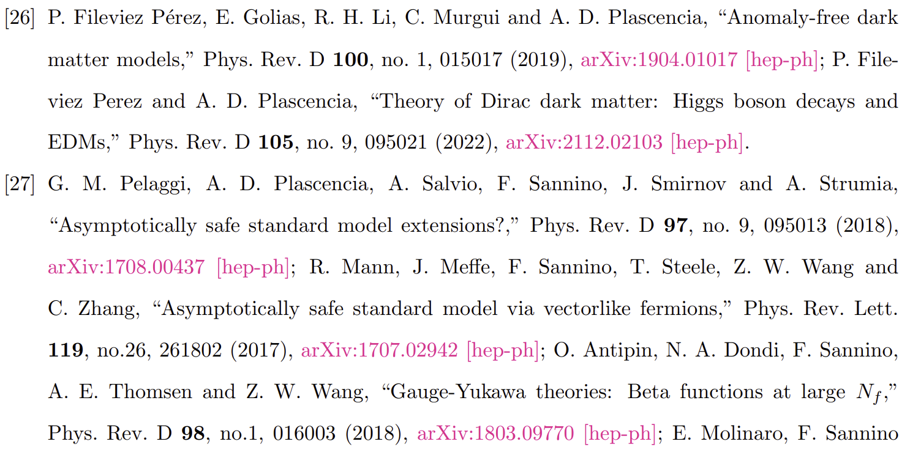
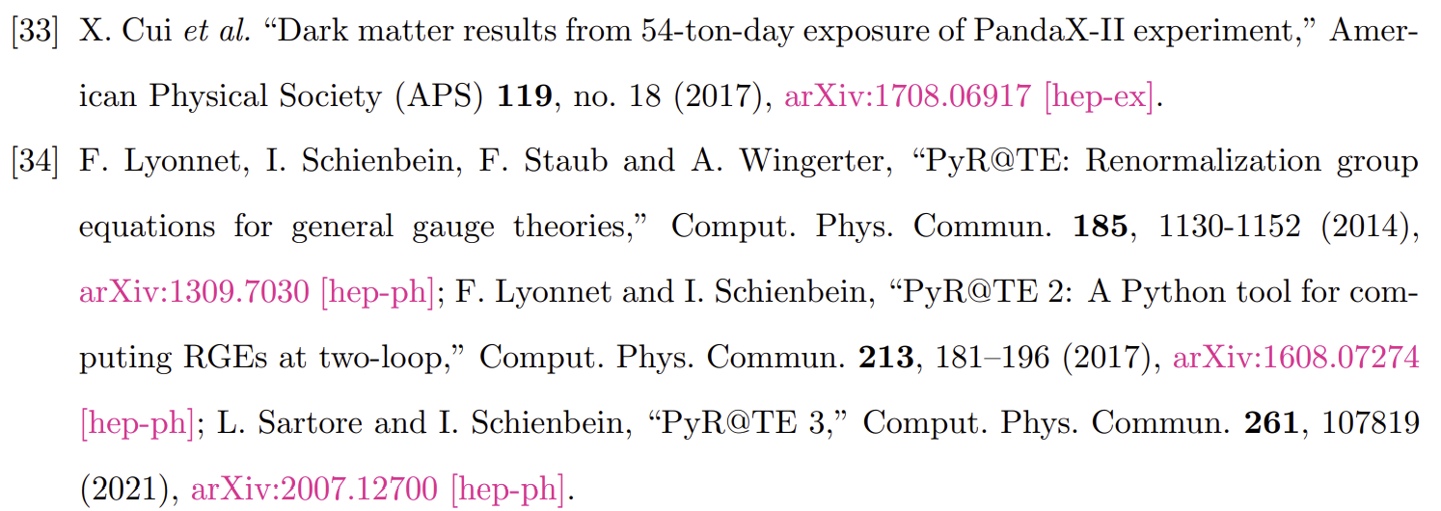
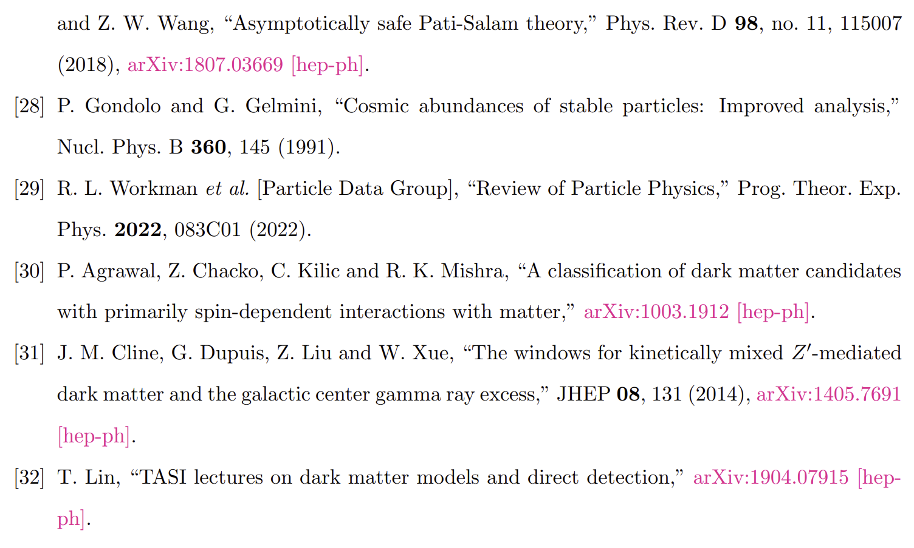
References (Cont.):

Slide 17
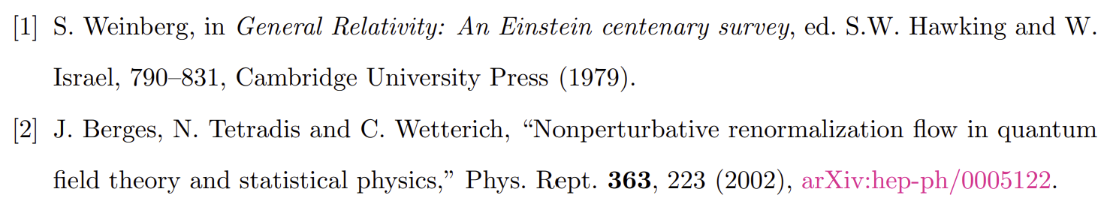
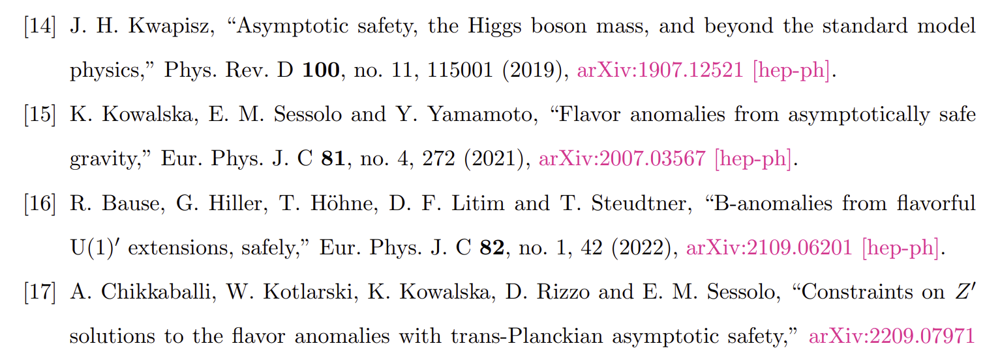
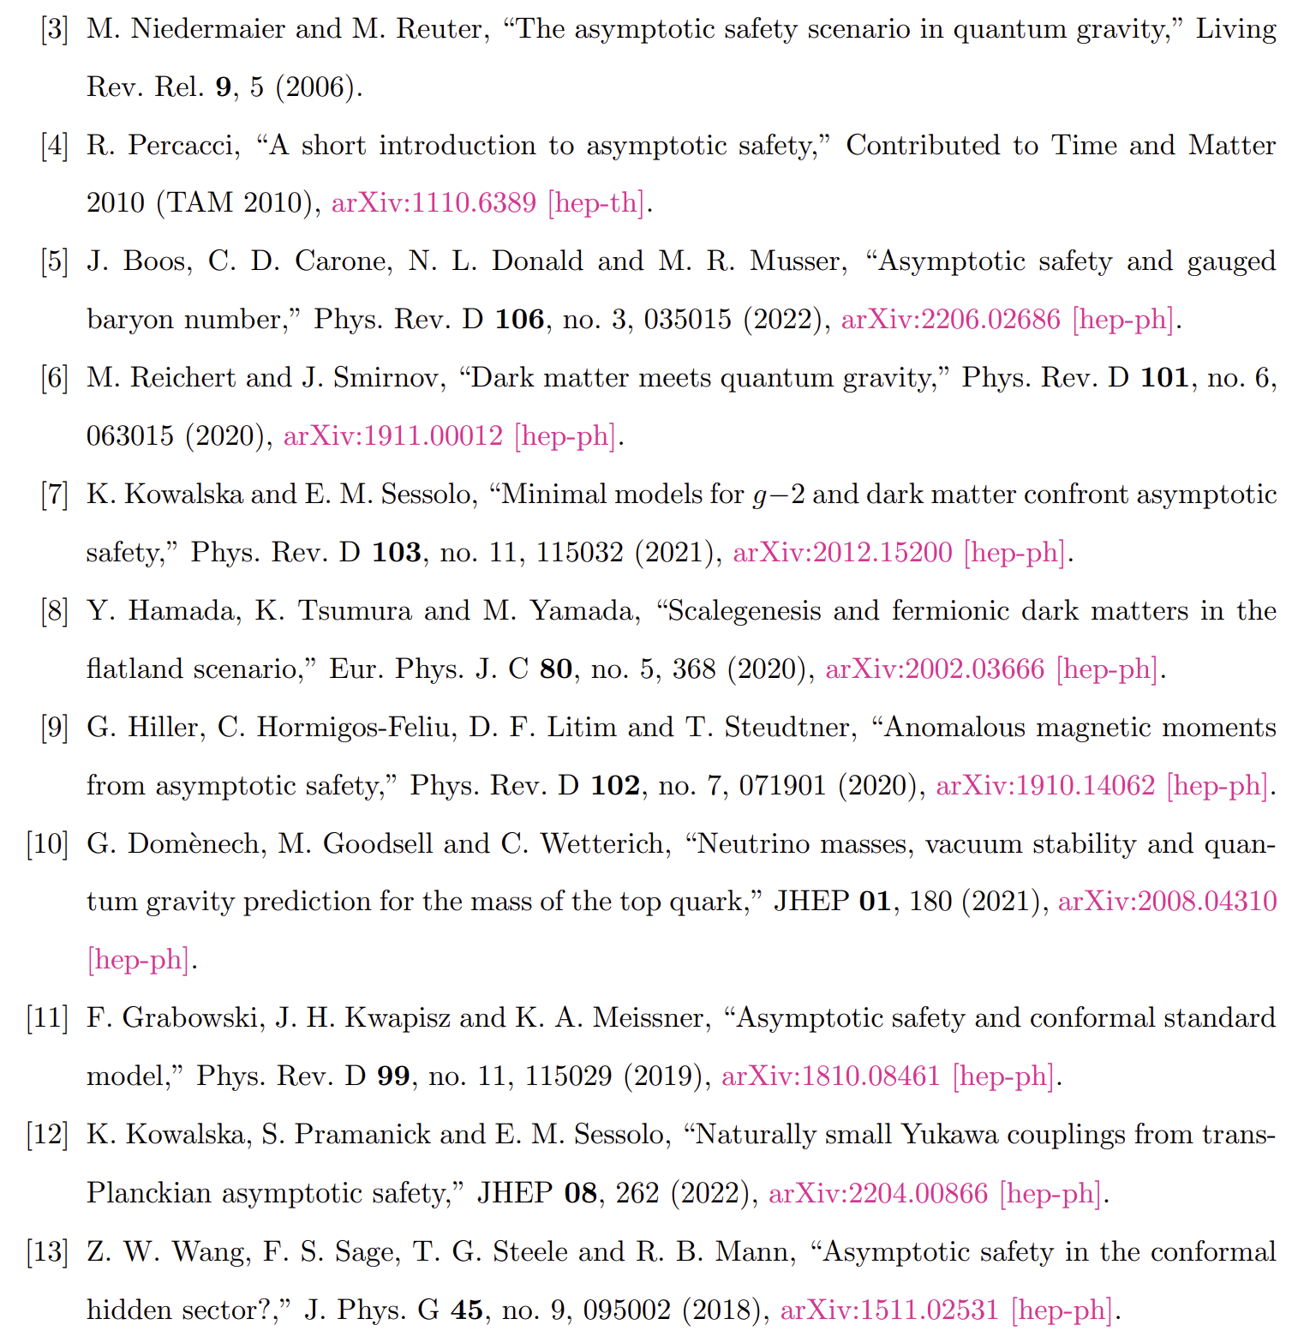
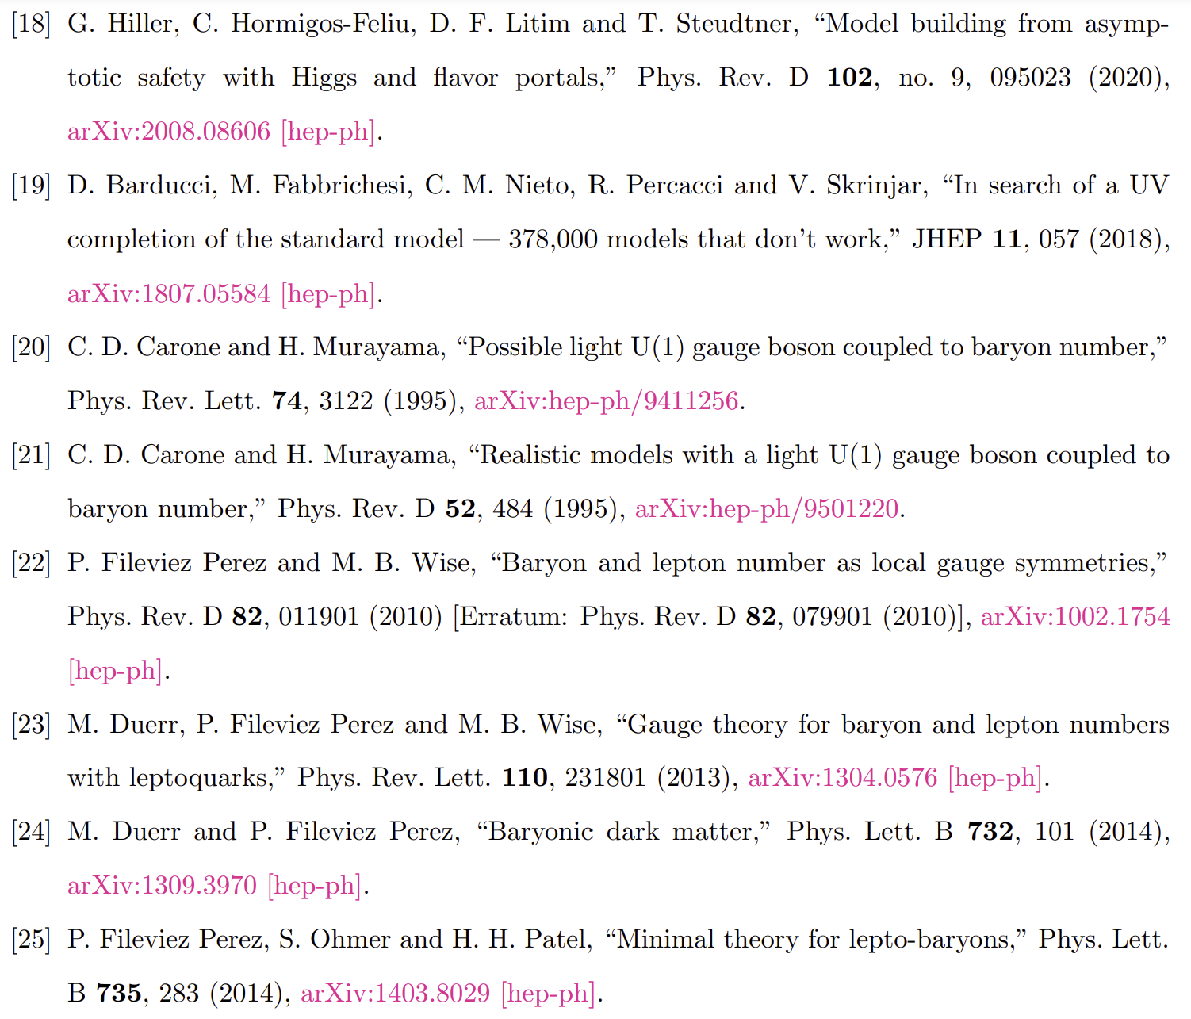
References:

