Slide 1

FIMP Dark Matter from Flavon Portals
Shreyashi Chakdar
College of the Holy Cross, MA
in collaboration with K.S. Babu, N. Das, D. Ghosh and P. Ghosh
Based on arXiv: 2305.03167
Phenomenology 2023 Symposium
May 8, 2023

Slide 2


DM and Fermion mass: ${U(1)}_{FN}$
Fermion mass hierarchy and existence of DM are two pressing puzzles addressed through Froggatt Nielson (1977) mechanism
Flavor dependent ${U(1)}_{FN}$ symmetry suppresses Majorana DM
mass and interactions FIMP DM candidate
DM non-thermally produced from the decay of the flavon
relic through the freeze-in mechanism
Explore viable parameter space for DM from current constraints and relic abundance
Notes:
fermions have masses spanning many decades and exhibiting peculiar patterns — the "flavor problem" — is addressed by an elegant mechanism presented in 1977 by Froggatt & Nielsen, through introducing a new symmetry

Slide 3
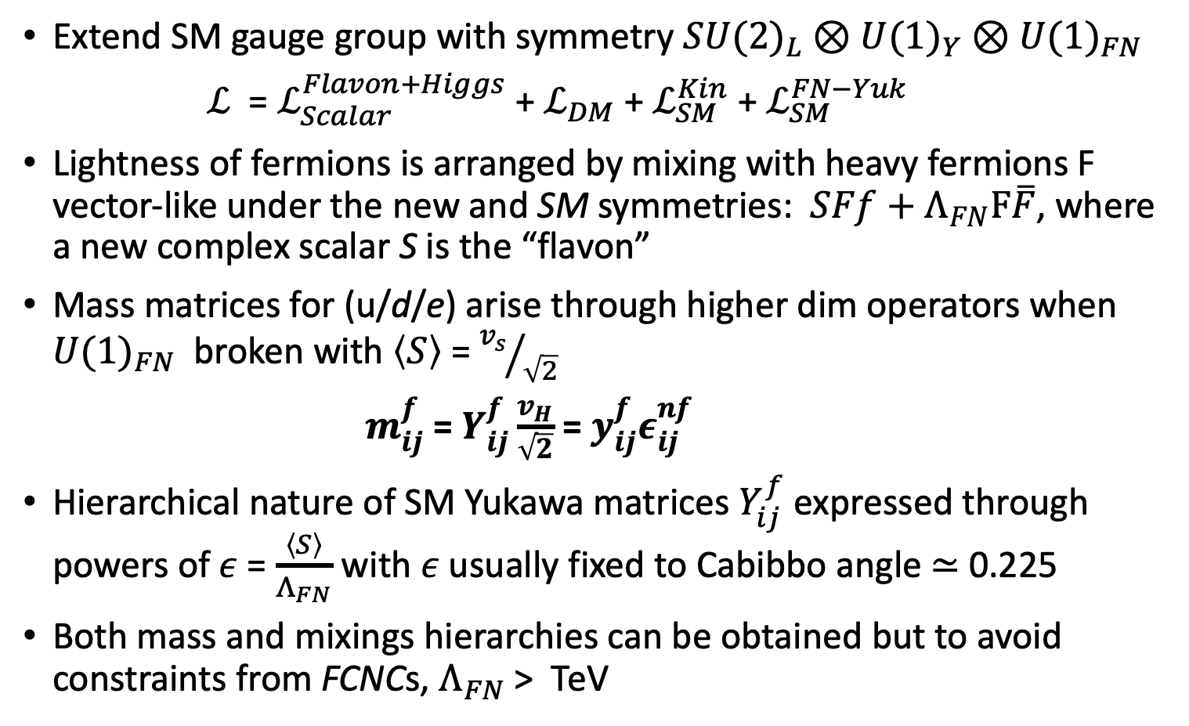
Froggatt-Nielsen Mechanism
Extend SM gauge group with symmetry ${SU(2)}_{L}$ $⊗U{(1)}_{Y}$ $⊗$ $U{(1)}_{FN}$
$ℒ$ = $ℒ_{Scalar}^{Flavon+Higgs}$ + $ℒ_{DM}$ + $ℒ_{SM}^{Kin}$ + $ℒ_{SM}^{FN−Yuk}$
Lightness of fermions is arranged by mixing with heavy fermions F vector-like under the new and SM symmetries: $SFf+Λ_{FN}F\overline{F}$, where a new complex scalar S is the “flavon”
Mass matrices for (u/d/e) arise through higher dim operators when ${U(1)}_{FN}$ broken with $\left\langle S\right\rangle$ = ${v_{s}}/{\sqrt{2}}$
$m_{ij}^{f}$ = $Y_{ij}^{f}\frac{v_{H}}{\sqrt{2}}$ = $y_{ij}^{f}ε_{ij}^{nf}$
Hierarchical nature of SM Yukawa matrices $Y_{ij}^{f}$ expressed through powers of $ε$ = $\frac{\left\langle S\right\rangle }{Λ_{FN}}$ with $ε$usually fixed to Cabibbo angle ≃ 0.225
Both mass and mixings hierarchies can be obtained but to avoid constraints from FCNCs, $Λ_{FN}$> TeV
Notes:
that extends the SM gauge group with a (global or local) symmetry. The lightness of fermions f is then arranged by mixing with heavy fermions F vector-like under the new and SM symmetries: SFf + ΛFNFF ̄, where S is the “flavon”, a scalar field acquiring a vev vs and breaking the symme- try.

Slide 4
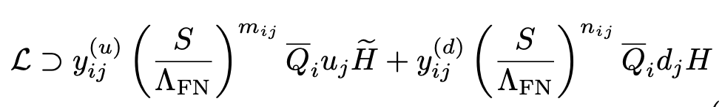
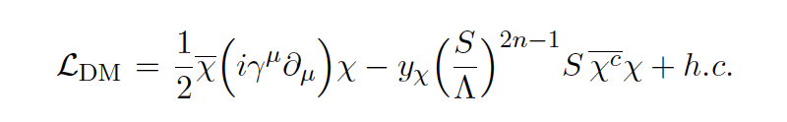
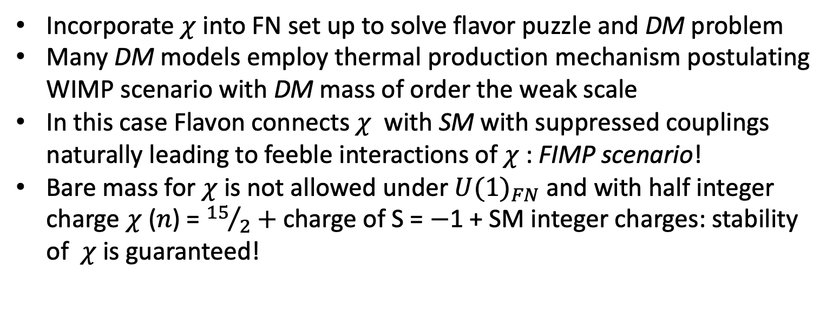
Extension to Dark Sector
Fermions couple to Higgs doublet only via non-renormalizable
terms containing several powers of S
Incorporate $χ$ into FN set up to solve flavor puzzle and DM problem
Many DM models employ thermal production mechanism postulating WIMP scenario with DM mass of order the weak scale
In this case Flavon connects $χ$ with SM with suppressed couplings naturally leading to feeble interactions of $χ$: FIMP scenario!
Bare mass for $χ$ is not allowed under ${U(1)}_{FN}$ and with half integer charge $χ$ ($n$) = ${15}/2+$ charge of S = $−$1 + SM integer charges: stability of$χ$ is guaranteed!

Slide 5
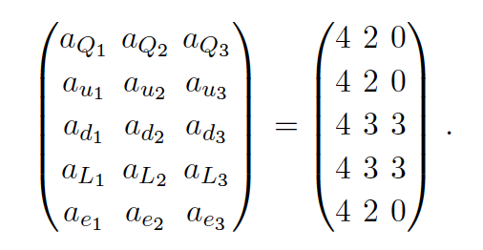

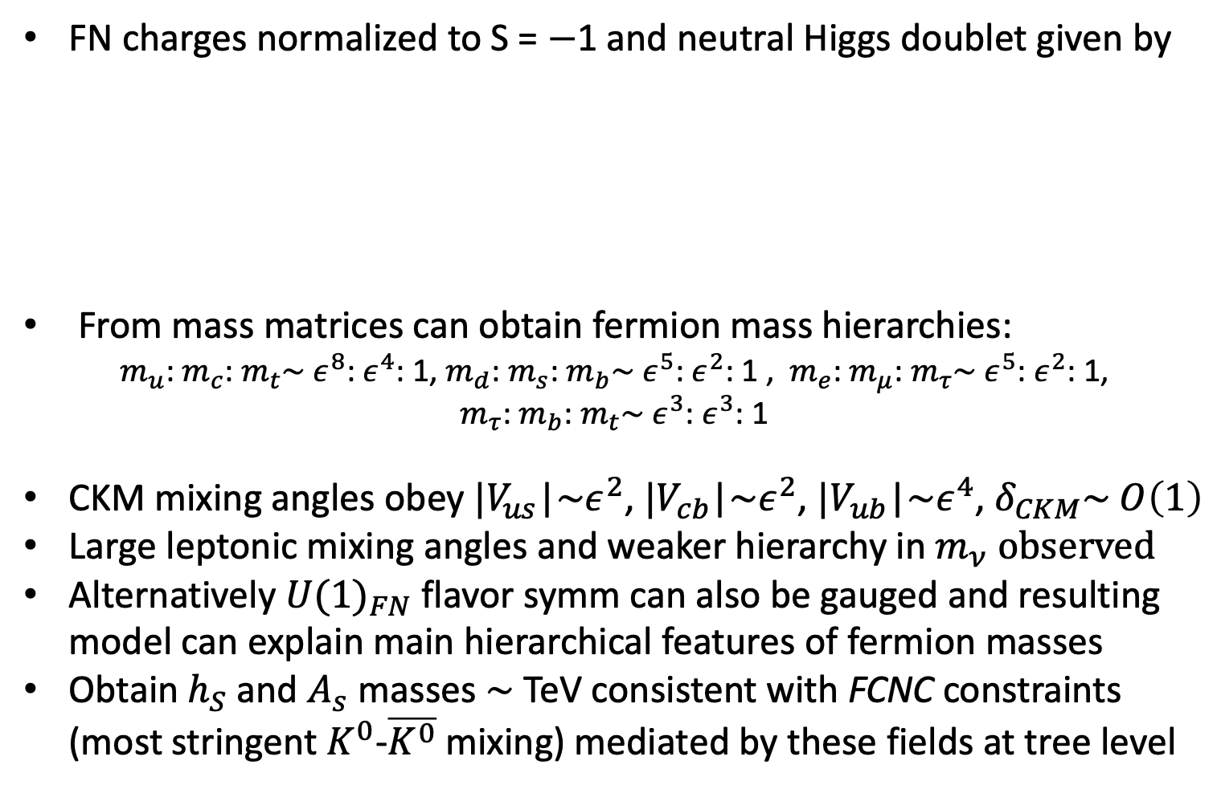
Flavor models: $global and local$
FN charges normalized to S = $−$1 and neutral Higgs doublet given by
From mass matrices can obtain fermion mass hierarchies:
$m_{u}$: $m_{c}$: $m_{t}\sim ε^{8}$: $ε^{4}$: 1, $m_{d}$: $m_{s}$: $m_{b}\sim ε^{5}$: $ε^{2}$: 1 , $m_{e}$: $m_{μ}$: $m_{τ}\sim ε^{5}$: $ε^{2}$: 1,
$m_{τ}$: $m_{b}$: $m_{t}\sim ε^{3}$: $ε^{3}$: 1
CKM mixing angles obey $|V_{us}$|$\sim ε^{2}$, $|V_{cb}$|$\sim ε^{2}$, $|V_{ub}$|$\sim ε^{4}$, $δ_{CKM}\sim O\left(1\right)$
Large leptonic mixing angles and weaker hierarchy in $m_{ν} observed$
Alternatively ${U(1)}_{FN}$ flavor symm can also be gauged and resulting model can explain main hierarchical features of fermion masses
Obtain $h_{S}$ and $A_{s}$ masses $\sim$ TeV consistent with FCNC constraints (most stringent $K^{0}$-$\overline{K^{0}}$ mixing) mediated by these fields at tree level

Slide 6
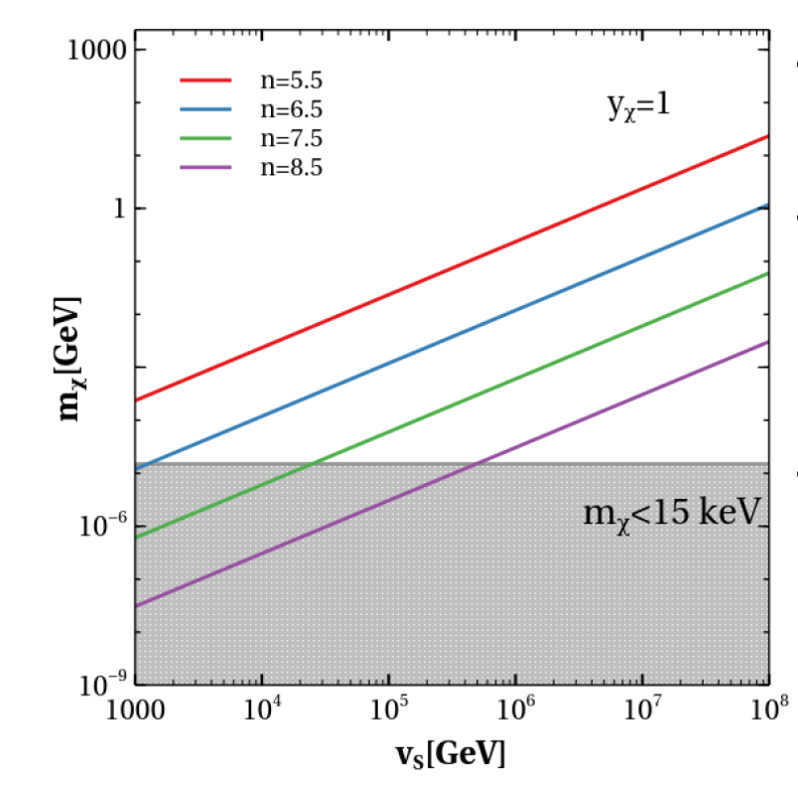



FIMP DM phenomenology
Sub-MeV FIMP leads to naturally suppressed coupling to visible sector DM-nucleon scattering cross sec lies well below DD bounds
Structure formation bounds from Lyman-$α$forest data place a strong constraint: $m_{χ}≳15 keV$
$m_{χ}≳15 keV$ constraint on $v_{S}$ via $m_{χ}$ = $y_{χ}\frac{v_{S}}{\sqrt{2}}$ $ε^{2n−1}$
Gray region: constraint $on m_{χ}$ from structure formation
DM FN charges $n=7.5 \left(8.5\right)$ allowed values of $v_{S }$larger than $\sim 2×{10}^{4}$ ($5×{10}^{5}$ GeV)
$v_{S}≥ {10}^{6}$ GeV for $n ≤8.5$
Fig (L): $m_{χ}$ presented as a function of $v_{S}$

Slide 7
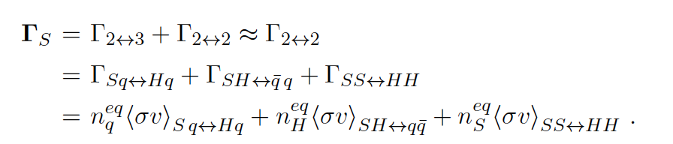

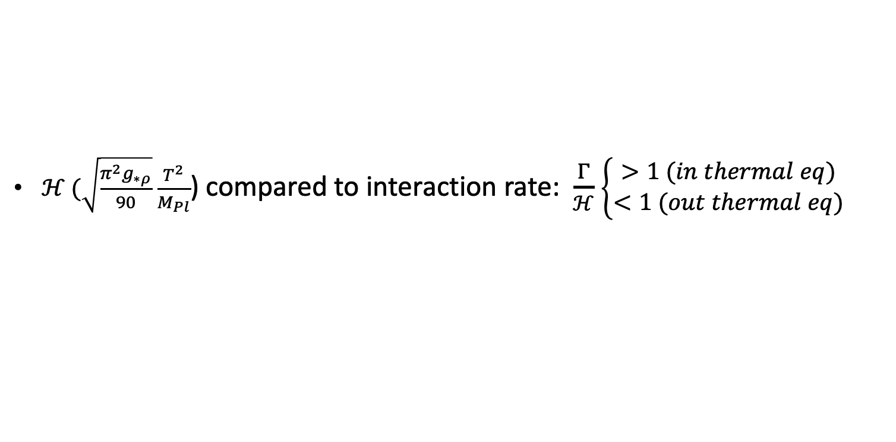
Freeze-in production
Feeble interaction $χ$and S: $χ$ never attains thermal equilibrium in early universe leading to freeze in
Freeze in starts with negligible initial abundance and $χ is$gradually produced through S decays
Dim 6 Yukawa interactions (2$⟷2 /\text{2}⟷3$) + Higgs portal interactions ${(S}^{†}$S)($H^{†}H)$ keep S in thermal bath
Total interaction rate of S at $T$ ($T_{EW}$ < T < $v_{S}$):
$ℋ (\sqrt{\frac{π^{2}g_{∗ρ}}{90}}$ $\frac{T^{2}}{M_{Pl}}$) compared to interaction rate: $\frac{Γ}{ℋ}$ $\left\{\begin{aligned}>1 (in thermal eq) \\ <1 (out thermal eq)\end{aligned}\right.$
Notes:
Only scalar portals included in the plots

Slide 8
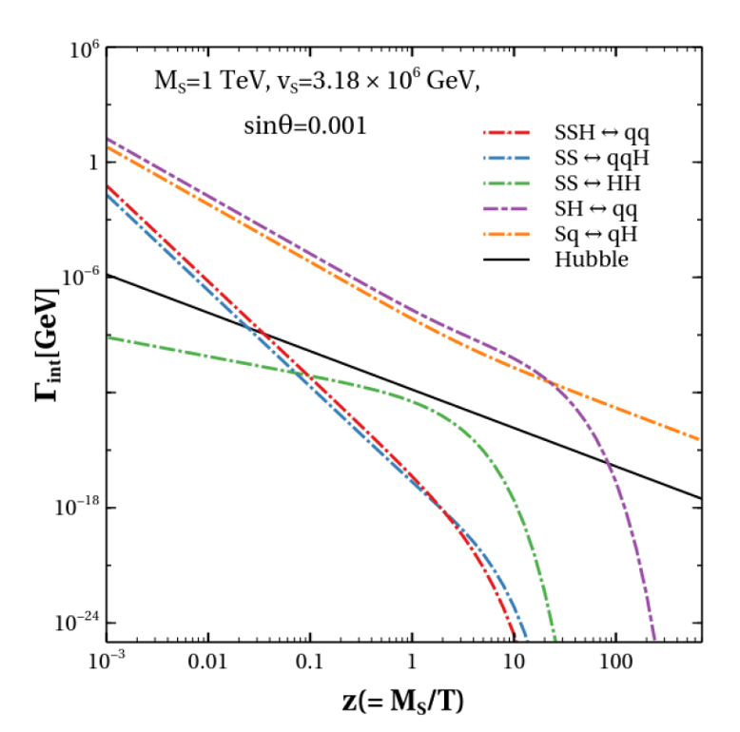
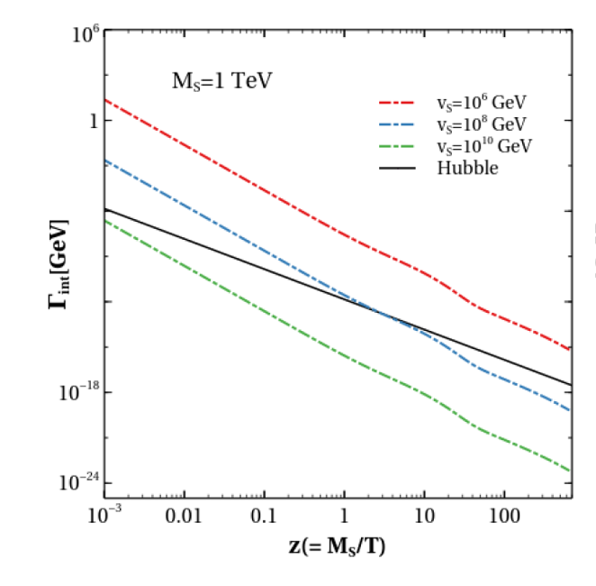

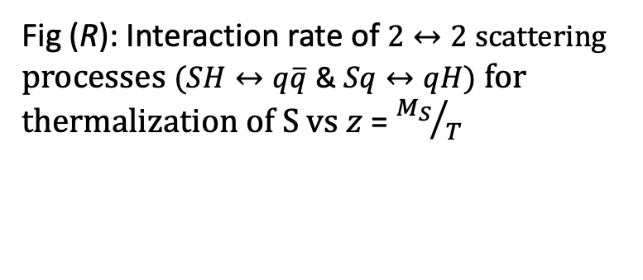
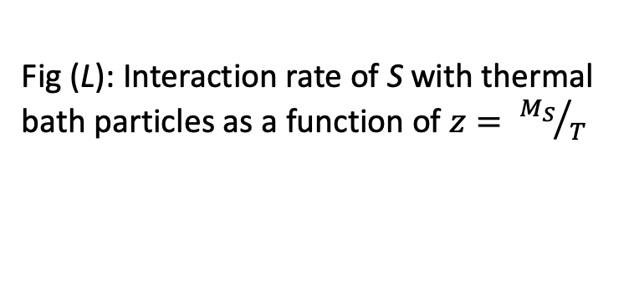
$χ$production: Thermalization of S
Fig (L): Interaction rate of S with thermal bath particles as a function of $z= {M_{S}}/T$
Fig (R): Interaction rate of $2↔2 scattering$ processes $(SH↔q\overline{q}\text{ \& }Sq↔qH)$ for thermalization of S $vs z$ = ${M_{S}}/T$

Slide 9
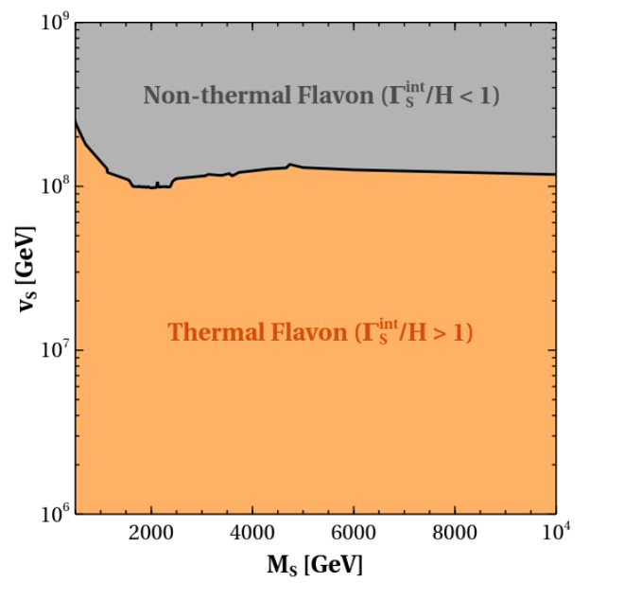
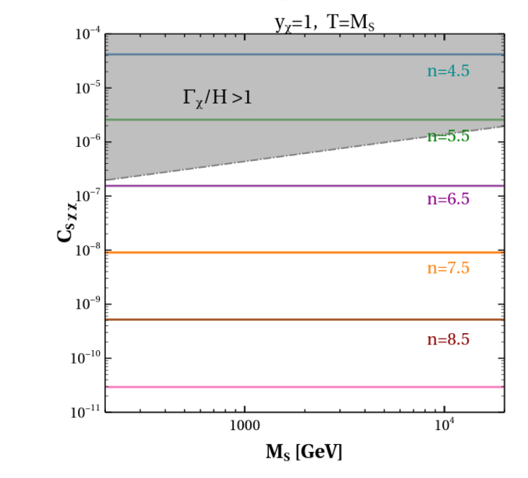

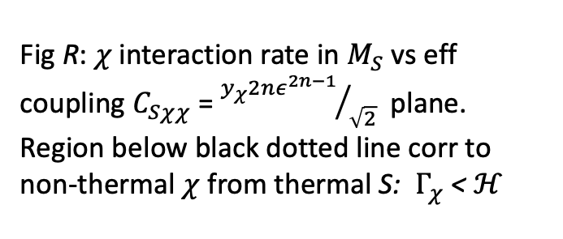
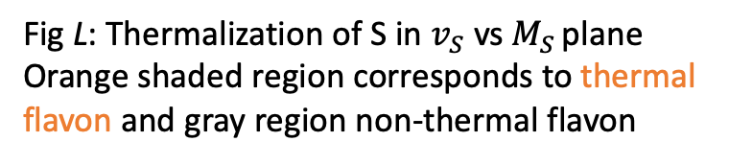
Non-thermal $χ$ & thermal S
Fig L: Thermalization of S in $v_{S}$ vs $M_{S }$plane
Orange shaded region corresponds to thermal
flavon and gray region non-thermal flavon
Fig R: $χ$interaction rate in $M_{S}$ vs eff coupling $C_{Sχχ}$= ${y_{χ}2nε^{2n−1}}/{\sqrt{2}}$ plane. Region below black dotted line corr to non-thermal $χ$from thermal S: $Γ_{χ}$ < $ℋ$
$χ$remains non-thermal at high T for $n≥$5.5 for $T= M_{S}$ and $y_{χ}$ = 1
Notes:
We find that the DM remains non-thermal at high temperature for higher values of n, i.e for n 5:5 for T = MS and y = 1.

Slide 10
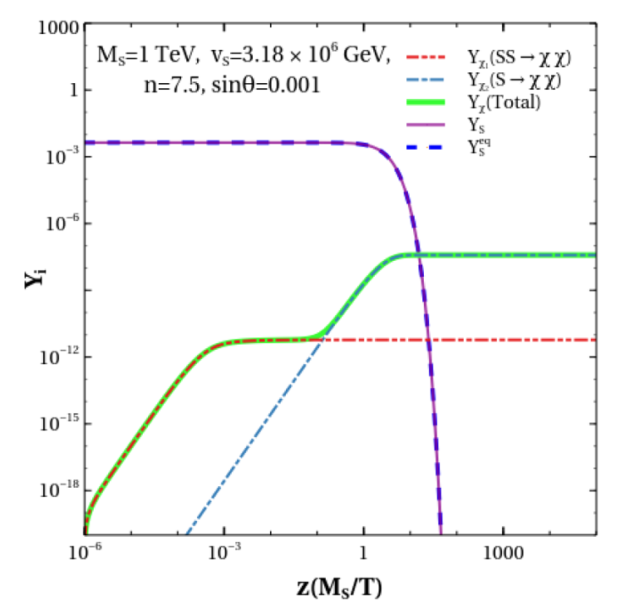
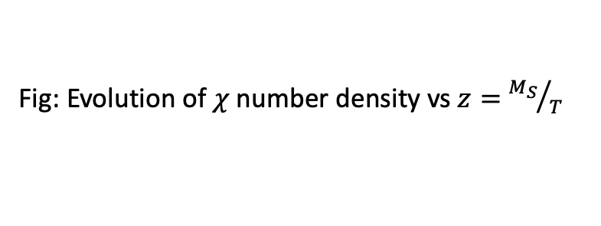
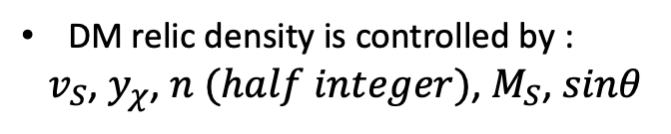
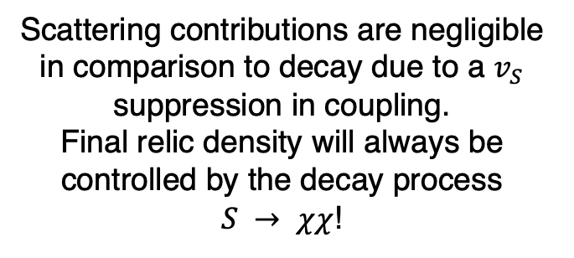
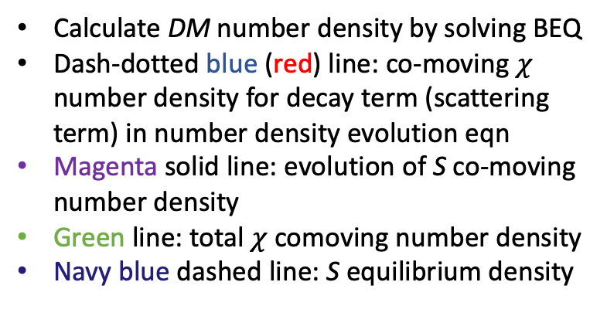
DM number density
DM relic density is controlled by :
${ v}_{S}$, $y_{χ}$, $n (half integer)$, $M_{S}$, $sinθ$
Calculate DM number density by solving BEQ
Dash-dotted blue (red) line: co-moving $χ$ number density for decay term (scattering term) in number density evolution eqn
Magenta solid line: evolution of S co-moving number density
Green line: total $χ$comoving number density
Navy blue dashed line: S equilibrium density
Scattering contributions are negligible in comparison to decay due to a $v_{S}$ suppression in coupling.
Final relic density will always be
controlled by the decay process
$S → χχ$!
Fig: Evolution of $χ$number density vs $z=$ ${M_{S}}/T$

Slide 11
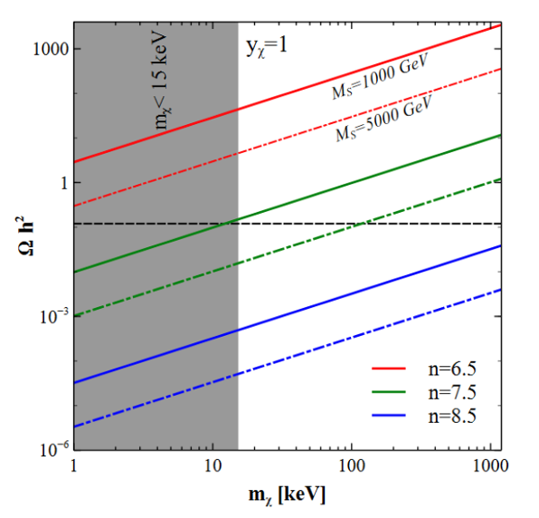


DM relic density
PLANCK relic density bound ($Ω_{DM}h^{2}$= 0.12 $±0.001$) presented by black dashed line
Gray shaded region excluded from structure formation (Lyman-forest)
Solid(dashed) lines correspond to ${ M}_{S}$ = 1(5) TeV for $n= 6.5, 7.5, 8.5$
Fig: DM Relic density as a function of $m_{χ}$ = $y_{χ}\frac{v_{S}}{\sqrt{2}}$ $ε^{2n−1}$
For $n$ = 7.5 preferred DM mass 100 keV
Notes:
Brown region= perturbative limit

Slide 12
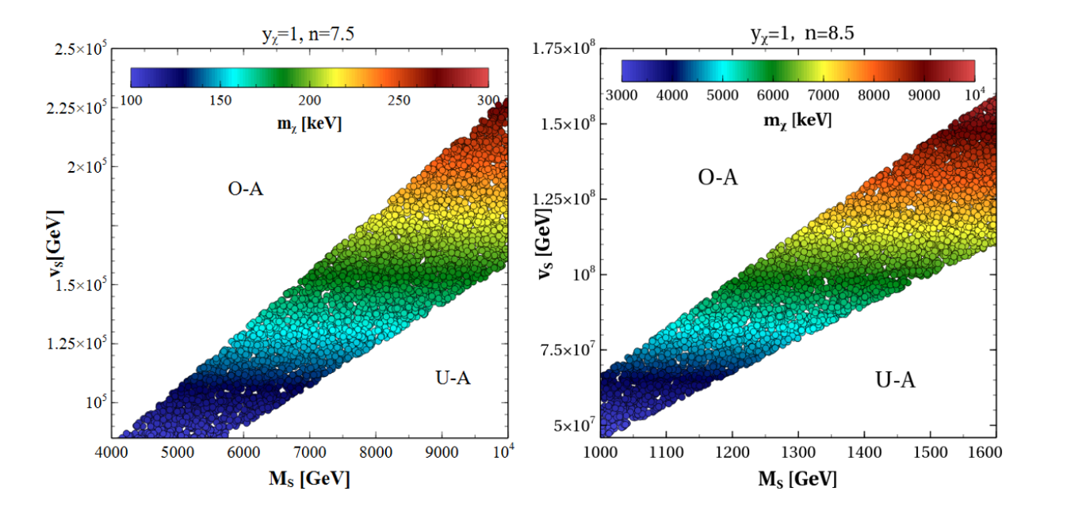
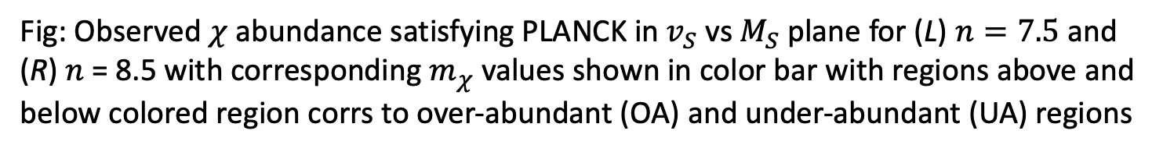
DM abundance
Fig: Observed $χ$abundance satisfying PLANCK in $v_{S}$ vs $M_{S}$ plane for (L) $n=7.5$and
(R) $n$ = 8.5 with corresponding $m_{χ}$ values shown in color bar with regions above and below colored region corrs to over-abundant (OA) and under-abundant (UA) regions

Slide 13
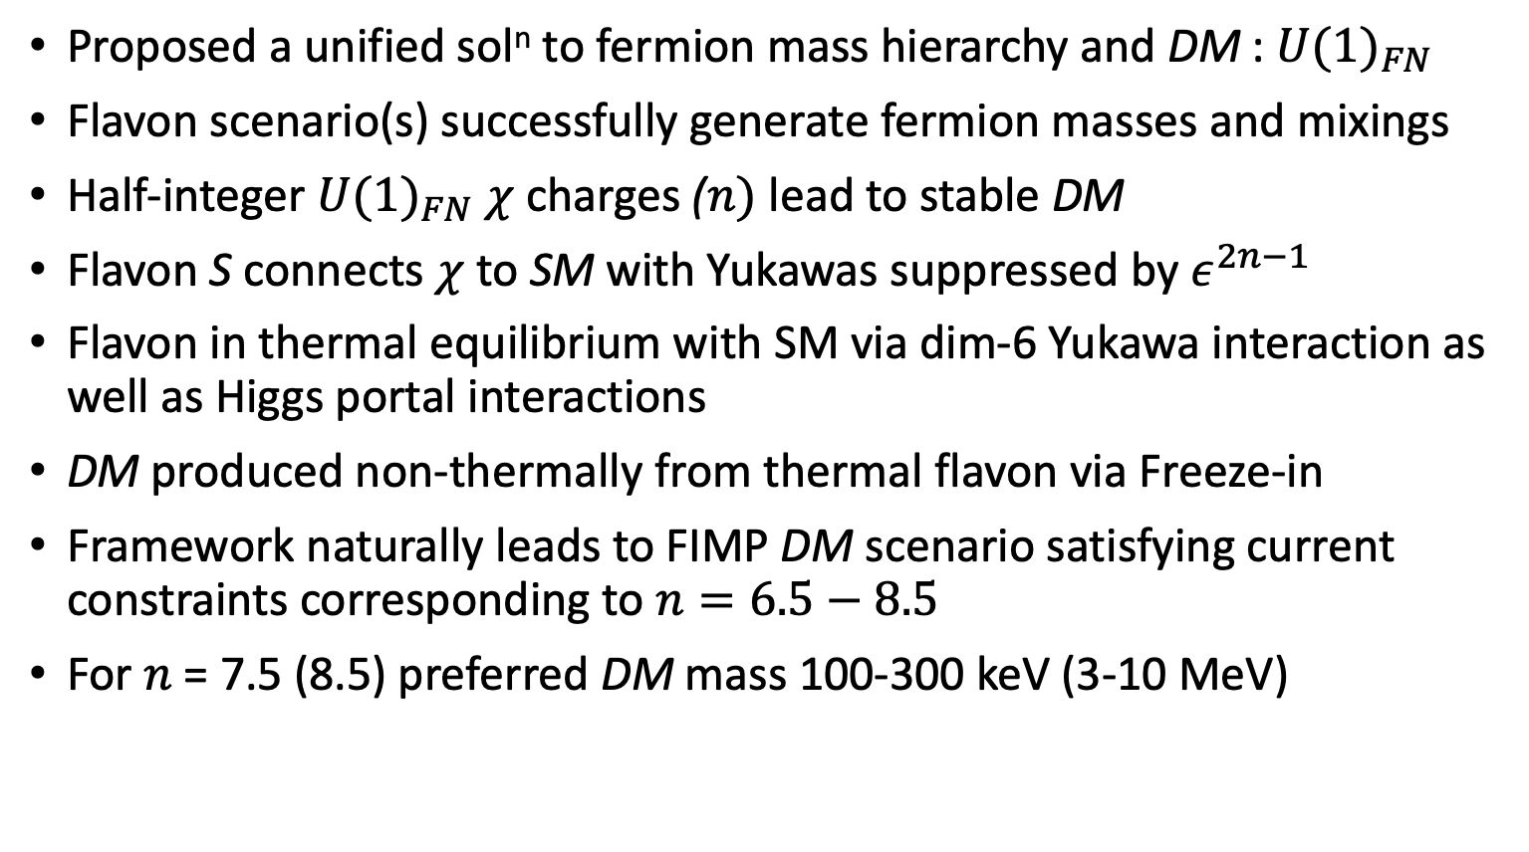
Summary
Proposed a unified sol^{n} to fermion mass hierarchy and DM : ${U(1)}_{FN}$
Flavon scenario(s) successfully generate fermion masses and mixings
Half-integer ${U(1)}_{FN}$ $χ$charges ($n)$ lead to stable DM
Flavon S connects $χ$ to SM with Yukawas suppressed by $ε^{2n−1}$
Flavon in thermal equilibrium with SM via dim-6 Yukawa interaction as well as Higgs portal interactions
DM produced non-thermally from thermal flavon via Freeze-in
Framework naturally leads to FIMP DM scenario satisfying current constraints corresponding to $n=6.5−8.5$
For $n$ = 7.5 (8.5) preferred DM mass 100-300 keV (3-10 MeV)
Thank you!

Slide 14
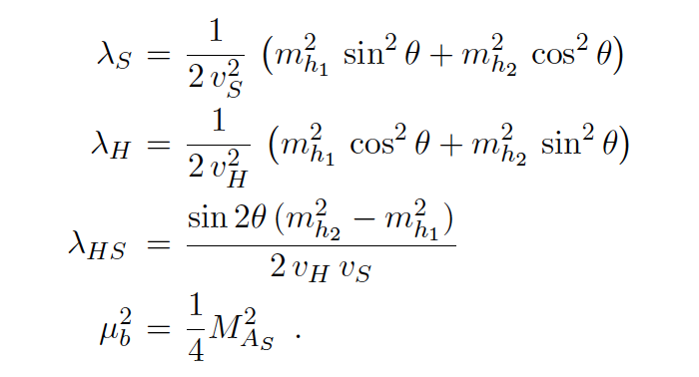


Back up slide: Scalar Sector
$ℒ_{Scalar}^{Flavon+Higgs}= {\left|D_{μ}H\right|}^{2}$ +${\left|∂_{μ}S\right|}^{2}−V(H, S)$
CP odd scalar $A_{s}$ has no mixing with CP even scalar
$m_{AS}^{2}$ $=4 μ_{b}^{2}$
CP even states $h_{H}$ and $h_{S}$ mix with mass matrix: $ℳ^{2}=$ $\left(\begin{matrix}2λ_{H}v_{H}^{2} & λ_{HS}v_{H}v_{S} \\ λ_{HS}v_{H}v_{S} & 2λ_{S}v_{S}^{2}\end{matrix}\right)$
Scalar sector parameters in terms of physical masses & mixing angle

