Slide 1


Finding Exotic Particles with
Fireballs
Melissa Diamond
Queen’s University
Pheno 2023
Based on 2106.03879, 2303.11395 and ongoing work with Damiano Fiorillo, Gustavo Marques Tavares, Irene Tambora, and Edoardo Vitagliano
05.09.2023

Slide 2
Hot Neutron Stars
A powerful tool for exploring dark matter and beyond the standard model (BSM) particles
ρ~${10}^{14}$ g/cm${}^{3}$
T> 30 MeV
Core Collapse Supernovas
Binary neutron star mergers
Can thermally produce particles with masses up to 100’s of MeV, and couplings to the SM weaker than neutrinos

Slide 3
Use hot neutron stars to look for BSM particles that escape the star, but decay to the SM before reaching Earth with masses between 1 MeV and 1 GeV

Slide 4
Axions
$$L⊃-\frac{1}{4}FF^{′}-\frac{1}{2}m_{a}^{2}a^{2}+g_{aγγ}aE∙B$$
Massive psuedo-scalar
Couples to $E∙B$
Thermally produced in NS
Can decay to two photons before reaching earth
$g_{aγγ}∼{10}^{-9}-{10}^{-10}$ GeV${}^{-1}$

Slide 5
The Fireball

Slide 6
From source to signal
Reprocessed thermal Fireball
Exotic particles radiated by source
Expanding plasma shell
Pair production and scattering are fast
Decay to standard model
Pair production and scattering are slow
Decay products free stream. No fireball

Slide 7
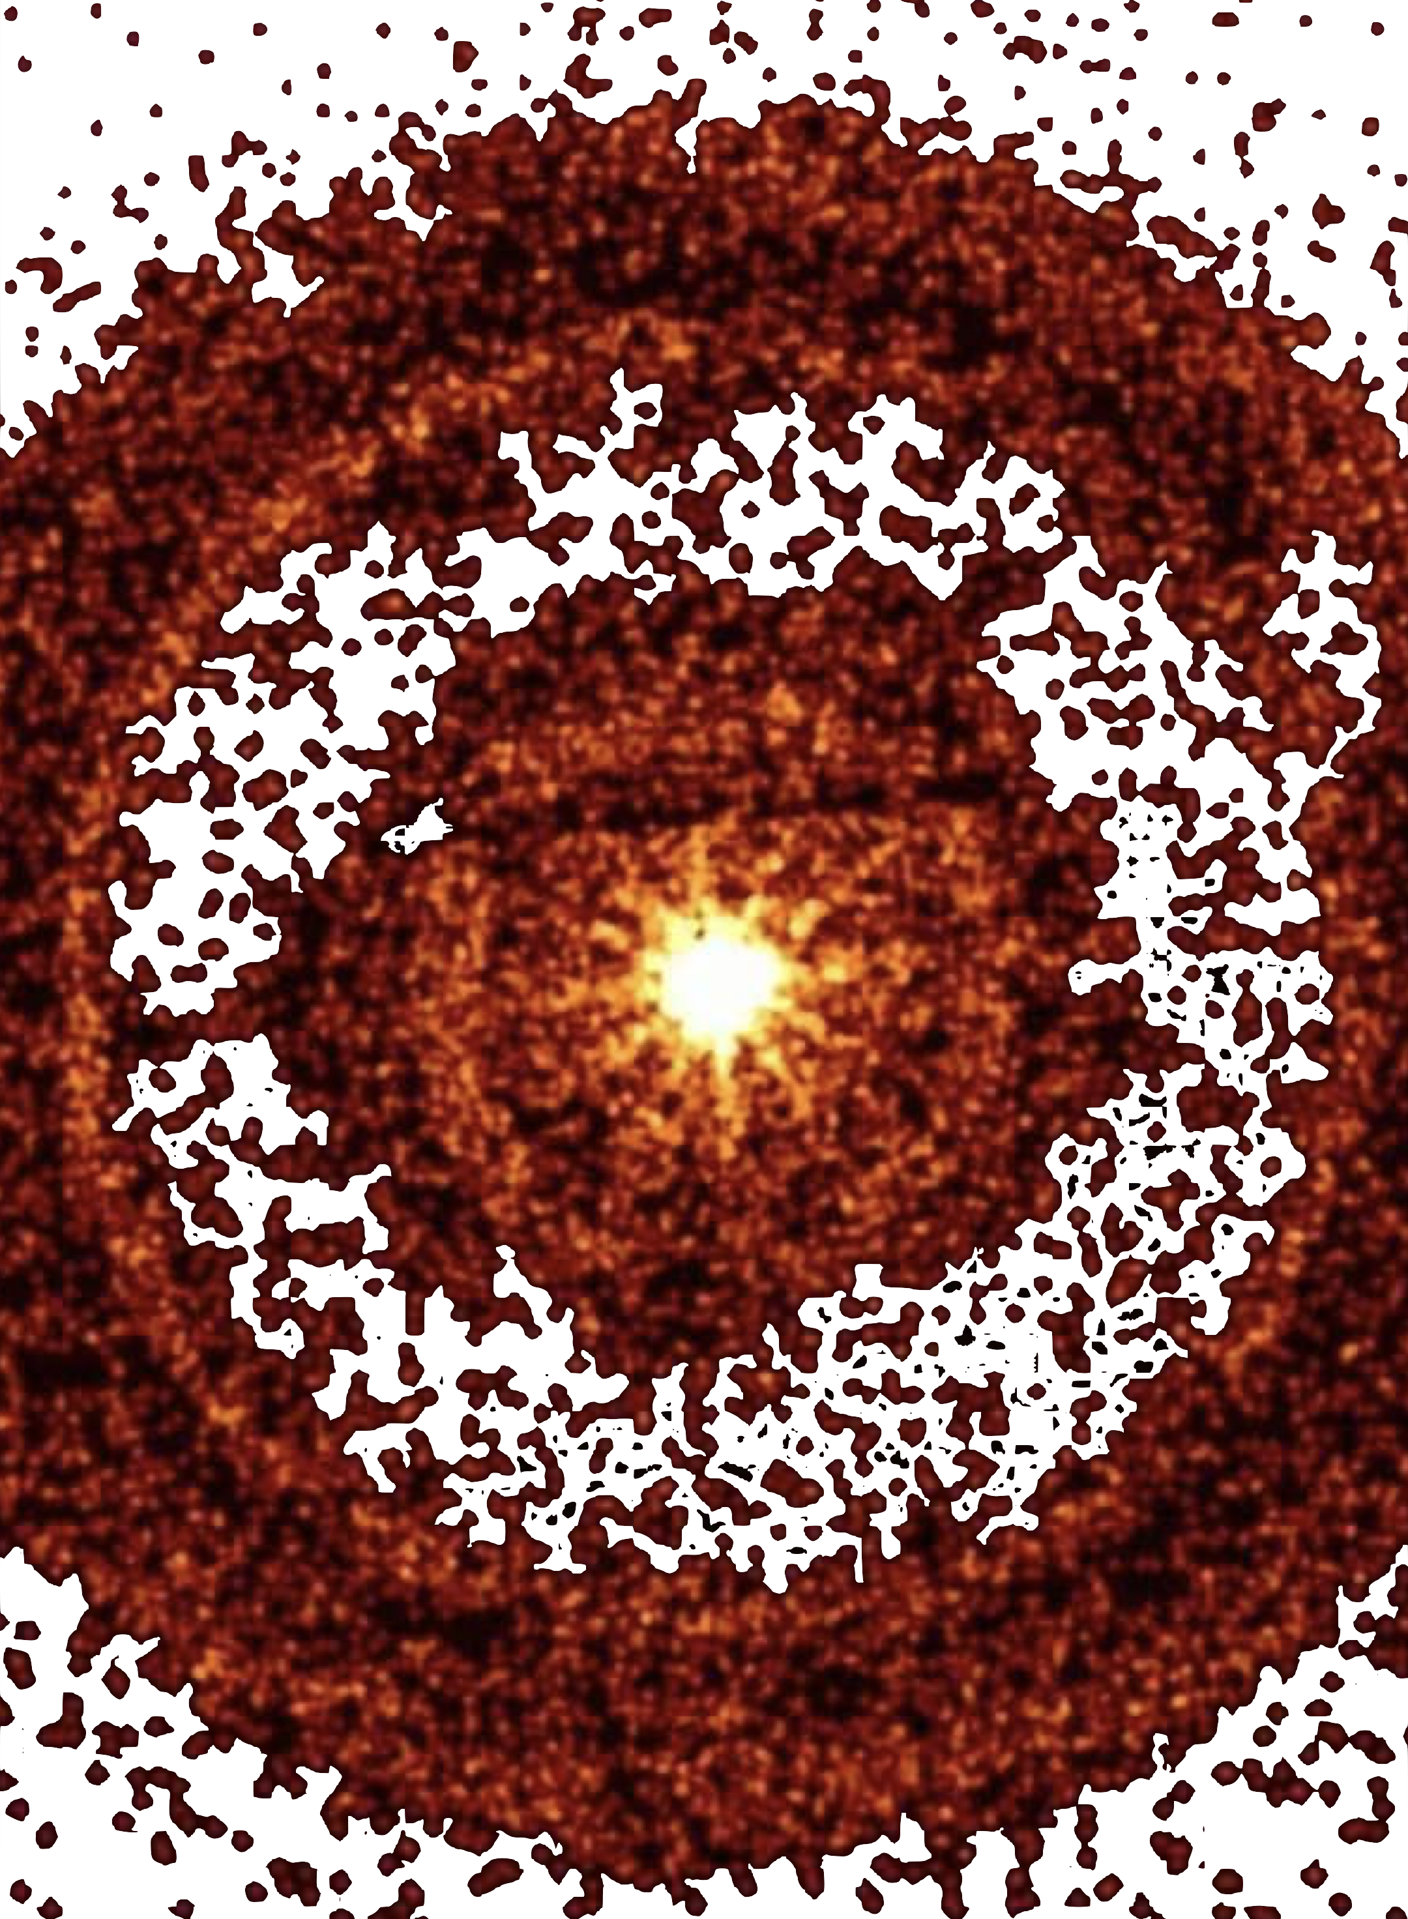
The Fireball
An opaque thermalized expanding shell of photons and e${}^{+}$ and e${}^{-}$
Thermal energy drives accelerated relativistic expansion until the shell becomes cool/diffuse enough to be transparent

Slide 8
The resulting signals
Fireball
Free Streaming
Resulting signal should be roughly thermal, boosted and isotropic with energies around 100 keV
Identified by:
        total energy
        energy spectrum
        signal timing and duration
        isotropy
Vs
Typical energies around 10s of MeV

Slide 9
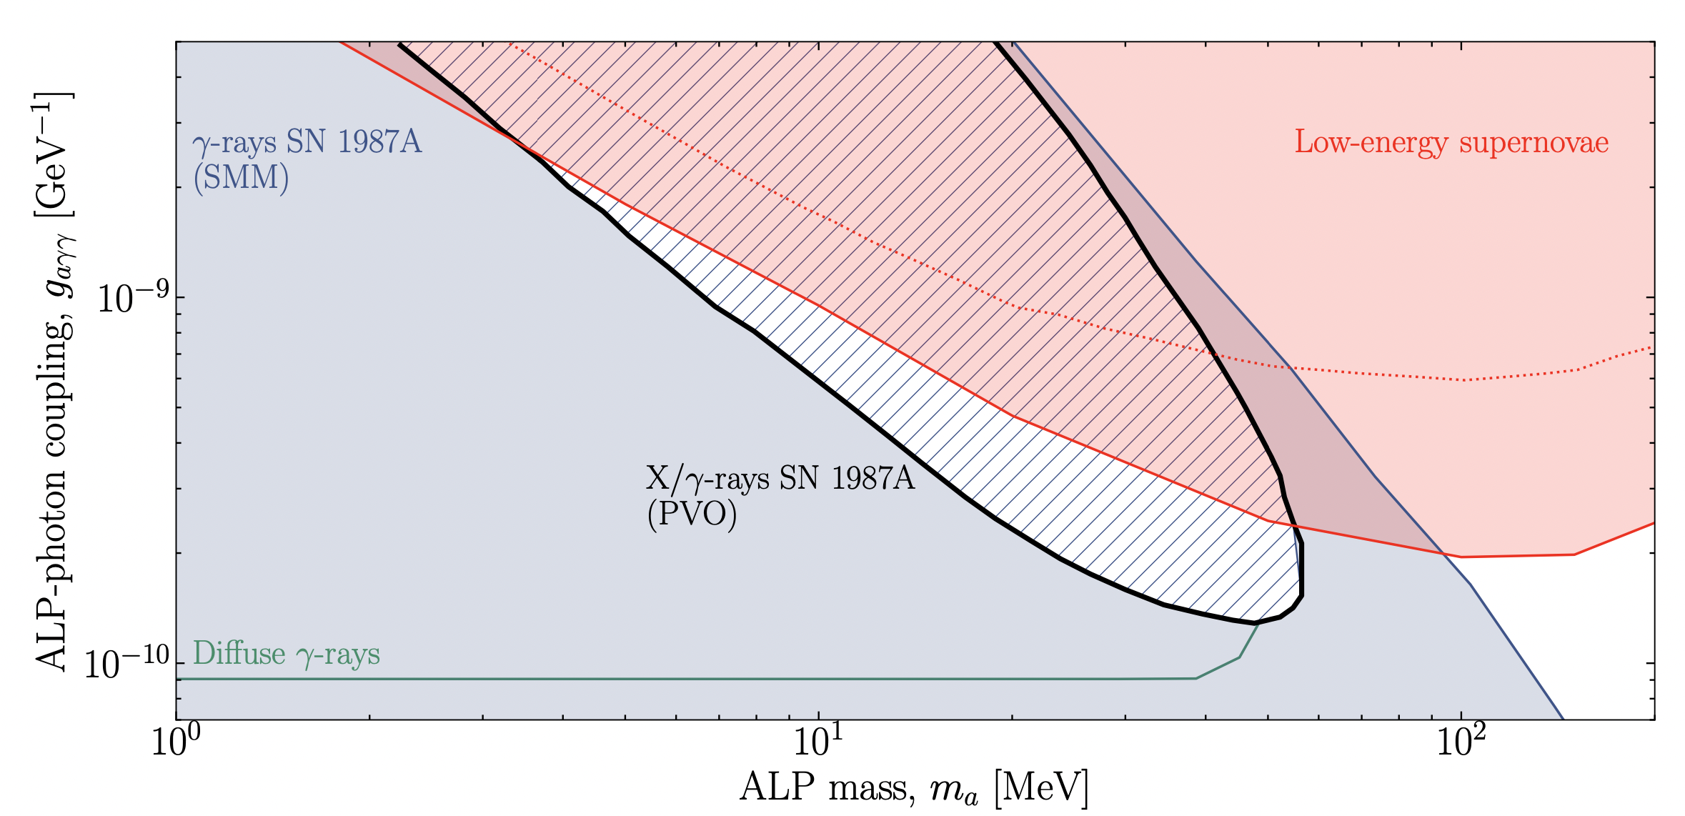
Updating Axion constraints
Photons reprocessed by fireball
Fireball reprocessing pushes signal into x-ray energies inaccessible to SMM but observable to Pioneer Venus Orbiter (PVO)
Rely on >25 MeV Signal
Arxiv 2303.11395

Slide 10
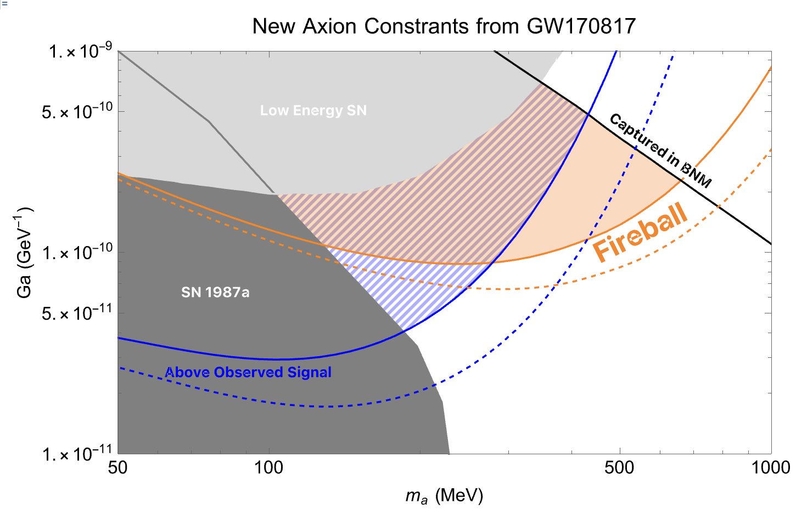
New Axion Constraints
Compare observed gamma ray burst signal from GW170817 to one predicted to result from axion fireball
Preliminary

Slide 11
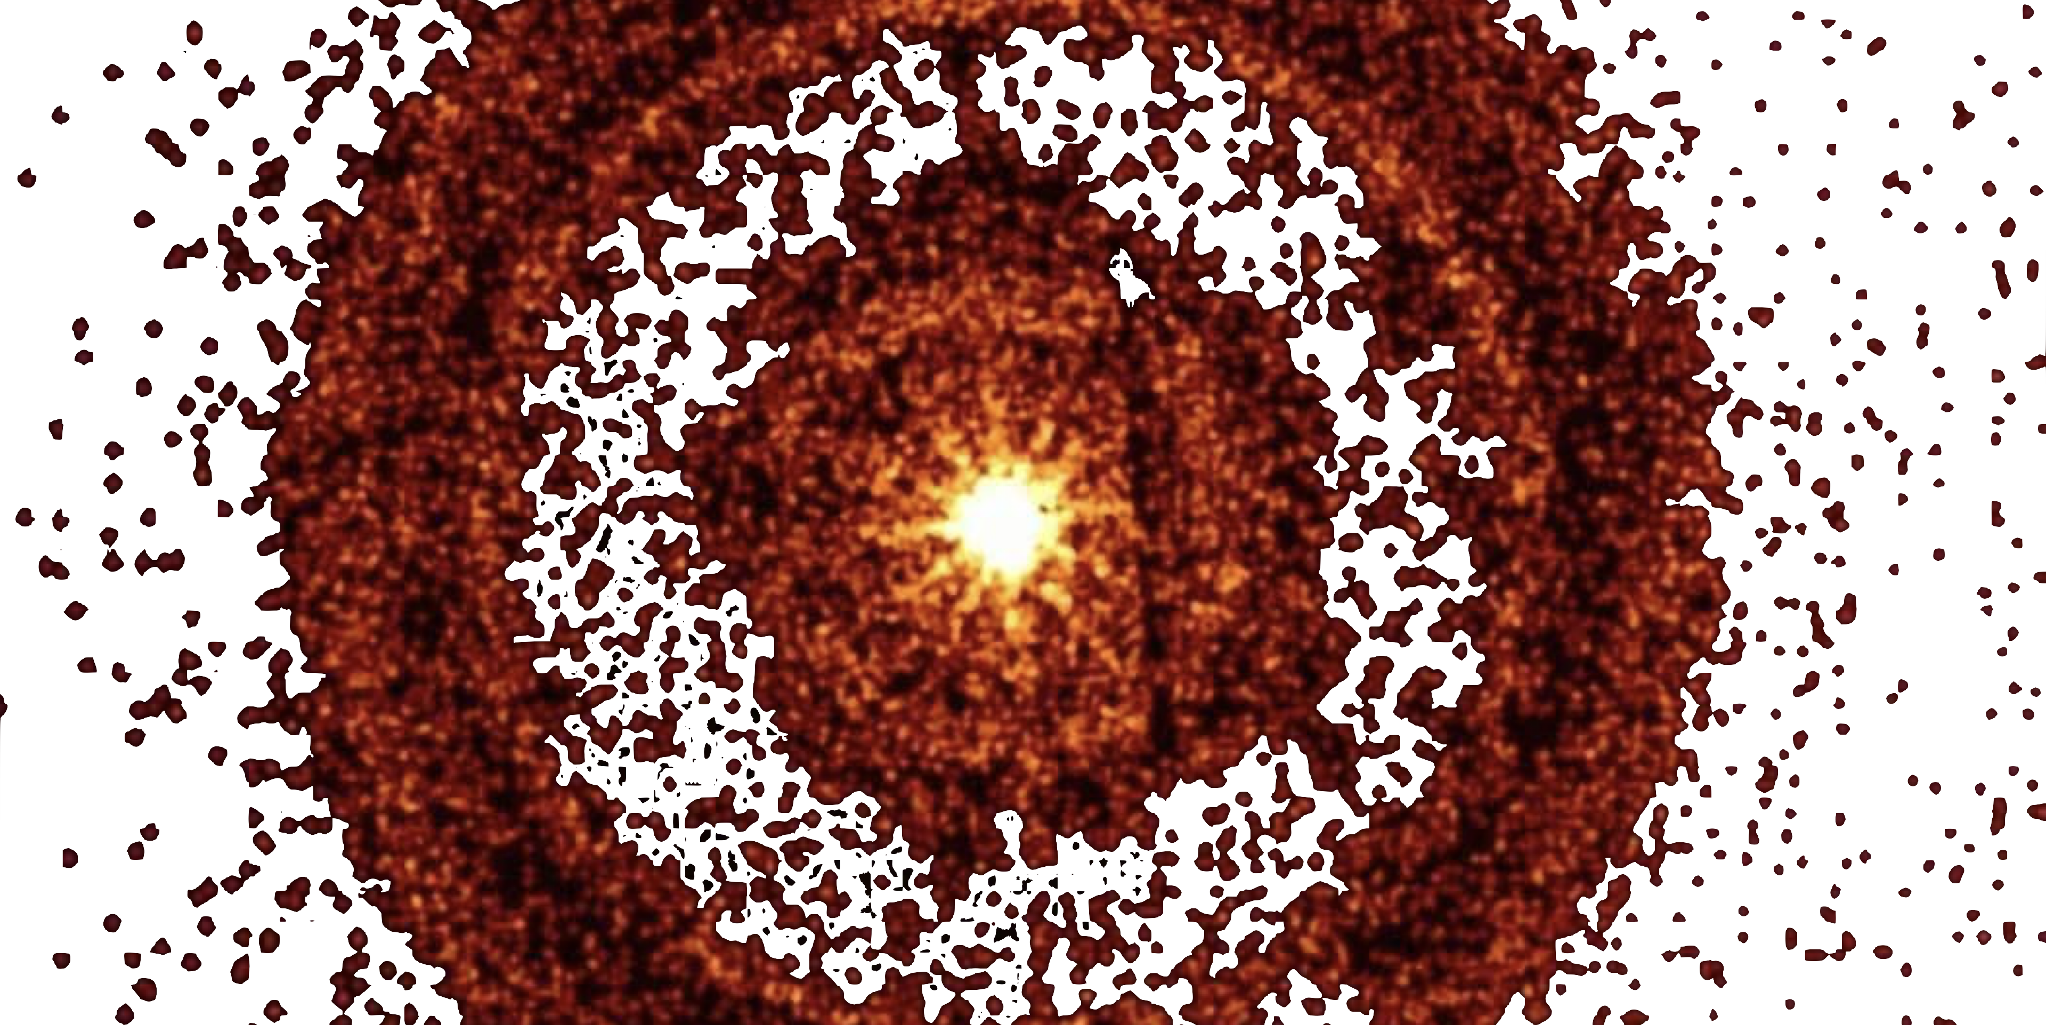
Conclusions
Hot neutron star transients are large sources of light BSM particles
Axions from these can produce observable signals
Final signal depends on whether fireball forms
More observations and better modeling will allow us to explore new parameter space
Thank You

Slide 12
Thank You
m.diamond@queensu.ca

Slide 13
The Sources

Slide 14
The resulting signal
Plasma shell is initially opaque to photons and cooling by expansion
Plasma thermalizes if pair annihilation and bremsstrahlung happen quickly compared to the expansion rate
Bremsstrahlung and expansion drives the plasma temperature below ~$m_{e}$, number of electrons in plasma drops, and photons are free to escape
Resulting signal should be roughly thermal, boosted and isotropic with energies around 100 keV

Slide 15
Introduction
Looking for ways to observe said dark matter
Particles escape the source and decay to the standard model
These form an opaque expanding shell aka a Fireball

Slide 16
Axions
Produced through:
  1.Photon coalescence
          $$γ+γ→a$$
  2.Primakoff Process
          $$γ+Ze→Ze+a$$

Slide 17
Axions
Produced through:
  1.Photon coalescence
          $$γ+γ→a$$
  2.Primakoff Process
          $$γ+Ze→Ze+a$$

Slide 18
The resulting signals
Fireball
Gamma Ray Burst
Resulting signal should be roughly thermal, boosted and isotropic with energies around 100 keV
Identified by:
        total energy
        energy spectrum
        signal timing and duration
        isotropy
Typical energies around 100s of keV
Beamed
Non-thermal and thermal components
Vs

Slide 19
Binary Neutron Star Mergers
Core Collapse
Supernovas
10 km region with ρ~${10}^{14}$ g/cm${}^{3}$
T~ 30-80MeV
Remnant survives 1 -1000 ms
Debris contained within ~1000 km
10 km region with ρ~${10}^{14}$ g/cm${}^{3}$
T~ 30 MeV
Hot emission for 1-10 s
Debris spread over ~ ${10}^{7}$ km

Slide 20
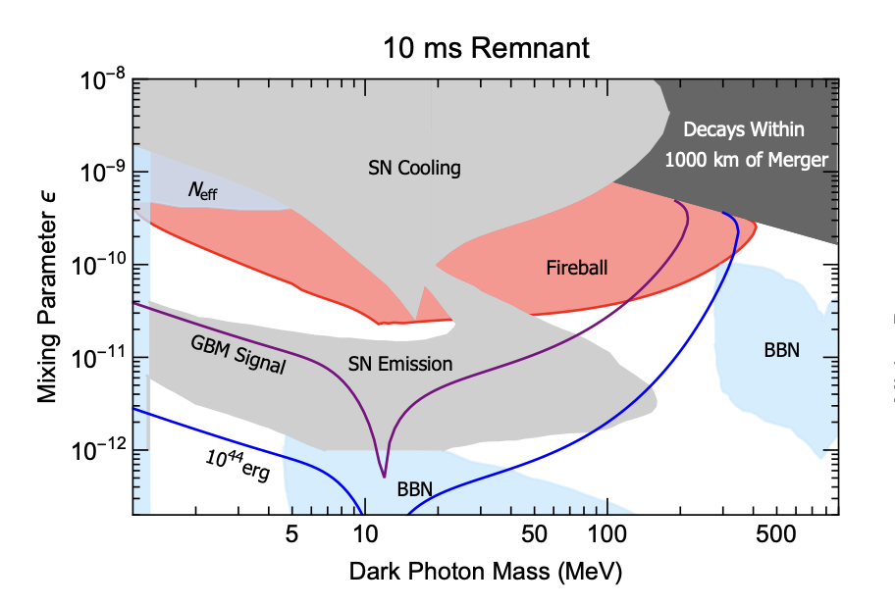
New Dark Photon Constraints??
Estimates using a simplified model of GW170817.
5-10km shell
T=30MeV
$$ρ=4×{10}^{14}$$
Duration= 10ms
https://arxiv.org/abs/2106.03879

Slide 21
Contents
Compact Sources
Axions with m=(MeV-GeV)
Making a fireball
Revising existing constraints
Adding new constraints

Slide 22
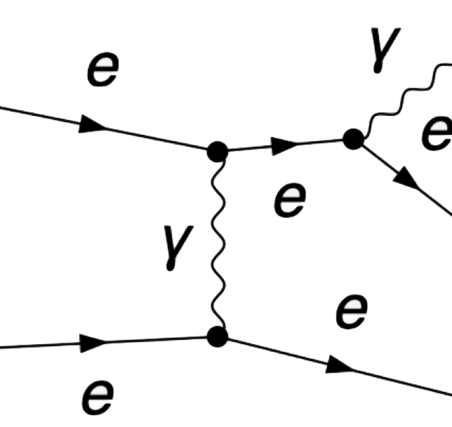
“Fast Scattering”
Expansion
Pair Production
Bremsstrahlung
vs
Dark photons $→e^{+}+e^{-}$
Axions $→γ+γ$

Slide 23
Dark Photons
$$ℒ⊃−\frac{1}{4}F^{′2}−\frac{ε}{2}FF^{′}+\frac{m^{′2}}{2}A^{′2}$$
Massive Vector
Kinematically mixes with the photon
Connects dark sector to standard model
Can decay to $e^{+}+e^{-}$

Slide 24
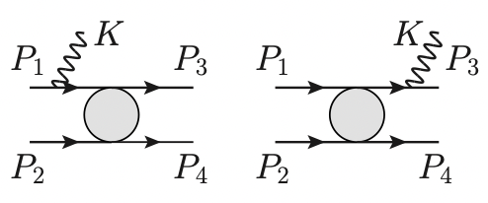
Dark Photons
Produced Through:
    Nucleon-Nucleon Bremsstrahlung
    $$n+p→n+p+A$$
A
A

