Slide 1
Metric Reconstruction in Kerr spacetime in a Horizon penetrating setting.
Mohamed Fawzi, Dejan Stojkovic
HEPCOS Group, SUNY at Buffalo

Slide 2
Background

Slide 3
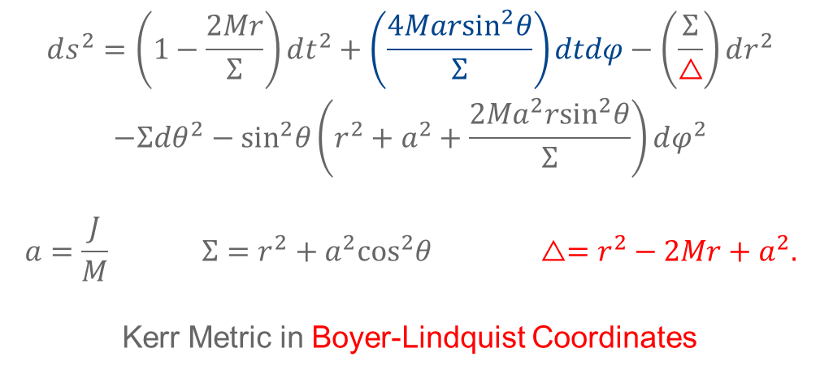
Kerr Spacetime
An axial symmetric & stationary solution for the Einstein Field Equations (EFE).
A candidate to describe rotating astrophysical objects in General relativity. For example a rotating blackhole of Mass M and Angular momentum J.
$$\begin{aligned}ds^{2}=\left(1−\frac{2Mr}{Σ}\right)dt^{2}+\left(\frac{4Mar\sin^{2}θ}{Σ}\right)dtdφ−\left(\frac{Σ}{△}\right)dr^{2} \\ −Σdθ^{2}−\sin^{2}θ\left(r^{2}+a^{2}+\frac{2Ma^{2}r\sin^{2}θ}{Σ}\right)dφ^{2}\end{aligned}$$
$$a=\frac{J}{M} Σ=r^{2}+a^{2}\cos^{2}θ △=r^{2}−2Mr+a^{2}.$$
Kerr Metric in Boyer-Lindquist Coordinates

Slide 4
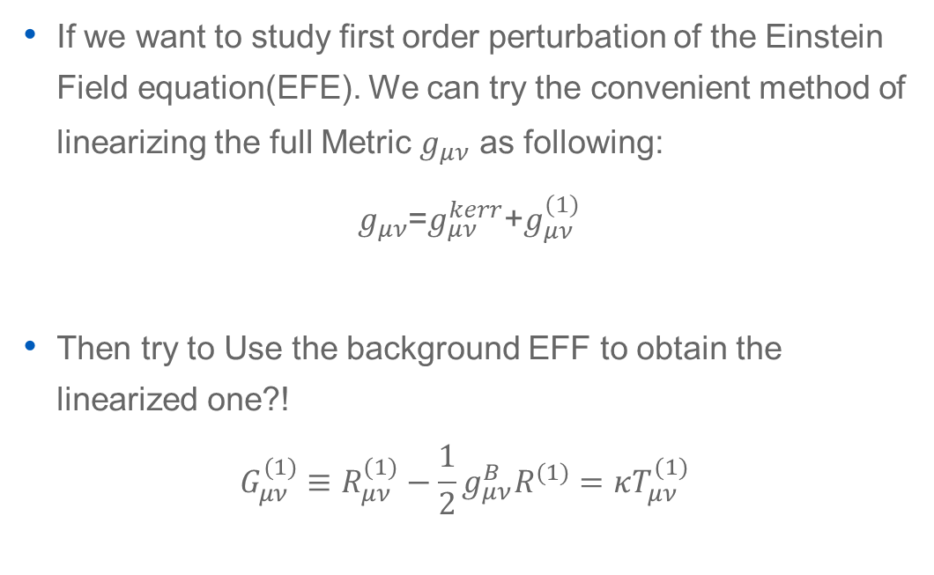
Perturbed Kerr: Path I
If we want to study first order perturbation of the Einstein Field equation(EFE). We can try the convenient method of linearizing the full Metric $g_{μν}$ as following:
$g_{μν}$=$g_{μν}^{kerr}$+$g_{μν}^{(1)}$
Then try to Use the background EFF to obtain the linearized one?!
$$G_{μν}^{(1)}≡R_{μν}^{(1)}−\frac{1}{2}g_{μν}^{B}R^{(1)}=κT_{μν}^{(1)}$$
Won’t be fruitful due to lack of gauge decoupled the Background and linearized FE.

Slide 5
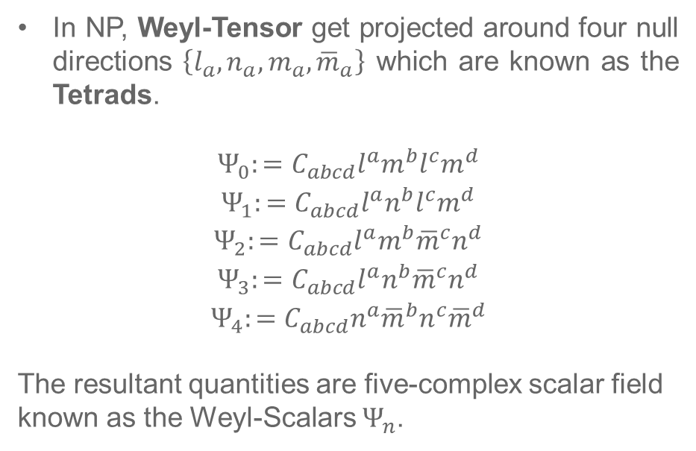
Perturbed Kerr: Path II
Perturbing Kerr spacetime is conducted within the Newman–Penrose (NP) formalism.
Instead of starting with linearized metric, we linearized the Weyl-Scalars.
In NP, Weyl-Tensor get projected around four null directions $\left\{l_{a},n_{a},m_{a},{\overline{m}}_{a}\right\}$ which are known as the Tetrads.
$$\begin{aligned}Ψ_{0}:=C_{abcd}l^{a}m^{b}l^{c}m^{d} \\ Ψ_{1}:=C_{abcd}l^{a}n^{b}l^{c}m^{d} \\ Ψ_{2}:=C_{abcd}l^{a}m^{b}{\overline{m}}^{c}n^{d} \\ Ψ_{3}:=C_{abcd}l^{a}n^{b}{\overline{m}}^{c}n^{d} \\ Ψ_{4}:=C_{abcd}n^{a}{\overline{m}}^{b}n^{c}{\overline{m}}^{d}\end{aligned}$$
The resultant quantities are five-complex scalar field known as the Weyl-Scalars $Ψ_{n}$.

Slide 6
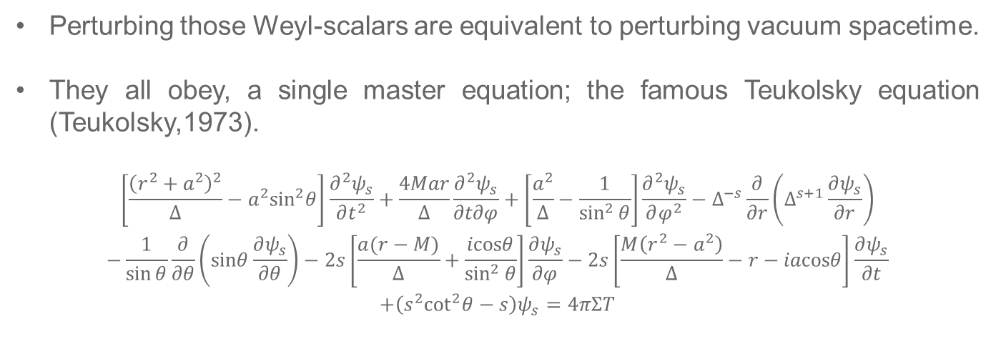
Perturbed Kerr: Path II
Perturbing those Weyl-scalars are equivalent to perturbing vacuum spacetime.
They all obey, a single master equation; the famous Teukolsky equation (Teukolsky,1973).
$$\begin{aligned}\left[\frac{{\left(r^{2}+a^{2}\right)}^{2}}{Δ}−a^{2}\sin^{2}θ\right]\frac{∂^{2}ψ_{s}}{∂t^{2}}+\frac{4Mar}{Δ}\frac{∂^{2}ψ_{s}}{∂t∂φ}+\left[\frac{a^{2}}{Δ}−\frac{1}{\sin^{2}{θ}}\right]\frac{∂^{2}ψ_{s}}{∂φ^{2}}−Δ^{−s}\frac{∂}{∂r}\left(Δ^{s+1}\frac{∂ψ_{s}}{∂r}\right) \\ −\frac{1}{\sin{θ}}\frac{∂}{∂θ}\left(sinθ\frac{∂ψ_{s}}{∂θ}\right)−2s\left[\frac{a(r−M)}{Δ}+\frac{icosθ}{\sin^{2}{θ}}\right]\frac{∂ψ_{s}}{∂φ}−2s\left[\frac{M\left(r^{2}−a^{2}\right)}{Δ}−r−iacosθ\right]\frac{∂ψ_{s}}{∂t} \\ +\left(s^{2}\cot^{2}θ−s\right)ψ_{s}=4πΣT\end{aligned}$$
$ψ_{s}$ is related $Ψ_{n}$ through the Teukolsky-decoupling Transformation.
Scalar, Electromagtatic and Gravitonal Pertubation are represented by$s=0, ±1,±2$ respectively.
$T$ is a constructed from the perturber stress energy-tensor.

Slide 7
Problem Statement

Slide 8
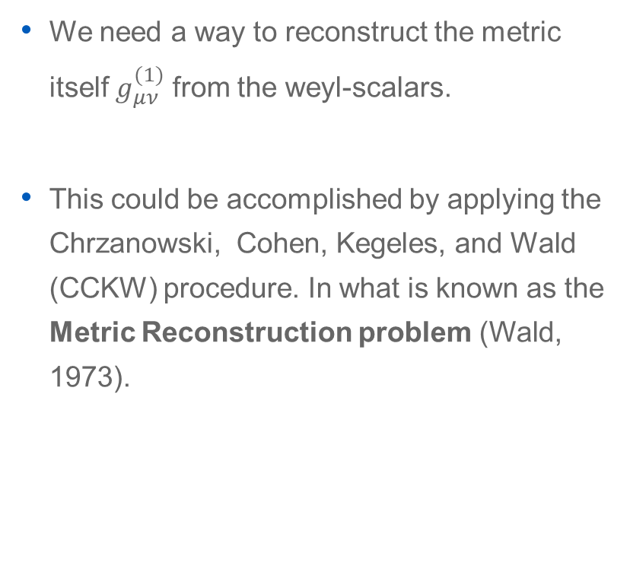
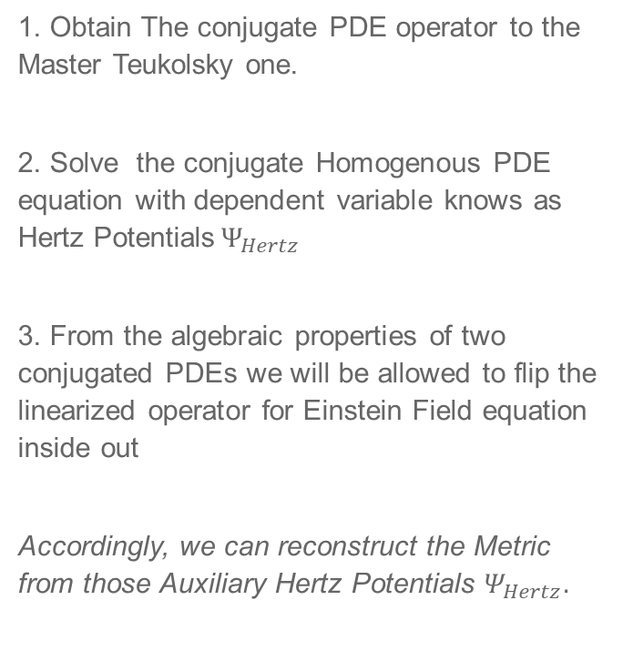
What is a the “Kerr Reconstruction Problem”?
We need a way to reconstruct the metric itself $g_{μν}^{(1)}$ from the weyl-scalars.
This could be accomplished by applying the Chrzanowski, Cohen, Kegeles, and Wald (CCKW) procedure. In what is known as the Metric Reconstruction problem (Wald, 1973).
Appendix: CCKW Procedure
1. Obtain The conjugate PDE operator to the Master Teukolsky one.
2. Solve the conjugate Homogenous PDE equation with dependent variable knows as Hertz Potentials$Ψ_{Hertz}$
3. From the algebraic properties of two conjugated PDEs we will be allowed to flip the linearized operator for Einstein Field equation inside out
Accordingly, we can reconstruct the Metric from those Auxiliary Hertz Potentials $Ψ_{Hertz}.$
Notes:
$ψ$ is related $Ψ_{n}$ through the Teukolsky -decoupling Transformation

Slide 9
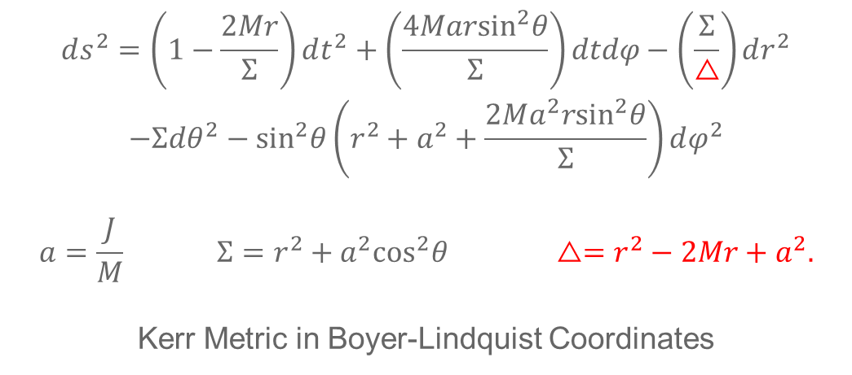
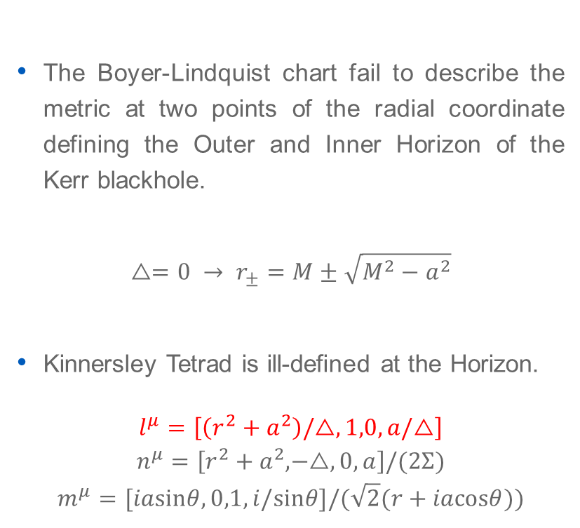
Boyer-Lindquist Chart & Kinnersley Tetard are ill defined Near the Horizon!
The Boyer-Lindquist chart fail to describe the metric at two points of the radial coordinate defining the Outer and Inner Horizon of the Kerr blackhole.
$$△=0 → r_{±}=M±\sqrt{M^{2}−a^{2}}$$
Kinnersley Tetrad is ill-defined at the Horizon.
$$\begin{aligned}l^{μ}=\left[\left(r^{2}+a^{2}\right)/△,1,0,a/△\right] \\ n^{μ}=\left[r^{2}+a^{2},−△,0,a\right]/(2Σ) \\ m^{μ}=[iasinθ,0,1,i/sinθ]/(\sqrt{2}(r+iacosθ))\end{aligned}$$
$$\begin{aligned}ds^{2}=\left(1−\frac{2Mr}{Σ}\right)dt^{2}+\left(\frac{4Mar\sin^{2}θ}{Σ}\right)dtdφ−\left(\frac{Σ}{△}\right)dr^{2} \\ −Σdθ^{2}−\sin^{2}θ\left(r^{2}+a^{2}+\frac{2Ma^{2}r\sin^{2}θ}{Σ}\right)dφ^{2}\end{aligned}$$
$$a=\frac{J}{M} Σ=r^{2}+a^{2}\cos^{2}θ △=r^{2}−2Mr+a^{2}.$$
Kerr Metric in Boyer-Lindquist Coordinates
Notes:
$ψ$ is related $Ψ_{n}$ through the Teukolsky -decoupling Transformation

Slide 10
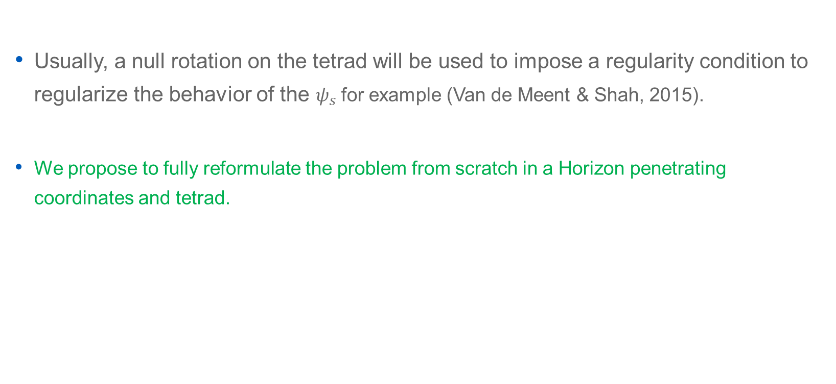
How to overcome this problem?
Usually, a null rotation on the tetrad will be used to impose a regularity condition to regularize the behavior of the $ψ_{s}$ for example (Van de Meent & Shah, 2015).
We propose to fully reformulate the problem from scratch in a Horizon penetrating coordinates and tetrad.
Notes:
$ψ$ is related $Ψ_{n}$ through the Teukolsky -decoupling Transformation

Slide 11
Motivation

Slide 12
I. Redo the Metric Reconstruction in a Horizon regular settings.
Metric reconstruction problem has been addressed for both circularly (Shah, 2012) and elliptically (Van de Meent & Shah, 2015) rotating perturber in BL.
Still, it is not a bad idea to revisit the reconstruction problem in a fully regular null coordinates & tetrad across the horizon (ingoing Eddington Finkelstein (IEF) & Modified Kinnersley Tetrad.

Slide 13
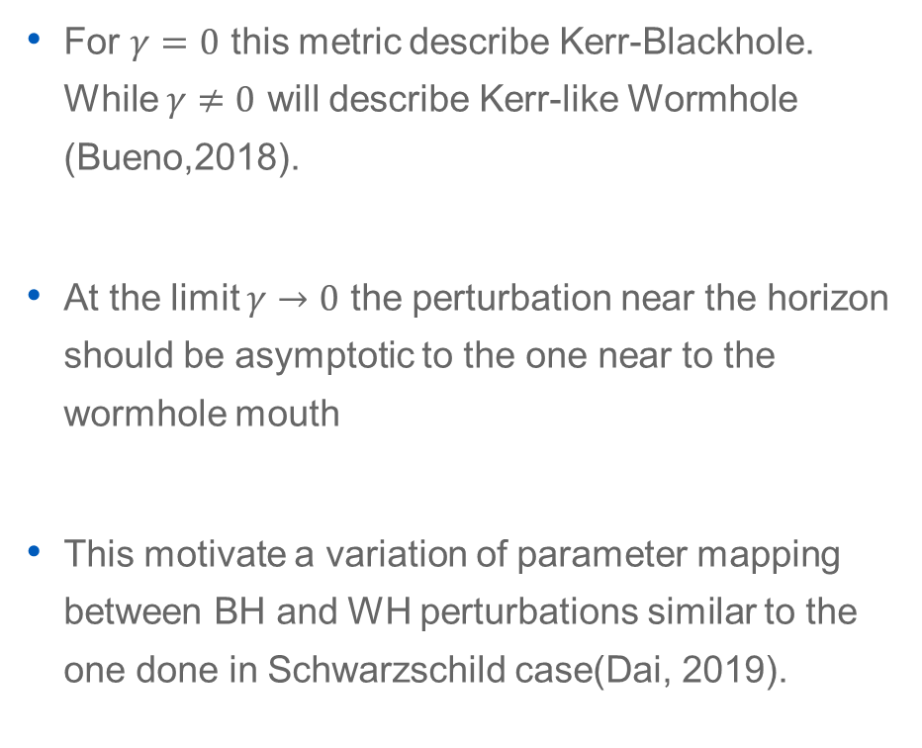
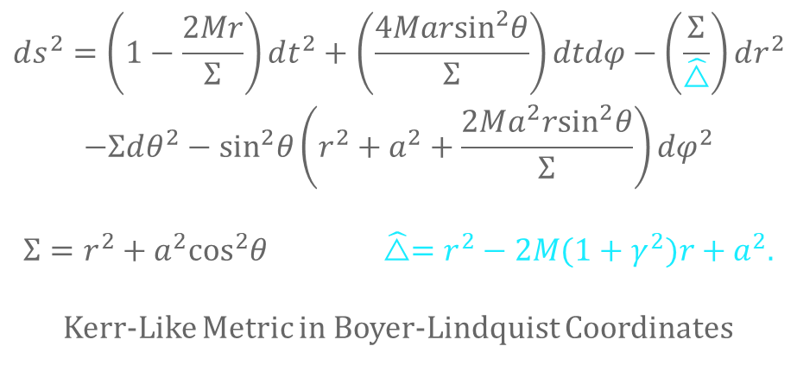
II. Near Horizon and Near Mouth Perturbation should be asymptotic.
For $γ=0$ this metric describe Kerr-Blackhole. While $γ≠0$ will describe Kerr-like Wormhole (Bueno,2018).
At the limit $γ→0$ the perturbation near the horizon should be asymptotic to the one near to the wormhole mouth
This motivate a variation of parameter mapping between BH and WH perturbations similar to the one done in Schwarzschild case(Dai, 2019).
$$\begin{aligned}ds^{2}=\left(1−\frac{2Mr}{Σ}\right)dt^{2}+\left(\frac{4Mar\sin^{2}θ}{Σ}\right)dtdφ−\left(\frac{Σ}{\hat{△}}\right)dr^{2} \\ −Σdθ^{2}−\sin^{2}θ\left(r^{2}+a^{2}+\frac{2Ma^{2}r\sin^{2}θ}{Σ}\right)dφ^{2}\end{aligned}$$
$$Σ=r^{2}+a^{2}\cos^{2}θ \hat{△}=r^{2}−2M(1+γ^{2})r+a^{2}.$$
Kerr-Like Metric in Boyer-Lindquist Coordinates

Slide 14


III. Studying the Behavior of Radial-Teukolsky equation under Transformation.
The Teukolsky equation is separable in the BL coordinate. It reduces to two ODEs: Radial and Angular in nature using the following ansatz (Teukolsky, 1973).
$$ψ_{s} =e^{−iωt}R_{s}\left(r\right)S_{s}\left(θ\right)e^{imφ}$$
The ODE govern the Radial part is shown below
$$Δ^{−s}\frac{d}{dr}\left(Δ^{s+1}\frac{dR}{dr}\right)+\left(\frac{K^{2}−2is(r−M)K}{Δ}+4isωr−λ\right)R=0$$
$K≡\left(r^{2}+a^{2}\right)ω−am \text{and} λ≡A+a^{2}ω^{2}−2amω$
Given that this ODE is a confluent Heun ODE with 3 singular points, one of them is irregular. It is solved using the MST solution (Mano, 1996).
We are curious to how transformation to ingoing Eddington Finkelstein (IEF) coordinate can change the singular structure of the radial equation (Campanelli,2001).
$$\begin{aligned}dr=dr \\ dθ=dθ \\ d\tilde{t}=dt+\frac{r^{2}+a^{2}}{△}dr \\ d\tilde{φ}=dφ+\frac{a}{△}dr\end{aligned}$$

Slide 15
Metric perturbation for a circularly orbiting perturber around a black hole in Kerr spacetime.

Slide 16
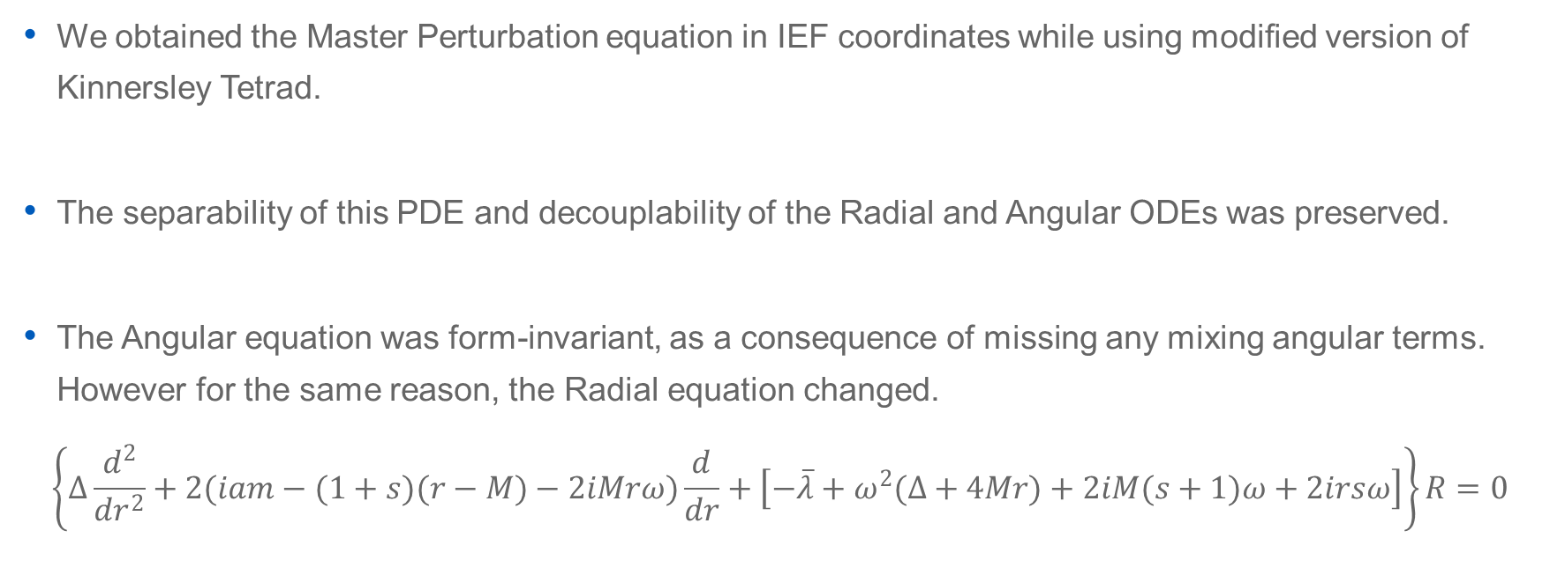
I. Master Perturbation Equation in IEF
We obtained the Master Perturbation equation in IEF coordinates while using modified version of Kinnersley Tetrad.
The separability of this PDE and decouplability of the Radial and Angular ODEs was preserved.
The Angular equation was form-invariant, as a consequence of missing any mixing angular terms. However for the same reason, the Radial equation changed.
$$\left\{Δ\frac{d^{2}}{dr^{2}}+2(iam−(1+s)(r−M)−2iMrω)\frac{d}{dr}+\left[−\overline{λ}+ω^{2}(Δ+4Mr)+2iM(s+1)ω+2irsω\right]\right\}R=0$$

Slide 17
II. Radial Equation and Boundary Conditions
Still, the Radial equation had the same singular structure that make it a Confluent Heun ODE. Hence, there is an effective single radial transformation equivalent to the BL-IEF transformation (Ronveaux, 2007).
In IEF, the Asymptotes of the Radial ODE, near the Horizon and in the asymptotic flat region; satisfy the physical boundary condition without any need for regularity conditions.
For the case of circularly orbiting perturber, we solved the inhomogeneous Radial equation using green method by utilizing the adjoint property of the decoupling operator for the linearized Einstein field for the Weyl scalars.

Slide 18
III. CCKW and Metric Reconstruction and Completion
The Hertz-Weyl equations persevered their angular and radial signatures as well. Moreover the Angular one was form invariant in the outgoing radiation gauge.
Algebraizing this equation was manageable after utilizing that also Hertz potential satisfy the master perturbation equation (shah, 2015).
We also obtained regular missing perturbation parts due to perturbating the Angular Momentum and Mass of the Blackhole.

Slide 19
Conclusion and Discussion
We have constructed the Metric in terms of the Radial and Angular solution for the case of Circularly orbiting perturber close to the Horizon. This still valid beyond the Horizon although we are not sure what might be the possible theoretical outcomes of working the construction in region between two horizons.
In principle the Master Teukolsky perturbation equation has the same analytical structure in both of BL and IEF coordinates which makes the MST solution for the radial part valid also for the latter.
There was no need for any regularization condition on the Horizon to make the radial part satisfy the physical boundary conditions there.

Slide 20
Questions?

Slide 21
Thank You!

