Slide 1


Workshop Summary
JINR, DUBNA
Wolfgang Lohmann, BTU, DESY and RWTH

Slide 2
The Collaboration
FCAL comprises currently 13 Institutes/Universites, 67 researchers
Publication and speakers committee formed (chair Strahinja Lukic)
Clustering working group (chair Sasha Borysov)
Hardware working group (chair Marek Idzik)

Slide 3
General talks
Status of CLIC and ILC (Lucie Linssen, me)
Physics at CLIC and future linear collider (Igor Boyko)
Bhabha scattering (A. Arbuzov)
Reports from the working groups (Marek Idzik & Oleksandr Borysov)

Slide 4
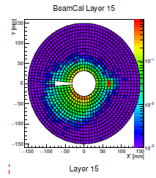
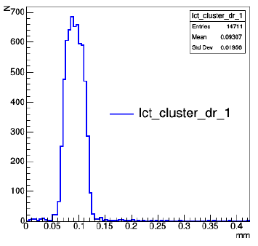
Simulations and Alignment
Andre Sailer: BeamCal reconstruction with DD4HEP Geometry
Oleksandr Borysov: LumiCal performance with tracking detector

Slide 5
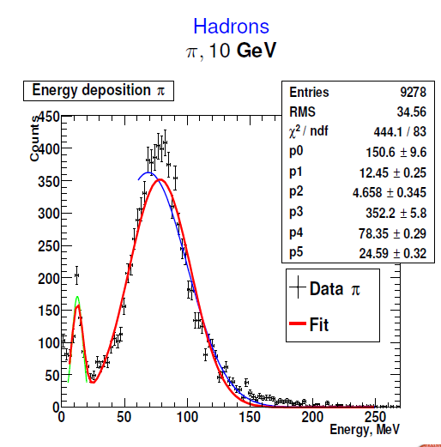
Simulations and Alignment
Evgeniy Lutsenko: Efficieny map (BeamCal)
Vladyslav Lukianchuk: The LCAL Monte Carlo Simulations

Slide 6
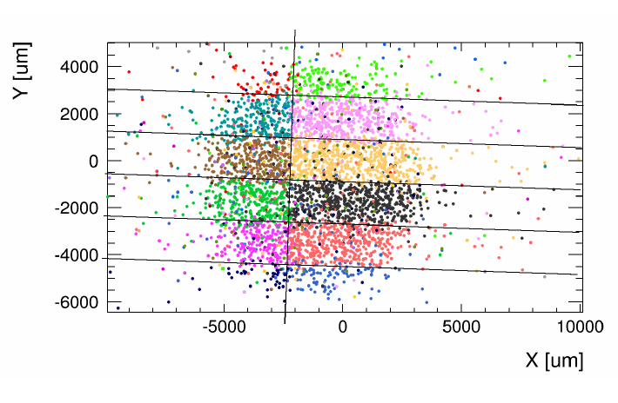
Simulations and Alignment
Oron Rosenblat: Sensor Alignment for TB 2014
Vladimir Makarenko: New generator for Bhabha scattering

Slide 7
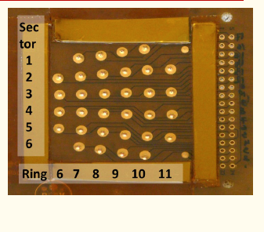
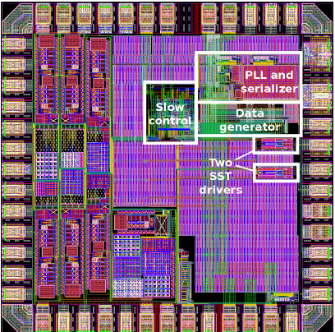
Hardware and FE
Lucia Bortko: Investigation of a fan-out technology
Marek Idzik: FAME, a new readout ASIC for LumiCal detector

Slide 8
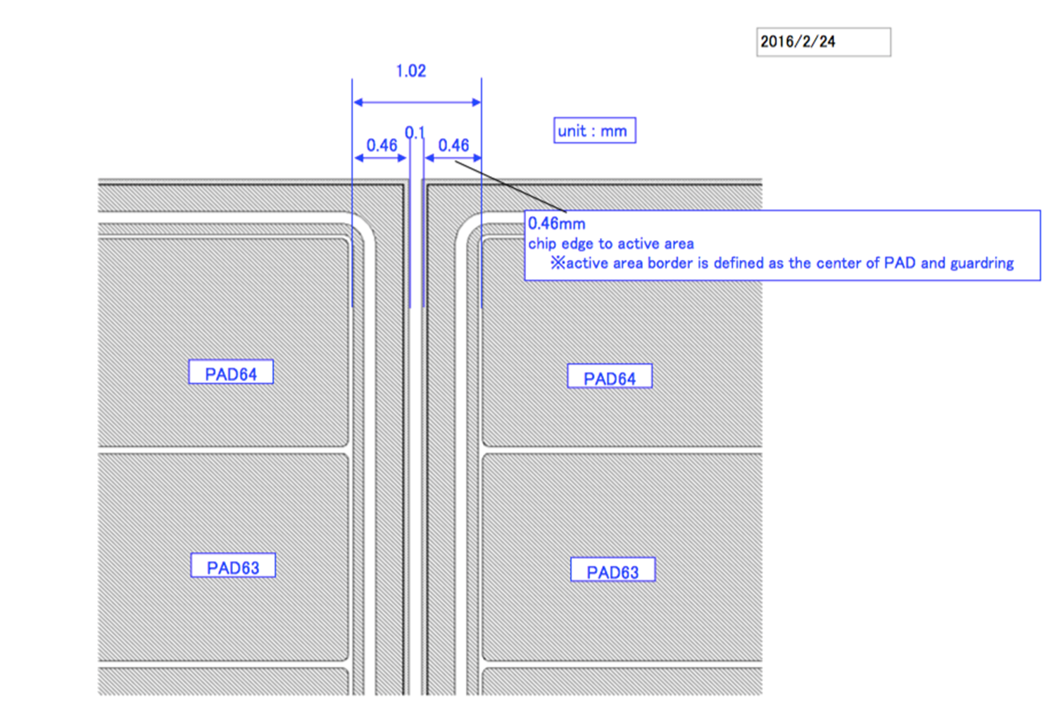
Hardware and FE
M. Gostkin: Tungsten plate measurements
Y. Benhammou: New LumiCal sensor design

Slide 9
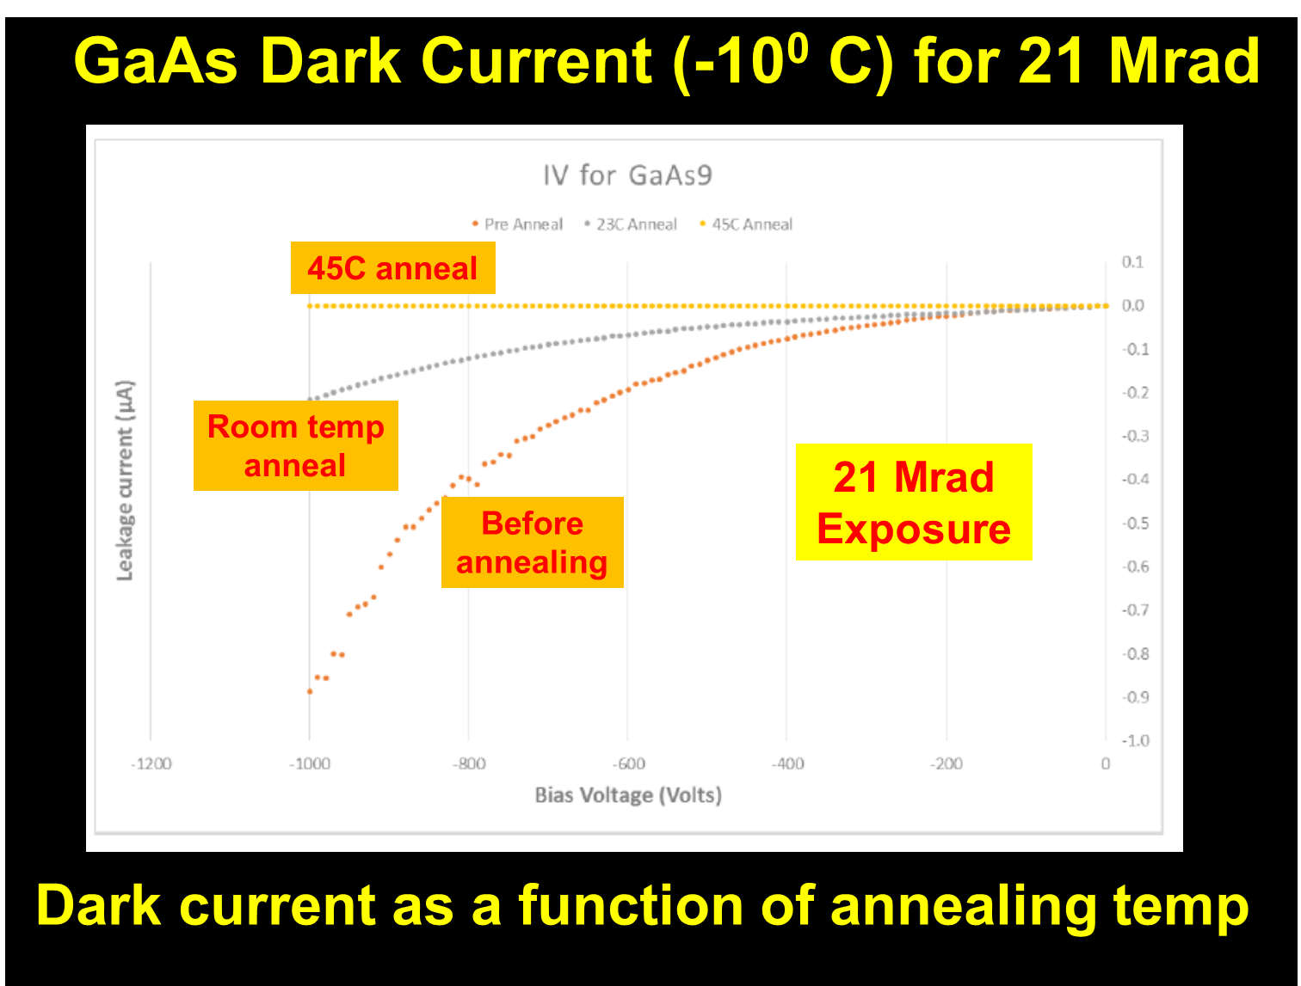
Hardware and FE
B. Schumm: Update from the SLAC
L. d` Hauthuille : Power draw of the BeamCal as a function of temperature and radiation Dosage

Slide 10
Hardware and FE
L. Zawiejski: R&D work carried out at IFJ PAN

Slide 11
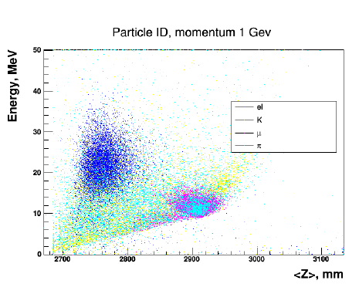
Simulation and testbeam
Maryna Lazorenko: LHCal study. Particle identification
Itamar Levy: Measurement of the Moliere radius in 2014 TB data

Slide 12
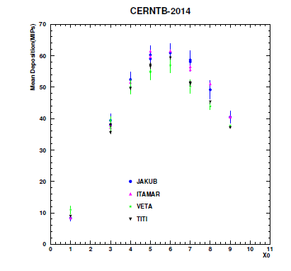
Simulation and testbeam
Strahinja Lukic: Resolving the differences in the simualtions of TB 2014 geometry
Alina Neagu: The influence of the Geant4 EM modes on the 2014 TB results

Slide 13
Simulation and test-beam
Itamar Levy: TB 2015 system calibration
Beata Krupa: HV scan – first results on the analysis of the 2015 TB data

Slide 14
This year
Finalise and Publish the TB 2014 analysis (3 months)
Complete the Testbeam 2015 analysis
Presentation of results on the LC workshop, ICHEP ...
Progress in AIDA 2020 related issues (sensors, ASICS,
Backend → compact calorimeter prototype)
Testbeam in summer, 22.8. for one week
FCAL workshop in Tel Aviv Sept. 16-20
Long term future: we hope for progress on the political level !!!!!
(a message to the deirector of this institute)

Slide 15

Thanks to the organisers
It was an excellently organised meeting
Many thanks to:
Natasha Dokalenko
Natasha Zaizeva
Andrey Sapronov
The JINR management
Our program committee

