Slide 1
28th FCAL Workshop – JINR, Dubna
21-22 March 2016
Welcome!
Vadim Bednyakov
Director of Dzhelepov’s Laboratory of Nuclear Problems

Slide 2
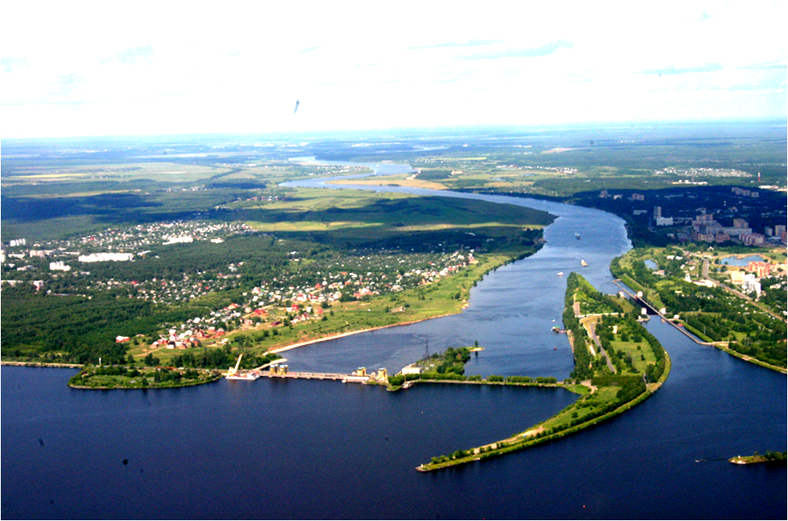
JINR is located in the city of Dubna in 120 km to the north from Moscow
Volga River
JINR
Special Economic Zone
Sluice
12 meters Damb
Water Power Station
Volga-Moscow Channel
“Ivan’kovskoe” Water Storage

Slide 3

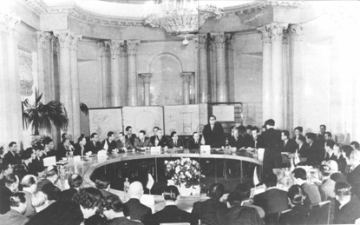
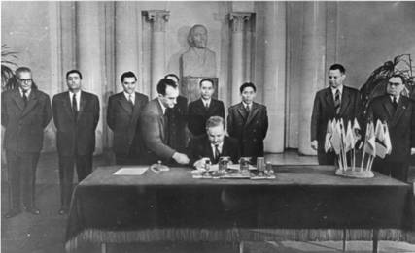
Albania
Bulgaria
Hungary
GDR
China
DPRK
Mongolia
Poland
Romania
USSR
Czechoslovakia
The agreement for creation of JINR
was signed by 11 founder-states on
26 March 1956 in Moscow

Slide 4

















JINR member states (18)
  Azerbaijan
  Armenia
  Belarus
  Bulgaria
  Vietnam
  Georgia
  Kazakhstan
  DPRK
  Cuba
  Moldova
  Mongolia
  Poland
  Russia
  Romania
  Slovakia
  Ukraine
  Uzbekistan
  Czech
Intergovernmental agreement (6)
Hungary
Egypt
Germany
Italy
Serbia
ZAR

Slide 5
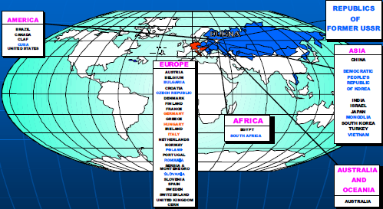
International collabiraton
JINR collaborates with more than 700 scientific centres and universities in 63 countries of the world.

Slide 6

JINR Research Experimental Facilities
• Heavy Ion Superconducting Complex Nuclotron-NICA
Physics of dense and hot baryon matter
Spin structure and dynamics of nuclear matter
Intensive pulsed neutron breader reactor IBR-2:
Condensed matter & Nuclear physics
High Power Cyclotron Complex and SHE Factory
Superheavy elements and Exotic nuclei
Dubna Radioactive Ions Beam studies DRIBs
• Complex of computing & information technologies
Tier-1 complex for LHC and NICA
Neutrino Gigaton Volume Detector GVD at Baikal lake
Neutrino Physics and Astrophysics
• Accelerator facility for radiobiology and medical studies
Hadron therapy, astrobiology, cosmic medicine

Slide 7
JINR in some figures
JINR’s staff members ~ 4300
Researchers ~ 1200
including from the Member States (but Russia) ~ 400
PhD and Full Doctors of Science ~ 1000
Engineers and specialists ~2100
Services ~ 1000
JINR Budget
(actual and foreseen
in the 7-year Plan)

Slide 8
JINR activity in FCAL
JINR joined FCAL in 2003 To work on high load calorimeters in the very forward regions.
Areas covered by the JINR members:
  Hardware design
  Software simulations
  Testbeam activity
The facilities used in the JINR for FCAL related activities:
  IBR-2 neutron source for irradiation tests
  Clean room with high precision current-voltage and capacitance-voltage measurement set-ups. Mechanic parameter measurements.

Slide 9
We wish you a productive workshop!

