Slide 1


Welcome FCAL WS March 2016
JINR, DUBNA
Wolfgang Lohmann, BTU, DESY and RWTH

Slide 2
Mission of FCAL
Development of novel detector technologies for:
Measurement of the luminosity in future e+e- linear collider
Instrument the region near the beam-pipe for beam optimization and masking from background, Design and R&D
Development of algorithms to measure Bhabha scattering
Exploit the luminosity spectrum
Estimate background processes
Input from theory
Exploit beamstrahlung depositions for beam-tuning
Contribute to the physics program

Slide 3
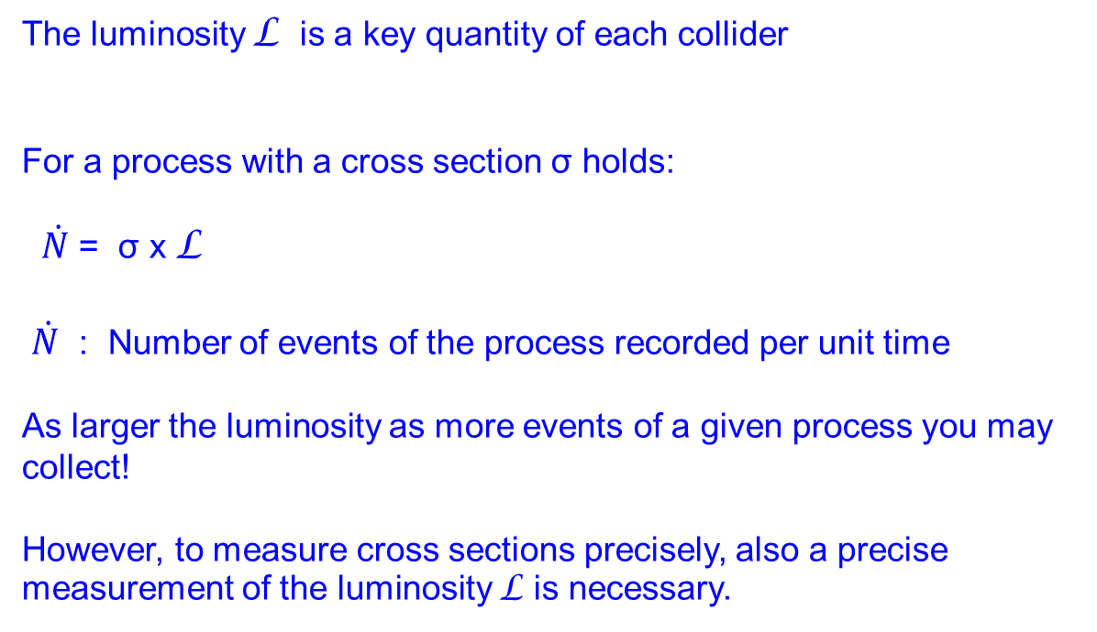
Luminosity
The luminosity L is a key quantity of each collider
For a process with a cross section σ holds:
$\dot{N}$ = σ x L
$\dot{N}$ : Number of events of the process recorded per unit time
As larger the luminosity as more events of a given process you may collect!
However, to measure cross sections precisely, also a precise measurement of the luminosity L is necessary.

Slide 4
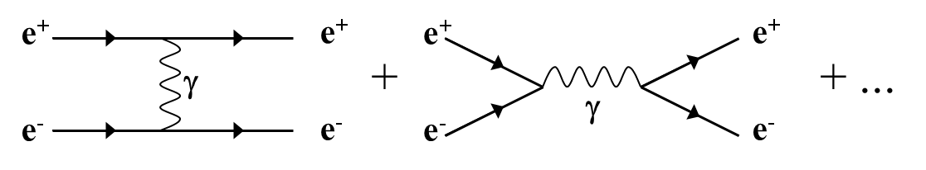
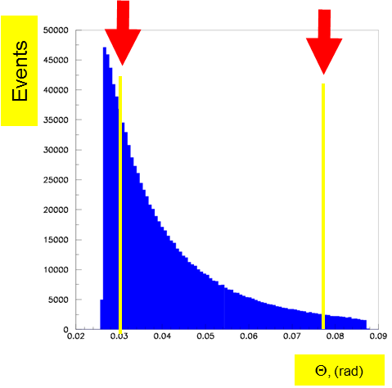
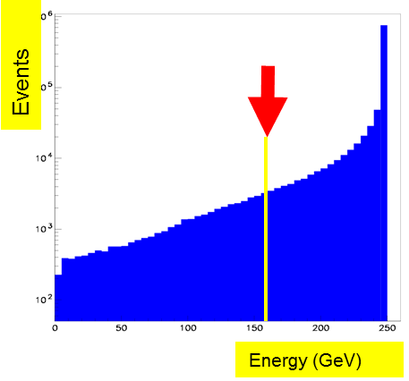
Luminosity at e⁺e⁻ collider
Bhabha scattering at low polar angles is used as a gauge process
e⁺e⁻ e⁺e⁻ (γ)
L = N / σ
Count Bhabha events
From theory

Slide 5
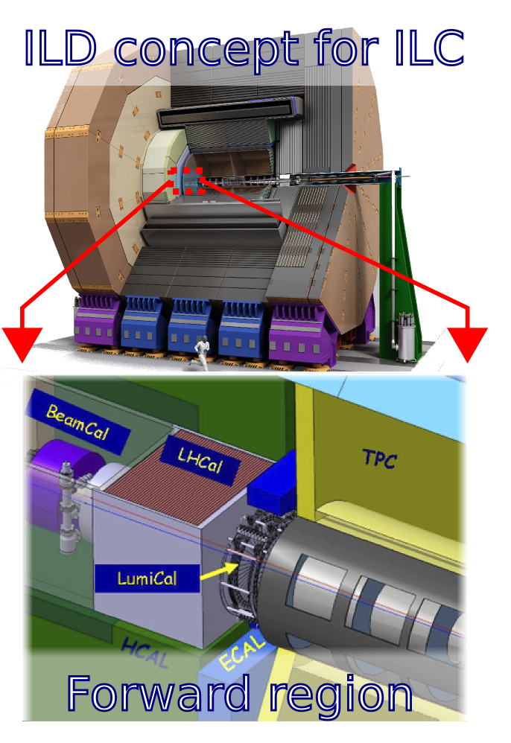
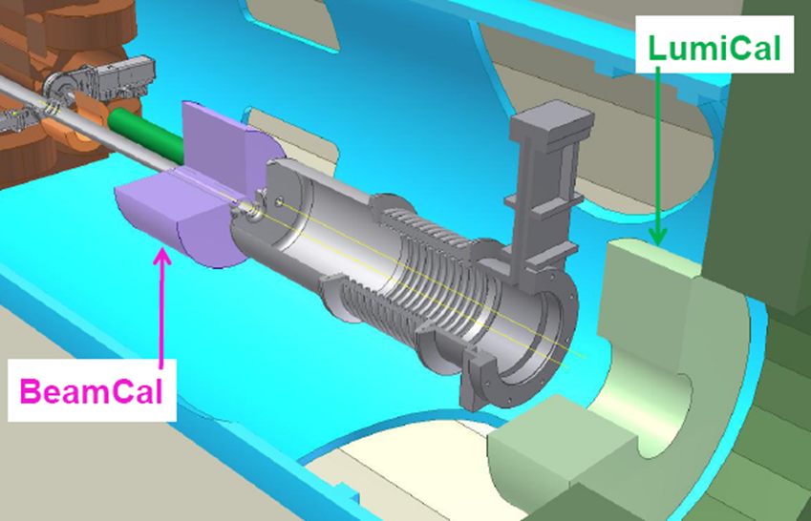
e⁺e⁻ collider
Optimisation of the design of the very forward region of LC detector
Precision luminosity measurement
Fast luminosity measurement and beam tuning
Detector hermeticity
Challenge: Fast readout, radiation hard sensors
Detectors at ILC and CLIC

Slide 6
Luminosity in e⁺e⁻ collider
for a highly compact calorimeter
  novel connectivity technology (e.g. bump bonding, thin fan-out
  PCB)
Construction of a demonstrator calorimeter
  completion of the mechanical structure (+laser alignment)
  production of sufficient ASICs in 130 nm technology
  demonstration of power pulsing
  readout board with data concentrator and data transfer
Beam tests
  Energy resolution (luminosity spectrum)
  spatial resolution (angular spectrum)
  bias in the angular measurements (systematic shift to be quantified)

Slide 7
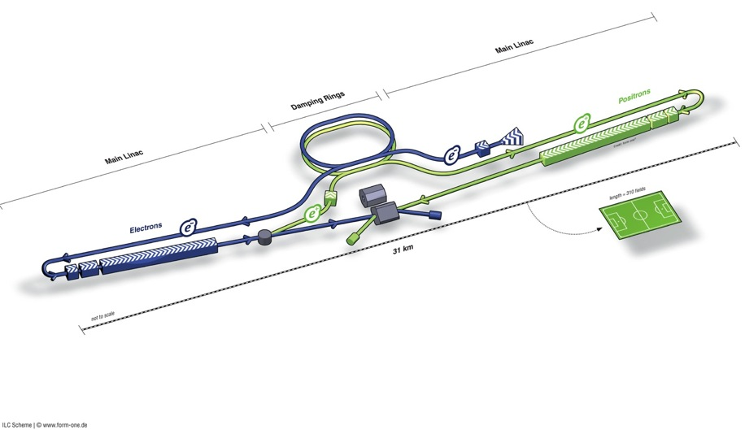
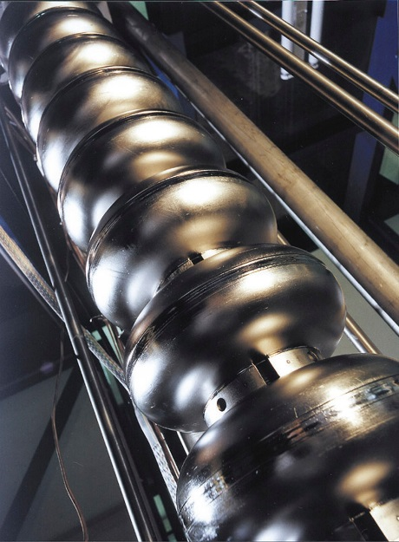
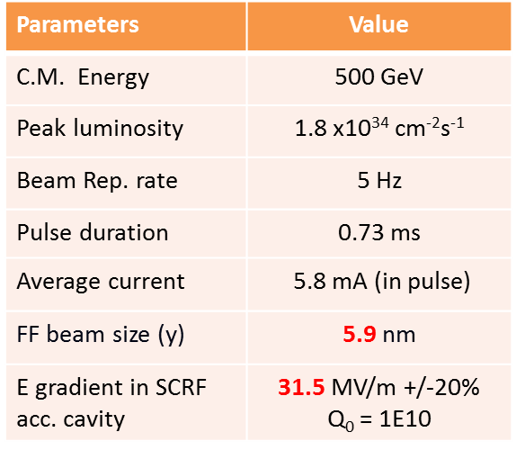
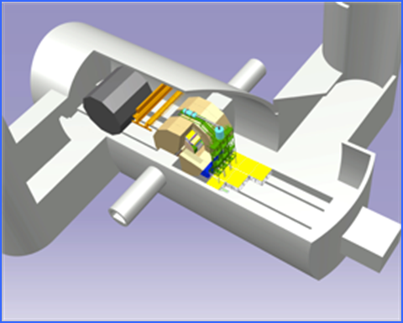
The ILC
Superconducting niobium cavities

Slide 8
The LC management

Slide 9
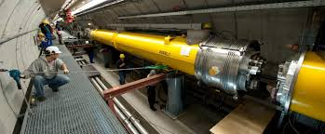
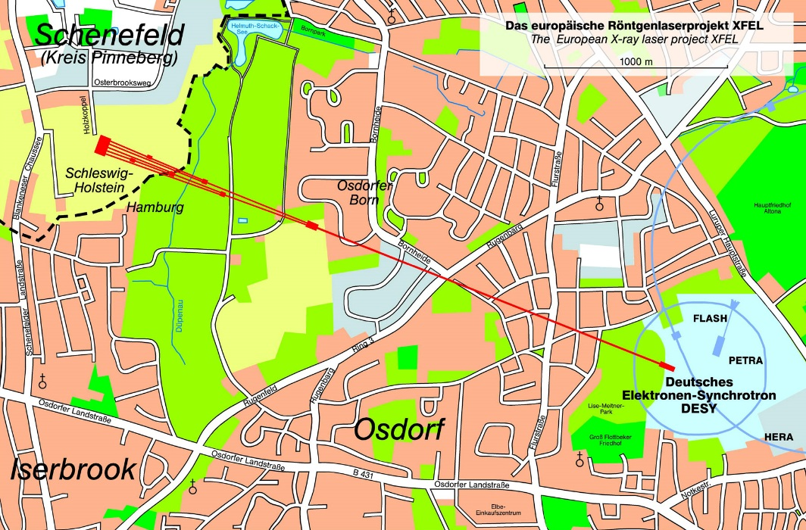
Running SC Linacs: FLASH and XFEL
FLASH
Stable operation since many years
Several acceleration modules
End energy: 1 GeV
3 km linear accelerator
End energy: 20 GeV
First segments operating, first beam in January
First beam for commissioning: End 2016

Slide 10
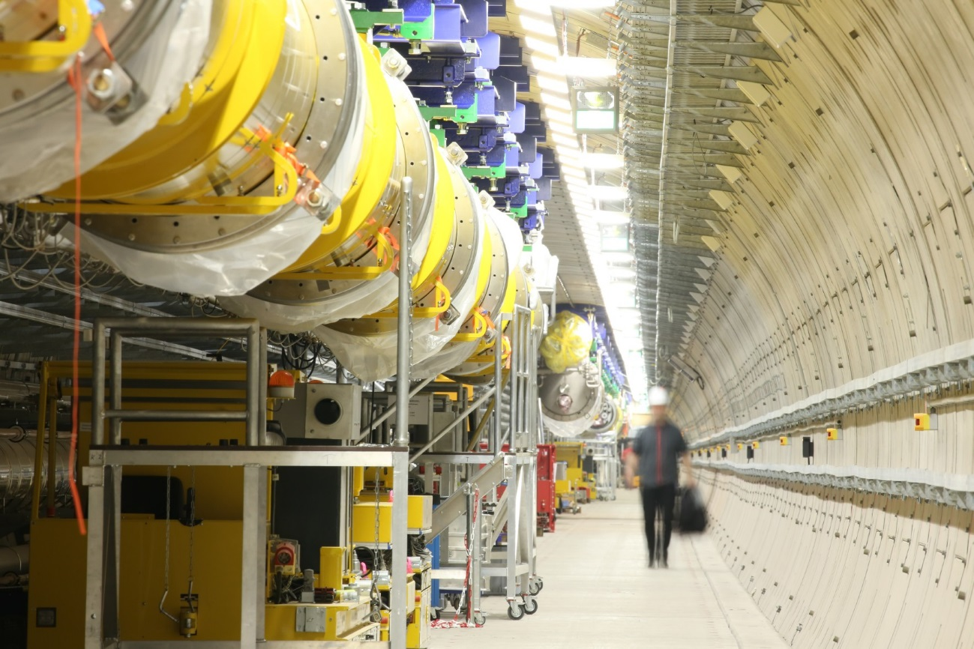
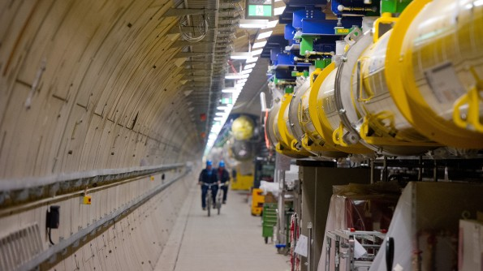
Running SC Linacs: FLASH and XFEL

Slide 11
The ILC
Cavity gradients
    E-XFEL: exceeded 90 % of 800 cavity production, and 65 % of 100 cryomodule assembled and tested
    Fermilab-ASTA: reached the ILC specification gradient of ≥31.5 MV/m
    KEK-STF2: CM1+2a (12 cavity string) under cold test, First 4 reaching> 35 MV/m
Nano-beam
    ATF2 Collab.: reached 44 nm at the FF, closing to the primary goal of 37 nm
CFS
    Geological Survey & boring at a candidate IP region in progress in Tohoku
    Tunnel Optimization Tool (TOT) being developed by CERN/KEK-ARUP cooperation
Accelerator Design and Integration (ADI)
    Post-TDR design update
      Common L* for both detectors of ILD and SiD
      Vertical access at Detector Hall at IR point

Slide 12
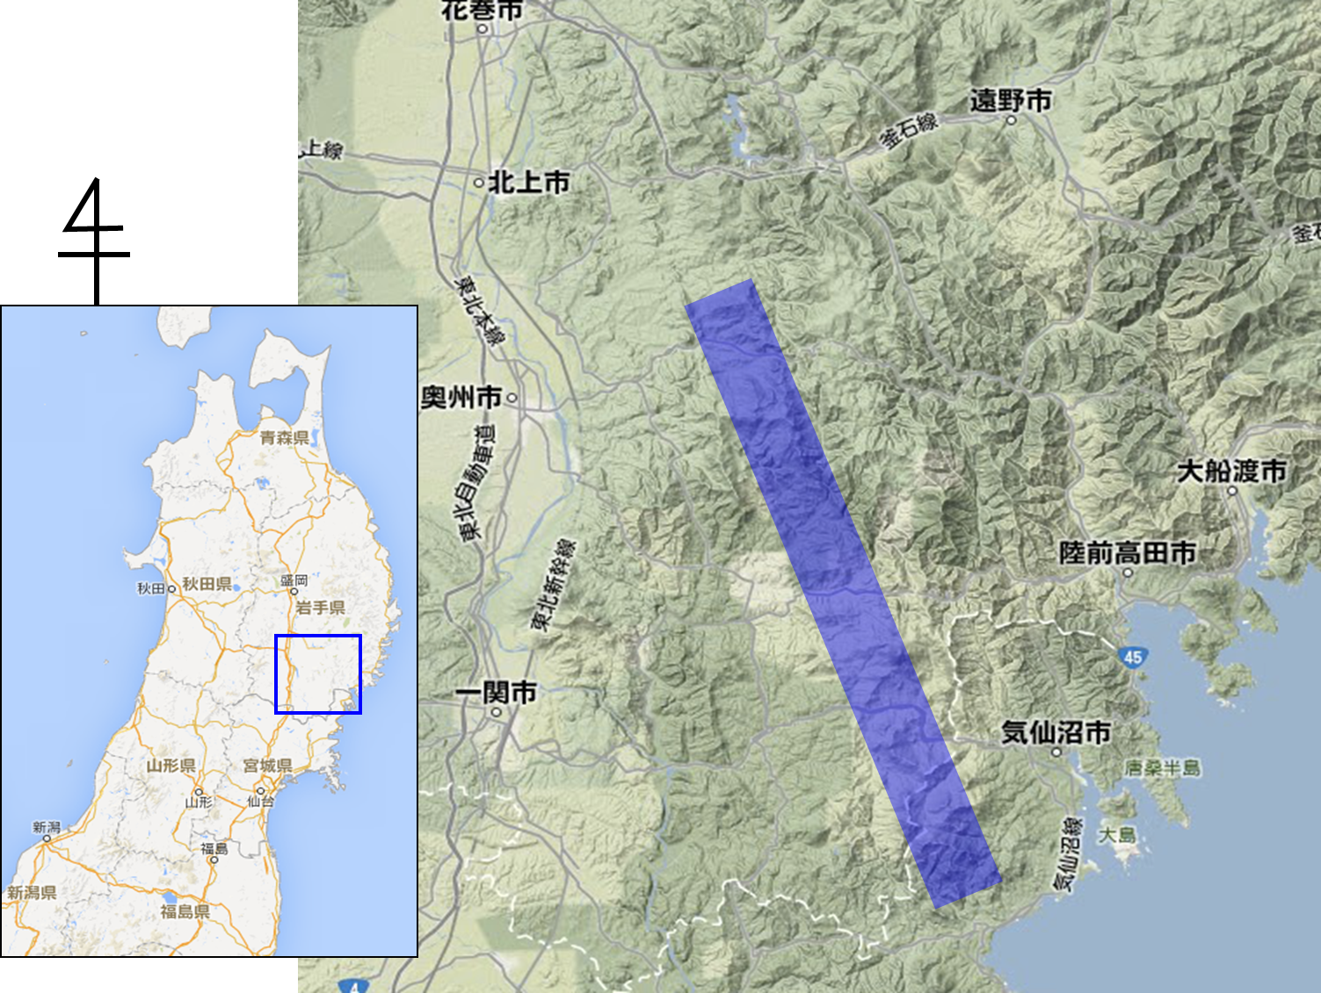
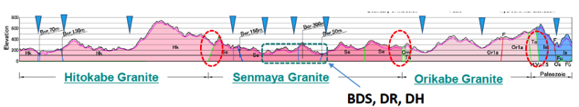
The ILC
The ILC
Preferred site selected by JHEP community,
Endorsed by LCC, in 2013
Oshu
Express-
Rail
Ofunato
Kesen-numa
Sendai

Slide 13
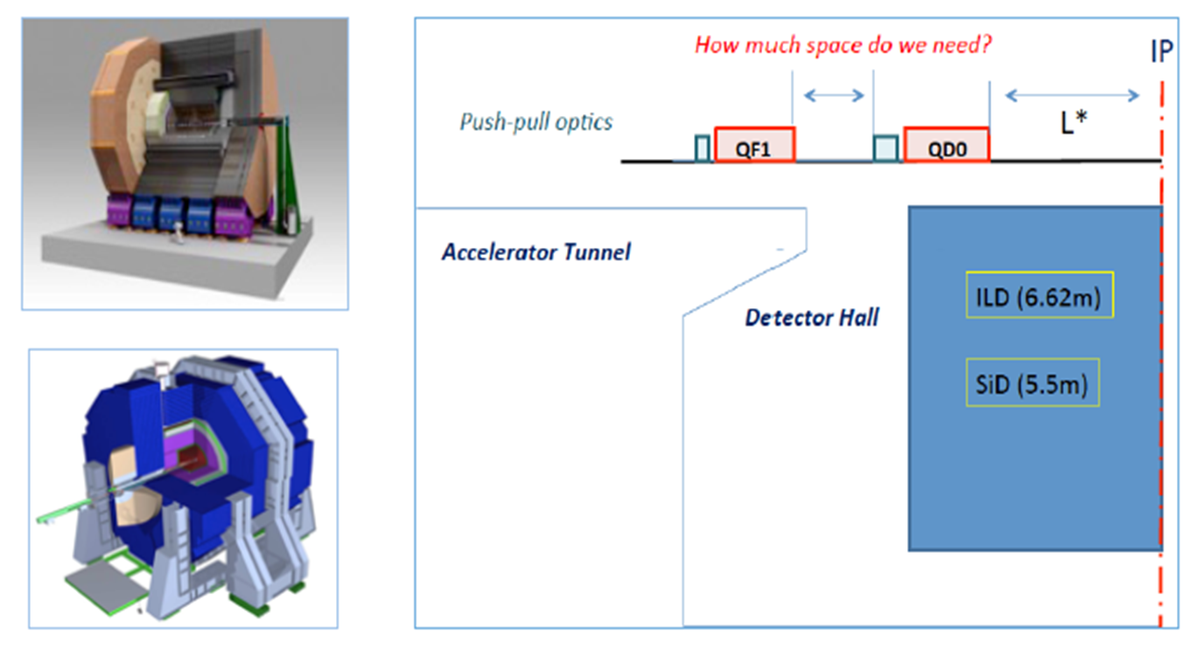
L* equal for both detectors
New L* is 4.1 m for both ILD and SiD

Slide 14
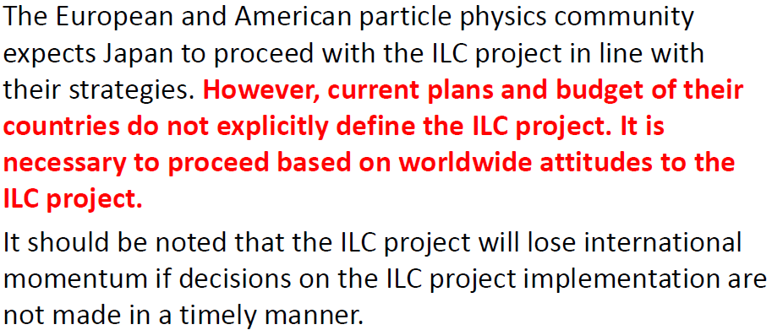
Comments from the MEXT ILC advisory panel

Slide 15
The ILC
The MEXT ILC advisory panel
  new working group for infrastructure and human resources
  report to the government in summer/autumn 2016
International activities
  visit of a Japanese delegation in US, meeting with DoE officials
  recently, foundation of a “forum for advanced science and
  technology”
  Joint DESY-KEK meeting in February
  French International Linear Collider days (this week)
Organisational
  The LCC mandate ends in 2016
  Lynn Evans will not continue
  ILD management established and working, similar for SiD

Slide 16
The current LCC
May be more informations available ?

Slide 17
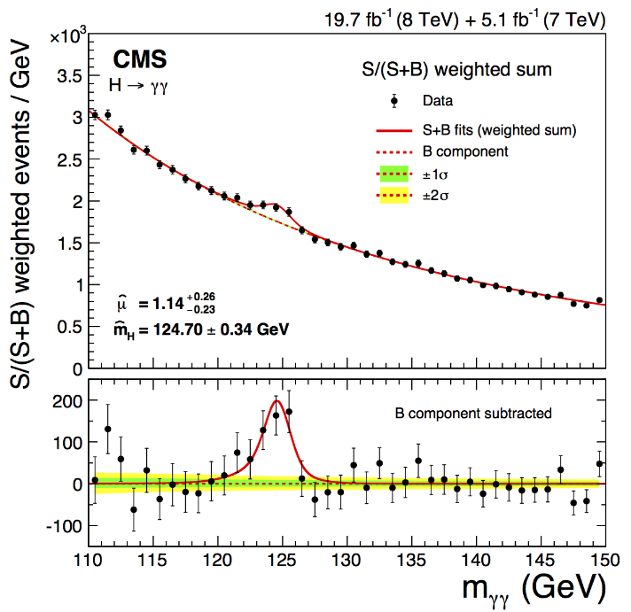
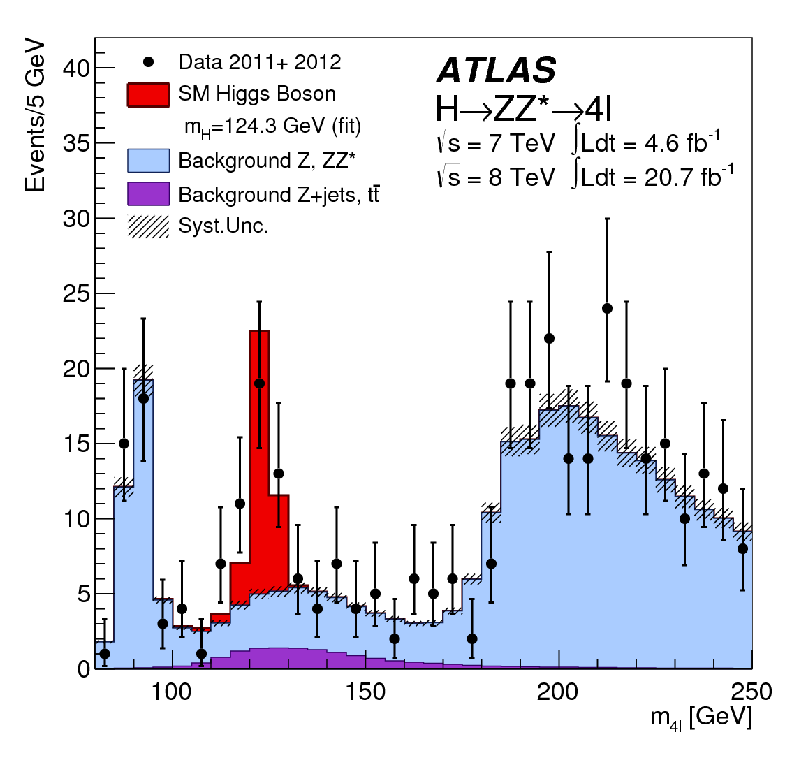
Comment on Physics
The discovery of the Higgs boson has a deep meaning – it was the key stone of a successful theory from which we know that it is not all-embracing.
How to proceed:
- Search for new
particles/phenomena at higher
energies → LHC
Perform precision measurements
→ e+e- collider

Slide 18
Comment on Physics
Comparison of the precision of the measurement of Higgs boson couplings

Slide 19
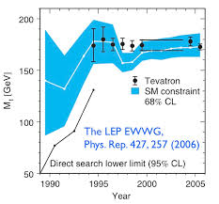
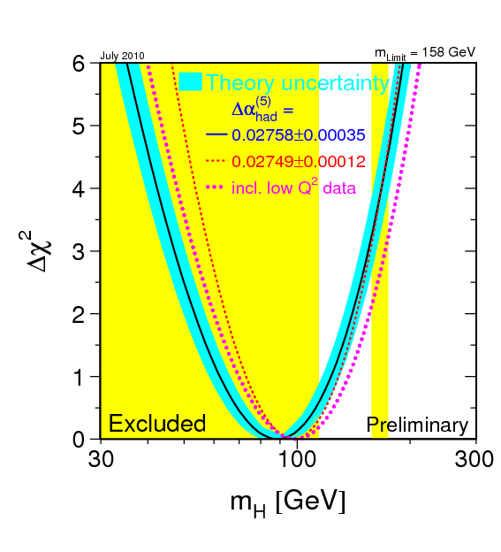
Comment on Physics
This concept was successful in the past ......

Slide 20
Summary ILC
Superconducting cavity technology is mature, applied in smaller scale facilities, industrialisation successful
Site selection done, Civil engineering studies are ongoing.
The physics case is exciting, sharpening still possible
The political process is still at the beginning. Progress must come soon
→ We cannot do R&D forever, the community needs a structured plan
For 2017 on a new governing structure will be prepared and brought into operation.

Slide 21
For this workshop
Testbeam results
Design improvements, justified by simulations
Sensors, FE electronics, readout
Alignment
Calorimeter prototype
Treatment of Bhabha scattering
The unexpected

