Slide 1
New LumiCal sensor design
Yan Benhammou
Tel Aviv University

Slide 2
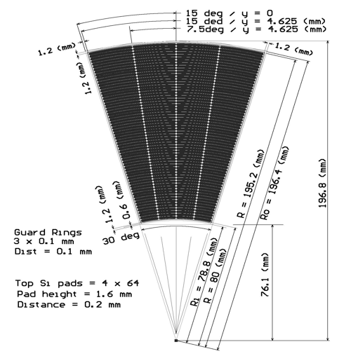
Actual sensor design
From EUDET-MEMO-2009-07

Slide 3
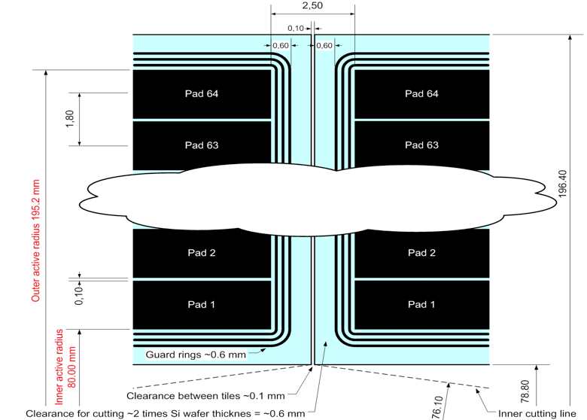
Zoom on the edge

Slide 4
Simple calculation :
Surface of the sensor : 8299.83 mm2
Edge dead area : 2.4 x 115.2 = 276.48 mm2
Sensor active area : 8023.35 mm2

Slide 5
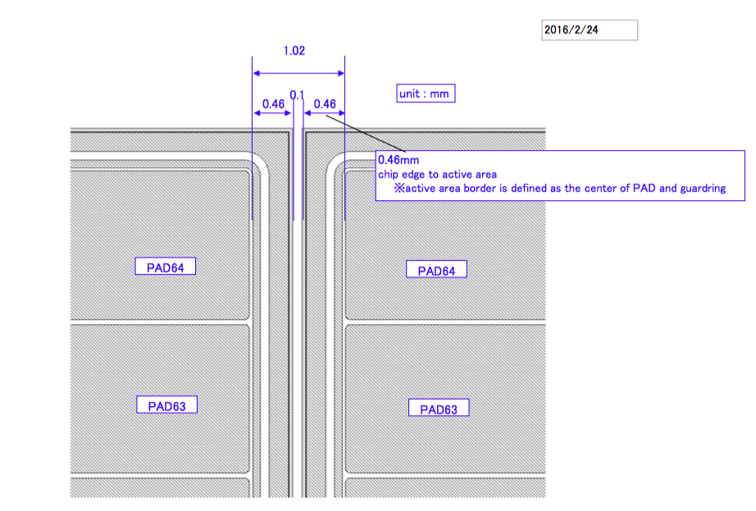
New Hamamatsu proposition
Single guard ring

Slide 6
Simple calculation
Actual dead area : 276.48 mm2
New design dead area : 105.89 mm2
New Hamamatsu dead area 68% smaller than the actual one
This is for the whole detector. What for a particle in between two sensors ?

Slide 7
Moliere radius : 15 mm
Shower volume : ~49490 mm3
20 W layers = 70mm
Dead area
Volume : 30x2.5x70 =5250mm3
10.6% of the shower is lost
New Hamamatsu :
Volume : 30x1.02x70=2142 mm3
4.3% of the shower is lost

Slide 8
Conclusion
New design from Hamamatsu : one guard ring, smaller dead area
Hamamatsu dead area : 0.92x115.2 = 105.98mm2
Actual dead area : 276.48 mm2
New design area : 105.98 mm2
Price :
NRE FEE :2.7million JPY ~ 24200 $
Unit Price: 170,000JPY each x 40pcs ~1524 $ each
Need simulations !!!

