Slide 1
New processes?
New ideas
A M Cooper-Sarkar
Xfitter meeting
Dubna Feb 2016
Extension of tools to
NNLO
Resummation
parton showers
QED
Beyond DGLAP at low-x
Extend PDF fits to fit fundamental parameters
Combine LHC data sets CMS,ATLAS, LHCb
Combine LHC data sets, ratios of different beam energies

Slide 2
Can we do more?- better calculations, more processes?
Our tools are developing
At NLO
MCFM interfaced to Applgrid for W,Z and DY data and for t-tbar differential distributions
NLOJet++ interfaced to Applgrid/FastNLO for jets
Beyond NLO
K-factors are used using FEWZ and DYNNLO
But developing Applgrid interface to DYNNLO for Drell-Yan
Also FastNLO interface to DiffTop for approximate NNLO top
We are always told that NNLO jets are coming?
Are the fixed order calculations always adequate?
e.g. Zpt, W+jets, Z+jets, also W+b,c, Z+b,c
Can one use re-summed calculations- New methods using Mellin moments?
Recently aMCfast arXiv:1406.7693(authors included M Sutton and J. Rojo) has been developed interfaced to MadGraph5_aMC@NLO and Applgrid for more processes.
This will allow the inclusion of parton showers into the calculations.

Slide 3
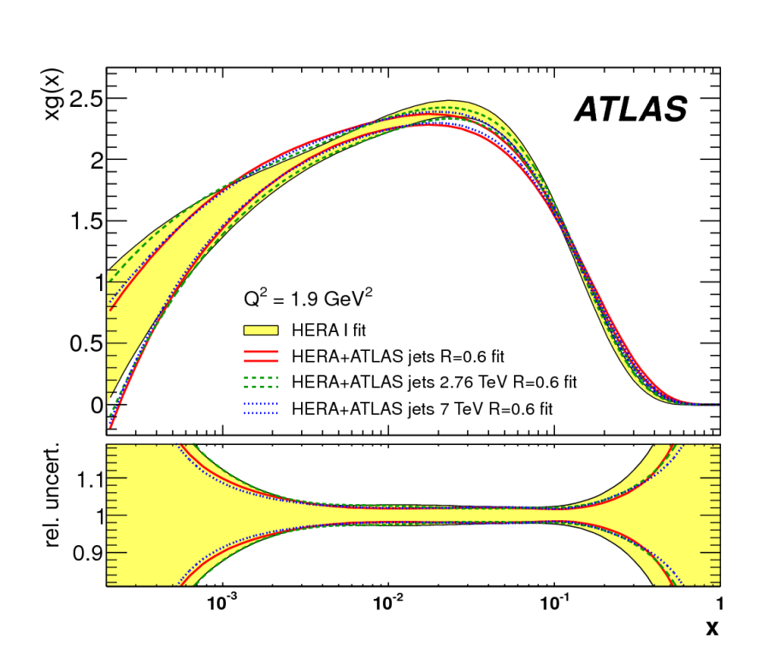
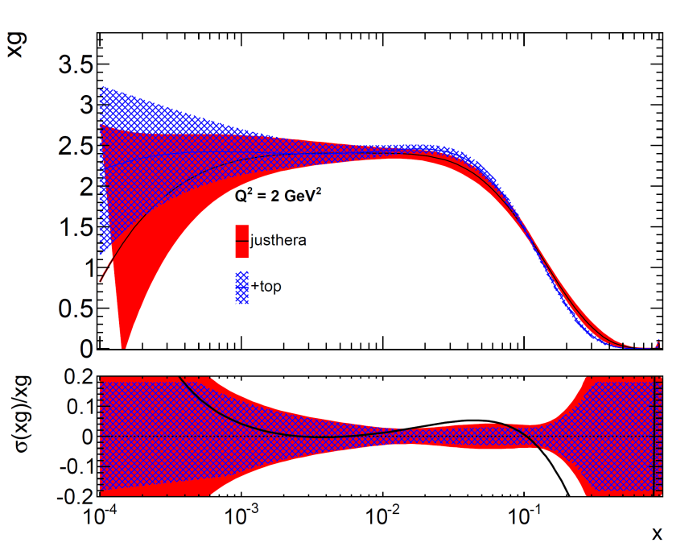
NNLO
Adding NLO top (pt-top, mass t-tbar, y t-tbar)
Pulls to a softer high-x gluon
But adding NLO jets (2.76/7 Tev ratios)
Pulls to a harder high-x gluon
This is probably not new physics but differing NNLO corrections / higher order EW corrections
Could there also be a sensitivity to resummation in t-tbar Pt?

Slide 4
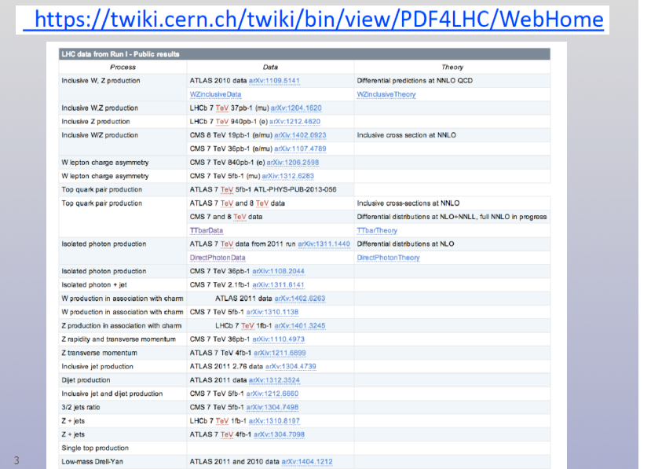
New processes?
Here’s the PDF4LHC compendium of PDF sensitive data vs calculations
Some of these will certainly require better calculations
And what about di-boson production?

Slide 5
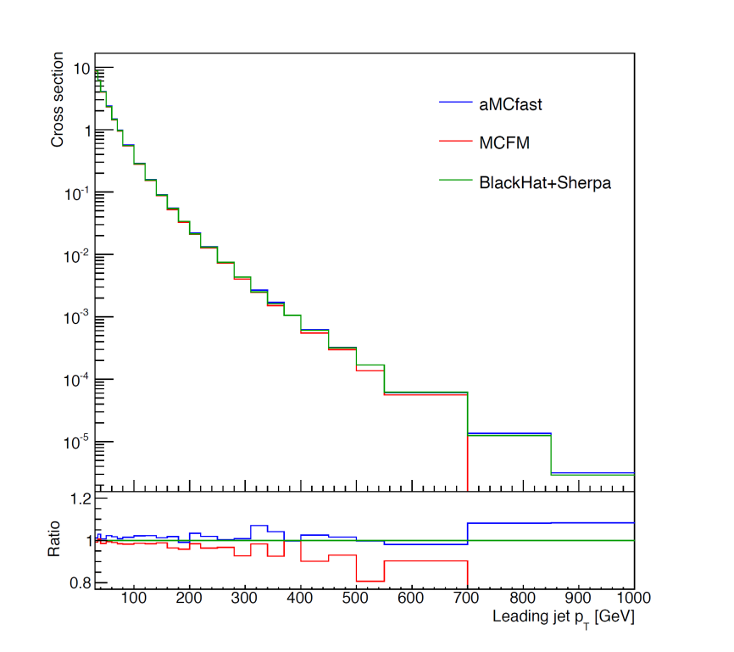
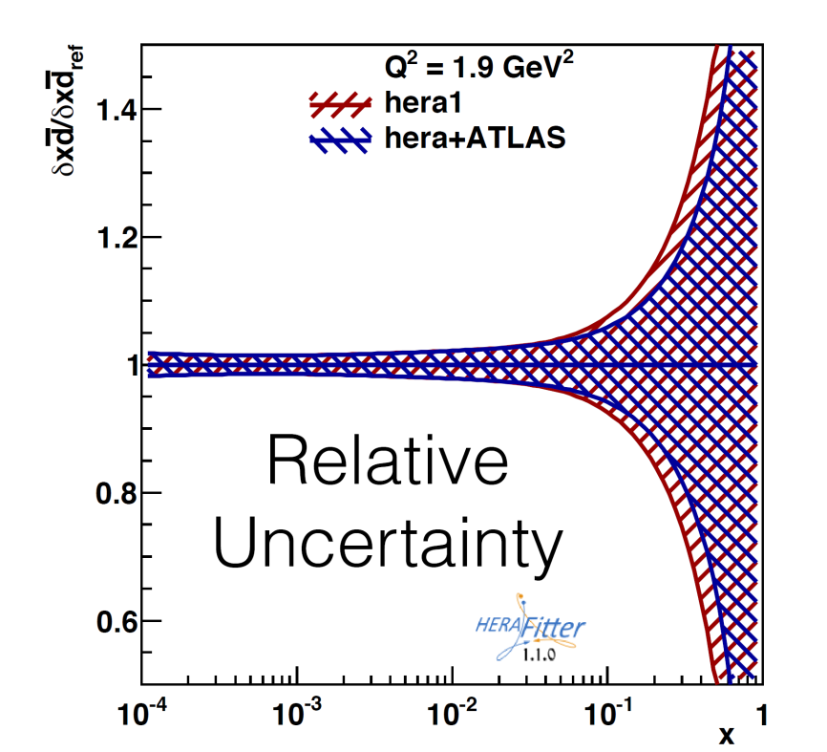
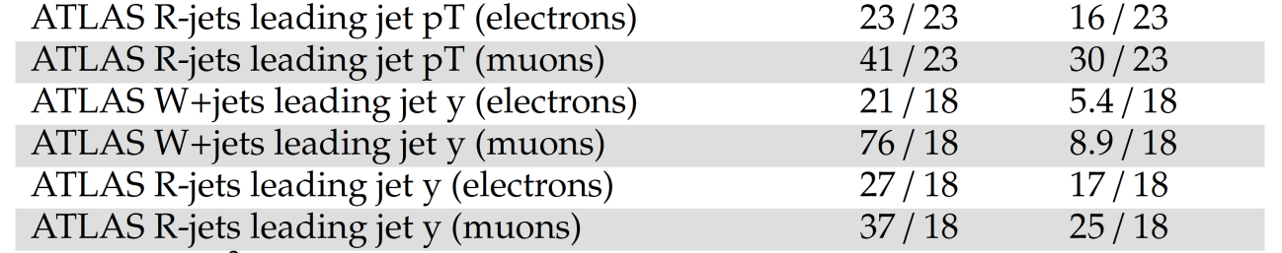
W+jets study aMCfast vs MCFM etc
By Craig Sawyer
PDF fits done using MCFM to W+jets and R+jets pt and rapidity spectra
Some small decrease in dbar high-x uncertainty.
Chisq depends on treatment of correlations
JER correlated uncorrelated

Slide 6
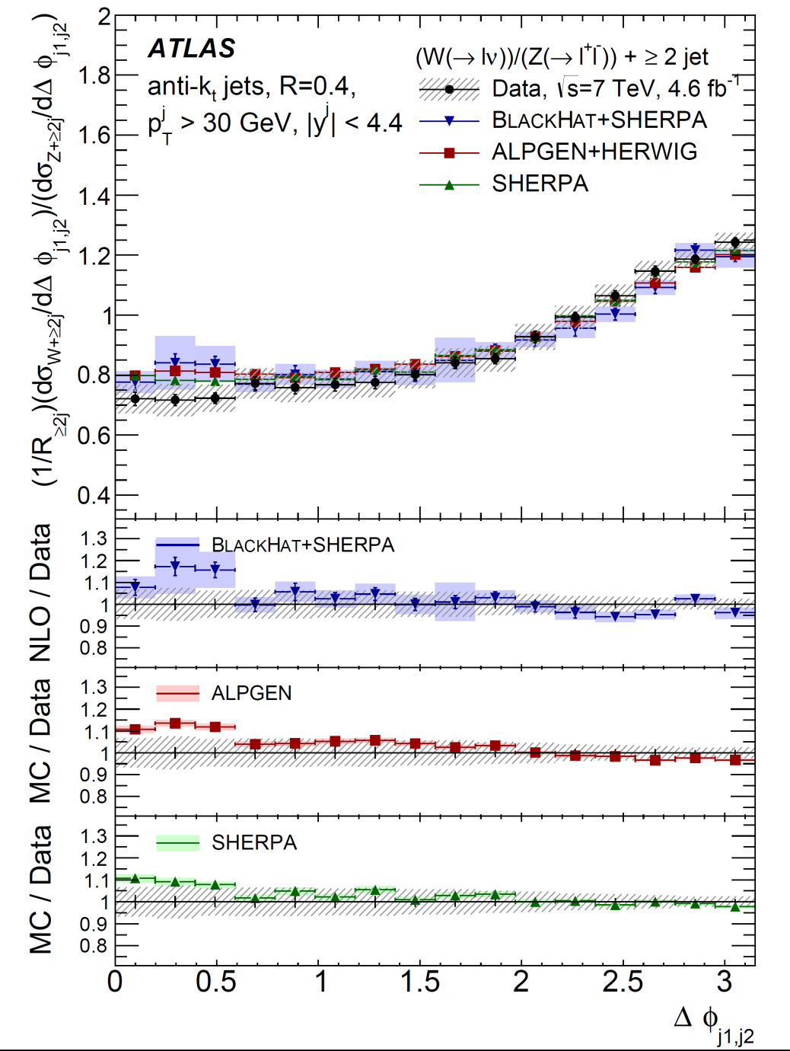
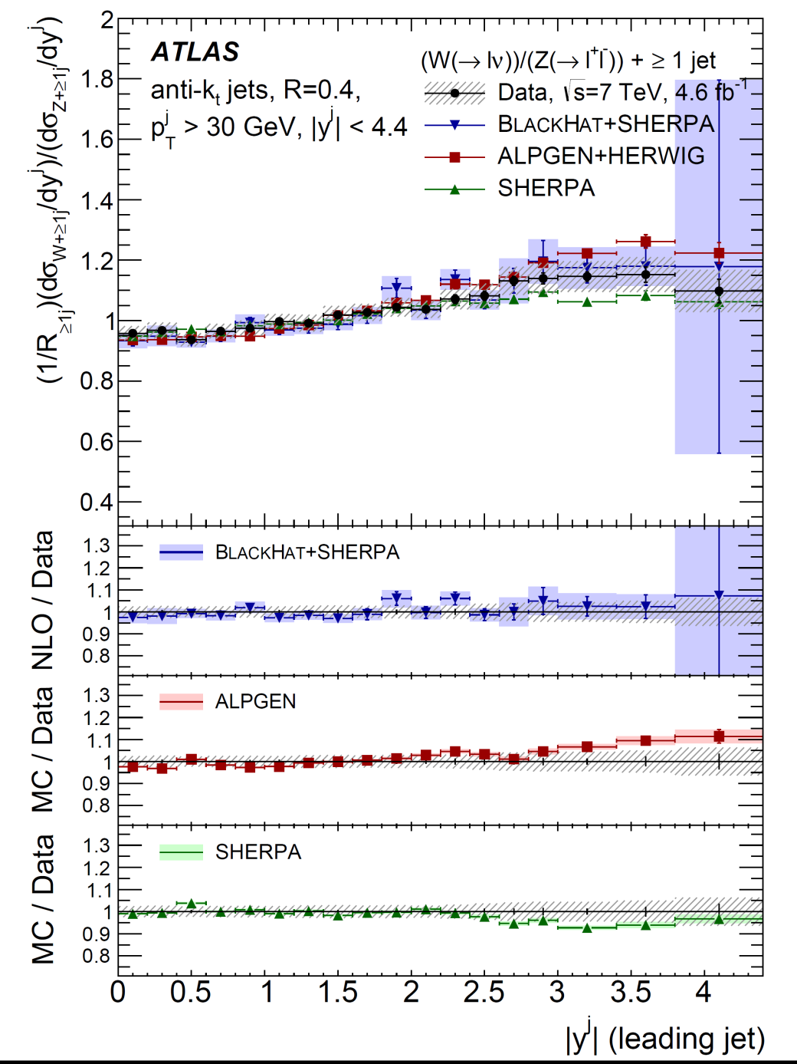
Are any calculations really adequate ?

Slide 7
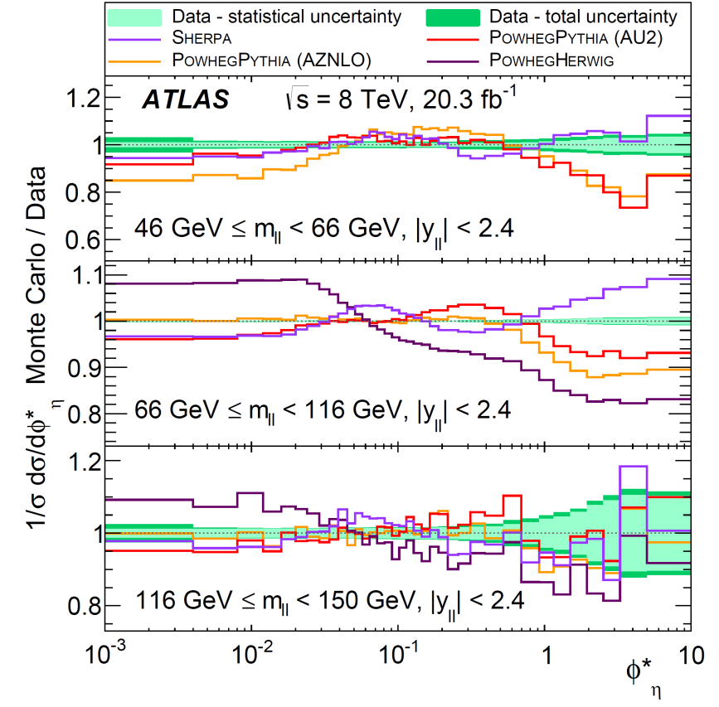
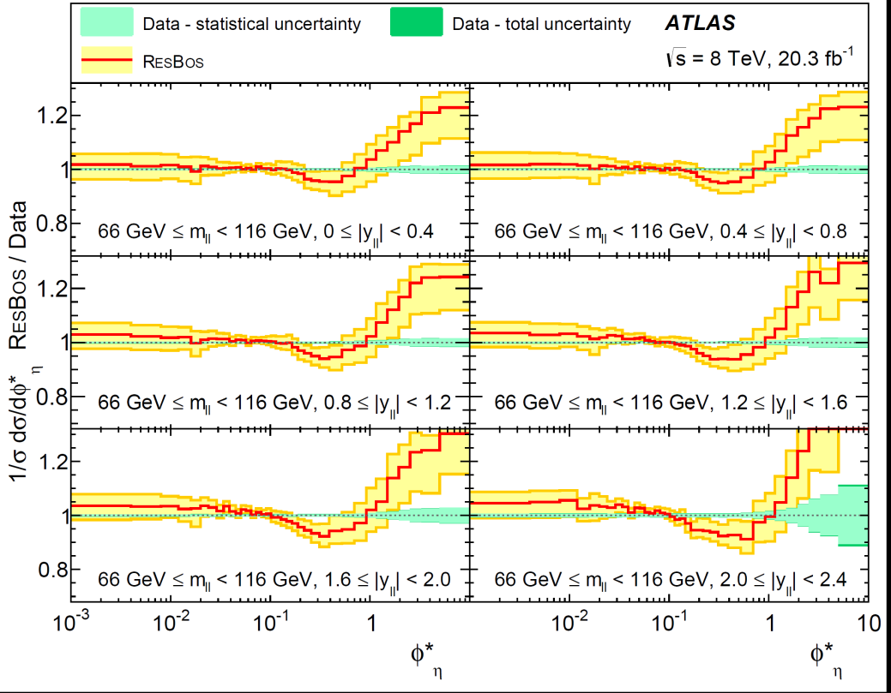
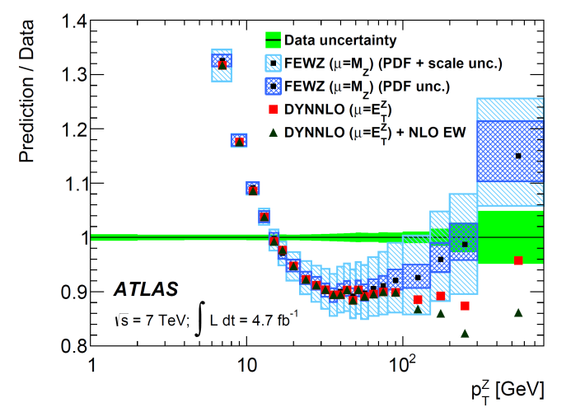
ATLAS 8 TeV: Z pt and Z φ* ArXIV:1512.02912
And the same question can be asked for Zpt
Are present calculations really adequate ?
ATLAS 7 TeV Z pt

Slide 8
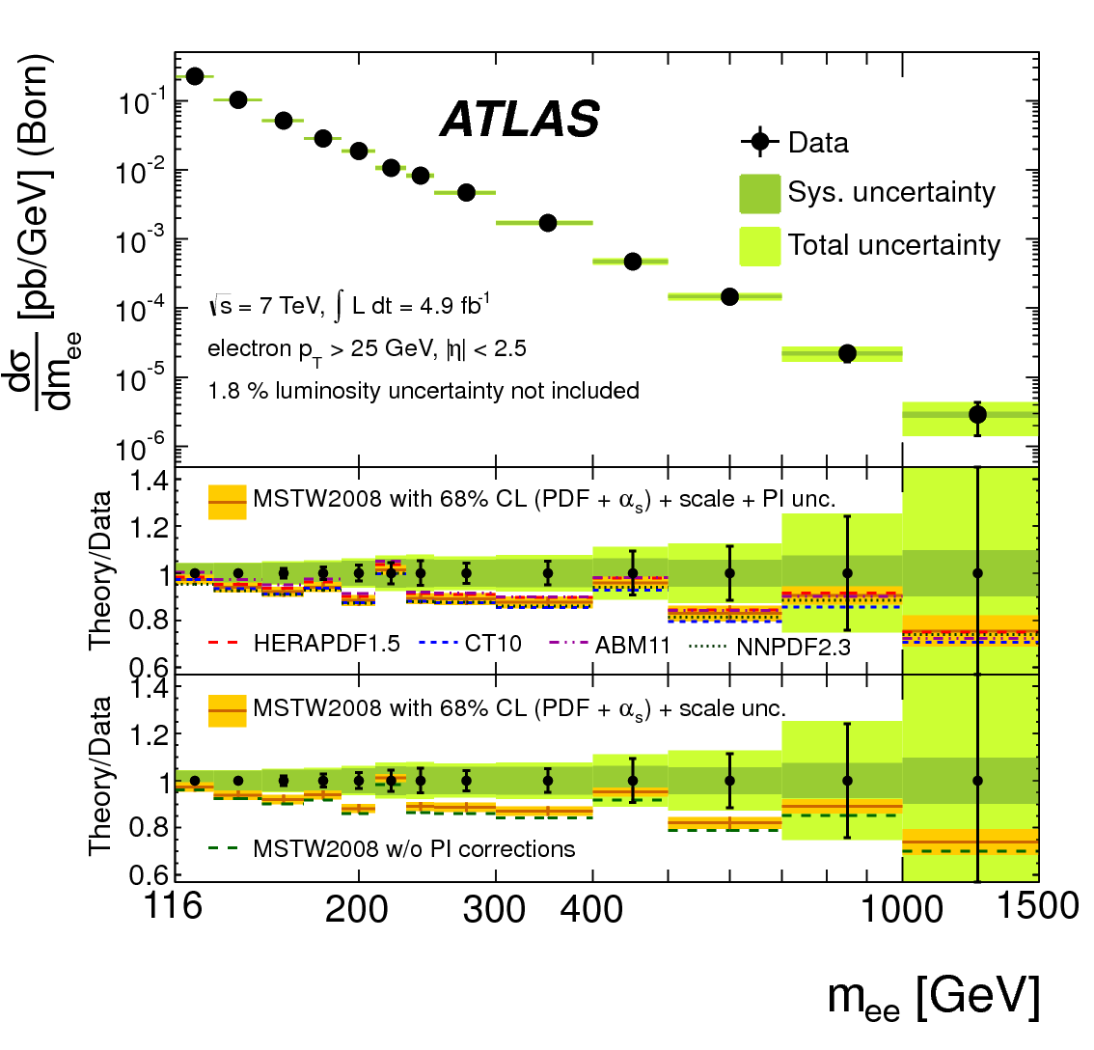
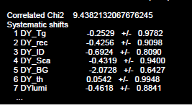
Including the QED part in the proton is now becoming essential
Illustration on 7 TeV High-Mass Drell-Yan
(but much clearer in forthcoming 8 TeV)
Background nuisance parameter shift is large without account for the photon induced irreducible contribution to di-lepton production
There is now a QEDevol module available in xFitter
And Applgrid has been extended to allow for a photon density to be fitted

Slide 9
Other Ideas
We could make more use of ratios
We could combine data sets CMS and ATLAS and LHCb
We could go beyond DGLAP at low-x
We could extend PDFs to fit fundamental parameters together with PDFs
α_{S}(M_{Z}) is perhaps the most obvious.
But there are also heavy quark masses
Electroweak parameters: NC vector and axial-vector couplings
Sin²θ_{W} and M_{W}
CKM matrix Vcs
Use the Higgs?

Slide 10
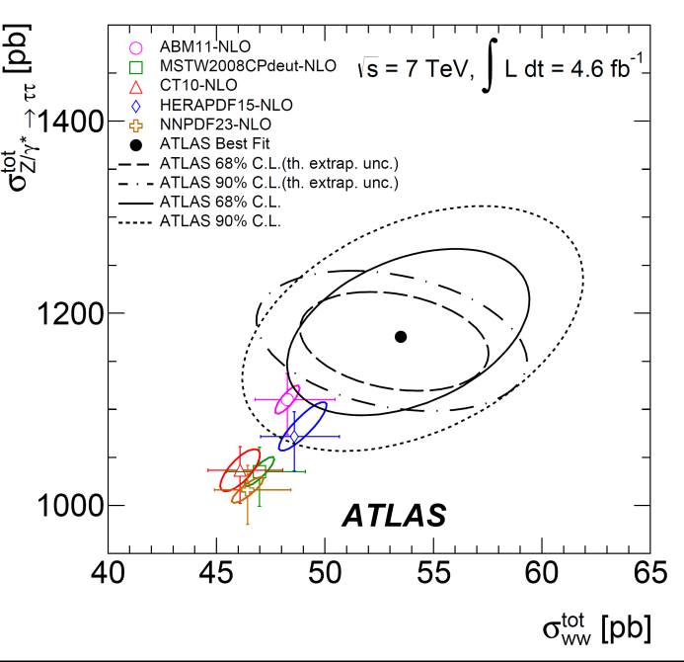
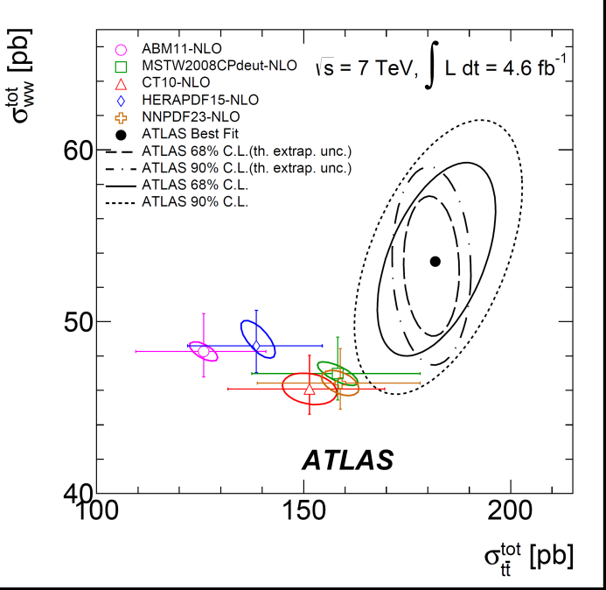
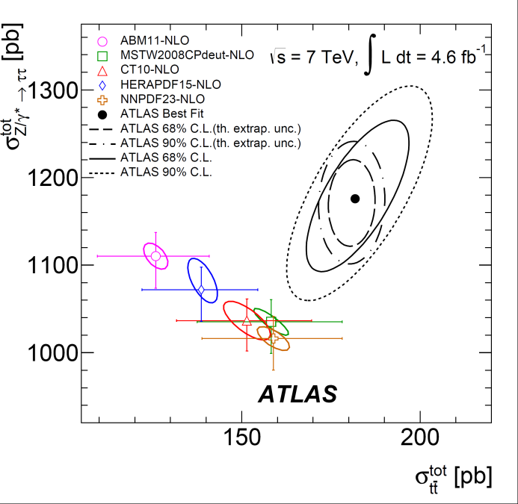
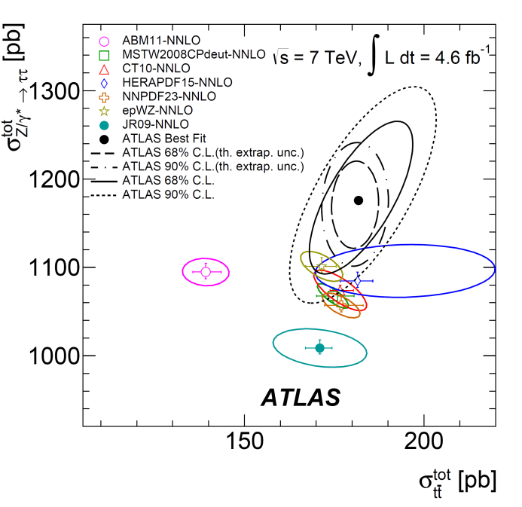
Information from ratios- or correlations between different channels are interesting.
WW,t-tbar and Z→ττ can all feed into electron+muon final states..
NNLO PDFs are inadequate

Slide 11
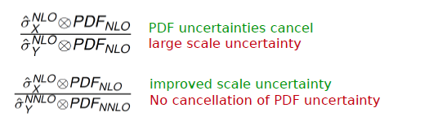

PDF sets at LO/NLO/NNLO with correlated uncertainties
arXiv:1404.4234
Theoretical predictions are available at different orders
LO used in parton shower MCs
NLO for most predictions
NNLO for a few predictions
Uncertainties come from the PDFs and the sub-process cross-sections
Scale uncertainties affect the sub-process cross-sections more at lower orders
Ratios are often used as a way of cancelling experimental uncertainties.
But the corresponding theoretical uncertainties may not cancel out
Large scale uncertainty because NLO calculation
Improve this by going to NNLO but what if this is only available for ONE of the cross sections?
Preserve correlations between PDFs of different orders
This has been done using the HERAPDF formalism and HERA-1 combined data
varying the model and parametrization assumptions (as in JHEP 1001, 2010, 109)

Slide 12
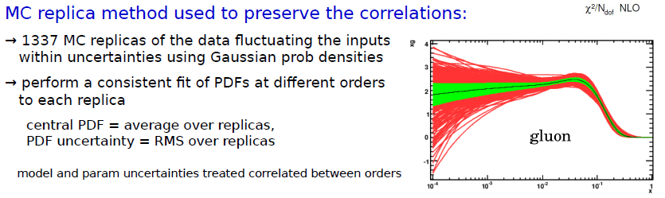
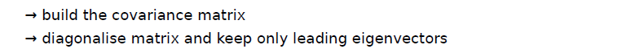
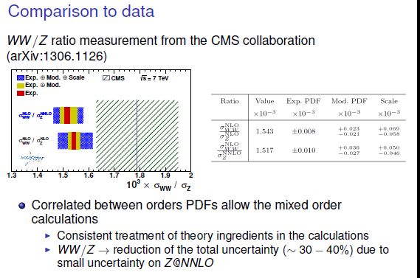
In practice an eigenvector representation can be more convenient than MC replicas
The MC replica results can be converted using the method used to extract META-PDFs (arXiv:1401.0013)
This preserves strong correlations between NLO and NNLO PDFs.
These PDFs have been used to calculate the WW/Z ratio and compare to CMS data
arXiv:1306.1126
The total theoretical uncertainty of the calculation is reduced by 30-40% if σ_{Z} is calculated to NNLO because of reduced scale uncertainties
BUT ONLY because the PDF uncertainties at NLO and NNLO are correlated

Slide 13
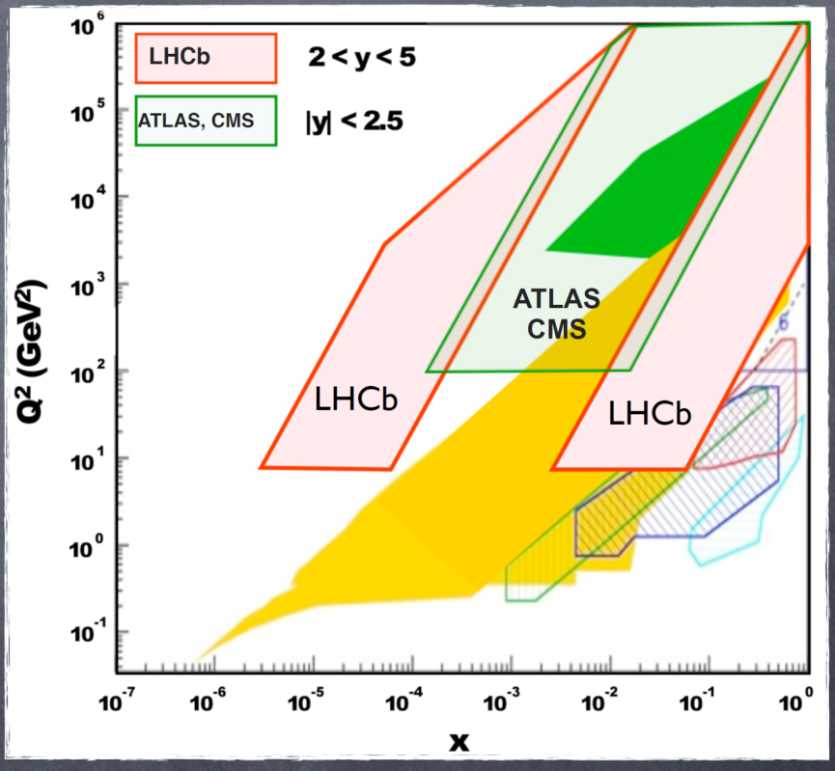
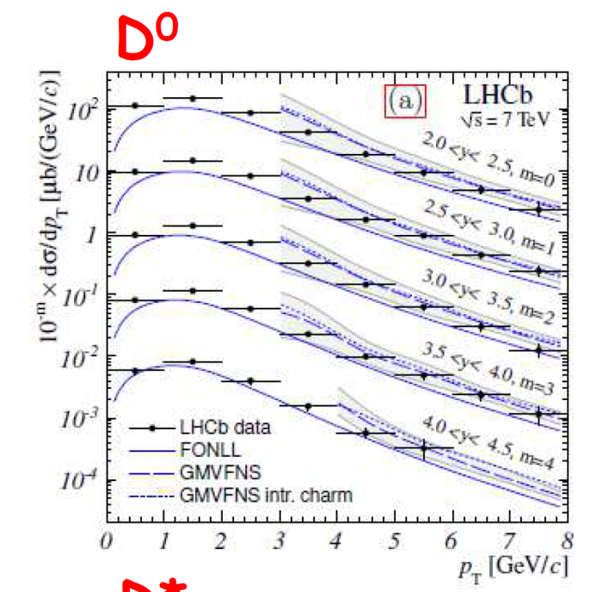
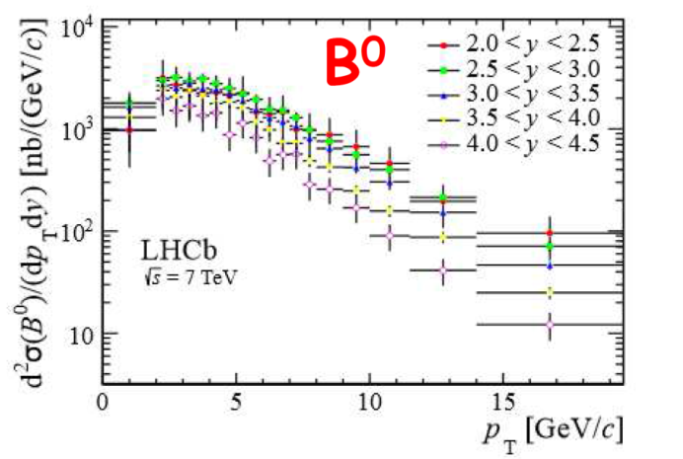
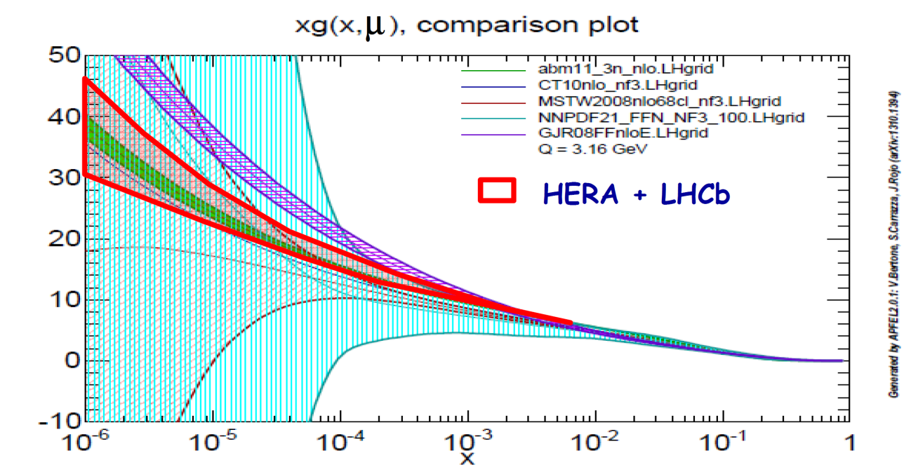
Use Charm and beauty data from LHCb together with HERA inclusive and HERA charm+beauty data to improve the low-x gluon
PROSA study uses single differential fixed order NLO calculations for heavy flavours at LHC by Nason, Dawson, Ellis 1989 which are very fast and so can be input directly to QCD fits.
They are available as part of the MNR software package, Mangano, Nason, Ridolfi 1992, which was added to HERAFitter

Slide 14
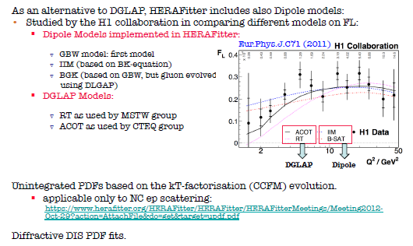
Going beyond DGLAP at low-x

Slide 15
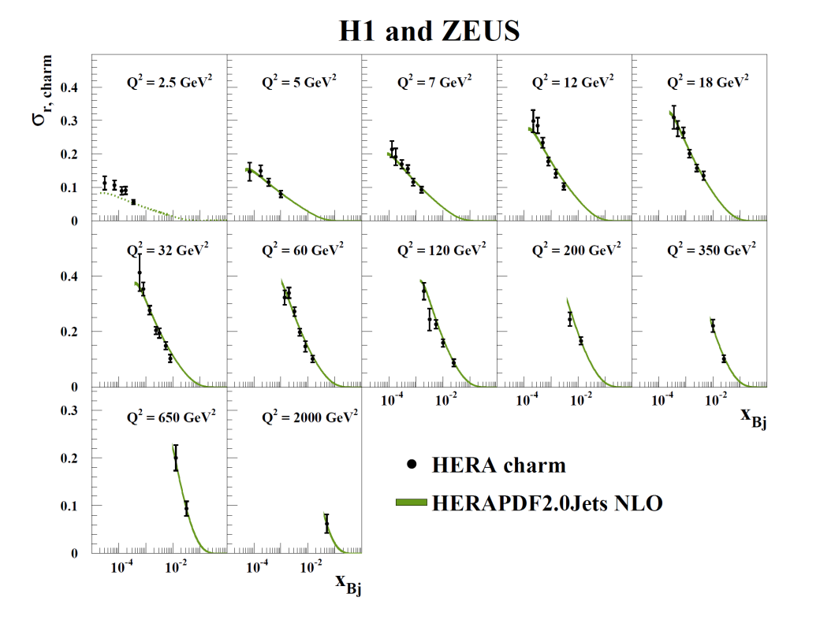
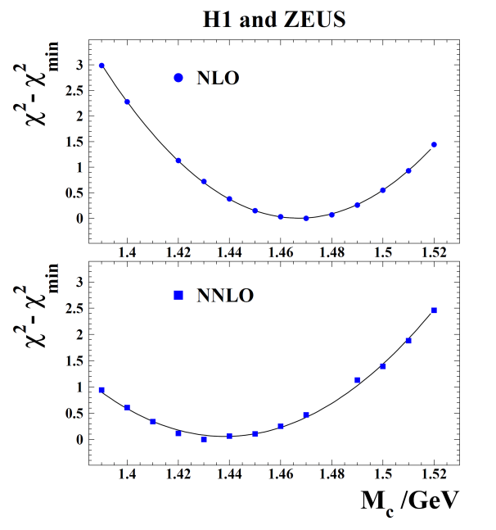
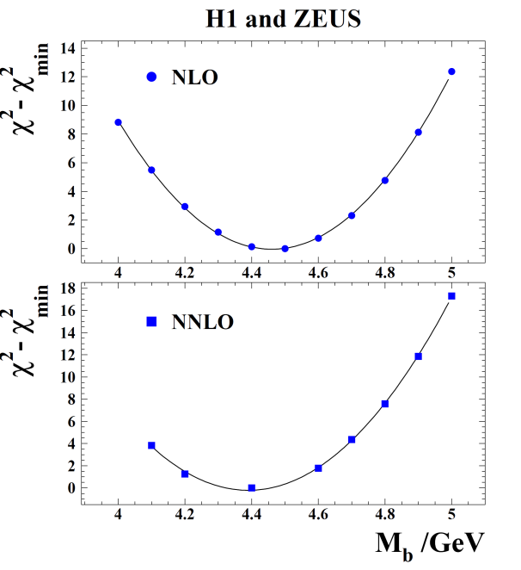
Fitting other fundamental parameters--Heavy quark masses
The data from the HERA charm combination is added to the HERAPDF2.0 fit.
The PDFs do not change significantly.
The main effect is to determine the optimal charm mass parameter and its variation.
EPJC73(2013)2311
ZEUS and H1 data on beauty production EPJC75(2015)265, EPJ65C(2010)89
Are similarly used to determine the optimal beauty mass parameter and its variation
These are pole-masses -- a running mass and indeed the running of the mass can also be determined…

Slide 16
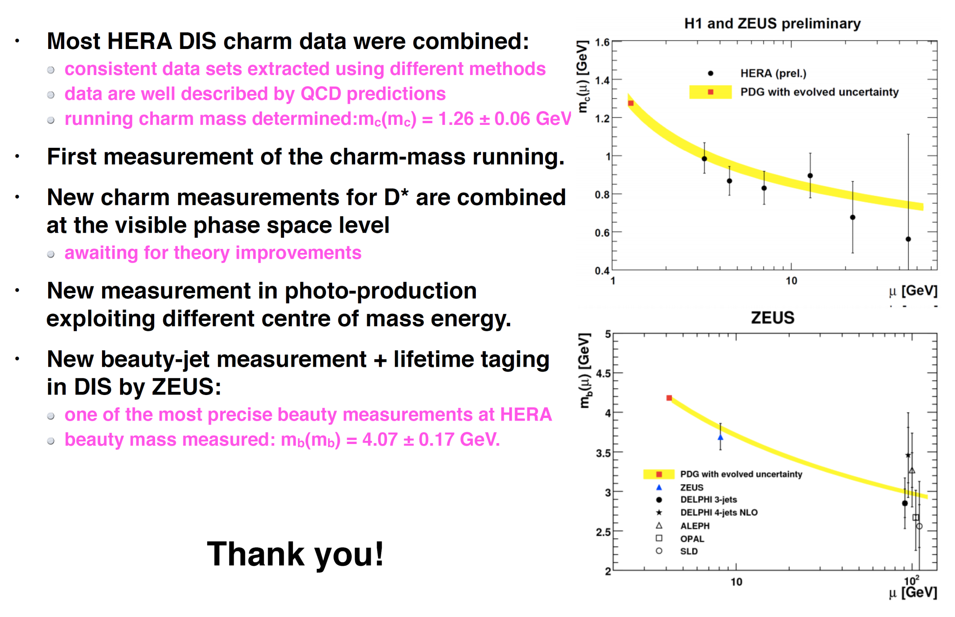
From one of Voica’s talks

Slide 17
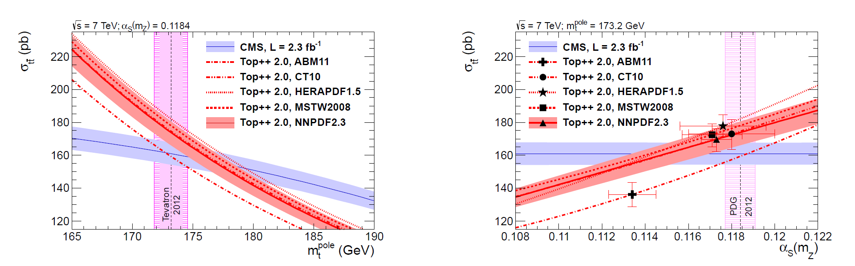
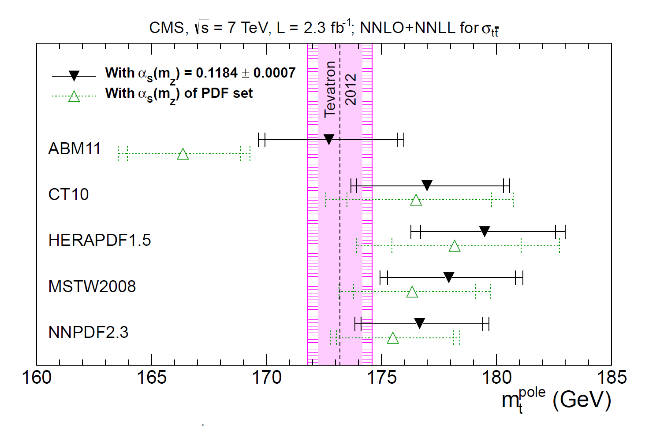
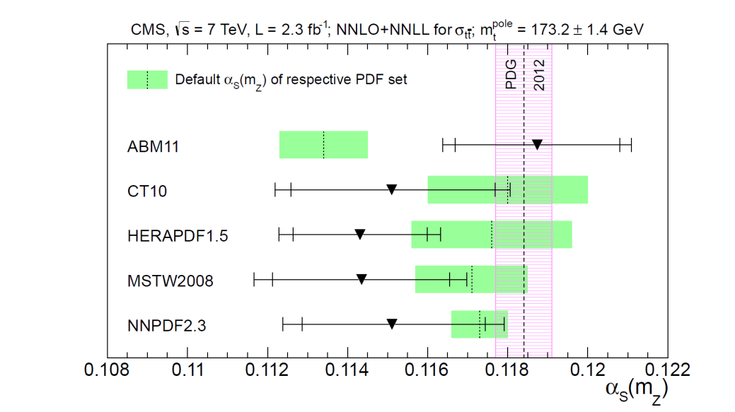
Fitting other fundamental parameters--Heavy quark masses and α_{S}(M_{Z})
And CMS made a simultaneous top mass and α_{S}(M_{Z}) measurement

Slide 18
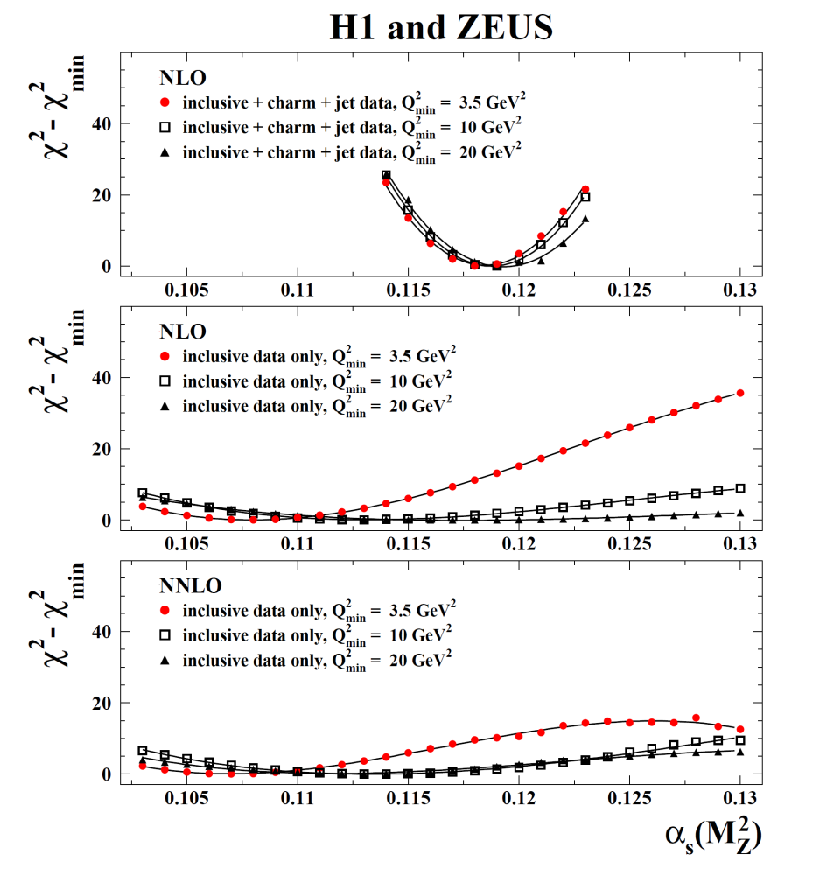
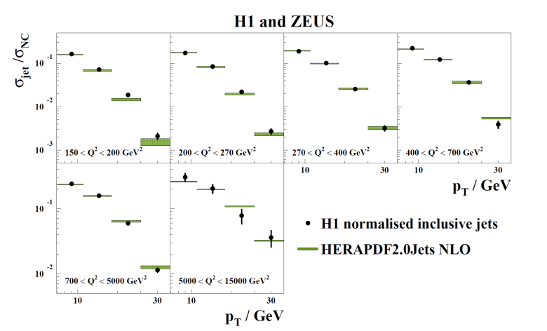
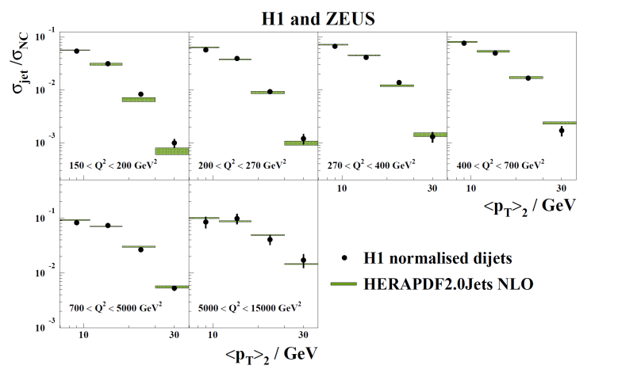
Fitting fundamental parameters α_{S}(M_{Z})
HERAPDF2.0Jets is based on inclusive + charm + jet data
The fits with and without jet data and charm data are very compatible for fixed α_{S}(M_{Z})
Let’s look at freeing α_{S}(M_{Z})
Inclusive data alone cannot determine α_{S}(M_{Z}) reliably either at NLO or at NNLO
When jet data are added one can make a simultaneous fit for PDF parameters and α_{S}(M_{Z}) at NLO--- NNLO calculation still not available

Slide 19
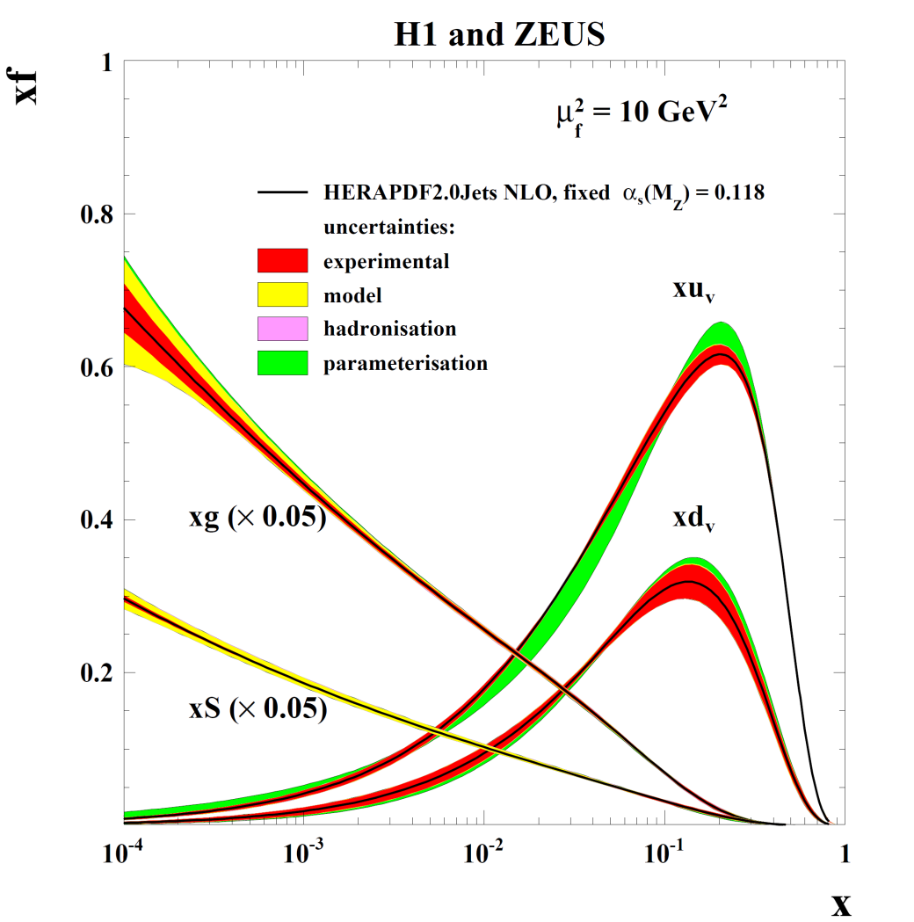
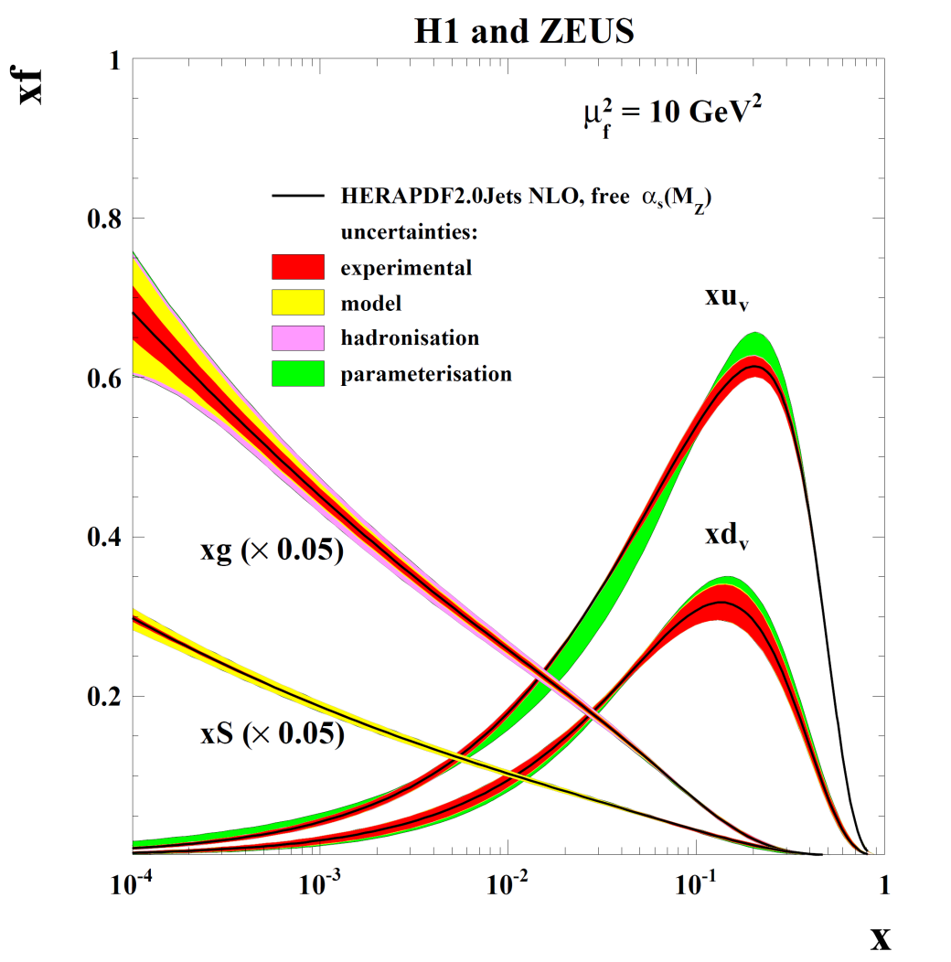

Fits are made with fixed and free α_{S}(M_{Z})
These PDFs are very similar since the fitted value is in agreement with the chosen fixed value. The uncertainties of gluon are not much larger when α_{S}(M_{Z}) is free since it is well determined. Scale uncertainties are not illustrated on the PDFs
α_{S}(M _{Z}) = 0.1183 ± 0.0009_{(exp)} ± 0.0005_{(model/param)} ± 0.0012_{(had)}

Slide 20
Fitting other fundamental parameters—Neutral current couplings
Prehistoric slides on HERA EW couplings…
Updates are coming

Slide 21
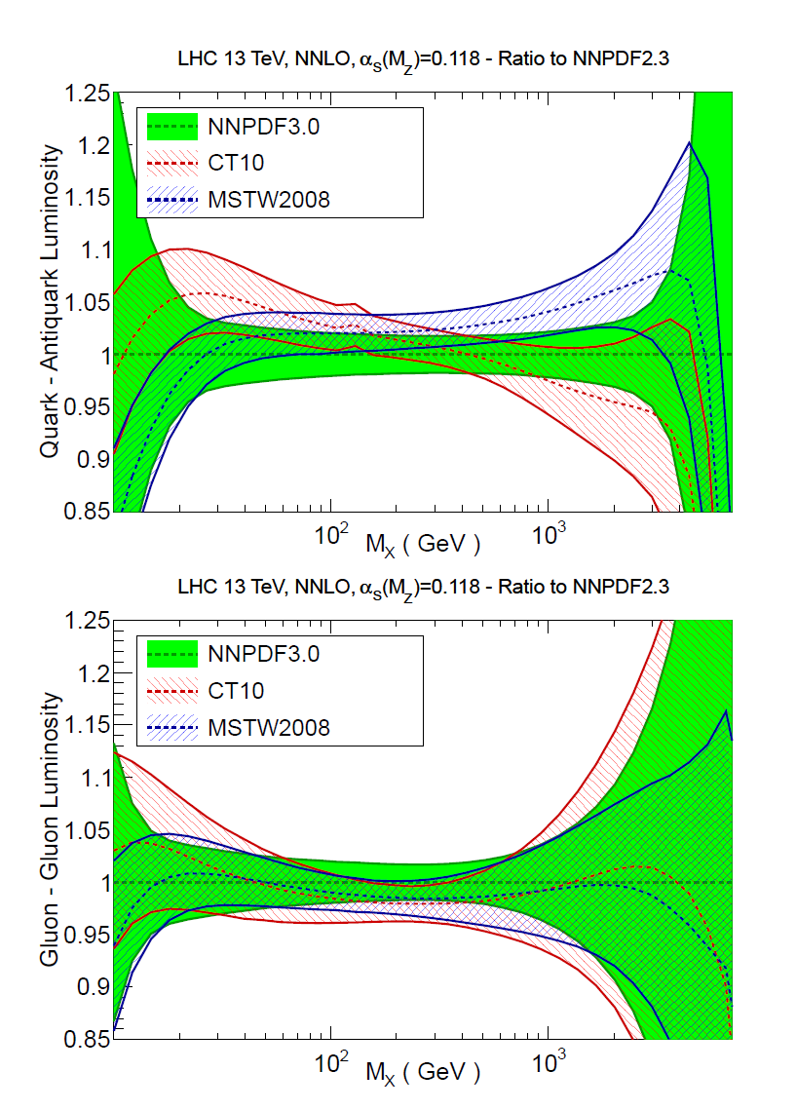
So what will Run- 2 bring?
13 TeV parton luminosity plots
The kinematic region moves to lower x
Higgs production is at x values of 0.005 for central rapidity
The HERA gluon measurements become more important.
We will use our own data on the classic processes------ W,Z production, Drell-Yan, jets and top production ------ to constrain PDFs in this new kinematic regime
BUT PDFs are improved by precision measurements which take time.
The PDF4LHC (arXiv:1507.00556) made a profiling study of the use of ratios as input to PDFs..

Slide 22
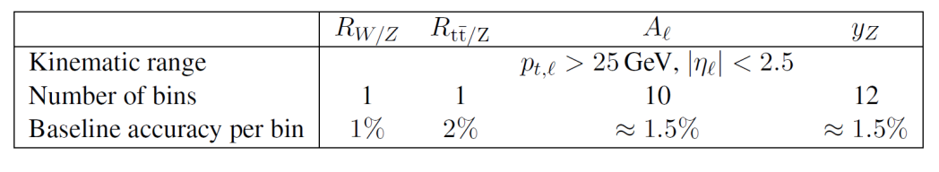
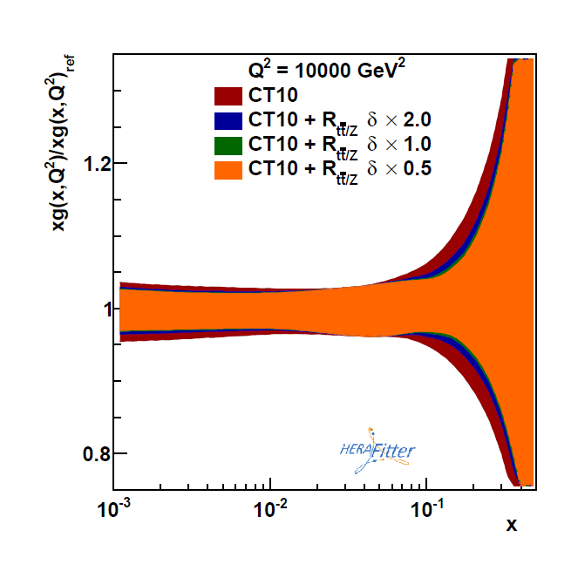
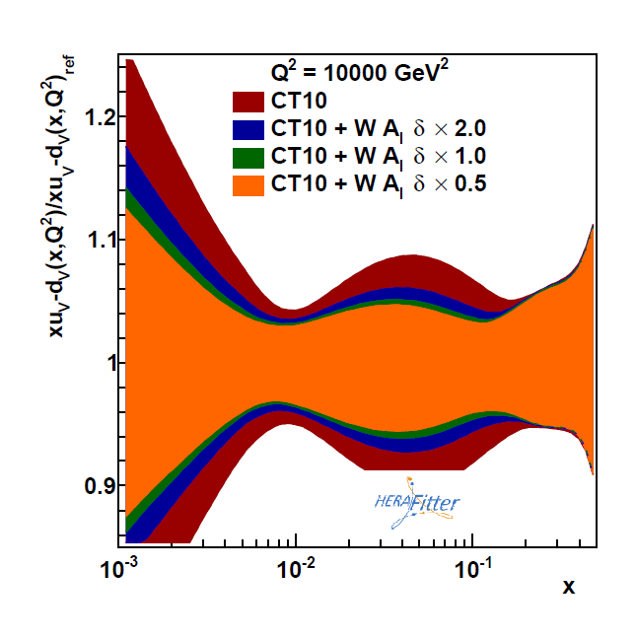
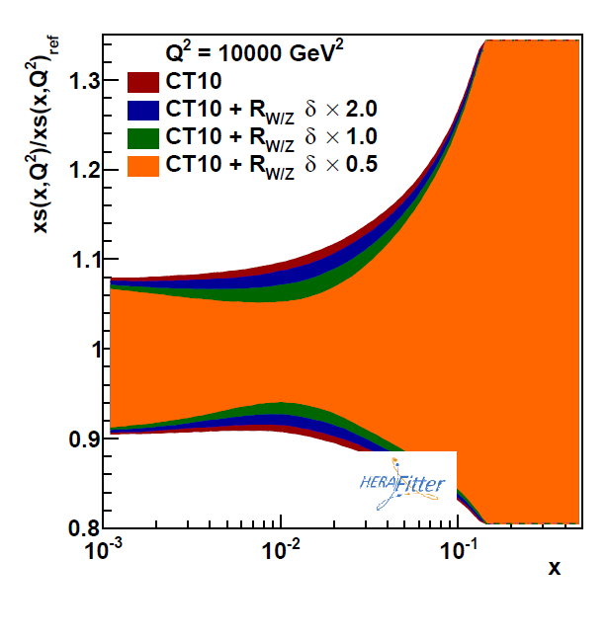
And now we HAVE some of these ratios…

Slide 23
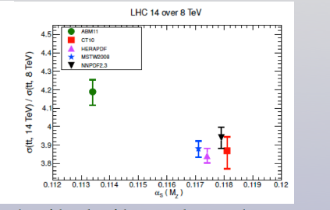
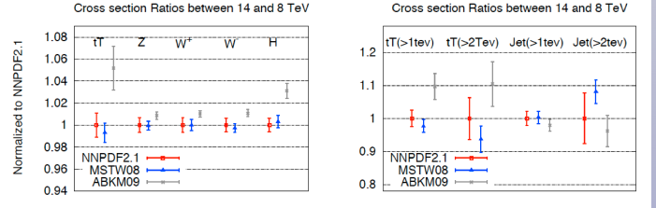
Another idea for quick measurements which have PDF impact is to use ratios of cross sections at 13 to 8 or 7 TeV

