Slide 1
Critical Neutron-Rich Sn Isotopes in Rapid Neutron-Capture Process
Melvin Storbacka
under the direction of
Assoc. Prof. Chong Qi
Annual Swedish Nuclear Physicist’s meeting and SFAIR Meeting 2022
October 26, 2022

Slide 2
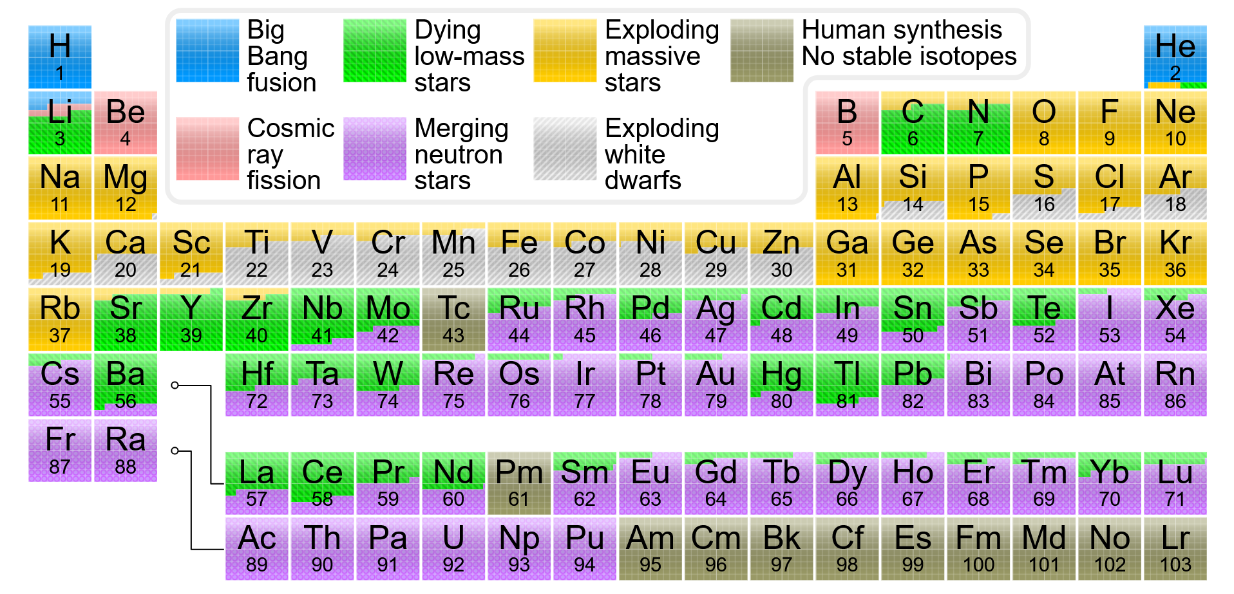

Slide 3
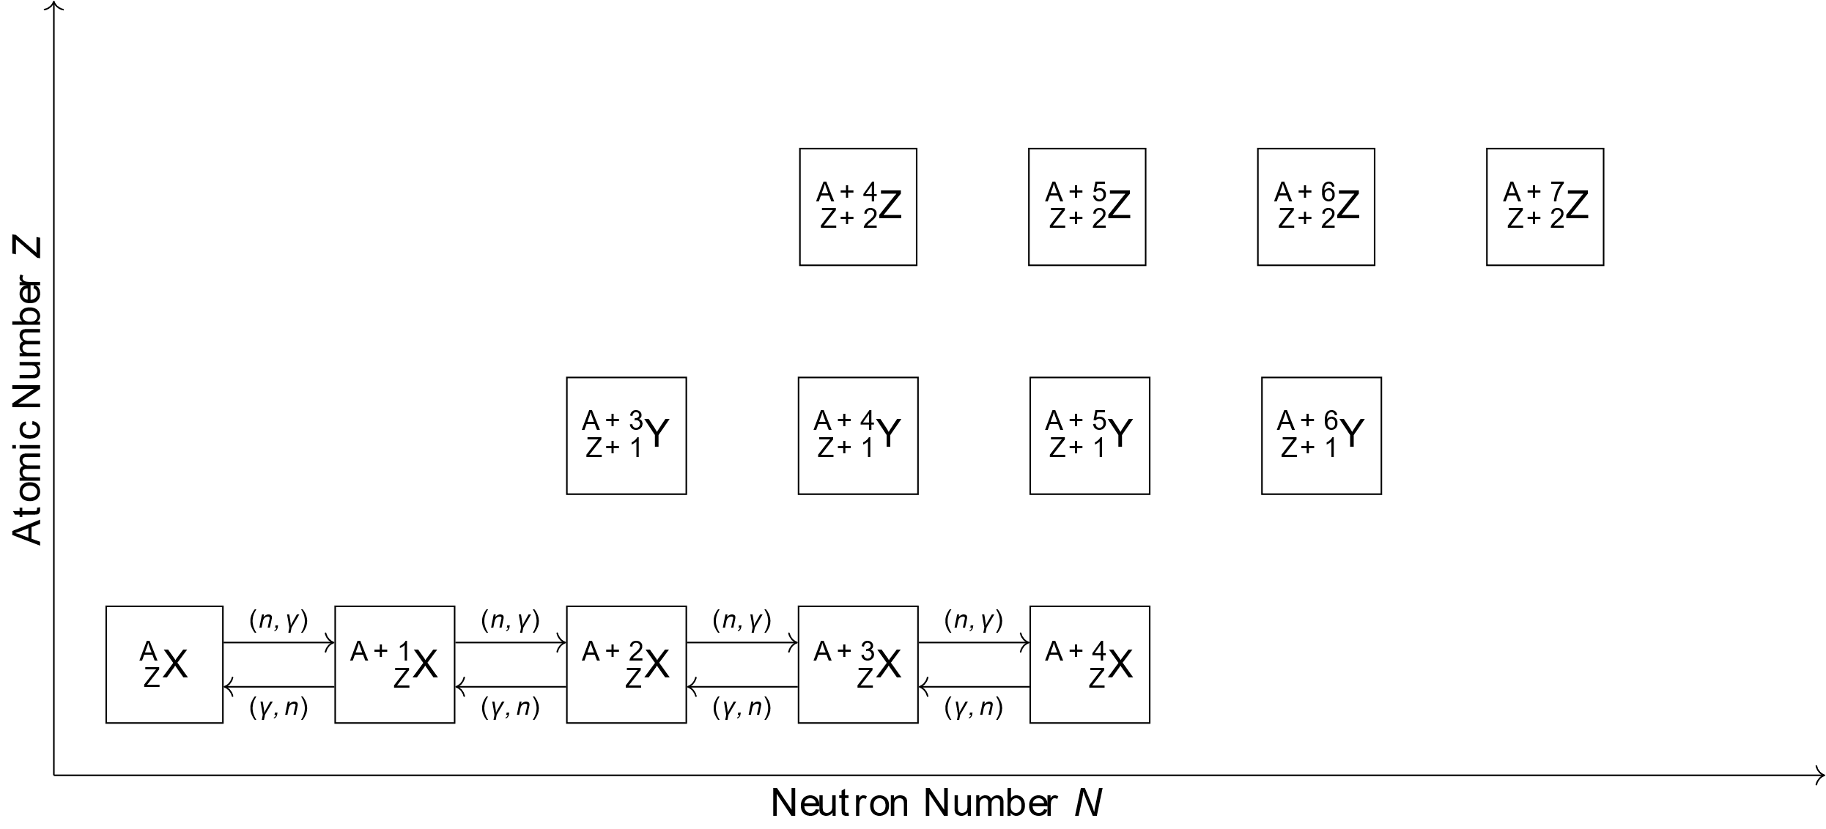
The r-process

Slide 4
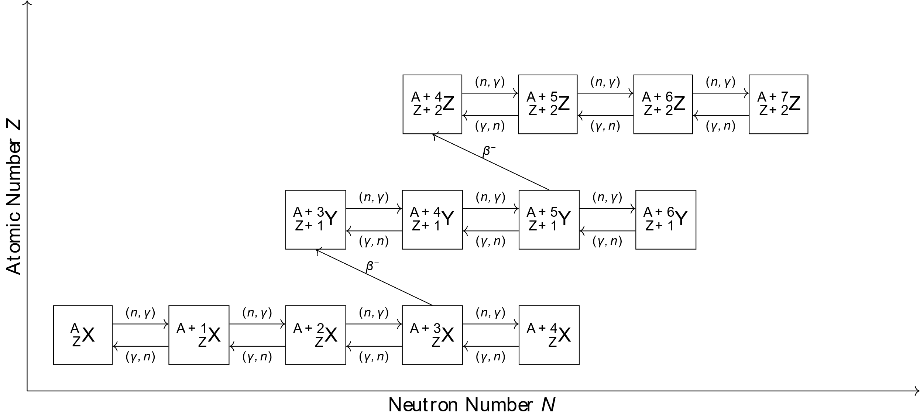
The r-process

Slide 5
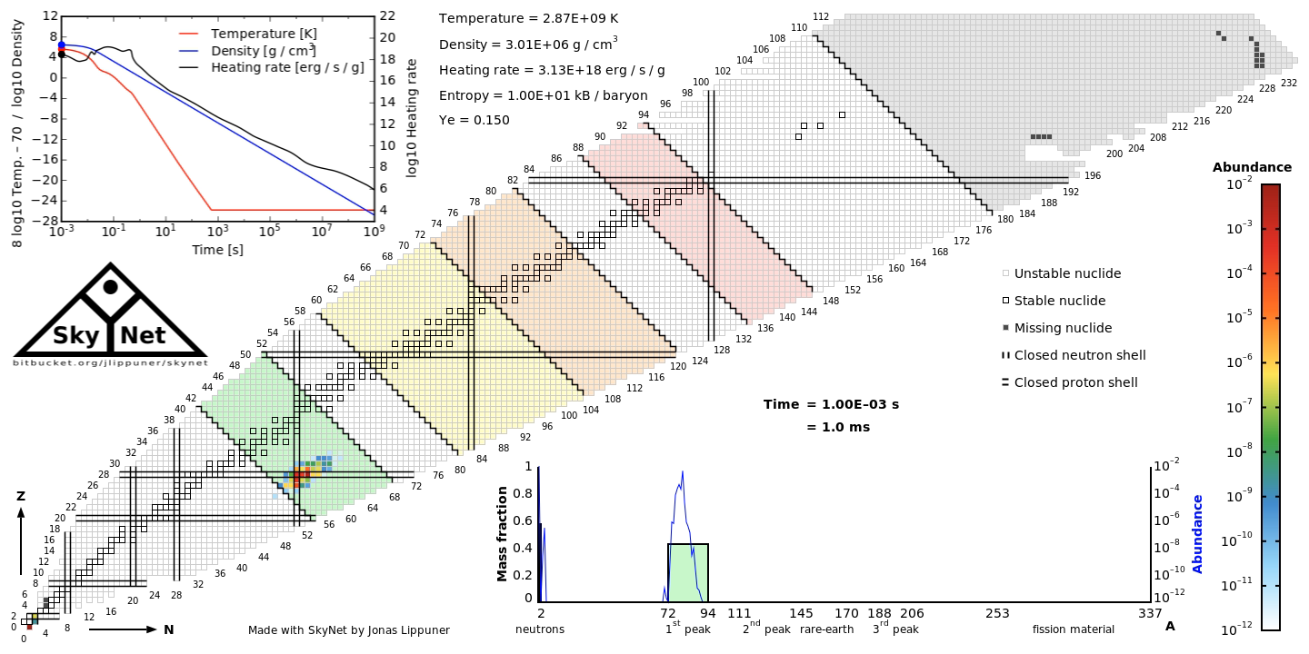
r-process Simulations

Slide 6
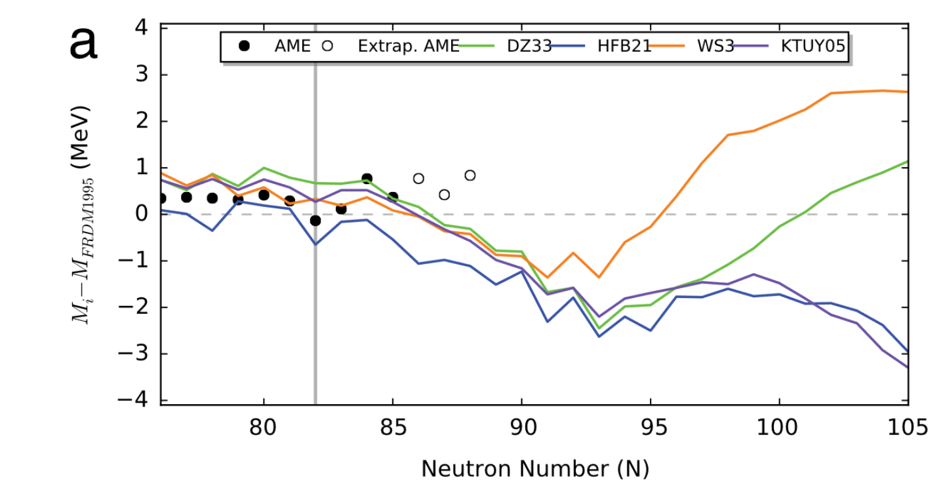
Mass Models
[2]

Slide 7
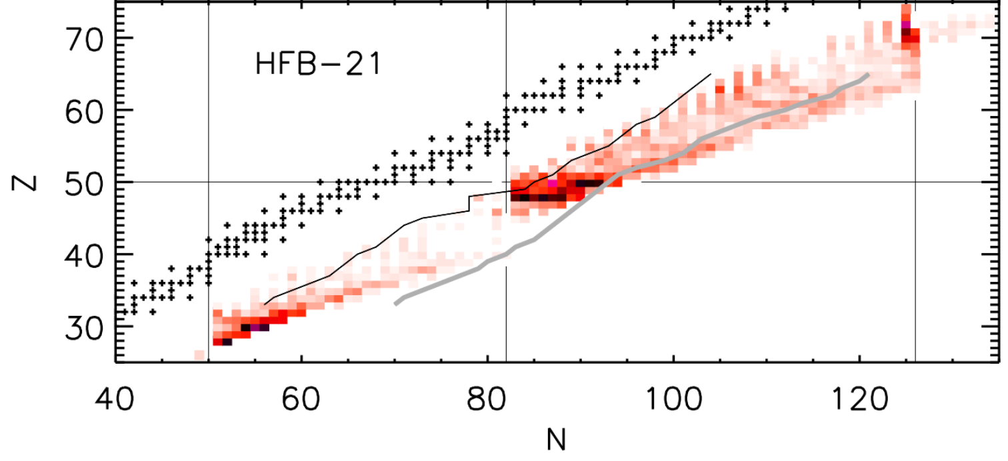
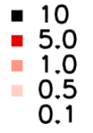
Impact of Nuclear Masses
[3]

Slide 8
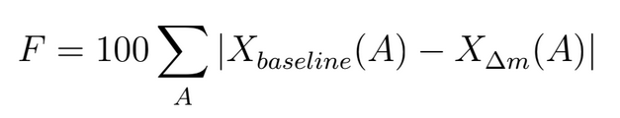
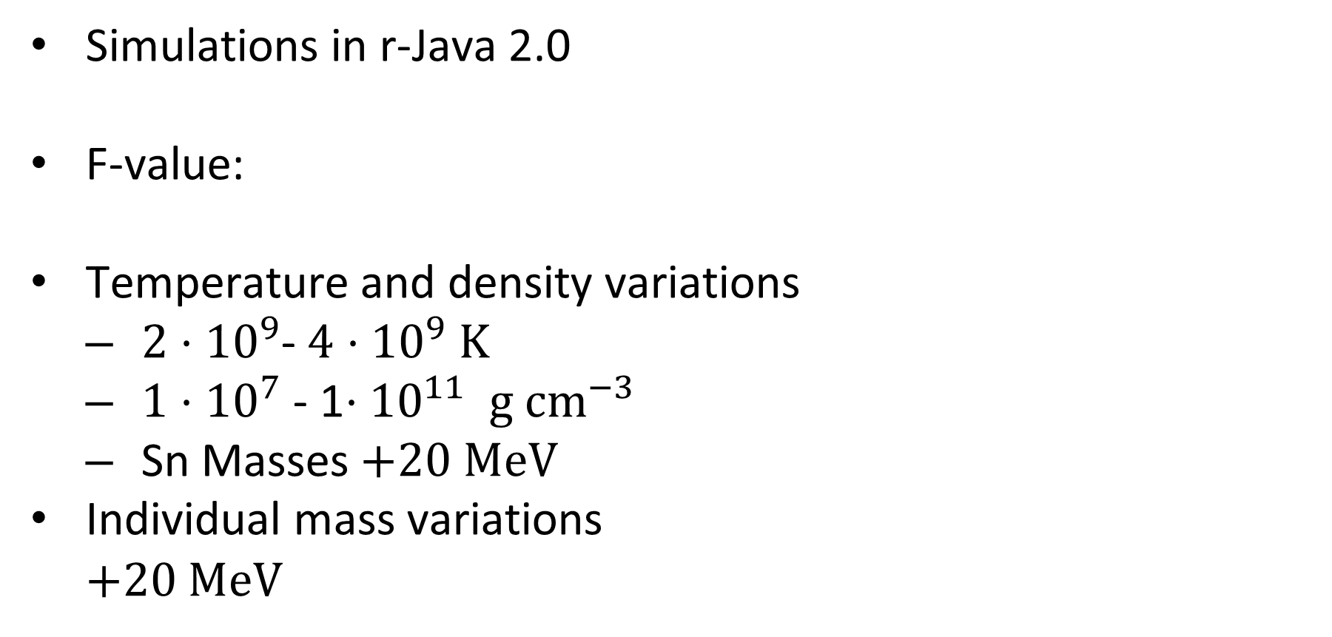
Method
Simulations in r-Java 2.0
F-value:
Temperature and density variations
  $2⋅{10}^{9}$- $4$ ${⋅10}^{9}$ K
  ${1⋅10}^{7}$ - 1${⋅10}^{11} g {cm}^{−3}$
  Sn Masses +20 MeV
Individual mass variations
  +20 MeV

Slide 9
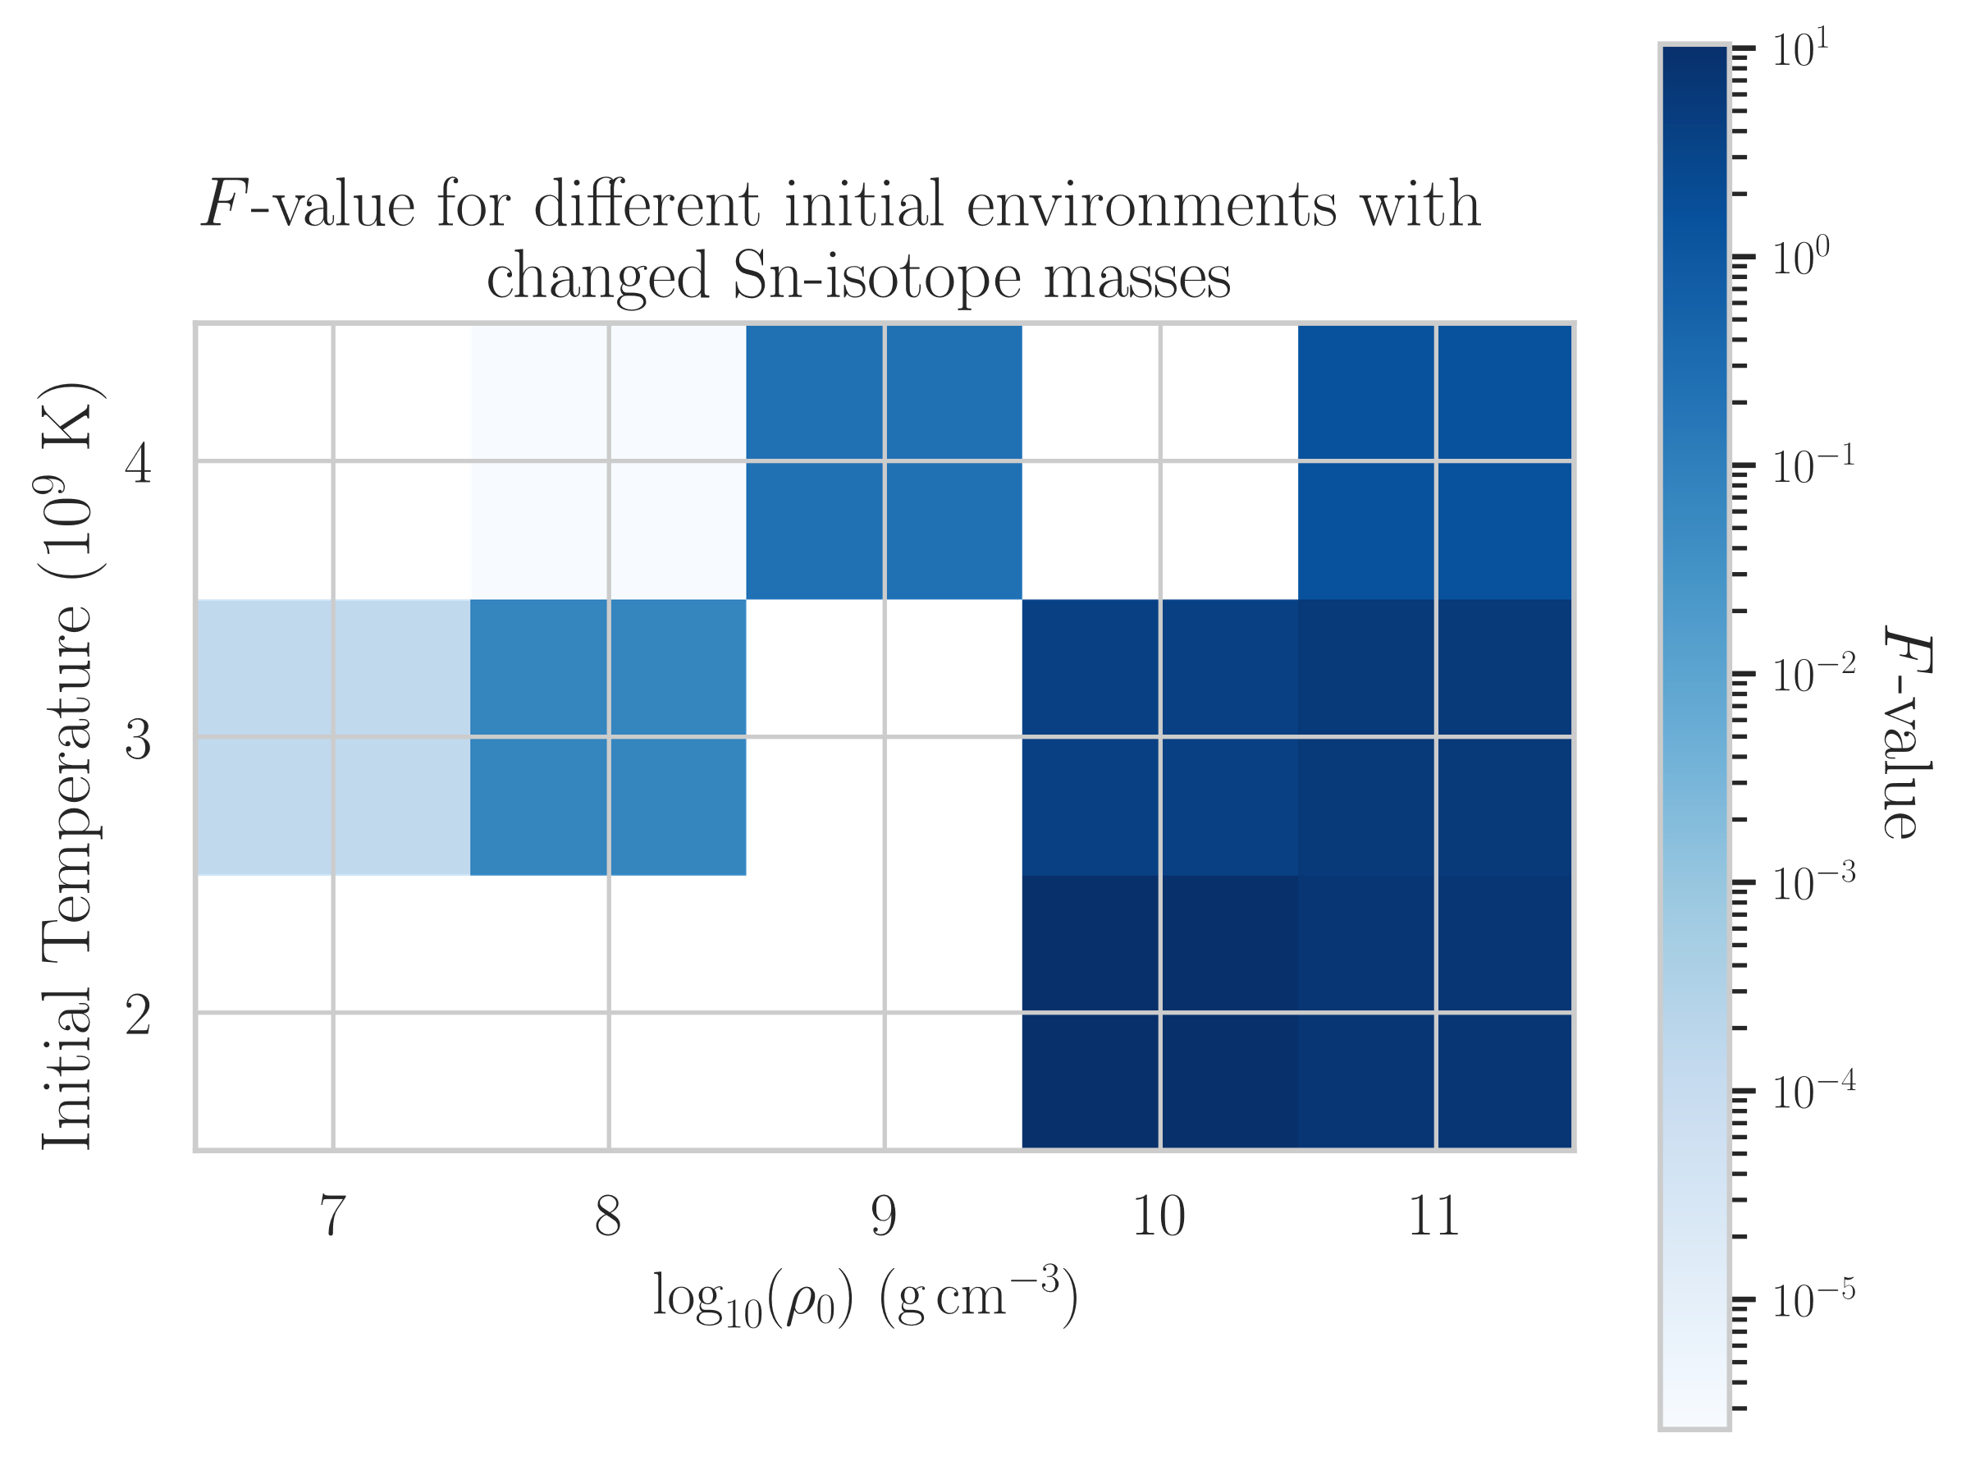
Results & Discussion

Slide 10
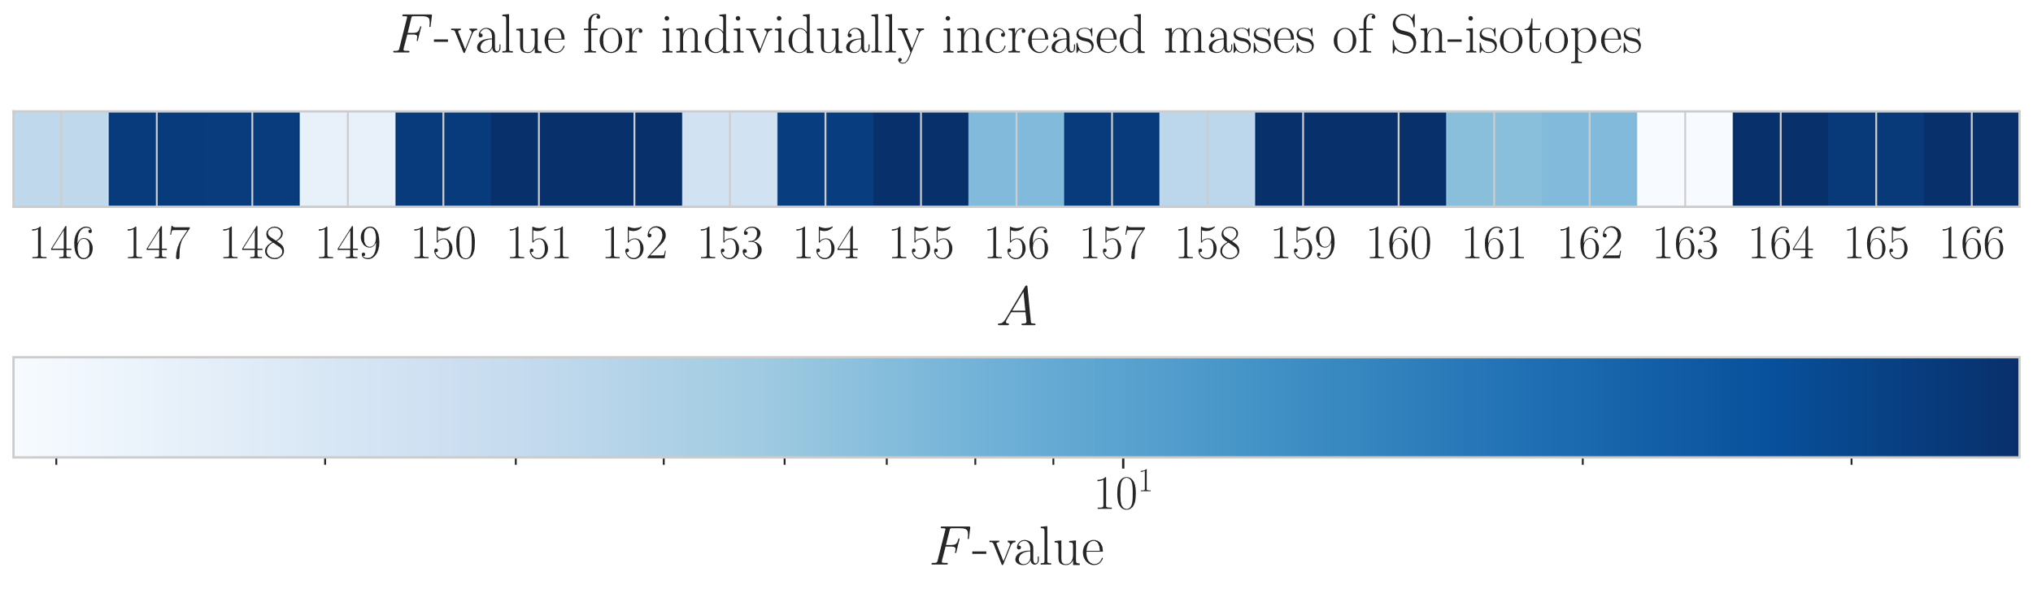
Results & Discussion

Slide 11
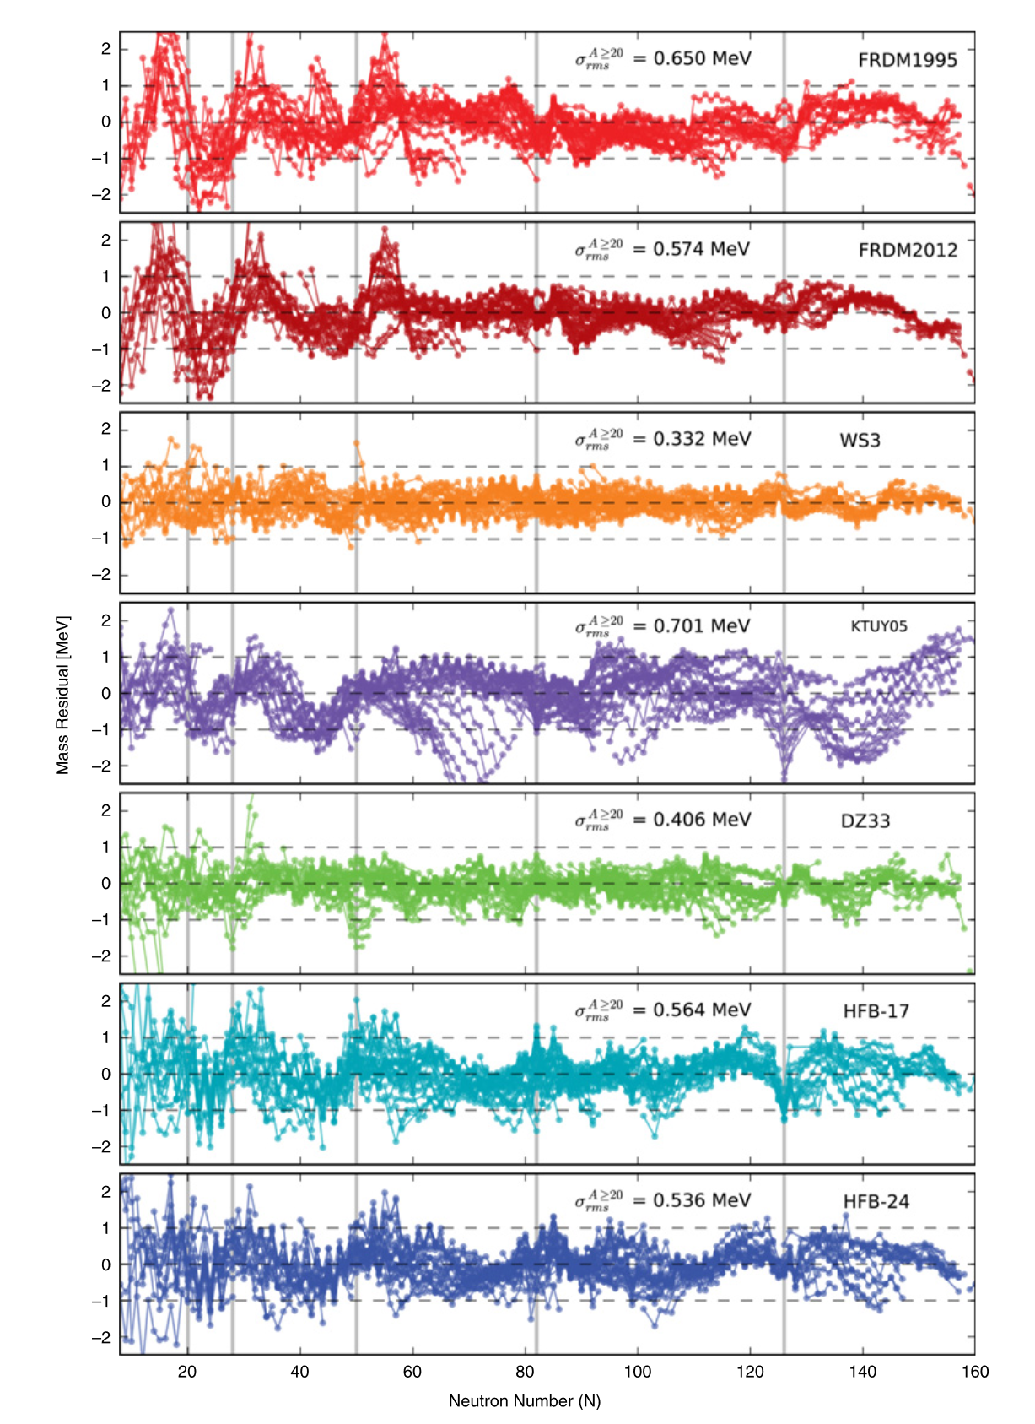
Current/Future Work
“Continuous” variation of models
  More physical representation
  of uncertainty
  Reflects gain of measurement
[2]

Slide 12
References
[1] Cmglee, CC BY-SA 3.0 <https://creativecommons.org/licenses/by-sa/3.0>, via Wikimedia Commons
[2] Mumpower MR, Surman R, McLaughlin G, Aprahamian A. The impact of individual nuclear properties on r-process nucleosynthesis. Progress in Particle and Nuclear Physics. 2016;86:86-126.
[3] Brett S, Bentley I, Paul N, Surman R, Aprahamian A. Sensitivity of the r-process
to nuclear masses. The European Physical Journal A. 2012;48(12):1-5.

