Slide 1
Beta decay of halos…
K. Riisager
Aarhus University

Slide 2
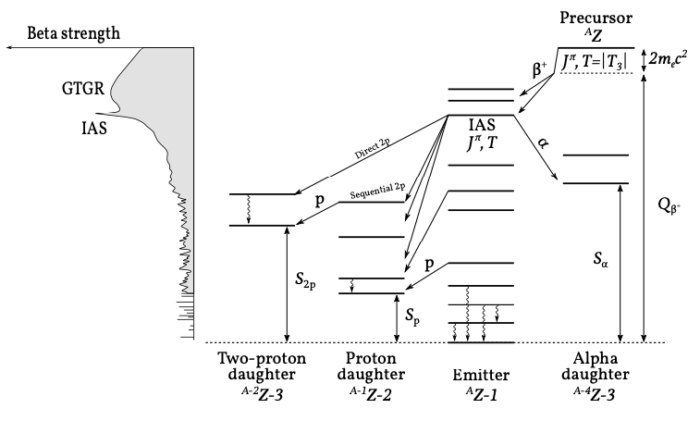
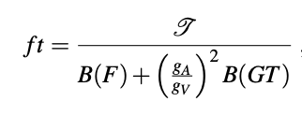
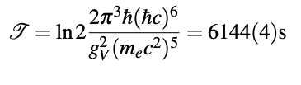
Beta decay – some observations
Rev.Mod.Phys. 84 (2012) 567
Clean mechanism for allowed decays
Fermi strength concentrated (IAS)
Gamow-Teller GR

Slide 3
Halo states – some properties
Rev.Mod.Phys. 76 (2004) 215
Large spatial extension (beyond “nuclear core”), related to
  Low separation energy (if g.s., close to driplines) and
  Small extra-nuclear barriers (angular momentum / Coulomb)
Clustered structure – core + halo
Factorization in ideal cases, giving:

Slide 4

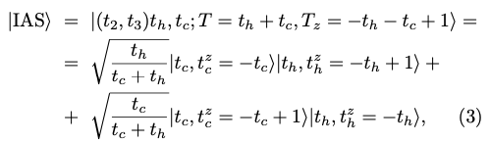
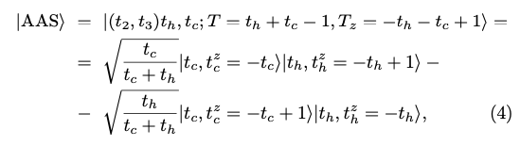
… remember isospin !
Strong isospin-isospin forces
  …leads naturally to isobaric analogue states (and anti-analogue states)
D. Robson, Phys. Rev. 137 (1965) B535
E. Garrido et al., Phys. Rev. C107 (2023) 014003

Slide 5
Isospin purity ?
NB! Isospin mixing - distinct from “IAS non-overlap”
  Coulomb mixing matrix elements at most around 100 keV…
  Typically, small effects (10⁻⁴), in halos of order 10⁻³ – 10⁻²
Larger mixing expected:
  In the low-lying continuum
  (Do for halos = just below continuum)
  At intermediate distances
e.g. Robson (1965) or Mitchell et al, RMP 82 (2010) 2845
e.g., Garrido et al, PL B 648 (2007) 274

Slide 6
Halo signals in beta decays ?
Handbook of Nuclear Physics, chap 27
Spatial extension changes overlap matrix element
  W.r.t. to mirror systems: lower binding may change wavefct. structure…
Imprints of the clustered structure
  Low separation energies give new (beta-delayed) decay channels…
Different decay dynamics - decays directly to continuum…
The obvious example: beta-delayed deuteron emission
e.g. Q_{βd} = 3.007 MeV-S_{2n}
B. Jonson, KR, NP A 693 (2001) 77

Slide 7
Two beta-d cases: ⁶He and ¹¹Li
Phys. Rev. C 92 (2015) 014316
⁶He:
  g.s. in ⁶Li has alpha-d structure
  significant cancellation for the continuum part
¹¹Li:
  clearly continuum spectrum
  theory difficult (but seems ok)
Here: beta strength extracted bin by bin NP A 925 (2014) 112
Phys. Rev. Lett. 101 (2008) 212501

Slide 8
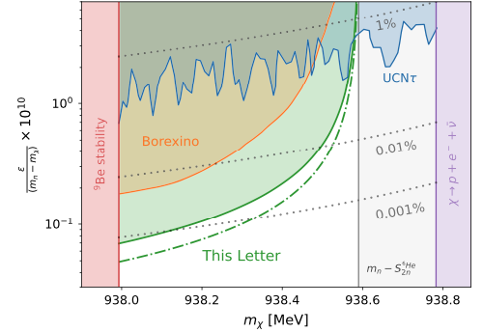
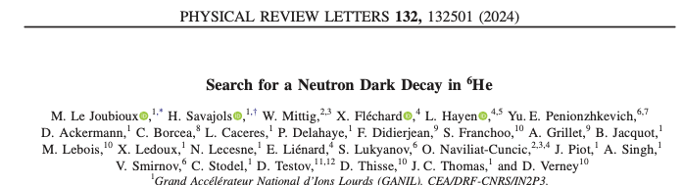
Intermezzo: dark decays
Fornal and Grinstein, PRL 120 (2018) 191801
Idea – inconsistencies in n decay due to small “n to X” branch ?
Free neutron or neutrons in n-halo nuclei
Recent impressive limits from ⁶He exp at GANIL
PR C97 (2018) 042501

Slide 9
What about beta-delayed p emission ?
A halo decay case: ¹¹Be
  Final state p + ¹⁰Be, focus here on its branching ratio
  A series of attempts to detect ¹⁰Be gave upper limit 2.2 10⁻⁶
  Positive identification of p in active target exp, 8.0 10⁻⁶
  As yet unpublished upper limit 2 10⁻⁶ with optical TPC
  Too many calculations to list – could have 1/2⁺ and 3/2⁺ levels nearby
  New observations of a near-threshold level
  A “core decay” case: ⁸B
    Expect a branching ratio of 2 10⁻⁸, current limit 2.6 10⁻⁵…
EPJ A (2020) 56:100
PRL 123 (2019) 082501
N. Skolowska et al
PRL 129 (2022) 012501; ibid 012502
J.Phys. G 40 (2013) 035109

Slide 10
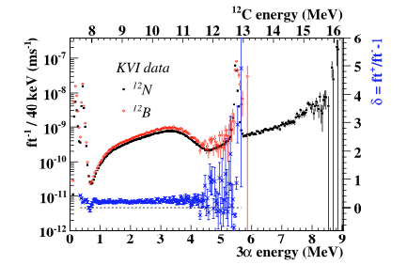
Continuum decays for ⁸B and ¹²N ?
⁸B decay about 10% slower than ⁸Li decay
¹²N decay also slower than ¹²B decay:
Evidence for decays to continuum ?
Wilkinson and Alburger, PRL 26 (1971) 1127
PL B 678 (2009) 459
NP A 940 (2015) 119

Slide 11
Proton halos – beta asymmetry as probe
Eur. Phys. J. A (2023) 59:35
First attempt, ¹⁷Ne (to 1st excited state ¹⁷F)
  Exp: first forbidden, twice that of ¹⁷N – Theory: radial extension/occupations ??
Second case, ²⁶P (to several states in ²⁶Si)
  Exp: varies (1st ex: 0.6 that of ²⁶Na) – Theory: shell model may give this, systematics ??
Third case, ²²Al* (²²Si into 1st 1⁺ state)
  Exp: 0.3 that of ²²F – Shell-model: due to too little d-wave (more s-wave) configuration…
Need more theory to obtain solid conclusions!
N. Michel et al., NP A 703 (2002) 202
D. Pérez-Loureiro et al., PR C 93 (2016) 064320
J. Lee et al., PRL 125 (2020) 192503

Slide 12
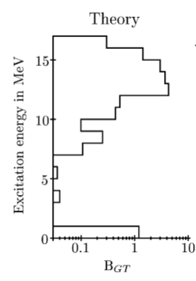
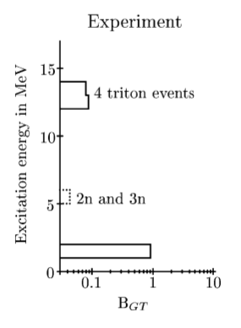
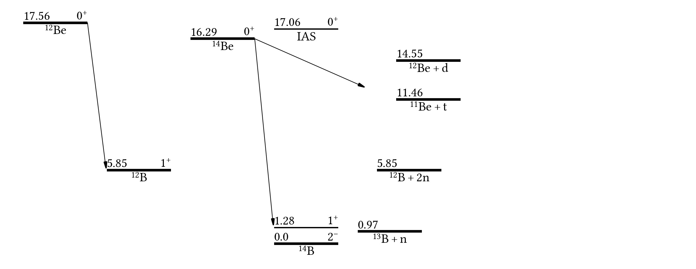
The puzzle of ¹⁴Be
Why so simple ? Only core decay ??
H. Jeppesen et al.,
N.P. A 709 (2002) 119

Slide 13
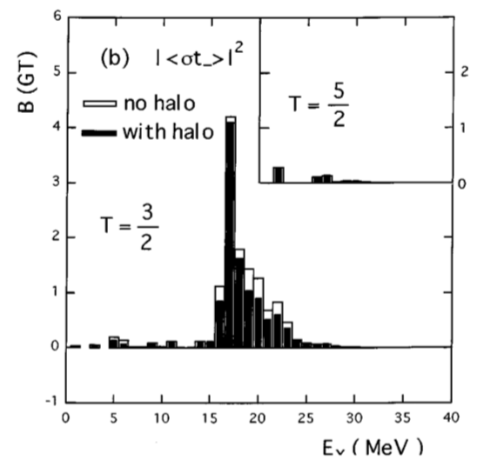
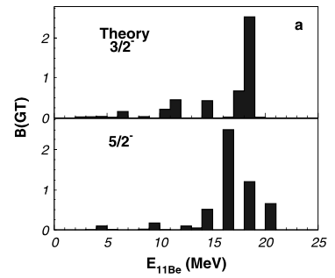
More detailed look at ¹¹Li
Clear halo state, complex decay, Q_{β} = 20.55 MeV
Branches (%): 1n - 86.3(9), 2n - 4.1(4), 3n - 1.9(2), α - 1.7(3), d+t - 10⁻²
Most experiments go up to 8-10 MeV, but do not agree internally
Shell model:
e.g. p_{1/2} to p_{3/2} feeding low-lying 1/2⁻
T. Suzuki, T. Otsuka
PR C56, 847
M. Madurga et al.,
PL B677, 255

Slide 14
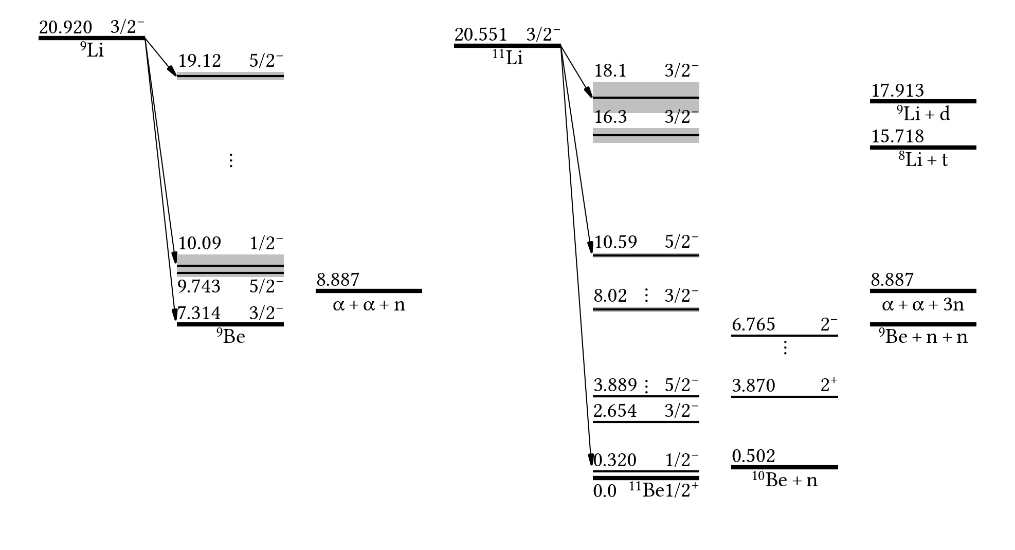
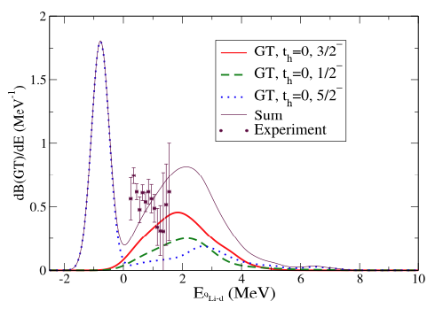
Three-body model with explicit isospin
Adjust core-n potentials to exp data
E. Garrido et al., Phys. Rev. C107 (2023) 014003
t_{h} = 1
IAS
AAS
⁹Be_{gs}
Theory GT strength
Quantum numbers as:
t_{h} = 0
Miss: core-decays to excited states
and p_{1/2} to p_{3/2}…

Slide 15
Not yet there: decay of hypernuclei
Expect hypertriton to be Lambda loosely bound to deuteron…
Many recent experiments (ALICE, STAR…)
  Lifetime – modified from free Lambda lifetime ?
  Binding energy – around 100-200 keV
  Weak decay branching ratios – few measurements…
“Classic” halo observables ?
  Electromagnetic response
  Interaction radius
C.A. Bertulani, Phys.Lett. B 837 (2023) 137639

Slide 16
Conclusions
Beta decays directly to continuum states occur for halos
  Clearly for beta-d decays, potentially more general
  Neutron halos: multi-particle continuum (difficult experiments)
Decay patterns may reflect the halo structure
Mirror asymmetry not yet quantitative indicator
Wanted: Theory that handles continuum and isospin correctly

Slide 17

Thanks to:
and the many students that have spent time in the group !
Theory colleagues (D.V. Fedorov, E. Garrido, A.S. Jensen…)
My Danish funders (NICE, DFF…)

Slide 18
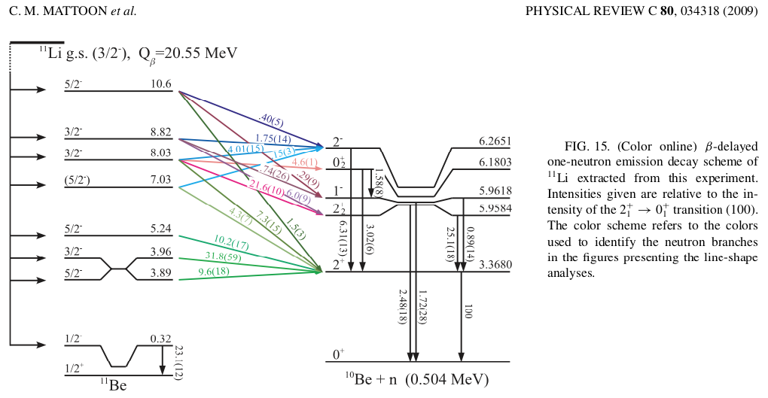
Decay scheme for ¹¹Li
Low E: 1n (+ γ) channel

Slide 19
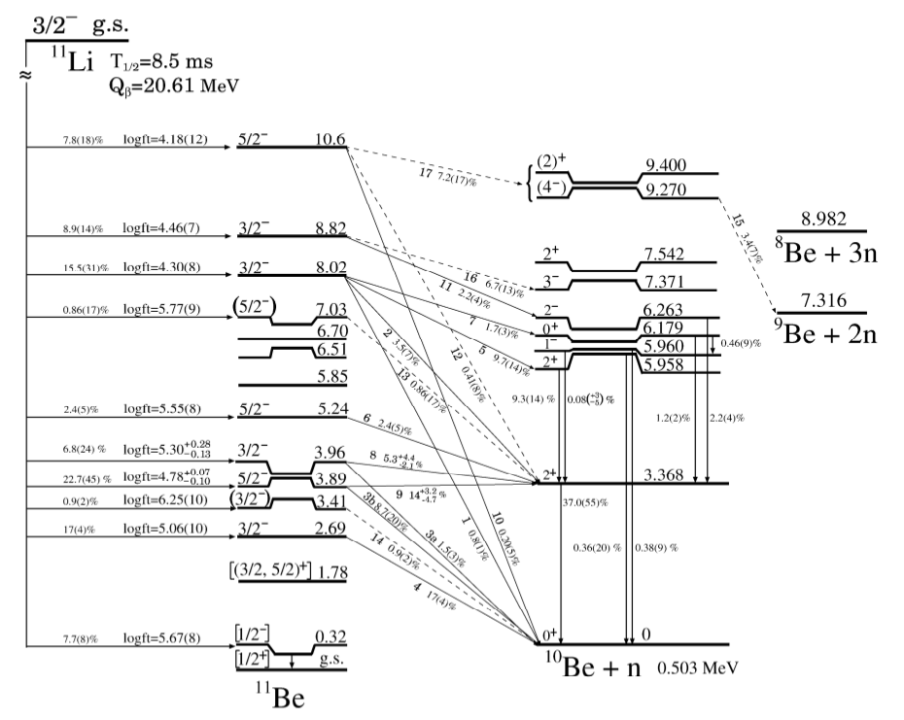
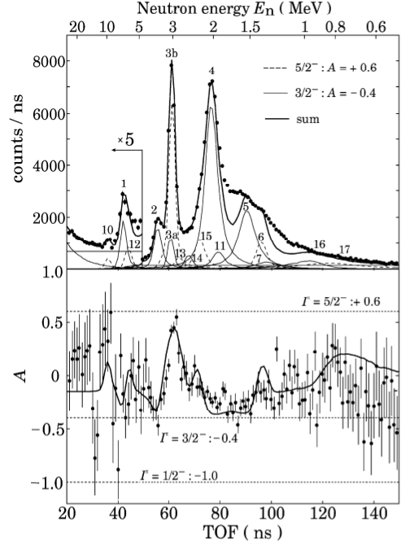
Y. Hirayama et al., Phys. Lett. B611 (2005) 239

Slide 20
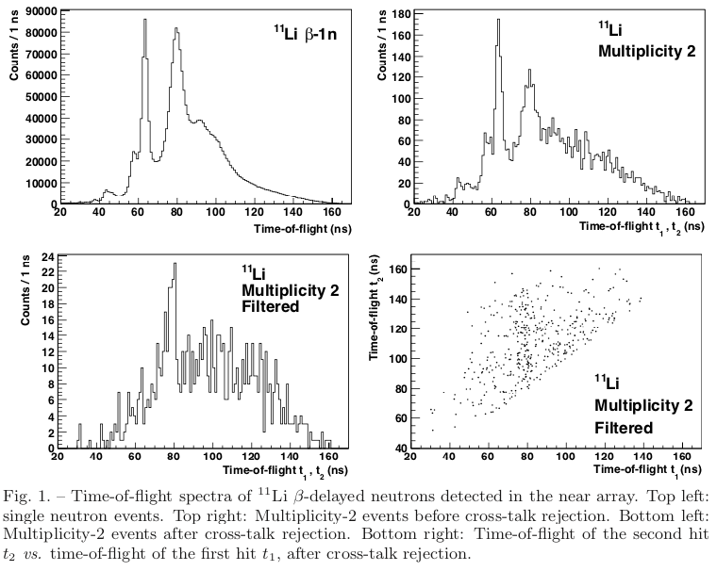
The beta-2n and -3n branches
P_{n} = Σ iP_{in}= 100.3(1.4) %
  P_{1n} = 86.3(9) %
  P_{2n} = 4.1(4) %
  P_{3n} = 1.9(2) %
  14% of n’s from 2n/3n
  Multiplicity 2: more 3n than 2n
IS525, Delauny et al
  arXiv:1906.04699
  Il Nuovo Cimento 42 C (2019) 98
2 MeV

Slide 21
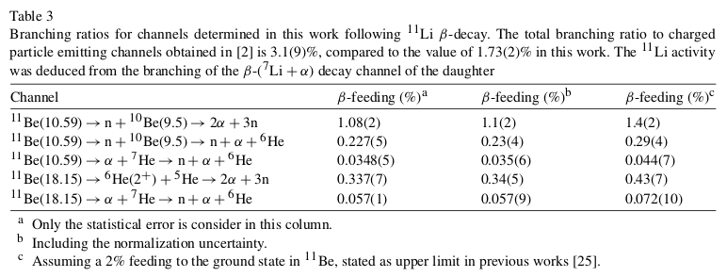
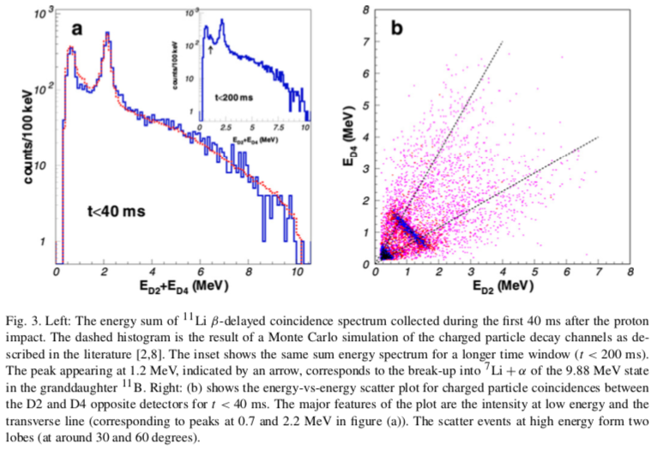
M. Madurga et al., Nucl. Phys. A810 (2008) 1

