Slide 1


The Electroweak Phase Transition and Standard Model Effective Field Theory
Rikard Enberg
Physics Days / Particle Days, Lund, 15 June 2022
Based on work with E. Camargo-Molina and J. Löfgren

Slide 2
The scalar potential = energy density of Higgs field
The minimum determines the ground state
of the Universe
But why does it look like that? With a negative mass term?
We need to probe the scalar potential further:
𝜆 is the only SM param we haven’t probed in expt
𝜇 is the only dimensionful parameter in the SM
𝜙 = neutral component
of Higgs doublet H

Slide 3
Probing the potential
Triple Higgs self-coupling
How to test?
Higgs pair production
Electroweak phase transition
New BSM physics will often affect the Higgs self-coupling and the scalar potential
New physics can be heavy or light… We will consider SMEFT
H
H
H

Slide 4
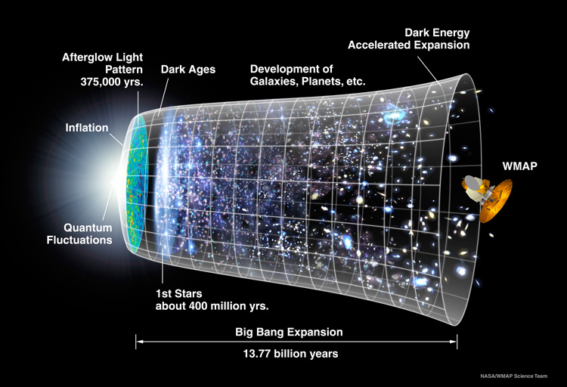

Before: SU(2)_{L}×U(1)_{Y}
symmetry, no Higgs field,
all particles massless
After: Only U(1)_{EM} symmetry, Higgs field nonzero, particles massive
Electroweak symmetry
broken when
T ∼ 100 GeV ~ 10¹⁵ K
t ~ 10 ps
After inflation, long before
nucleosynthesis and CMB

Slide 5
How did this electroweak phase transition occur?
There are different types of phase transitions:
First order: abrupt transition with release of latent heat
Second order: continuous transition, long range correlations, critical phenomena
Crossover: not a phase transition at all (?) according to orthodox definition. Very smooth transition.
We want to know what the EW phase transition was in our Universe!

Slide 6
First order phase transitions are great
They are abrupt, violent affairs with energy released in the form of bubble nucleation of the new phase
The bubbles expand, collide, create sound waves, turbulence
If the transition is ”strongly first order”…
the bubble dynamics can generate observable
gravitational waves (with space-based expts like LISA)
non-perturbative dynamics at the bubble walls can lead to electroweak baryogenesis

Slide 7
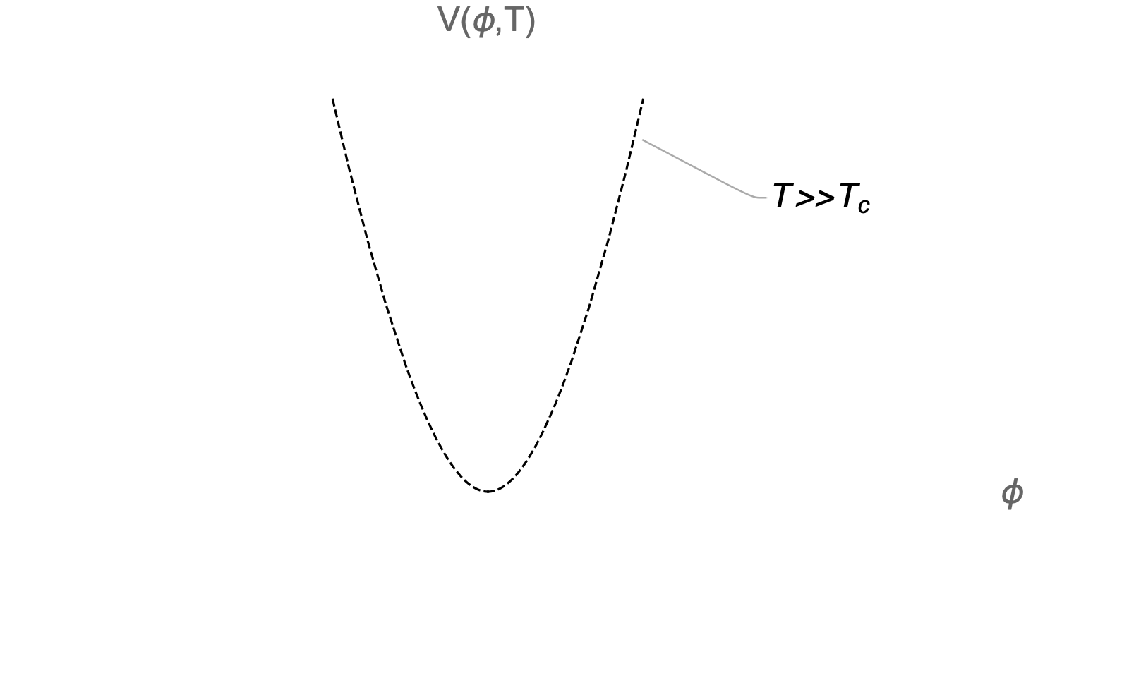
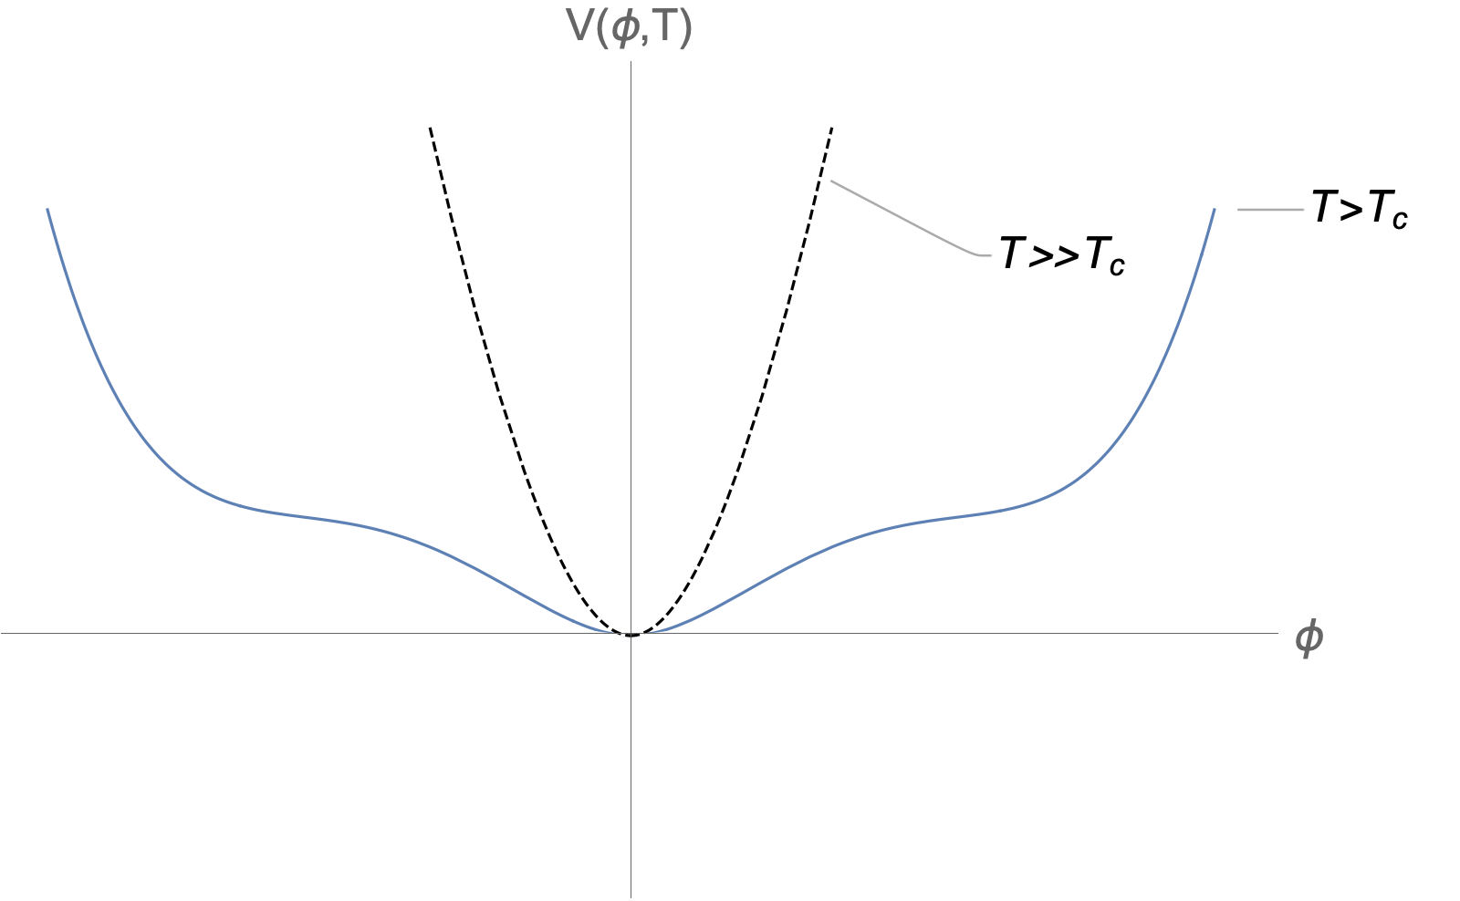
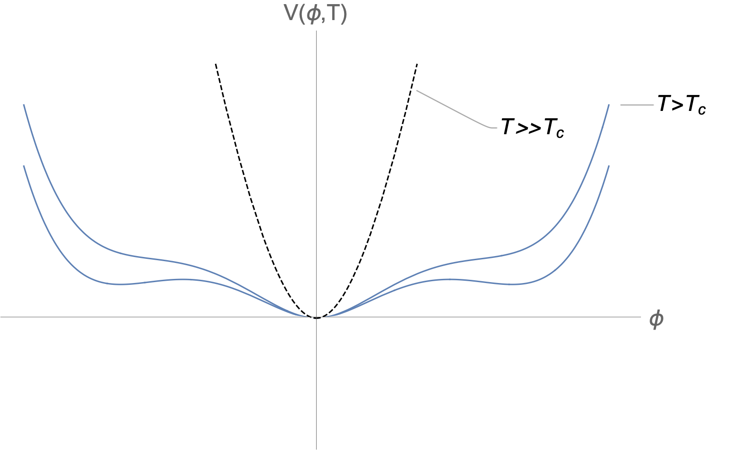
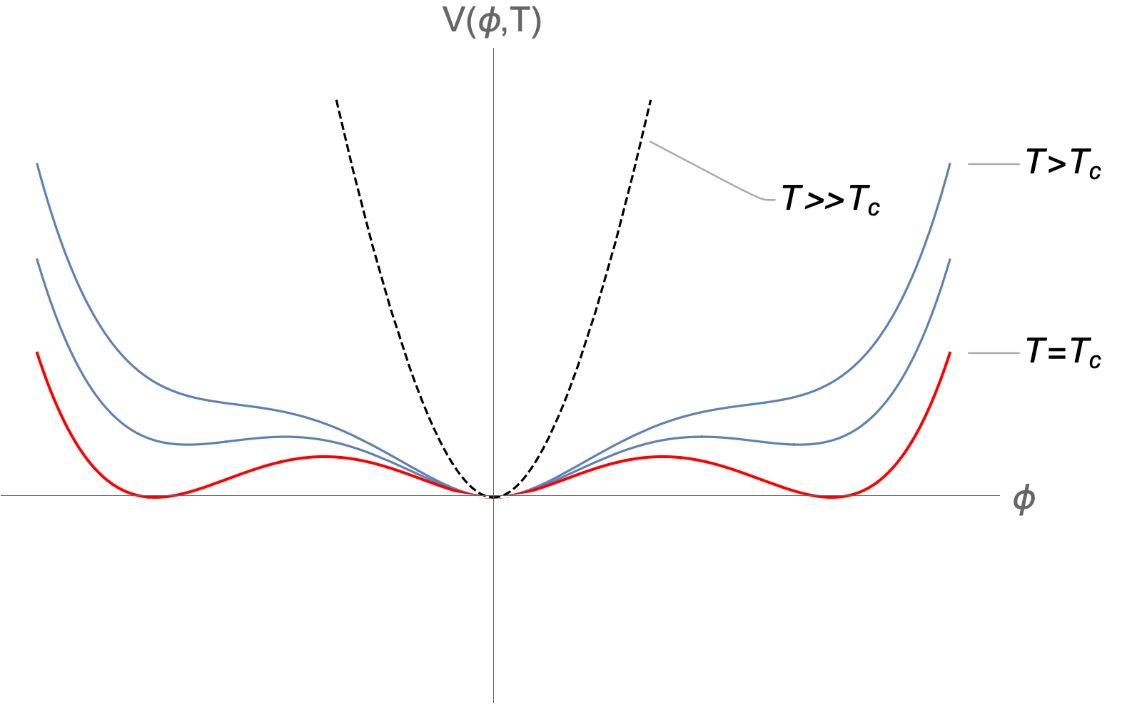
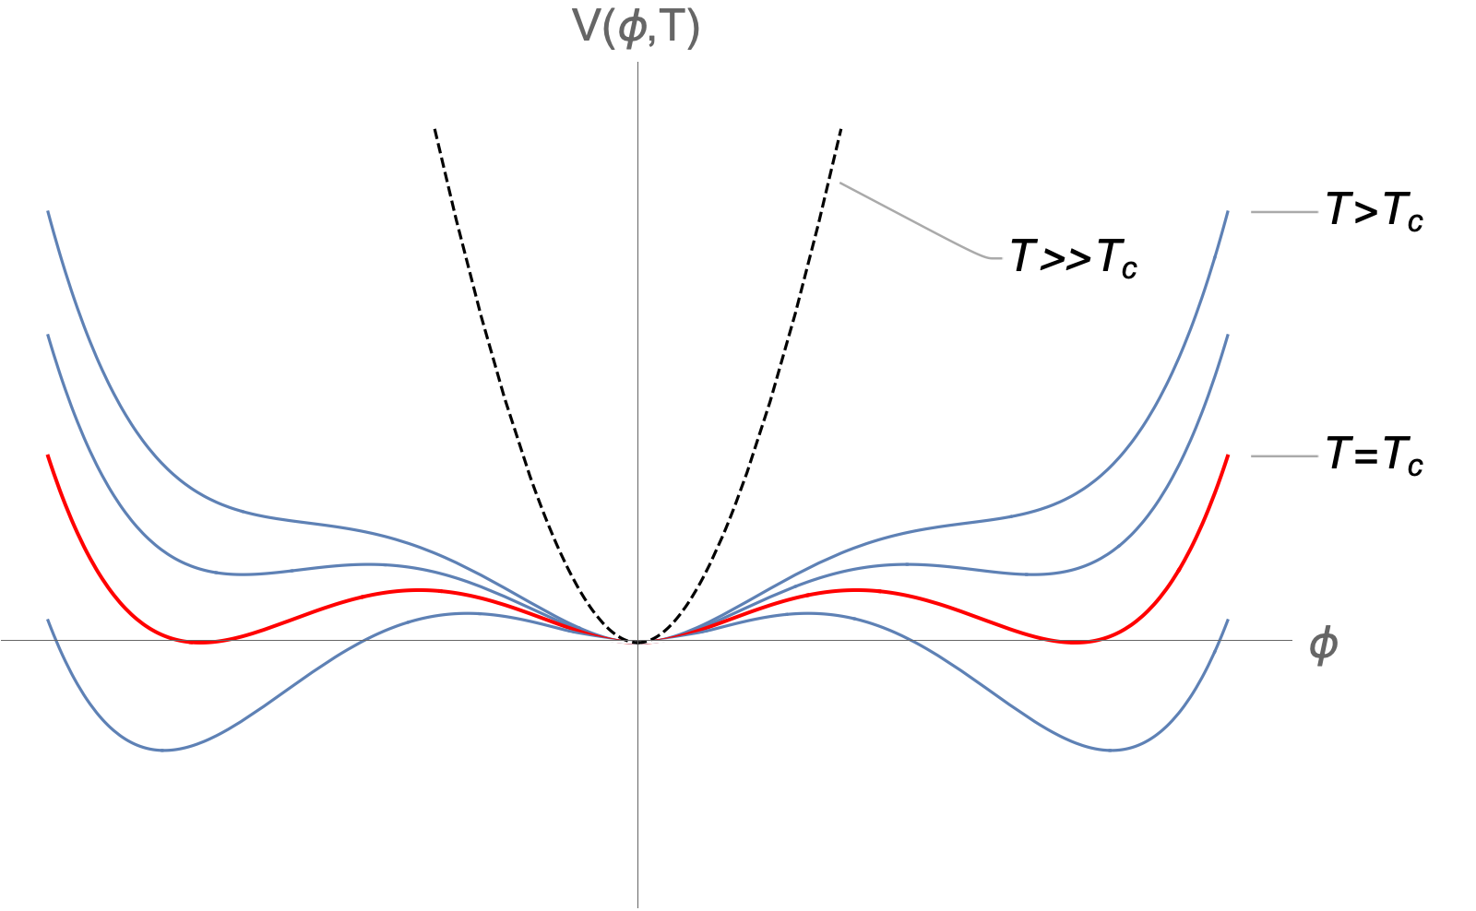
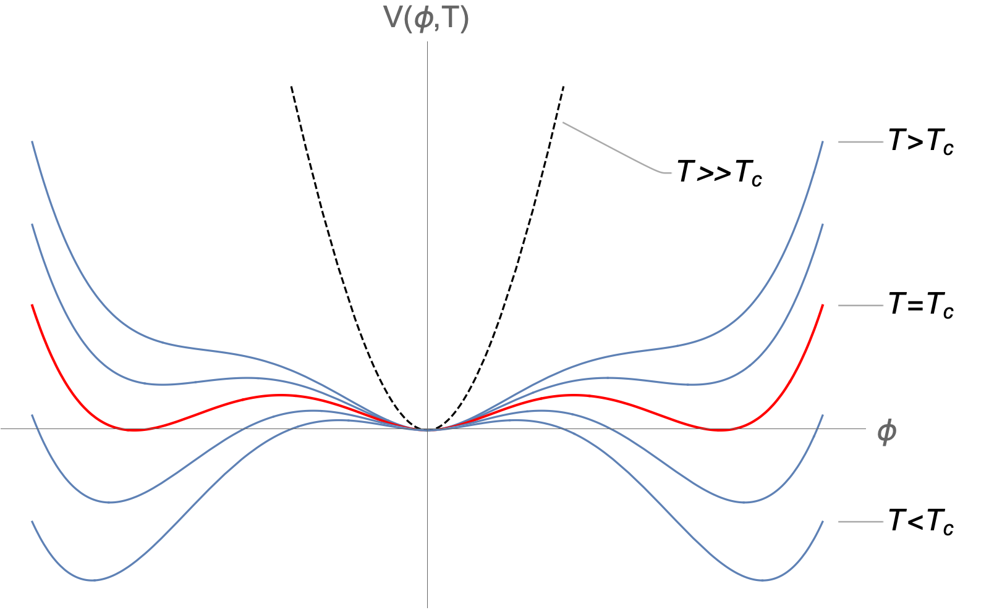
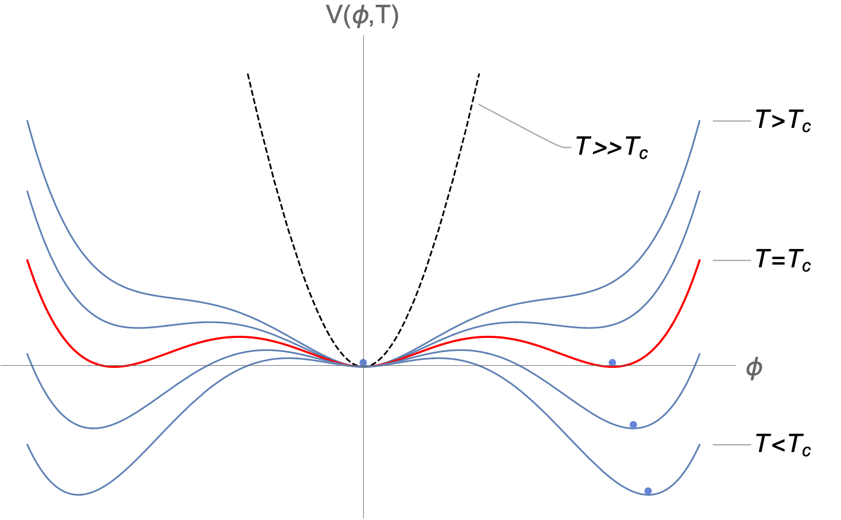
Free energy density = effective potential
The effective potential is equivalent to the free energy
and determines the ground state of the theory
The effective
potential V_{eff} (𝜙,T)
is the temperature-
dependent Higgs
potential with
higher order
corrections (e.g.
Coleman-Weinberg)
barrier

Slide 8
Order of phase transition depends on V_{eff}
A barrier means
tunneling to the
new ground state
→
abrupt, discontinous
1st order transition
with latent heat
No barrier
→
smooth, continuous
2nd order or crossover
1st order
transition
(order parameter
is discontinuous)
2nd order
transition
Plots adapted from E. Senaha, Symmetry 2020, 12(5), 733 (CC BY 4.0)

Slide 9
Electroweak phase diagram of the SM
Plot adapted from
Kajantie, Laine
Rummukainen,
Shaposhnikov
(1996 and 1998)
Critical point at
m_{H} = m_{Hc} = 72 GeV
T = T_{c} = 109 GeV
A first order phase transition is only possible if m_{H} < 72 GeV
– in our universe, it was a smooth crossover transition

Slide 10
So how do you get a barrier?
There is no barrier at T=0 so it must be created radiatively:
Gauge boson contributions at finite T give a cubic term:
…but is it large enough to give a substantial barrier?
or
?

Slide 11
Why does m_{H} determine the barrier?
In order to have a large barrier, the cubic term must be
about the same size as the quadratic and quartic terms:
Power counting (Arnold and Espinosa): we need scaling 𝜆∼e³,
which is not satisified in the SM: 𝜆 is ~5 times too large
The Higgs mass is given by m_{H}² = 2𝜆v²: we need smaller 𝜆
and thereby smaller m_{H} for a 1st order transition

Slide 12
Use higher dimension operators to do this!
Grojean, Servant, Wells (and others later) considered EWPT with dimension-6 operators
They took 𝜆<0 to get a barrier at tree-level with the 𝜙⁶ term providing the Mexican Hat-type potential
This does not work so well because it requires a rather small cutoff scale ~ 700 GeV
We will instead consider 𝜆>0 as in SM but small. This makes a 1st order EWPT possible with correct Higgs mass, because
we can get the right Higgs mass anyway

Slide 13
Standard Model Effective Field Theory (SMEFT)
Effective field theory with SM symmetries and dimension-6 operators built out of SM fields:
There are 59 such operators (with B and L conservation) but the ones relevant for the Higgs sector are
2

Slide 14
Phase transition in the SMEFT
SMEFT at T=0:
but power-counting at high T → dimension-6 term does not influence the phase transition!
Thus we can use the same EWPT calculation as in the SM*
but for smaller 𝜆! However:
* 𝜇_{eff} gets a contribution from SMEFT Wilson coefficients

Slide 15
The scan and the results
For small 𝜆 we can get
a strong 1st order PT
(The 1/ 𝜆 dependence
comes from the power
counting in the potential)
𝜆~0.023
(SM value 0.26)
Camargo-Molina, RE, Löfgren, JHEP 10 (2021) 127, arXiv:2103.14022

Slide 16
Scan over Wilson coefficients: 𝞚~1 TeV
The best fit to data is a point with
a strongly 1st order phase transition
The fit uses the codes smelli, flavio and wilson
(Aebischer, Kumar, Stangl, Straub)
Camargo-Molina, RE, Löfgren, JHEP 10 (2021) 127, arXiv:2103.14022

Slide 17
W mass!
In fact the fit gives a better fit to
the W mass than the SM, because
it predicts a slightly larger m_{W}
The Wilson coefficients relax
some of the parameter relations
in the Standard Model

Slide 18
Higgs pair production in SMEFT
These exist in the SM but are
modified in SMEFT by dim-6
operators, including a new
p-dependence. But roughly
These are new diagrams
that can modify the rate
and the kinematical
dependence of the cross
section

Slide 19
Next steps
Investigate Higgs pair production in this small 𝜆 scenario
Part of SHIFT activities; see related talks by Christina Dimitriadi and Elin Bergeås Kuutmann
Gravitational waves?
Best way: dimensional reduction, see next talk by Andreas Ekstedt
Electroweak baryogenesis?
Need to include CP-violation: more operators

