Slide 1





The SHIFT project:
status and prospects
Elin Bergeås Kuutmann
on behalf of the SHIFT project
SHIFT (Solving the Higgs Fine-tuning problem with Top partners)
Funded by the Knut & Alice Wallenberg foundation 2018 – June 2023
news.com.au

Slide 2
People
Faculty:
Elin Bergeås Kuutmann, Uppsala University (experiment)
Rikard Enberg, Uppsala University (theory)
Gabriele Ferretti, Chalmers University (theory)
David Milstead, Stockholm University (experiment)
Jörgen Sjölin, Stockholm University (experiment)
Sara Strandberg, Stockholm University (experiment, PI)
Researchers/postdocs:
Avik Banerjee (Chalmers), Laura Barranco Navarro (SU), Diogo Buarque Franzosi (Chalmers, SU), Venugopal Ellajosyula (UU), Karl Gellerstedt (SU), Xuanhong Lou (SU), Luca Panizzi (UU), Stefan Richter (SU), Antonia Strübig (SU)
PhD students:
Yosse Andrean (SU), Filip Backman (SU), Dongwon Kim (SU), Thomas Mathisen (UU), Patrawan Pasuwan (SU), Laura Pereira Sanchez (SU), Ellen Riefel (SU)
International collaborators:
Juan Antonio Aguilar-Saavedra (U Granada, IFT Madrid), Andy Buckley (U Glasgow), Christoph Englert (U Glasgow), James Ferrando (DESY), Roberto Franceschini ("Roma Tre"), Fabio Maltoni (Louvain, CP3), David Shih (Rutgers U), Michael Spannowsky (Durham U), Riccardo Torre (INFN, Genova)
Other affiliated people:
Faculty / PIs
Rachid Benbrik (Cadi Ayyad University, Marrakech), Christophe Clément (SU), Stefano Moretti (Southampton University/UU), Christian Ohm (KTH),
Researchers / postdocs
Eliel Camargo-Molina (UU), Alexander Leopold (KTH), Harri Waltari (UU)
PhD students
Tom Ingebretsen Carlson (SU), Johan Löfgren (UU)
Master students
Simon Johansson Nyberg (UU)

Slide 3
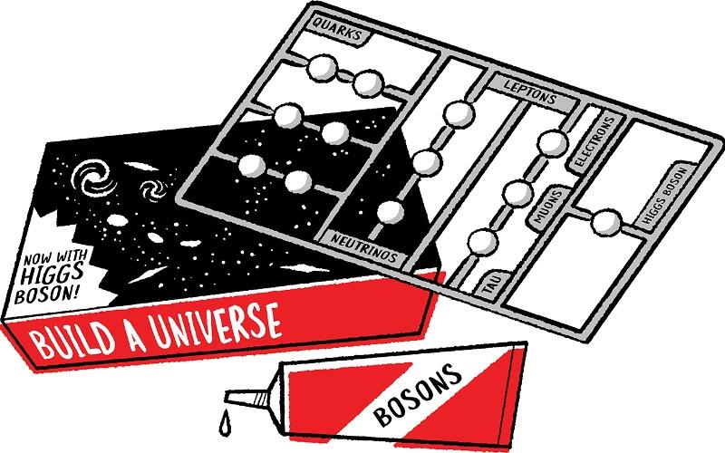
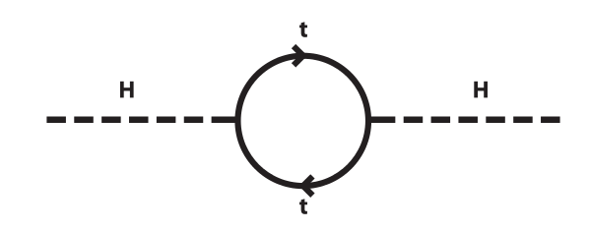
Scientific motivation
The Higgs mechanism generates the masses of the elementary particles.
Manifest in the Higgs boson
==> See Sara Strandberg's talk about the discovery, tomorrow afternoon
Higgs potential:
μ is the only SM parameter with dimension mass.
hierarchy
μ (and the Higgs boson mass) is sensitive to quantum loop corrections O(10¹⁹ GeV)
especially from the top quark
This needs fine-tuning
It is very very unlikely that μ has the value observed.
Is this a problem?
$V=−μ^{2}ϕ^{\text{†}}ϕ+λ\left(ϕ^{\text{†}}ϕ\right)$
Image from iop.org
$μ^{2}≪M_{Planck}^{2}$
$μ^{2}=\frac{m_{H}^{2}}{2}, Δm_{H}^{2}=\frac{−λ_{f}}{8π}\left[Λ_{UV}^{2}+...\right]$

Slide 4

Scientific motivation (2)
Why is this a problem?
We like to understand why things are as they are.
Solving the Higgs fine-tuning problem:
- Declare it not to be a problem (not us...)
- Say that there must be more physics which can explain this
SHIFT: Solving the Higgs Fine-turning problem with Top partners
Our tracks:
- SUSY
- Compositeness
- Indirect searches
(T. Hudson Creative Commons BY-SA 3.0 )

Slide 5
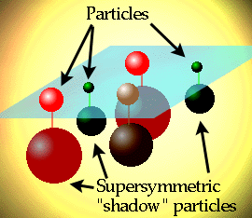
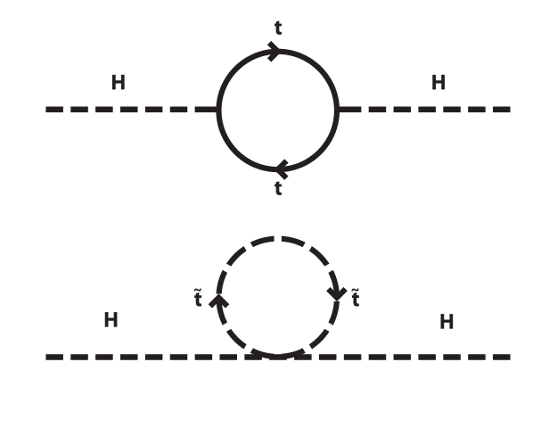
Solution 1: Supersymetry (SUSY)
Image: atlas.ch
Extend the SM with supersymmetry (SUSY)
For each SM boson: a bosino
For each SM fermion: a sfermion
==> for each top quark t: a stop
Top loop corrections and
stop loop corrections cancel
(almost).
The stop particle must have a mass of
≤ 1.4 TeV
==> detectable at the LHC!
$\tilde{t}$
h⁰
h⁰
h⁰
h⁰

Slide 6
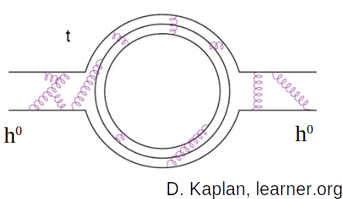
Solution 2: A composite Higgs boson?
Maybe h⁰ is not elementary but a pseudo-Nambu-
Goldstone boson (pNGB).
Higgs mass protected!
Can we detect this experimentally?
Many scenarios with a composite Higgs also include vector-like quarks (VLQ), especially vector-like tops, top partners.
What are VLQs?
  carry colour charge
  spin 1/2
  their right and left components have the same quantum numbers (“vector-like”, i.e. not chiral).
Typical mass: ~ 1 TeV (LHC!)
These models typically also come with new scalars, S.
h⁰
h⁰

Slide 7
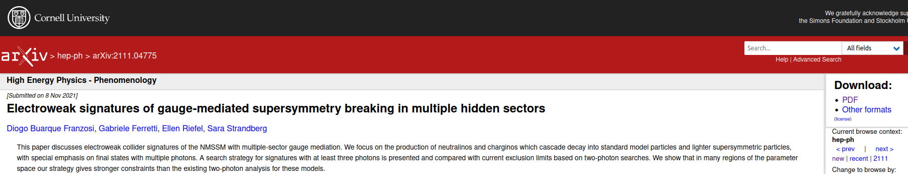
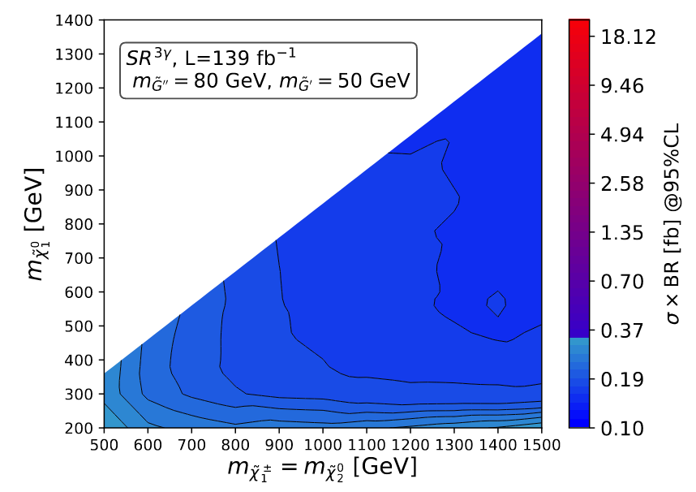
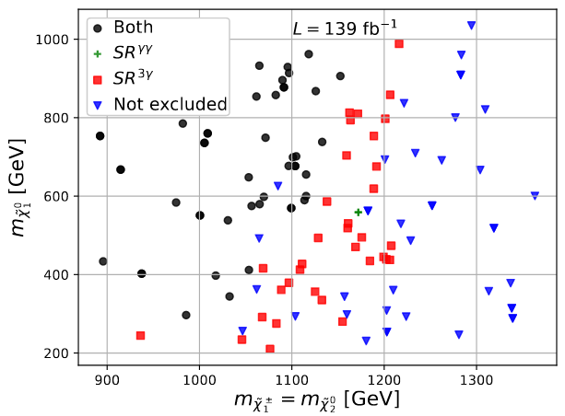
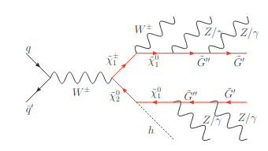
SUSY: Phenomenological studies
arXiv: 2111.04775
EW production of charginos and neutralinos cascading into SM particles and lighter SUSY particles
These models give unexplored experimental signatures with multiple gauge bosons
Search for events with three photons is proposed and found to perform better than existing two-photon searches.
Expected limits on σ_{prod}xBR are derived and
exclusion tests are carried out

Slide 8
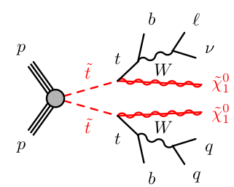
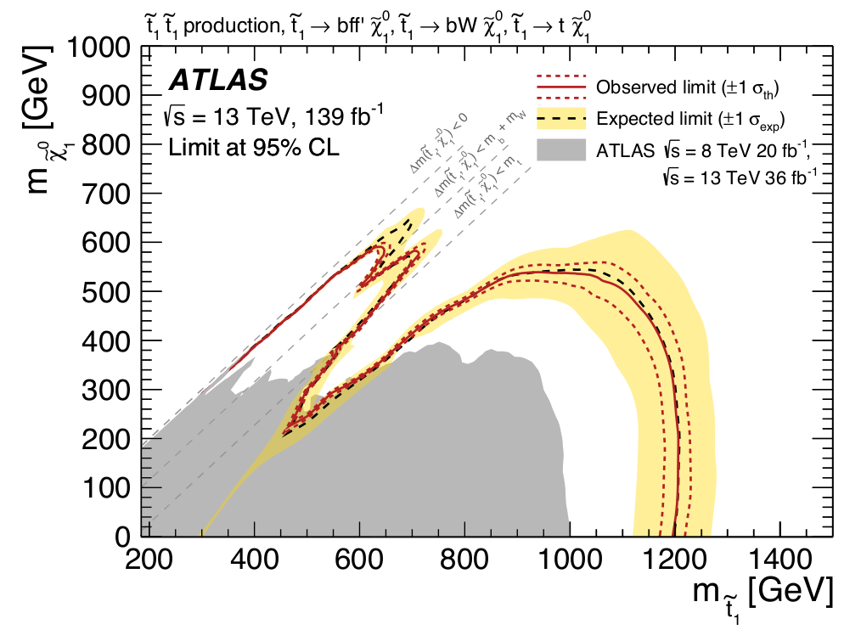
SUSY: Experimental searches 1: direct stop pair production
Y. Andrean, L. Barranco Navarro, C. Clément, P. Pasuwan, L. Pereira, S. Strandberg, A. Strübig
JHEP 04 (2021) 174
Next step: take the signal regions developed in the simplified model search into a grand pMSSM scan.
No public result at the moment. Similar study from Run 1: arXiv:1508.06608

Slide 9
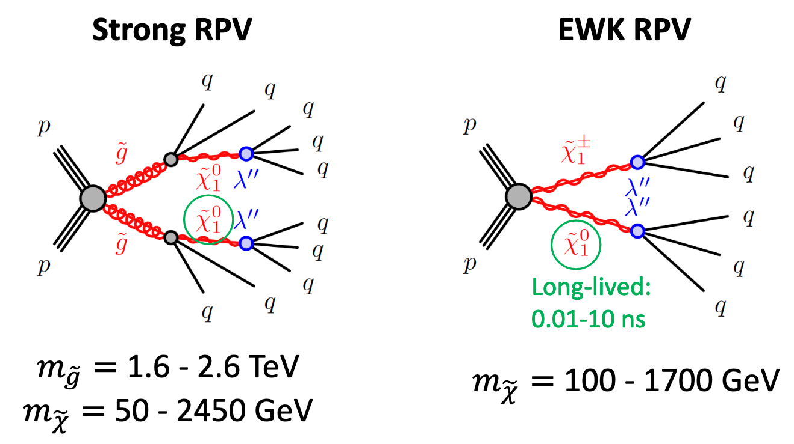
Experimental SUSY 2
R-parity violating SUSY: Displaced vertices in multijet events
F. Backman, S. Richter, D. Milstead (SU)
as part of KTH/SU effort with C. Ohm, A. Leopold, G. Ripellino (KTH)
DV+ Jets
Benchmark models: Strong RPV & EWK
There are no SM interactions that can mimic the signature
ATLAS paper in preparation
More details in F. Backman's presentation earlier today,
C. Ohm's presentation earlier today,
G. Ripellino's PhD thesis.
1

Slide 10
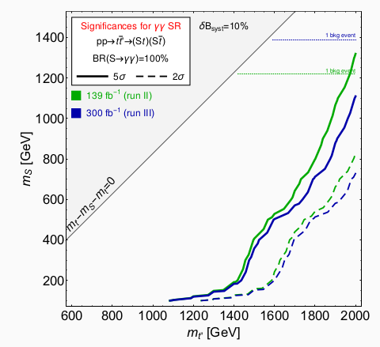
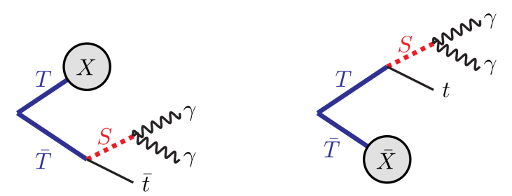
Composite Higgs: Experimental searches
SHIFT participants: E. Bergeås Kuutmann, V. Ellajosyula, T. Mathisen, L. Panizzi (STA)
ATLAS and CMS have searched for VLQs, but only decaying into SM particles.
In compositeness (and other BSM theories), we get pNGBs as scalars S, which can occur in the decay chain
If so, the stated limits could be wrong!
Phenomenological study for prospects in Run 2 and Run 3 evaluated in JHEP05(2020)028 (1907.05929), a SHIFT phenomenology paper
Search for pairs of top-like VLQ (T)
Decay signature: 2 photons, one b-jet + lots of energy.
The only VLQ -> BSM analysis in ATLAS!
Plots from JHEP05(2020)028
$T\bar{T}→St+X, S→γγ$

Slide 11
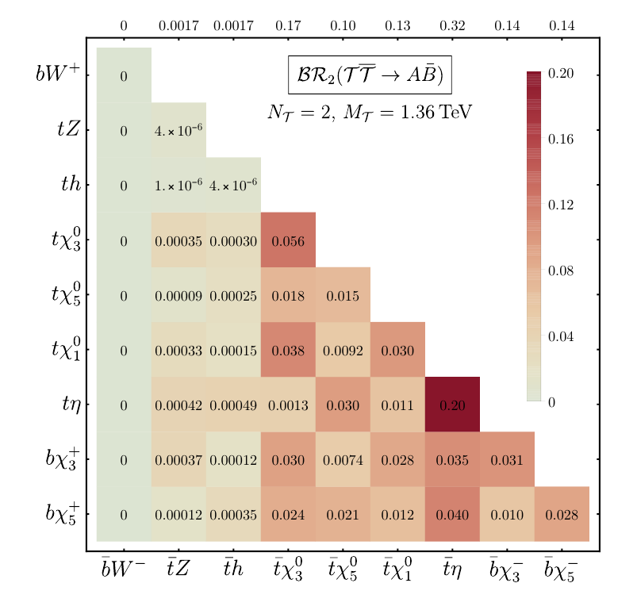
Vector-like quarks in composite Higgs models
arXiv: 2202.00037 A Banerjee, D B Franzosi, G Ferretti
VLQs in SU(5)/SO(5) model can have significant BRs to the new scalars and 3rd gen quark, compared to the SM channels. Amongst the most promising signatures at the LHC are final states containing a diphoton resonance along with a top quark.
Systematic construction of the general low energy Lagrangian to study the phenomenology of VLQs and pNGBs.
Emphasis on the specific pattern in the VLQ spectrum arising in this class of models, especially focusing on the presence of nearly degenerate states.

Slide 12
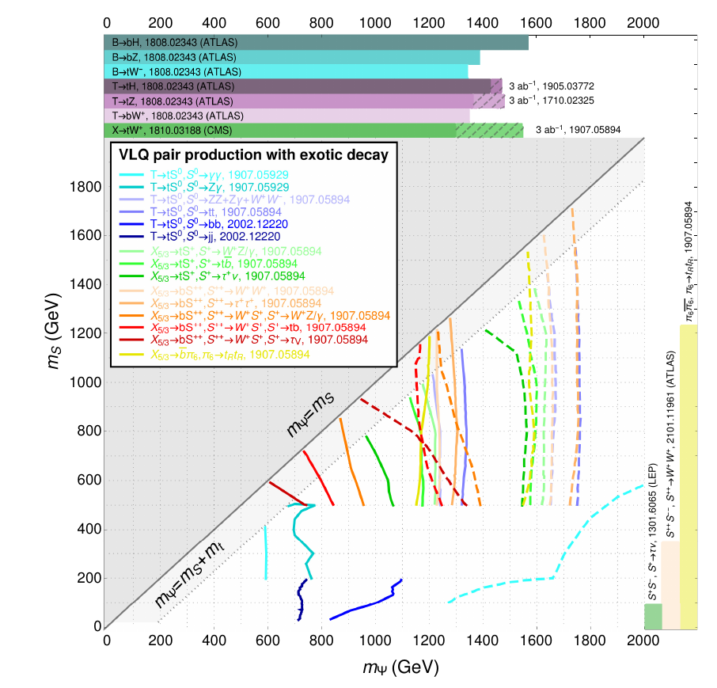
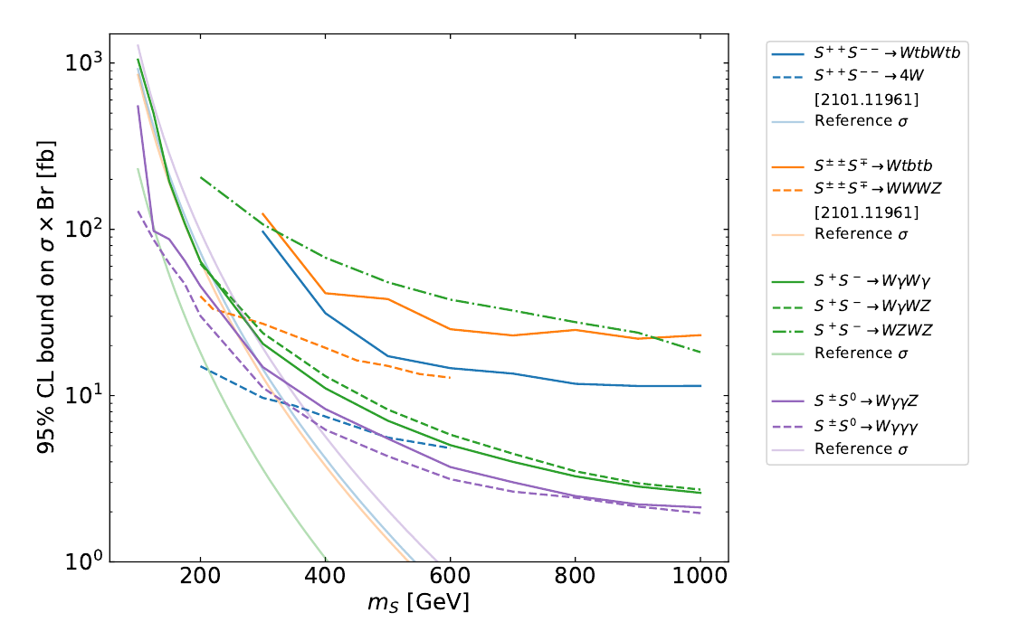
Compositeness phenomenology 2:
Snowmass contribution
arXiv: 2203.07270 SHIFT contribution: A Banerjee, D B Franzosi, G Ferretti, L Panizzi
Summary plots of exclusion limits for pNGBs and VLQs using currently available information.
Also describes a general parametrisation implemented in a software for Monte Carlo simulations and study the SU(5) / SO(5) scenario as a concrete example.

Slide 13
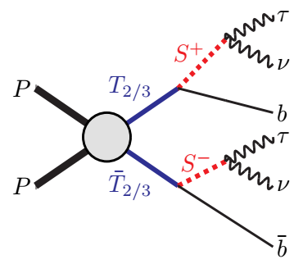
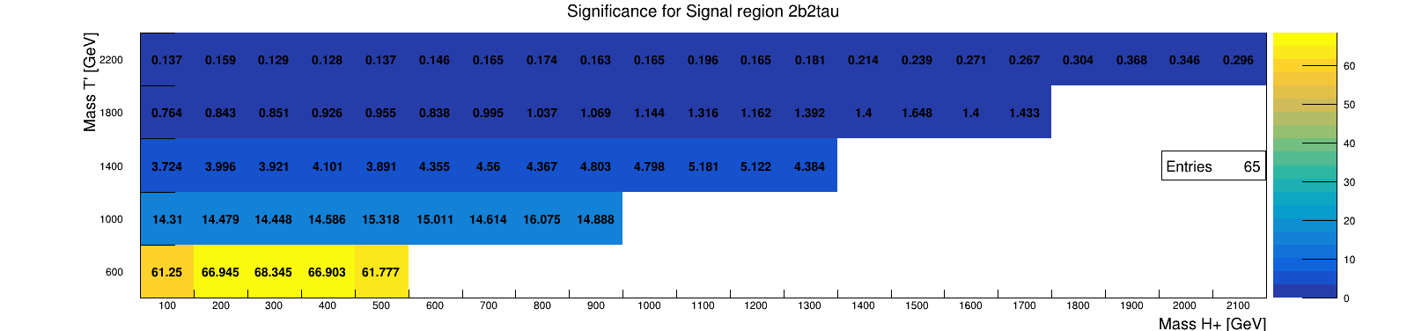
Compositeness phenomenology 3:
Vector-like tops decaying to S⁺b
R. Benbrik, EBK, V. Ellajosyula, S. Moretti, L. Panizzi, S. Johansson Nyberg
Previous pheno study to estimate sensitivity for T→ S⁰t
(JHEP05(2020)028 (1907.05929), the SHIFT phenomenology paper )
Newer possibilities include T→S⁺b
T as a part of a doublet (T B) in models such as 2HDM+VLQ gives significant branching into S⁺b, and S⁺ can further decay into τν
Pheno analysis
performed by MSc
student, Simon
Johansson Nyberg

Slide 14
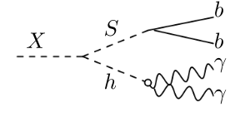
Search for signature of an extended Higgs sector
Y. Andrean, C. Clement, L. Pereira, S. Strandberg
The extension gives out multiple extra scalar particles.
Here focus on asymmetric decay of X->SH
where X (S) is a heavier (lighter) scalar.
First in ATLAS for search of this model.
See talk by Y. Andrean earlier today, link.

Slide 15
Di-Higgs EFT & top partner models
T. Carlson, L. Pereira, J. Sjölin, S. Strandberg:
Effective field theory interpretations of HH events in the ATLAS detector using event reweighting.
Includes combination of decay channels.
For examples of public results see e.g. ATL-PHYS-PUB-2022-019
(also C. Dimitriadi, A. Ferrari, S. Ördek (UU))
See C. Dimitriadi's presentation earlier today.
HH decay to bb𝜏𝜏
S. Moretti, L. Panizzi, J. Sjölin, H. Waltari: Simplified top partner models in HH events at LHC.
The simplified models are matched to UV model benchmark points.
MSSM. Right-handed stop at 600 GeV, nearly degenerate with the LSP. Left-handed stop beyond the reach of current experiments - large stop mixing.

Slide 16
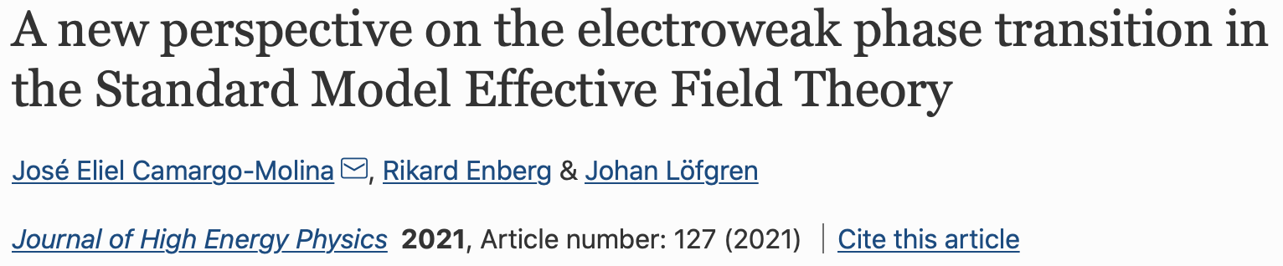
Indirect searches
Maybe the top partners exist but are beyond the reach of the LHC
Electroweak phase transition in the SMEFT
E. Camargo-Molina, R. Enberg, J. Löfgren
See separate talk by R. Enberg earlier today.
The aim is to connect electroweak symmetry breaking and the Higgs sector to early-universe cosmology and ultimately to Higgs pair production and gravitational waves.
J. High Energ. Phys. 2021, 127 (2021)

Slide 17
Indirect searches (cont.)
L. Barranco Navarro, D. Kim, J. Sjölin:
Constraining top-Z couplings in ttWj events.
The ttWj channel provides constraints to break degeneracies among top-Z related EFT operators derived from direct ttZ measurements.
Blinded data analysis Nabila Ahlgren’s PhD thesis (2020), unblinding of the data on-going.
Analysis inspired by arXiv:1511.03674.
K. Gellerstedt, J. Sjölin:
Use of Fourier methods for estimating continiuous probability densities to analyze events in higher dimensions.
See arXiv:2202.13801 for more information.

Slide 18
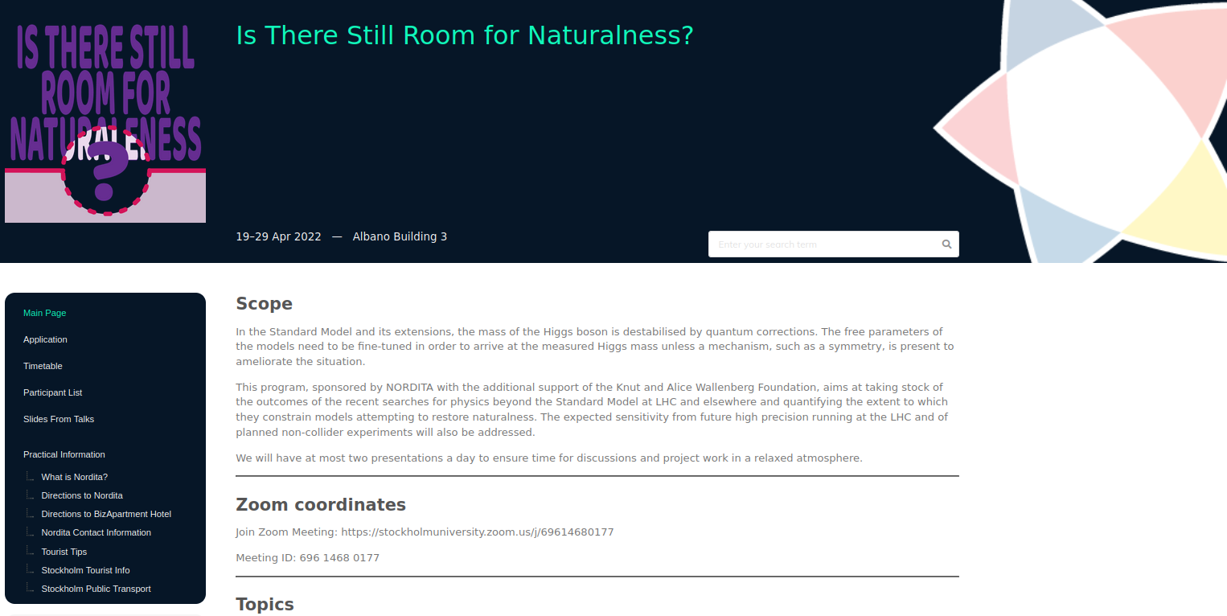

The NORDITA workshop nordita.org/events/naturalness2022
Orignially planned for April 2020 .... but Covid
then April 2021 ... but Covid
then October 2021 ... but Covid
then April 2022 ... and we could meet!
2 weeks, 2 talks per day, rest of the time was discussion time.
Theorists and experimentalists met.
Is There Still Room for Naturalness?
Yes

Slide 19
The NORDITA workshop
Scientific talks:
E. Camargo-Molina: The EWPT and musings about the scale of new physics
J. Wells: Unnatural theories and their untenable conspiracies of numbers
C. Hays: The CDF W mass measurement
A. Juste: Probing the composite nature of the Higgs boson at the LHC
B. Liu: Non-natural signatures in the pursuit of naturalness
S. Cooperstein: Rare Higgs Boson Decays and Searches for BSM Signatures within the Higgs Sector
S. Moretti: A Composite 2HDM
N. Craig: 22 Solutions to the Hierarchy Problem
C. Vázquez Sierra: Looking forward to Naturalness: results and prospects for low-mass searches in the forward region at the LHC
S. Bruggisser: An Answer from the SMEFT
W. Porod: LHC bounds on composite Higgs models, implications for naturalness
G. Dvali: Naturalness and new physics
R. Torre: The legacy of HL-LHC for the high energy precision program
K. Agashe: Collider Physics Opportunities of Extended Warped Extra-dimensional Models
A. Banerjee: Chasing the Higgs shape at LHC
A. Wulzer: Muon colliders
Only 19 left

Slide 20
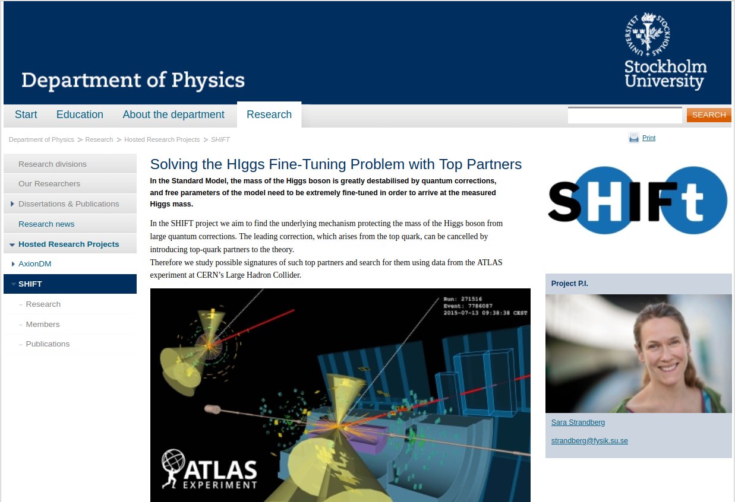
Summary and prospects
Project ends 30 June 2023 (prolonged 6 months b/c Covid)
Many articles in the pipeline, lots of new results and insights
Even after this project, we are not done with compositeness, SUSY and indirect searches at the LHC
Di-Higgs studies another path
Visit our page at SU:
https://www.fysik.su.se/english/research/hosted-research-projects/shift

