Slide 1



The ESS neutrino Super Beam ESSnuSB and ESSnuSB+
A report on
The achievements of the ESSnuSB Design Study 2018-2022
and on
The preparations for a ESSnuSB+ INFRADEV-1 EU project 2023-2026
Tord Ekelöf
Uppsala university

Slide 2
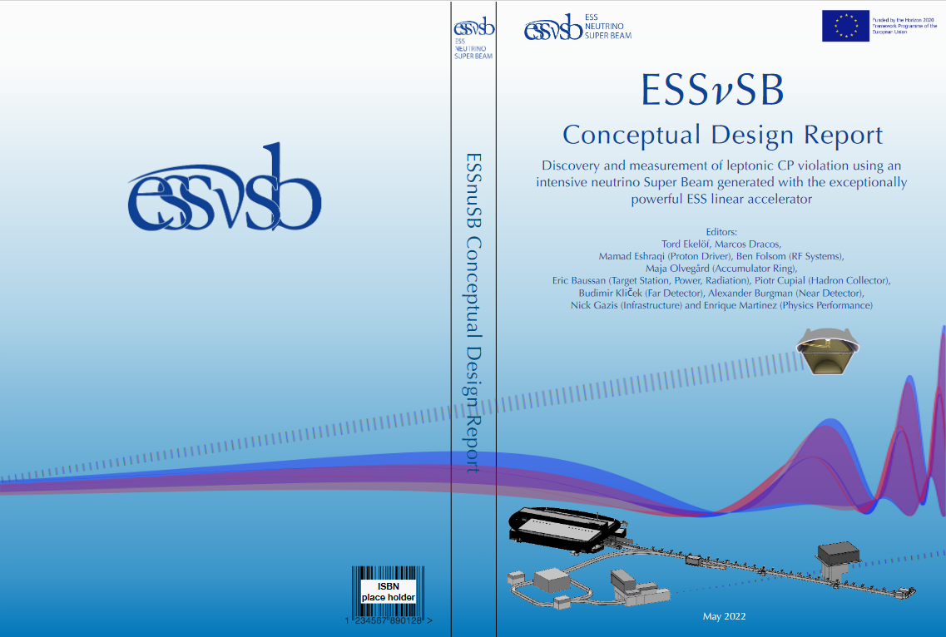
ESSνSB Conceptual Design Report
Publicly available at
https://arxiv.org/abs/2206.01208
Submitted on 6 June 2022
for publication in
European Physical Journal
The European Spallation Source neutrino Super Beam
White Paper submitted to the Snowmass 15 March 2022
USA Particle Physics Community Planning Exercise
Publicly available at arXiv:2203.08803v1
https://arxiv.org/abs/2203.08803

Slide 3
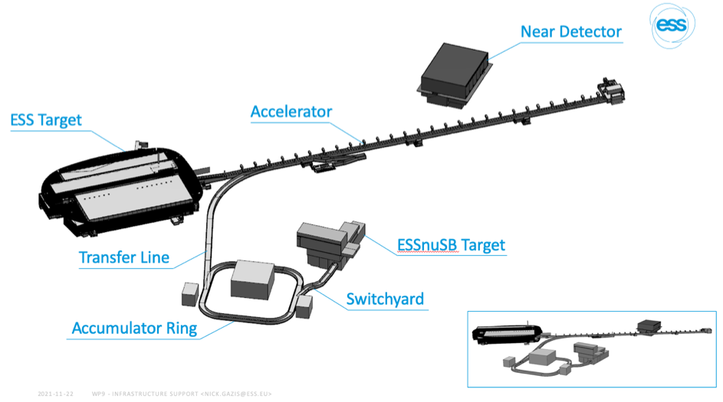
ESSnuSB lay-out atthe ESS site in Lund , Sweden

Slide 4
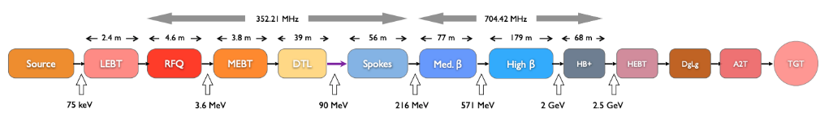
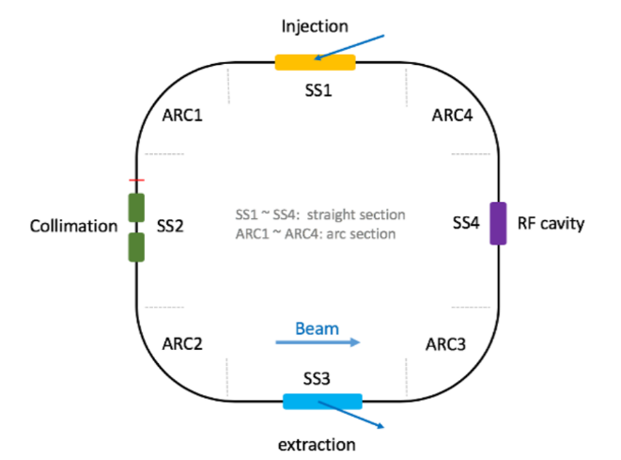
The ESS linac, the accumulator and the switchyard
Currently being tested at FREIA in Uppsala
ESSnuSB addition
5 MW H⁻ beam
H⁻
p
ESSnuSB addition
The linac
Normalconducting part
Superconducting part
ESSnuSB lay-out
The Accumulator
The Switchyard

Slide 5
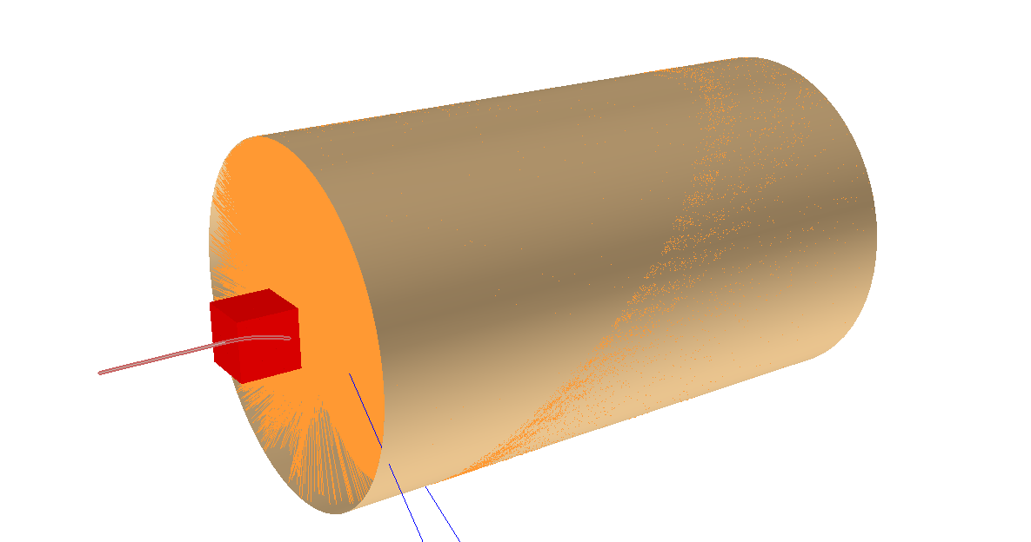
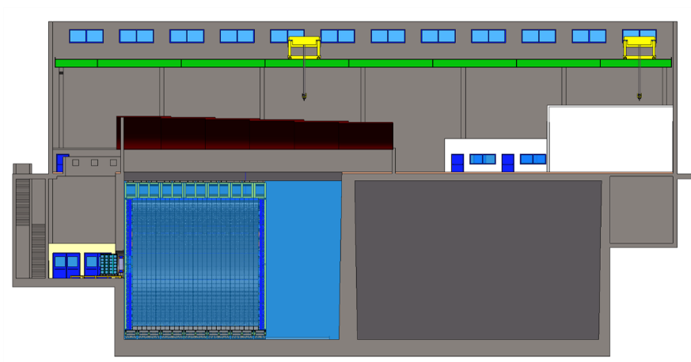
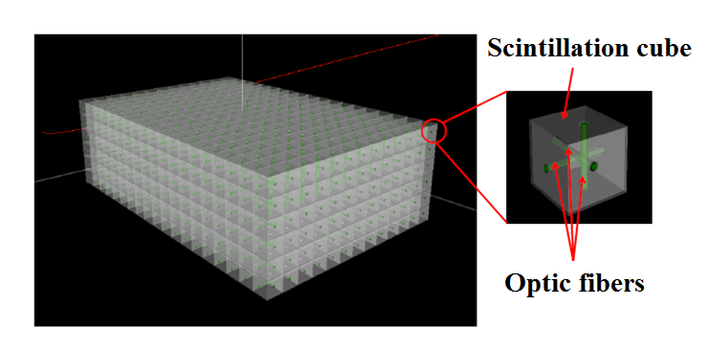
The target station and the near detector
Target underground station
The water Cherenkov near detector and the sFGD
The underground near detector hall
The super Fine-Grained Detector sFDG

Slide 6
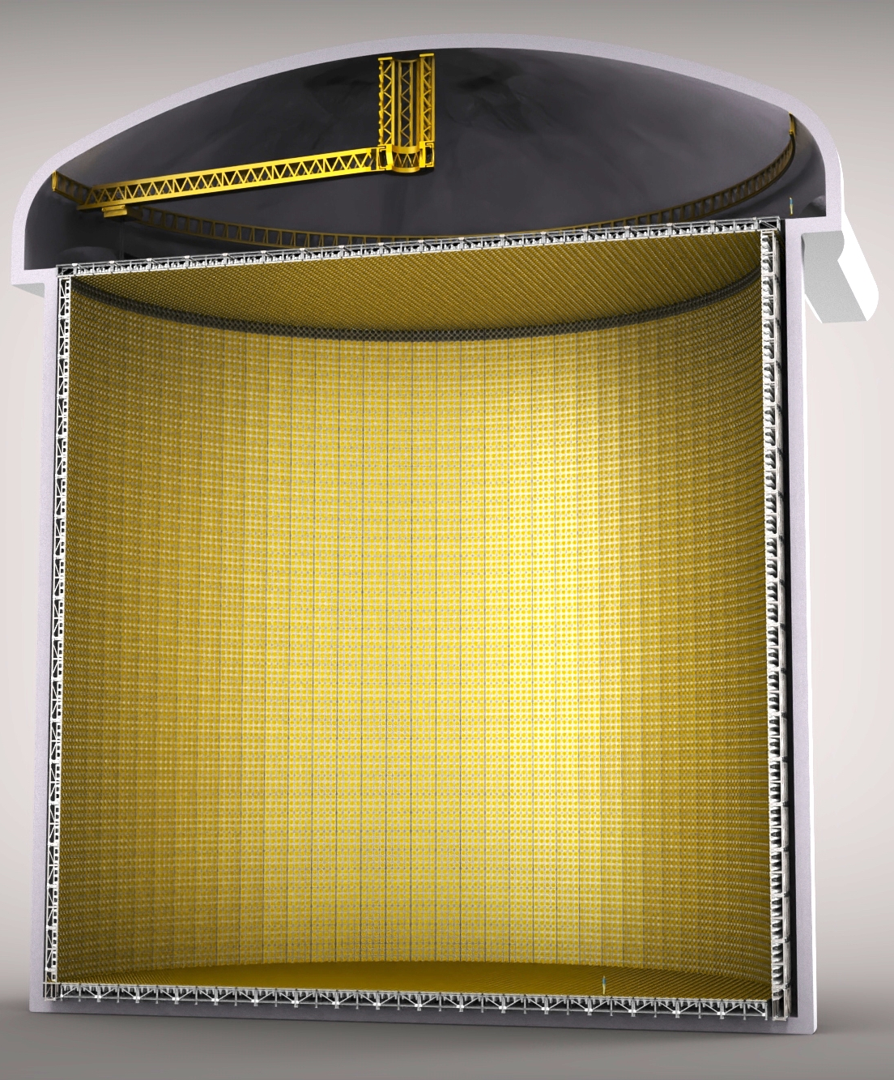
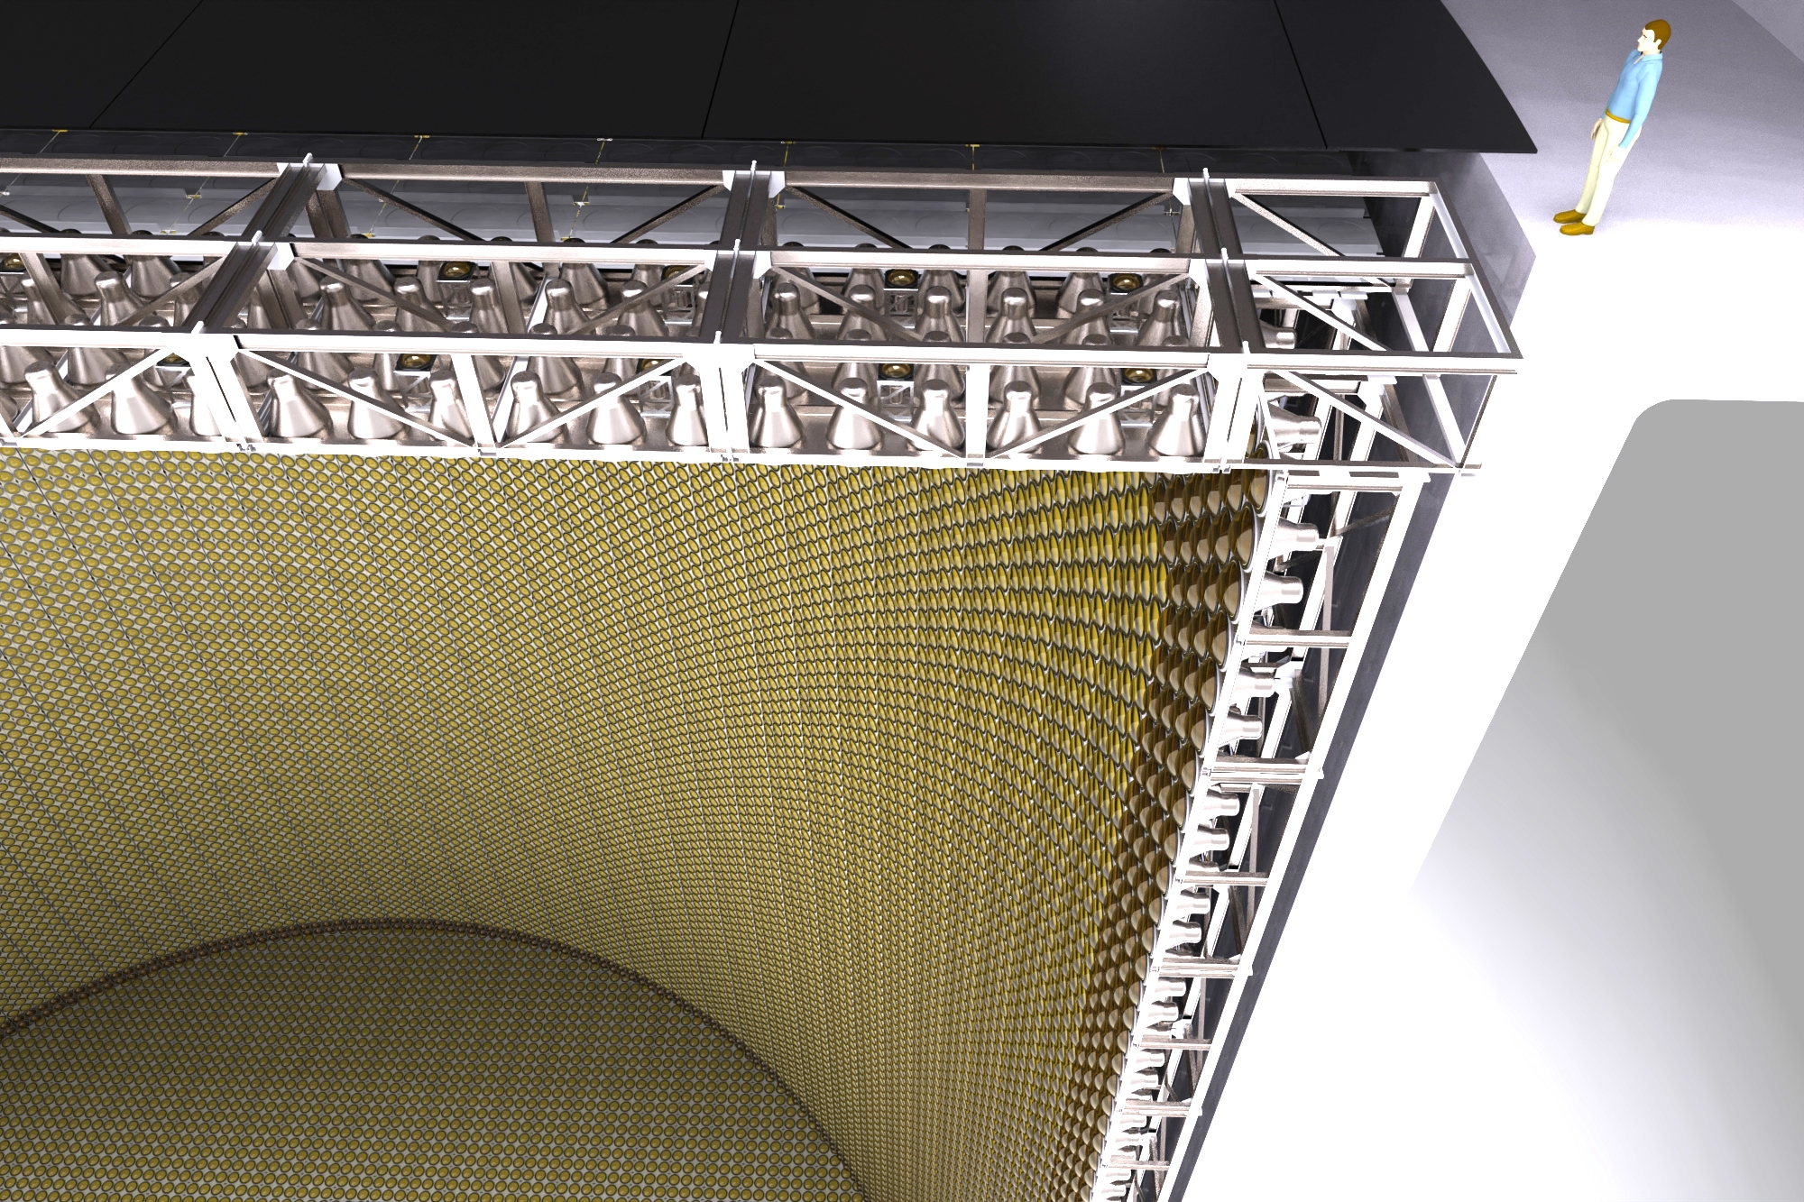
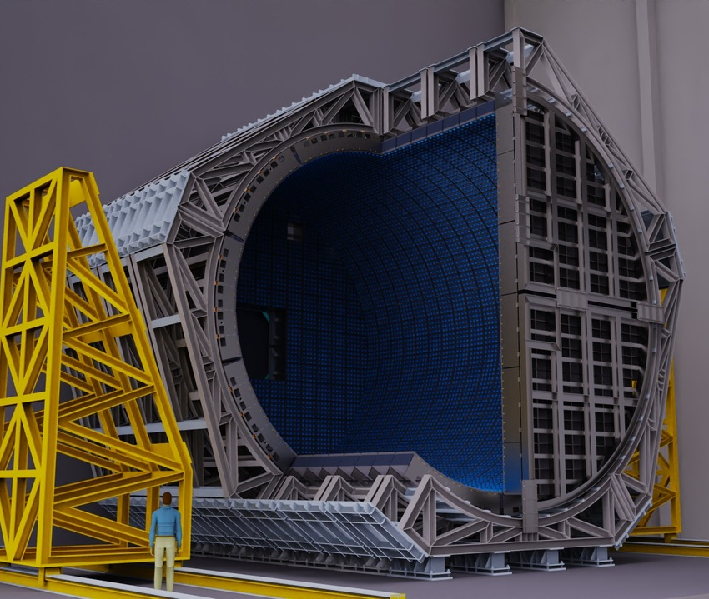
The Neard Detector and the Far Detector
The NeardDetector
The Far Detector
For Cherenkov imagies in the Far Detector see https://drive.google.com/drive/folders/1DidkJRA05GJtm0vFSqpfpCTAooNWAv22

Slide 7
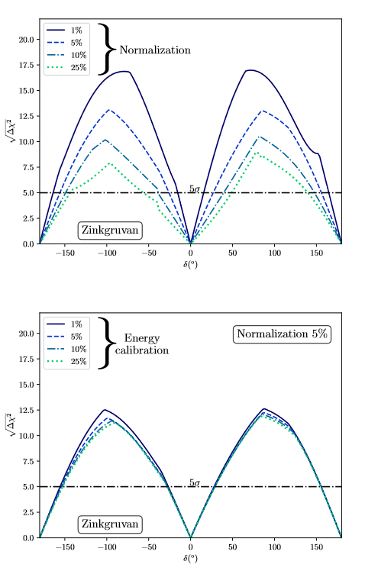
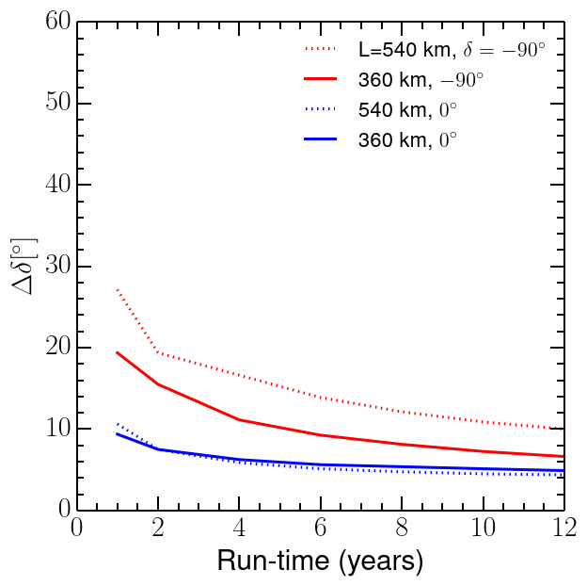
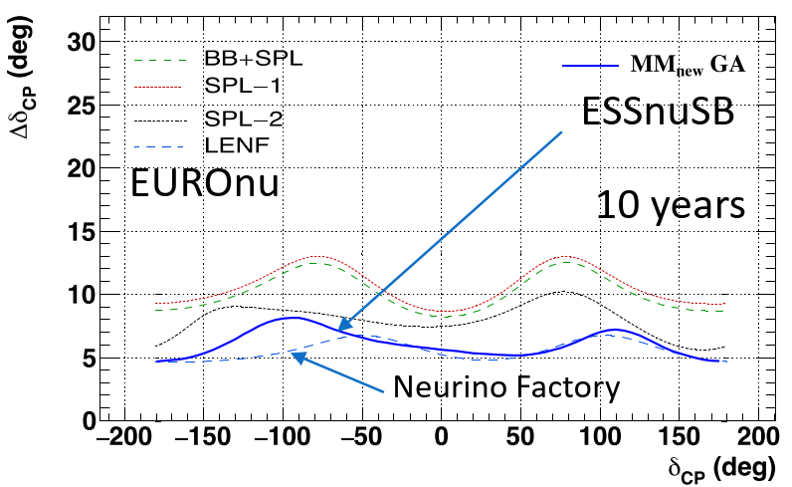
Performance for CV discovery and δ_{CP} measurement
Discovery potential vs δ_{CP} angle after
10 years with 5% normalization error
Error in δ_{CP} angle vs δ_{CP} angle after
10 years with 5% normalization error
Error in δ_{CP} angle vs run tim
with 5% normalization error

Slide 8
Design Study ESSνSB January 2018 - March 2022
More information on:
http://essnusb.eu/
EU Grant recieved
3 M€
CDR published
6 June 2022
https://arxiv.org/abs/2206.01208

Slide 9
We have submitted on 20 April 2022 an INFRADEV Design Study ESSnuSB+ to EU for the period 2023-2026
- We submitted on 20 April 2022 a proposal for EU Horizon Europe INFRADEV-1 for a design study of aspects of the ESSnuSB design that have not yet been studied during 2018-2021.
- The fact that we intend to study new aspects is of great significance as there is an EU rule that states that for one and the same project only one design-study application can be granted. CERN's FCC project has shown that a second grant can be obtained if new aspects are to be studied.
- The new aspects to be studied are building construction, licensing and security that will be required at ESS and in the Zinkgruvan mine, and design a Low Energy nuSTORM and a Low Energy Monitored Neutrino Beam for measurement of neutrino cross-sections and searches for sterile neutrinos.
HORIZON-INFRA-2022-DEV01
Developing European Research Infrastructures to maintain global leadership Deadline: 20 April 2022
Topics | Type of Action | Budgets (EUR million) | Expected EU contribu tion per project (EUR million) | Number of projects expecte d to be funded
 |  | 2022
Opening: 10 Nov 2021 Deadline(s): 20 April 2022
HORIZON-INFRA-2022- DEV-01-01 | RIA | 20.3 | 1.00 to 3.00 | 7
Overall indicative budget |  | 20.4

Slide 10
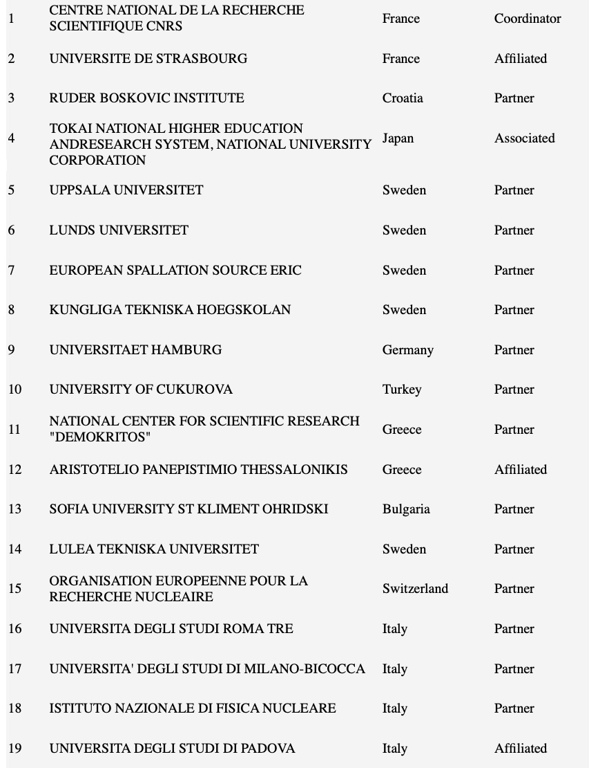
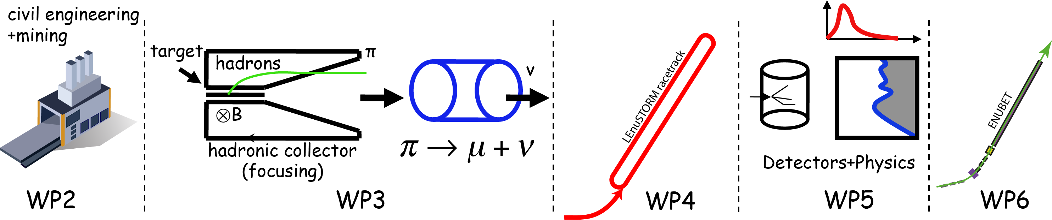
ESSnuSB+ participants and Work Packages
Work Packages
Management
Civil engineering at ESS and mine sites, safety, licensing and environment preservation.
Low Energy nuSTORM (LEnuSTORM) race-track design and adaption to the accelerator complex
LEnuSTORM Target Station and pion extraction for Low Energy nuSTORM
Detectors and physics performance –expected improvements due to ESSnuSB and LEnuSTORM.
Low energy Monitored Neutrino Beam design
ESS BILBAO Spain Partner

Slide 11
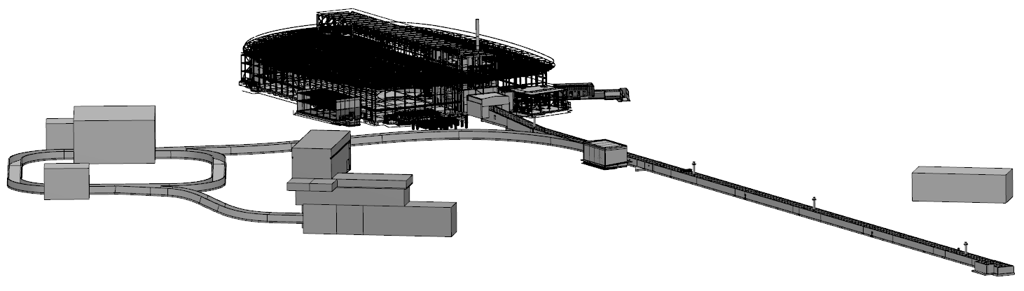
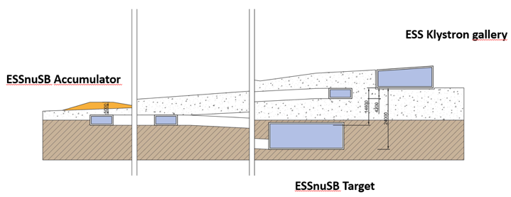
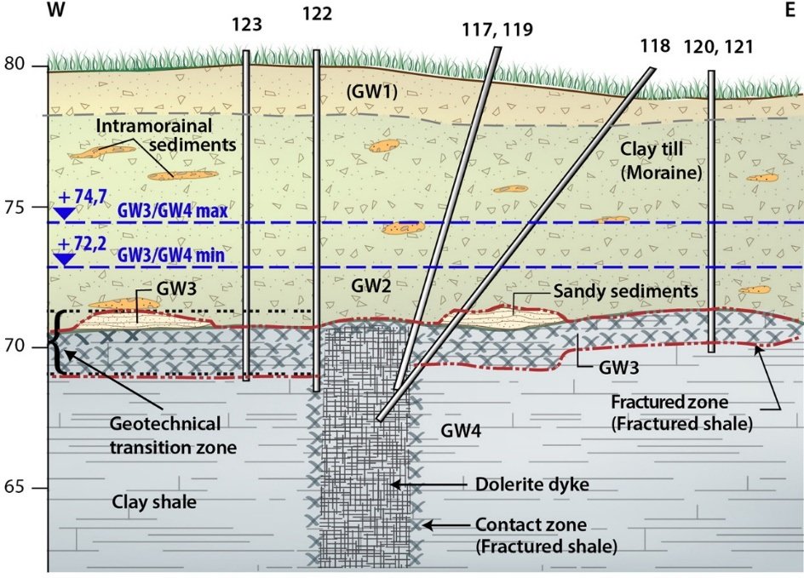
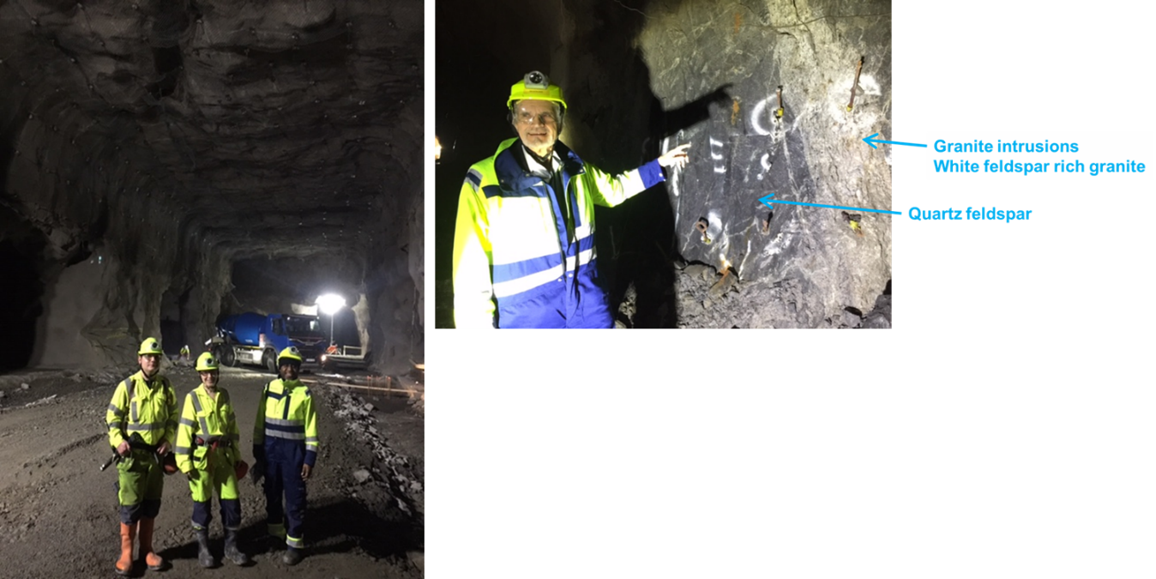
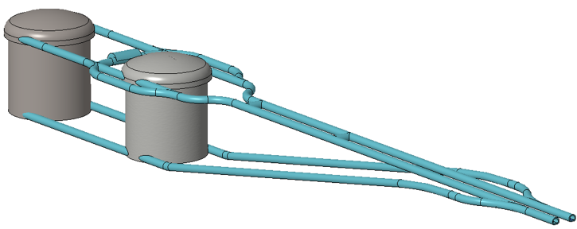
WP2 ESS Site and mine site civil engineering
Participants: ESS and Luleå Univ.
Design Study of civil engineering
  ESS site, all installations are underground
    Investigation of bedrock and ground water
    Design of underground tunnels and halls Supply of electric power, cooling, ventilation
  Cavern constructions at Zinkgruvan at 1000 m below ground level
Rock properties
Stability of the caverns
Sustainability
    Site layout
Excavation, reinforcement & ground control
Licencing
Safety
Environment protection
Far Detector

Slide 12
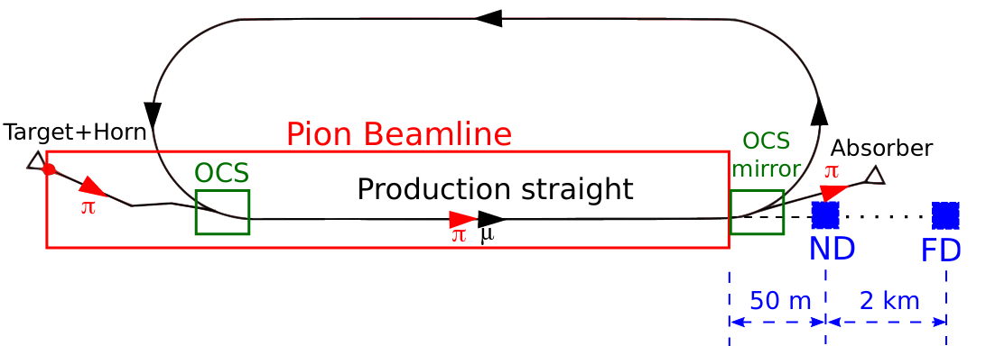
WP4 Low Energy nuSTORM
Participants: CRNS, Hamburg Univ., ESS Bilbao
Design of a racetrack storage ring for low energy muons produced with a beam from the ESS linac.
Design a transfer system from the initial collection and extraction of pions behind the target station, up to the injection point.
Design a transfer line from the ESSnuSB ring-to-switchyard transfer line to the nuSTORM target.
Design an injection scheme for the racetrack storage ring
Optimize the performance of the ESSnuSB accelerator complex
Neutrino Detectors
Optical Correction Scheme

Slide 13
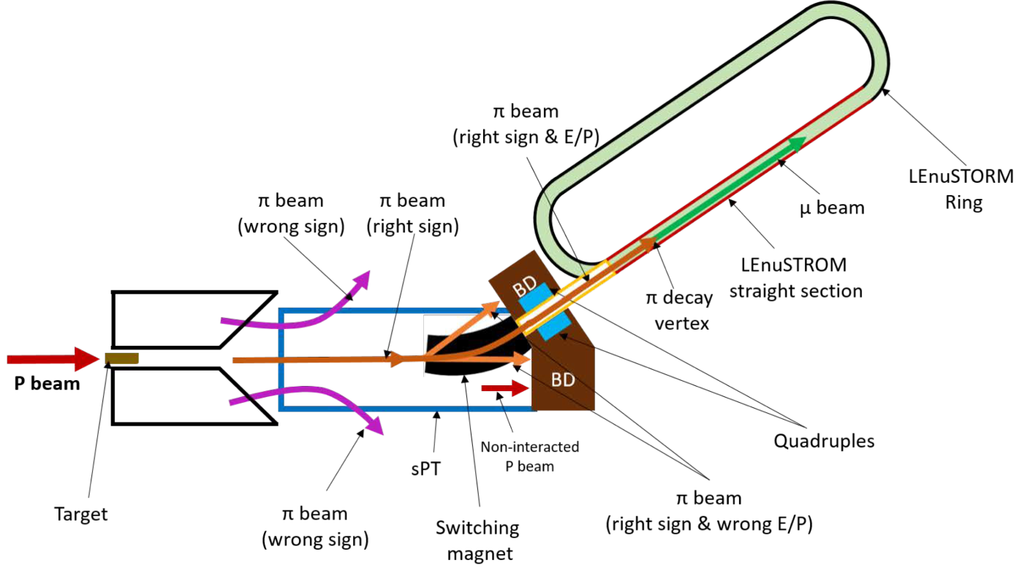
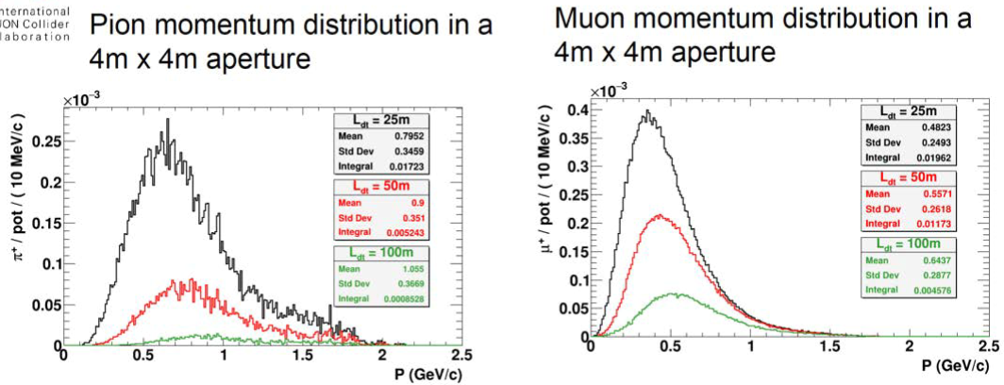
WP3 Low Energy nuSTORM target station
Participants: CRNS, Hamurg univ., Uppsala Univ., ESS, ESS Bilbao
• Adapt the ESSnuSB Target Station to the muon production requirements.
-Target material and horn design optimization for the pion beam production.
• Investigate pion extraction and initial focusing system.
- Pion extraction short tunnel and deflection+focussing magnet design
• Power supply unit for the pion extraction and initial focusing system.
- Power unit design for the current pulse required
• Target Station Facility.
-Beam window, remote handling, alignement, proton dump
The nuSTORM

Slide 14
WP5 Physics performance with ESSnuSB including nuSTORM and ENUBET
Participants: CRNS, KTH, Sofia univ., RSI, NCSRD, Cukurova univ.
• Design a single near detector for LEnuSTORM and LEMNB and optimize its performance.
• Determine the expected precision of neutrino interaction cross section measurement with the full setup.
• Study the sensitivity of the setup for new physics searches like sterile neutrinos.
• Study effects of gadolinium doping to sensitivity and performance of the ESSnuSB water Cherenkov detectors (near and far).
• Study sensitivity and performance of the ESSnuSB far detectors for physics not related to the neutrino beam.
• Develop an advanced analysis for the estimation of physics reach on the above topics using full MC chain for all detectors (analysis beyond GLoBES).
ESSnuSB March 2022 with 1% normalization error
Low energy sterile neutrino searches

Slide 15
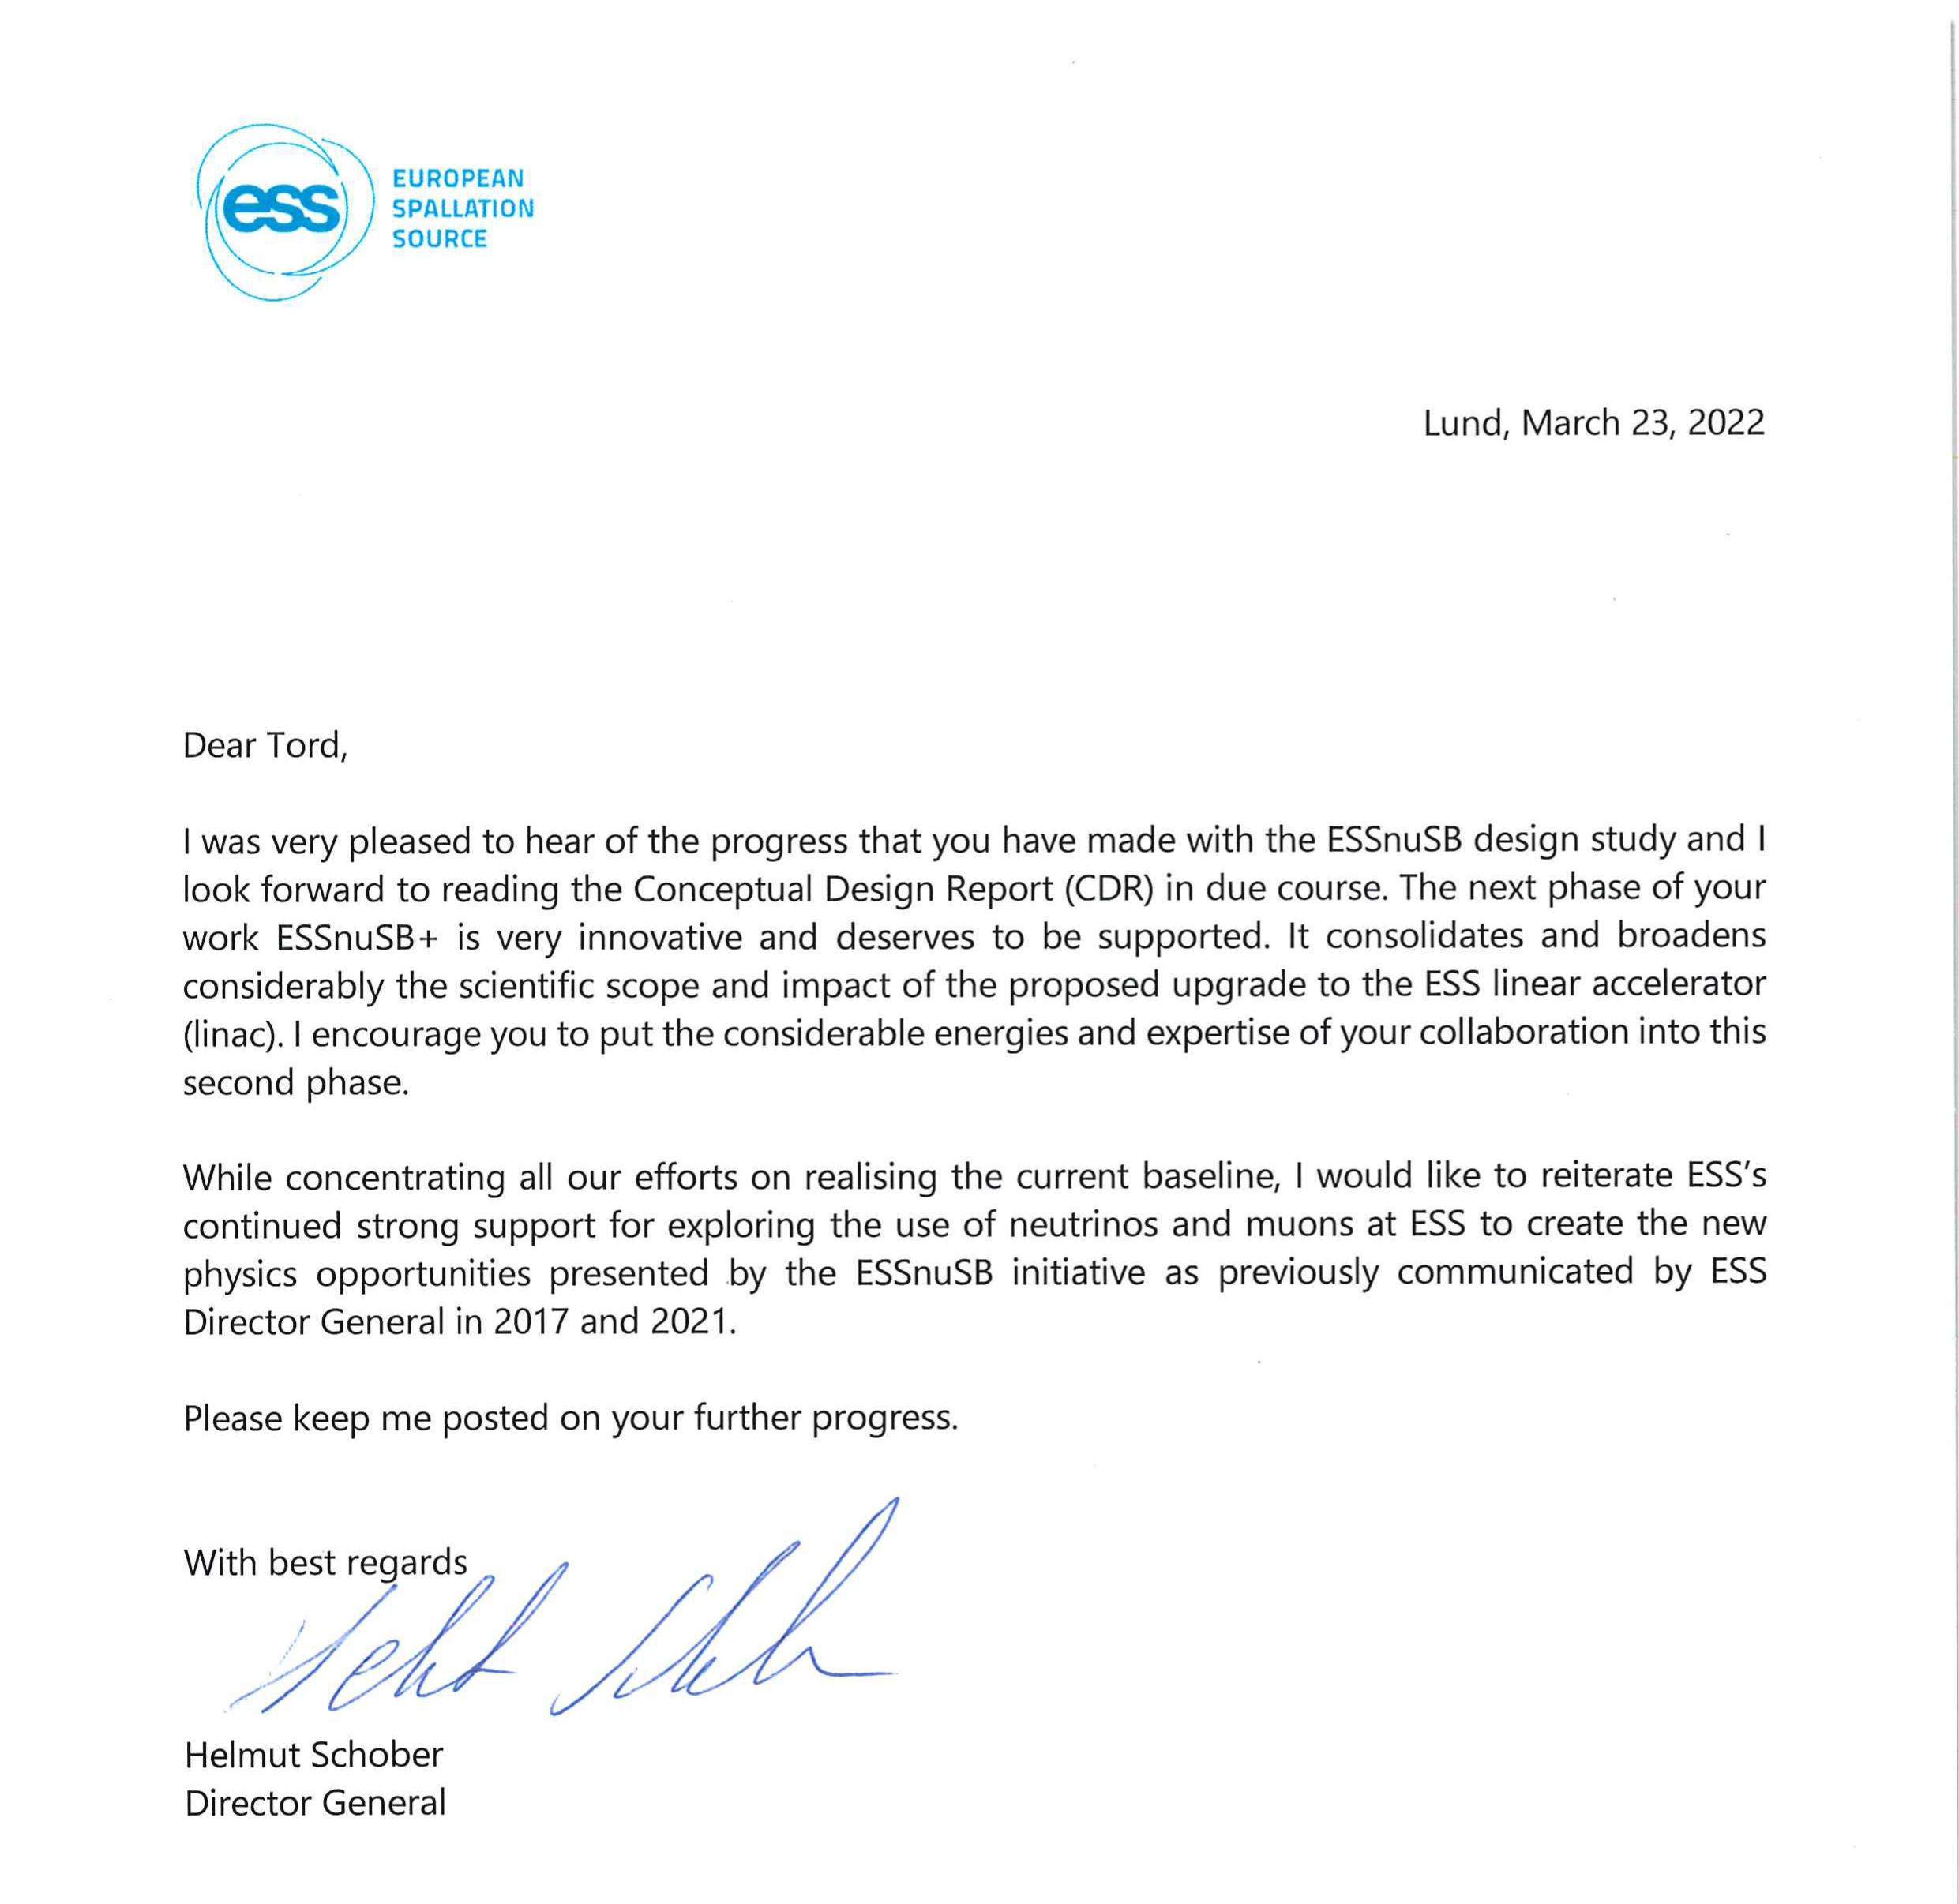
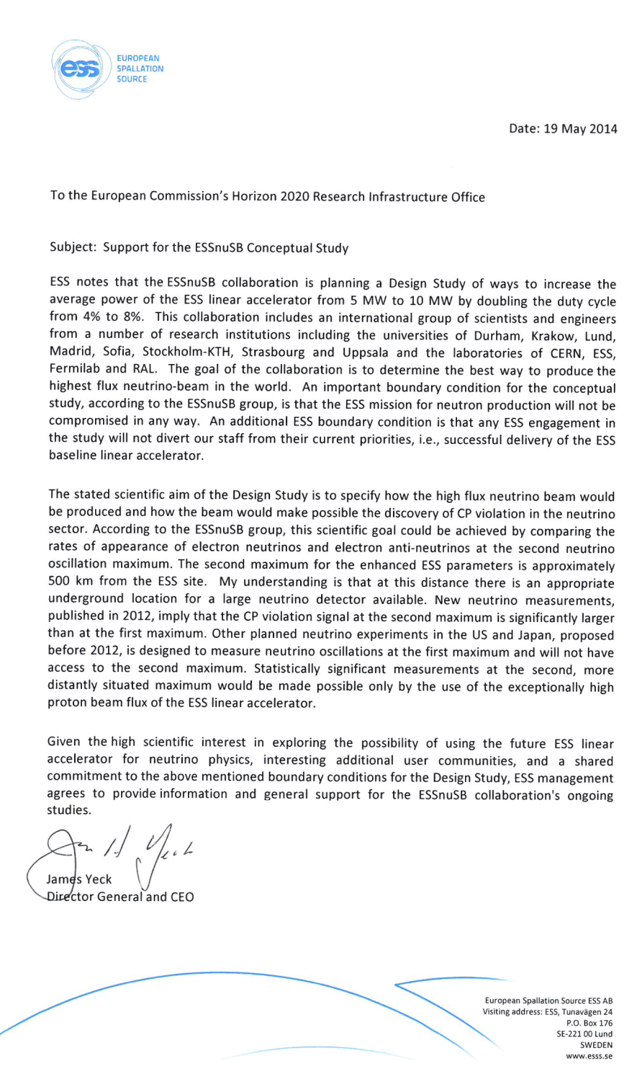
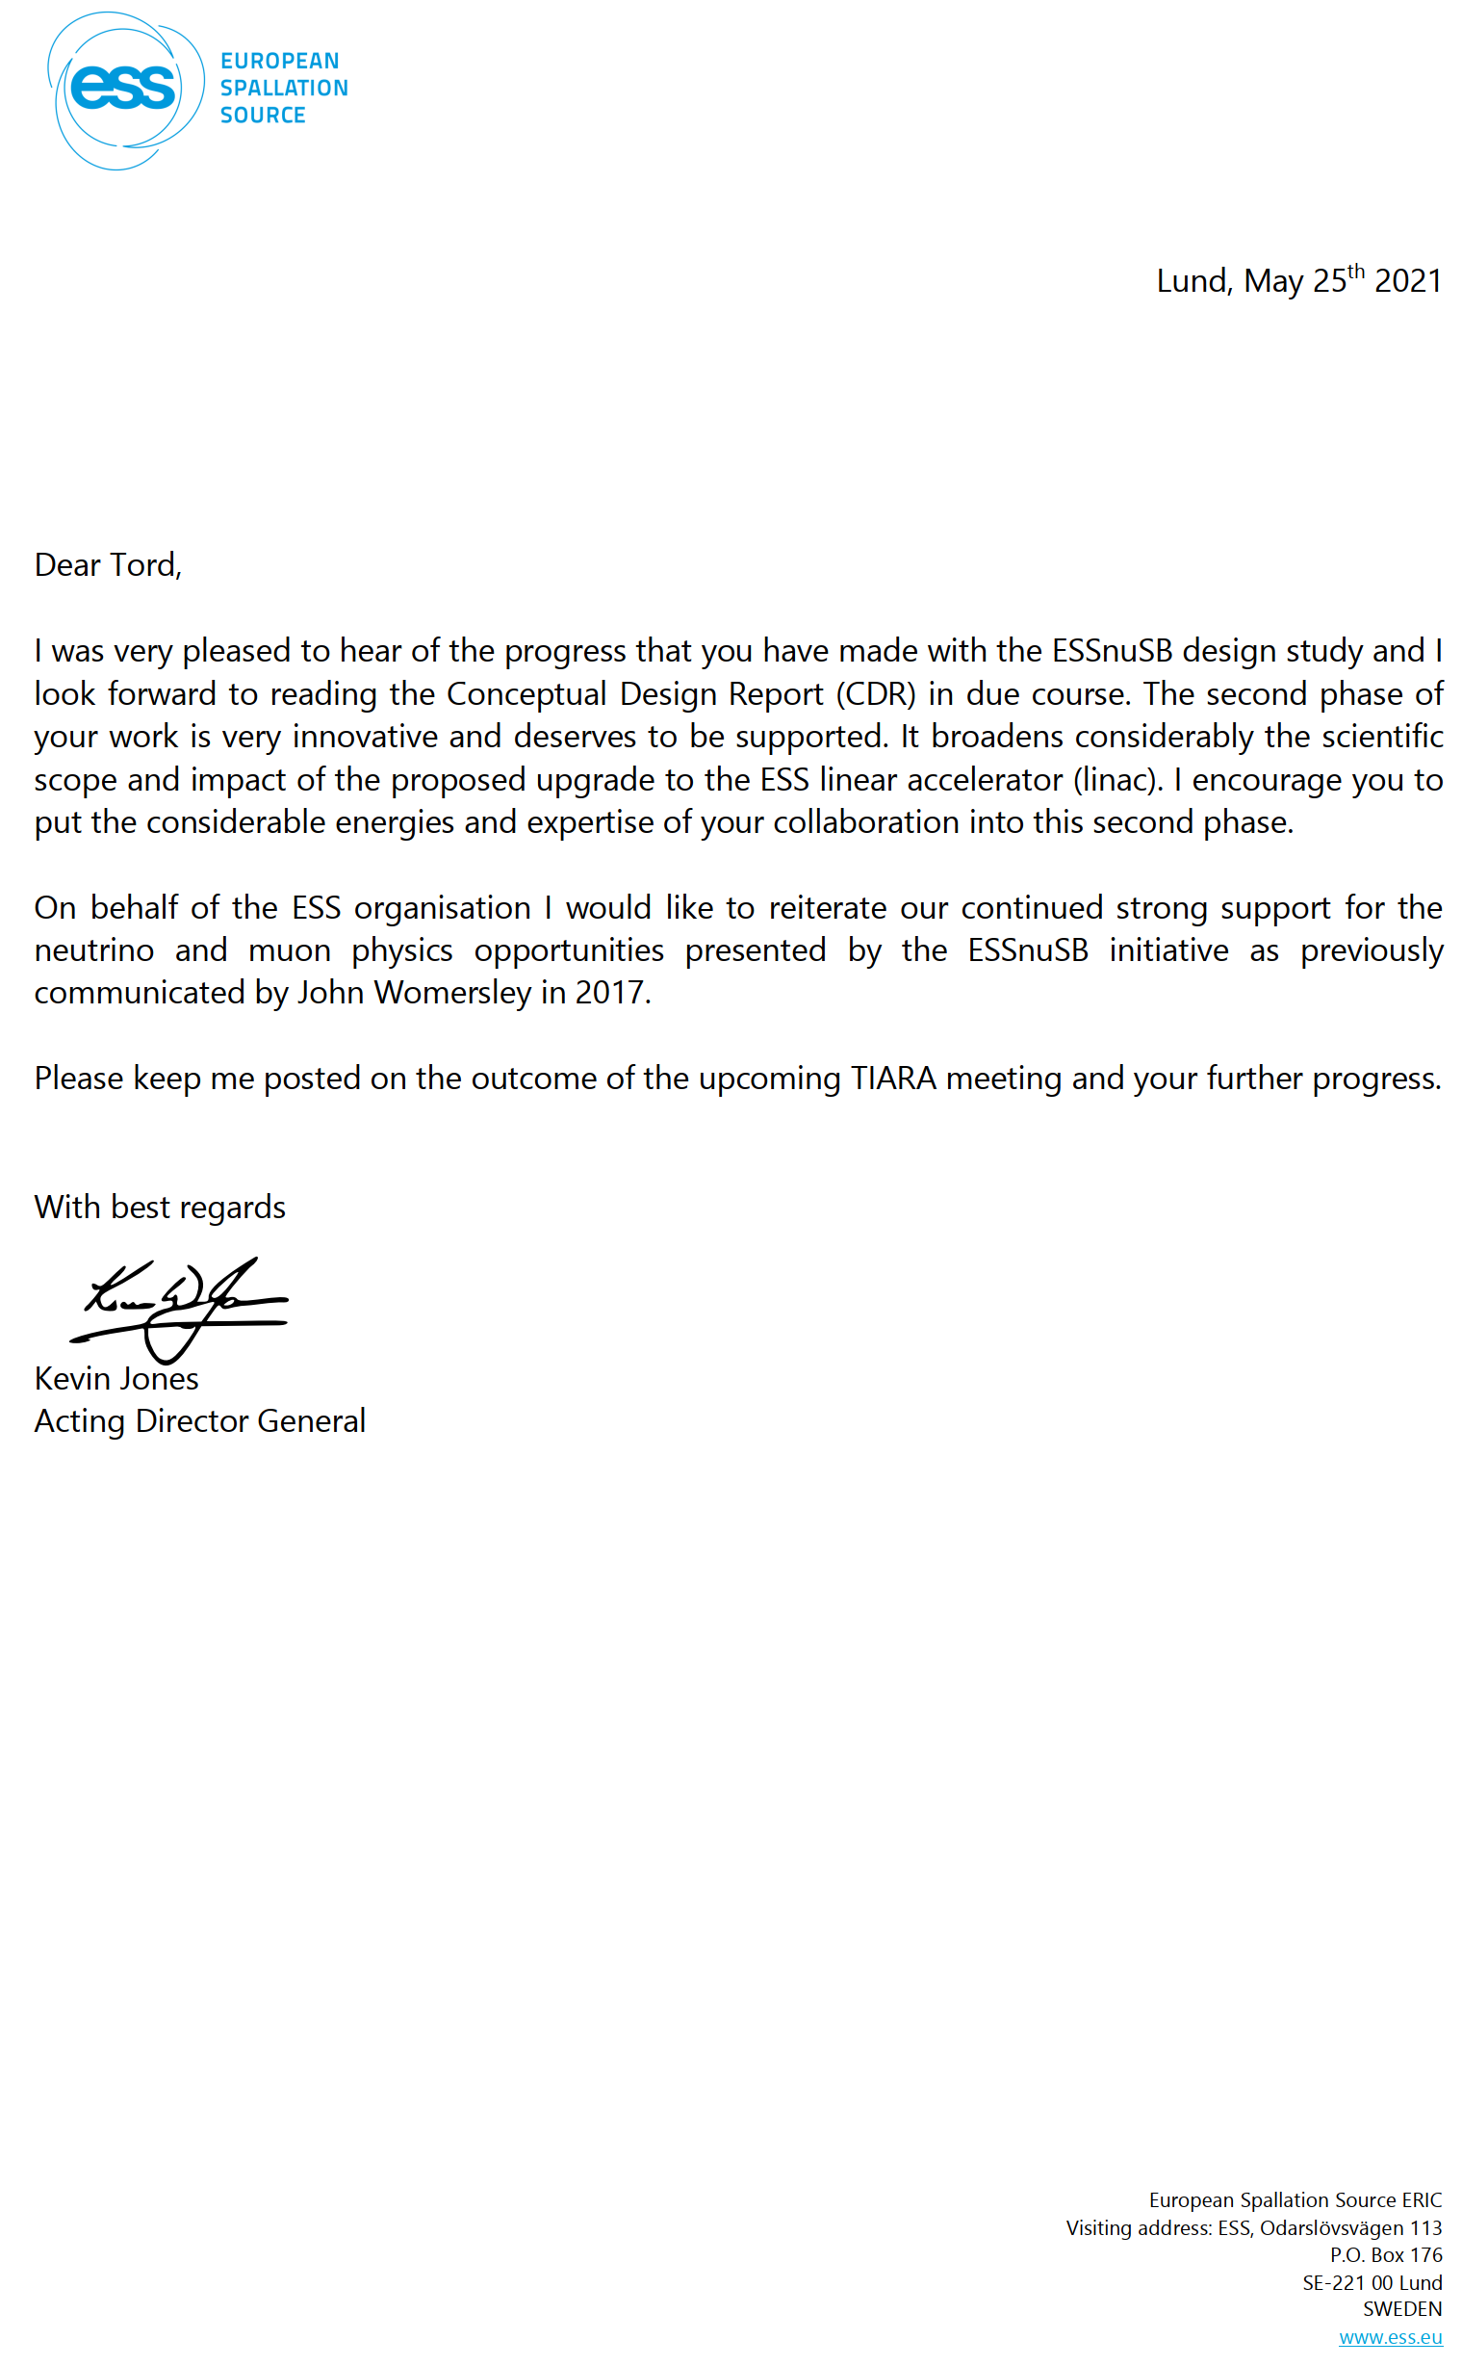
ESSnuSB support letters from
4 ESS Director Generals:
Jim Jeck in 2014
John Womersly in 2017
Kevin Jones in 2021
Helmut Schober in 2022

Slide 16
Use of the EU grant of 3 M€ requested for ESSnuSB+
All participants | Cost Category |  | Total cost €
 |  |  | (48 months)
Direct Costs: | Personnel:
 | Senior Staff |  | 2443171
 | Post docs |  | 1792891
 | Students |  | 0
 | Other |  | 0
 | Total Personnel: |  | 4236061
 | Other Direct Costs:
 | Equipment |  | 0
 | Consumables |  | 0
 | Travel |  | 431000
 | Publications, etc |  | 40000
 | Other |  | 0
 | Total Other Direct Costs: |  | 471000
 | Total Direct Costs: |  | 4707061
Indirect Costs (overheads): | Max 25% of Direct Costs |  | 1176765
Subcontracting Costs: | (No overheads) |  | 9800
Total Costs of project: | (by year and total) |  | 5893627
Requested Grant: | (by year and total) |  | 3163402
3000000

Slide 17
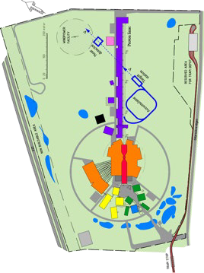
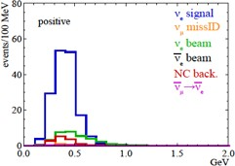












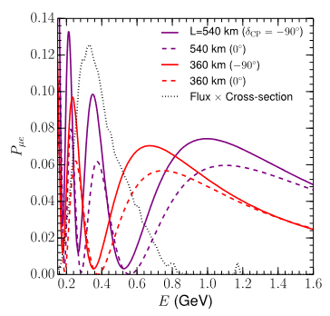








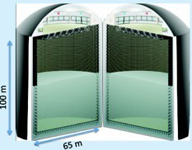

Schedule for a 2nd generation
ESS-based neutrino Super Beam ESSnuSB
Now
2036-:
Start of data taking
2029-2035:
2027-2028:
Construction of the facility and detectors, including commissioning
2023-2026:
Continuation of Design Study, final costing and an TDR to ESFRI
Preconstructi on Phase, International Agreements
2022: End of ESSνSB
Design Study,
preliminary costing and CDR
2018:
Beginning of ESSνSB
Design
Study (EU- H2020)
2016-2019:
Beginning of COST
Action EuroNuNet
2012:
Inception of the project
Nucl. Phys. B 885 (2014) 127
17

Slide 18
European Particle Physics Strategy
Conclusions:
"The design studies for next-generation long-baseline neutrino facilities should continue. "
"The first priority is the completion of the programme of measurements of the oscillation parameters, most notably the CP-violating phase of the mixing matrix and the neutrino mass ordering."
"Future European facilities such as FAIR, NICA and ESS envisage research programmes that are of interest to particle physics."
"The European particle physics community should work with the European Commission to shape and establish the funding instruments that are required for the realisation of common R&D projects, e.g. in the Horizon Europe programme."
"A roadmap should prioritise the technology, taking into account synergies with international partners and other communities such as photon and neutron sources, fusion energy and industry."

Slide 19
Thank you!

Slide 20
Back-up slides

Slide 21
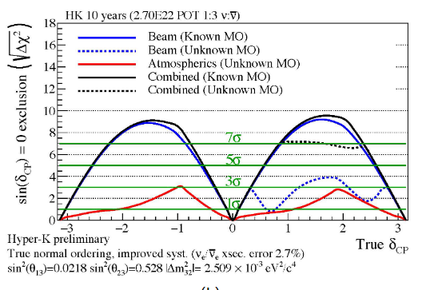
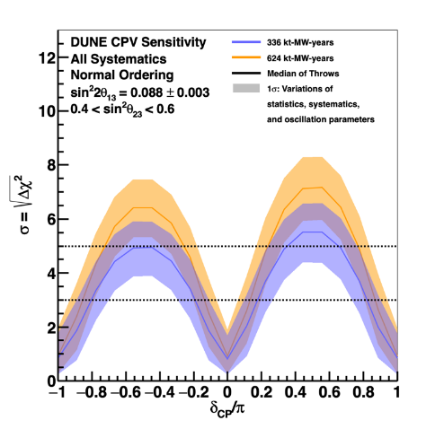
ESSnuSB in the international context – CPV discovery
ESSnuSB March 2022 with 5% normalization error
DUNE Snowmass March 2022
HyperKamokandeSnowmass March 2022

Slide 22
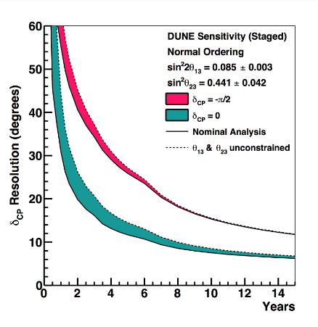
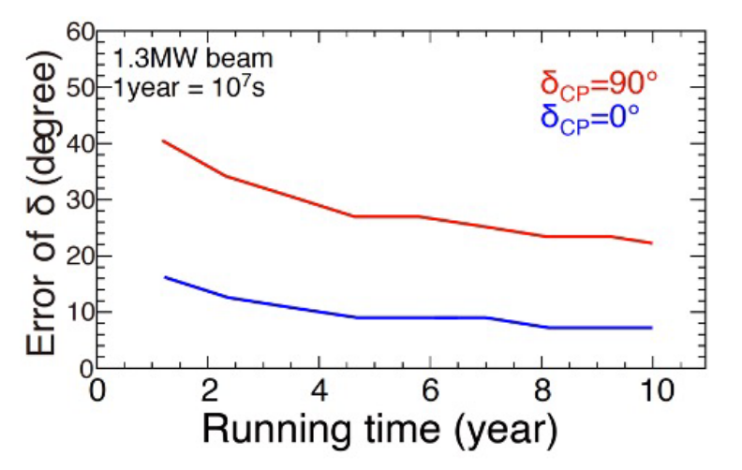
ESSnuSB in the international context – CPV resolution
ESSnuSB March 2022 with 5% normalization error
DUNE Snomass March 2022
HyperKamokandeSnowmass March 2022

Slide 23
Resolution in degrees of the measurement of δ_{CP}
ESSnuSB 10 years
DUNE 10 years yellow curve
HyperKamiokande 10 years

Slide 24
ESSnuSB at the second neutrino oscillation maximum
Coverage of the second oscillation maximum
Signal (ν_{e}) and background energy distributions

Slide 25
Preliminary ESSnuSB investment budget
Item | Sub-item | Cost [M€] | Cost [%]
Linac upgrade | Ion Source and Low-Energy Beam Transport (LEBT) | 5.00 | 0.35%
 | Radio-Frequency Quadrupole | 6.90 | 0.48%
 | Medium Energy Beam Transport (MEBT) Upgrade | 3.00 | 0.21%
 | Drift-Tube Linac with BPMs, BCMs | 13.40 | 0.93%
 | High-Beta Linac (HBL) Upgrade | 10.40 | 0.72%
 | 33 Modulator Upgrades | 3.50 | 0.24%
 | 8 New Modulators | 9.00 | 0.62%
 | 15 Grid—Modulator Transformers | 5.60 | 0.39%
 | 11 Grid—Modulator Transformers Retrofitted | 0.50 | 0.03%
 | 26 Solid State Spoke Amplifiers | 26.00 | 1.79%
 | New Klystrons for upgraded HBL | 12.10 | 0.84%
 | Remaining Klystron Refurbishment/Replacement | 25.20 | 1.74%
 | Cryogenics, Water Cooling, Civil Eng. | 12.00 | 0.83%
 | Total | 132.60 | 9.15%
Accumulator | Item | Cost [M€]
 | DC magnets and power supplies | 50.00 | 3.45%
 | Injection system | 11.00 | 0.76%
 | Extraction system | 7.00 | 0.48%
 | RF systems | 16.00 | 1.10%
 | Collimation | 8.00 | 0.55%
 | Beam instrumentation | 19.00 | 1.31%
 | Vacuum system | 24.00 | 1.66%
 | Control system | 30.00 | 2.07%
 | Total | 165.00 | 11.38%
Target Station | item | Cost [M€]
 | Target Station | 30.00 | 2.07%
 | Proton Beam Window System | 5.20 | 0.36%
 | PSU + Striplines | 5.40 | 0.37%
 | Target and Horn Exchange System | 40.42 | 2.79%
 | Facility Building Structure | 26.60 | 1.84%
 | General System & Services | 9.21 | 0.64%
 | Total | 116.83 | 8.06%
Detectors | item | Cost [M€]
Emulsion detectors | 130 water-emulsion cloud chamber modules | 1.00 | 0.07%
 | Detector assembly, installation, air-conditioning, etc | 1.00 | 0.07%
 | Total | 2.00 | 0.14%
Super Fine-Grained Detector | Scintillator cubes (980,000, 1x1x1 cm3 each) | 1.25 | 0.09%
 | Wavelength shifting fibers | 0.22 | 0.02%
 | Multipixel photon counters + optical couplers | 0.74 | 0.05%
 | Mechanical structure | 0.50 | 0.03%
 | Front-end readout and other electronics | 2.10 | 0.15%
 | Data acquisition and calibration systems | 0.08 | 0.01%
 | Superconducting magnet and power supply | 0.50 | 0.03%
 | Assembly and installation effort (Personnel) | 0.10 | 0.01%
 | Total | 5.49 | 0.38%

Slide 26
Near water Cherenkov detector | Detector truss and carbon window | 0.50 | 0.03%
 | Detector water storage | 0.50 | 0.03%
 | Water pumping and purification plant | 10.00 | 0.69%
 | PMT modules, support, power and signal transmission | 11.32 | 0.78%
 | Calibration, monitoring and control systems | 0.40 | 0.03%
 | Assembly and installation effort (Personnel) | 2.50 | 0.17%
 | Total | 25.22 | 1.74%
Far water Cherenkov detector | Two detector tanks and water storage | 0.80 | 0.06%
 | PMT modules (PMTs, housing, power, readout) | 387.07 | 26.71%
 | PMT module support | 15.00 | 1.04%
 | Data logging, processing and transmission | 0.50 | 0.03%
 | Calibration, monitoring and control systems | 1.50 | 0.10%
 | Water pumping and purification plant | 40.00 | 2.76%
 | Counting, testing, assembly, storage rooms (x3) | 3.00 | 0.21%
 | Veto detector (smaller PMTs looking outward) | 23.20 | 1.60%
 | Assembly and installation effort (Personnel) | 10.00 | 0.69%
 | Total | 481.07 | 33.19%
Underground cavern excavations | Civil engineering - excavation of two caverns | 507.15 | 34.99%
 | Cranes and other mechanical infrastructure | 0.50 | 0.03%
 | Access systems | 3.00 | 0.21%
 | Air conditioning and ventilation | 5.50 | 0.38%
 | Monitoring systems | 2.50 | 0.17%
 | Installation effort (Personnel) | 2.50 | 0.17%
 | Total | 521.15 | 35.96%
Grand Total |  | 1449.35 | 100.000%

