Slide 1
Antihydrogen and the ALPHA and GBAR experiments
Svante Jonsell
Stockholm University

Slide 2
Complementary ways to look for new physics
Higher energy (enter new regimes)
Higher luminosity (rare events)
Higher precision (undetected phenomena)
To gain high precision:
Go to lower energy
  more control
  longer time to study
  less thermal noise
Measure frequency
  interferometric techniques
  frequency combs
1S-2S spectroscopy of hydrogen
(Latest: 4.2* 10⁻¹⁵ in 2011, PRL 107 203001)

Slide 3
Hydrogen spectroscopy
Bohr’s model of the hydrogen atom (1913), ~PHz
Quantum mechanics (1920s)
Relativistic quantum mechanics (fine structure) ~10 GHz
Quantum Electro Dynamics (Lamb shift, 1947) ~ GHz
Radio astronomy (1420 MHz)
Charge radius of proton (muonic hydrogen)

Slide 4
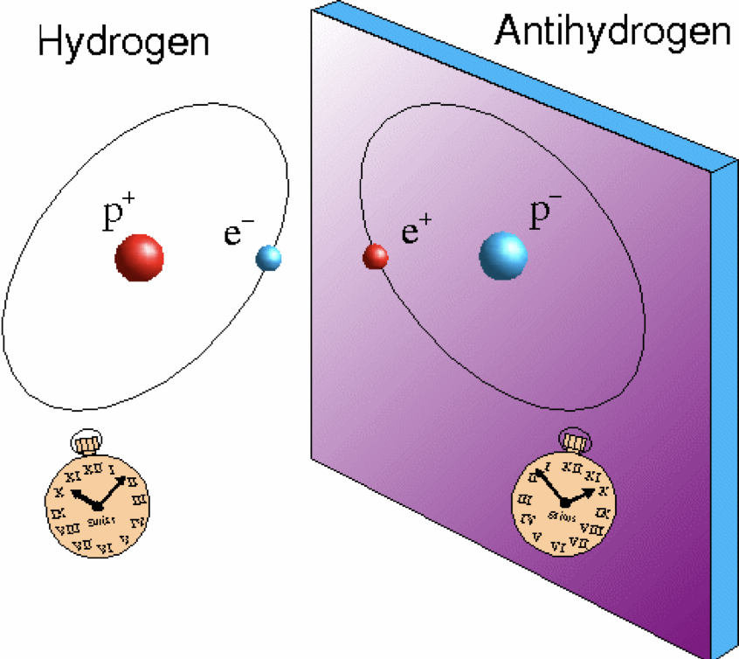
An ideal probe: antihydrogen
Hydrogen very well understood
Neutral
Can be trapped with magnetic fields
Single atom detection possible
Laser spectroscopy with extreme accuracy possible
Many different sectors can be probed
(leptons/baryons/B-fields/etc.)

Slide 5
Missing antimatter problem
Antimatter is believed to be a perfect mirror image of ordinary matter
Created in equal amounts at big bang?
Annihilated and created in pairs
Why do we (almost) only see one kind?
Balanced universe?
Matter-antimatter asymmetry?

Slide 6
Looking for cracks in the mirror image: a look at symmetry
What if the mirror image is not perfect?
Parity symmetry (3D mirror) broken
Combination Charge conjugation (particle-> antiparticle) and Parity broken
CP breaking too small to solve the problem
Combination CPT (T=time reversal) valid in any local, Lorentz-invariant Quantum Field Theory
CPT implies that atoms of matter and antimatter have identical spectra
Test this!

Slide 7
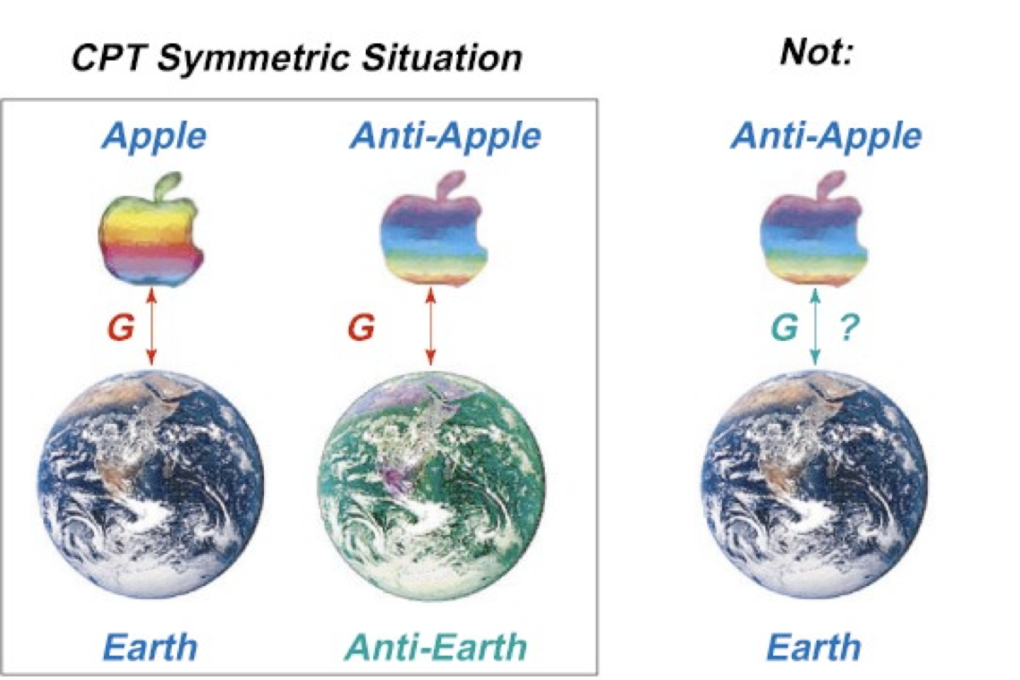
Matter-antimatter gravity
CPT -> antimatter attracts antimatter same as matter attracts matter
Einstein’s Weak Equivalence principle (~ everything falls the same way) says that matter attracts antimatter the same way.
Test using neutral bodies

Slide 8
Antiprotons at CERN
At CERNs Proton Synchrotron 10¹³ protons with energy 26 GeV are collided with a target
Antiprotons are formed in the collision, some enter the Antiproton Decelerator (AD)
The AD slows ~3 10⁷ antiprotons from 3-4 GeV to 5.3 MeV
ELENA further slows to 0.1 MeV and delivers to experiments (ALPHA, GBAR, BASE, ASACUSA, AEGIS, formerly also ATHENA and ATRAP)
ALPHA traps antihydrogen with energies less than 0.5 Kelvin (0.04 meV)
Overall cooling by a factor 6*10¹⁴

Slide 9
ALPHA (and ATHENA) achievements
2002 first “cold” antihydrogen formed
2010 first antihydrogen trapped in magnetic trap (on average 1 per 2 tries)
2011 antihydrogen trapped for 15 minutes (ground state!)
2012 first study of internal structure (spin flip of positrons using microwave)
2012 original ALPHA upgraded to ALPHA2 (e.g. laser access)
2016 antihydrogen 1S-2S transition observed
2017 now trapping for hours, about 10 per shot, but up to 1000 by accumulating
2018 antihydrogen 1S-2S measured with relative accuracy 2*10¹² (hydrogen still *1000 better)
2018 1S-2P (Ly-a) observed (needed for laser cooling, very difficult wavelength: 121 nm)
2021 Laser cooling of antihydrogen

Slide 10
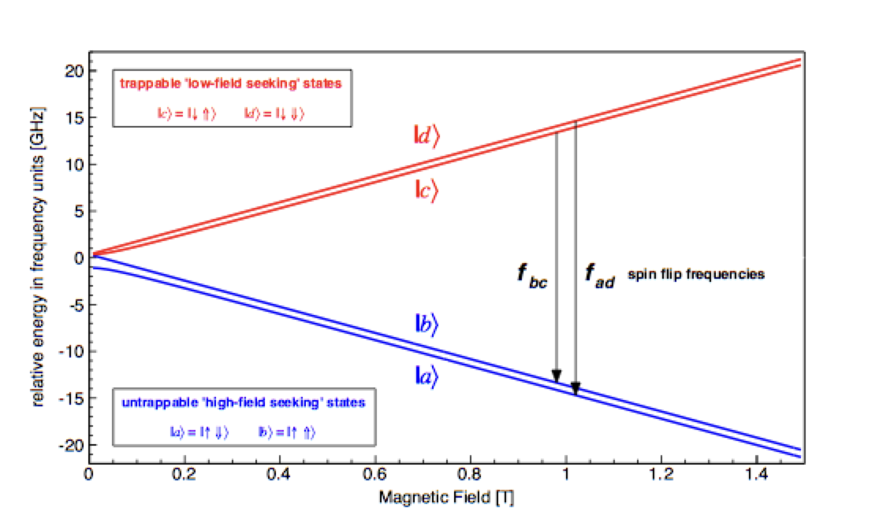
Spectroscopy with a handfull of antiatoms
Design experiment so that signal = loss of antiatoms
Individual antiatoms can be detected through annihilation
Either: hold antiatoms while you do something to them – turn off trap and see if they are still there
Or: detect antiatoms when they are kicked out (more difficult)

Slide 11
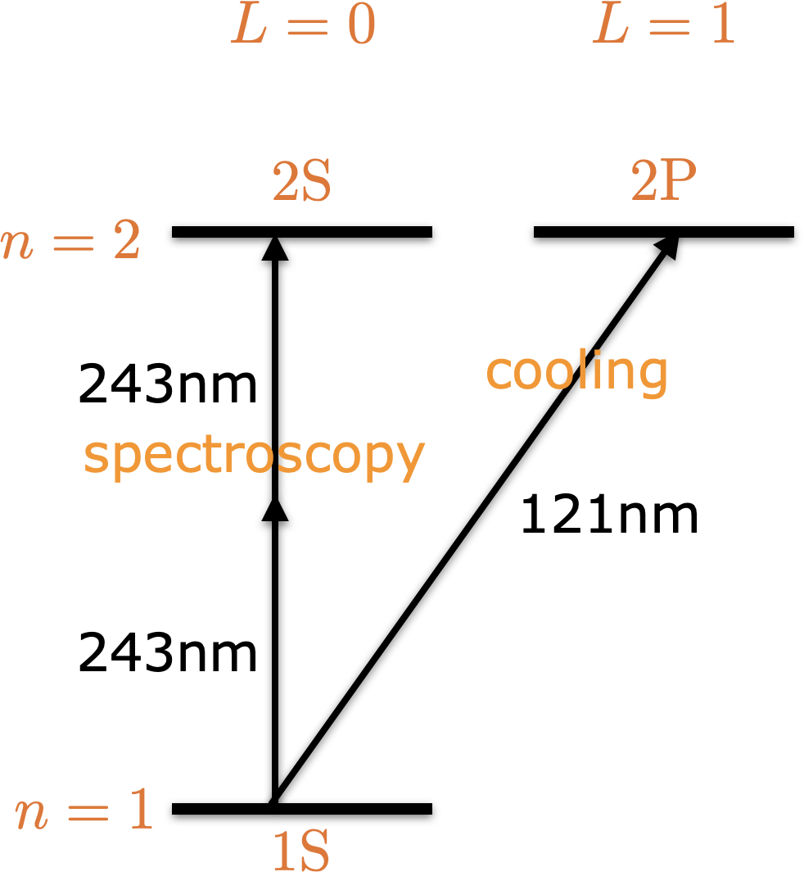
Level structure of (anti-)hydrogen
Photon angular momentum L=1
Conservation of angular momentum
1S-2P: 1 photon
1S-2S: 2 photons
2S has no 1-photon decay
lifetime 0.125 s
width 5.2 *10⁻¹⁵ eV
2-photon spectroscopy is Doppler free
(to first order)

Slide 12
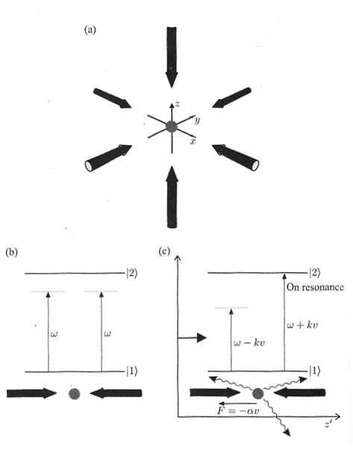
Laser cooling
Photon hits atom
“hit” = absoption and re-emission in random direction
Overall effect: slowing in one direction
Problem: push from behind
Photon energy must match transition
Trick: slightly mismatch photon energy
Doppler effect selects atoms moving towards laser

Slide 13
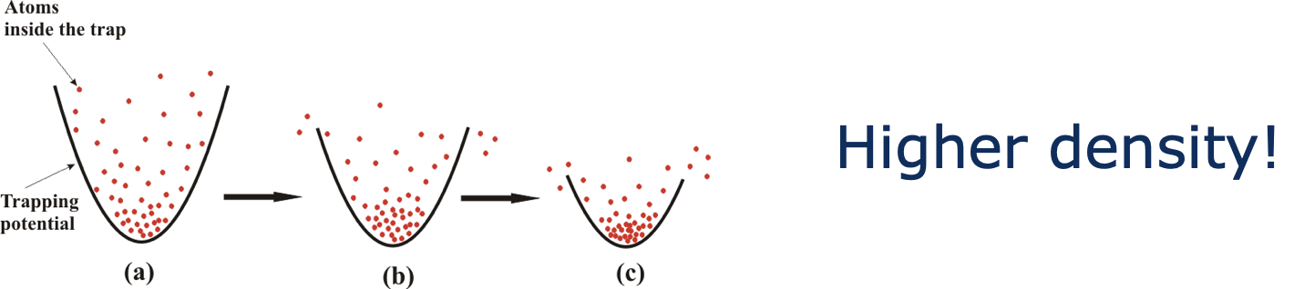
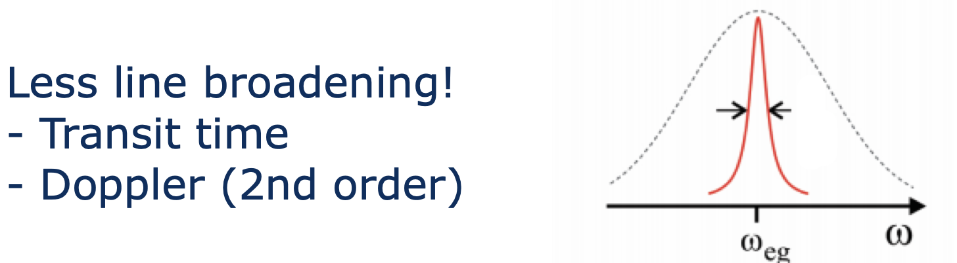
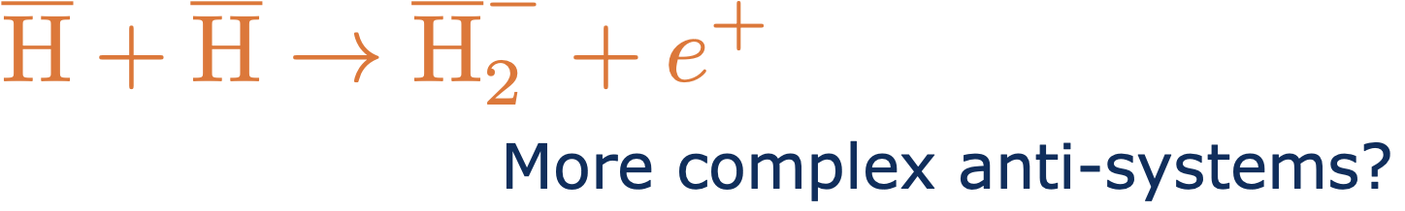
Why is colder better??

Slide 14
Results
Reconstructed kinetic energy perp. to laser
Line shape with and without cooling

Slide 15

Gravitational Behaviour of Antimatter at Rest (GBAR)
measure g for antiatoms
Drop and measure time-of-flight + position
Gravity is very weak
Attempts with antiprotons failed due to interaction with stray electric fields
Thermal motion must be reduced
Laser cooling helps, but GBAR chose different method

Slide 16
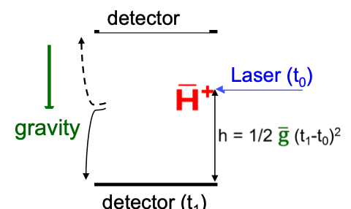
GBAR: cooling scheme
Form the antihydrogen ion anti-H⁺ ( )
Charged -> easier to manipulate
trap together with very cold ions (e.g. Be⁺)
Ion cools through collisions
++ Repulsion -> never gets close enough to annihilate
a very carefully tuned laser removes one positron
The neutral antiatom falls

Slide 17
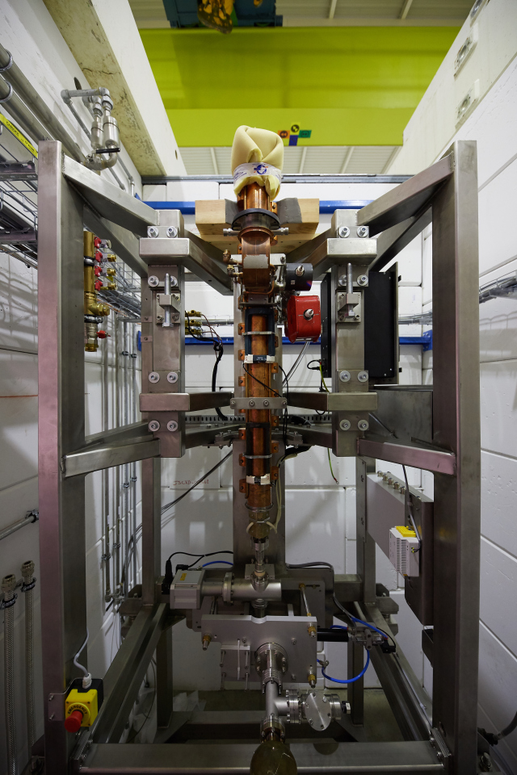
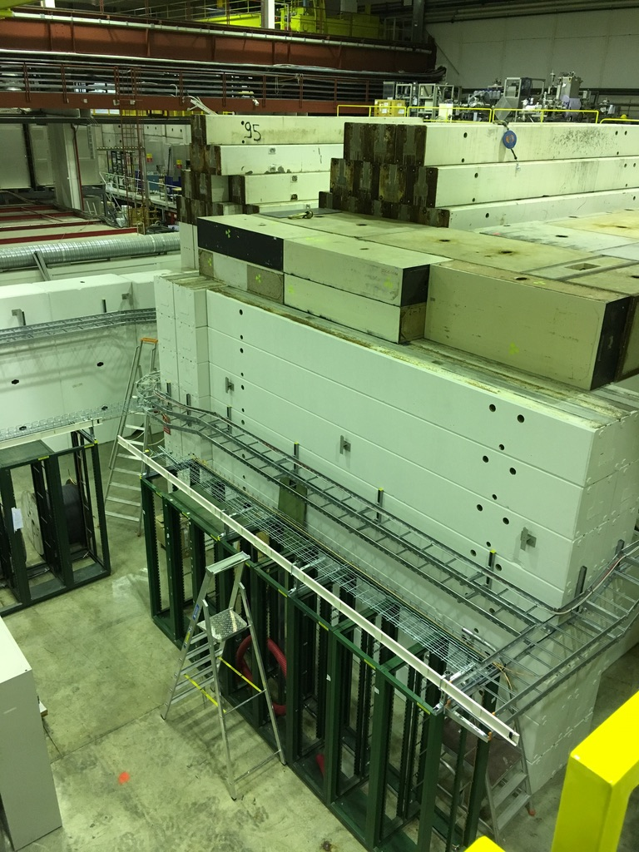
GBAR: creating the antihydrogen ions
Scheme: slow beam of antiprotons enter a could of positrons
First antihydrogen is formed though the reaction
A second collision makes the ion
Reaction rates are very low
Need lots and lots of positrons
GBAR has its own little accelerator to create prositrons

Slide 18
Conclusions
High-precision studies of antihydrogen at low energies is a probe for new physics.
Comparing to spectra of normal hydrogen tests the Charge-Parity-Time reversal symmetry
Spectroscopy at ALPHA is approaching accuracy of normal hydrogen
So far no differences have been detected
Antimatter gravity will be studied by GBAR (and others)

