Slide 1
Bio-medical imaging using synchrotron radiation
Martin.bech@med.lu.se Medical Radiation Physics

Slide 2
About me
Associate professor
Department for Medical Radiation Physics
Lund University
Spokesperson for biomedical imaging
beamline project at MAX IV
Martin.Bech@med.lu.se

Slide 3
Outline
What is phase contrast imaging and dark-field imaging?
Why are these new imaging modalities good for bio-medical imaging?
Future prospects of phase-contrast imaging?

Slide 4
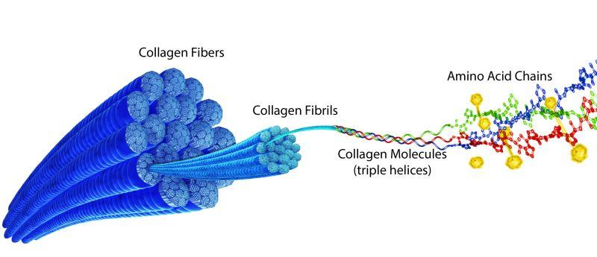
Biology can best be understood if studied at different length and time scales

Slide 5
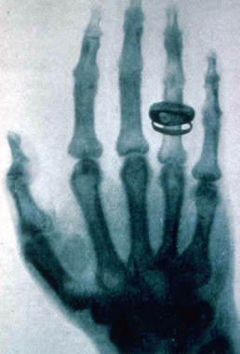
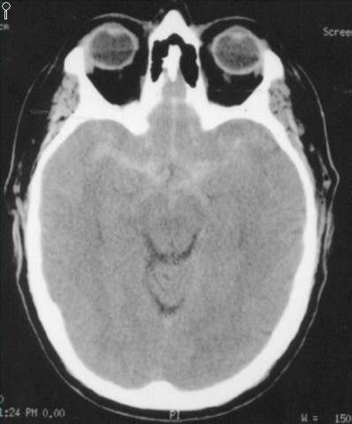
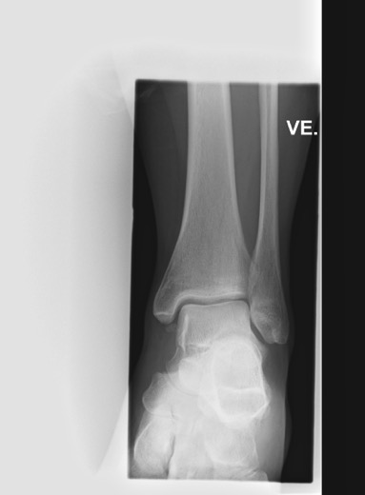
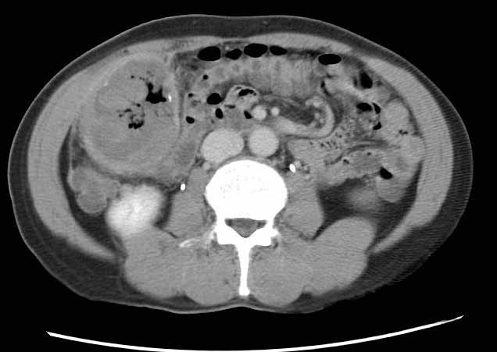
High Contrast / Low Contrast
First x-ray image
made by Röntgen in 1896
Modern x-ray image today

Slide 6


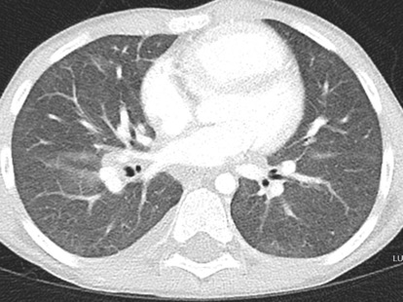
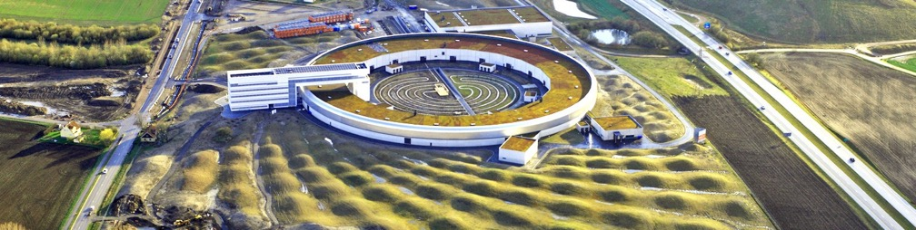

Synchrotron-based phase contrast micro-CT
Electron accelerator, highly parallel X-rays

Slide 7
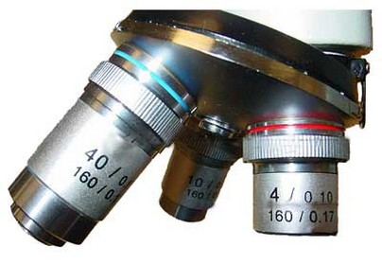
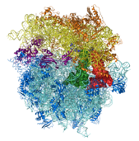
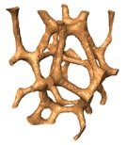
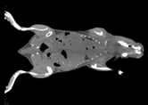
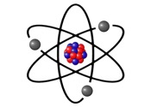
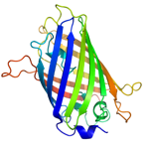
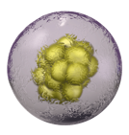
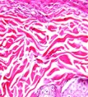
Medicine at different length scales
MicroMAX
BioMAX
coSAXS
NanoMAX
MedMAX I
MedMAX II
10⁻¹⁰ m
10⁻⁹ m
10⁻⁶ m
Atoms
Biomolecules
Molecular
complexes
Micro-
structures
Cells
Tissues
Organs
Animals
Molecular Medicine/Drug Design
Cellbiology
Disease
models

Slide 8
Phase contrast and dark-field imaging

Slide 9
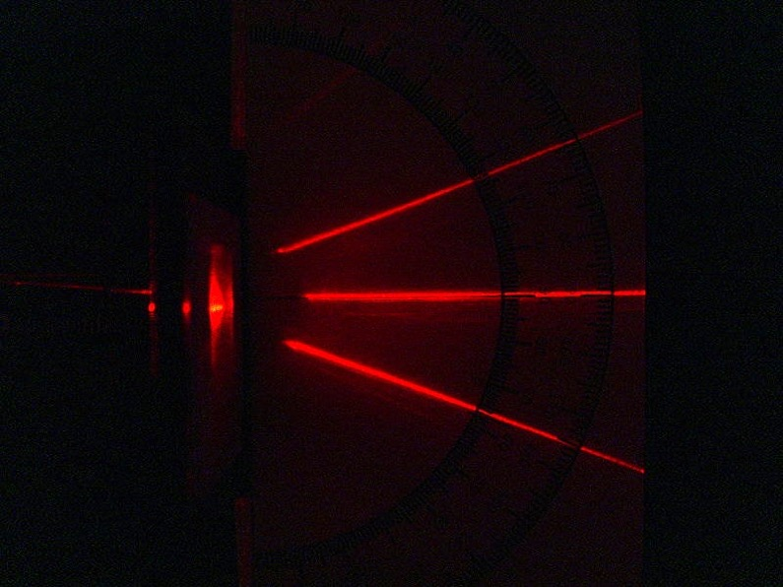
Analogy – Visible Light
Diffraction
Refraction
Wikimedia Commons
Notes:
15 Nobel Prizes:
1901 Röntgen, 1914 Laue, 1915 Bragg & Bragg, 1917 Barkla, 1924 Siegbahn, 1927 Compton, 1936 Debye, 1962 Perutz & Kendrew, 1962 Crick & Watson & Wilkins, 1976 Lipscomb, 1979 Cormack & Hounsfield, 1981 Siegbahn, 1985 Karle & Hauptman, 1988 Deisenhofer & Huber & Michel

Slide 10
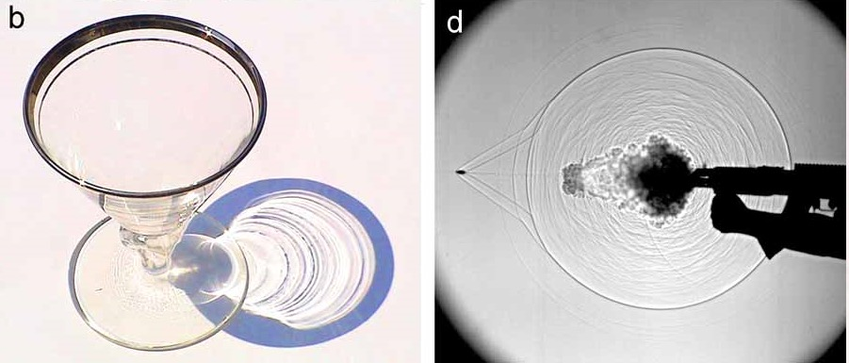
Analogy – Visible Light
A
B
Images by Gary S. Settles, Penn State Gas Dynamics Lab
Phase contrast imaging
Notes:
Good analogy because it is the same: Electromagnetic waves

Slide 11
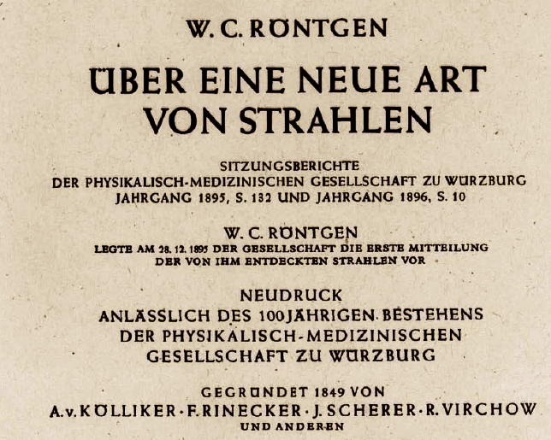
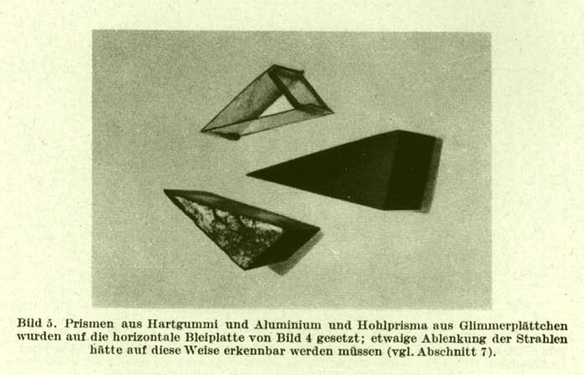
Röntgen was also looking for refraction…
Notes:
George de Hevesy, Chemist

Slide 12
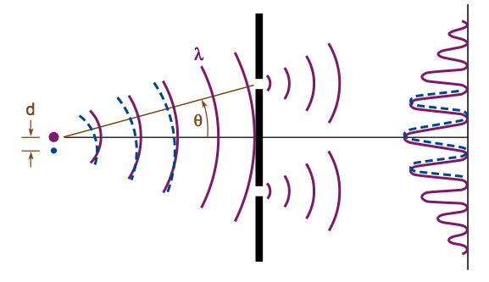
Coherence
Ability to interfere due to particle/wave duality

Slide 13
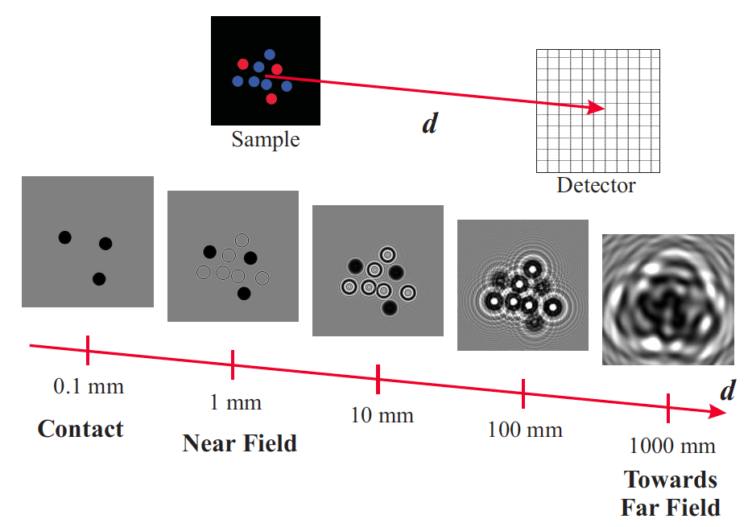
Near-field versus far-field
Image courtesy: Timm Weitkamp

Slide 14
Wave propagation for beginners
Wave propagation regimes: Fresnel number:
a = “resolution”, λ = wavelength, Z = propagation distance
For λ = 10⁻¹⁰ m a Z
Contact regime F >> 1 1 mm 10 cm
Near field regime (Fresnel) F ~ 1 1 µm 10 cm
Far field regime (Fraunhofer) F << 1 1 nm 10 cm
Near field regime (Fresnel) F ~ 1 1 mm 10 km
Near field regime (Fresnel) F ~ 1 1 µm 10 cm
Near field regime (Fresnel) F ~ 1 1 Å 1 Å

Slide 15
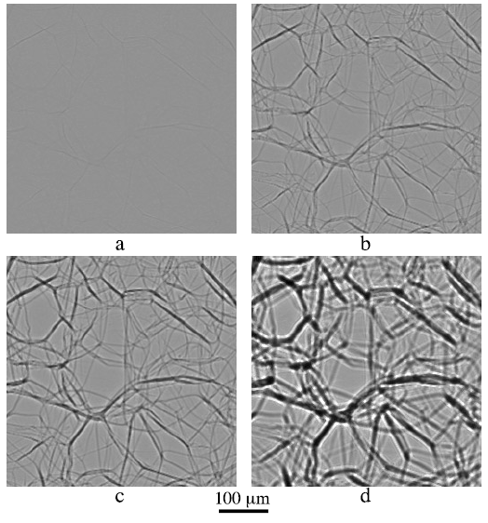
Holotomography
Polystyrene foam.
P. Cloetens 1999

Slide 16
Outline
What is phase contrast imaging and dark-field imaging?
Why are these new imaging modalities good for bio-medical imaging?
Future prospects of phase-contrast imaging?

Slide 17
Selected Application
3D imaging by nano holotomography
Notes:
Many applications in virtually any field where histology is but.

Slide 18
Zoom tomography of biopsies from human peripheral nerves

Slide 19
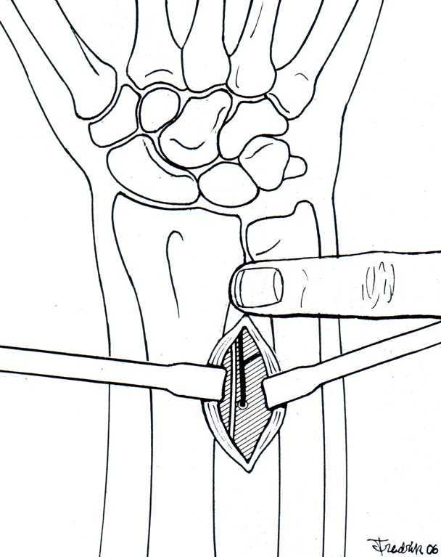
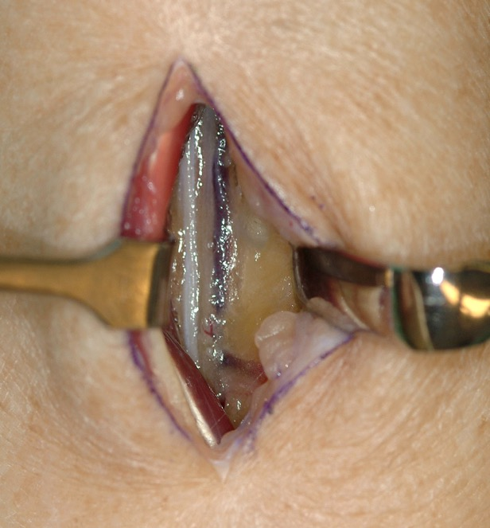
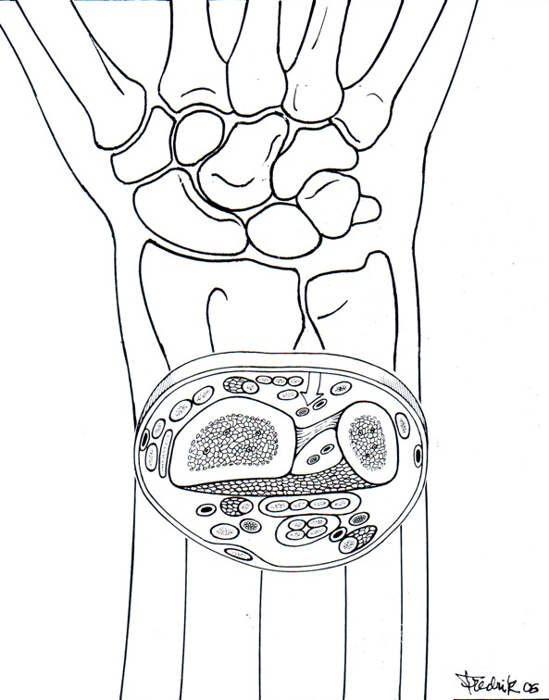
PIN biopsy method
Radius
Ulna
Posterior interosseus nerve
Collaboration Niels Thomsen and Rayaz Malik
Notes:
The PIN biopsy can be performed as an outpatient procedure. Local anasthesia. After innervating the extensor pollicis longus and extensor indicis proprius muscles the distal part of the PIN becomes purely sensory and passes deep to the interosseous membrane in the radial part of the fourth compartment. Innervate the central two-thirds of the dorsal aspect of the radio- and inter-carpal joints. Incision 1 cm proximal to the DRUJ
Open the 4 extensor compartment
Postopr. Light dressing, The patient is encouraged to use the hand for lightweight activities. Removed outher bandage after 5 days, removal of sutures day 10.

Slide 20
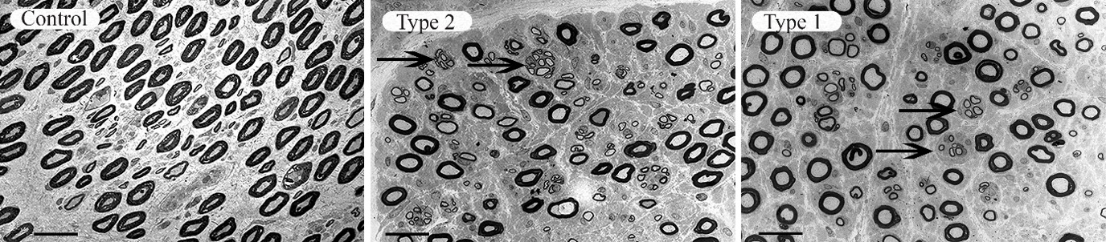
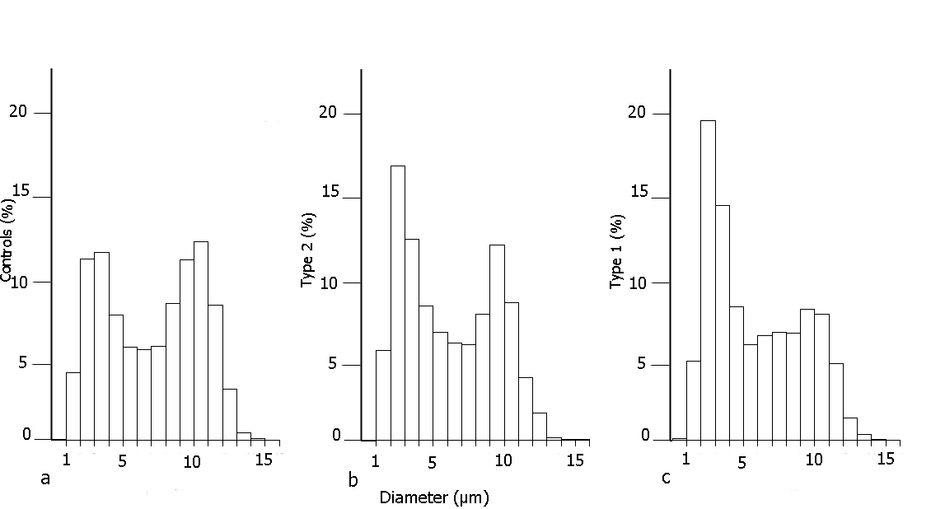
Diabetic Neuropathy – nerve fiber distribution
Posterior interosseous nerve – upper extremity
Notes:
Sural nerve biopsy

Slide 21
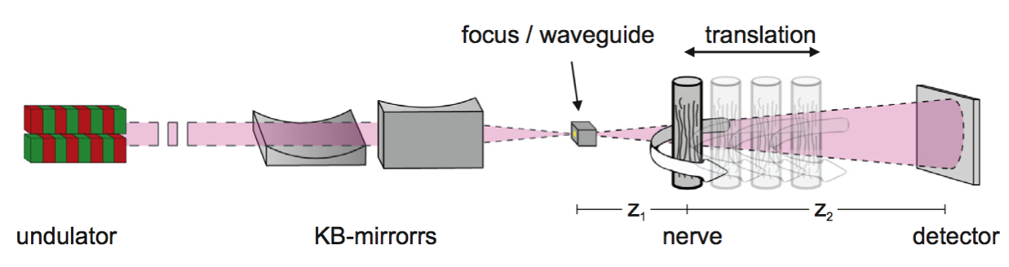
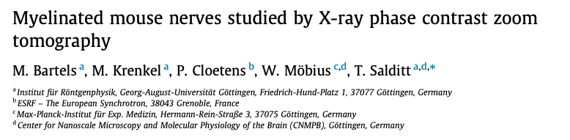

Nano tomography @ synchrotron

Slide 22
Synchrotron Nano CT versus
3D Electron microscopy
Technique | Resolution | Field of View | Acquisition Time | Other
Synchrotron Imaging | 75 nm | ~150 µm | Hours | Non destructive
3D Electron microscopy | In plane: ~ 5-20 nm Slice-wise: ~ 50+ nm |  | Days | Destructive Artifacts in different slices Need for alignment of 2D images
Abdollahzadeh
et al. 2019
~15 x 15 x 15 µm³
Lee et al. 2019 48 x 36 x 20 µm³

Slide 23
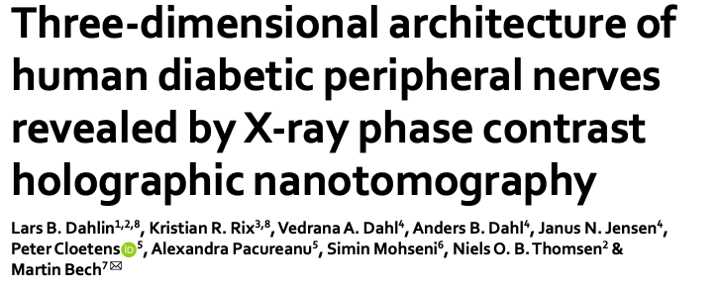
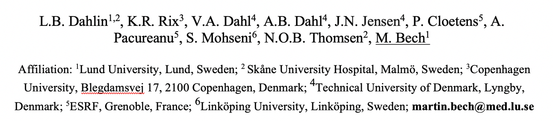
Nano-Tomography at ID-16NI, ESRF
Scientific Reports (2020) 10:7592 https://doi.org/10.1038/s41598-020-64430-5

Slide 24
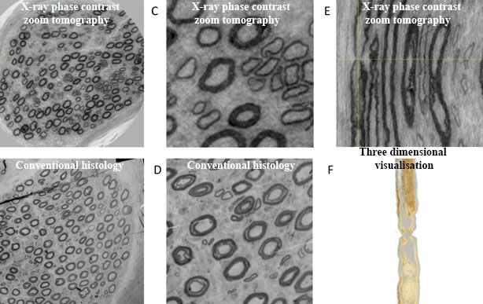
X-ray phase contrast zoom tomography

Slide 25
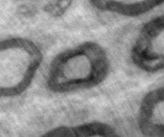
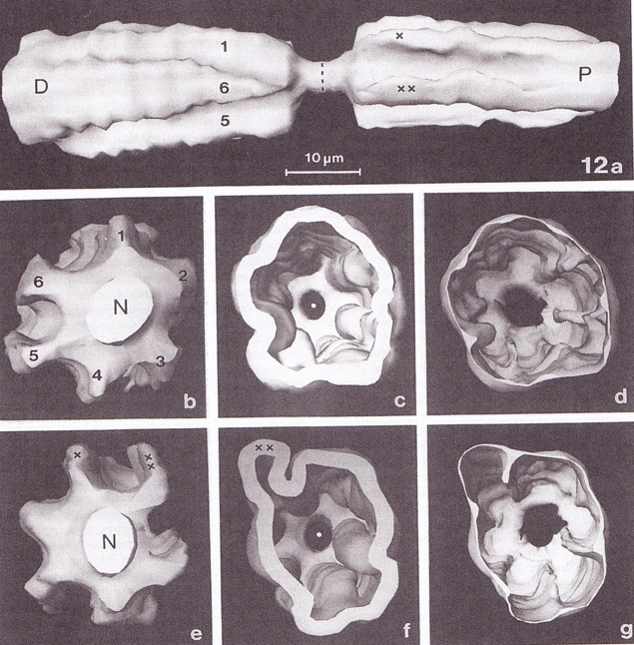
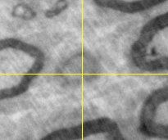
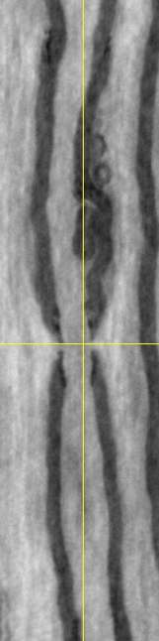
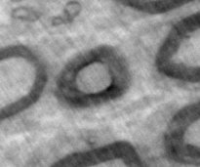
Node of Ranvier
Node of Ranvier – myelinated nerve fiber with myelin deleted
Berthold et al 1990
Notes:
Electron microscopic serial section analysis of nodes of Ranvier

Slide 26
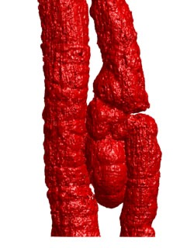
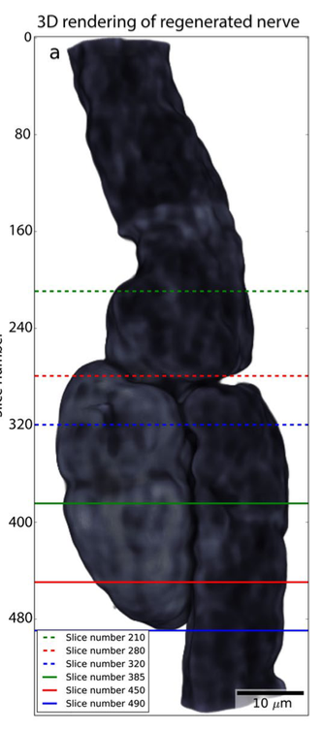
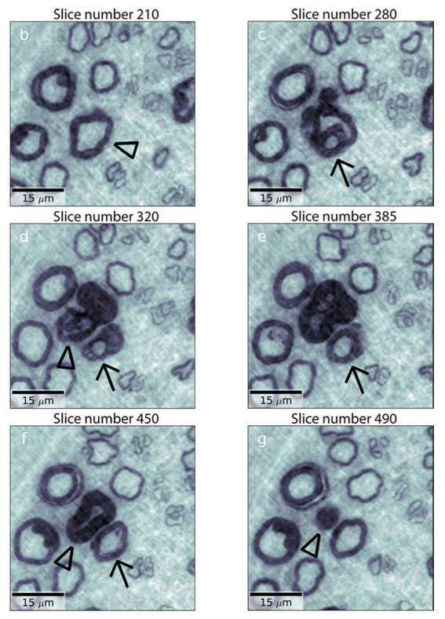
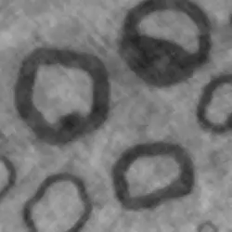
Regeneration – the birth of an axon

Slide 27
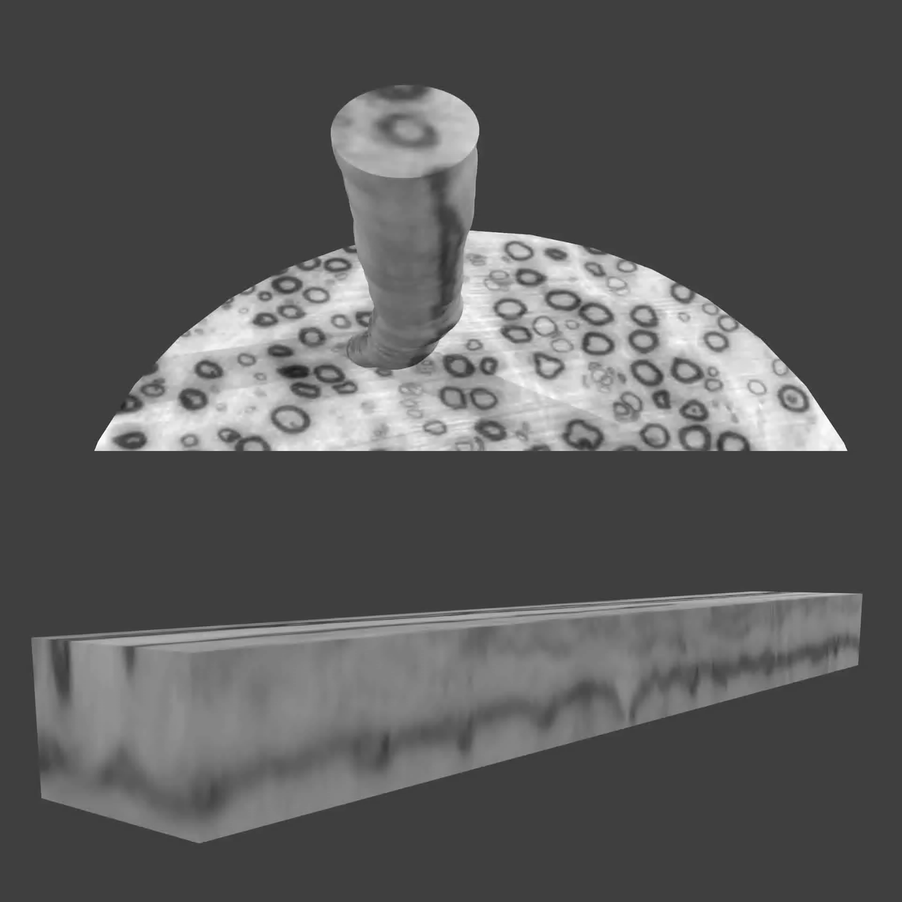
Data segmentation
Extraction of both inner and outer surface
Dahl, V. A., Trinderup, C. H., Emerson, M. J., & Dahl, A. B. (2018) Content-based Propagation of User Markings for Interactive Segmentation of Patterned Images. IEEE Transactions on Image Processing. 2018
Data analysis by
Hans Martin Kjer

Slide 28
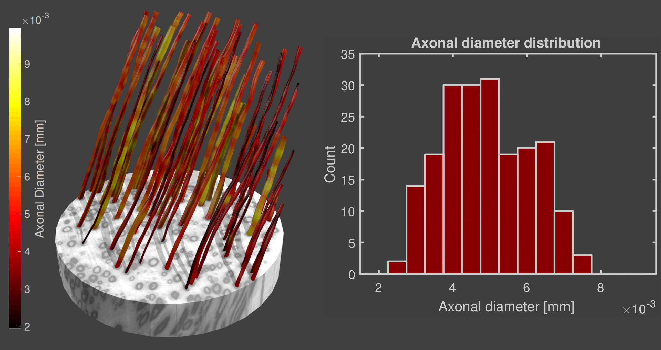
Morphology: Axonal diameter
Data analysis by Hans Martin Kjer, DTU

Slide 29
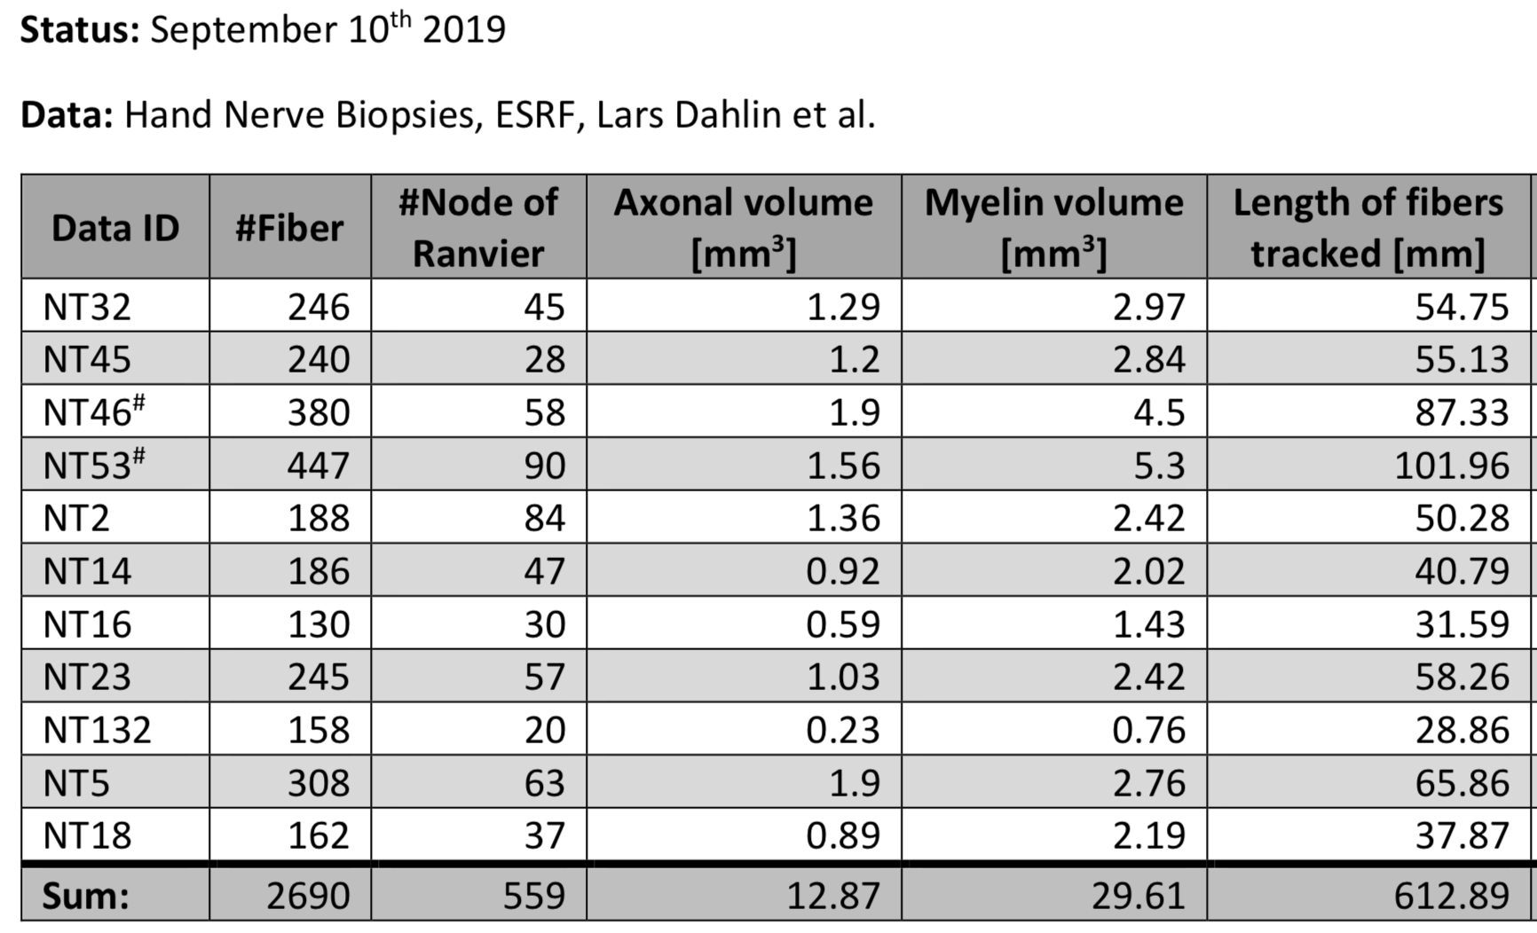
Quantitative data extraction
X10⁻³
X10⁻³

Slide 30
Outline
What is phase contrast imaging and dark-field imaging?
Why are these new imaging modalities good for bio-medical imaging?
Future prospects of synchrotron phase-contrast imaging?

Slide 31
Outlook: Bio-medical Imaging and pre-clinical implementation

Slide 32
Bio-imaging at different length scales
Protein crystallography
Coherent diffractive imaging
Nano/Micro tomography
10⁻¹⁰ m
10⁻⁹ m
10⁻⁶ m
Atoms
Biomolecules
Molecular
complexes
Micro-
structures
Cells
Tissues
Organs
Animals
Slide courtesy: Tomas Lundqvist

Slide 33
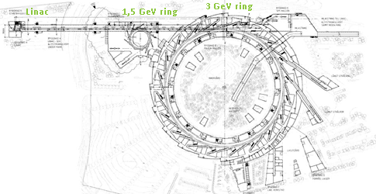
MedMAX – for biomedical imaging
Imaging beamline
  165 m long
  Large field-of-view
Energy range
  5 – 50 keV
MedMAX

Slide 34
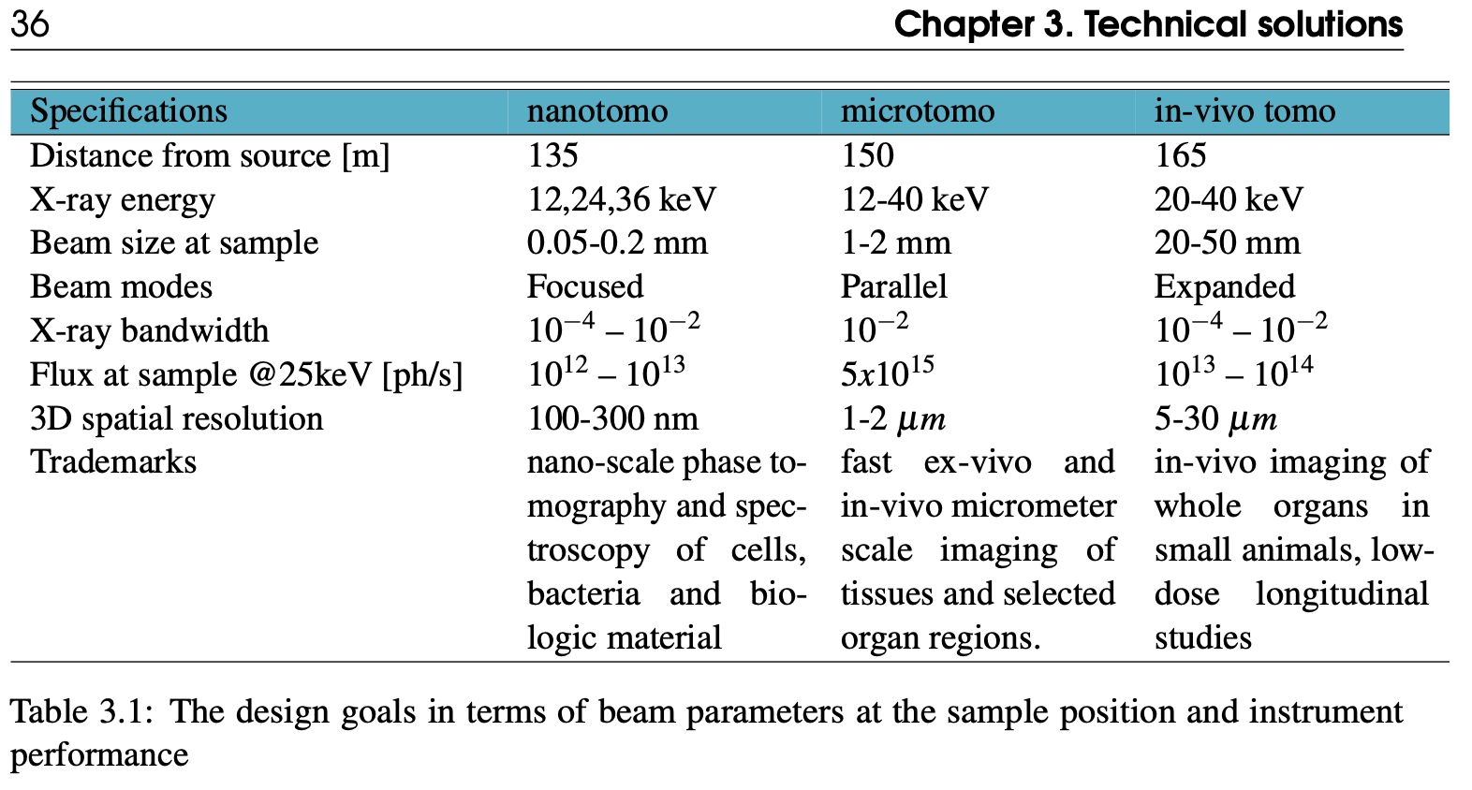
Technical scope for Biomedical beamline, MedMAX
Conceptual design report
Notes:
density sensitivity down to 0.5 mg/cm³

Slide 35
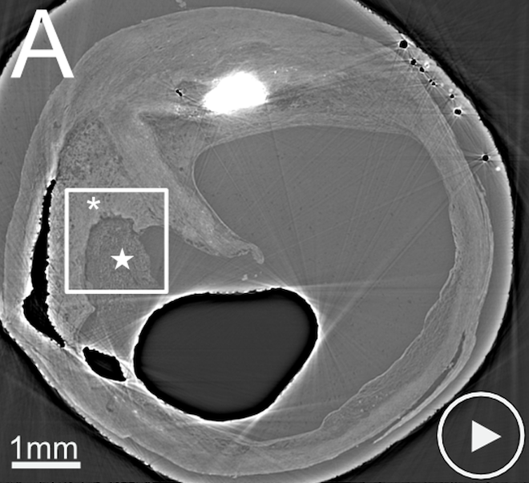
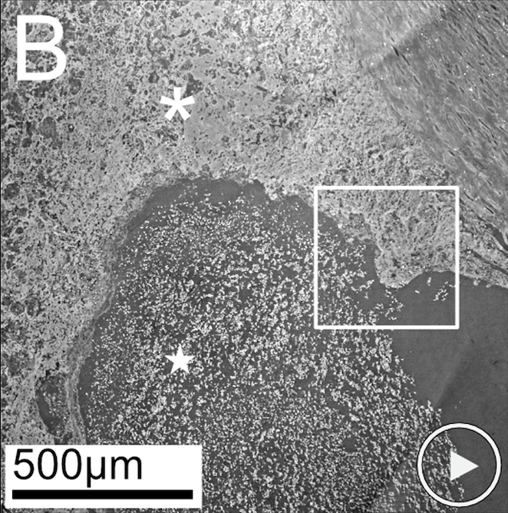
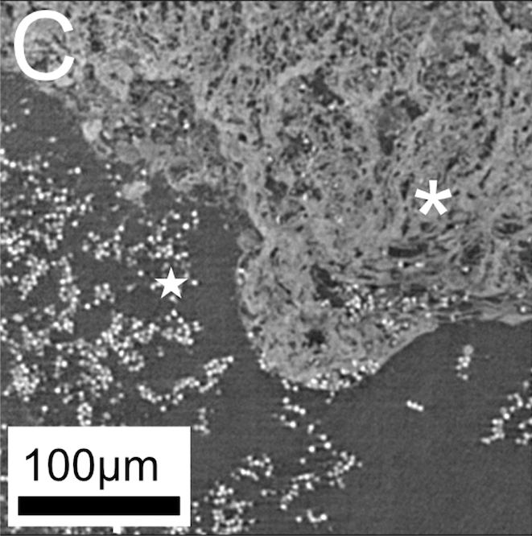
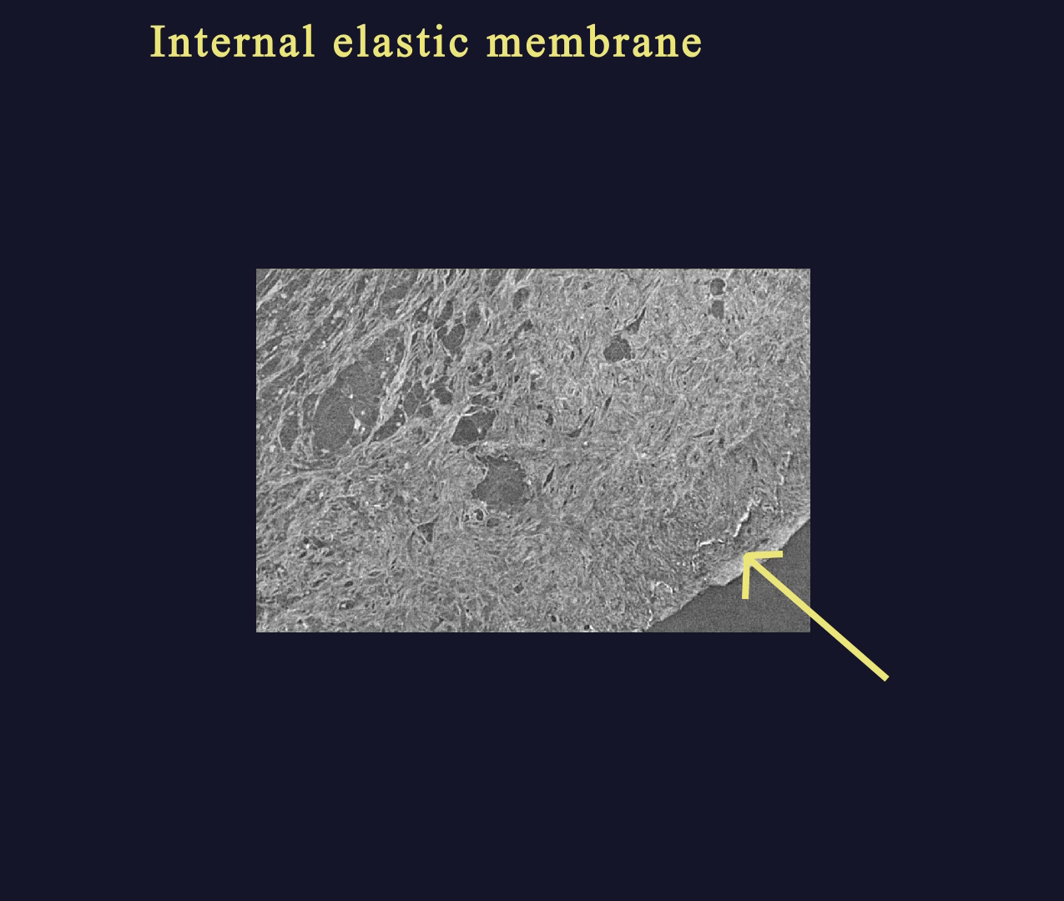




Imaging with synchrotron x-rays
Truong et al. (2022) Sub-micrometer morphology of human atherosclerotic plaque revealed by synchrotron radiation based μCT—A comparison with histology. PLOS ONE 17(4): e0265598.
Notes:
Rupture with plaque tissue exposed to the bloodstream with thrombus formation.
(A) LR SRμCT of a ruptured shoulder region with plaque tissue (asterisk) exposed to the bloodstream with the formation of a thrombus (star). (B) the zoomed-in area of the interface between plaque tissue and thrombus, obtained with HR SRμCT. The white square in (A) corresponds to the area in (B). (C) shows the area of the white square in B with the zoomed-in region of the plaque tissue (asterisk) and thrombus (star) interface. Individual erythrocytes are also seen scattered within the exposed plaque tissue, which is also seen in histology (D-F). The corresponding section in histology, stained for erythrocytes (Glycophorin A), is seen in (D), with the black squares marking zoom-in regions in (E) and further in (F). The black asterisk indicates plaque tissue and the black star marks the thrombus. The "play" symbols in (A) and (B) indicate related movie material, showing the LR (S4 Movie in S1 File) and HR (S5 Movie in S1 File) tomographic image stacks. Plaque ID 1 in S1 Table in S1 File.

Slide 36
Thank you for your attention
Lund University
Region Skåne
Medicon village

