Slide 1
MAX-IV Synchrotron Facility
Dr Stephen Molloy, Head of Accelerator Operations, MAX-IV

Slide 2
This is a presentation of the work of many people over many years.
All credit should go to them.
Any mistakes are mine.

Slide 3
What is a synchrotron light source?

Slide 4
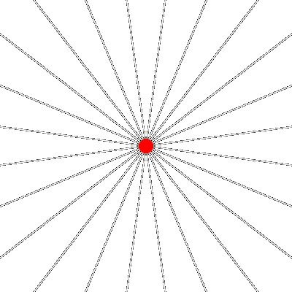
Some electromagnetism
E-field around a charge is disrupted by acceleration
This disruption moves at c, and is observed as a flash of light

Slide 5
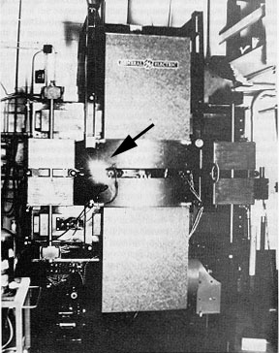
Some electromagnetism
E-field around a charge is disrupted by acceleration
This disruption moves at c, and is observed as a flash of light
24th April, 1947, (almost exactly 75 years ago) this light was first observed in the GE 70 MeV synchrotron
  Initially thought to be arcing, they soon realised they were observing direct emission from orbiting electrons

Slide 6
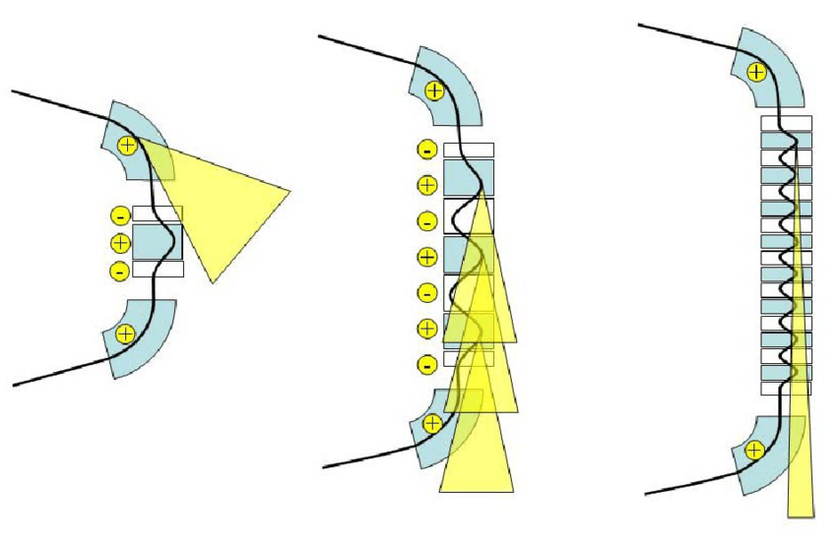
Some electromagnetism
E-field around a charge is disrupted by acceleration
This disruption moves at c, and is observed as a flash of light
24th April, 1947, (almost exactly 75 years ago) this light was first observed in the GE 70 MeV synchrotron
  Initially thought to be arcing, they soon realised they were observing direct emission from orbiting electrons
First taken advantage of as a side-effect of such accelerators, before machines dedicated to light generation were built
  Dipole, wiggler, and undulator light

Slide 7
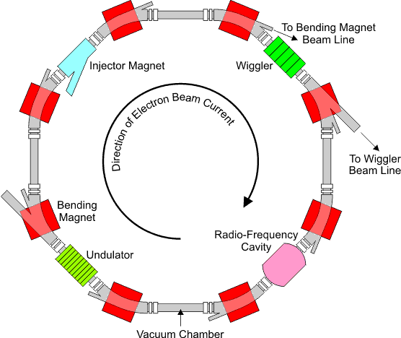
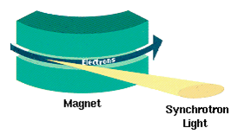
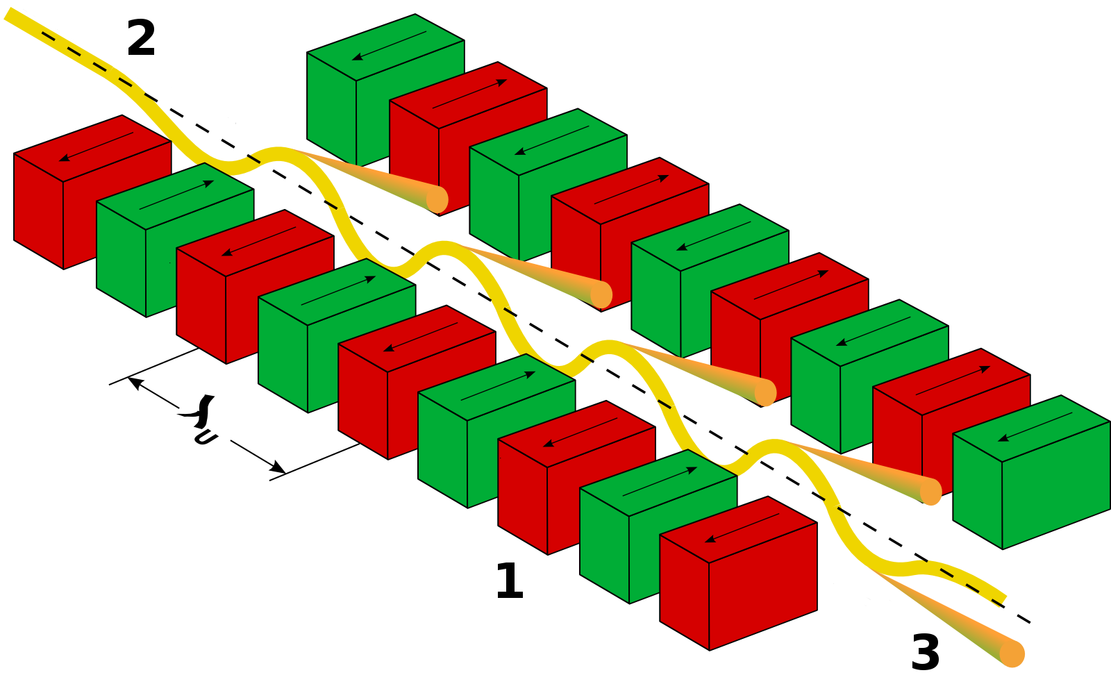
Synchrotron Light Sources
R. Bartolini, John Adams Institute (license)
https://commons.wikimedia.org/wiki/File:Undulator.png (license)
http://pd.chem.ucl.ac.uk/pdnn/inst2/work.htm

Slide 8
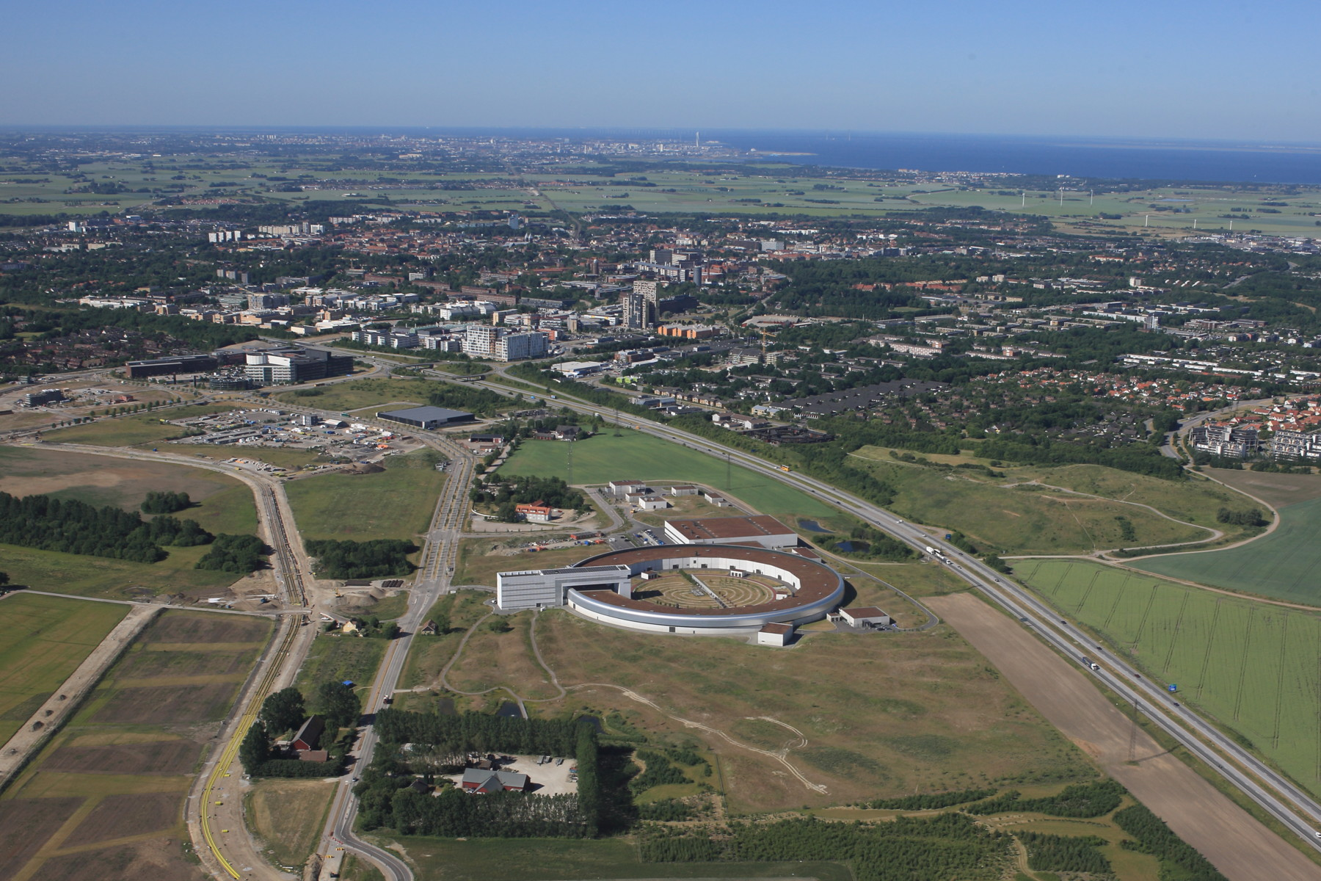


Slide 9
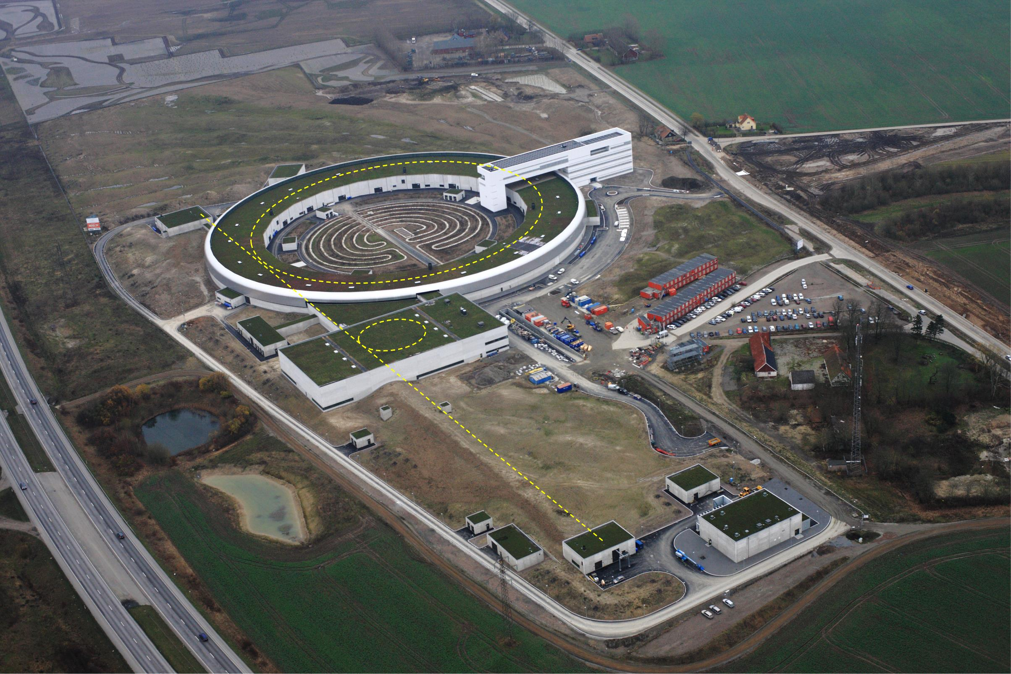
The MAX IV Accelerators
3 GeV ring
528 m circ, MBA, 330 pmrad
Short Pulse Facility
1.5 GeV Ring
96 m circ., DBA, 6 nmrad
Linear accelerator (ca 250 m)
Electron sources
Slide by S.Werin

Slide 10
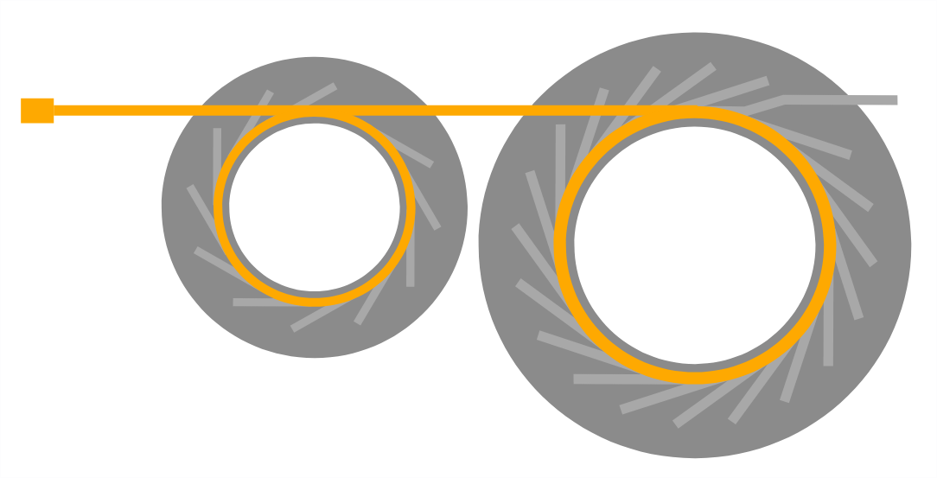
Short Pulse Facility
1.5 GeV Ring
3.0 GeV Ring

Slide 11
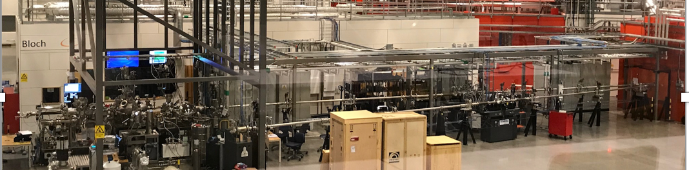
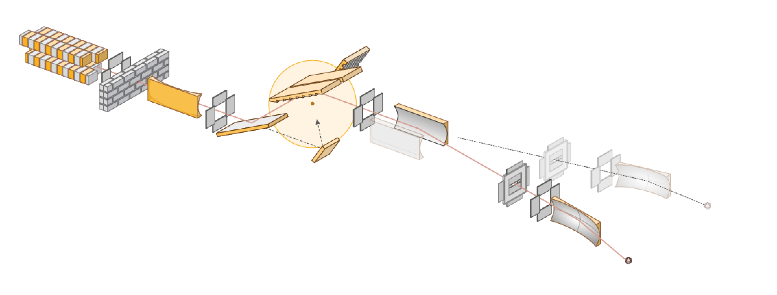
An example beamline – BLOCH
Apple II type
quasi-periodic undulator
Four different gratings can be used
A cylindrical mirror M3_{A} or M3_{B} selects an endstation, and focuses the beam vertically on to the exit slit
A toroidal mirror M1 focuses the beam horizontally on to the exit slit and collimates it vertically.
Spin-Arpes
Plane mirror M2 or M2_{NIM} directs the beam on to the grating
Exit slit
An ellipsoidal mirror M4_{A} or M4_{B} focuses the beam on to the sample.
Arpes

Slide 12
MAX-IV’s 3 GeV Ring is the most brilliant in the world…
...But what does that mean?
...And how was that done?

Slide 13
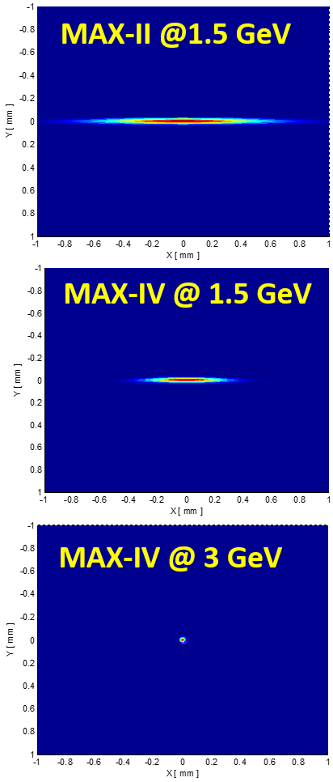

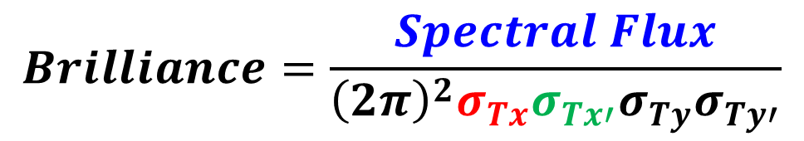
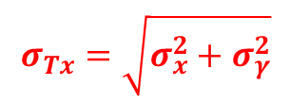
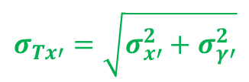
What is Brilliance ?
Total Horizontal Beamsize:
Total Horizontal Divergence:
Electron beam
Size
Photon beam
Size
Electron beam
Divergence
Photon beam
Divergence

Slide 14
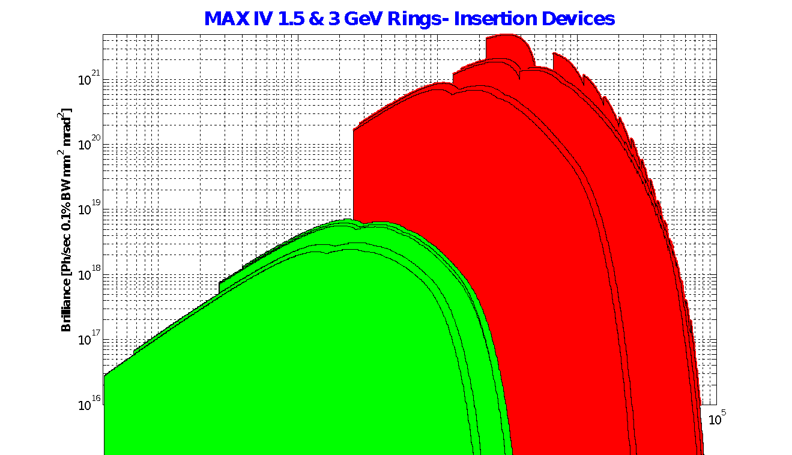
Brilliance @ MAX IV
3 GeV
1.5 GeV

Slide 15
So, brilliance is a result of the phase-space of the photon & e⁻ beams.
What control do we have over this?

Slide 16
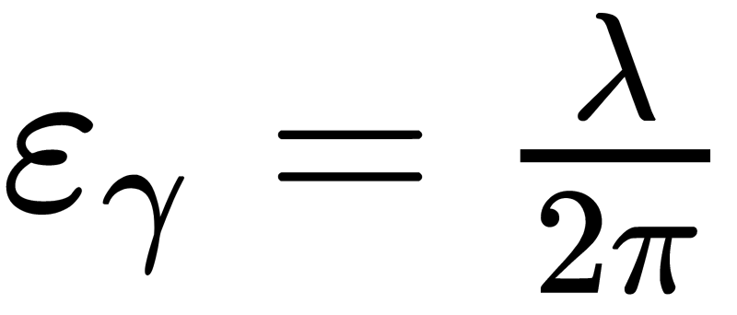
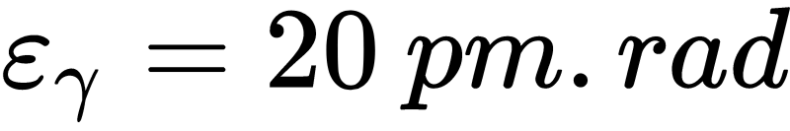
Photon beam emittance
“Emittance” is, roughly speaking, a measure of the size of a bunch of particles and the rate at which it is diverging
Very simple → the diffraction limit of EM radiation at that wavelength
All beamlines have different demands, but a typical number at MAX-IV might be:
Note that this value is set by the needs of the users, and therefore not controllable

Slide 17
Electron beam emittance
A balance between two processes:
  Damping due to particle acceleration
  Excitation due to the quantum nature of synchrotron emission
That is, the e⁻ emittance is a function of the magnetic fields in the accelerator
Therefore, this can be optimised through the design of the machine

Slide 18
29 November 1993
Dieter Einfeld, Mark Plesko
“Design of a diffraction limited light source”
International Symposium on Optics, Imaging, and Instrumentation
On this date: I was 14, and Meatloaf was top of the charts in the UK and the US

Slide 19
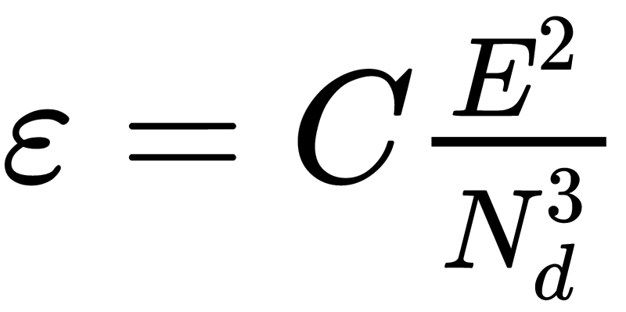
Key insight from that paper
Imagine you had a God-like ability to optimise the field strengths in an accelerator
  For any accelerator, you could find the fields that minimise the emittance
In this case, the emittance goes as:
More bending magnets, with softer bends, have a *cubic* effect on the beam emittance

Slide 20
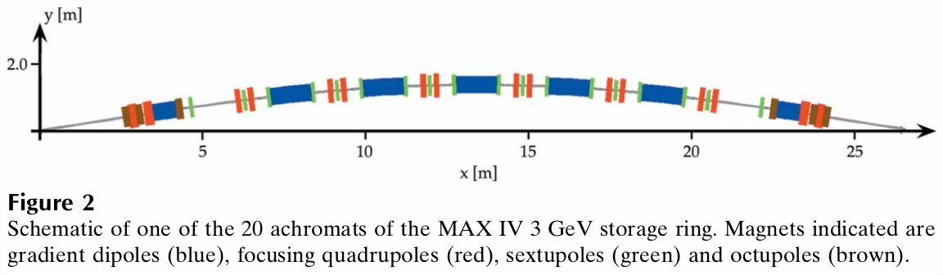
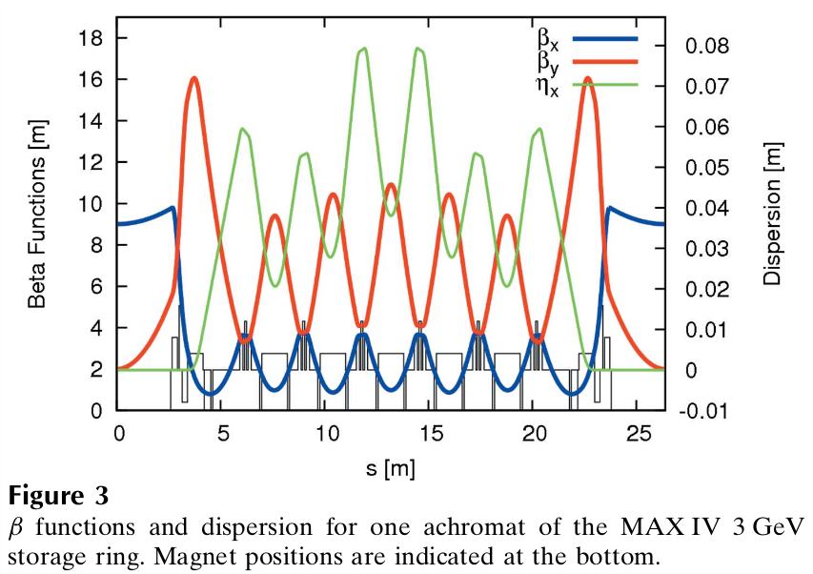
Multi-Bend Achromat at MAX-IV
20 achromats
7 bends per achromat
5 full-strength, 2 half-strength at the ends
(full-strength = 3°)

Slide 21
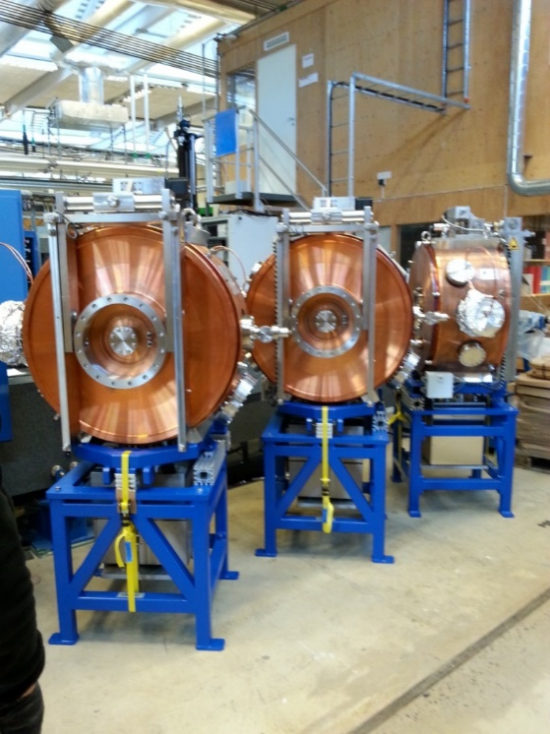
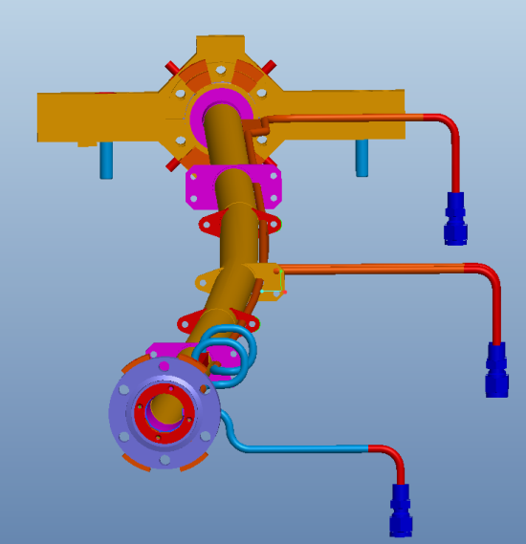
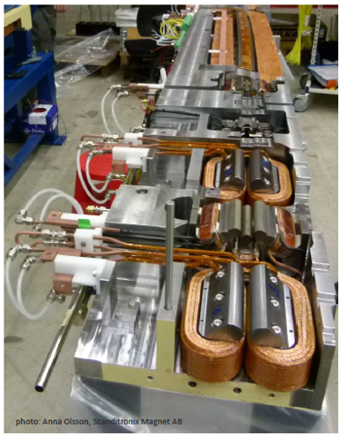
MAX-IV Engineering Issues
100 MHz accelerating RF
Circular, Cu, NEG-coated vacuum chambers
Compact magnet design

Slide 22
Achieved Performance
300 mA e- stored during delivery to users
  500 mA demonstrated
Emittances:
  𝛆_{x} = 320 ± 18 pm.rad
  𝛆_{y} = 6.5 ± 0.1 pm.rad
e- beam position stability (integrated to 5 kHz)
  <2% of beam size horizontally
  <5% of beam size vertically

Slide 23
Achieved Performance
X-ray brightness (over all wavelengths)
300 mA e- stored during delivery to users
  500 mA demonstrated
Emittances:
  𝛆_{x} = 320 ± 18 pm.rad
  𝛆_{y} = 6.5 ± 0.1 pm.rad
e- beam position stability (integrated to 5 kHz)
  <2% of beam size horizontally
  <5% of beam size vertically

Slide 24
Achieved Performance
X-ray brightness (over all wavelengths)
300 mA e- stored during delivery to users
  500 mA demonstrated
Emittances:
  𝛆_{x} = 320 ± 18 pm.rad
  𝛆_{y} = 6.5 ± 0.1 pm.rad
e- beam position stability (integrated to 5 kHz)
  <2% of beam size horizontally
  <5% of beam size vertically
Spectral purity and apparent source-size (diffraction limited in many cases)

Slide 25
Achieved Performance
X-ray brightness (over all wavelengths)
300 mA e- stored during delivery to users
  500 mA demonstrated
Emittances:
  𝛆_{x} = 320 ± 18 pm.rad
  𝛆_{y} = 6.5 ± 0.1 pm.rad
e- beam position stability (integrated to 5 kHz)
  <2% of beam size horizontally
  <5% of beam size vertically
Spectral purity and apparent source-size (diffraction limited in many cases)
Stability of apparent source location

Slide 26
Short pulse facility (SPF)

Slide 27
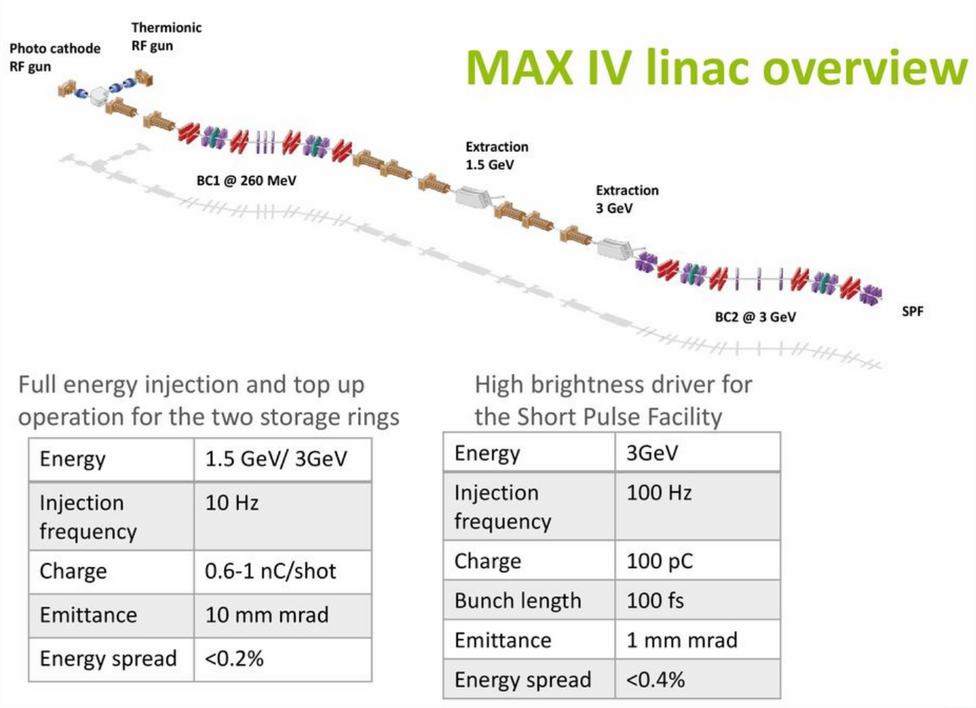

Slide 28
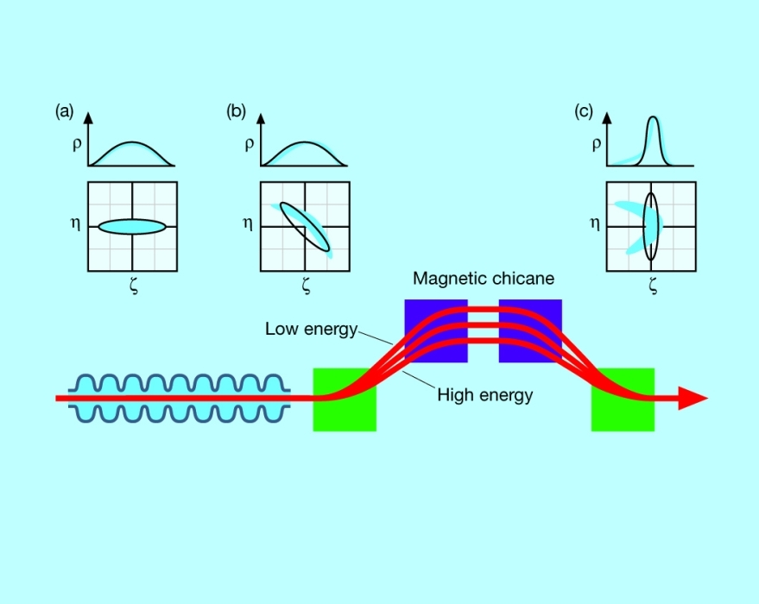
Bunch compression in a linac
The compression scheme in SPF is somewhat different, but this serves to illustrate the main concept
http://photon-science.desy.de/facilities/flash/the_free_electron_laser/how_it_works/bunch_compression/index_eng.html

Slide 29
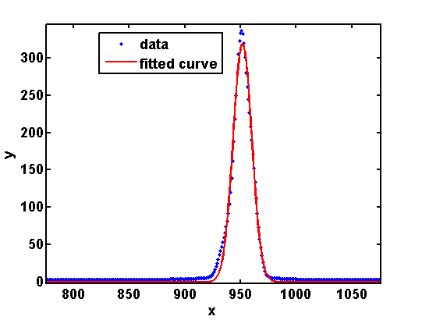
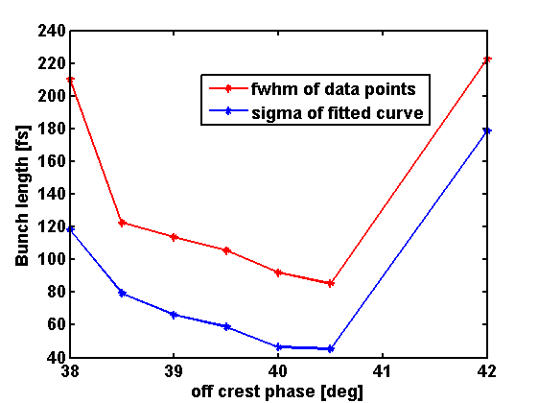
Achieved at SPF

Slide 30
Pump-probe experiments
Such short pulses can capture fast processes in intermediate stages
One technique,
  “Pump” a sample with a high power laser, then “probe” it with the X-ray pulse
  Sweep the time-delay between pump & probe to watch the reaction of the sample evolve
For example,
  Observe non-thermal melting
  Lattice parameter changes and then breaks down as the crystal evolves to liquid state

Slide 31
Looking to the future

Slide 32
Continue to lead the way
The range of impressive new synchrotrons coming online now share something in common – the MAX-IV MBA concept
Our plan is to continue to lead for the foreseeable future
3 GeV ring:
  Ultralong bunches
  Dramatic improvement in brightness
  Diffraction limit for high energy photons
1.5 GeV ring:
  Transparent top-up
  Pseudo single-bunch
  Alternative timing modes
SPF
  Ultrashort bunches
  Low jitter
  Soft X-ray FEL
  Hard X-ray FEL

Slide 33
Conclusion
The MAX-IV accelerators can satisfy a wide range of X-ray users
  Hard X-rays, soft X-rays
  Imaging, scattering, diffraction, spectroscopy, time-resolved, …
  Impossible to do justice to the range of research possibilities
    Including the advances in accelerator physics/engineering
The MBA concept has been successfully demonstrated
  Inspired multiple upgrade programs at light sources around the world
Much to look forward to in the future!

Slide 34
Thanks!

Slide 35
Backup Material

Slide 36
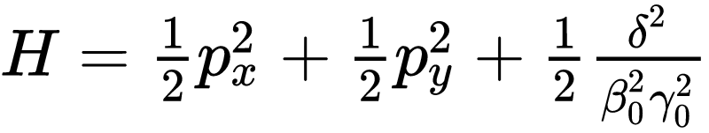
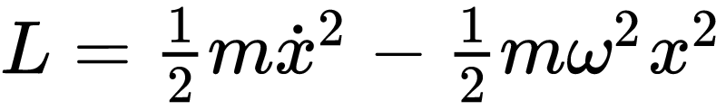
Some terminology
Particle dynamics in accelerators is done in the Hamiltonian formalism
  Phase space ⇒ Position and conjugate momentum
This is quite different from High Energy Physics, which typically uses the Lagrangian formalism
  Phase space ⇒ Position and velocity
Emittance ⇒ The area of the Hamiltonian phase space occupied by the beam in one plane (x, y, or longitudinally)
  Units: pm.rad
  A beam with a lower emittance is said to be “colder”
  Beam size goes with the square root of the emittance
    Smaller emittance (colder beam) is better

Slide 37
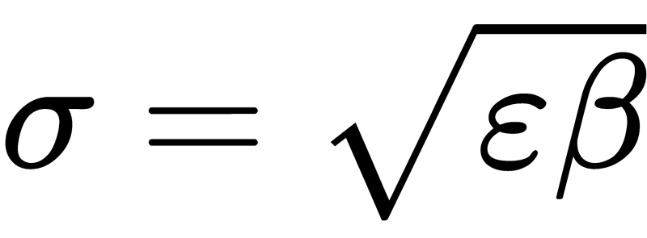
Some more terminology
Achromat:
  Sequence of magnets whose effect is independent of particle energy
  A pure dipole is *not* achromatic
  A sequence of dipoles and quadrupoles might be
Twiss parameters:
  A set of functions that describe the envelope of the beam’s size and divergence
    α, β, γ
    Beam size;
Dispersion:
  A function describing the path of an off-energy particle
    η

Slide 38

Key point from Einfeld & Plesko
Natural emittance determined almost solely in the magnetic bends
  That is, not in the straight sections where undulators are installed
The emittance goes linearly with H averaged over the bending magnets
H is minimised by designing η to have a minimum in the bending magnets
Real-world criteria forbid this
Instead, split large magnets into many smaller ones, and satisfy the constraint in most of them
  Reduce the bending angle of those where the constraint is broken to reduce their impact on H.

Slide 39
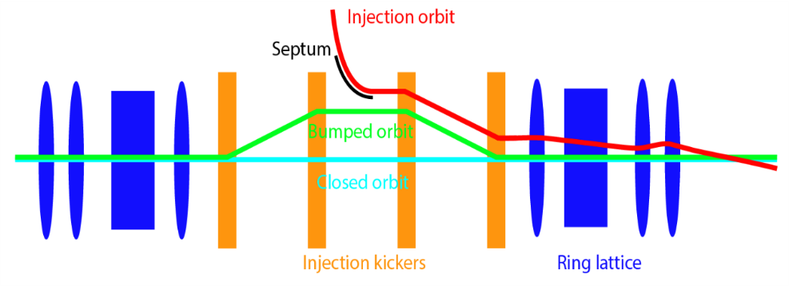
Injection is always disruptive to the stored beam
http://ados.web.psi.ch/SLS2/Notes/Notes%20before%202017/SLS2-Note-04-2016-10-25_deNeeve.pdf

Slide 40
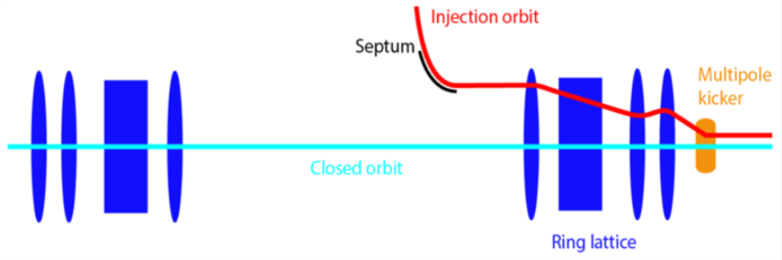
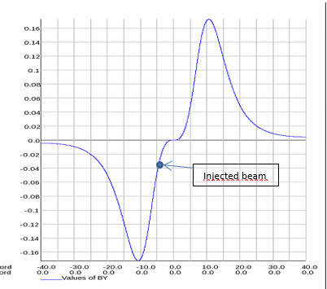
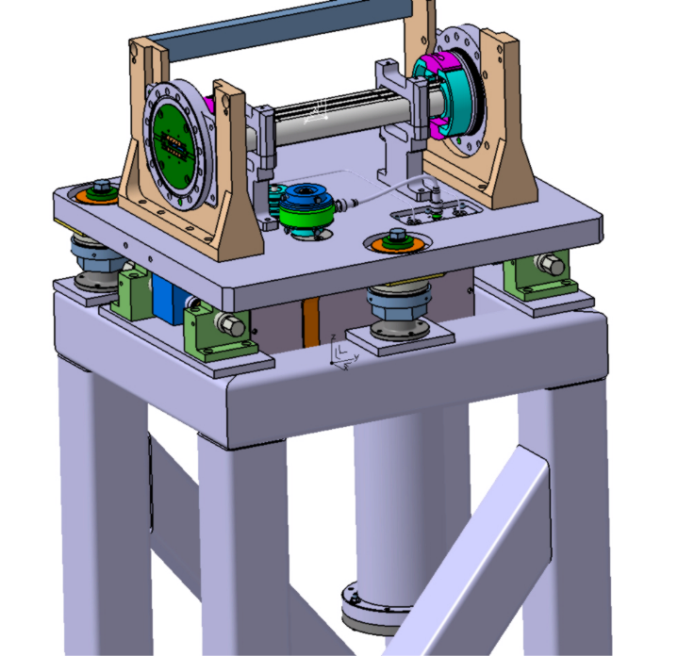
Multipole Injection Kicker (MIK)
http://ados.web.psi.ch/SLS2/Notes/Notes%20before%202017/SLS2-Note-04-2016-10-25_deNeeve.pdf
Joint project with SOLEIL, based on concept from BESSY

Slide 41
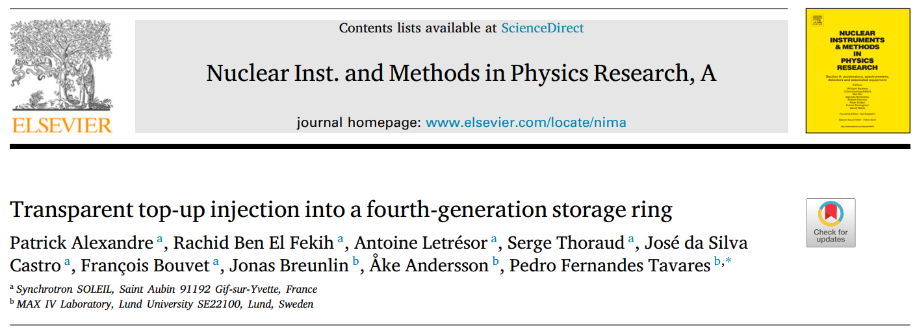
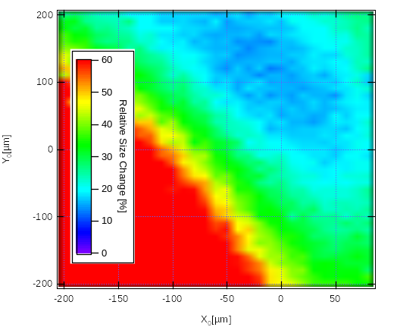
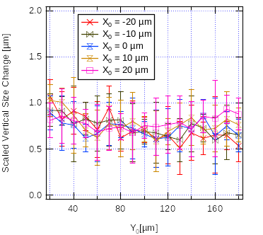
MIK Performance

