Slide 1
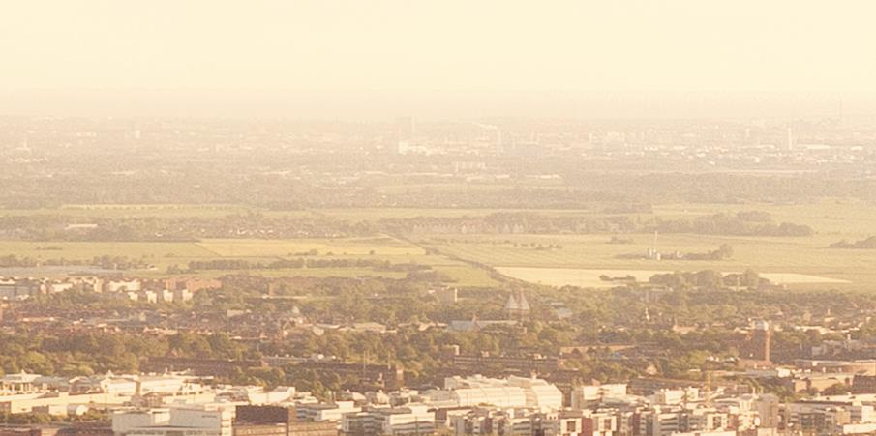
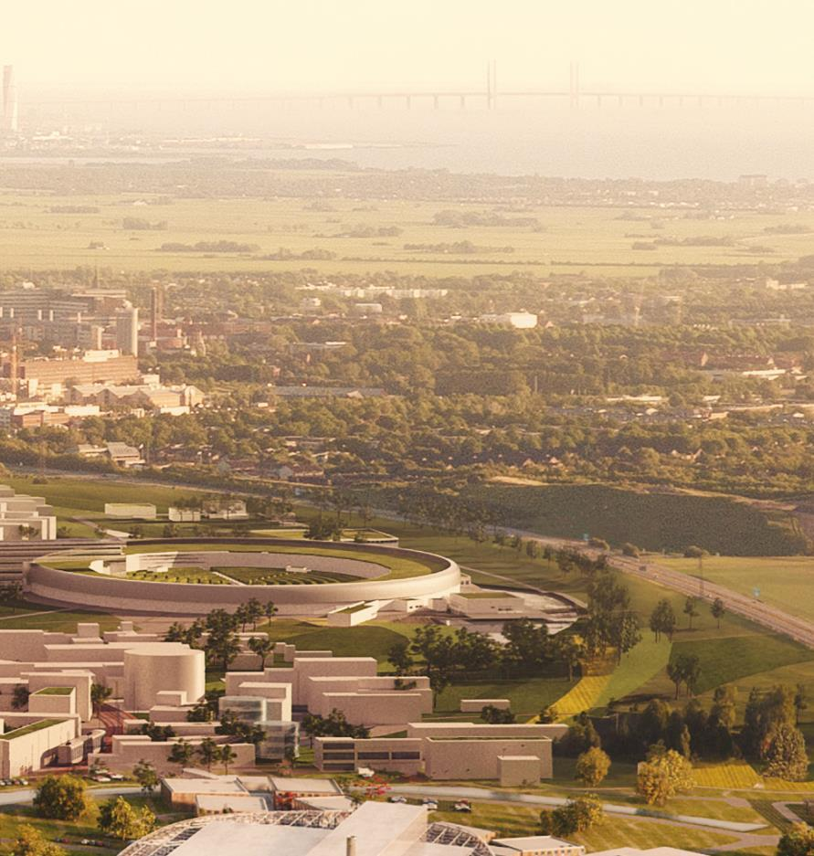
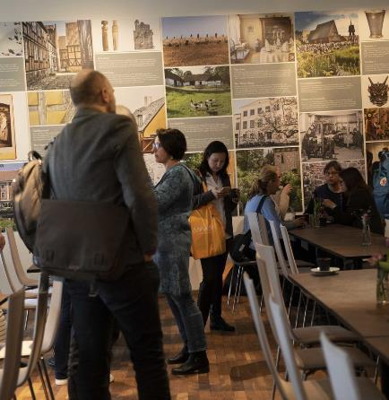
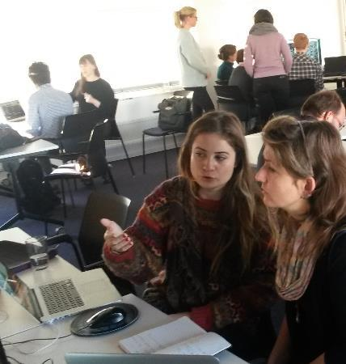

Slide 2
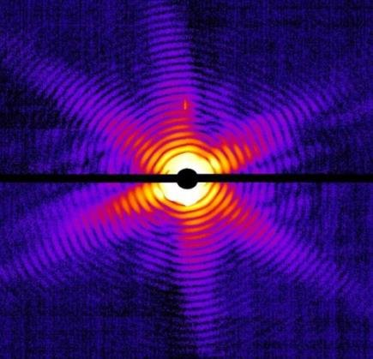
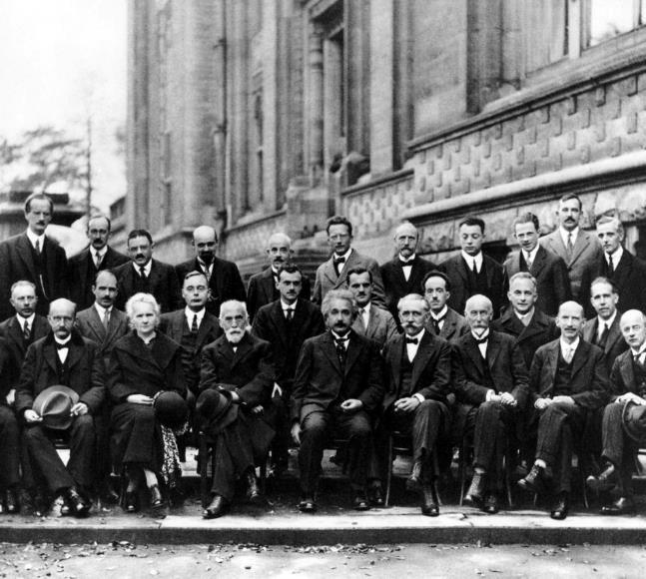
  Getting the right people together!
LINXS is an
advanced study institute
Our mission is to advance science and education for all research activities that can benefit from the use of neutrons and x-rays
We bring together scientific communities - experimentalists, theoreticians and modellers
“Advanced” is relative; the forefront can be found at different levels and manifestations depending on the community involved
Fifth Solvay Conference, Brussels, 1927
(image: Wikipedia)
Notes:
The Solvay conference (e.g. with Einstein, Marie Curie, Heisenberg Schrödinger, Bohr and Dirac) was the archetype for advanced studies institutes.
This is an old way of working – research now is massively interdisciplinary
The most important distinction that LINXS makes is that researchers are to be found both in academia, institutes and industry
Everyone asks what ”Advanced” means – In LINXS definitition, this is relative, it depends on the status of the field or sectors involved
I.e. LINXS is a ”Broad Church”

Slide 3
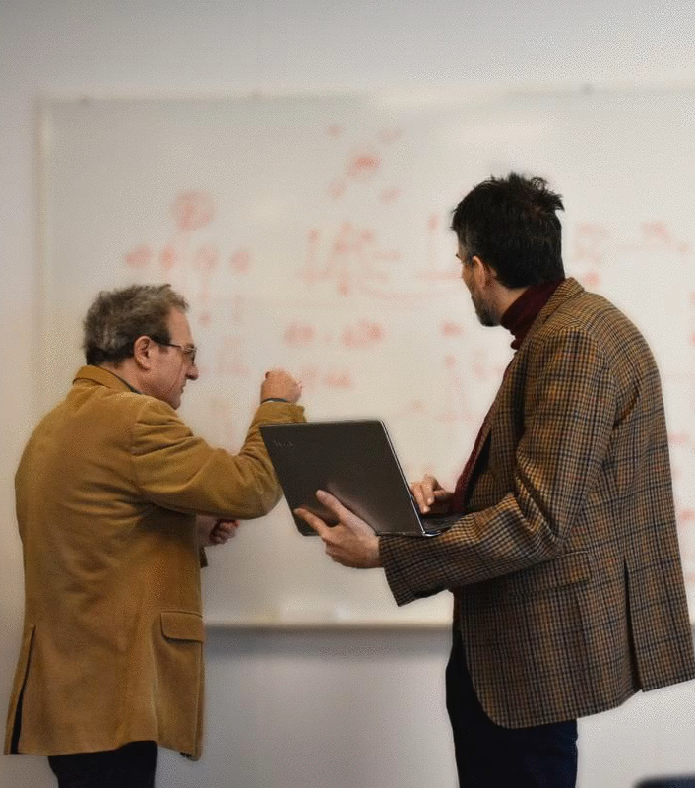
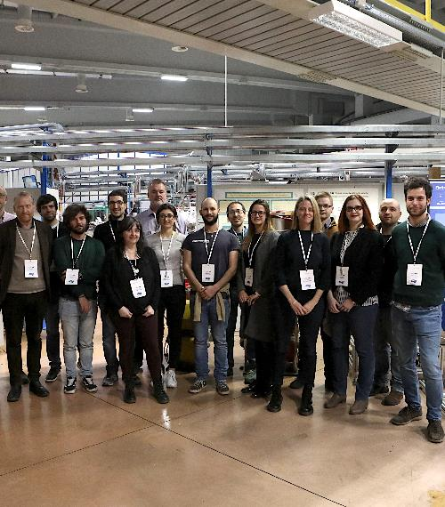
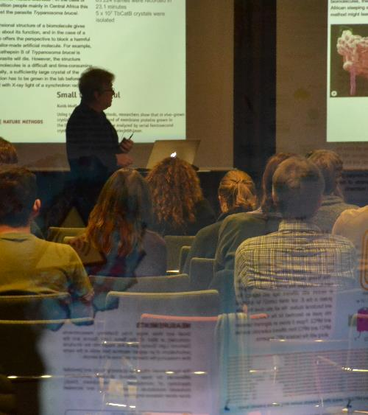
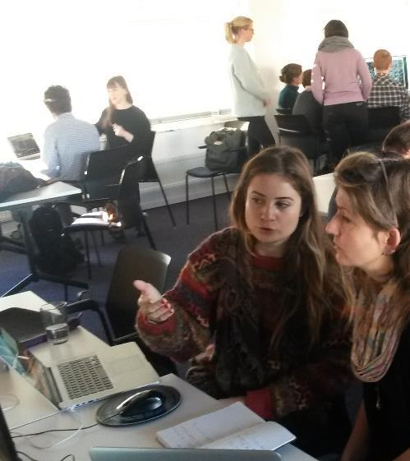
What is LINXS?
LINXS provides the time and space to bring researchers together to solve challenges
LINXS’ work is based around Themes, a time-limited programme of activities (3 years), with many active Working Groups focusing on specific topics
Themes are suggested by the com-munity and address key research challenges. Costs ~1,25 MSEK / yr to run, 1 for researcher salaries and 0,25 for activities. Most of the work is in-kind.
  Guest researchers
  Schools and try-outs
  Workshops, conferences and symposia
  Hackathons and
  research programs
Notes:
First click
The ways of working are modernised today! LINXS’ working principles are a combination of ones found in other modern advanced study instintues (e.g. Kavlí – KITP in Santa Barbara, Pufendorf, Oregon,…)
Anyone who’s in town doing research is welcome to work at LINXS – we won’t kick anyone out! (as long as there’s space)
LINXS is now located in Ideon right next to the Tram (you will pass it tomorrow, top two floors) and will be present in the first general buildings to go up in Science Village
Second click
We work with Themes – 3-4 year initiatives that focus on a specific set of challenges. These are planned to have a specific impact, in terms of science, funding och establishing longer term activities – thereby developing the user communit
Within each theme there are typically many Working Groups (6-10) dealing with a particular subset or research direction
Third click
There is a call procedure for themes, they are suggested by the community.
Important to involver the younger generations of researchers (PIs of the future)

Slide 4























2170+
people in the
LINXS network
Partners
Core partners
Members
LINXS in numbers
6 Themes so far
145 Fellows in 2021
(people active in Working Groups)
120+ Educational videos in repository
Current LINXS Fellows come from the
following organisations:
2021 statistics
2020
Collaborations:

Slide 5
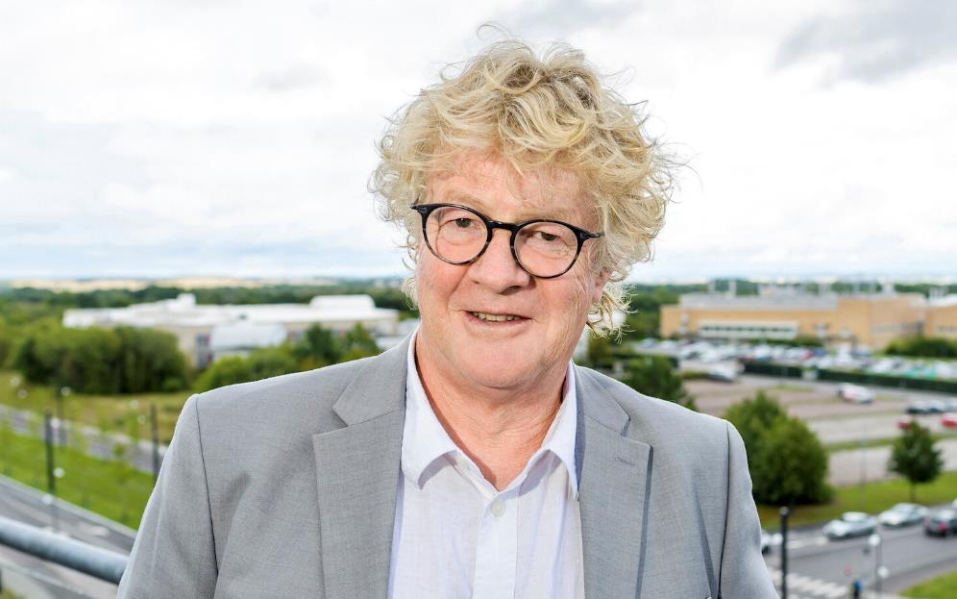
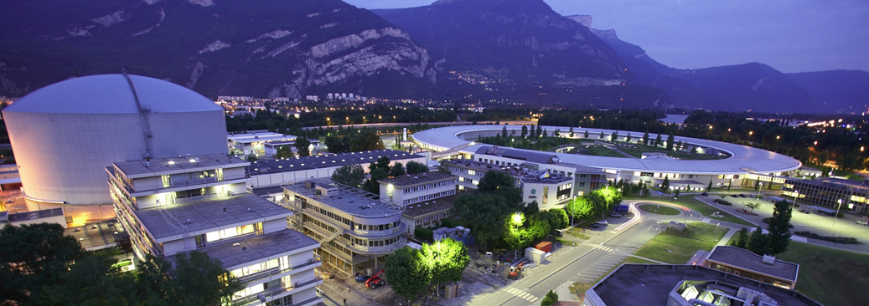
New Director – Trevor Forsyth
Appointed by Erik Renström,
first ever tri-faculty recruitment
Built up an interdisciplinary research environment linking four European Large Scale Research Facilities in Grenoble, France
LINXS Director (50%),
Research Professor (50%), at
Faculty of Medicine,
Lund University
Grenoble, EPN campus

Slide 6
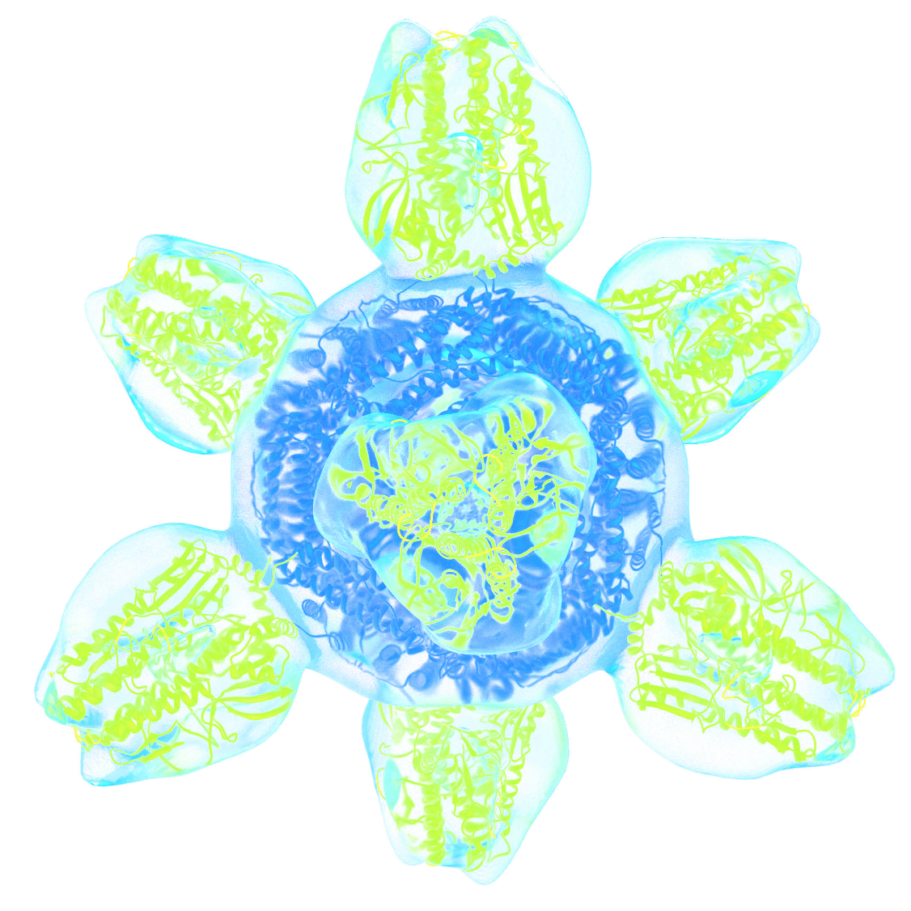
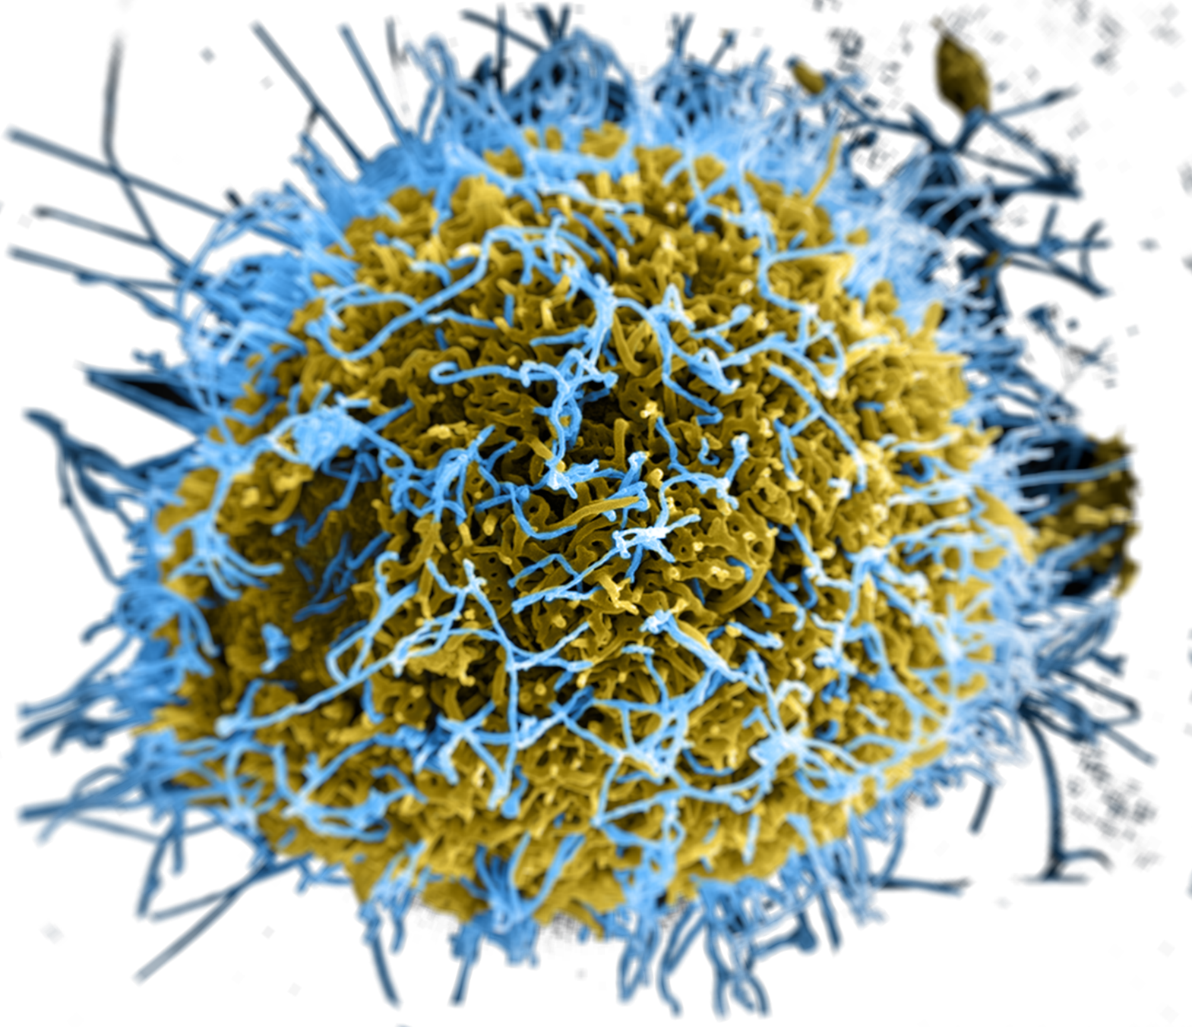
Latest Theme:
Integrative Pharmacology
and Drug Discovery
From structure-based drug design of small molecules and macromolecular drugs to their interplay with tissue and its formulation
Combination of high throughput and rational design, classical and non-classical approaches at various lengthscales.
AI and Machine Learning is changing the
landscape of how techniques are used:
X-ray, neutron and electron based
CSO of Pfizer in the Core Group
Image Credits: National Institutes of Health, NIH
Notes:
AI and Machine Learning is changing the landscape
CryoEM and the change in technologies
CSO of Pfizer in the Core Group (Mikael Dolsten)
Combination of high throughput and rational design

Slide 7

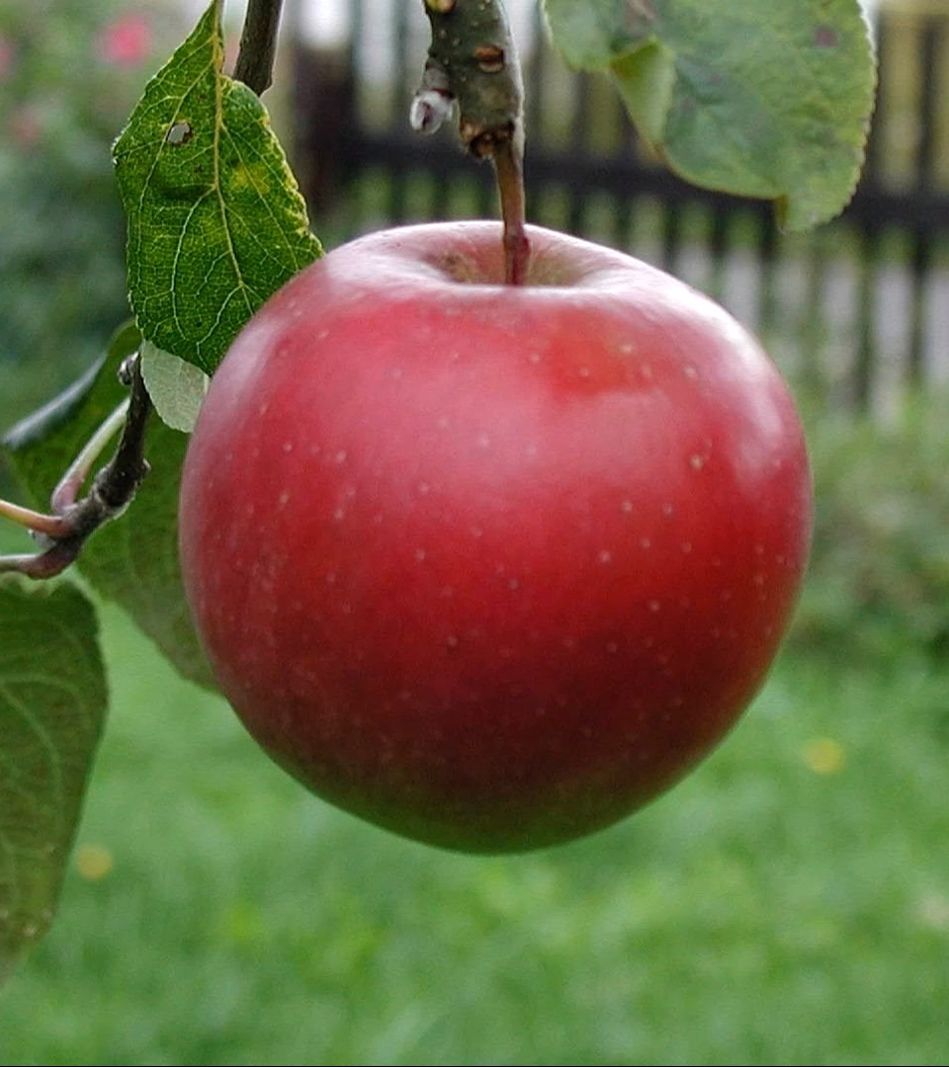
Theme
Brings together expertise in food science and technology for new knowledge and innovation.
Signature developments:
Started as a Working Group, with the outcome of becoming a Theme
Received booster financing from Formas, TVV and, lately, VINNOVA
Example of LINXS acting as an incubator for nationally relevant initiatives
“From farm
to fork”
Notes:
A prime example of LINXS boosting academia-industry collaboration
12 private sector organisations initially involved in Theme (now, open for many more)
Nice progression from Working Group, to Theme, with the funding agencies picking up on the possibilities
LINXS can act as an incubator for good initiatives – release them when they’re scaled up

Slide 8
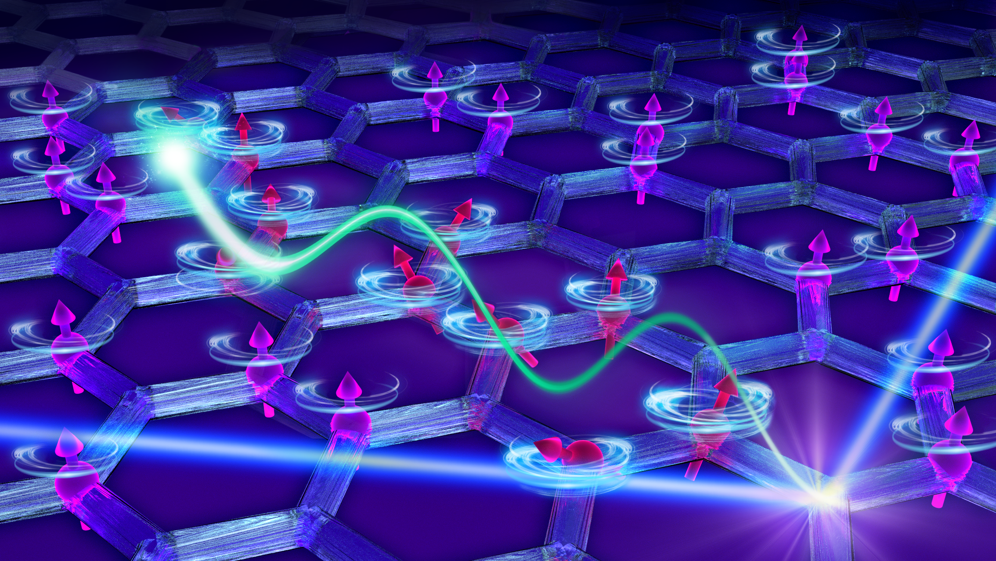
New Materials for Energy and Sustainability
Drives the development and characterisation of new materials for future applications in energy and sustainability
Materials discovery
Working groups on catalytic, light harvesting, charge transfer, magnetic, and nanostructured materials
Notes:
Hard core materials discovery at sientific cutting edge
Collaboration with industry, not least in catalysis for industrial processes, optochemistry and ”Power to X” technology (also a big part of the MAX IV strategy)
Next generation materials, better traditional computing, new magnetic systems (computing and storage), quantum materials and computing

Slide 9
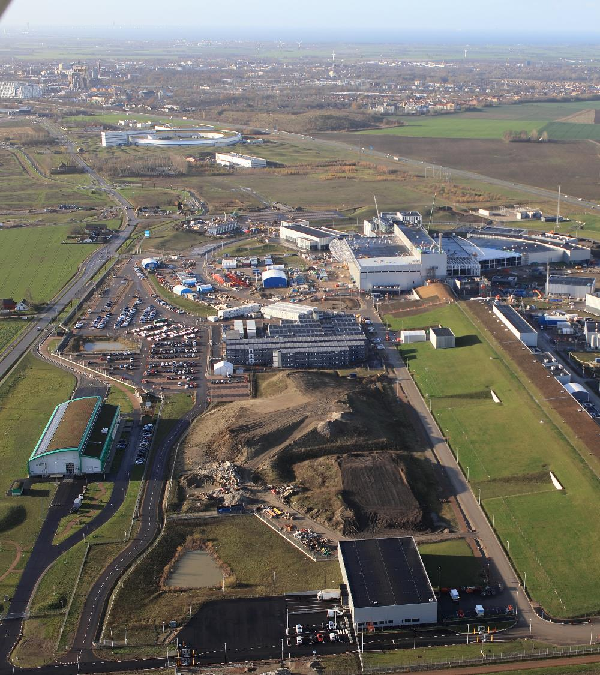
The evolution of LINXS
Under the new management LINXS will be taking several progressive new steps targeted to the national and international community, specifically:
Broaden the call for Themes
So that people from any organisation can be PIs. This will be contingent on the coordinating organisations contributing resources to the theme, in a similar manner to the Helmholtz schools.
Progressing partnerships
LINXS is officially in talks with Uppsala University on a partnership model.

Slide 10
The evolution of LINXS
Continue to establish LINXS in SVS as soon as possible
Supporting the PIs of tomorrow
LINXS will seek to involve itself further in Schools, Undergraduate and Postgraduate Education, Learning & Outreach, and various funding schemes that support these activities.
Focus on the digital and physical
Continue to improve the digital presence, resources and branding of LINXS and facilitate on-line and hybrid collaborative modes and practices, while increasing physical working modes in safe and targeted ways, both in SVS and nationally.

Slide 11
New Materials for Energy and Sustainability
Drives the development and characterisation of new materials for future applications in energy and sustainability
Materials discovery
Working groups on catalytic, light harvesting, charge transfer, magnetic, and nanostructured materials
Notes:
Hard core materials discovery at sientific cutting edge
Collaboration with industry, not least in catalysis for industrial processes, optochemistry and ”Power to X” technology (also a big part of the MAX IV strategy)
Next generation materials, better traditional computing, new magnetic systems (computing and storage), quantum materials and computing

Slide 12
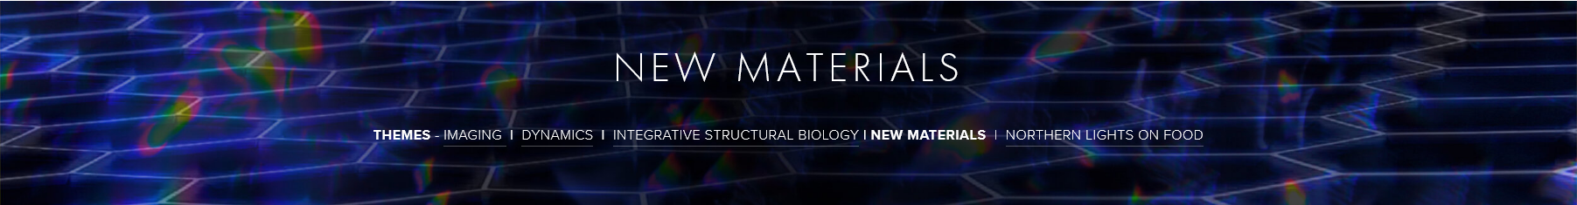
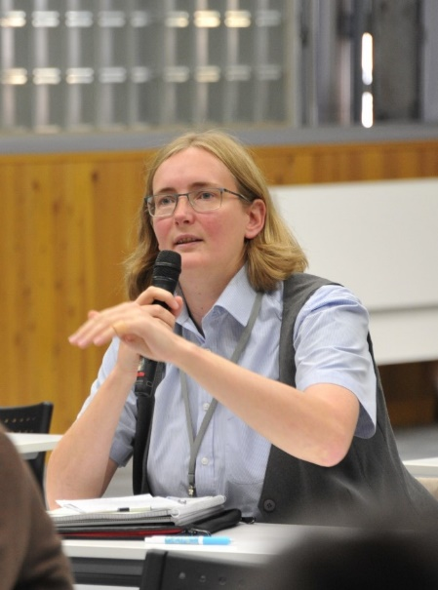
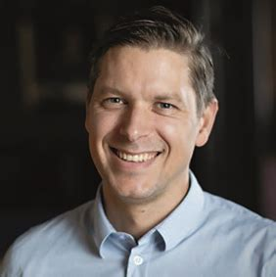
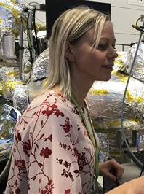
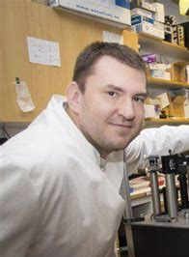
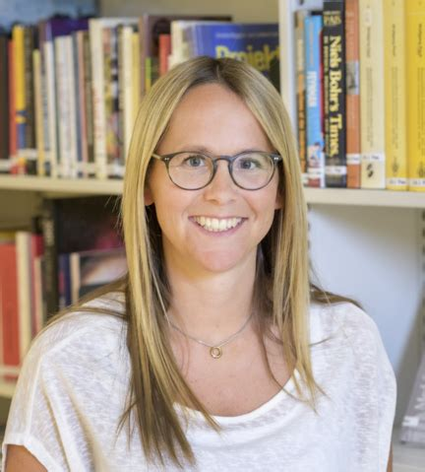

Magnetic Materials
Elizabeth Blackburn
LU Physics
Martin Sahlberg
UU Chemistry
Catalysis
Sara Blomberg
LU Chem. Eng.
Charge Transfer Materials and Light Harvesting
Jens Uhlig
LU Chemistry
Nanostructures and Interfaces
Maria Messing
NanoLund
https://www.linxs.se/new-materials

Slide 13
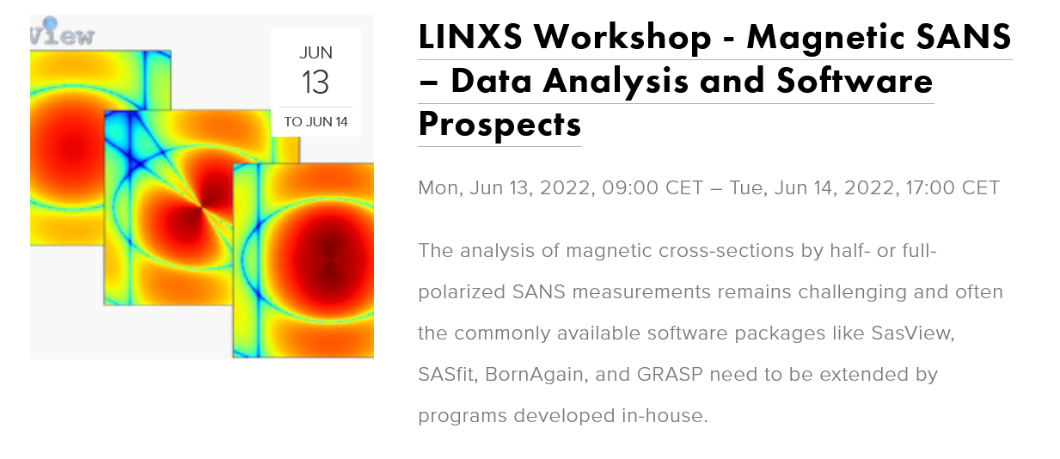
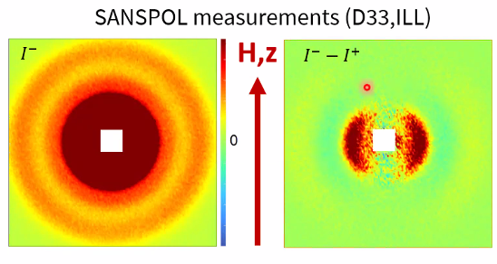
Image: Philipp Bender

Slide 14
www.linxs.se

