Slide 1
Swedish Research Council
Partikeldagarna Mathias Hamberg
The Swedish Research Council is Sweden’s largest governmental research funding body at Swedish universities, colleges and institutes.
Notes:
Thank you very much for inviting me here to the Particle Days
And for the very nice introduction!
My name is Mathias Hamberg,
Ive been active at department of research infrastructures at the Swedish Research Council since 2019.

Slide 2



VR Overview
Swedish Research Council (VR)
Provides funding for research of the highest scientific quality
Overall responsibility for research infrastructures
Promotes international collaborative research
Performs analyses and advises the government
Coordinates and develops communication about the significance, results and conditions of research
Notes:
The mission of the Swedish Research Council it to fund research of the highest quality
We also have the responsibility for several research infrastructures of various types.
Part of our aim is to promote international collaborations
In addition we analyze the funding, outcomes and more to advise the government
A very important job is to communicate regarding research conditions, results, their significance and to overall coordinate these processes

Slide 3

Funding research of the highest scientific quality
Open competition where the best research ideas are rewarded
Efficient, clearly-defined processes
Peer review for highest research quality
Researchers on subject advisory boards, councils and committees
Notes:
We strive for
Open competition where the best research ideas are rewarded
To have Efficient, clearly-defined processes
We also practice Peer review processes for highest research quality
In addition we use Researchers on subject advisory boards, councils and committees

Slide 4
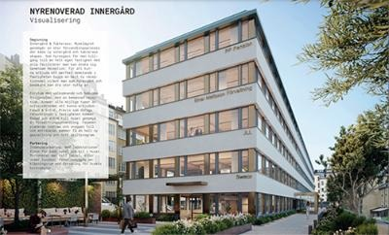
News from VR
Covid-19 situation: return to the office in the autumn to at least two days per week in Stockholm
The Swedish Research Council moves to Kungsholmen, preliminary in April 2022
New Secretary General for Infrastructure from 1st of November: Lisbeth Olsson, professor of Industrial Biotechnology, Chalmers
Decision on the call for investment in infrastructure in June: 24 applications were approved, a total amount of 364 MSEK
Decision on grants for infrastructure of national interest in September, a total amount of about 1,3 billion SEK. Dialogues are now underway with the universities
Covid-19-situationen: återgång till kontoret, upptrappning under hösten till minst två dagar på plats
Vetenskapsrådet flyttar till Kungsholmen, prel april 2022
Ny huvudsekreterare för infrastruktur fr o m 1 november: Lisbeth Olsson, professor i industriell bioteknik, Chalmers
Beslut om investeringsutlysningen i juni: 24 ansökningar beviljades, totalt belopp 364 MSEK.
Beslut om bidrag till infrastruktur av nationellt intresse i september, totalt belopp ca 1,3 miljarder. Nu pågår dialoger med medelsförvaltarna.
Notes:
Regarding COVID, in addition we see that many infrastructures manage to keep on having a high performance and manage to adapt to the situaiton
The Swedish Research Council has decided on the applications to be awarded 32 grants within the call Research infrastructure of national interest. Our total grant amount for 2022-2027 is 1,3 billion SEK.

Slide 5

News from VR
Call by the end of the year on new infrastructure for large-scale calculations (SNIC), comments submitted until 5th of November
The needs inventory for new or developed infrastructure: 45 proposals were received, results will be published in the spring of 2022
The nomination committees appointed for election to the board and subject councils 2022-2024. December 14 the election takes place
Investigation regarding organization, management and financing of infrastructure (Krantz utredningen) for consultation until January 12 2022
Notes:
Utlysning till slutet av året om ny infrastruktur för storskaliga beräkningar (SNIC), (inlämnade synpunkter till 5 november)
Behovsinventeringen om ny eller utvecklad infrastruktur: 45 förslag kom in, resultat publiceras under våren 2022
Valberedningarna utsedda för elektorsval till styrelse och ämnesråd 2022-2024. 14 december sker valet.
Utredningen om organisation, styrning och finansiering av infrastruktur (Krantz) på remiss till 12 januari 2022.

Slide 6
Funding process
Needs inventory
Needs for infrastructures suggested by:
Evaluated by:
- RFI:s advisory panels
- Scientific Councils of VR
- Universities
Needs inventory
Decisions by RFI.
Published in the appenidix to the Guide
-Universities
- Gov agencies which fund research
- Scientists
Needs inventory
YEAR 1
Call
RFI decides on a call – prioritised infrastructure needs
Call
Application by :
- Universities
- Gov agencies
Call
Evaluate proposals
- International panel
- RFI:s advisory groups
--Scientific Councils of VR
Call
Decison by RFI
- Existing infrasructures where funding ends
YEAR 2
Notes:
The RFI funding process starts with a needs inventory which is initiated every two years
To be selected a proposal must be categorized as a high priority need for Sweden
The full process takes about two years from needs inventory to the grant decision.
So year one starts with the ”Needs inventory” where Needs for infrastructures can be suggested by:
Unviersities, Governmental agencies which fund research as well as Scientists!
The next step is evaluation by RFI´s advisory panels (RÅGar), Scientific Councils of VR (ämnesråd) and Universities.
The Council for Research Infrastructure (RFI) will then make the decision regarding needs inventory and publish the selected infrastructures.
The second year starts with that RFI decides on a call for the prioritised infrastructures and this call is handled throughout the year.
The application is made by universities and governmental agencies
Subsequently the proposals are evaluated by an international panel, RFI:s advisory groups (RÅGar) and Scientific Councils (ämnesråd) of VR
Finally the decision is made by RFI
At this time we are here.

Slide 7
VR and CERN
Council :
  Mats Johnsson, Ministry of Education
  Kerstin Jon-And, SU
  Mathias Hamberg, deputy, VR
  Richard Brenner, deputy, UU
Finance committee:
  Mathias Hamberg, VR
  Barbro Åsman, SU
TREF (TRipartite Employment conditions Forum):
  Barbro Åsman (Chair), SU
  Mathias Hamberg, VR
RRB (Resources Review Boards) (ALICE, ATLAS, WLCG):
  Niklas Ottosson, VR
EPPCN (EUROPEAN PARTICLE PHYSICS COMMUNICATION NETWORK):
  Kristina Careborg, VR
Notes:
Here is an overview of of some of the representatives at CERN which has not changed since last year
Kerstin Jon-And will in her upcoming presentation about CERN go into greater detail regarding the science

Slide 8
Respone to: Report on accelerator-based infrastructures in the fields of particle and nuclear physics
Recap: Recommendations on:
“For long-term funding and planning, initiate a dialogue between RFI, the Scientific Council for Natural and Engineering Sciences (NT, also a part of the Swedish Research Council), and the Swedish universities involved in the research (e.g. through URFI, the University infrastructure reference group).”
VR notes that the 2020 report points on structural problems and that a dedicated working group must be appointed for the purpose
VR take the issue very seriously although it is a complex problem with many involved parts and challenging to organise
It takes time to solve these kind of komplex matters
Notes:
VR notes that the 2020 report points on structural problems and that a dedicated working group must be appointed for the purpose
VR take the issue very seriously although it is a complex problem with many involved parts and challenging to organise
It takes time to solve these kind of komplex matters
When defining projects, there are a number of conditions that we can not control, such as currency, delays and the like that we can not control.
The type of grant you manage is somewhere between infrastructure and project grants and sometimes outside VR's standard calls.

Slide 9
Respone to: Report on accelerator-based infrastructures in the fields of particle and nuclear physics
As a consequence of the report:
A working group is appointed to deal with related issues. The working group's tasks will be to shed light on and make proposals regarding infrastructure issues in the intersection between RFI and the NT Council's areas of responsibility.
They will:
Define their assignment
Review the management of contingency
The work has started
In the spring, start discussions between universities and VR
Notes:
As a consequence of the report, a working group is appointed to deal with related issues. The working group's tasks will be to shed light on and make proposals regarding infrastructure issues in the intersection between RFI and the NT Council’s areas of responsibility.
They will:
Define their assignment based on current and future issues in the areas
Review the management of contingency in terms of time and money
The work has started but we are replacing parts of the RFI / NT councils and the new members need to be involved in the issue. Members of the working group who leave can be co-opted.
In the spring, it should be possible to start discussions between the universities and VR

Slide 10
Respone to: Report on accelerator-based infrastructures in the fields of particle and nuclear physics
Structured discussion with the Universities regarding responsibilities and management
Universities should be involved and share the responsibility for the participation of their researchers
You can be inspired by SKAO´s approach to division of responsibilities
This type of discussion can be made to URFI or SUHF
Currently a risk that risk management and Contingency will be skipped and risk falling between the cracks
Notes:
We envisage a more structured discussion with the Universities regarding division of responsibilities and management
We see in front of us that universities should be involved and share the responsibility for the participation of their researchers (note that 50% pays for the national infrastructures but often 100% for the international ones)
SKA can be used as an example for division of responsibilities
You can be inspired by MAX IV's approach to division of responsibilities
This type of call can be made to URFI or SUHF
Above all, there is currently a risk that risk management and Contingency will be skipped and risk falling between the cracks.
The cracks between: RFI, NT and the Universities
Vi ser framför oss en mer strukturerad diskussion med Universiteten kring ansvarsfördelning och hantering
Vi ser framför oss att universiteten bör vara med och dela ansvaret för sina forskares delaktighet (obs betalar 50% för de nationella infrastrukturerna men ofta 100% för de internationella)
SKA kan användas som exempel för ansvarsfördelning
Man kan inspireras av MAX IVs upplägg kring ansvarsfördelning
Denna typ av samtal kan ske mot URFI eller SUHF
Framförallt finns i nuläget en risk att riskhantering och Contingency hoppas över och riskerar att falla mellan stolarna.
De tre stolarna: RFI, NT och Universiteten
Jag kan inte diskutera frågor som inte har justerats

Slide 11

Questions?
Notes:
With those words I would like to thank you for your attention
If you have any questions I would be happy to answer them now
Fråga från Allan:
It is true that the case also applies to applications received by NT. The case concerns the applications that have been screened out before the evaluation group's meeting and thus are not discussed in detail by the entire evaluation group. We have come a long way in the work of meeting the requirements that the new Public Administration Act places on the justification of decisions on research grants. To get all the way, however, extensive system development is required and the work therefore needs to take place step by step. In a first step to improve the motivation for screened applications, we have introduced in the 2020 preparation that these applications must receive grades for all grading criteria, not just a summary grade, and that the explanation of the grade must be included. This gives the applicant more information about the strengths and weaknesses of the application. For the time being, the explanations for all grading steps will be included at the beginning of all opinions, regardless of whether the application has been screened or not. The applications that will be screened in the 2020 call will thus receive grades for all grading criteria but not an individually adapted text.
”Det stämmer att ärendet även gäller ansökningar inkomna till NT. Ärendet gäller de ansökningar som har sållats ut innan beredningsgruppens möte och därmed inte diskuteras ingående av hela beredningsgruppen. Vi har kommit långt i arbetet med att uppfylla kraven som den nya förvaltningslagen ställer på motivering av beslut om forskningsbidrag. För att komma hela vägen krävs dock omfattande systemutveckling och arbetet behöver därför ske stegvis. I ett första steg att förbättra motiveringen för sållade ansökningar har vi i 2020 års beredning infört att dessa ansökningar ska få betyg för samtliga betygskriterier, inte bara ett sammanfattande betyg, och att förklaringen av betyget ska vara med. Detta ger sökanden mer information om styrkor och svagheter i ansökan. Tillsvidare kommer förklaringarna till alla betygssteg finnas med i början av samtliga yttranden, oavsett om ansökan sållats eller inte. De ansökningar som sållas kommer i 2020 års utlysning alltså få betyg för samtliga betygskriterier men inte någon individuellt anpassad text.”

Slide 12
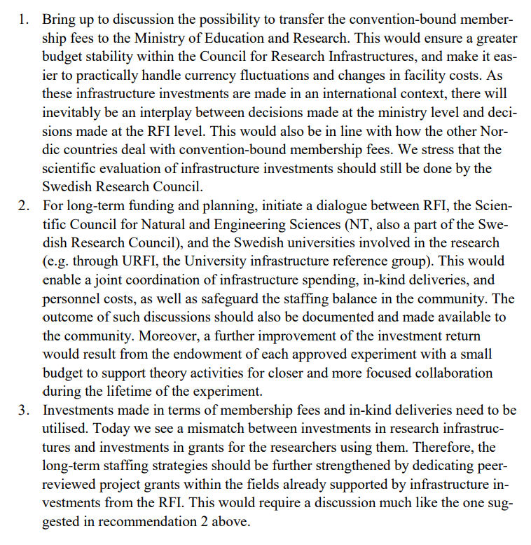

Slide 13
RFI Overview
Council for Research Infrastructure (RFI)
Provides funding for and monitors national research infrastructures
Also provide funding for memberships in international infrastructure organisations.
Develops strategies and plans
  VR’s Guide to Research Infrastructures
  New version in 2018 and upcoming year
  RFI has three advisory groups and an e-Infrastructure committee to support.
Notes:
I would now like to give an overview over the Council for Research Infrastructure (RFI) which is the part of VR dealing with infrastructure
The Council has thirteen members with competence within research infrastructures from several different fields. From your field you are represented by Richard Brenner at Uppsala University
RFI plays a major role in monitoring and funding national research infrastructures.
The Council also take care of memberships within international infrastructure organisations (such as ERICs)
Is developing strategies through -VR´s Guide to Research Infrastructures
Last but not least RFI has three advisory groups (RÅGar) and an e-Infrastructure committee to support

Slide 14
Survey of opportunities at CERN for Swedes
Amanda Barasciutti and Elsa Carlsson at Vinnova
Tekniksprånget “The technology leap”
“Like having a gym card without going to the gym”
Report with suggestions on how we can improve the situation and harvest the fruits of CERN
Learning from best practices e.g. Norway
Notes:
I also would like to mention an investigation that throughout the autumn has been undertaken by Elsa Carlsson and Amanda Barasciutti at Vinnova
They contacted me informing me that they were ”Tekniksprångare” active at Vinnova interested in making a survey of what opportunities that exist at CERN for Swedes
Tekniksprånget or in English “The technology leap” is a pioneering initiative in which the private and public sectors, the government and employers' organizations work together to strengthen Sweden's future supply of skills. The project is run by The Royal Swedish Academy of Engineering Sciences (IVA) on behalf of the National Agency for Education (Skolverket).
About 30 interviews with individuals connected to CERN were made
The current situation is a bit like “Like having a gym card without going to the gym”
A report is produced with suggestions on how we can improve the situation and harvest the fruits of CERN
Learning from best practices e.g. Norway and this is not a joke, have had an increase of more than 250% with respect to their employees at CERN during just a few years.
One of the greatest outcome of this survey I would say is the compilation of opportunities at CERN. It is also reassuring to see that VR and Vinnova who fund the ILO organization BiSS together also work together in this perspective.
(This is an important question for CERN which could act as a model but it is also a very important question for all research infrastructure such as ESS, MAX IV, SKA.)

Slide 15
HEI revenues for research and third cycle education
Selection of Swedish research funding organizations.
Amounts in MSEK.
Source: Swedish Higher Education Authority 2018
Notes:
This image illustrates the higher educations institutions' revenues for research and education at the doctoral level during 2018, divided into funding (MSEK) for a selection of funding organizations.
HEI = Higher Education Instutions
Third cycle education = doctoral level education
Vinnova: Develops Sweden's innovation capacity for sustainable growth and benefiting society
Formas: Swedish research council for sustainable development
Forte: Swedish research council for health, working life and welfare
(Lärosätenas intäkter till forskning och utbildning på forskarnivå fördelat på finansiär (MSEK) av ett urval finansieringsorganisationer.)
(Källa Universitets Kanslers Ämbetet)

Slide 16
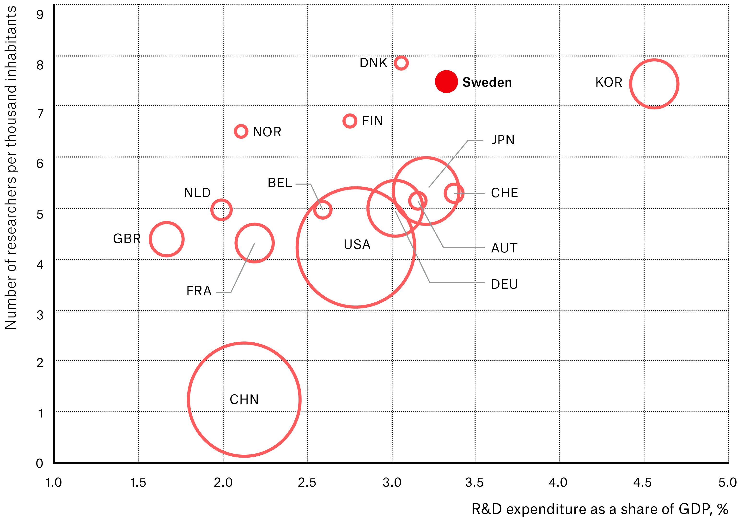
Sweden's R&D in international comparison
The size of the circles illustrates the gross domestic expenditure on R&D as a percentage of GDP in 2017 in each country, in absolute numbers.
Source: OECD
Notes:
The figure shows the countries' total expenditure on R&D as a percentage of GDP in 2017 and the number of researchers per thousand inhabitants. The area of ​​the circles corresponds to the countries' share of the total R&D expenditure in relation to the countries in the figure. The number of researchers is shown in relation to the country's population.
The picture shows that Sweden spends a large part of its GDP on R&D and that we also have a large proportion of researchers in the population. Only South Korea and Switzerland have higher R&D expenditure as a share of GDP than Sweden, while only Denmark has more researchers per thousand inhabitants.
Please note that the picture does not show expenditure for R&D in the higher education sector but in all sectors, industry included.
(The picture is based on figures from the OECD. The Swedish figures are reported from SCB. Figures are updated every two years. 2019 figures are updated by FP 2021)

Slide 17
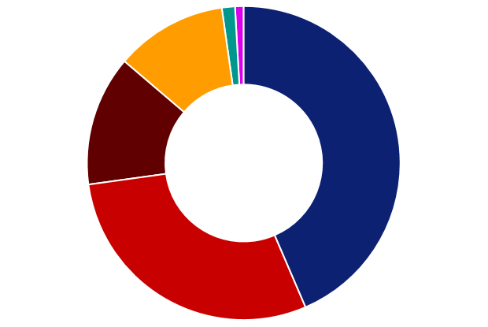
Distribution of forms of grants 2019
Non-targeted
research funding 59
Operational grant
Funding 90
Career support
funding 766
The Swedish Research Council finances just over a tenth of the research at higher education institutes.
Distributed research funding:
SEK 6.6 billion
Research environment
and Research collaboration
funding
892
Research
project
funding
2 893
Research infrastructure
funding
1 945
Notes:
In 2019, the Swedish Research Council paid out SEK 6.6 billion in support of mainly basic research in all areas of science and to research infrastructure.
A large part of the research support goes to projects that have been proposed by the researchers themselves so-called researcher-initiated research. In addition, research infrastructure, research environments, graduate schools, various forms of collaboration and membership in international organizations and major research facilities are funded.
In 2019, 34 calls were made for grants where the Swedish Research Council had the main responsibility. We prepared a total of 5,443 applications, of which 1,027 were approved.
Research Infrastructure funding includes support for international infrastructures such as ESS and CERN.
Operational grant funding includes, among other things, research grants via other financial and operating grants.
(Verksamhetsstöd innefattar bland annat forskningsbidrag via annan finansiär och driftsbidrag. )
(Infrastrukturstöd innefattar bland annat stöd till internationella infrastrukturer som ESS och CERN.)

Slide 18
Research infrastructure funding 2019
276
33
101
Larger infrastructures, SEK 1 862 million
310
123
495
524
MILLION SEK
Notes:
The figure shows funds distributed to research infrastructure in 2019.
Funds for the construction of the European Spallation Source ESS in Lund (SEK 524 million) cannot, however, be influenced by the Swedish Research Council, but are a transfer from the government. By convention-bound research infrastructure is meant that it is the Parliament that approves and the government that signs the convention or agreement. This applies above all to large central facilities such as CERN, XFEL and also SKA where we currently are working towards a funding decision
Examples of other international infrastructures are the ones for biobanks BBMRI-ERIC and for language technology CLARIN-ERIC.
MAX IV – the world-leading synchrotron in Lund - is the largest Swedish infrastructure investment ever and VR is the main financier but also e.g. region Skåne and Lund University contribute.
SNIC (Swedish National Infrastructure for Computing) provides resources for large-scale calculations and storage for e.g. other research infrastructures and thus has a special position.
Onsala Space Observatory builds and operates astronomical and geodetic infrastructure both on site in Onsala and internationally. (After MaxIV and SNIC, Onsala is the research infrastructure that receives the largest grant from the Swedish Research Council).
Other national research infrastructures include SITES, which consists of research stations in different habitat types and climate zones for for terrestrial and limnological research.

