Slide 1
Report from CERN Council
Partikeldagarna 2021
Gothenburg, November 23
Kerstin Jon-And, Stockholm University

Slide 2
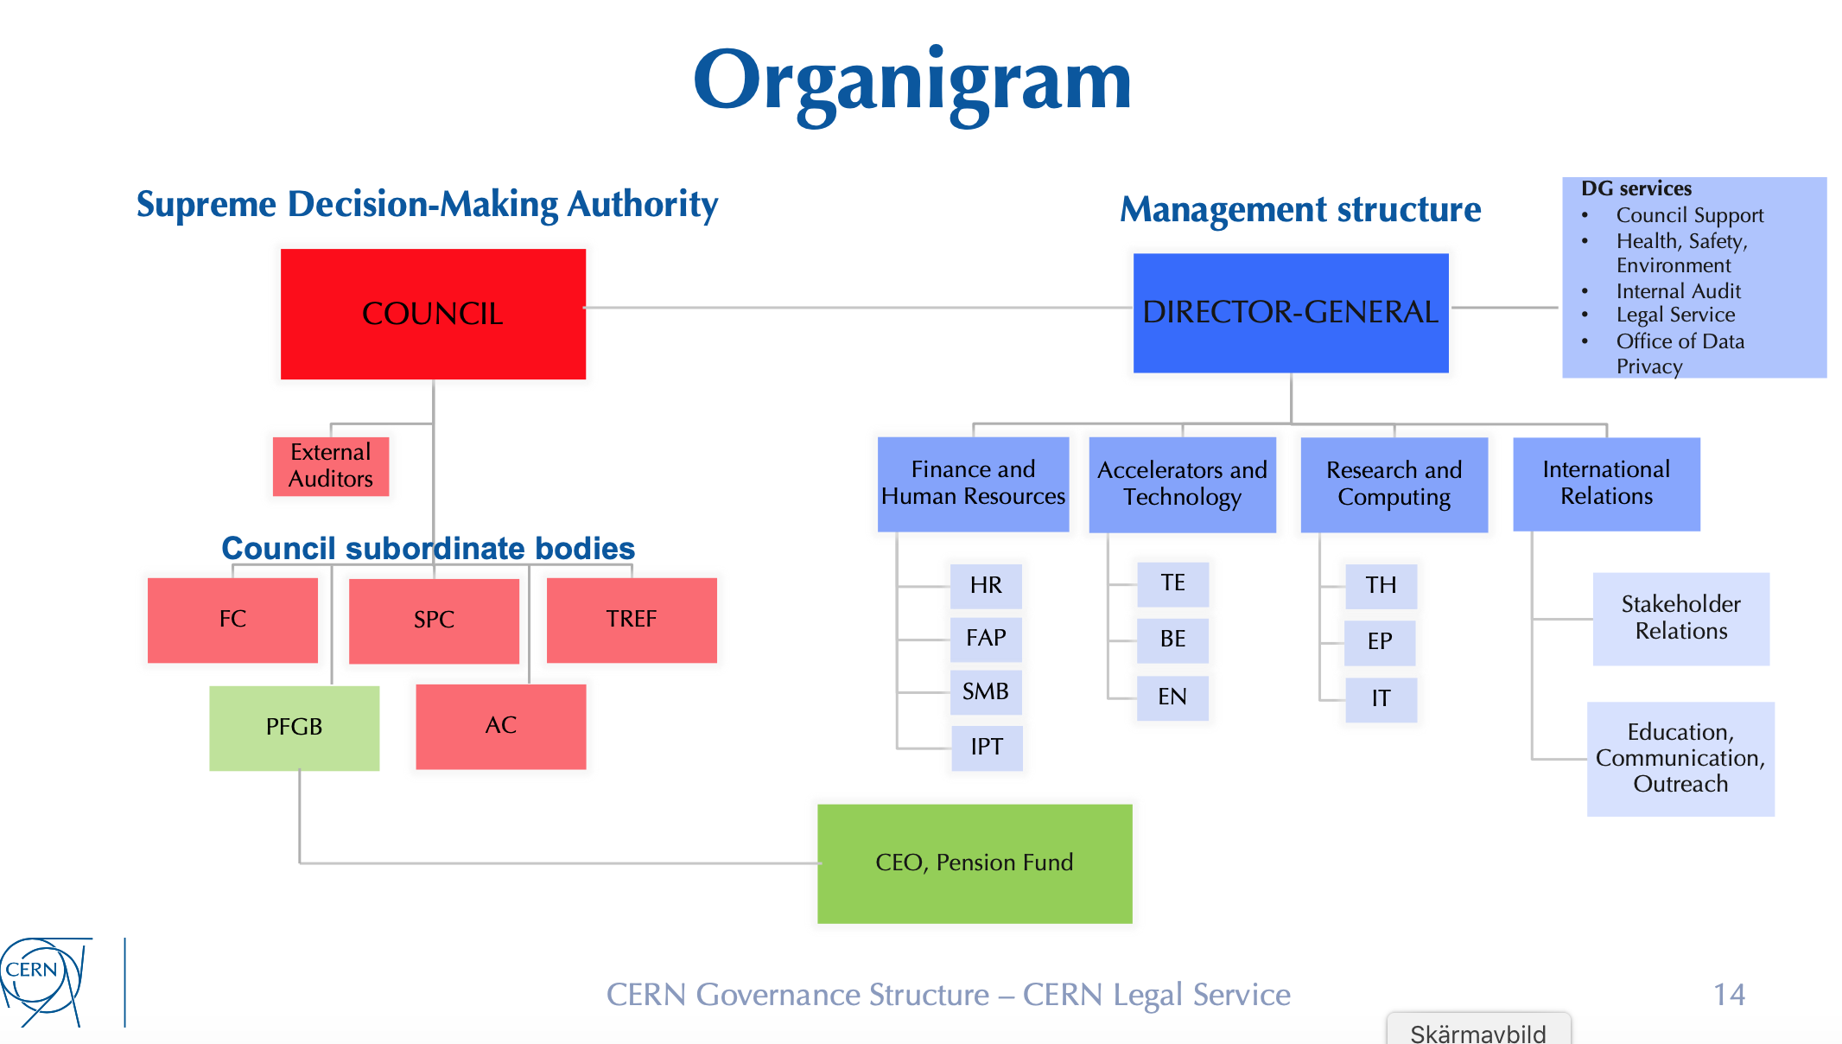
2021-25
M Johnsson
K Jon-And
R Brenner
(deputy)
F Gianotti
R Bello M Lamont J Mnich C Warakaulle
M Hamberg
B Åsman
B Åsman, Chair
M.Hamberg
SY

Slide 3
Current Council President and Vice-Presidents
Ursula Bassler, France, President until 31 Dec 2021
Péter Lévai, Hungary, Vice-President until 31 Dec 2021
Jochen Schieck, Austria, Vice-President until 30 June 2022
Elections with effect 1 January 2022
Eliezer Rabinovici, Israel, elected President of Council
Election of one Vice-President to be made in Dec 2021

Slide 4
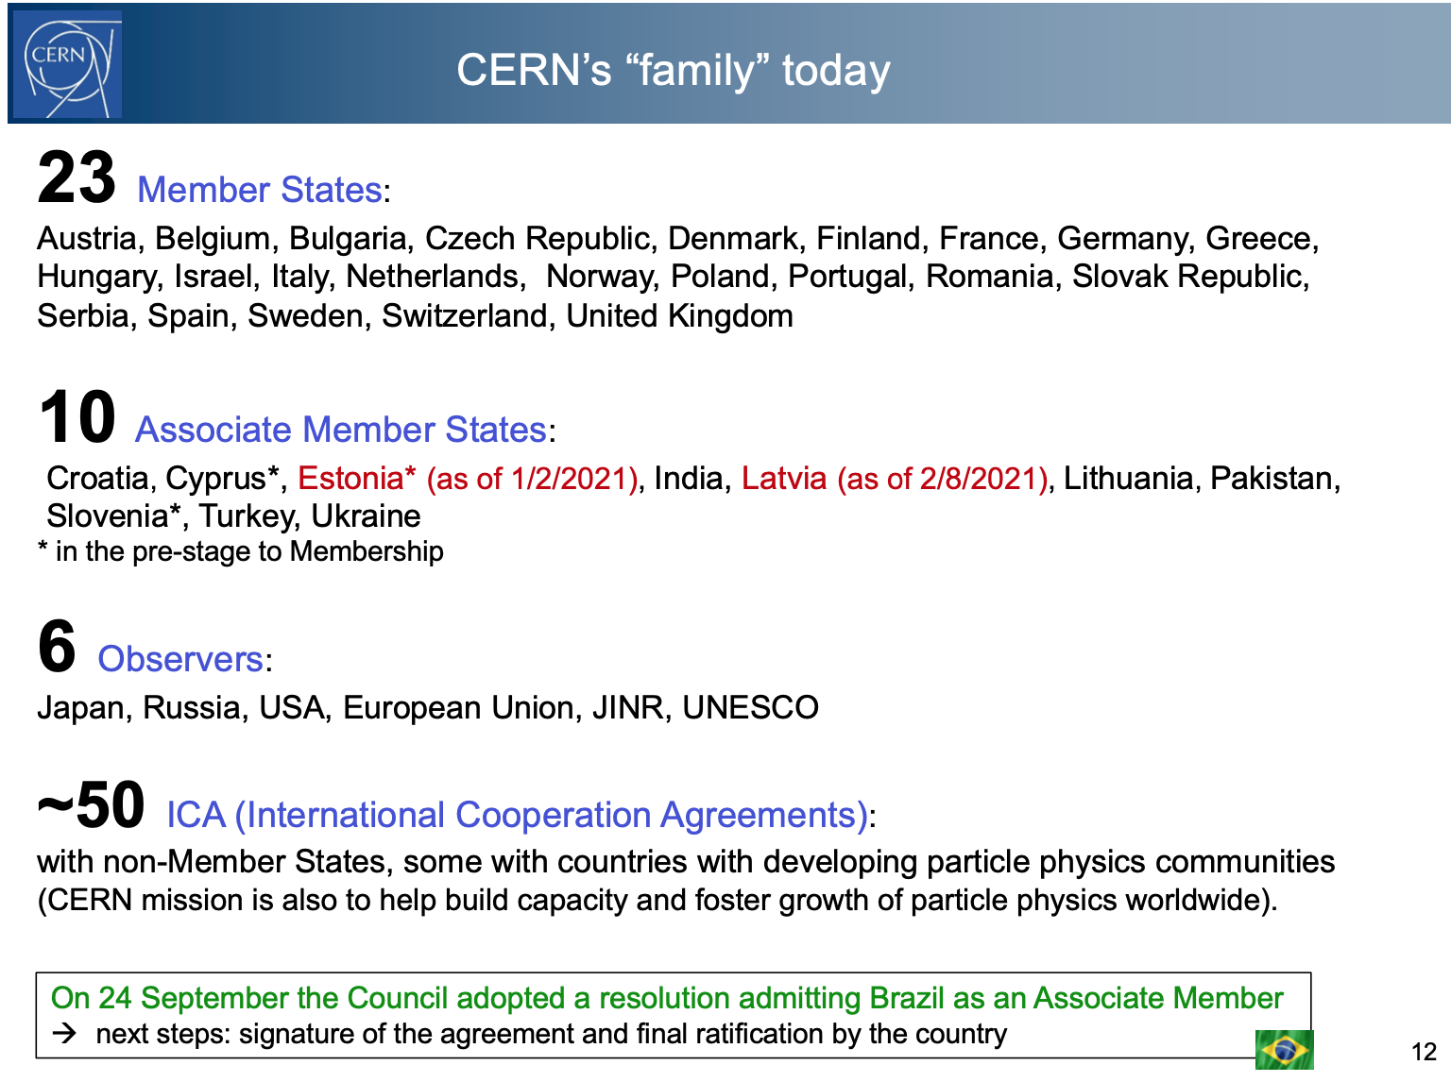
From F Gianotti
2021-10-11

Slide 5
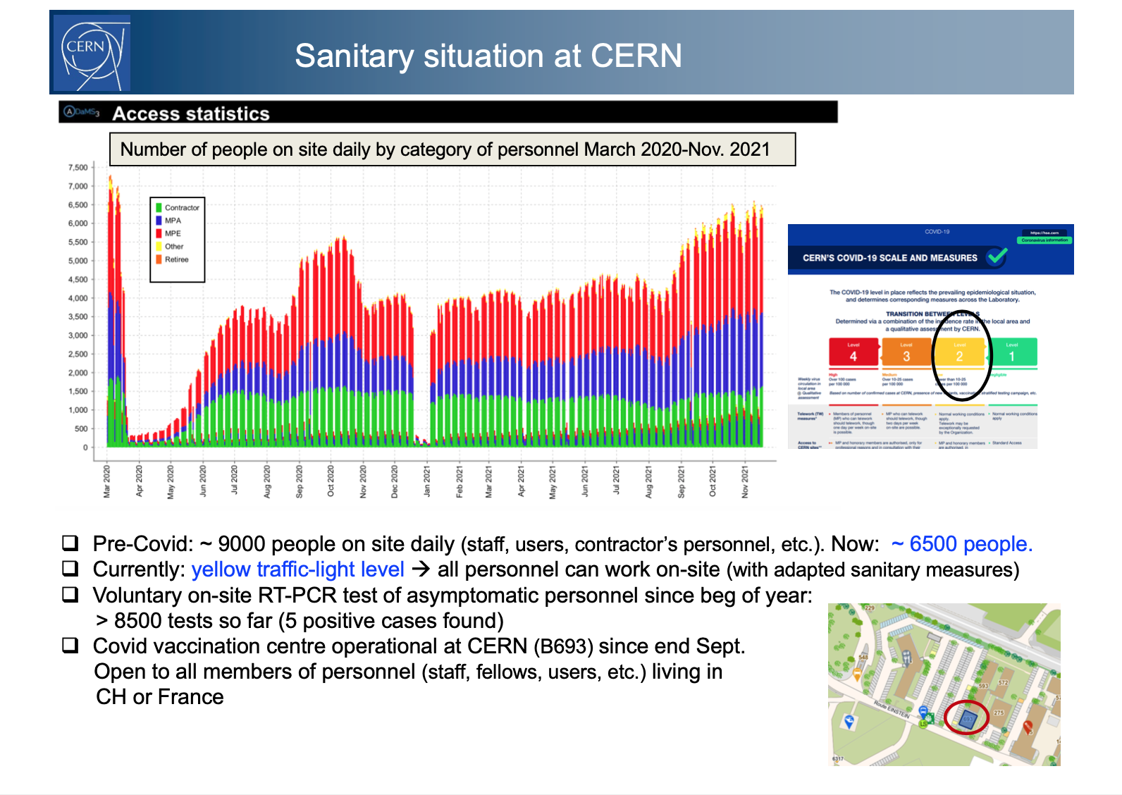
From F Gianotti Nov 2021

Slide 6
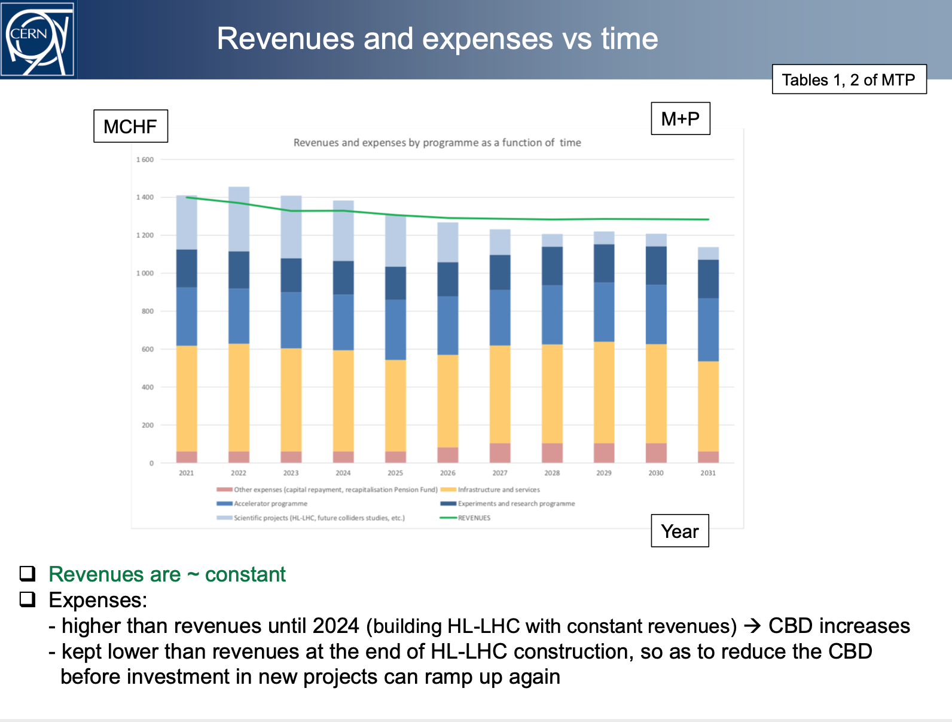
From F Gianotti Council June-2021
Mid Term Plan 2022-2026
2022
1.4 GCHF
Scientific projects (HL-LHC, energy frontier etc)
Exp’ts and research
progr.
Accelerator programme
Infrastructure and services
≈ 60% directly into science; ≈ 40% infrastructure

Slide 7
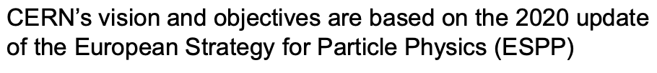
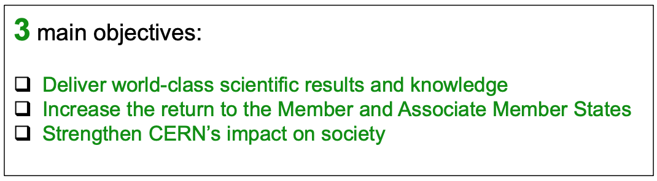
From F Gianotti Council Sep-2021
CERN management’s vision for their mandate 2021 - 2025
Updated document presented to Sep-2021 council: include additional SMART* objectives (Specific, Measurable, Achievable, Realistic, Time-bound).
Available at http://cds.cern.ch/record/2783560/files/English.pdf

Slide 8
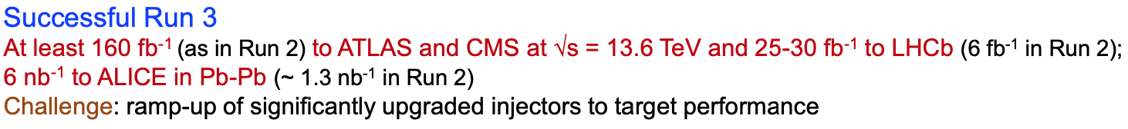
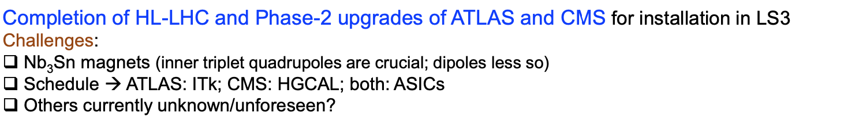
From F Gianotti Council Sep-2021
Current scientific programme
of LHC
e.g. SND (Scattering and Neutrino Detector)

Slide 9
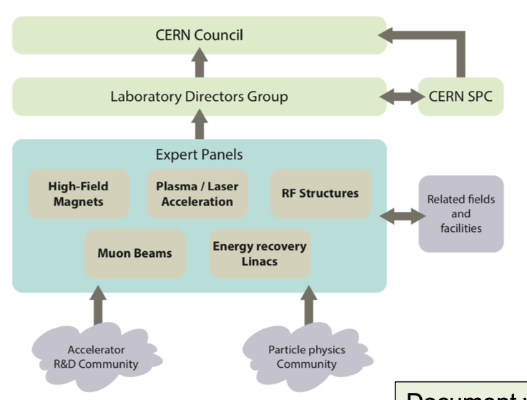
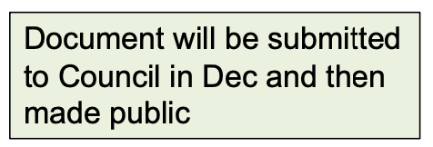
From F Gianotti Council Sep-2021
Accelerator R&D
Resources are allocated in
2020 Mid Term Plan.
Programme will be reviewed once the LDG:s Accelerator R&D roadmap completed

Slide 10
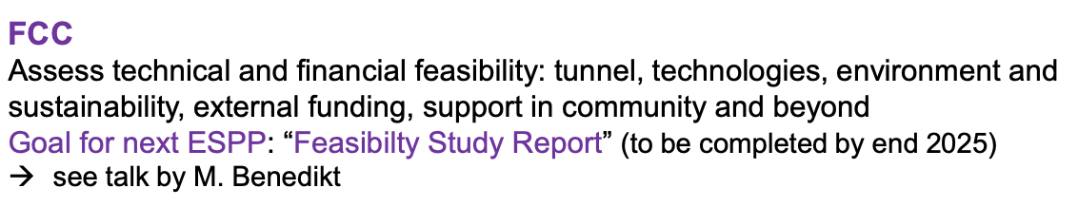
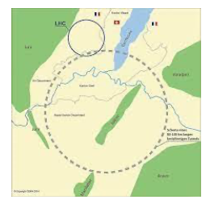
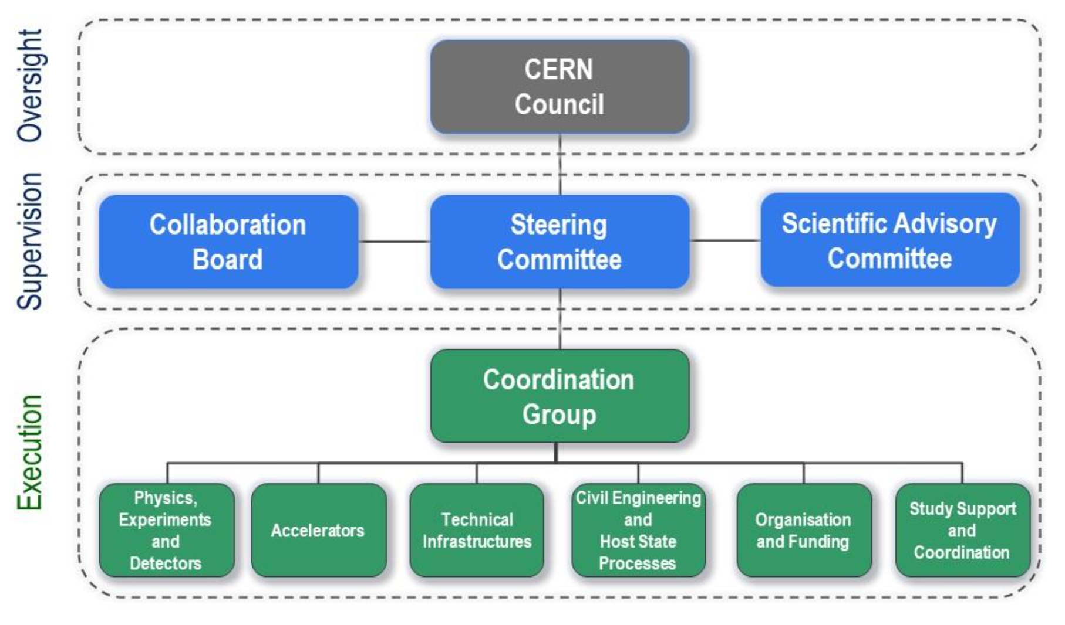
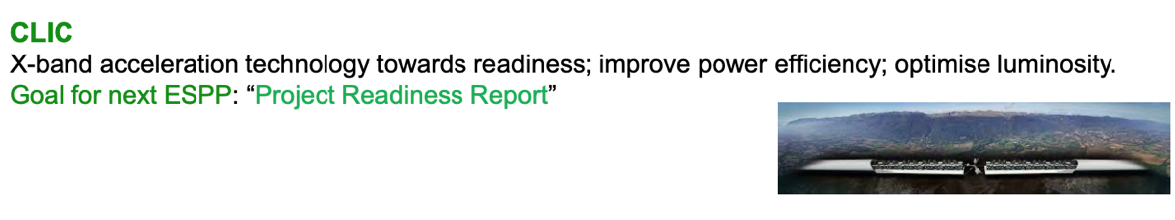
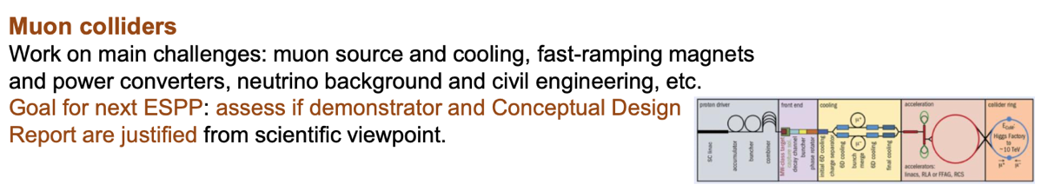
From F Gianotti
Future Collider options
Future Circular Collider
Organisation of FCC feasibility study
Goal for next ESPP:
Feasibility Study Report
(to be completed by end 2025)
Compact Linear Collider

Slide 11
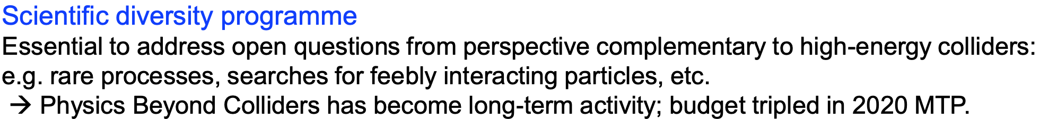
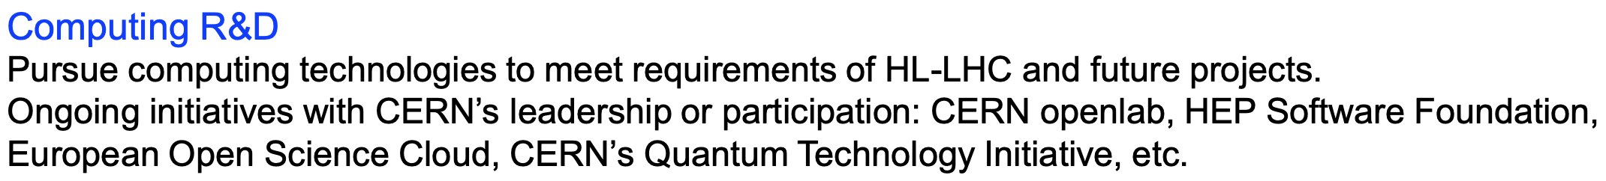
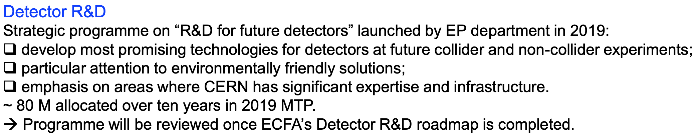
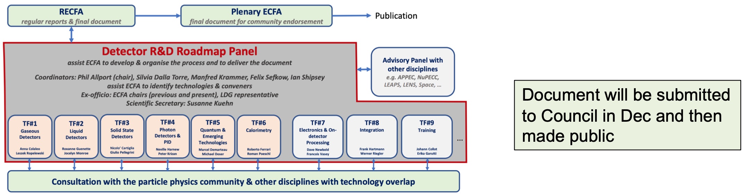
Further future objectives
From F Gianotti

Slide 12
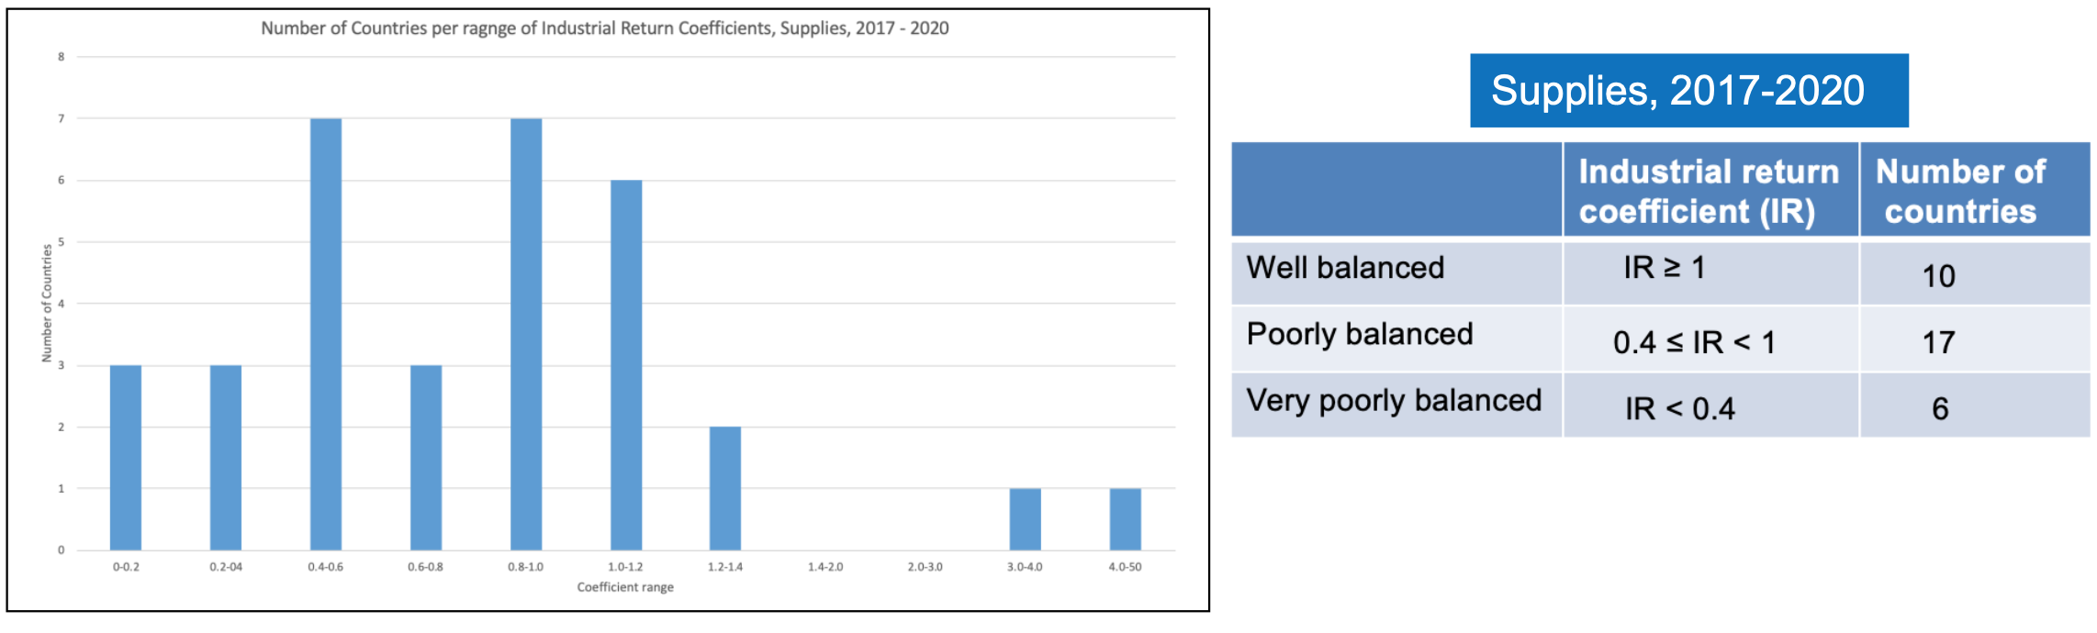
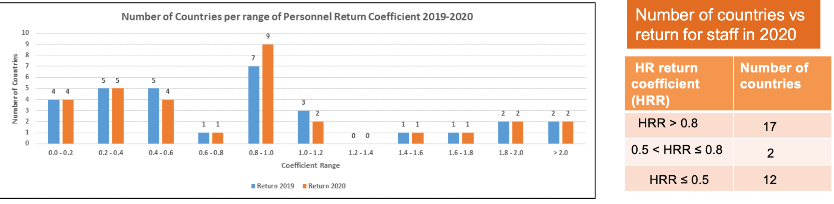
Increase return to Member and Associate Member States
7
Technological collaborations
Scientific education
0.8-1
0.8-1

Slide 13
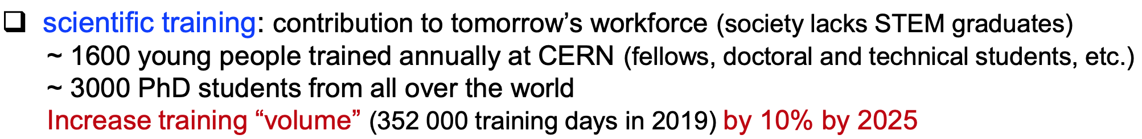
From F Gianotti
Strengthen CERN´s impact on society
(would double current number)

Slide 14
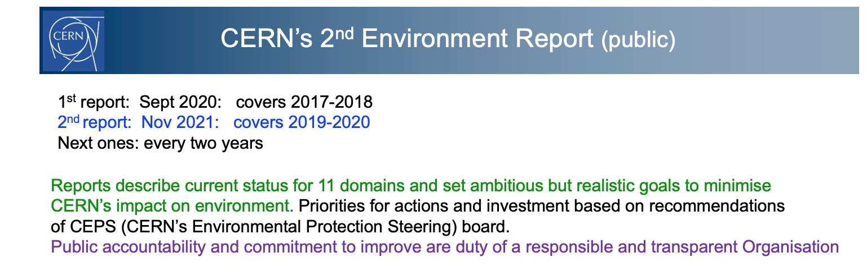
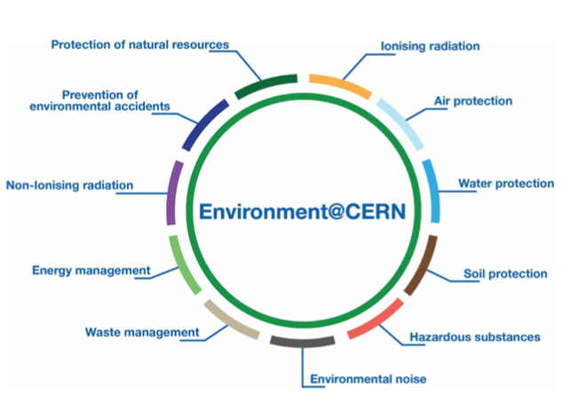
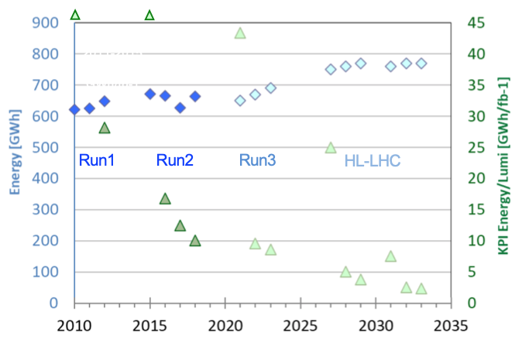



https://hse.cern/environment-report-2017-2018

Slide 15
SPARES

Slide 16
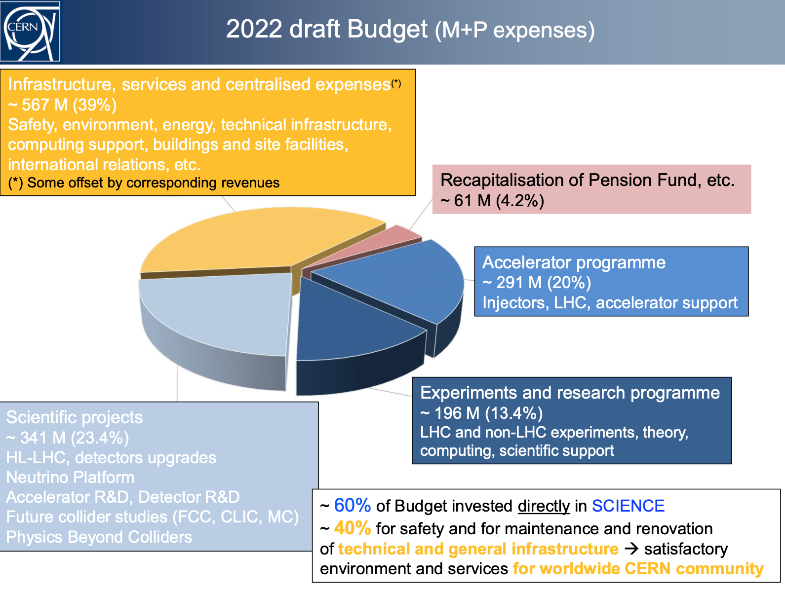

Slide 17
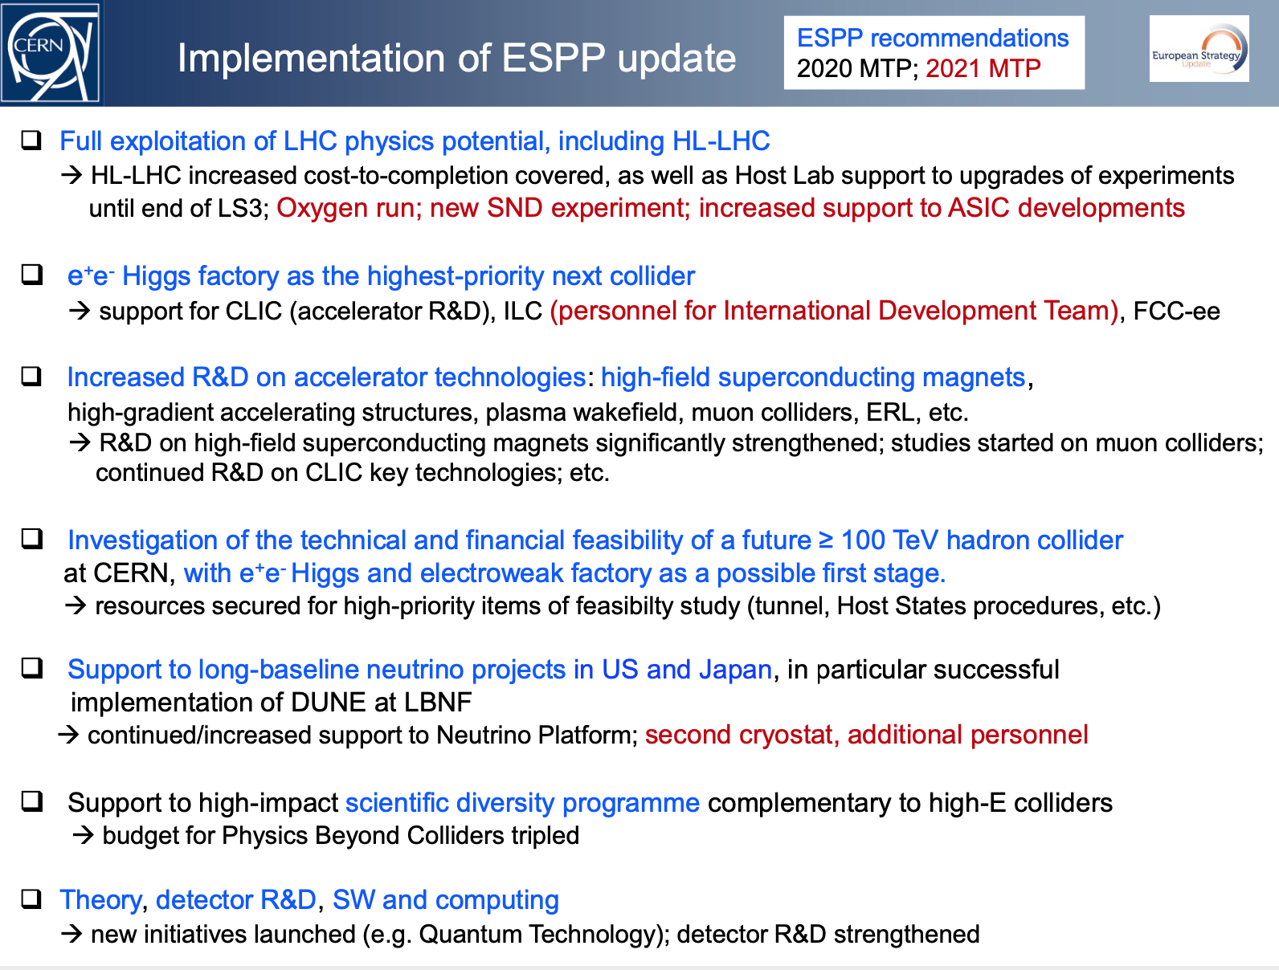

Slide 18
