Slide 1



Search for Light Dark Matter using a Primary Electron Beam
G.Mullier
Partikeldagarna 2020

Slide 2
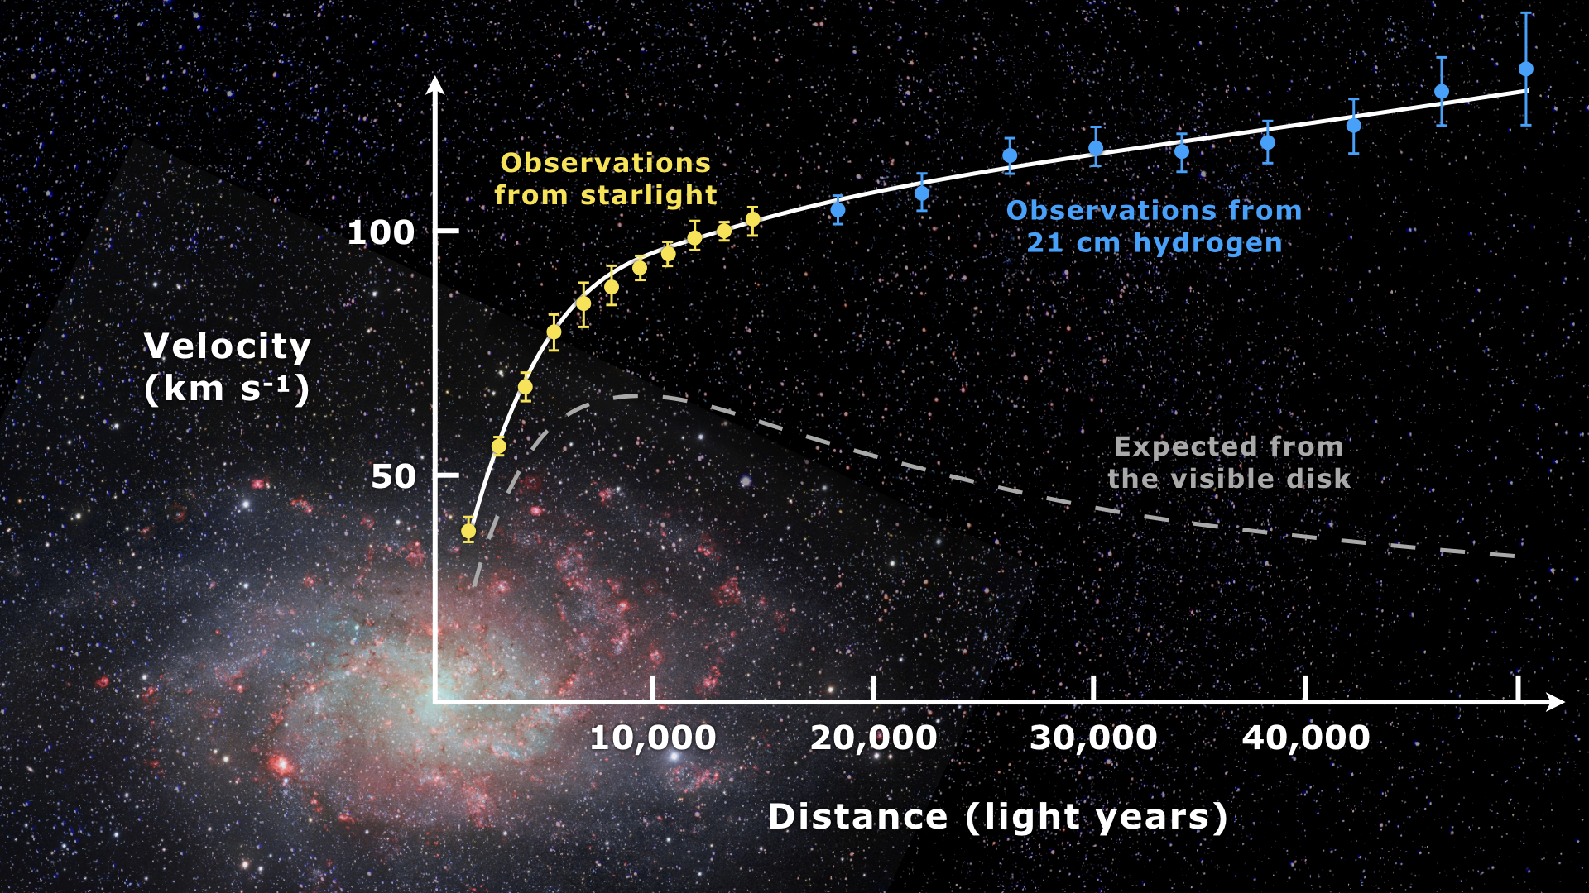
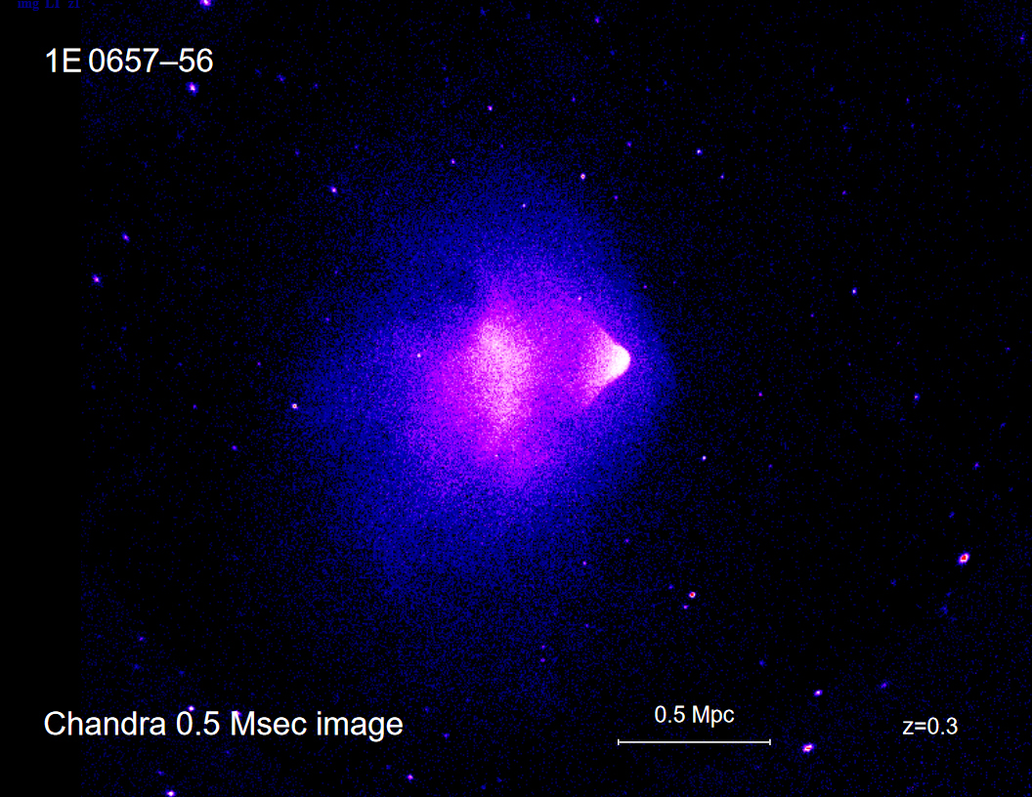
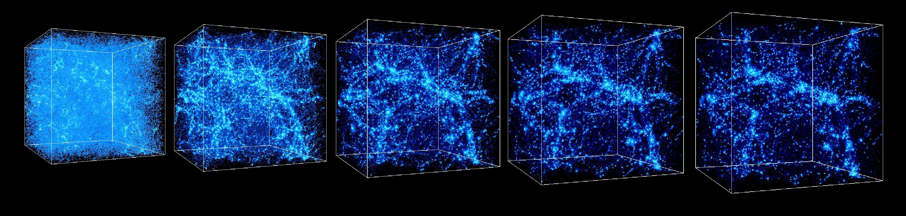
Why dark matter?
Cosmological observations
  Galactic rotation curves
  Large scale structures
  Bullet cluster

Slide 3
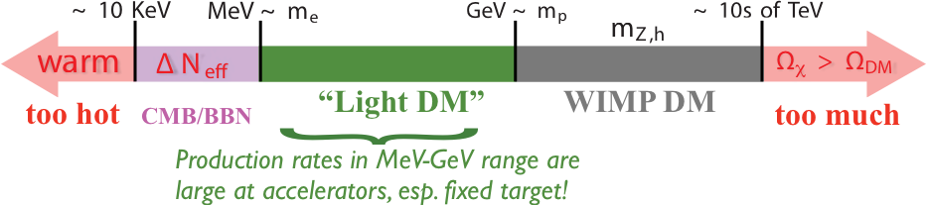
Dark Matter with an e⁻ beam, Why?
Cosmological observation, constrains Dark Matter and sets limits for masses of both DM and mediators
Extensive search program in the WIMP sector already but not of the Light DM sector
In a Light DM scenario, thermal relic DM requires light mediators for thermal freeze out.

Slide 4
Fundamental idea
Dark matter could have such properties that it could be produced via Dark Photons (Or a similar process)
Candidate events will leave only so much energy in the detector
Any other event would be caught thanks to energy deposits

Slide 5

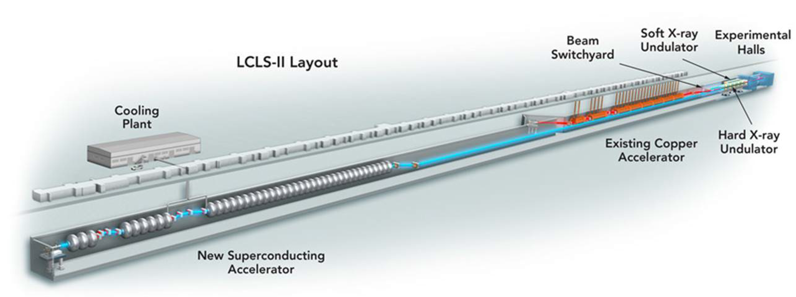
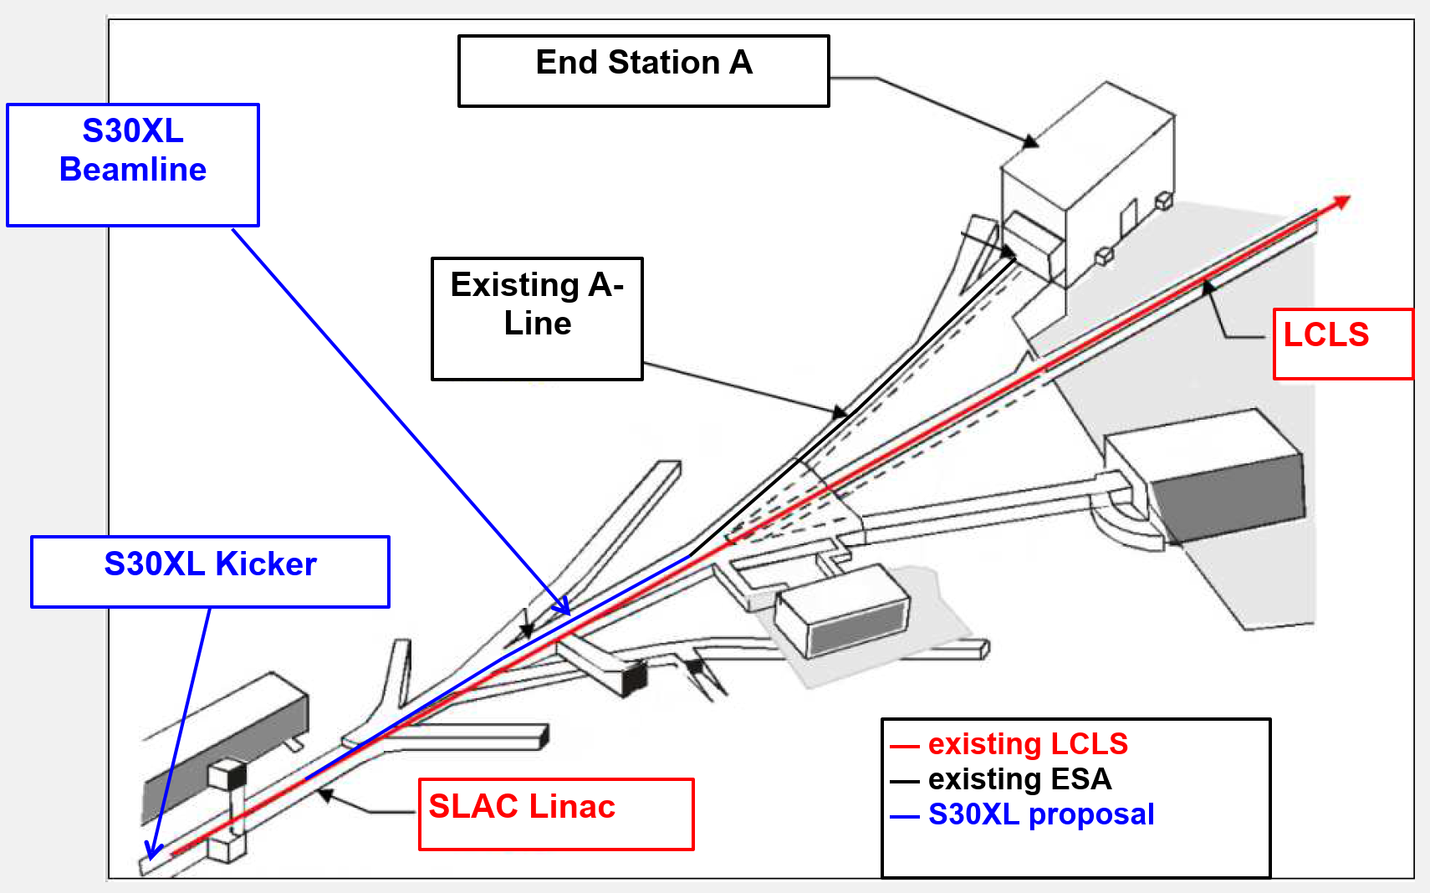
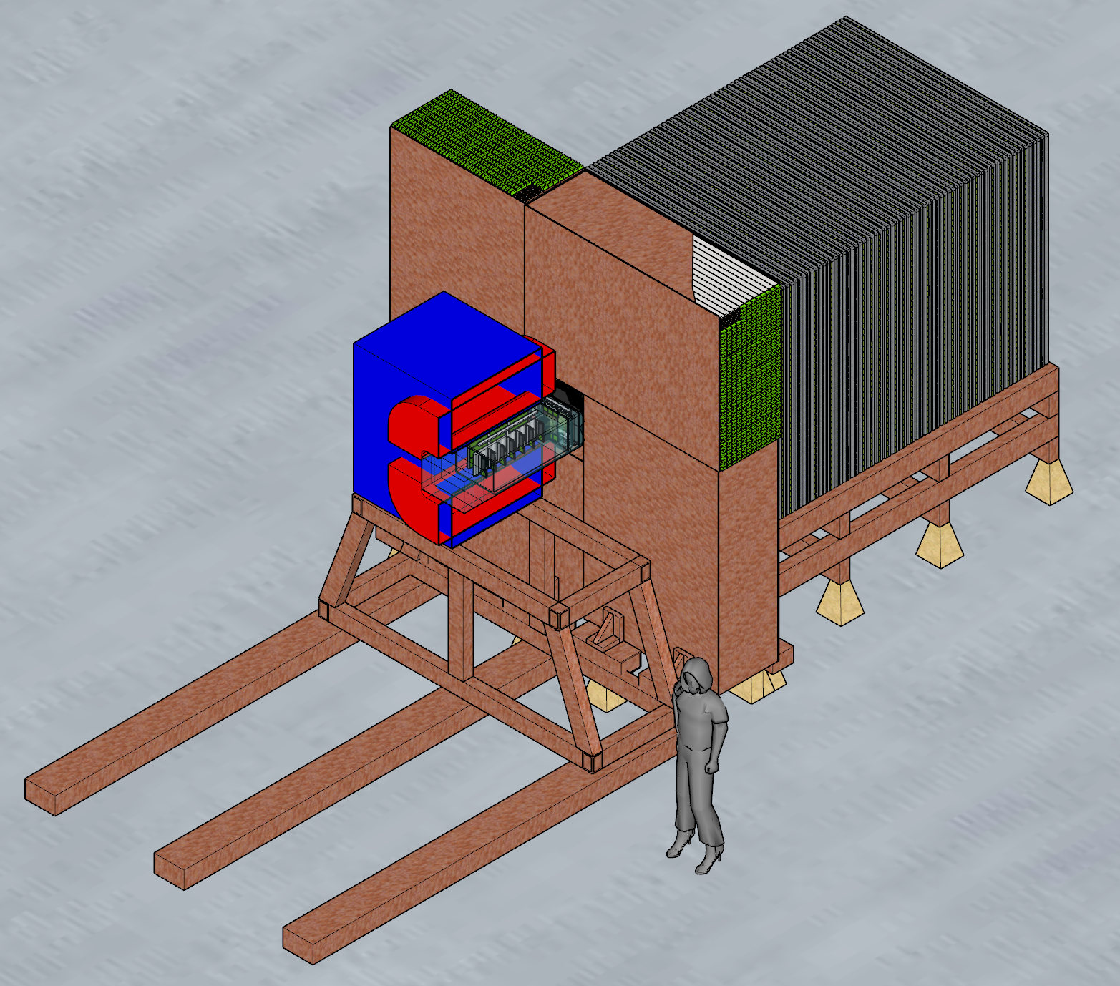
The Light Dark Matter Experiment (LDMX)
Collaboration between several US institutes and Lund U.
Making use of the e⁻ beam from the Linac Coherent Light Source (LCLS) X-Ray laser at SLAC
4/8 GeV beam
Using proven technology in order to minimise detector R&D costs
https://arxiv.org/abs/1808.05219
https://link.springer.com/article/10.1007/JHEP04(2020)003

Slide 6
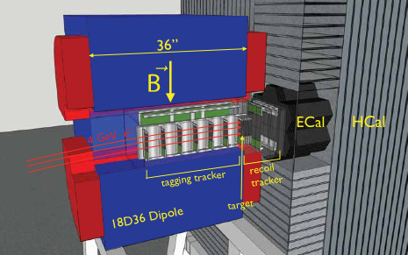
LDMX Detector
Tagging tracker (HPS)
  Identify incoming electrons
Recoil tracker (HPS)
  Identify outgoing products of the interaction with the target
Trigger Scintillator
  Electron counting for triggering purpose
Electromagnetic Calorimeter (CMS)
  Catching and tracking products of the interaction with the target
Hadronic calorimeter (Mu2e)
  Catching and identifying any nuclear products produced during any of the interactions

Slide 7



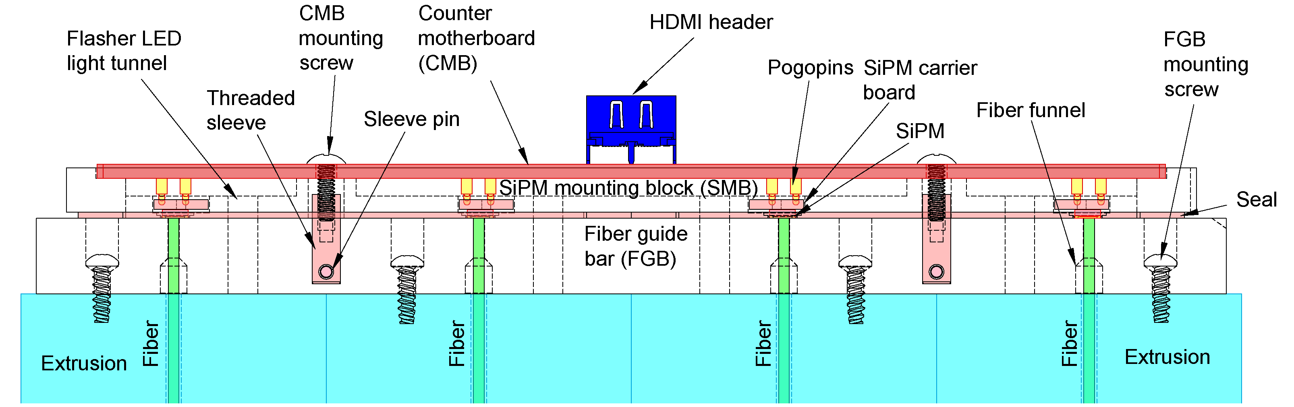
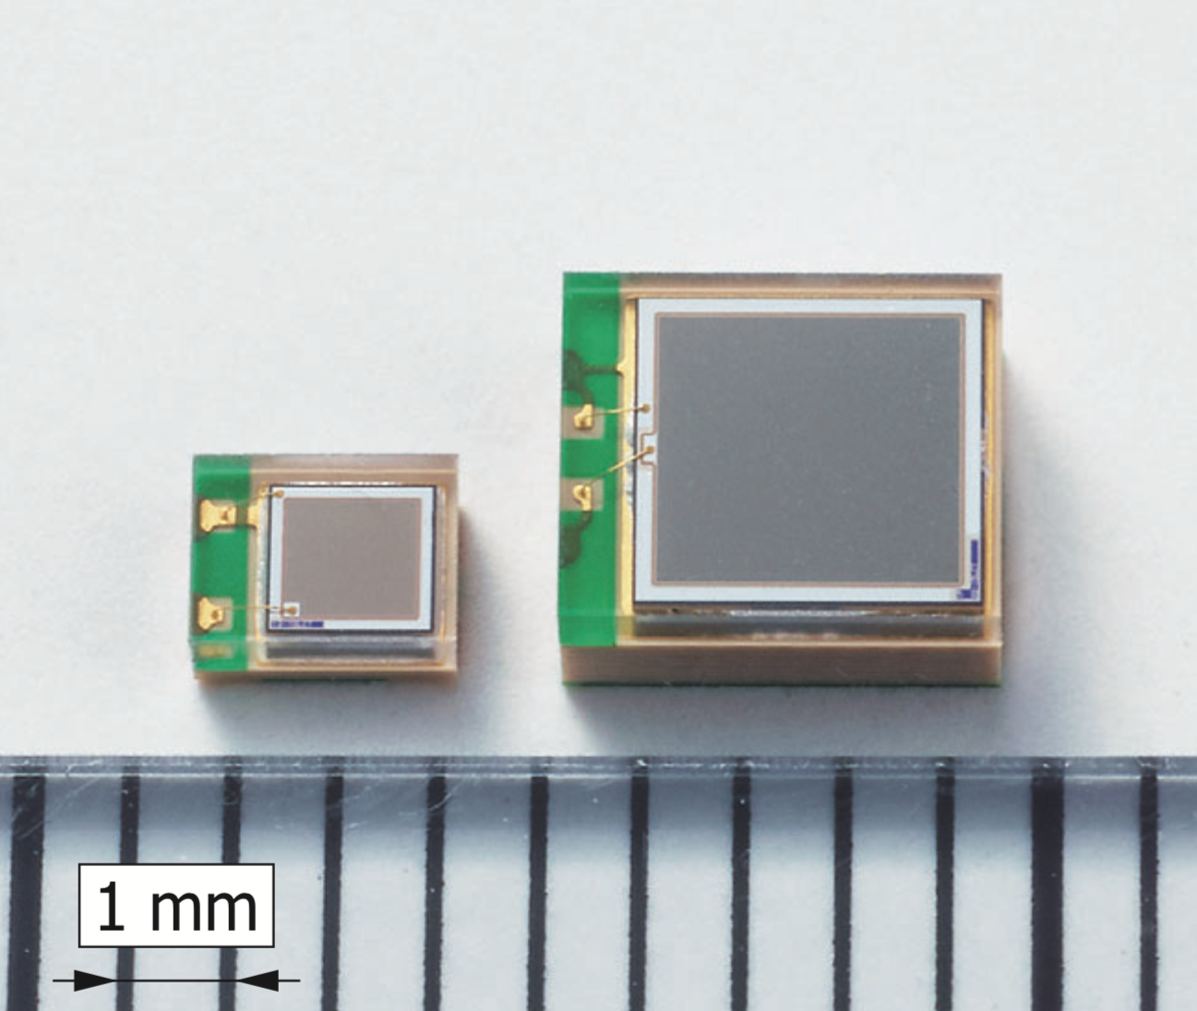
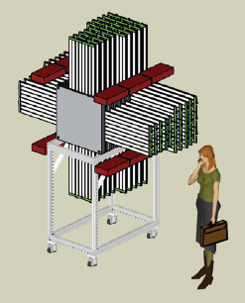
Hadronic Calorimeter
Scintillator bars with wavelength shifting fibers read out with Silicon Photomultipliers (SiPMs)
Mu2e based electronics
Front End boards designed by Lund based on the same readout chip as the ECal
Test setup being build at Lund for prototyping
Test Beam expected end of next year

Slide 8
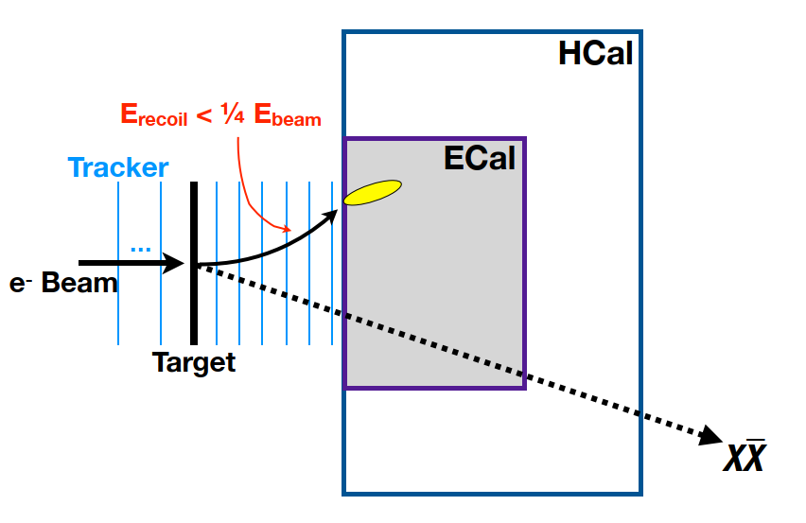
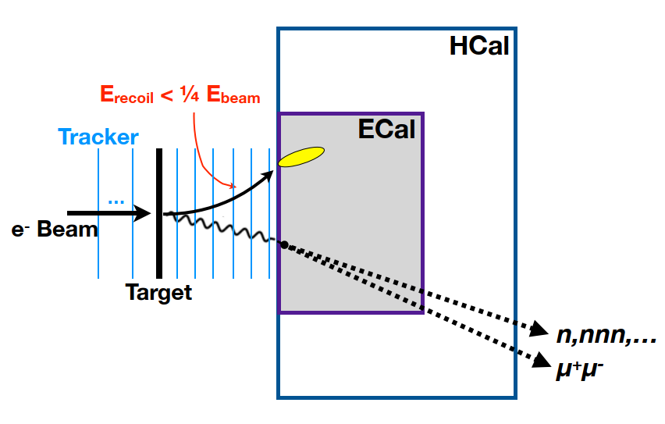
Getting back to the Physics
Signal
Backgrounds

Slide 9
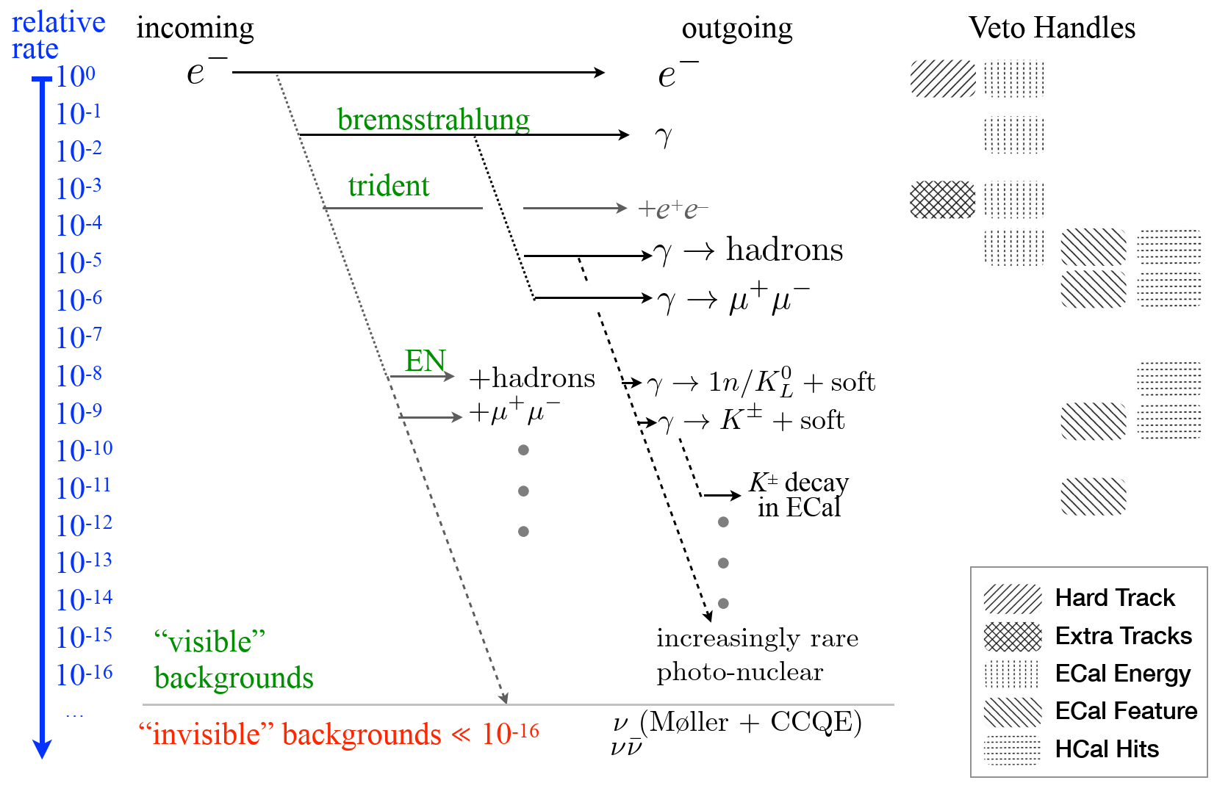
Backgrounds
In our sensitivity context every single rare background is challenging
We do have handle with MC but modeling is an important element
All of these are important not only for design of LDMX but also for the physics reach of the experiment
Any work at improving the understanding of any of those backgrounds is directly impacting LDMX results but also has applications outside of LDMX

Slide 10
Initiative for dark matter research
Combinaison of experimentalist and theorists from different universities
to tackle those challenging questions.
WP1 The Light Dark Matter eXperiment, Lund Particle physics 100% in LDMX
WP2 Simulation: Signal exploration & integration in PYTHIA, PYTHIA- GEANT4 integration, strengthening the nuclear physics modeling in GEANT4. Chalmers, Lund (Theory, Particle, Nuclear)
Experience will tell relevance for and interaction with LDMX
WP3 Data interpretation: Statistical inference & global fits. Lund Particle Physics, Chalmers, Stockholm Astroparticle, LDMX stakes: see WP2
WP4 Detector material evaluation for direct detection: Use lessons to prepare for future direct detection experiments. Chalmers and Stockholm
100% outside LDMX

Slide 11
Current development WP2
Basic idea:
  When in doubt, ask a friend
Integration of Pythia and Madgraph in Geant4 Simulation for signal generation
Allows to be much more precise on challenging processes

Slide 12
In Summary
LDMX is an electron fixed target experiment that aims to fully exploit the missing momentum technique with sensitivity to various asymmetric, thermal scalar elastic, Majorana, and inelastic/Pseudo-Dirac scenarios
Strong Swedish involvement in LDMX via Lund
There is in Sweden a broader involvement in the Dark Matter sector
In this context Sweden has a particular program that has reach beyond LDMX

Slide 13
Thank you for your attention!

