Slide 1

Time determination of primary vertices with the ATLAS experiment’s High- Granularity Timing Detector (HGTD)
Mattias Gullstrand and Stefan Maraš
Supervised by Christian Ohm at KTH
23/11/2020

Slide 2
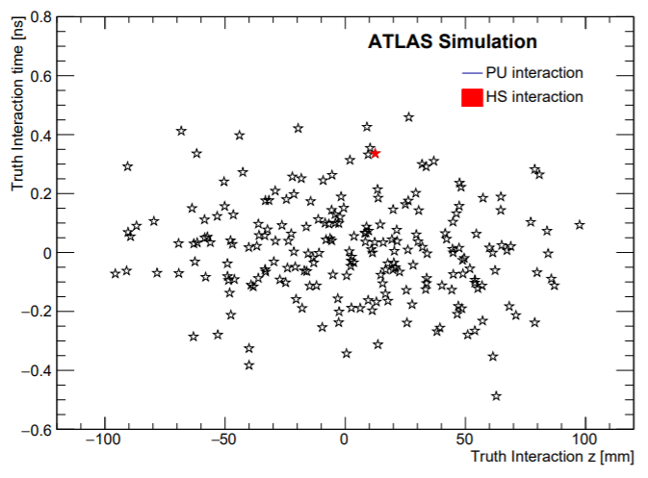
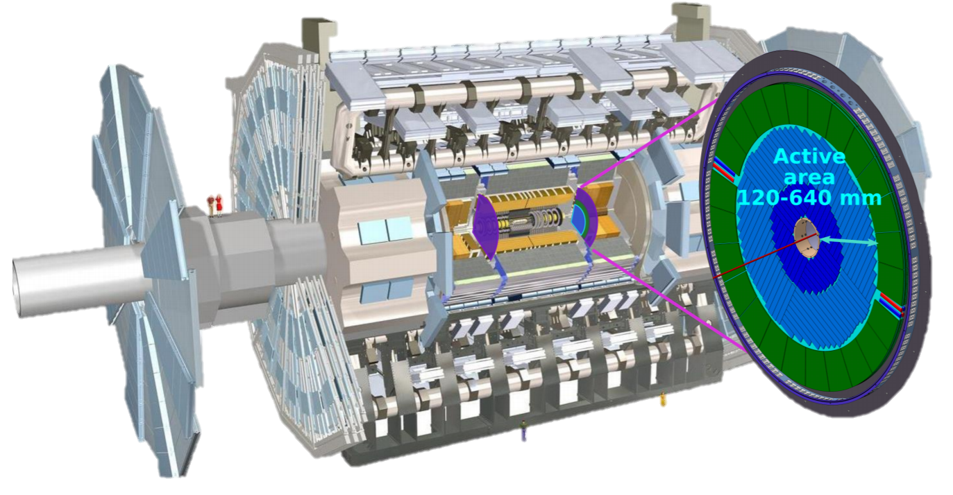
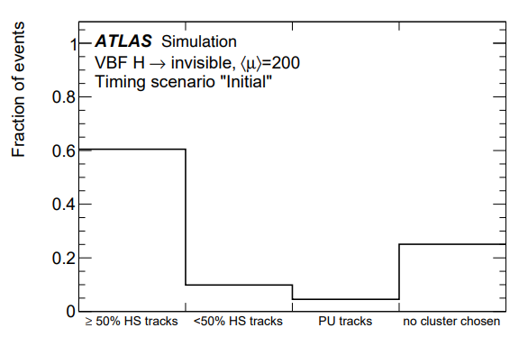
Problem formulation
High Granularity Timing Detector (HGTD) being developed
PU = Pile-up, HS = Hard-scatter
Too many interactions in small space → Difficult to separate
HGTD allows us, for the first time, to discern the interesting HS vertex from all the uninteresting pileup interactions in the time dimension
Currently, 25% of clusters are not given a time at all while 5% are given a time solely based on PU tracks yielding an incorrect time. We want to improve this!
Figure 1: Visualisation of the truth interactions in a single bunch crossing in the z-t plane. Taken from HGTD Technical Design Report (TDR), 2020.
Figure 2: BDT results of predicted HS clusters for all trained events in the VBF H → invisible data set.
Taken from HGTD Technical Design Report (TDR), 2020.
TDR available at: https://atlas.web.cern.ch/Atlas/GROUPS/PHYSICS/UPGRADE/CERN-LHCC-2020-007/
Notes:
Introducera förkortningarna PU, HS och HL
At each bunch-crossing, around 200 interactions occur
When interactions occur close in space, they become difficult to discern from eachother
As CERN moves into its HL-phase, utilize the HGTD to discern interactions in time, as shown in figure 1
The objective is to classify the tracks as PU or HS and then assign a time to the HS interaction
The current method uses a Boosted Decision Tree which first clusters tracks and then chooses the best cluster as the HS interaction
Currently, 25% of clusters are not given a time at all while 5% are given a time solely based on PU tracks yielding an incorrect time. We want to improve this!

Slide 3
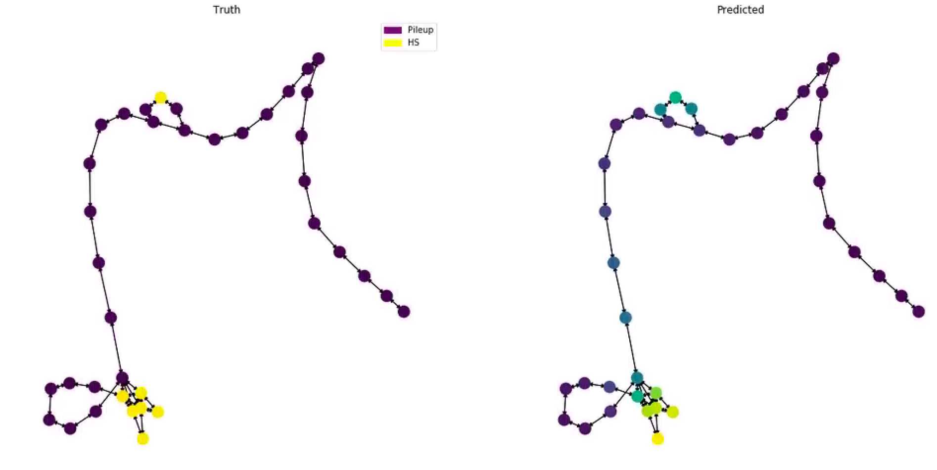
aDDressing the problem with modern ML Techniques
Examine if a more elaborate machine learning architecture can determine the times of the HS vertices more accurately than the present boosted decision tree model
We are applying a graph convolutional network (GCN)
Graph representation captures the link between the reconstructed tracks and vertices
Use the track information as features
Nodes are tracks
Edges are time and vertex links
Example of graph representation
and prediction in figure 3
Figure 3: One event (bunch crossing), trained on a GCN, represented as a graph with the truth information on the left and the predicted graph representation on the right
Notes:
Every event is represented as a graph, the netwrok then learns a set of graph representations.
Classify the HS-tracks to the HS-vertex and exclude PU-tracks.
In our prediction, even if the reconstruction is faulty, we can correctly classify tracks that have been assigned to different reconstructed vertices.

Slide 4
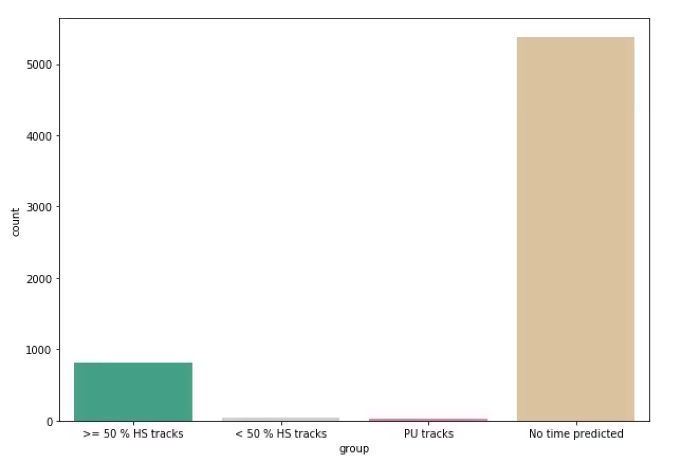
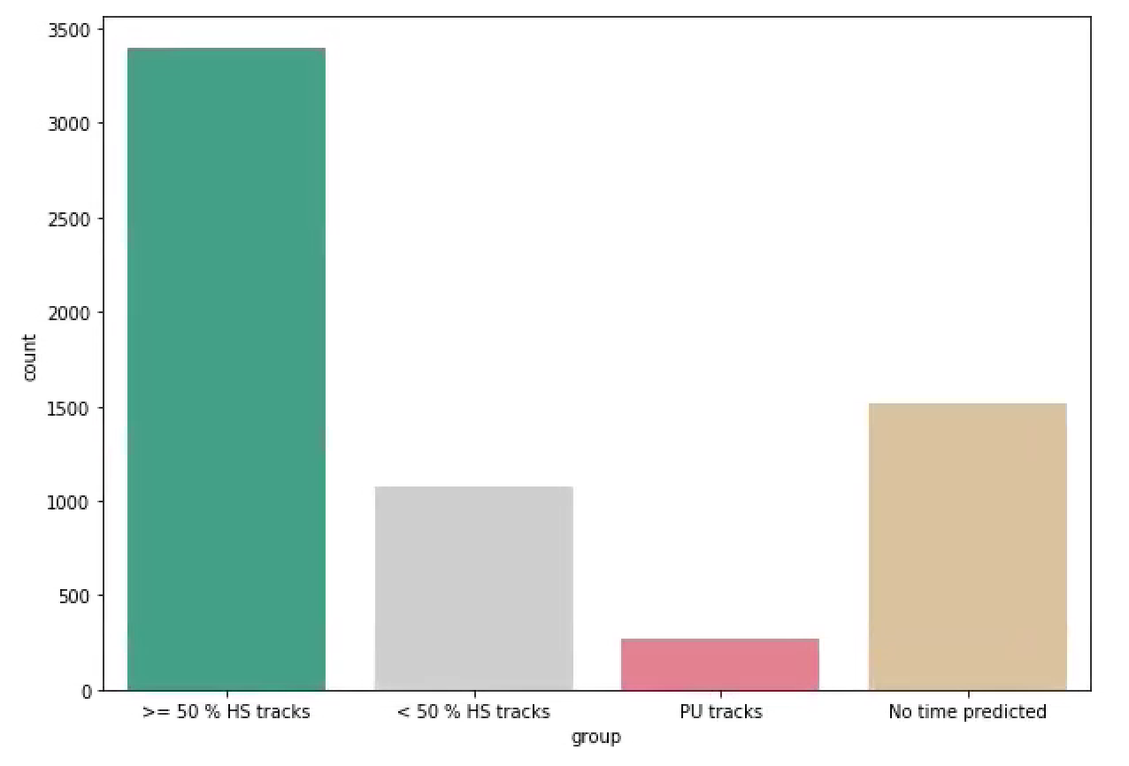
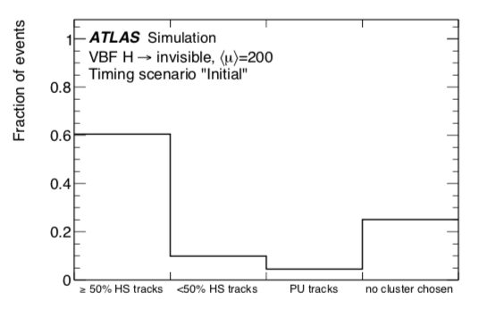
Preliminary results and comparison
Preliminary results show good predictive ability when focused solely on precision (figure 4)
When trained on 12500 events while prioritizing recall we got similar results to the BDT (figure 5 & 6)
Next step is to train on more events, perform variable importance analysis, hyperparameter tuning and examine potential preprocessing alternatives
ATLAS Simulation
Work in progress
ATLAS Simulation
Work in progress
Figure 4: Correctly assigned vertices when prioritizing precision. Nuimber of events = 6250 (our results from the testdata)
Figure 5: Correctly assigned vertices when prioritizing recall. Number of events = 6250 (our results from the testdata)
Figure 6: BDT results of predicted HS clusters for all trained events in the VBF H → invisible data set (TDR results)
TDR available at: https://atlas.web.cern.ch/Atlas/GROUPS/PHYSICS/UPGRADE/CERN-LHCC-2020-007/
Notes:
We will increase the training data to 120000 events
Figure 4 is very clean but only yields a time in 20% of the cases. Can be useful in some cases.
Figure 5 shows that 75% of the HS-vertices get an accurate time. There is thus a trade-off which can be chosen by the user. Our model is thus more flexible

Slide 5
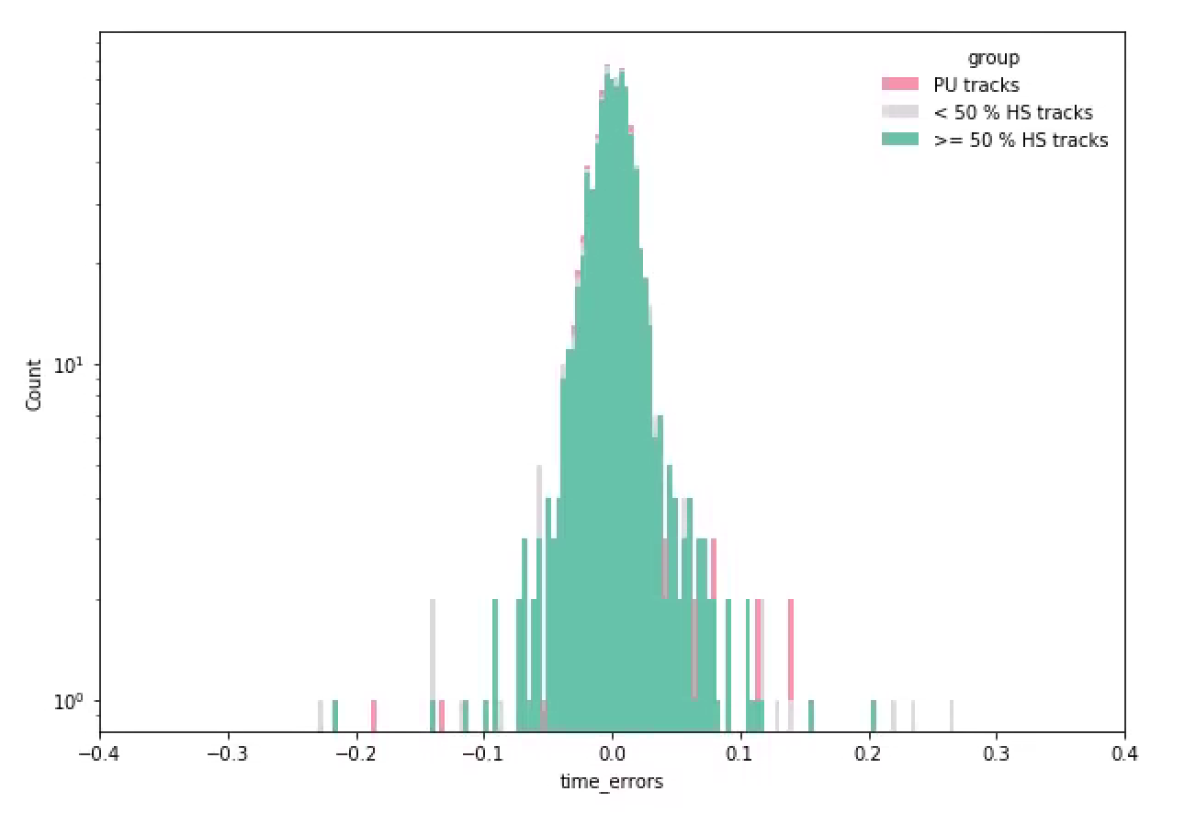
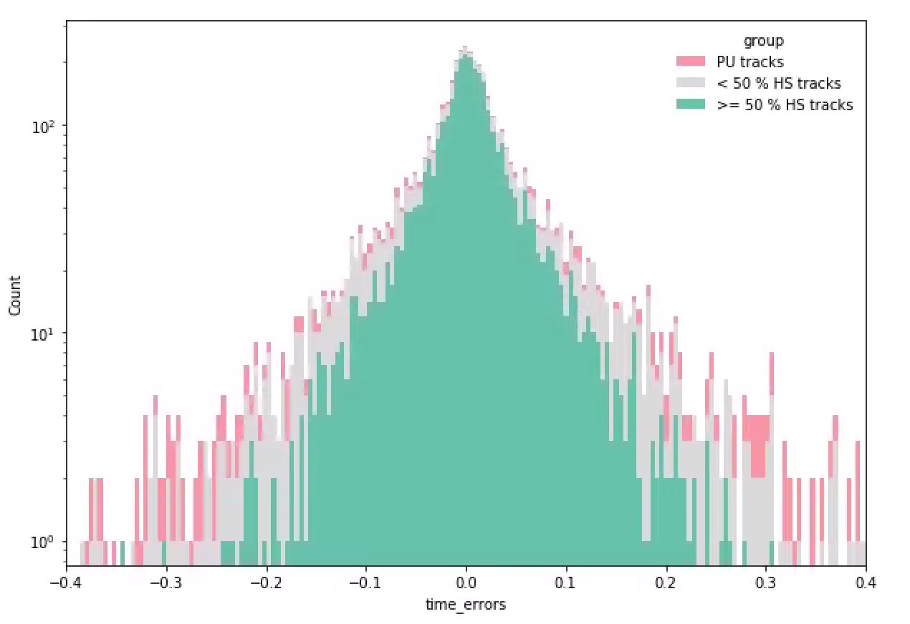
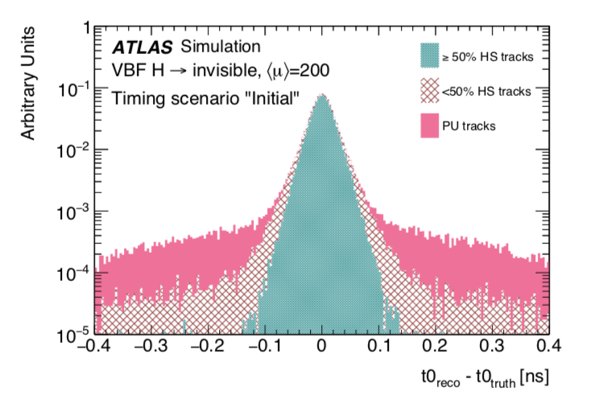
Appendix
ATLAS Simulation
Work in progress
ATLAS Simulation
Work in progress
Figure 7: Time deviation between predicted HS interaction and true HS interaction when prioritizing precision.
Number of events = 875 (our results from the testdata that have a time)
Figure 8: Time deviation between predicted HS interaction and true HS interaction when prioritizing recall.
Number of events = 4735 (our results from the testdata)
Figure 9: BDT results of predicted times for HS interactions and true HS interactions for all trained events in the VBF H → invisible data set (TDR results)
TDR available at: https://atlas.web.cern.ch/Atlas/GROUPS/PHYSICS/UPGRADE/CERN-LHCC-2020-007/

