Slide 1
Application
Offline discussions to target specifications of the call.
Plan
  Nordic Particle Physics Portal (N3P)
  A sustained and dynamic Open Science Knowledge center providing access to computational, research & education, training and analysis resources, as well as expertise.
  Training courses, Nordic LHC workshops, lab visits, exchanges, joint analyses.
  Draft is ok but needs rebalancing to account for 50% portal, 50% activities (more from Farid for portal, Dave to slim down text on other activities) .
  Draft
    https://docs.google.com/document/d/1P8Iyv4qUK8ymT_U8tg50BszYZN6GMTiY2wtdMlXhknY/edit?usp=sharing

Slide 2
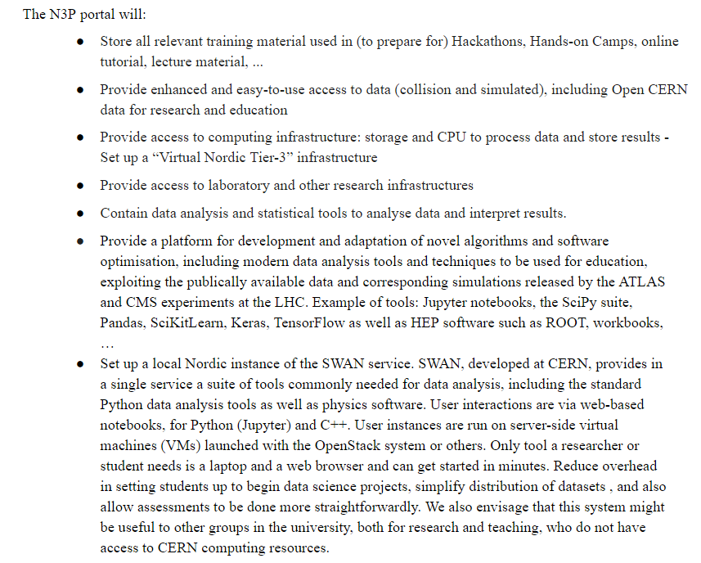

Slide 3
Nordforsk app
Budget
https://docs.google.com/spreadsheets/d/13T1KNo2ThrUa3A0sy3BPsOMvrujqqw1qVL3tsChydiY/edit?usp=sharing
Oslo/Lund one postdoc for development of portal with equivalent x2 in-kind contribution from that institution.
Other in-kind 10 seniors at 10% of their time (or ~20 seniors with 10%) for contributions.

Slide 4
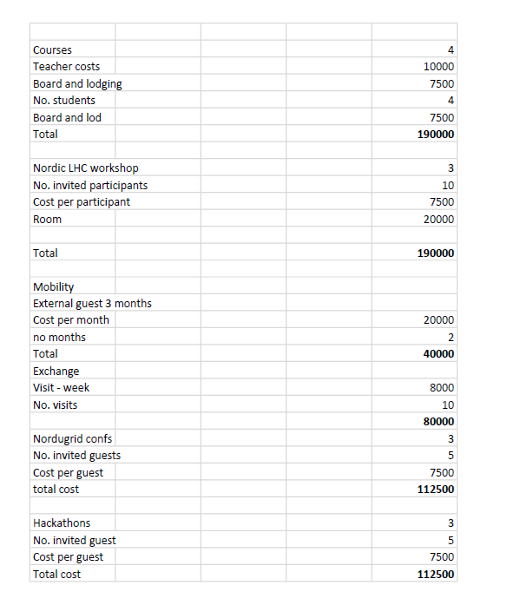
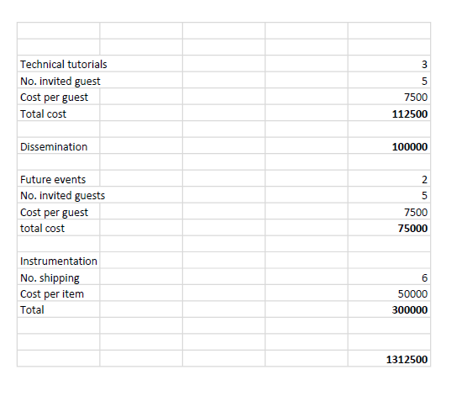

Slide 5
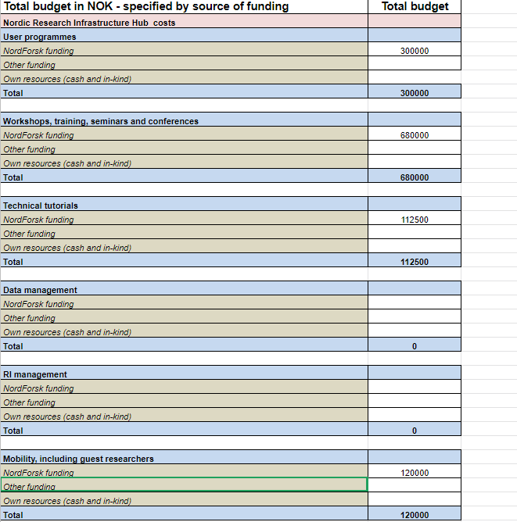
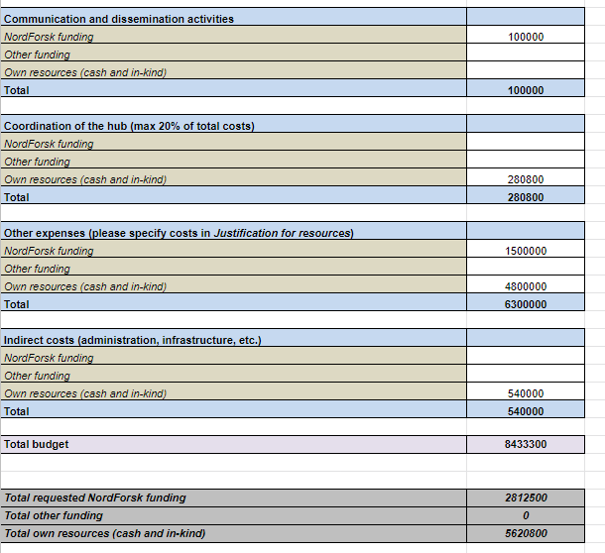

Slide 6
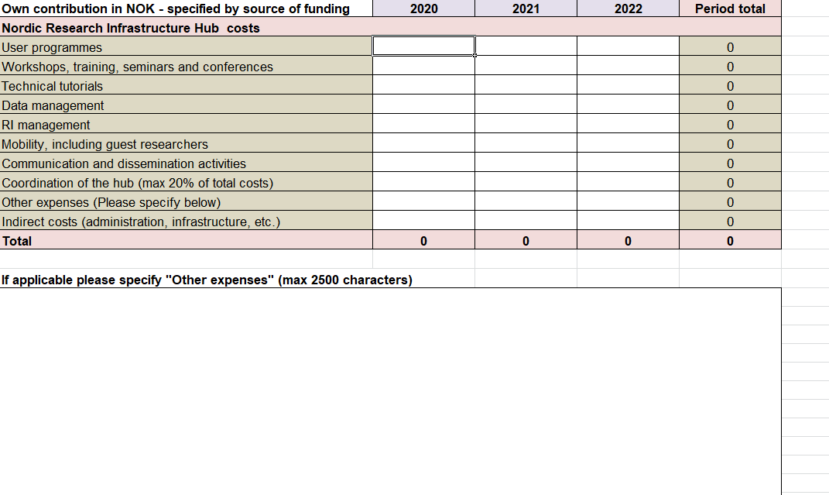
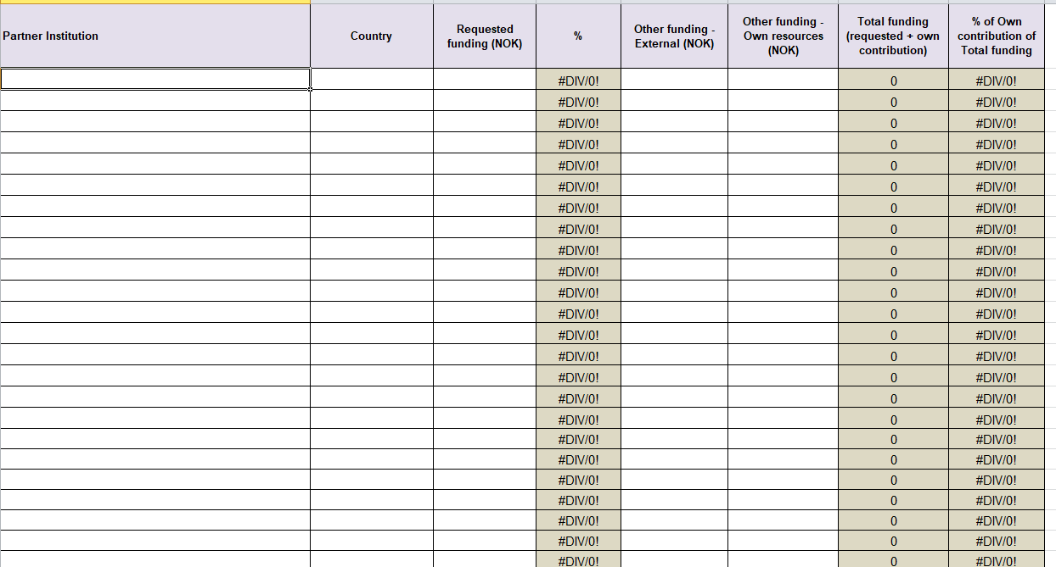
Total contributions from partners
Individual contributions from partners

Slide 7
Required today
Seniors from each institute who can take part in network
Separate
5% of salary costs
OH cost

Slide 8
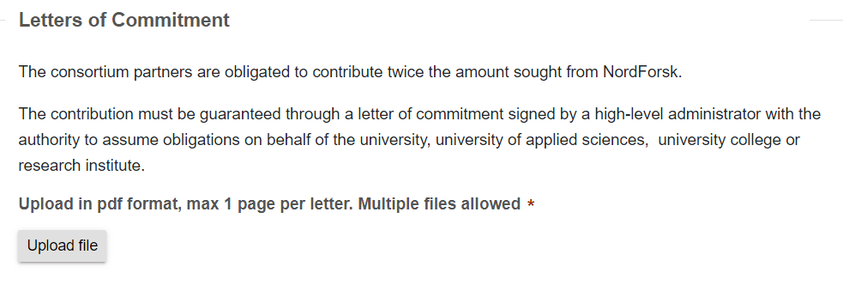
Required this week
Our deadline – Friday.
Real deadline 13:00 22nd October

