Slide 1


Physics potential of the ESSνSB
Mattias Blennow
KTH Physics

Slide 2
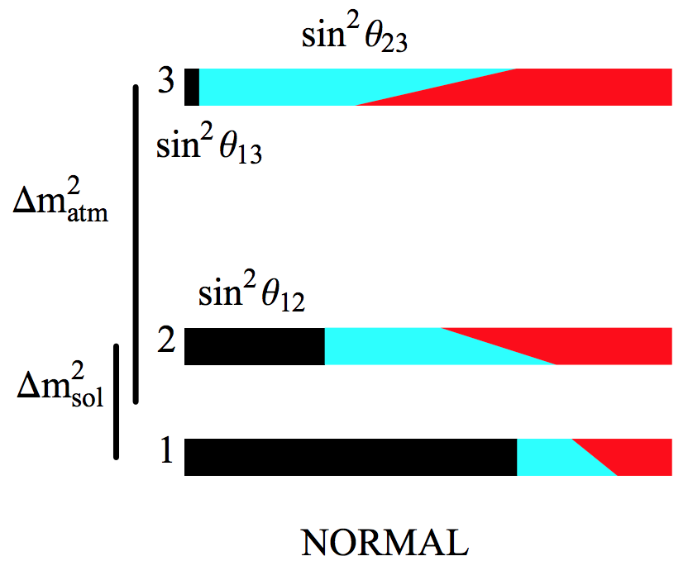

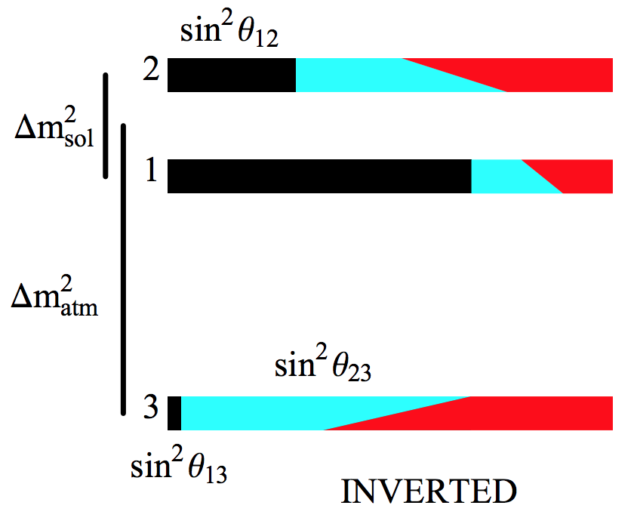
Physics goals
Establish (bounds on) CP violation in the lepton sector
Neutrino mass hierarchy
Investigate new physics in the neutrino sector
Other goals
Mena, Parke, Phys.Rev. D69 (2004) 117301

Slide 3
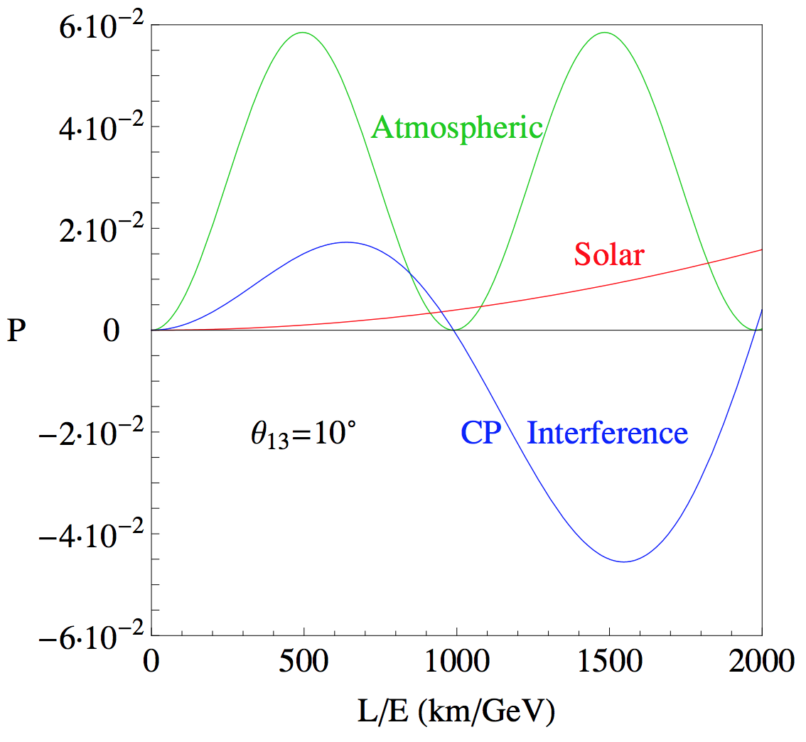
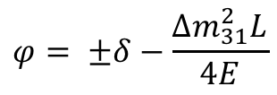
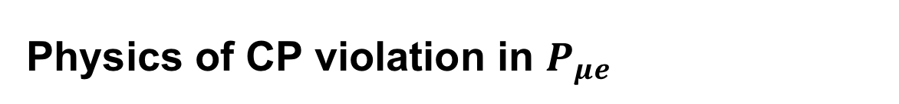



Physics of CP violation in $P_{μe}$
CP violation mainly through interference
Requires similar amplitude of different frequency oscillations
  Atmospheric
  Solar
$$P_{μe}= {\left|A_{sol}+e^{iφ}A_{atm}\right|}^{2}$$
$$A_{atm}=s_{23}\sin{(2θ_{13})}\sin{(\frac{∆m_{31}^{2}L}{4E})}$$
$$A_{sol}=c_{23}\sin{(2θ_{12})}\sin{(\frac{∆m_{21}^{2}L}{4E})}$$
$$φ= ±δ−\frac{∆m_{31}^{2}L}{4E}$$
Coloma, Fernandez Martinez, JHEP 1204 (2012) 089

Slide 4
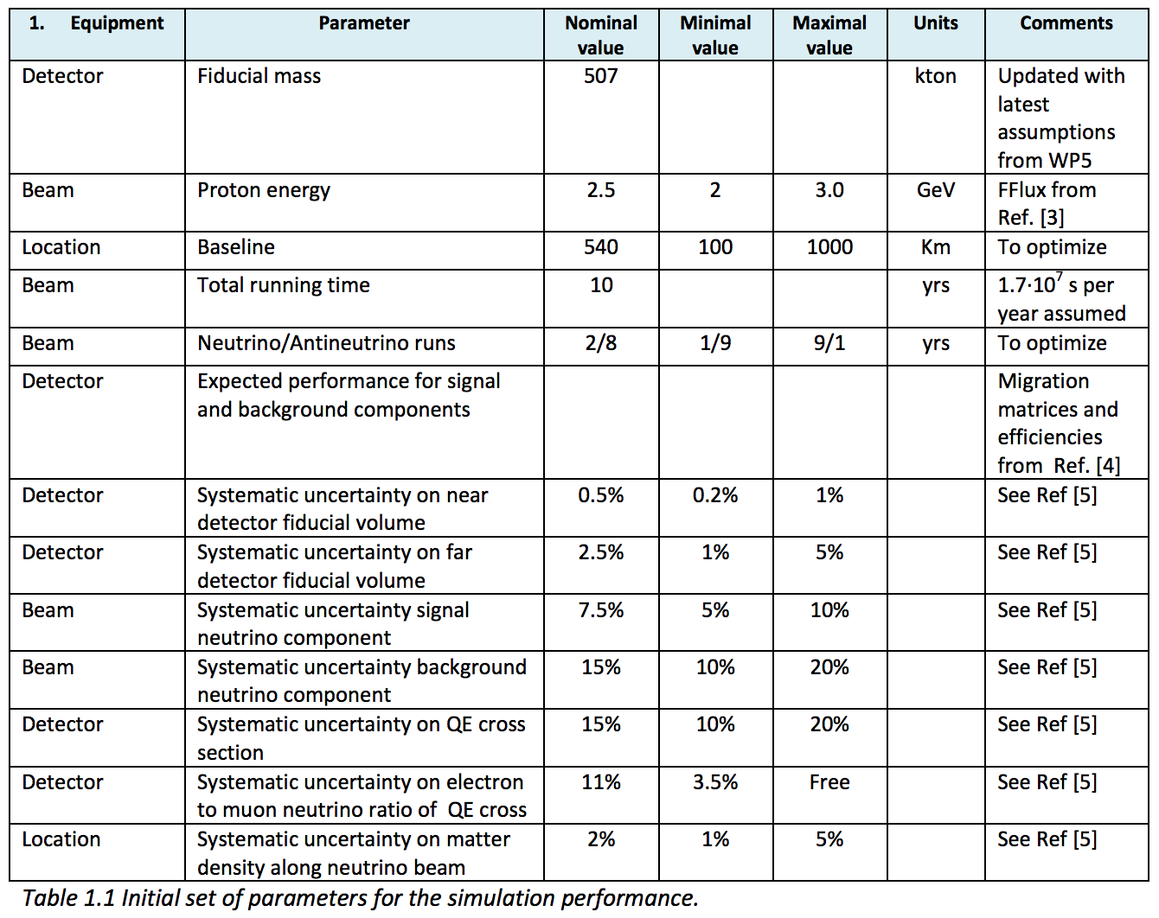
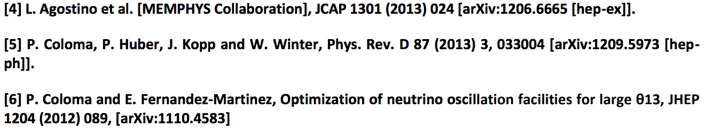
Base setup and assumptions
ESSnuSB WP6, Deliverable 6.1

Slide 5
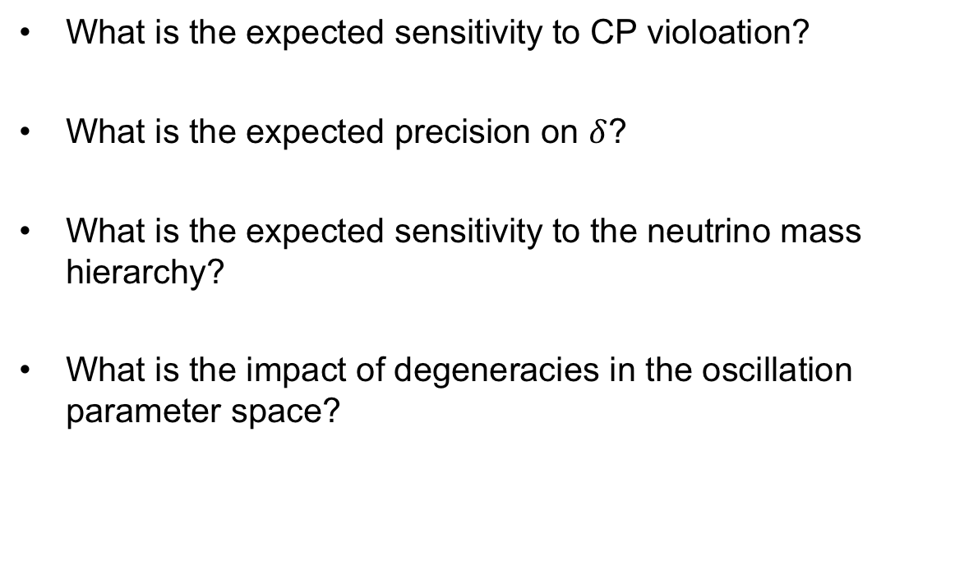
Performance of the beam experiment
What is the expected sensitivity to CP violoation?
What is the expected precision on $δ$?
What is the expected sensitivity to the neutrino mass hierarchy?
What is the impact of degeneracies in the oscillation parameter space?

Slide 6
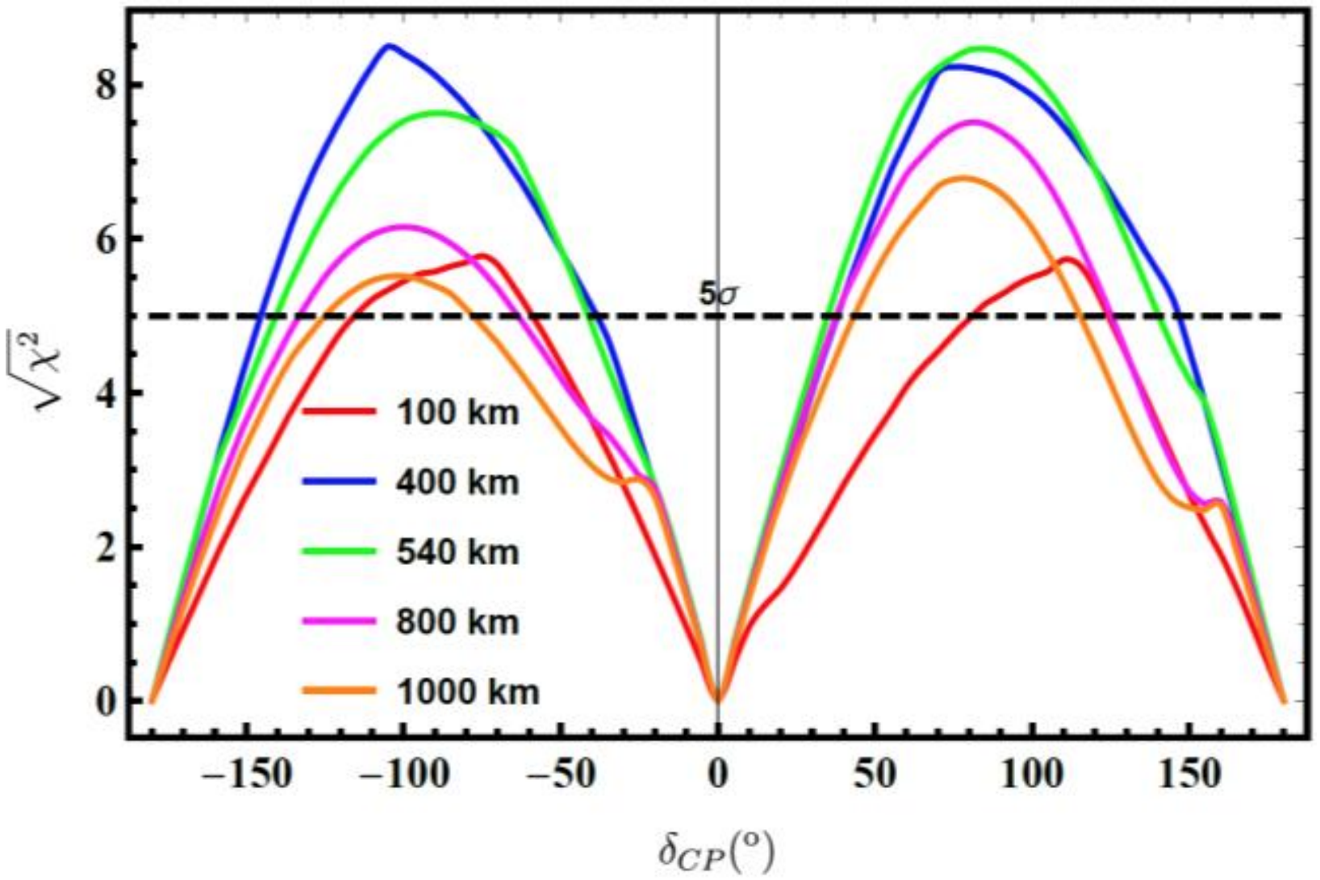
CP violation
ESSnuSB WP6, Deliverable 6.1

Slide 7
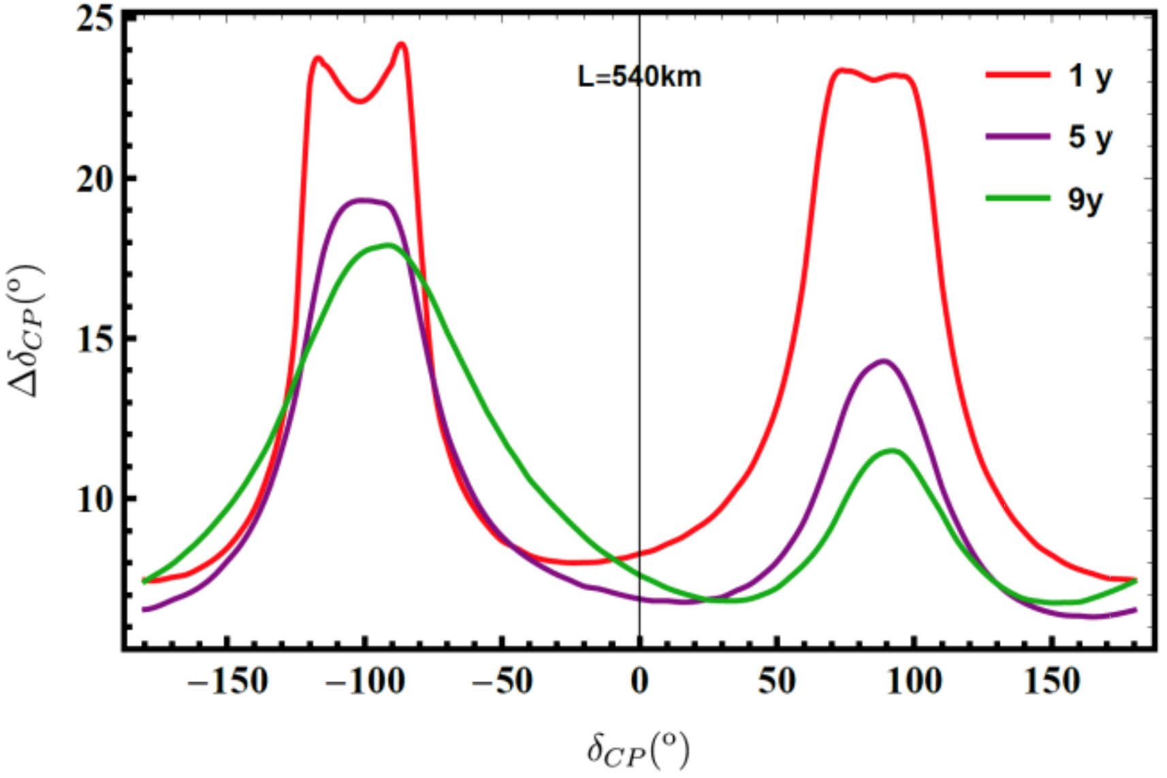
CP precision
ESSnuSB WP6, Deliverable 6.1

Slide 8
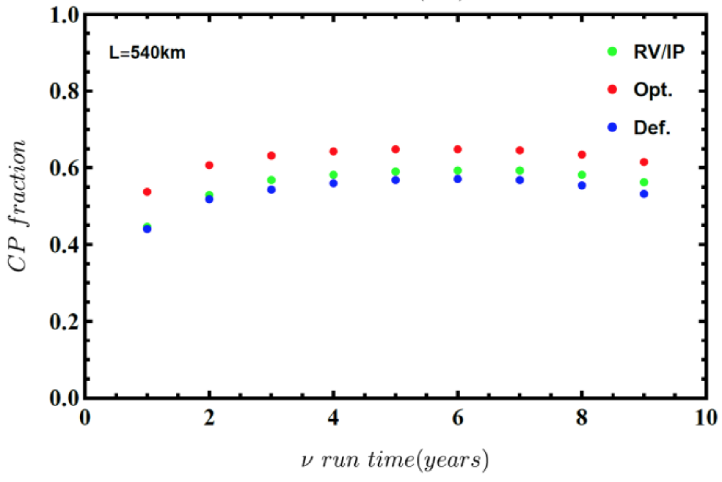
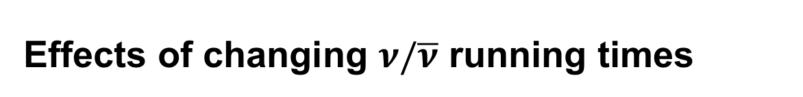
Effects of changing $ν/\overline{ν}$ running times
ESSnuSB WP6, Deliverable 6.1

Slide 9
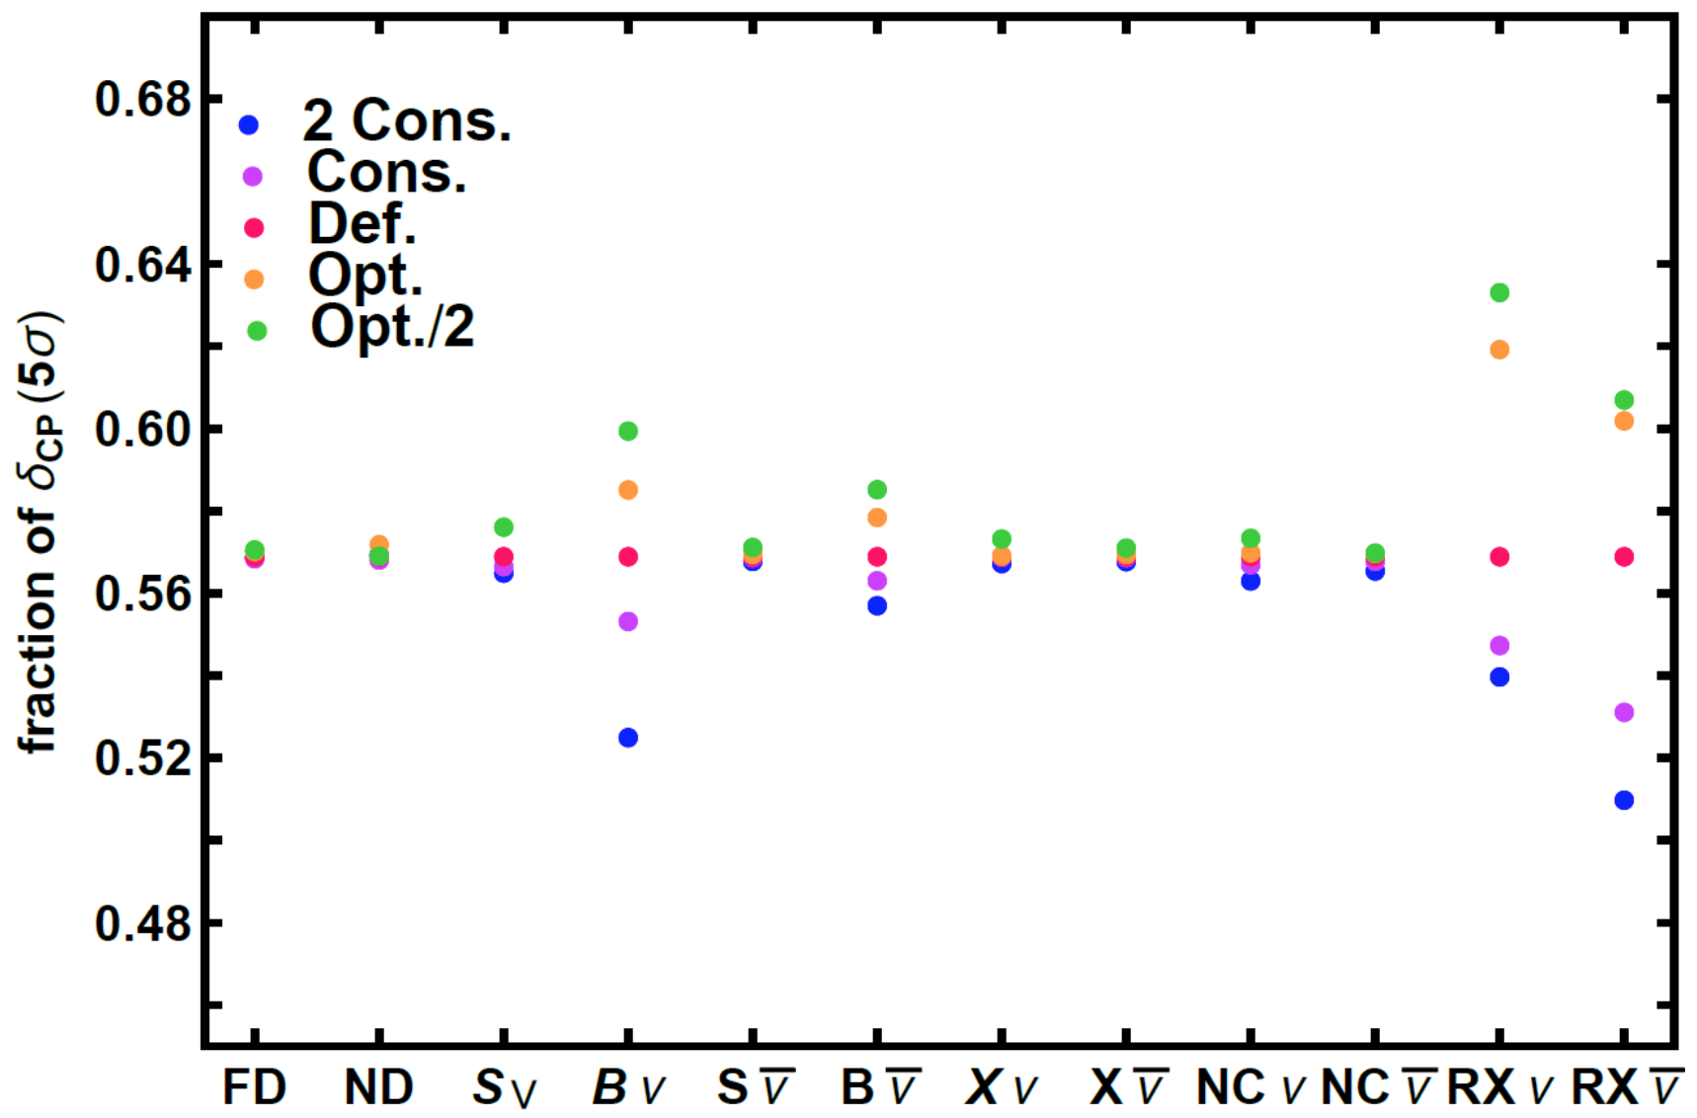
The impact of systematic errors
ESSnuSB WP6, Deliverable 6.1

Slide 10
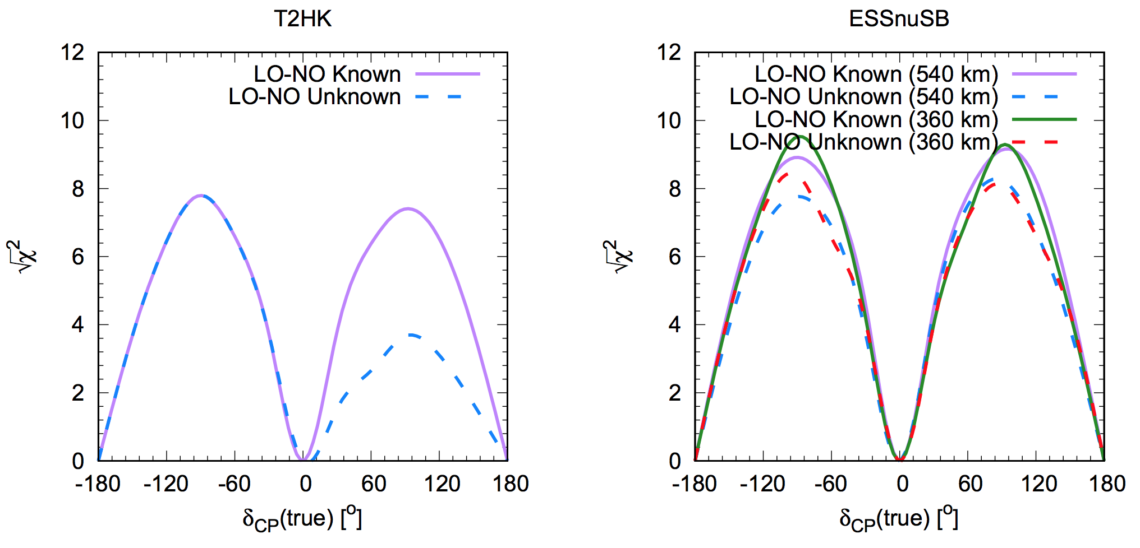
Comparisons to T2HK
Ghosh, Ohlsson, arXiv:1906.05779

Slide 11
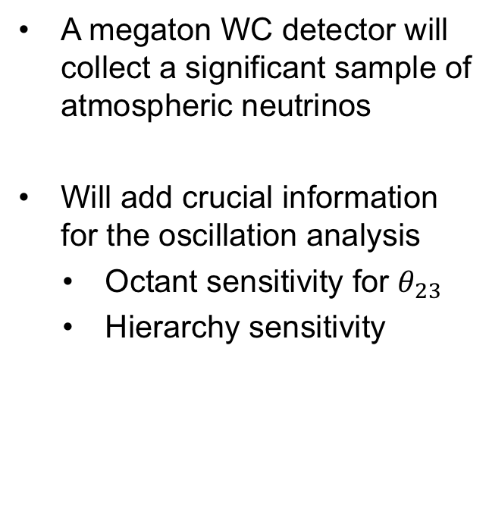
Adding atmospheric neutrino data
A megaton WC detector will collect a significant sample of atmospheric neutrinos
Will add crucial information for the oscillation analysis
  Octant sensitivity for $θ_{23}$
  Hierarchy sensitivity
Kajita, Proceedings of the Japan Academy, Series B

Slide 12
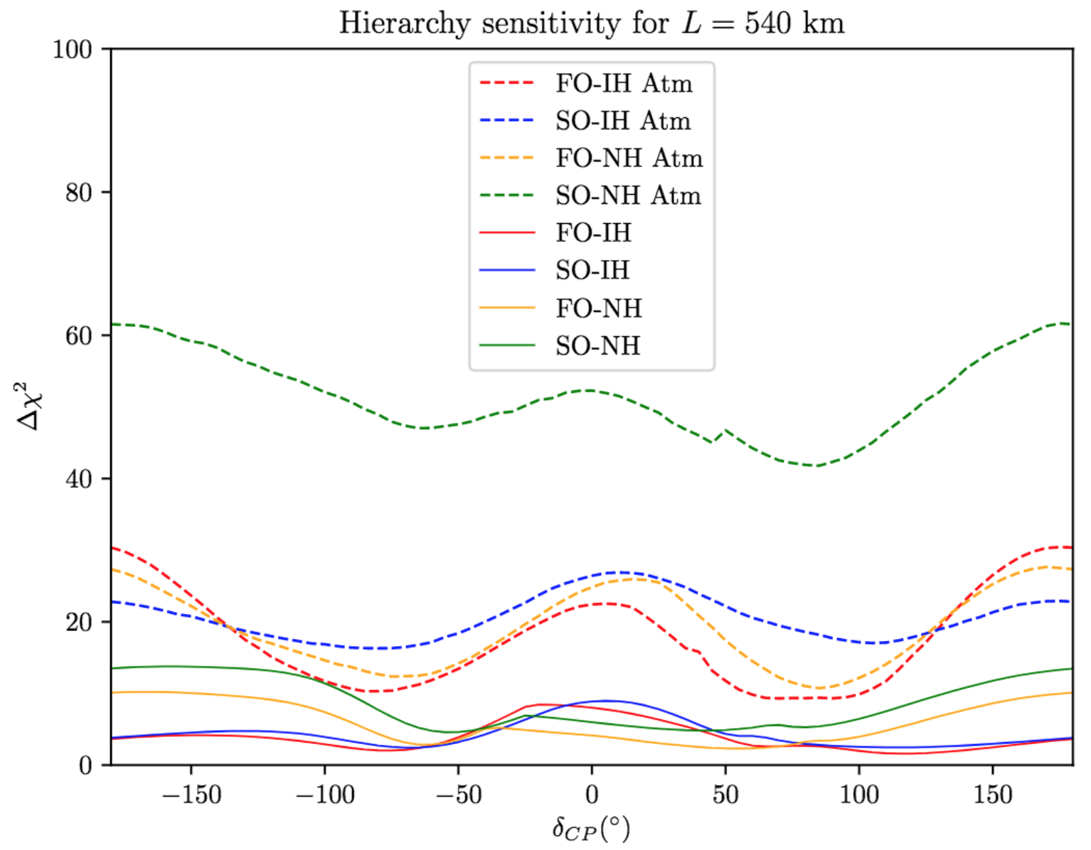
Mass hierarchy
ESSνSB WP6
PRELIMINARY
Courtesy of S. Rosauro

Slide 13
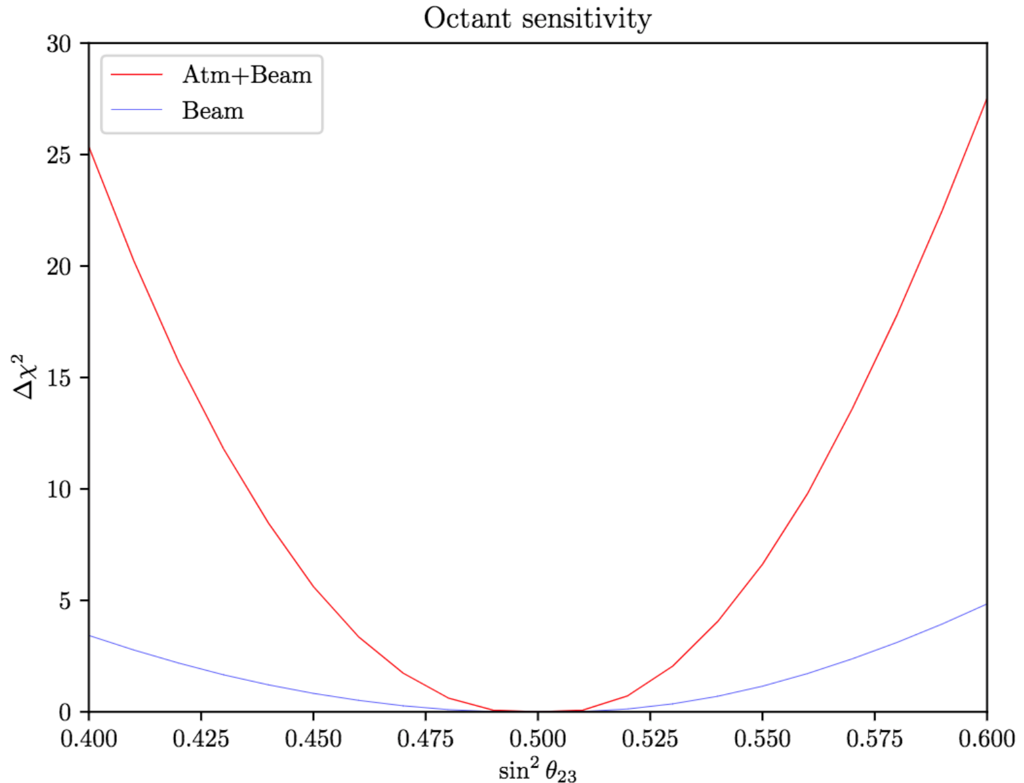
Octant sensitivity
ESSνSB WP6
PRELIMINARY
Current best-fit
Courtesy of S. Rosauro

Slide 14
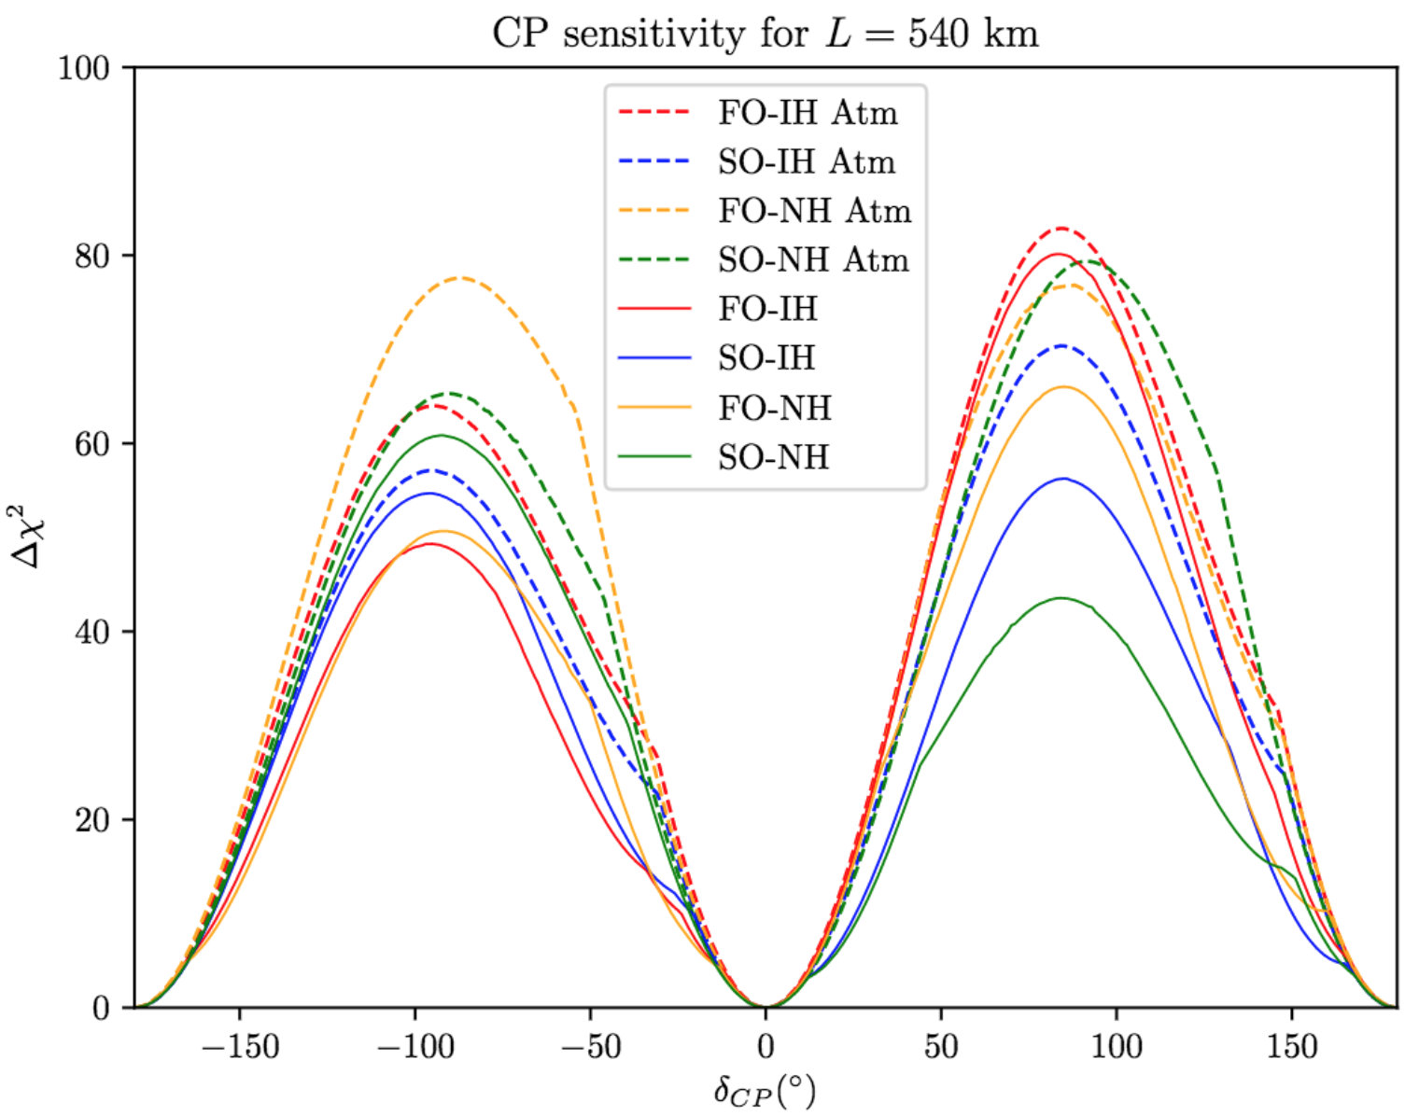
CP sensitivity
ESSνSB WP6
PRELIMINARY
Courtesy of S. Rosauro

Slide 15
New physics scenarios

Slide 16
Non-standard neutrino interactions (NSI)

Slide 17
Sterile neutrinos

Slide 18
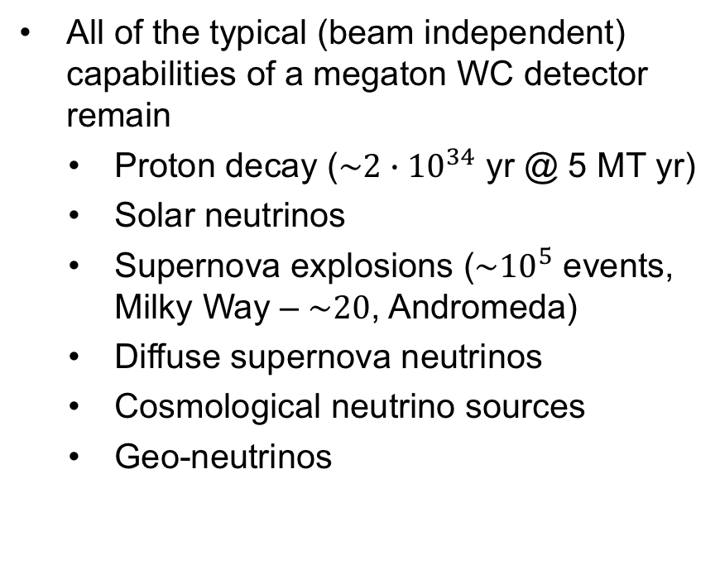
Other physics
All of the typical (beam independent) capabilities of a megaton WC detector remain
  Proton decay ($\sim 2∙{10}^{34}$ yr @ 5 MT yr)
  Solar neutrinos
  Supernova explosions (${\sim 10}^{5}$ events, Milky Way – $\sim 20$, Andromeda)
  Diffuse supernova neutrinos
  Cosmological neutrino sources
  Geo-neutrinos

Slide 19
Summary and conclusions

