Slide 1
Report from CERN Council and
Update of the
European Strategy for Particle Physics
Partikeldagarna 2019
Kerstin Jon-And, Stockholm University

Slide 2
CERN’s organisation
Council:
Decision making authority
Two delegates per member state (Sweden: Mats Johnsson, KJA, deputy Richard Brenner)
President: Ursula Bassler
Main advisory bodies:
Scientific Policy Committee (SPC)
Finance Committee (Swedish reps Mathias Hamberg, Barbro Åsman)
Tripartite Employment Conditions Forum (Chaired by Barbro Åsman)
Audit Committee (KJA council rep.)
Director General: Fabiola Gianotti, manages CERN, elected by Council
Directorate:
Director for Accelerators and Technology: Frédérick Bordry
Director for Research and Computing: Eckard Elsen
Director for Finance and Human Resources: Martin Steinacher
Director for International Relations: Charlotte Warakaulle
10 departments, e.g. Experimental Physics, Information Technology, Theoretical Physics

Slide 3
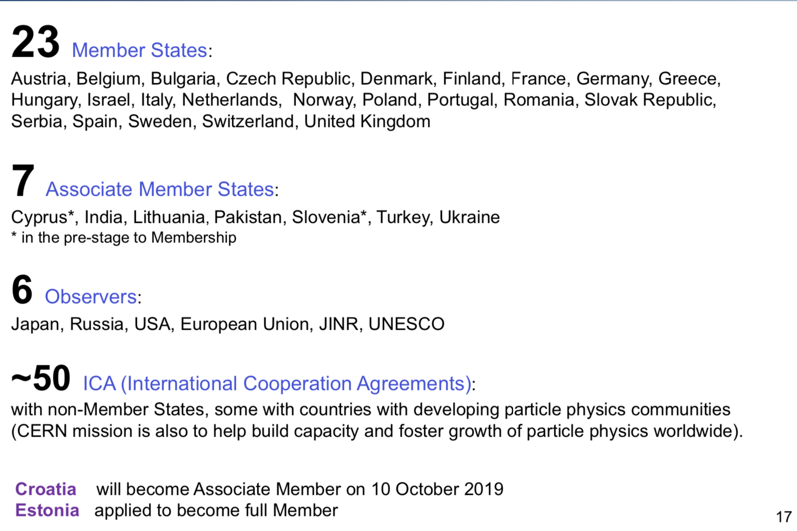
CERN comprises the following states and organisations

Slide 4
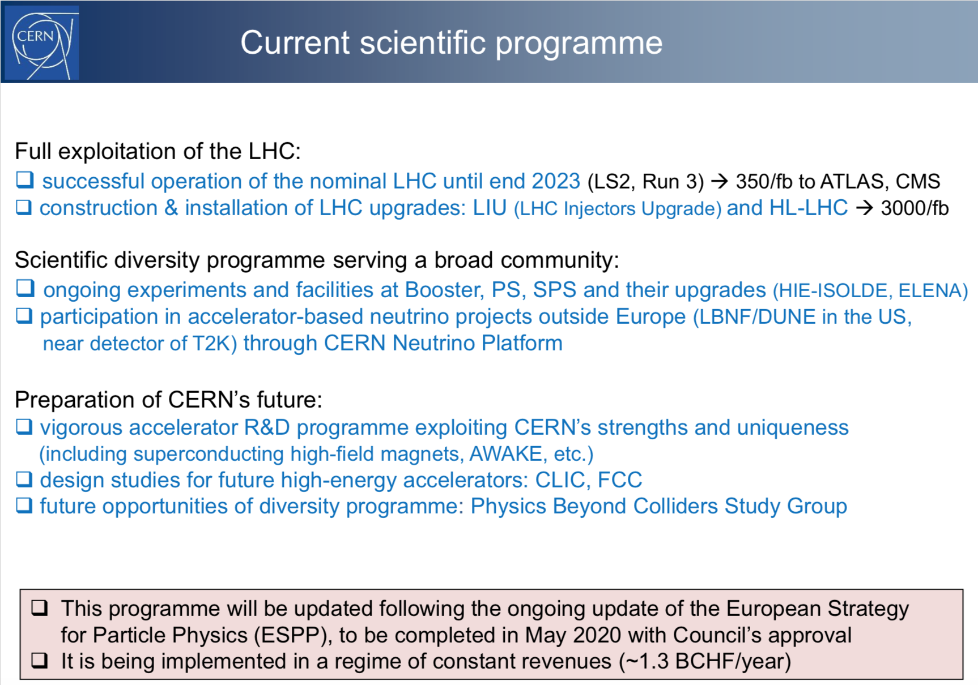
Fabiola Gianotti,
SPC, 23 Sep 2019

Slide 5
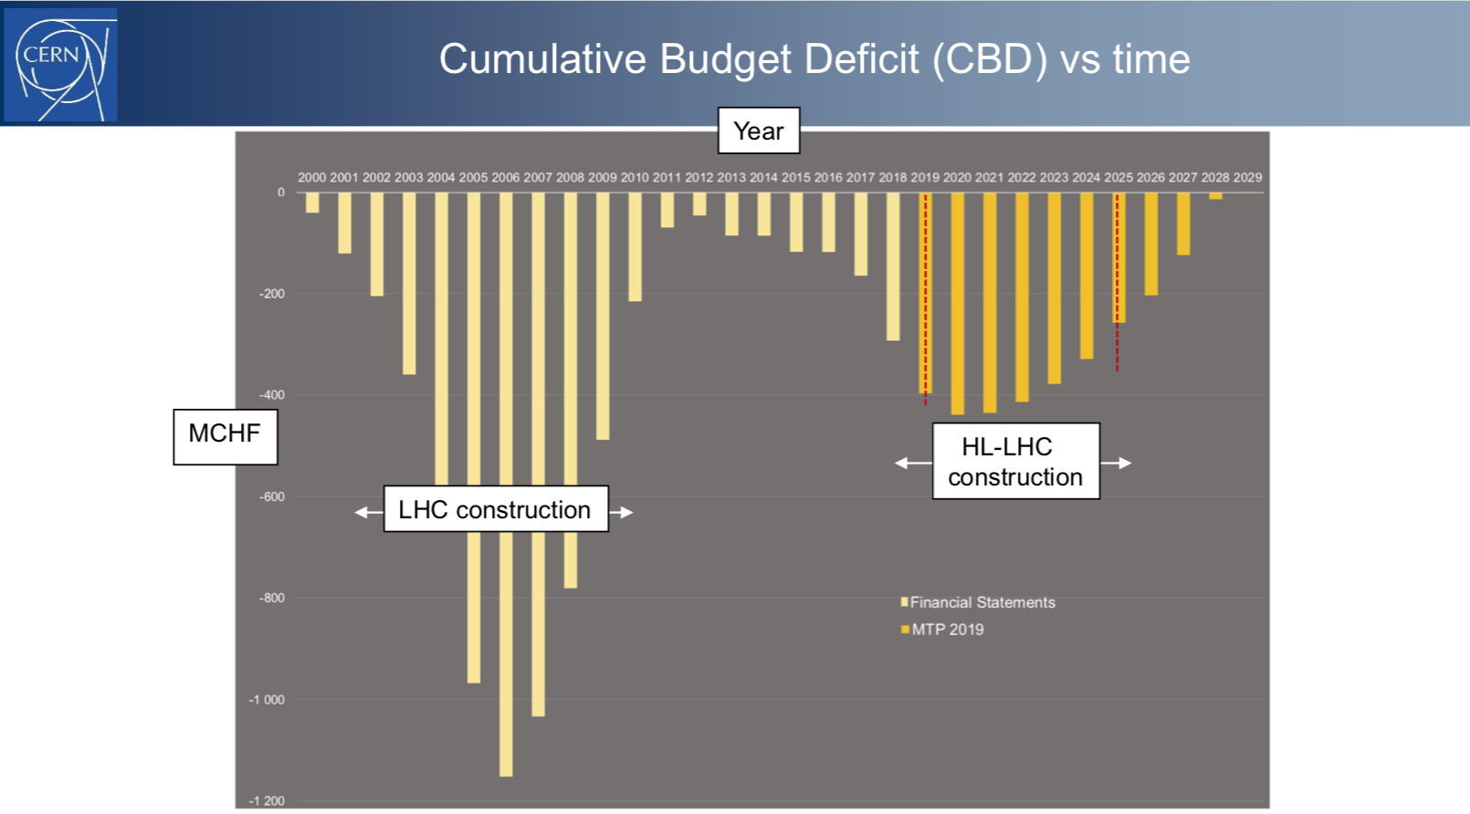
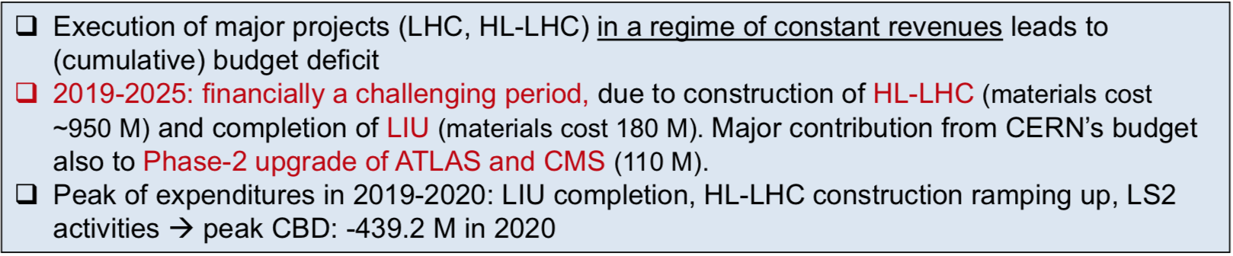
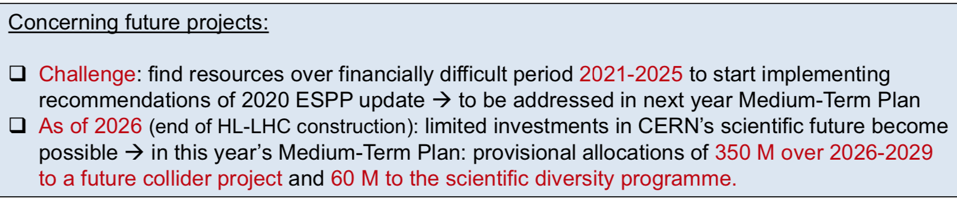
Fabiola Gianotti,
SPC, 23 Sep 2019
2006
2019
2025
-400
-1000

Slide 6
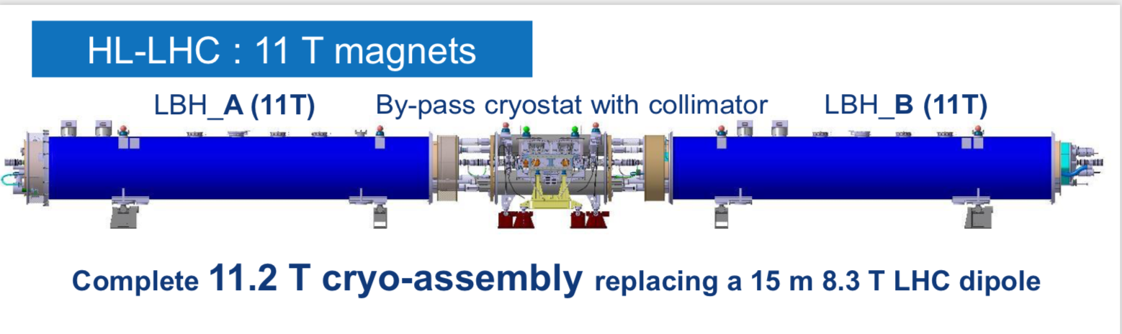
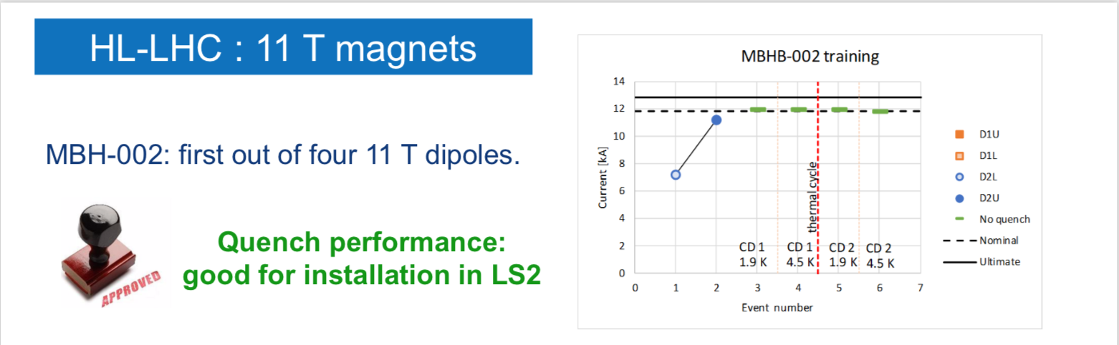
From news on Long Shutdown 2, Frédérique Bordry

Slide 7
Update on Elections in Council:
Mandate from 1 January 2020:
Finance Committee Chair: Umberto Dosselli, Italy
FC Vice-Chair: Laurent Salzarulo, Switzerland
SPC Chair: Leonid Rivkin, Switzerland
Interviews with shortlisted DG-candidates, Sep 2019
Election of new DG (2021-2025), Dec 2019

Slide 8
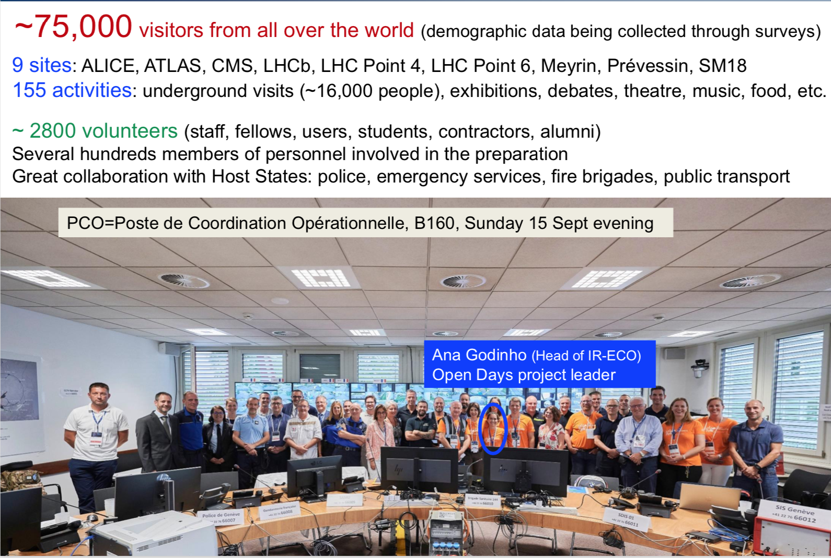
CERN Open Days 14-15 September
Fabiola Gianotti,
SPC, 23 Sep 2019

Slide 9
From European Strategy Group meeting 27 September 2019
Establish your communication procedures with your community
Physics Briefing Book available as of today at CDS at CERN, http://cds.cern.ch/record/2691414.

Slide 10
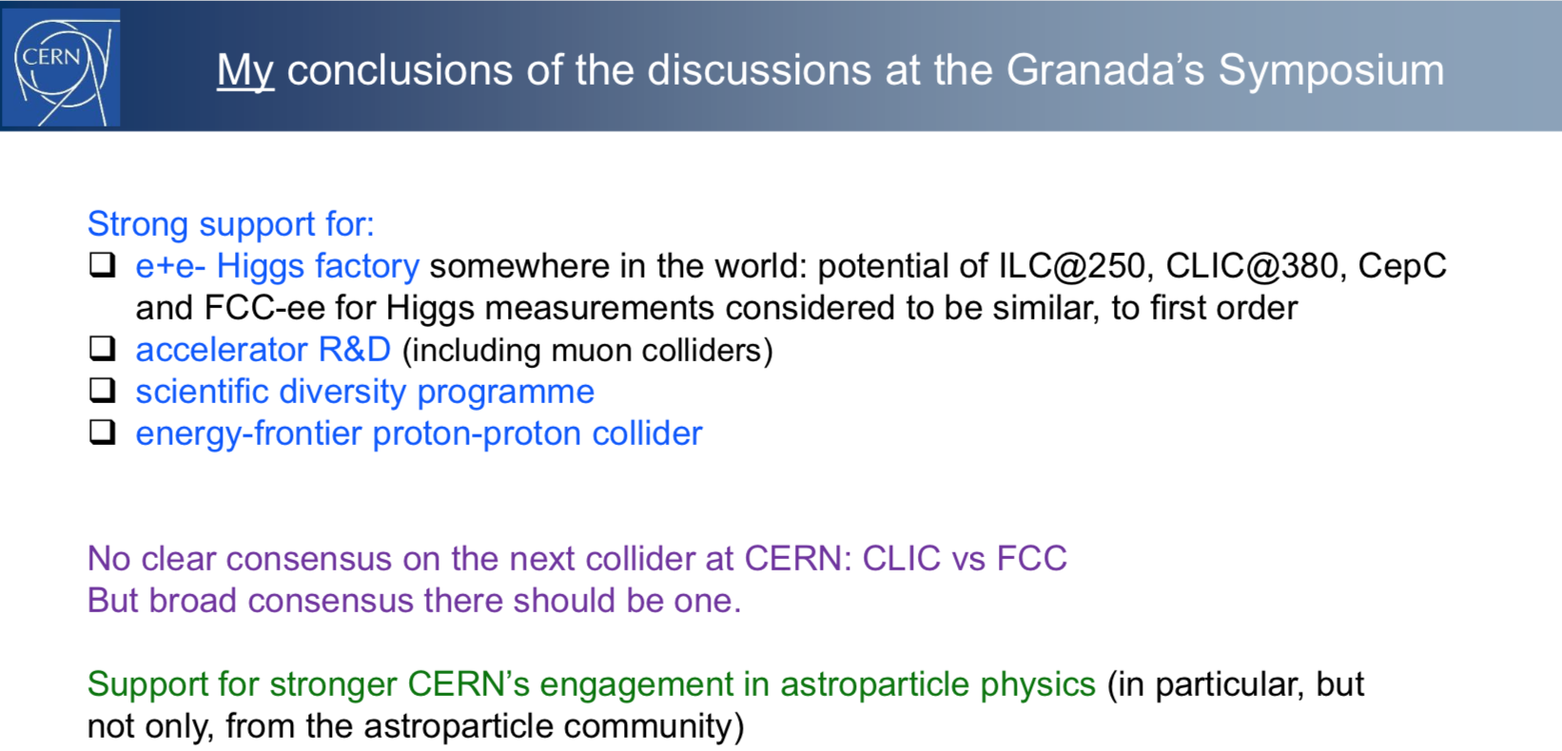
Fabiola Gianotti,
SPC, 23 Sep 2019

Slide 11
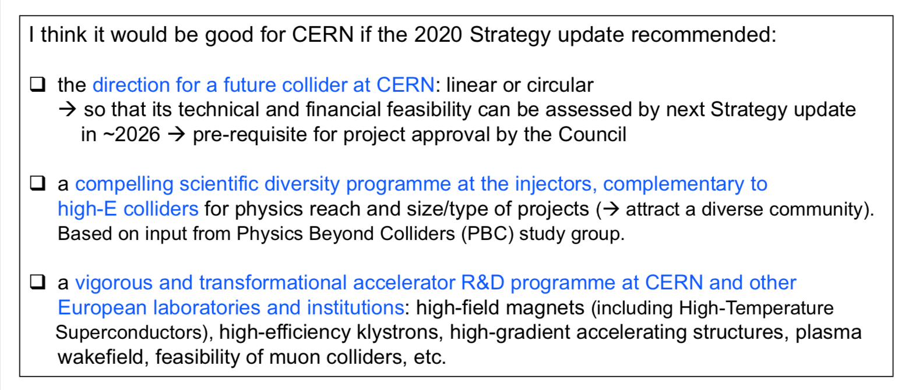
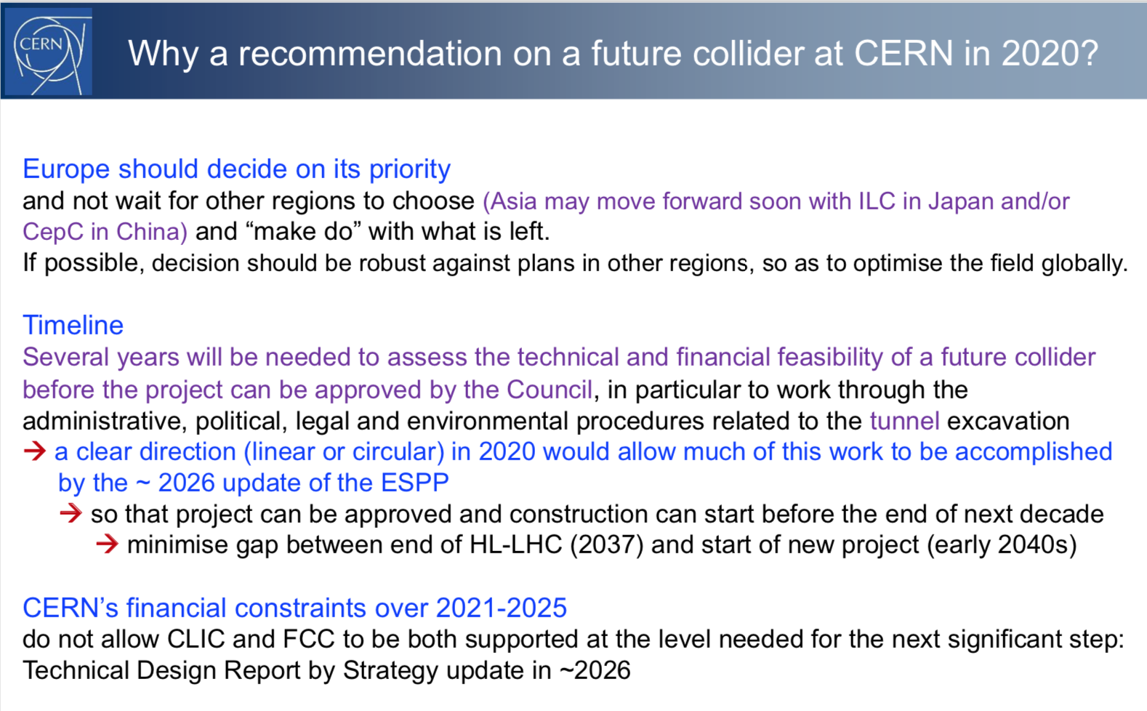
Fabiola Gianotti,
SPC, 23 Sep 2019
CERN’s Future

Slide 12
ESG meeting 27 September 2019
Global context
≈ (5.9 + 5.1 + 7.3) BCHF
≈ 1.1 BCHF
≈ (5.4+5.1) BCHF
≈ 17 BCHF
≈ 24 BCHF
≈ 7.2 BCHF
LE-FCC: ≈37.5 TeV
HE-FCC h/e/A
≈ 15 BCHF
≈ 17 BCHF

Slide 13
The landscape for colliders in Europe
Z/W/H/top factory era
Scenario
HL-LHC era
energy frontier era
(≈ 37.5TeV)
Identify the financial challenges in the context of the CERN budget
Elements to be considered in this and the next strategy update
Notes:
Energy Recovery Linac (ERL), Electron Ion Collider (EIC)

Slide 14
Future scenarios presented at the
ESG meeting 27 September 2019
The CLIC-all scenario
The FCC-all scenario
The CLIC-FCC-mixed scenario
The LE-FCC+HE-FCC scenario
The LHeC + FCC-h/e/A scenario
Compare pro&cons of the physics program of these scenarios
PPB
Compare the feasibility of these scenarios
e.g. this information
Compare community support for these scenarios
Document presenting scenarios will soon appear from Strategy Secretariat.
Plan to send you a questionnaire based on the document.
Propose a discussion meeting late October, w 44,
before the next ESG meeting 6 Nov.

Slide 15
SPARES

Slide 16
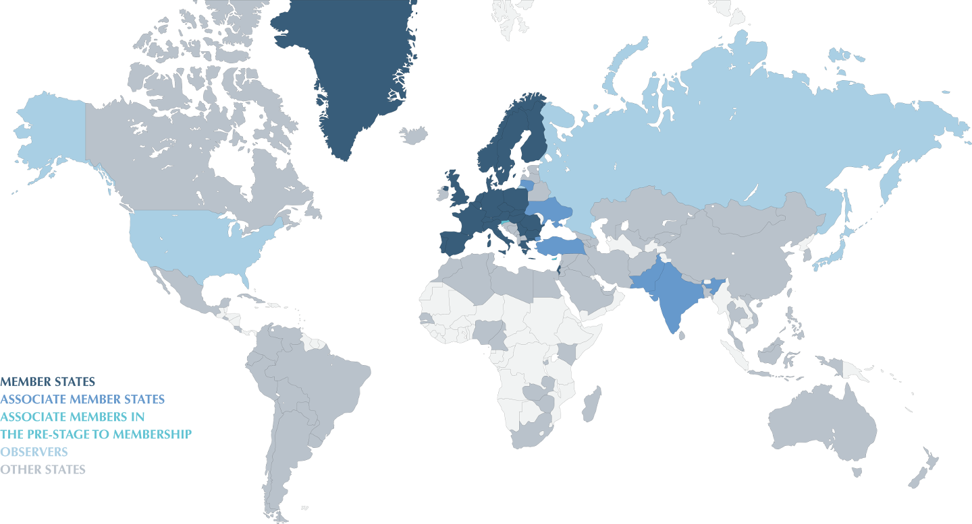
States connected to CERN

Slide 17
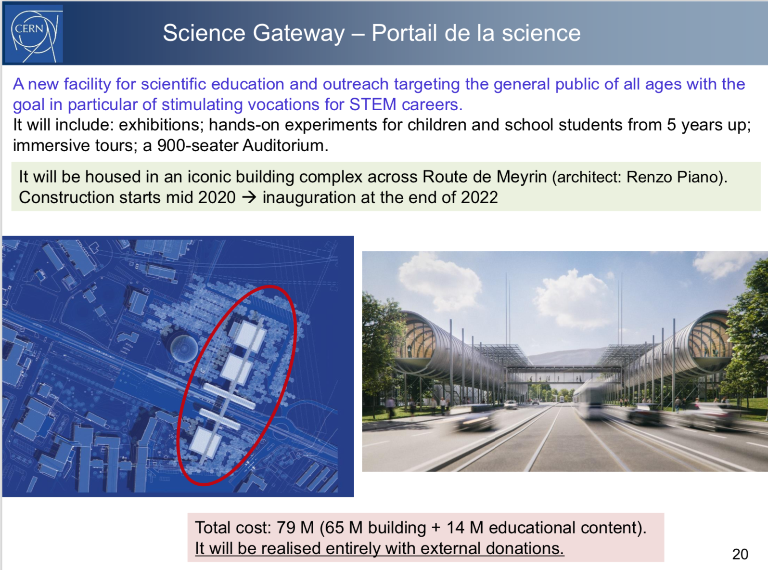
Fabiola Gianotti,
SPC, 23 Sep 2019
(96% secured 14% secured)

Slide 18
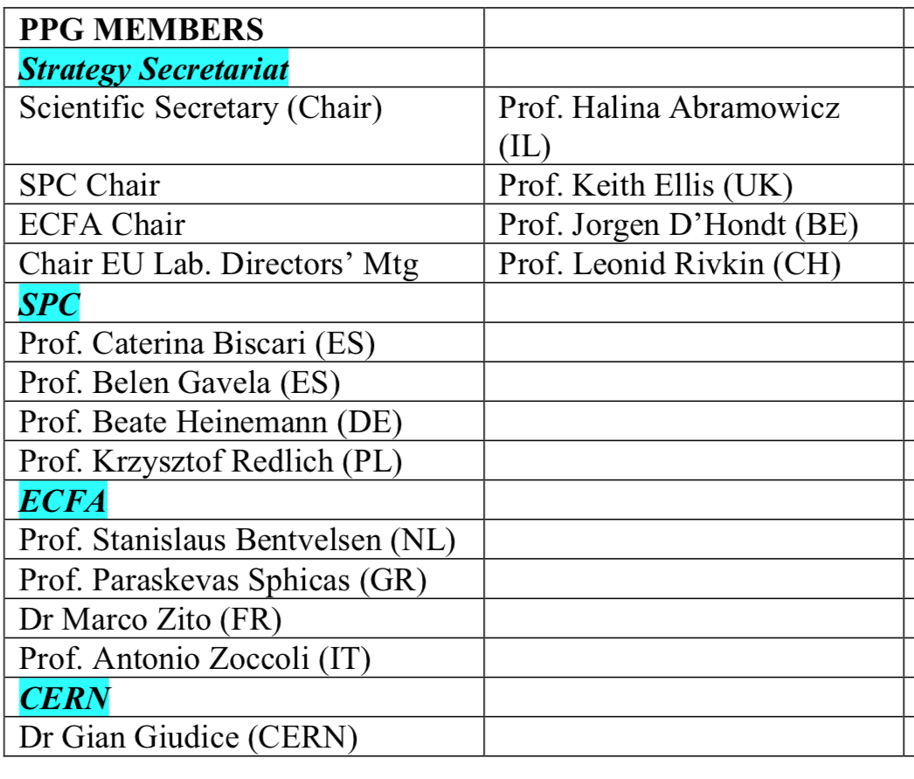
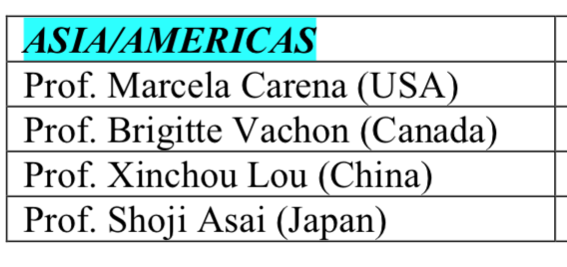
Physics Preparatory Group

Slide 19
European Strategy Group (ESG)
Members
The Strategy Secretary (chair)
One representative appointed by each CERN MS (22)
One representative appointed by each of the Labs participating in the European Laboratory Directors Group including its Chairperson (9)
CERN DG
SPC chair
ECFA chair
Invitees
President of CERN Council
One representative from each AMS and OS (6+3)
One representative from the European Commission
One representative from JINR
Chairs of ApPEC, NuPECC, FALC, ESFRI
Members of the PPG (17 - Secretariat)

Slide 20
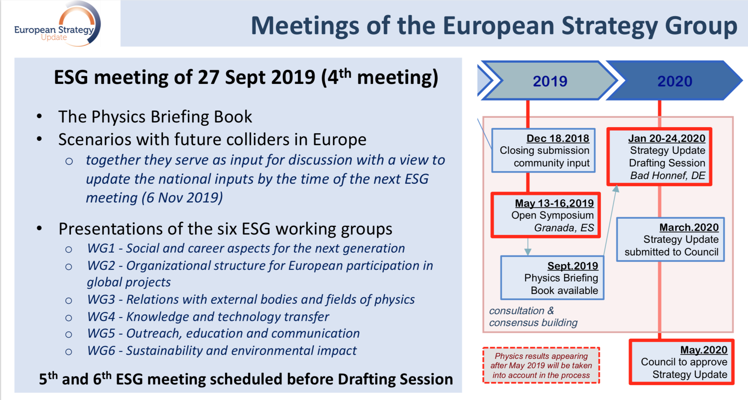

Slide 21
2020-2040
HL-LHC era
2040-2060
Z/W/H/top-factory era
2060-2080
energy frontier era
H couplings to few %
ν mass/mixing/nature
QGP phase-transition
b/c-physics
H couplings to %
EW & QCD & top
QGP vs Lattice QCD
b/c/τ-physics
H couplings to ‰
H self-coupling to %
proton structure
di-boson processes
precision
frontier
next-gen K-beams
proton precision
e & n EDM
lepton flavor (μ→e)
p EDM storage rings
rare top decays
small-x physics
breaking the SM
Beam Dump Facility
eSPS (light DM)
Long-Lived Signals / ALPs
DM vs neutrino floor
heavy neutral lepton
new high-mass part.
next-gen hidden exp.
low-mass DM
direct
searches

Slide 22
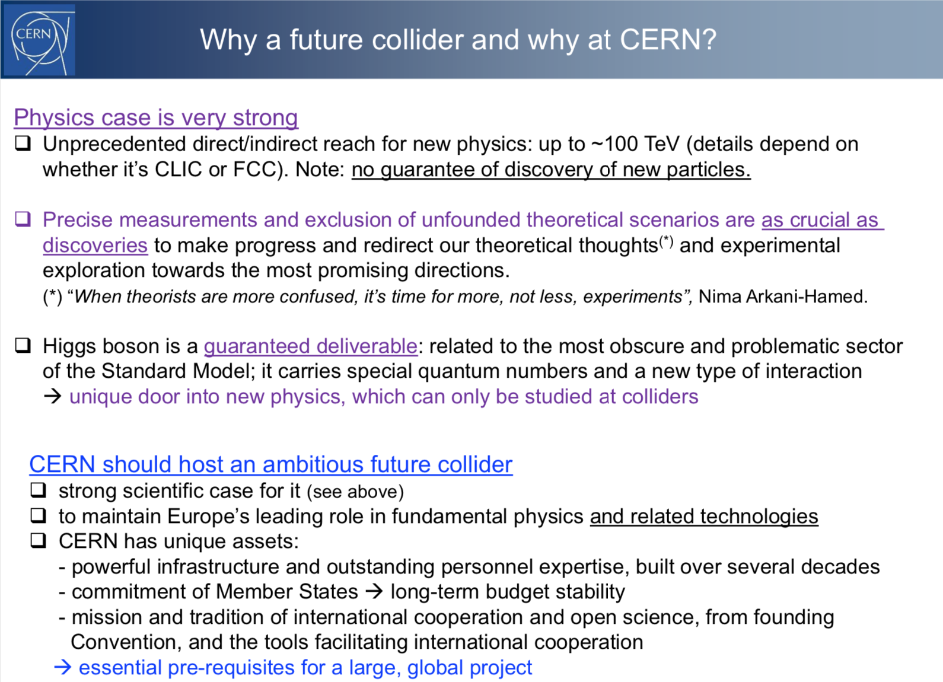
Fabiola Gianotti,
SPC, 23 Sep 2019

Slide 23
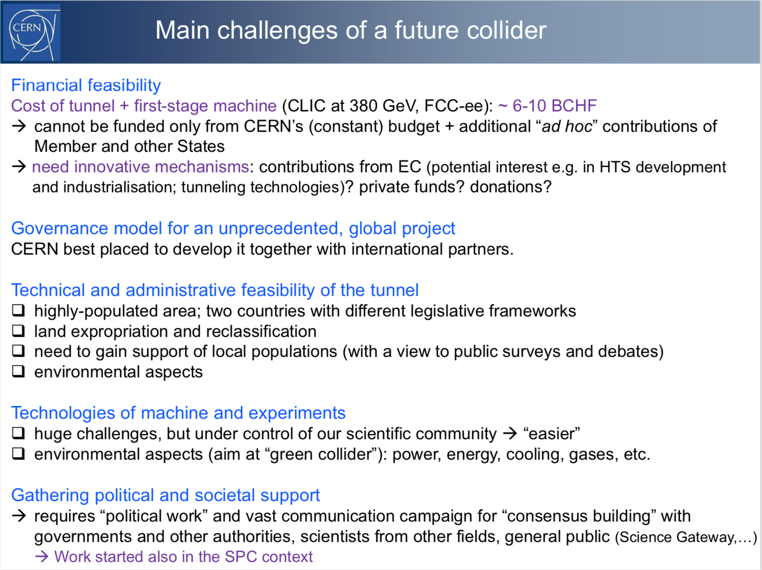
Fabiola Gianotti,
SPC, 23 Sep 2019

