Slide 1
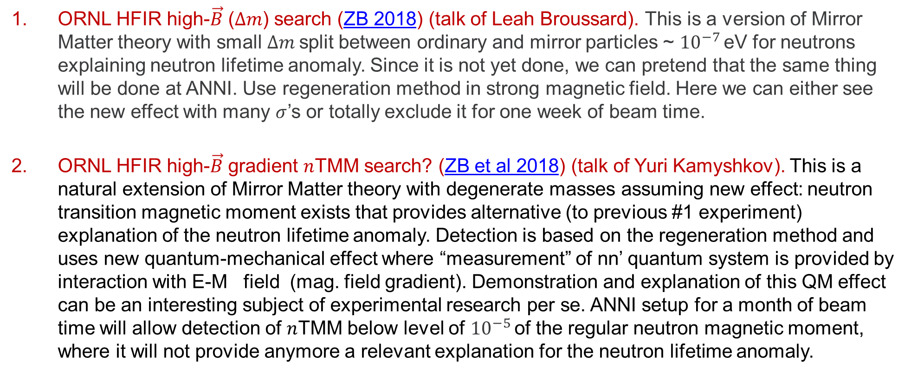

A Vision for a $n→n′$ Search Program (at ANNI) modification of Josh Barrow Nordita slide
ORNL HFIR high-$\vec{B}$ ($Δm$) search (ZB 2018) (talk of Leah Broussard). This is a version of Mirror Matter theory with small $Δm$split between ordinary and mirror particles ~ ${10}^{−7 }$eV for neutrons explaining neutron lifetime anomaly. Since it is not yet done, we can pretend that the same thing will be done at ANNI. Use regeneration method in strong magnetic field. Here we can either see the new effect with many $σ$’s or totally exclude it for one week of beam time.
ORNL HFIR high-$\vec{B}$ gradient $n$TMM search? (ZB et al 2018) (talk of Yuri Kamyshkov). This is a natural extension of Mirror Matter theory with degenerate masses assuming new effect: neutron transition magnetic moment exists that provides alternative (to previous #1 experiment) explanation of the neutron lifetime anomaly. Detection is based on the regeneration method and uses new quantum-mechanical effect where “measurement” of nn’ quantum system is provided by interaction with E-M field (mag. field gradient). Demonstration and explanation of this QM effect can be an interesting subject of experimental research per se. ANNI setup for a month of beam time will allow detection of $n$TMM below level of ${10}^{−5 }$of the regular neutron magnetic moment, where it will not provide anymore a relevant explanation for the neutron lifetime anomaly.
1

Slide 2
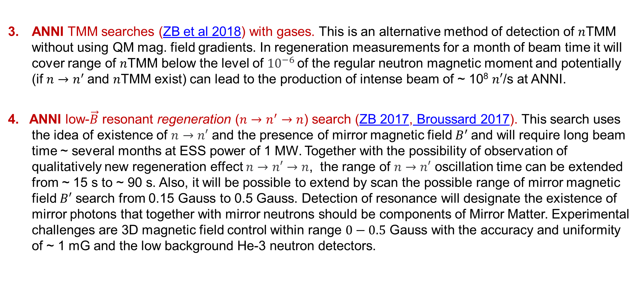
A Vision for a $n→n′$ Search Program (at ANNI) modification of Josh Barrow Nordita slide
ANNI TMM searches (ZB et al 2018) with gases. This is an alternative method of detection of $n$TMM without using QM mag. field gradients. In regeneration measurements for a month of beam time it will cover range of $n$TMM below the level of ${10}^{−6 }$of the regular neutron magnetic moment and potentially (if $n→n^{′}$and $n$TMM exist) can lead to the production of intense beam of ~ 10⁸ $n′$/s at ANNI.
4. ANNI low-$\vec{B}$ resonant regeneration ($n→n^{′}→n$) search (ZB 2017, Broussard 2017). This search uses the idea of existence of $n→n′$ and the presence of mirror magnetic field $B^{′}$and will require long beam time ~ several months at ESS power of 1 MW. Together with the possibility of observation of qualitatively new regeneration effect $n→n′$ $→n$, the range of $n→n′$ oscillation time can be extended from ~ 15 s to ~ 90 s. Also, it will be possible to extend by scan the possible range of mirror magnetic field $B′$ search from 0.15 Gauss to 0.5 Gauss. Detection of resonance will designate the existence of mirror photons that together with mirror neutrons should be components of Mirror Matter. Experimental challenges are 3D magnetic field control within range $0−0.5$ Gauss with the accuracy and uniformity of ~ 1 mG and the low background He-3 neutron detectors.
2

Slide 3
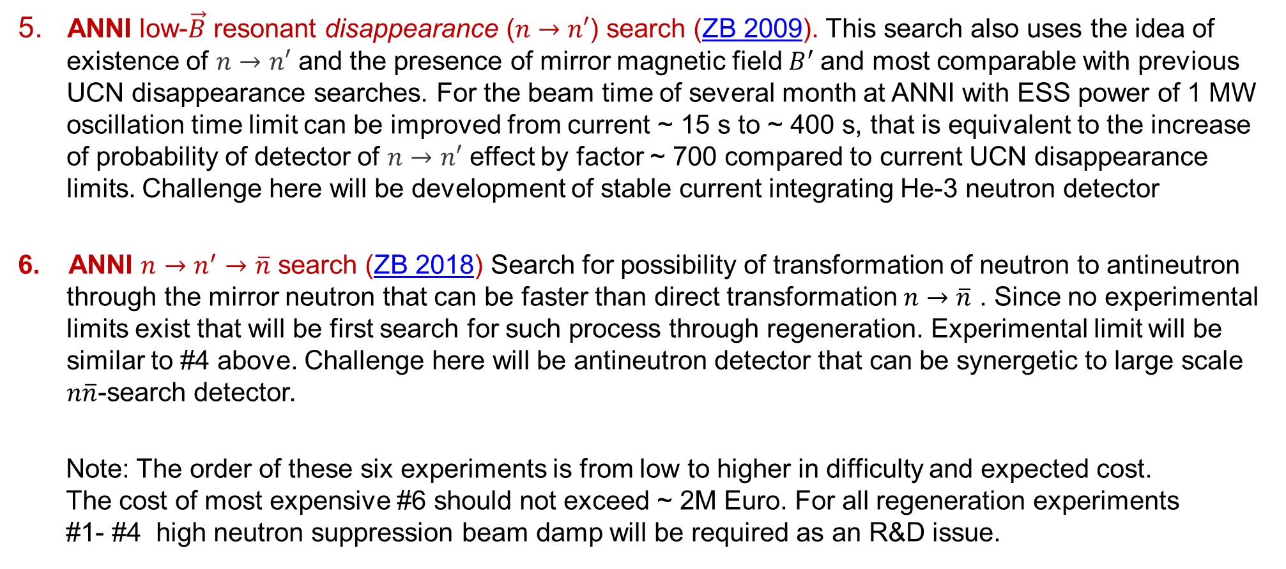
A Vision for a $n→n′$ Search Program (at ANNI) modification of Josh Barrow Nordita slide
5. ANNI low-$\vec{B}$ resonant disappearance ($n→n′$) search (ZB 2009). This search also uses the idea of existence of $n→n′$ and the presence of mirror magnetic field $B^{′}$and most comparable with previous UCN disappearance searches. For the beam time of several month at ANNI with ESS power of 1 MW oscillation time limit can be improved from current ~ 15 s to ~ 400 s, that is equivalent to the increase of probability of detector of $n→n′$ effect by factor ~ 700 compared to current UCN disappearance limits. Challenge here will be development of stable current integrating He-3 neutron detector
6. ANNI $n→n^{′}→\overline{n}$ search (ZB 2018) Search for possibility of transformation of neutron to antineutron through the mirror neutron that can be faster than direct transformation $n→\overline{n}$ . Since no experimental limits exist that will be first search for such process through regeneration. Experimental limit will be similar to #4 above. Challenge here will be antineutron detector that can be synergetic to large scale $n\overline{n}$-search detector.
Note: The order of these six experiments is from low to higher in difficulty and expected cost. The cost of most expensive #6 should not exceed ~ 2M Euro. For all regeneration experiments #1- #4 high neutron suppression beam damp will be required as an R&D issue.
3

