Slide 1
Report from CERN Council
Partikeldagarna 2018
Kerstin Jon-And, Stockholm University

Slide 2
CERN’s organisation
Council:
Decision making authority
Two delegates per member state (Sweden: Mats Johnsson, KJA, deputy Richard Brenner)
President: Sijbrand de Jong
Main advisory bodies:
Scientific Policy Committee (SPC)
Finance Committee (Swedish reps Catarina Sahlberg/Per Karlsson, Barbro Åsman)
Tripartite Employment Conditions Forum (Chaired by Barbro Åsman)
Audit Committee (KJA council rep.)
Director General: Fabiola Gianotti, manages CERN, elected by Council
Directorate:
Director for Accelerators and Technology: Frédérick Bordry
Director for Research and Computing: Eckard Elsen
Director for Finance and Human Resources: Martin Steinacher
Director for International Relations: Charlotte Warakaulle
10 departments, e.g. Experimental Physics, Information Technology, Theoretical Physics

Slide 3
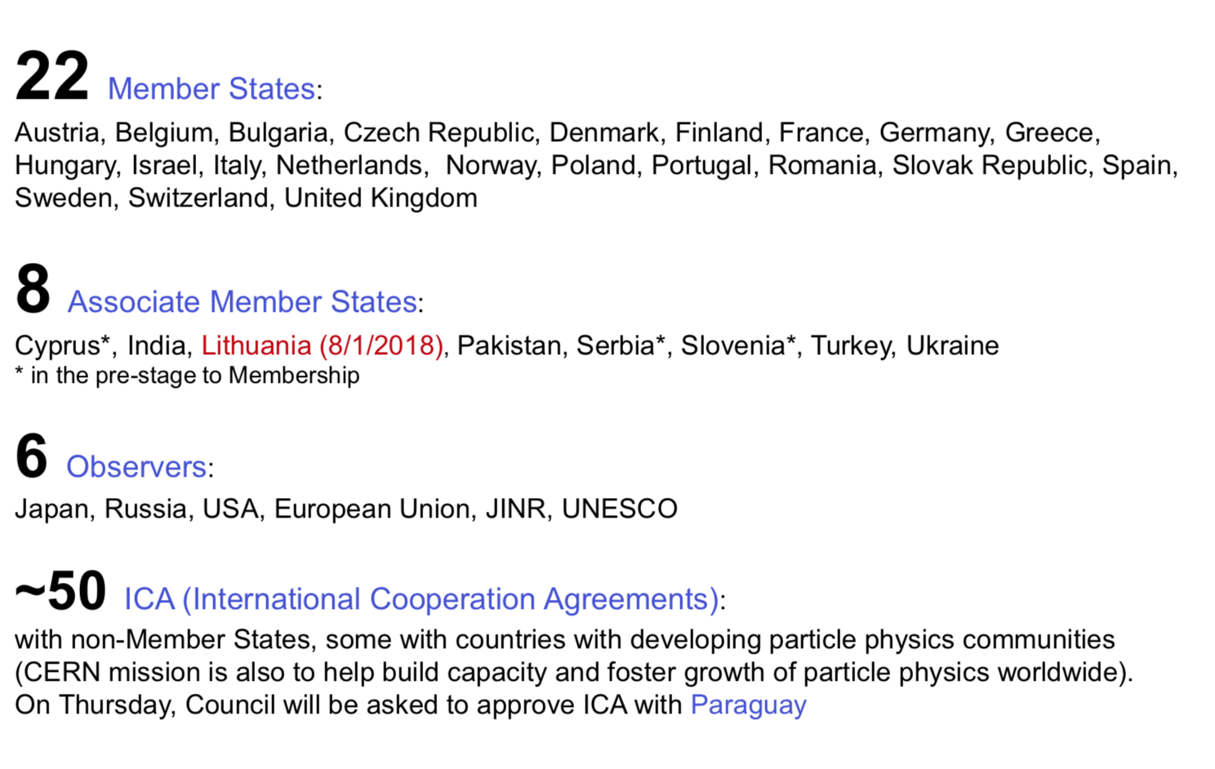
CERN comprises the following states and organisations (Fabiola Gianotti, SPC, 24 September 2018):

Slide 4
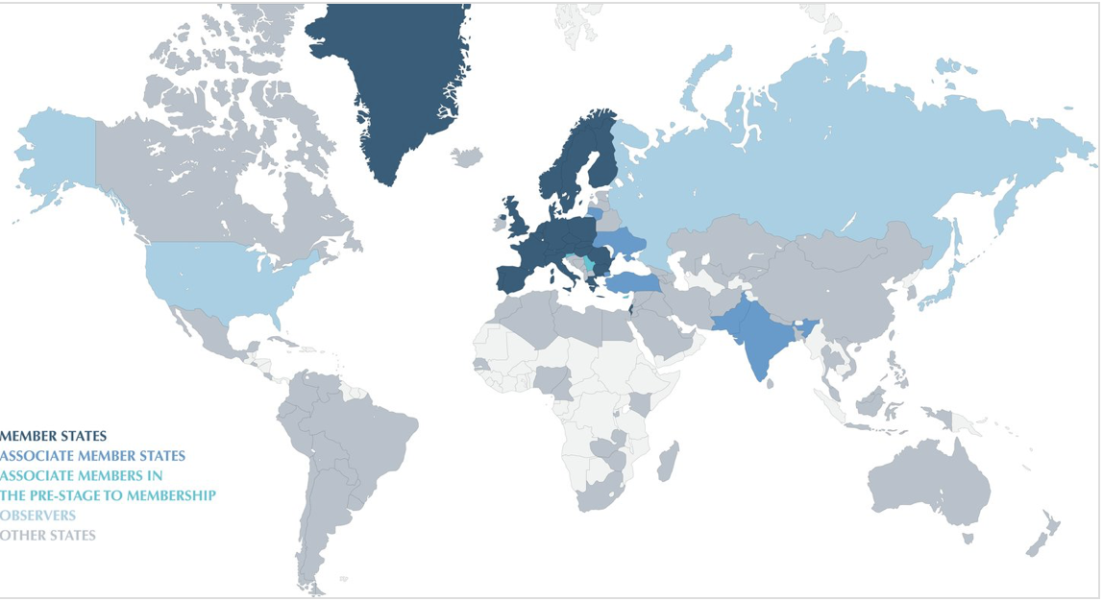
States connected to CERN

Slide 5
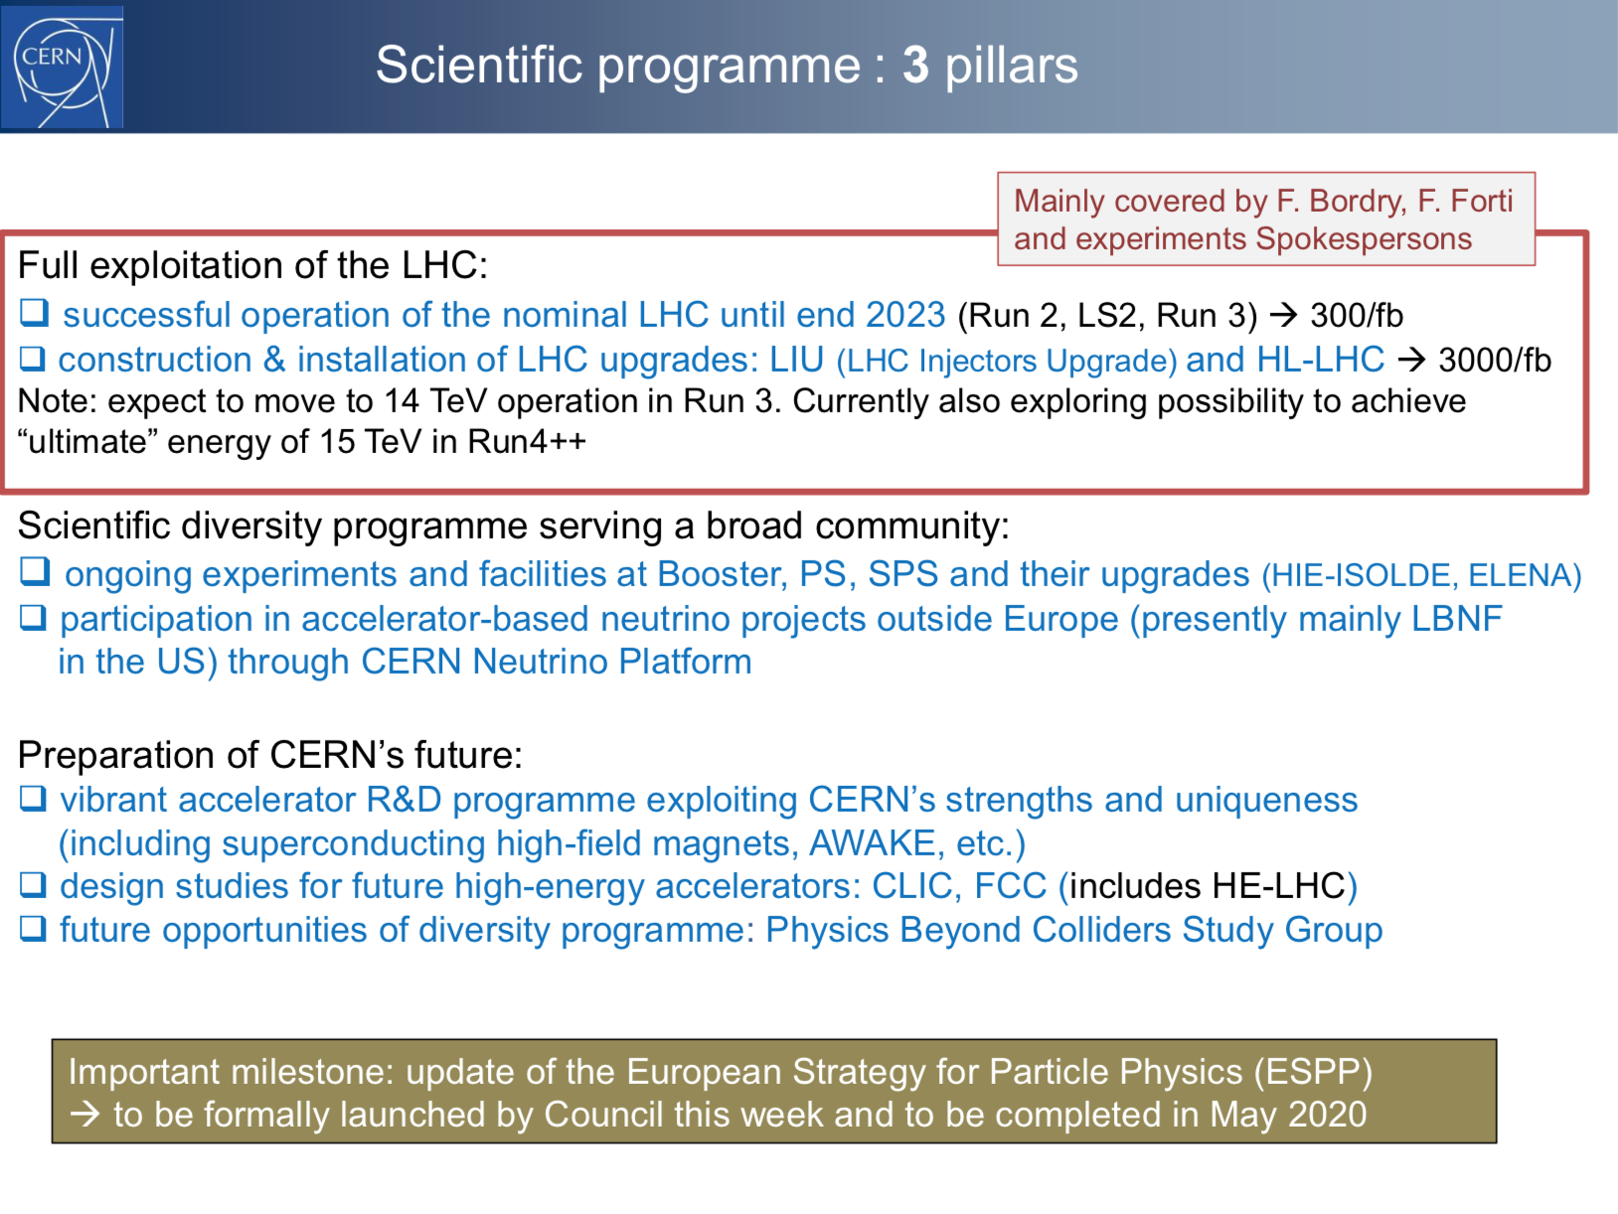
Fabiola Gianotti,
SPC, 24 Sep 2018

Slide 6
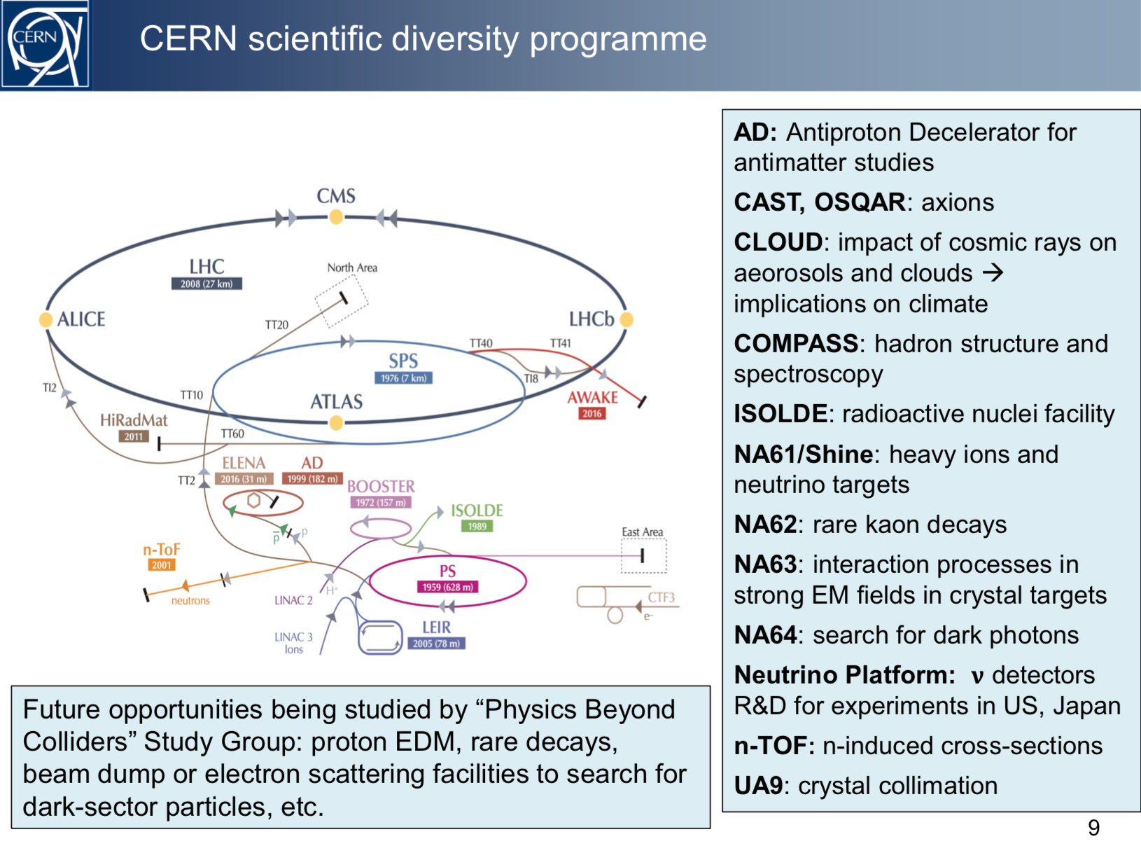
Fabiola Gianotti,
SPC, 24 Sep 2018

Slide 7
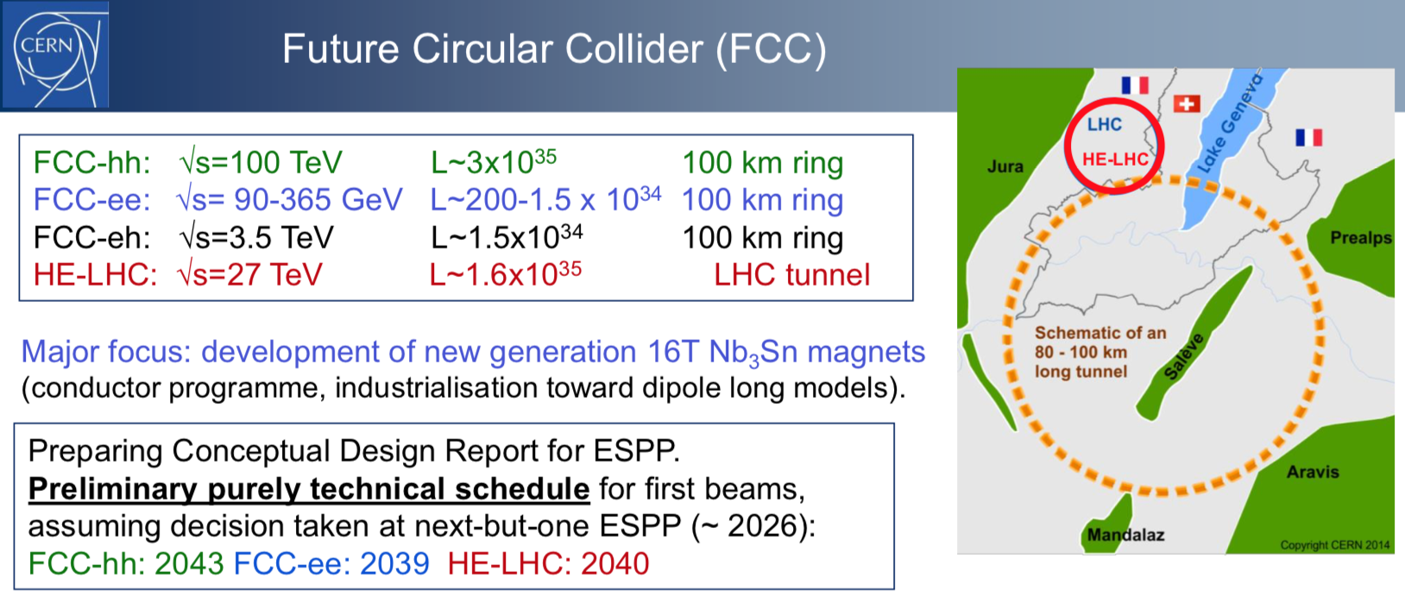
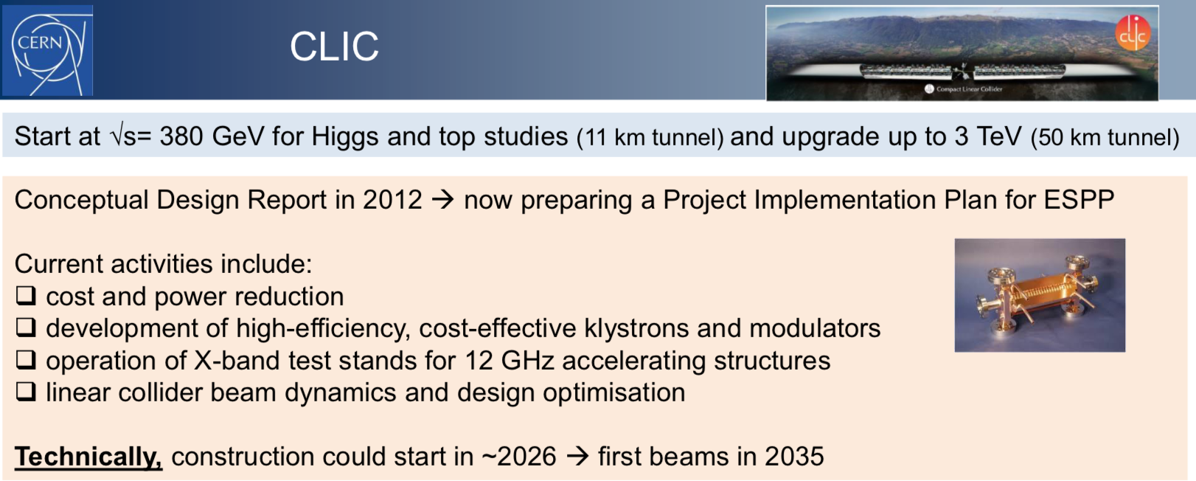
From
Fabiola Gianotti,
SPC,
24 Sep 2018

Slide 8
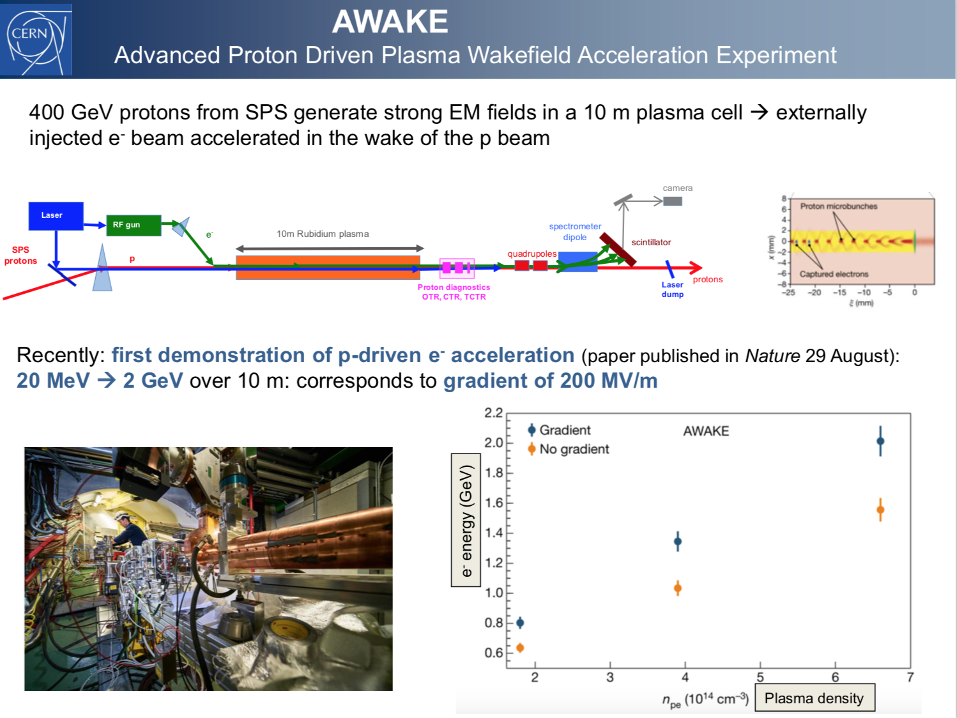
Fabiola
Gianotti,
Council,
27 Sep
2018

Slide 9
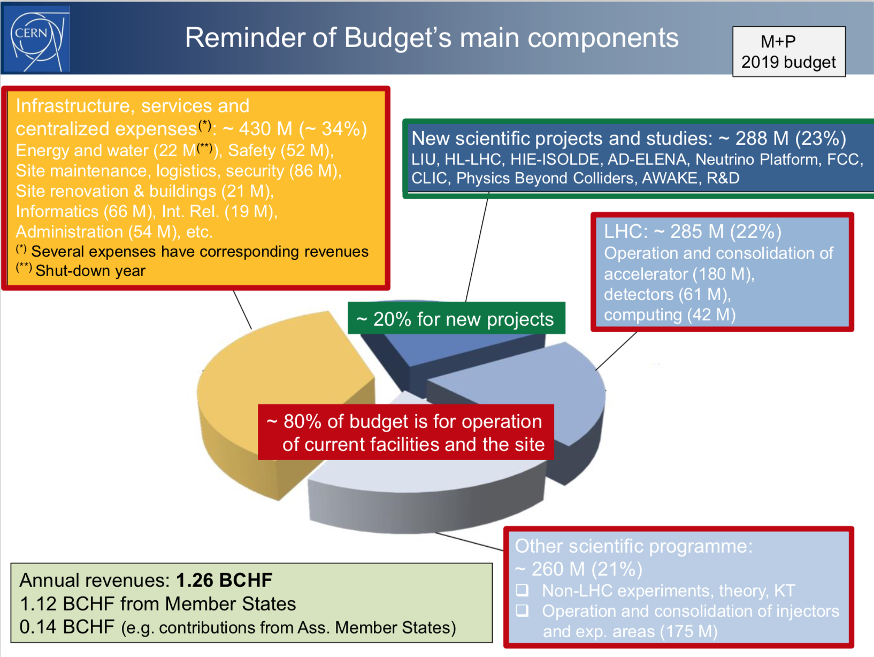
Fabiola Gianotti, SPC, 24 Sep 2018
Swedish share
2.66%, ~30 MCHF

Slide 10
From Council September agenda
First report from the
“Council Working Group to review certain aspects of the geographical enlargement policy of 2010”
(Swedish rep. Mats Johnsson, deputy KJA)
To review CERN’s strategy and criteria for enlargement
Aiming at producing a report to Council in March 2019

Slide 11
From Council September agenda
Applications to become a Member or Associate Member state:
Serbia is in the process of becoming a full Member
Croatia is in the process of becoming an Associate Member
Estonia has applied to become a full Member
Fact-finding task force appointed
Elections, with effect 1 January 2019 :
Ursula Bassler, France, elected President of the Council
Péter Lévai, Hungary, elected Vice-President of the Council

Slide 12
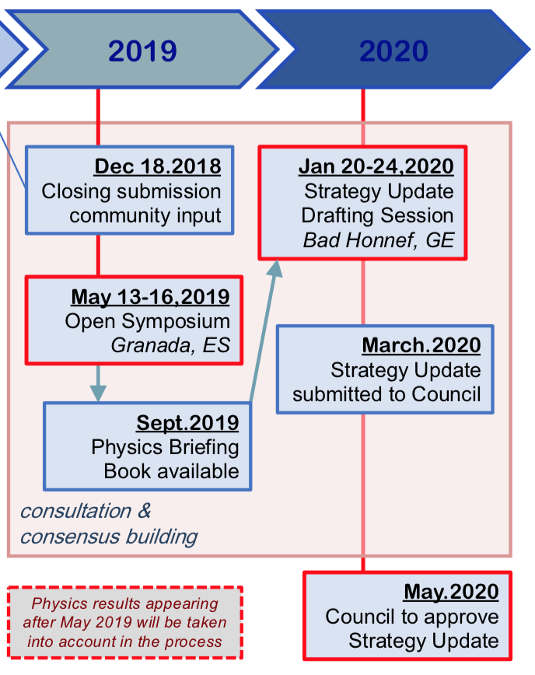
From Council September agenda
Formal launch of the Update of the European Strategy for Particle Physics:
Establishment of the Physics Preparatory Group (PPG) and the European Strategy Group (Swedish rep. KJA)
Time line presented
Proposed format of the Open Symposium (plenary and parallel sessions)

Slide 13
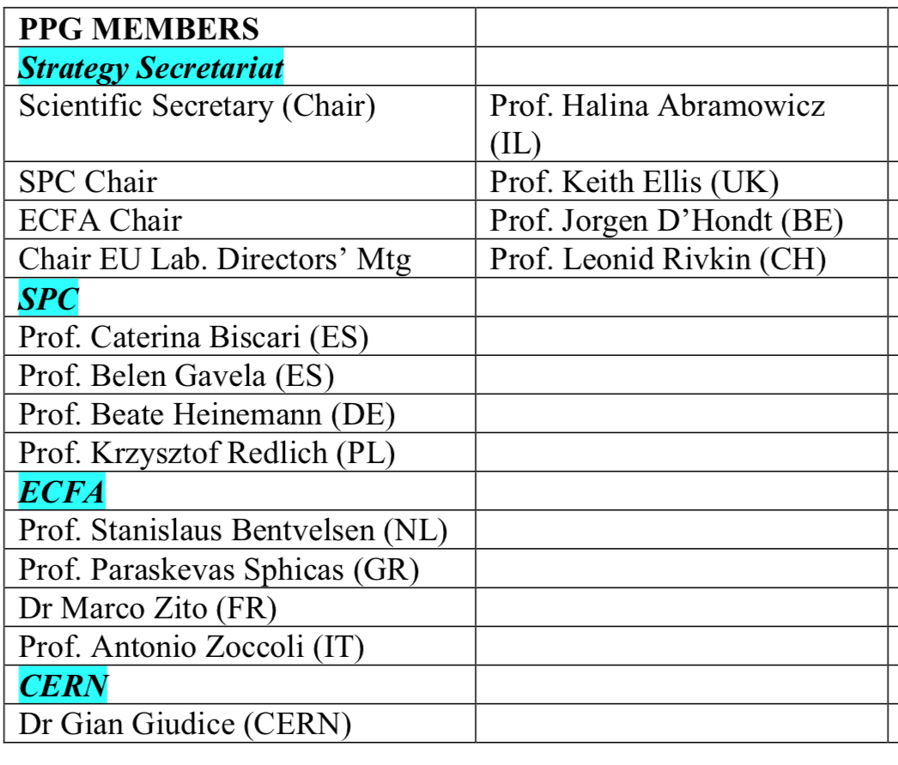
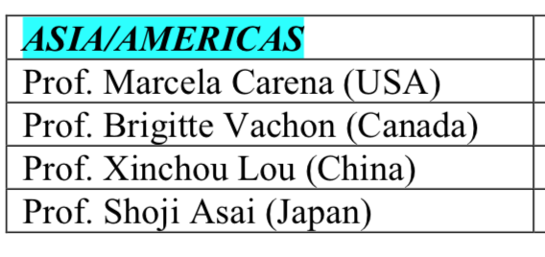
Physics Preparatory Group

Slide 14
From Council September agenda
Decision to support the implementation of the
Science Gateway Project
CERN receives ~130000 visitors every year, BUT gets > 300000 requests
A new hub for education, training and outreach. Activities will target the general public of all ages,
5 - 100+.
Designed by renowned architect Renzo Piano

Slide 15
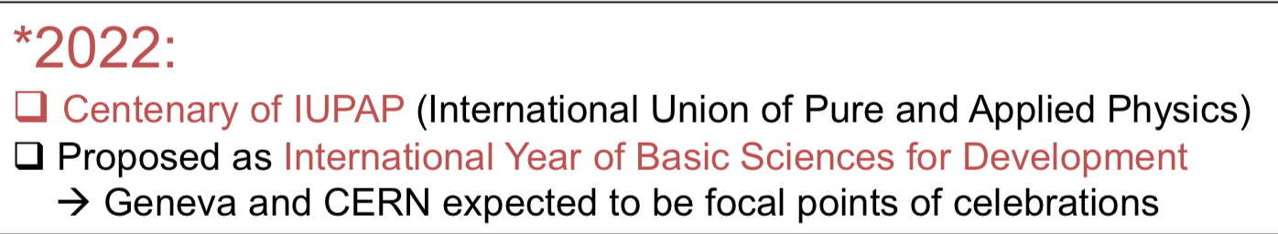
Funding of Science Gateway Project
Total cost estimated at 79 MCHF
Project will be financed by external donations
So far 12 MCH secured and 45 MCH pledged
Operating cost ~ 4 MCH/year
After revenues, < 2 MCHF/year from CERN budget
Time line (preliminary and ambitious…)
Architect and engineering consultants contract: Dec 2018
Building permit: 2nd half of 2019
Start tendering process: Mar 2019
Construction of building and content installation: Mar 2020 – Jun 2022
Inauguration and open to public second half of 2022*

Slide 16
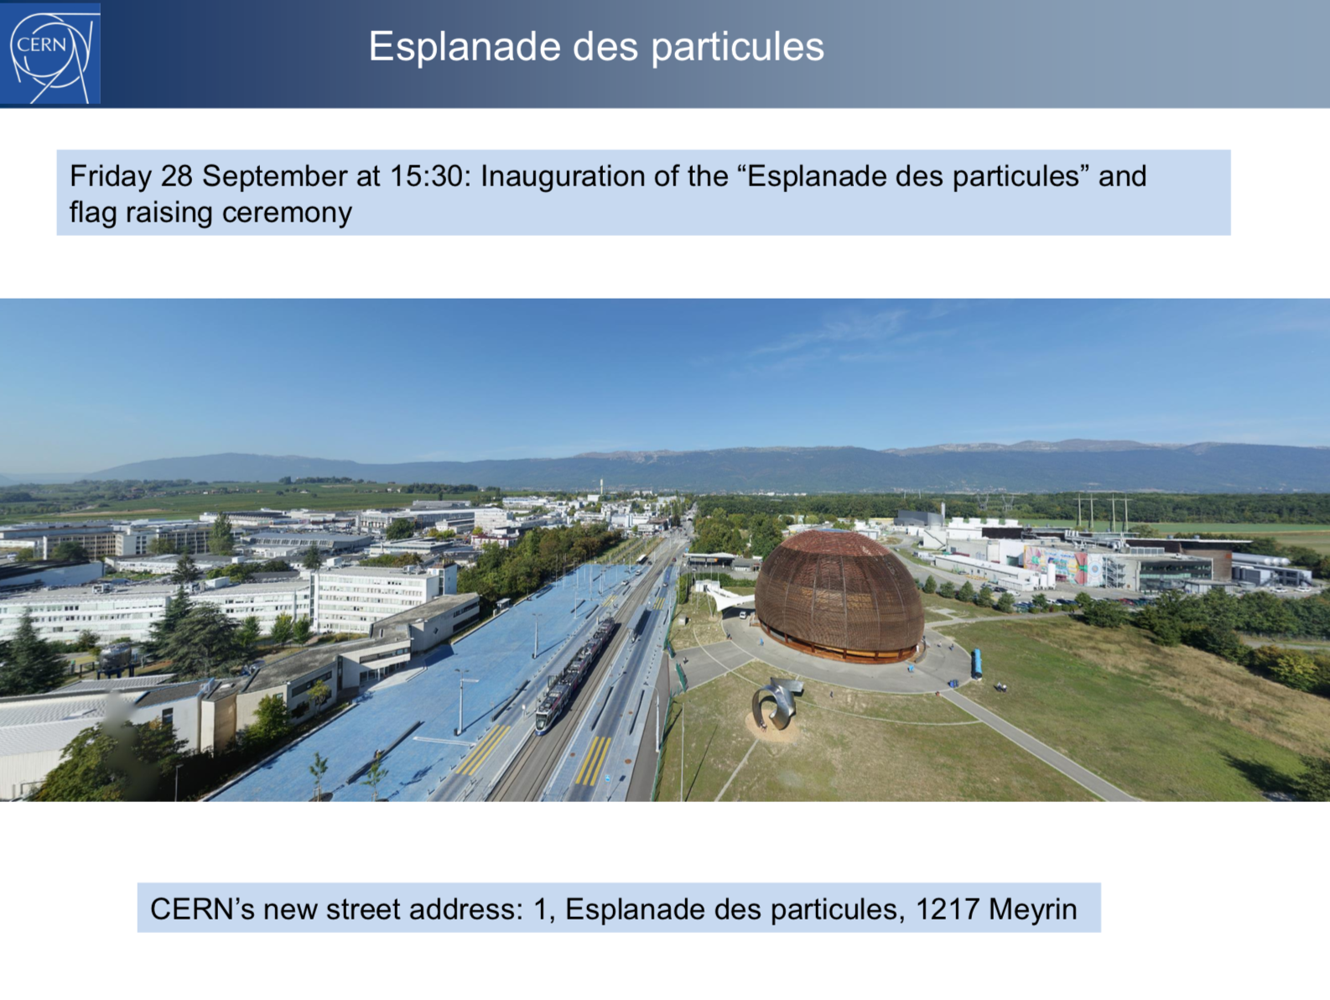
Fabiola Gianotti,
Council, 24 Sep 2018

Slide 17
SPARES

Slide 18
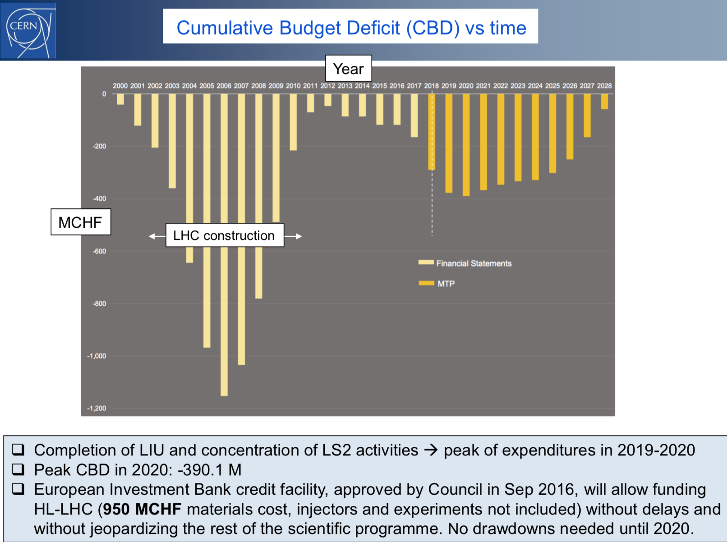
Fabiola Gianotti,
SPC, 24 Sep 2018

Slide 19
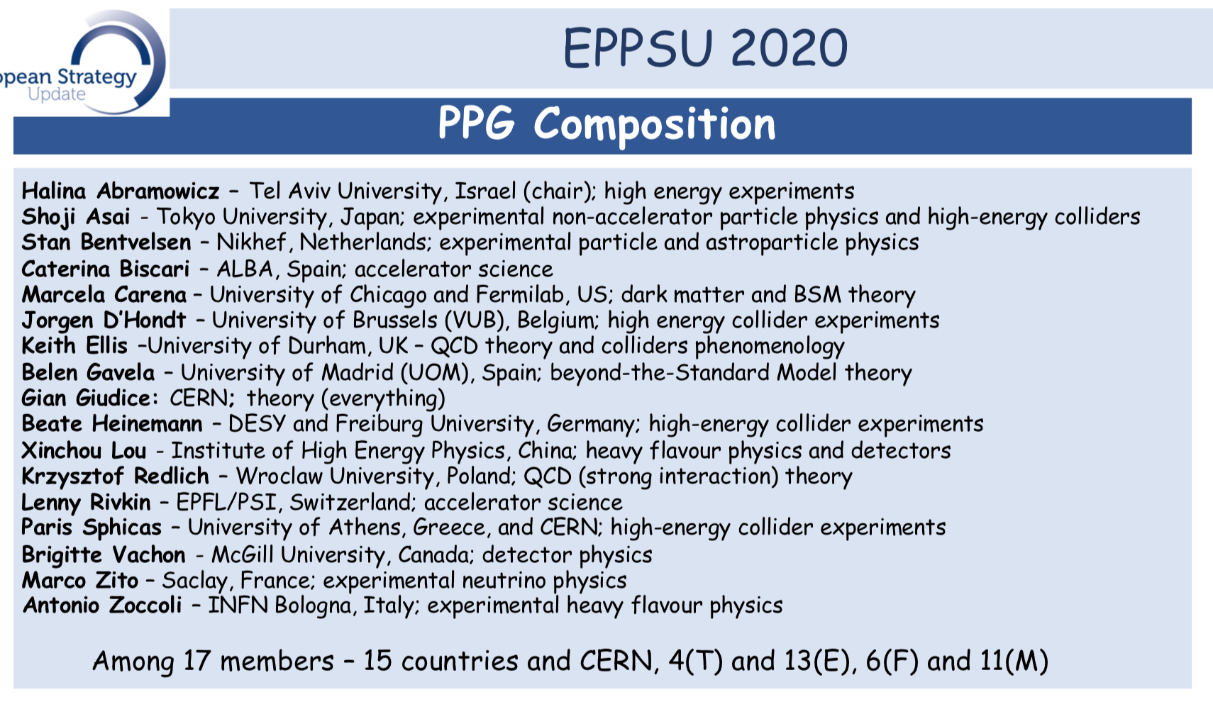
From Council September agenda

Slide 20
European Strategy Group (ESG)
Members
The Strategy Secretary (chair)
One representative appointed by each CERN MS (22)
One representative appointed by each of the Labs participating in the European Laboratory Directors Group including its Chairperson (9)
CERN DG
SPC chair
ECFA chair
Invitees
President of CERN Council
One representative from each AMS and OS (6+3)
One representative from the European Commission
One representative from JINR
Chairs of ApPEC, NuPECC, FALC, ESFRI
Members of the PPG (17 - Secretariat)

Slide 21
