Slide 1

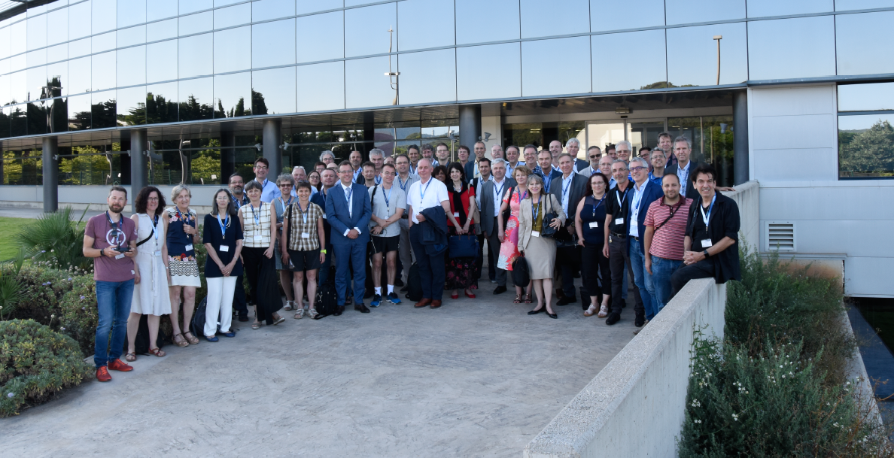
ECFA/RECFA
Alba, Barcelona, July 2018
Bengt Lund-Jensen, Roman Pasechnik, David Milstead

Slide 2
ECFA
Plenary ECFA (P-ECFA), Restricted ECFA (R-ECFA)
European Committee for Future Accelerators
Primary aim is the long-range planning of high-energy facilities, which include accelerators, large-scale facilities and equipment adequate for the conduct of a valid high-energy research programme by the community of physicists in the participating countries.
To achieve these aims ECFA can engage in
  among others - the following activities: - regular meetings;
  ad hoc symposia and conferences sponsored or organized by ECFA;
  study groups, set up by ECFA, or jointly with other organizations, for special problems
  demographic studies of the high-energy physics community and resources in the ECFA countries, repeated at regular intervals; - monitoring of the ongoing implementation of the European Strategy for Particle Physics in the CERN Member States, and presentation of corresponding status reports to the European Strategy Session of Council.

Slide 3
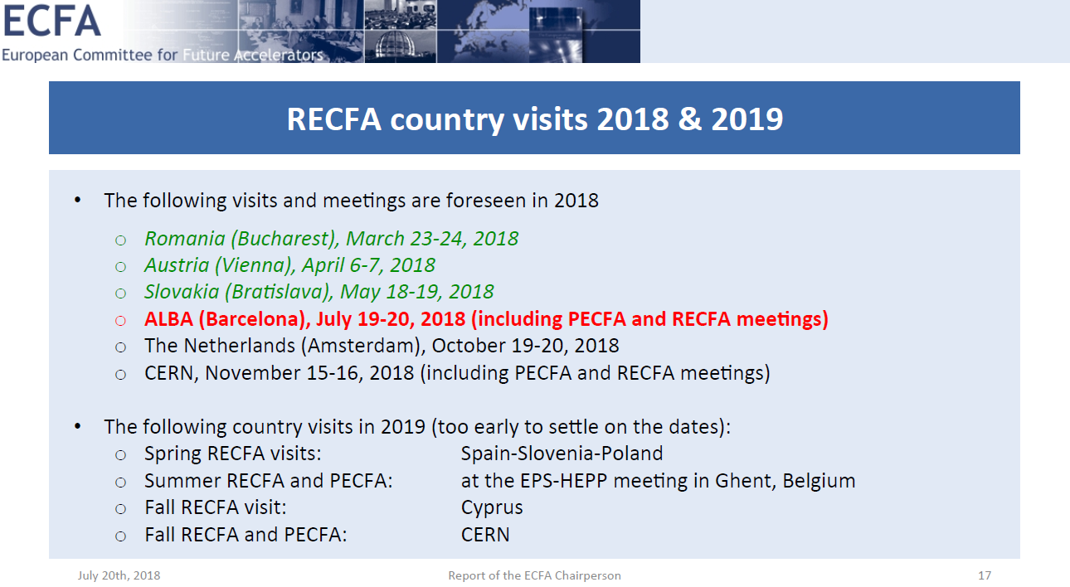
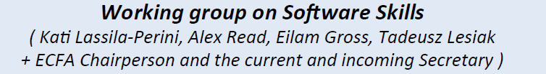


Slide 4
Recognition of individuals
Panel discussion
Pierluigi Campana (LHCB), Max Klein (ATLAS), Jo van den Brand (LIGO), Francesco Forti (SuperB), Enrique Kajamovitz. - Moderator: Manfred Krammer
Ways to recognise individuals
  authorship ordering, opting in/out of signing papers, conference talks, awards ..
Preceded by contact with collaborations and talk by J. D’Hondt.

Slide 5
ECFA Survey on Recognition of Individual Achievements in Large Collaborations
https://www.survio.com/survey/d/C6P2Y7A9E5F9F2Y0U
ECFA created a working group to examine the recognition of individual achievements in large scientific collaborations. Based on feedback from an initial survey of the leaders of 29 CERN-based or CERN-recognised experiments in particle, nuclear, astroparticle and astrophysics, ECFA found that the community is ready to engage in dialogue on this topic and receptive to potential recommendations. In response, ECFA has launched a community-wide survey to verify how individual researchers perceive the systems put in place to recognise their achievements. The deadline for responses is 26 October 2018.

Slide 6
Future colliders and the Update to the European Strategy for Particle Physics
CERN activates clause in its constitution allowing it to coordinate European Particle Physics Activities
2006
  First strategy
  http://council.web.cern.ch/sites/council.web.cern.ch/files/European_Strategy/ESStatement.pdf
2013
  Strategy update
  https://cds.cern.ch/record/1567258/files/esc-e-106.pdf
2020
  Strategy update
Discussion on Swedish submission on Thursday:
Protect and promote our current and planned program.
Show our thinking on the strategy questions.

Slide 7
What will (almost certainly) happen ?
The LHC will deliver 3000fb⁻¹ by 2035
  Sensitivity up to ~3 TeV in new physics
  Greater precision on SM quantities
New measurements of g-2 muon
  x 5 improvement in sensitivity
New searches for electron, neutron EDMs + other non-collider experiments
~order of magnitude improvement expected

Slide 8
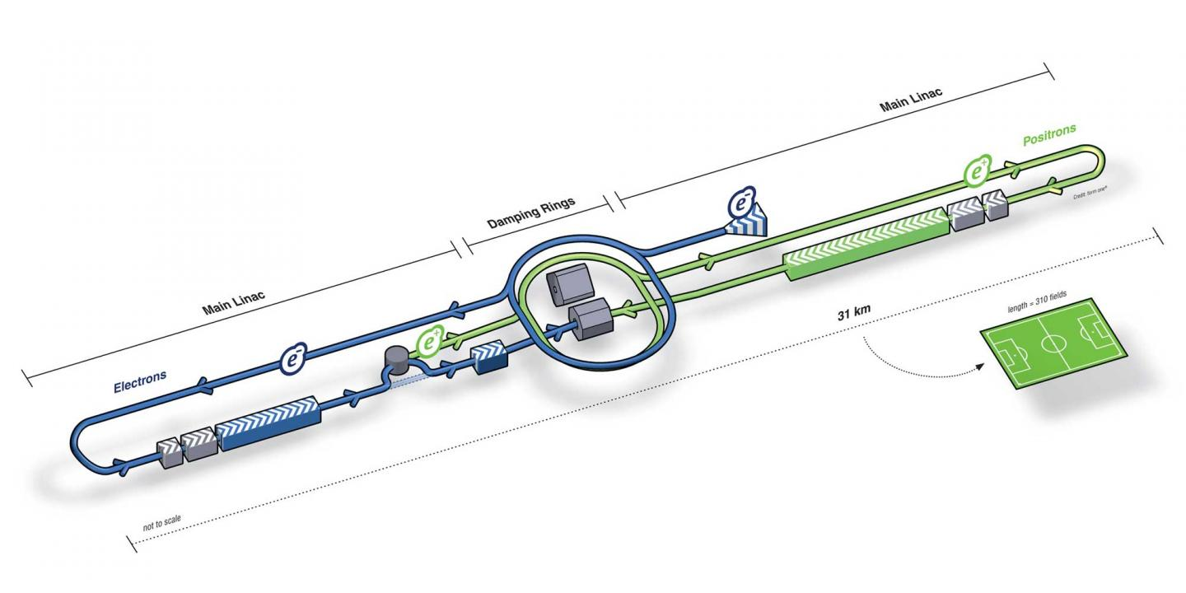
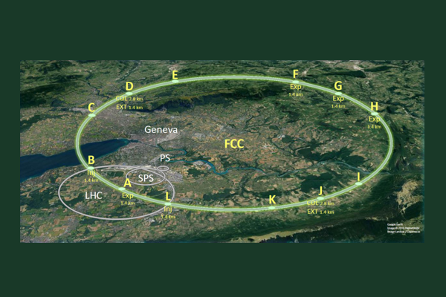

The strategic issues

Slide 9
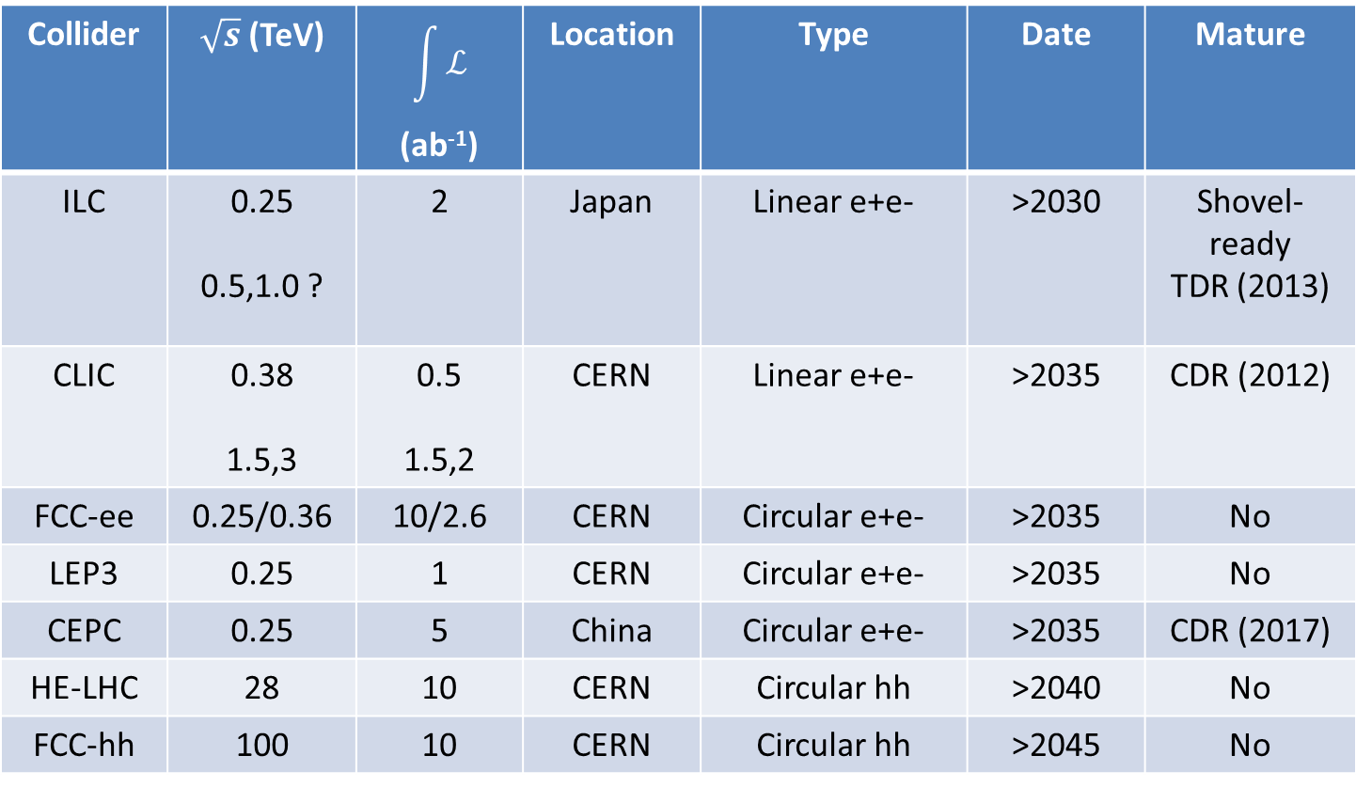
The collider market place
Collider | $\sqrt{s}$ (TeV) | $$\int{ℒ}$$ (ab⁻¹) | Location | Type | Date | Mature
ILC | 0.25 0.5,1.0 ? | 2 | Japan | Linear e+e- | >2030 | Shovel-ready TDR (2013)
CLIC | 0.38 1.5,3 | 0.5 1.5,2 | CERN | Linear e+e- | >2035 | CDR (2012)
FCC-ee | 0.25/0.36 | 10/2.6 | CERN | Circular e+e- | >2035 | No
LEP3 | 0.25 | 1 | CERN | Circular e+e- | >2035 | No
CEPC | 0.25 | 5 | China | Circular e+e- | >2035 | CDR (2017)
HE-LHC | 28 | 10 | CERN | Circular hh | >2040 | No
FCC-hh | 100 | 10 | CERN | Circular hh | >2045 | No

Slide 10
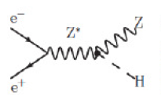
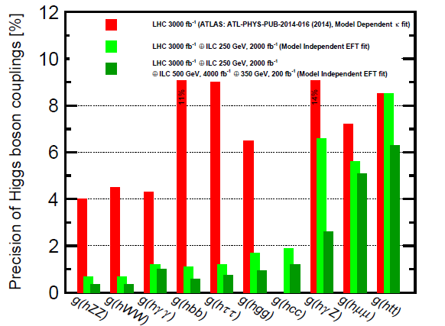
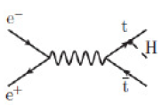
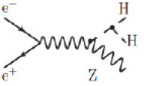
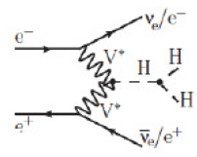
ILC~CLIC~LEP3 sensitivity, FCCee (x 2-5 better) Tree-level sensitivity to new physics:
Δg <1% for Λ>1 TeV
Sensitivity to new physics in loops

Slide 11
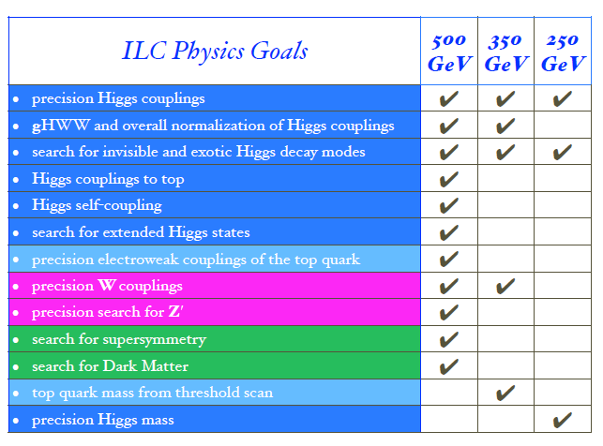
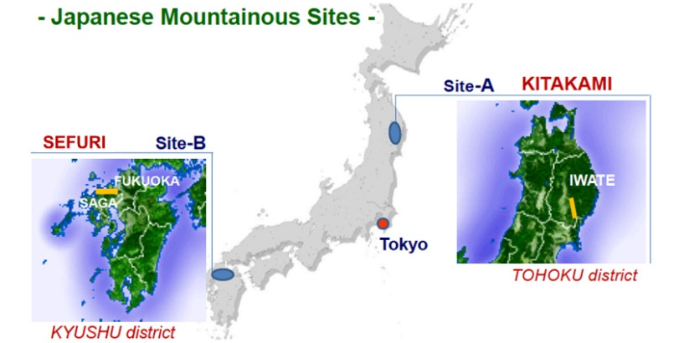

International Linear collider

Slide 12
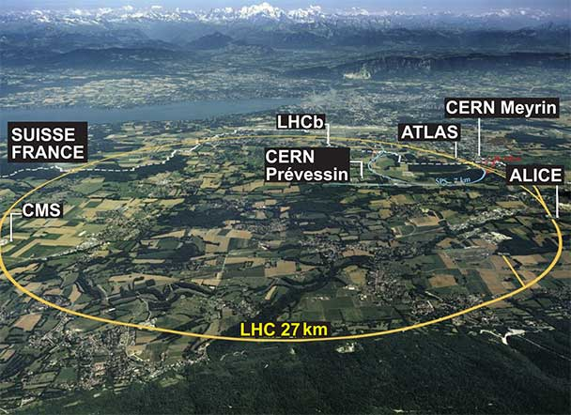
Hadron-hadron colliders

Slide 13


hh physics at 100 TeV
An order of magnitude lower in probed distance scale
Factors ~5-10 in mass scale for new physics
Complete exploration of the Higgs sector (quartic coupling)
  Test electroweak baryogenesis
High precision Higgs + SM measurements + DM searches
No ”no lose” theorem unlike Tevatron and LHC.
No consensus (yet??) in community.
For the first time in ~50 years its not clear that a new insight will come from pushing the high energy frontier.

Slide 14
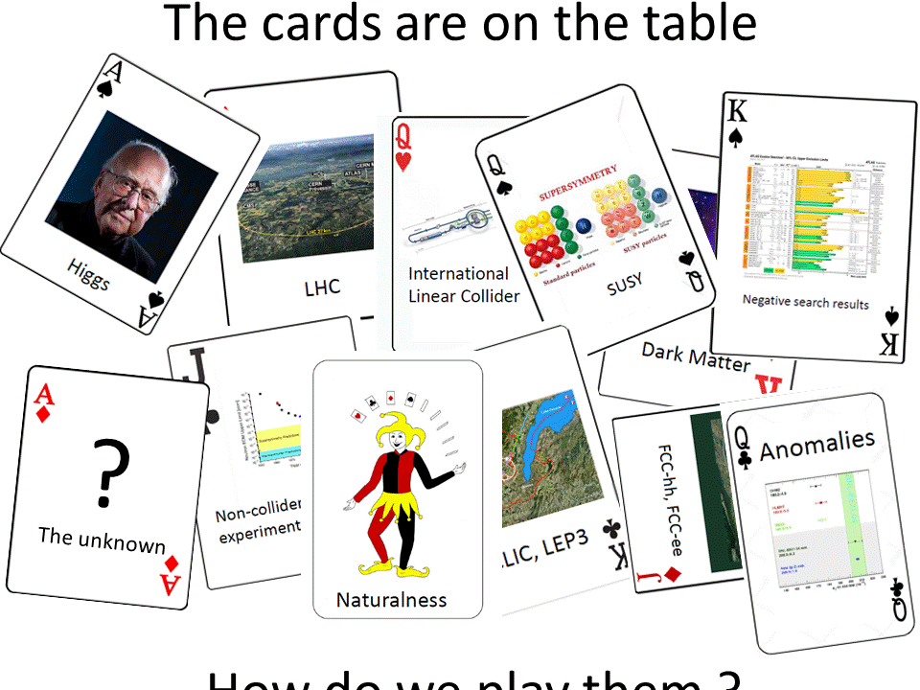
The cards are on the table
How do we think they should be played over the medium and long term ?

Slide 15
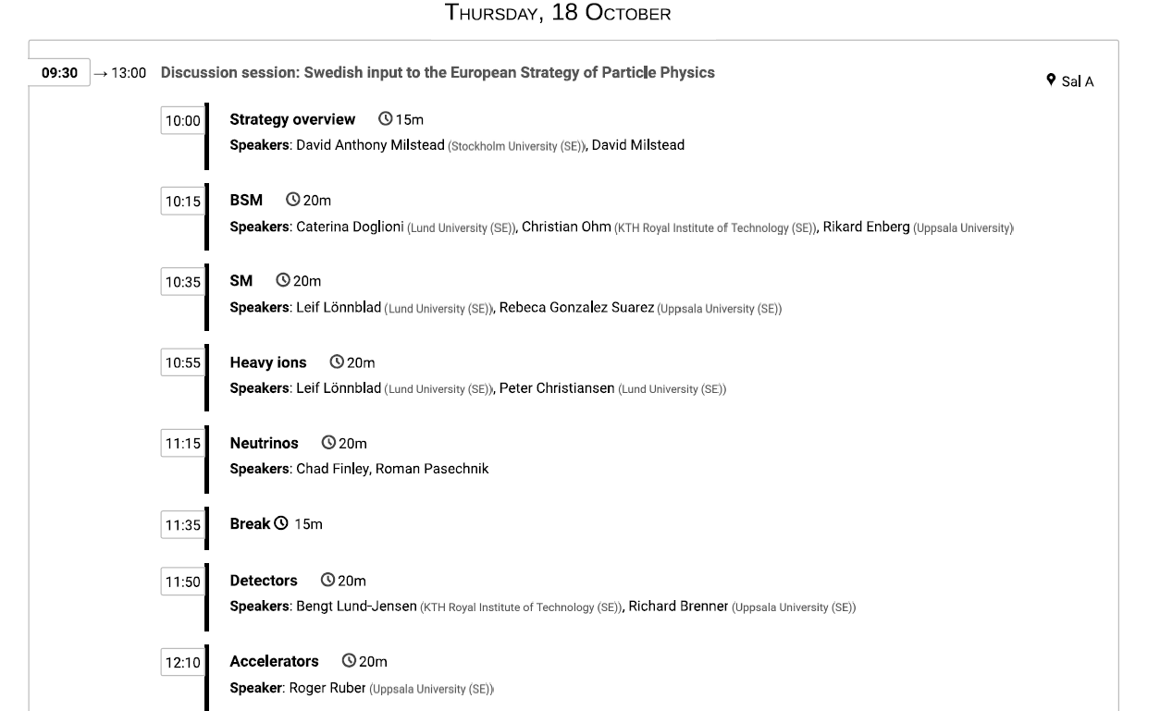
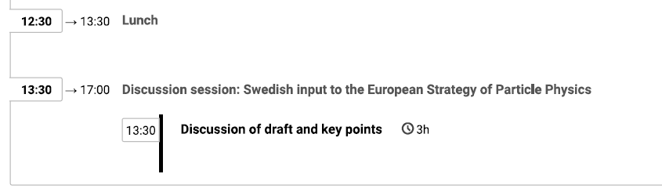
European PP strategy update discussion tomorrow
Please attend and make your voice heard.
This is the first time in 50 years when it is not obvious where to go in the long term.
Long term planning begins now.
We will submit a contribution for the Swedish pp community.
More details from Kerstin on the strategy process.

Slide 16
Summary
ECFA focus on individual recognition
Preparation for the European PP Strategy Update

