Slide 1


Searching for Low-mass Resonances with Trigger-level Jets at ATLAS
Alexander Ekman and William Kalderon, Lund University
Input from Eva Hansen, Eric Corrigan, Caterina Doglioni
Notes:
Hi, my name is Alexander Ekman, I'm doing my master thesis here at Lund University with Caterina Doglioni.
I'm here to present the Search for low mass resonances, using trigger level jets at ATLAS.
Me and Will Kalderon made these slides, together with input form Eva Hansen, Eric Corrigan and Caterina Doglioni

Slide 2
Outline
1/11
What is Trigger-object Level Analysis (TLA)
Results from 2016
Jet Calibration and future plans for TLA
Notes:
Firstly I'll talk about the constraints we have on low mass resonances, what trigger level analysis is and how it can help us improve these constraints.
Then I'll talk about the results from the trigger level analysis on the 2016 data set.
I'll then continue by talking about what's planned for my master thesis and the future plans of TLA

Slide 3
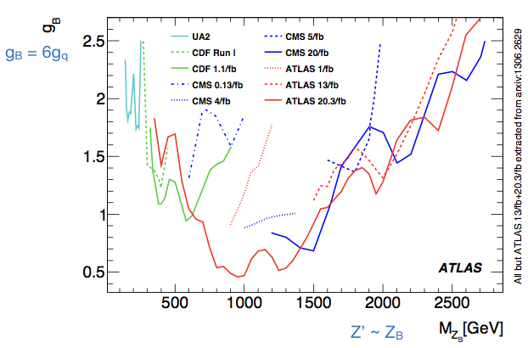
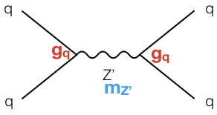
Constraints on New Resonances, End of LHC Run-1
2/11
At the end of LHC Run-1, parameter space for resonances decaying to jets below 1 TeV was still unexplored by ATLAS
jet
?
jet
[1] Phys. Rev. D. 91, 052007 (2015)
Notes:
In the search for dark matter, one option is to look for the particle which would mediate the interaction between dark matter particles, and standard model particles.
If such a mediator Z' exists, we should be able to observe it as a resonance in proton-proton to dijet searches
At the end of LHC Run-1 these constraints, shown here, were the constraints we had on such resonances.
As we can see here, the parameter space for resonances which decay into two jets was unexplored by atlas, when searching below 1 TeV.
It would therefore be interesting to try different approaches to push constraints at lower energies

Slide 4
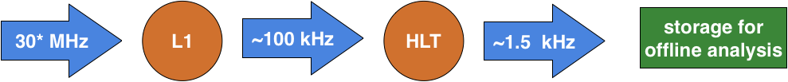
ATLAS Trigger and Low-mass Resonances
3/11
Level 1 Trigger
Higher Level Trigger
Reason for this unexplored region:
  Signal and background events have very similar characteristics
  Background (QCD) very high rate and cannot be recorded in its entirety
    Most events discarded by the ATLAS trigger system
  Signal is discarded as well!
Notes:
Lets look into the ATLAS trigger system.
We have an event rate from the LHC of approximately 30 MHz
We then have L1, the Level 1 trigger, which from this 3MHz picks which events to keep. The events which pass the Level 1 trigger, come at an approximate rate of 100 kHz
The higher level trigger makes even more educated cuts on our events, which brings the event rate down to 1.5kHz. The events coming out here are FULL events that are used in analysis
There are multiple reasons why the region below 1TeV is unexplored at higher precision
Firstly, Signal and Background events have very similar characteristics
The QCD background has such high rates that we are forced to discard events below 1 TeV at random. This means that the cuts Implemented at the higher level trigger doesn’t give us the background in it's entirety at these lower energies
And of course, Sometimes signal events are discarded in the higher level trigger

Slide 5
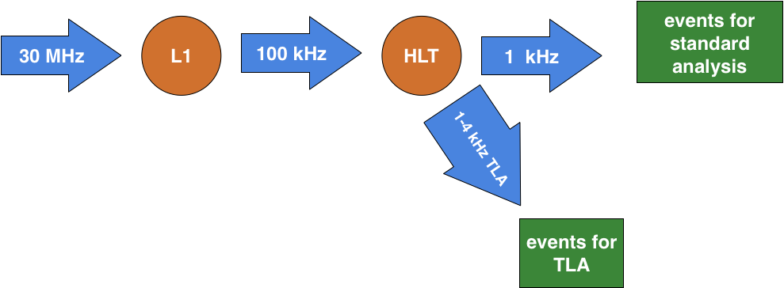
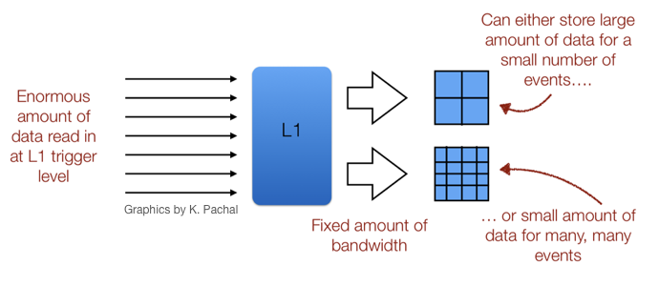
Solution: Trigger-object Level Analysis (TLA)
4/11
O(10)
events / second
O(1000) events / second
Instead of discarding the events, keep only the objects used for making the decision (0.5% of full size) and use for them analysis
LHCb: Turbo Stream, CMS: Data Scouting
[2] Comput. Phys. Commun. 208 (2016) 35, [3] Phys. Lett. B 769 (2017) 520
Notes:
So what can we improve in order to push the constraints at lower energies?
Instead of discarding events completely, we take the event information which was used in the trigger decision making. This is 0.5% of the full event size, and we store this information for Trigger Level Analysis.
So compared to a "Normal analysis", which stores large amount of data for small number of events. TLA will store small amount of data for a huge number of events.
This is similar to LHCb "Turbo stream" and CMS's "Data scouting" methods

Slide 6
Trigger-object Level Analysis (TLA): Rates
5/11
Event size reduced to <1%
of fully recorded event
Rates of TLA data recorded are larger than rates for all other ATLAS analyses combined
[4] https://twiki.cern.ch/twiki/bin/view/AtlasPublic/TriggerOperationPublicResults#2017_pp_at_13_TeV
Notes:
This method of using many more, but smaller sized events means that TLA has the largest data recording rates at ATLAS, whilst maintaining low impact on storage. So we actually record the most jet events relative to storage usage

Slide 7
TLA: Results
6/11
Increase in number of events recorded with TLA
compared to traditional techniques
[5] Phys. Rev. Lett. 121, 081801 (2018)
Notes:
As shown here: using trigger level analysis results in an increase in the number of events recorded compared to traditional techniques at energies below 1Tev

Slide 8
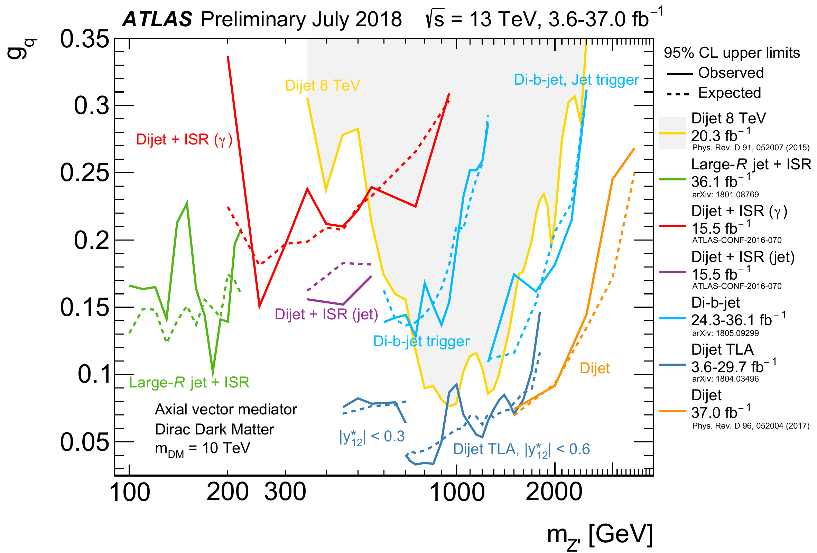
TLA: Results
7/11
[5] Phys. Rev. Lett. 121, 081801 (2018)
[6]_https://atlas.web.cern.ch/Atlas/GROUPS/PHYSICS/CombinedSummaryPlots/EXOTICS/
No signs of excesses in 2016 dataset
→
Set constraints on models of dark matter mediators
Notes:
From the 2016 dataset, this Trigger Level Analysis did not find any excess in the data
Not finding a signal allows us to set constraints on models which involve these dark matter mediators
And as shown here, with the 2016 dataset, the Trigger Level Analysis was able to push the constraints further

Slide 9
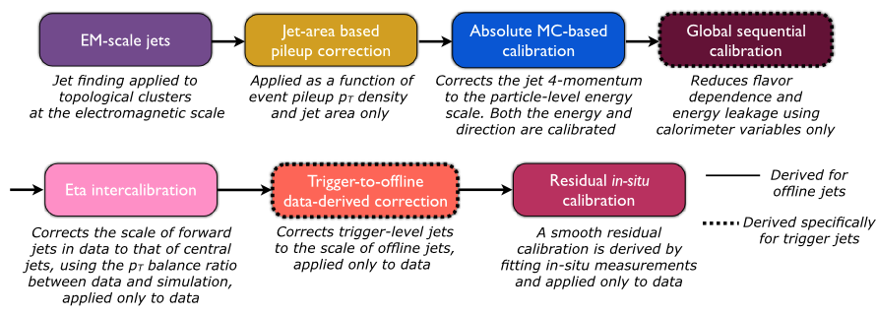
Jet Calibration: Crucial for this Analysis
8/11
The calibration is a chain of steps, each applying a different correction/calibration
Example: final in-situ calibration derives calibration factors by balancing jets and better calibrated objects (e.g. photons, Z bosons)
  Note: this step has less statistical precision than the TLA dataset
[5] Phys. Rev. Lett. 121, 081801 (2018)
Notes:
Since TLA uses events that contain less information, this means that some methods used in the "regular" analysis will have to change
An example of such a change is the Jet Calibration which is crucial for this analysis
The Jet calibration is a chain of steps, each applying a different correction/calibration. This chain of calibration will make the observed jets represent the particle level event as close possible
Here we have an example of the calibration chain used on the 2016 Dataset.
The final step of this chain is the in-situ calibration. It uses data to derive calibration factors by balancing jets and better calibrated objects such as photons and Z bosons
It is important to note, that this step naturally has less statistical precision than the TLA dataset

Slide 10
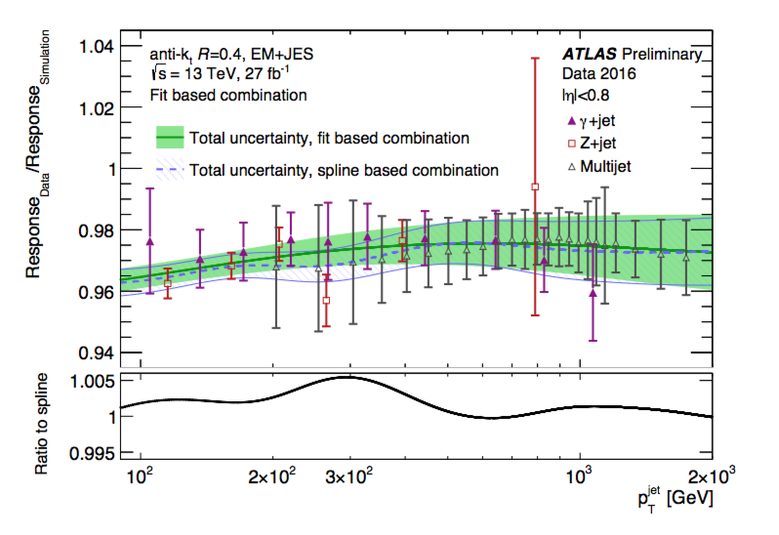
Challenges of Analysis With Very High Statistics
9/11
Background estimation relies on the fact that QCD is smoothly falling so we can use a fit
Case of in-situ step:
  Any features from calibration due to limited statistical precision can create “bumps” that are signal-like
  Necessary to use calibration techniques that keeps the calibration smooth
[5] Phys. Rev. Lett. 121, 081801 (2018)
Notes:
In order to continue pushing the constraints, we rely on the fact that QCD is smoothly falling
That means that we are sensitive to any features in the calibration which create signal-like bumps.
For example, the in-situ calibration step, due to it's limited statistical precision, can create signal-like bumps.
It is therefore necessary to use calibration techniques that keep the calibration smooth

Slide 11
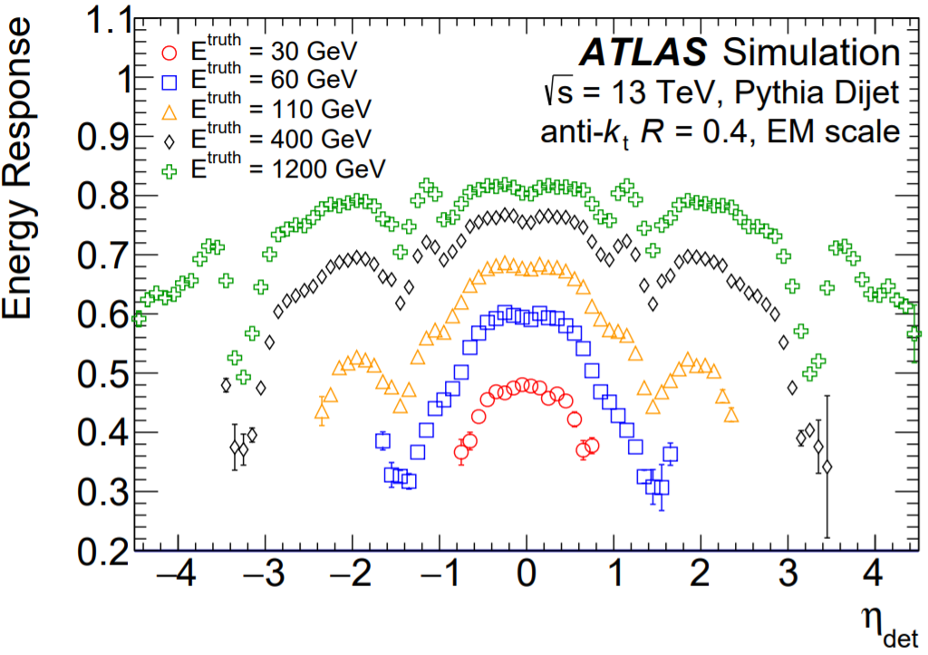
My Work for the 2018 Analysis: Jet Calibration
10/11
Master’s thesis with the ATLAS group
I am working on the “Absolute MC-based Calibration” step
  This step determines the calibration factors needed to bring reconstructed jets to the particle level energy scale
  My work will be about showing that it is smooth in pT
[5] Phys. Rev. Lett. 121, 081801 (2018)
[7] ATLAS-CONF-2015-037
Notes:
As my master thesis I am currently working on the "Absolute MC-based Calibration" step in the chain
This is the step where we determine the calibration factors needed to take the energy of a reconstructed jet in ATLAS, and bring it's energy down to the correct particle level energy scale
The end goal is to show that this step is smooth with respect to transverse momentum.
The TLA group will then merge all the steps in the chain and apply the full calibration to different data sets.
When satisfied, the whole calibration will be used to conclude our work on the dijet mass cross-section measurement

Slide 12
Summary and outlook
11/11
Trigger-object Level Analysis technique is very effective to search for low-mass resonances that would otherwise not be reachable
Results with 2016 LHC dataset show no excesses -> strongest constraints on certain kinds of dark matter mediators
Preparing for analysis with 3x more data (full Run-2)
Notes:
In summary, trigger level analysis is an effective technique to search for low-mass resonances at ATLAS.
The 2016 TLA analysis showed no excess, but was able to push the constraints for dark matter models
The TLA group is currently preparing for the analysis of Run-2, which will contain 3x more data. Where we are expecting to push the constraints at 400 GeV

Slide 13
References
[1] ATLAS Collaboration, Search for new phenomena in the dijet mass distribution using pp collision data at √s= 8 TeV with the ATLAS detector, Phys. Rev. D 91, 052007
[2] LHCb Collaboration, Tesla : an application for real-time data analysis in High Energy Physics, Comput. Phys. Commun. 208 (2016) 35, arXiv: 1604.05596 [physics.ins-det].
[3] CMS Collaboration, Search for dijet resonances in proton–proton collisions at √s = 13 TeV and constraints on dark matter and other models, Phys. Lett. B 769 (2017) 520, arXiv: 1611.03568 [hep-ex].
[4]_https://twiki.cern.ch/twiki/bin/view/AtlasPublic/TriggerOperationPublicResults#2017_pp_at_13_TeV
[5] ATLAS Collaboration, Search for low-mass dijet resonances using trigger-level jets with the ATLAS detector in pp collisions at √s = 13 TeV, Phys. Rev. Lett. 121, 081801 (2018), arXiv:1804.03496 [hep-ex].
[6] https://atlas.web.cern.ch/Atlas/GROUPS/PHYSICS/CombinedSummaryPlots/EXOTICS/
[7] ATLAS Collaboration, Monte Carlo Calibration and Combination of In-situ Measurements of Jet Energy Scale, Jet Energy Resolution and Jet Mass in ATLAS, ATLAS-CONF-2015-037, 2015

Slide 15
Further Calibration Work
Investigate difference in response between different shower models
  If no difference is observed, we have more confidence in removing the in-situ calibration step
Derive and apply the “Absolute MC-based Calibration”
  Its effect on MC vs offline data will be compared on multiple data sets in order to understand differences between different run conditions
All the steps in the calibration chain will be merged and applied
  The full calibration chain will be applied to different data sets, where the resolution of calibrated trigger jets will be compared to dijet balance techniques
  Satisfied with the comparison, the calibration will be used to conclude the work on the dijet mass cross-section measurement.
Notes:
The plan for this work is to firstly investigate the difference in response between different shower models
If no difference is observed, then we have more confidence that we can remove the in-situ calibration step
Then I will derive and apply the "Absolute MC-based Calibration".
I will then compare how this calibration differs between MC and Data, from multiple datasets.
This will give us an understanding of how different run conditions affect our output
Lastly, my calibration step will be merged with all the other calibration steps in the chain. These are steps developed and tested by other members of the collaboration
We will then together apply the full calibration chain to different data sets, where the resolution of calibrated trigger jets will be compared to ??dijet balance techniques??
When satisfied with this comparison, the whole calibration will be used to conclude our work on the dijet mass cross-section measurement

