Slide 1
Nordita workshop on fundamental physics at the ESS

Slide 2
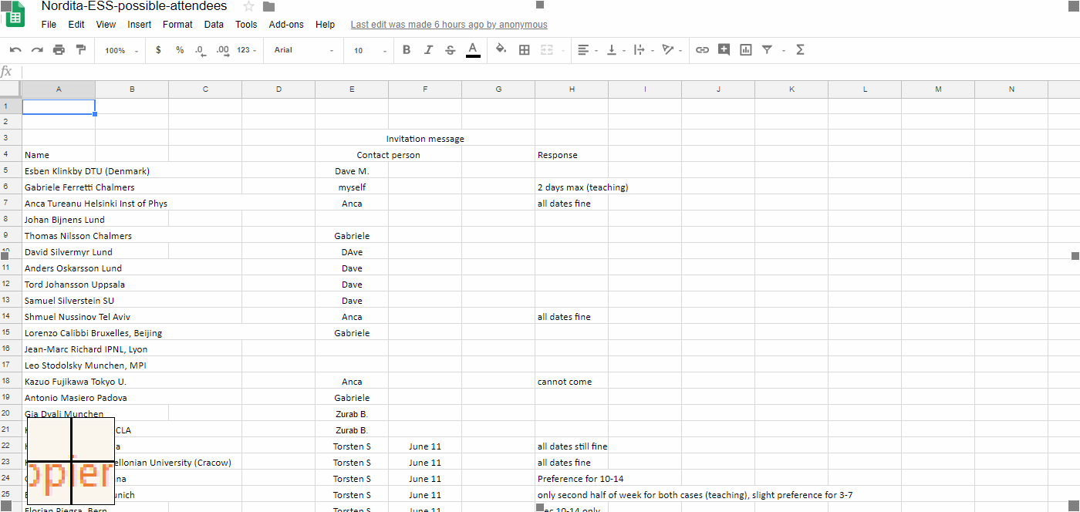
Dates
Both dates fine(7) , Dec 3-7(2) , 10-14 (3)
Spreadsheet still incomplete
Any preference for members of the OC ?
https://docs.google.com/spreadsheets/d/15BCJY_kQse0tv8PpctlxpKR0gnUoNhnriCz7flUxoOU/edit?usp=sharing

Slide 3
Output
Proceedings
Arxiv document (4-5 pages per session ?)
  ”Fundamental physics at the ESS”. An up-to-date quantification of the potential of the ESS in the context of coherence, open questions in physics, existing and planned experiments.
  Support for future bid (ESS/ILL)

Slide 4
Possible structure
Monday | Tuesday | Wednesday | Thursday | Friday
nnbar | nn’ | Nnbar collaboration | ANNI | Other ideas for ESS fund. Physics
 |  |  |  | Review of earlier sessions
Or is it better to mix , eg Monday: nnbar + ANNI to avoid folk feeling some days ”aren’t for them”
Format: 4-5 talks + discussions per day, excluding nnbar
Convenor: at least one exp + one theorist for each day.

Slide 5
Topics
Depends on what convenors want!
Eg
Nnbar
  Interplay with colliders (current + future)
    Eg RPV-SUSY
  Interplay with non-colliders
    Dune/Hyper-K
    Bound vs free
  Interplay with neutrino physics (Delta (B-L)=2)
    Concrete models for neutrinoless double beta decay and nnbar.
  Baryogenesis
    Post-sphaleron baryongenesis, bottom-up EFT approach
  The role of nnbar in BSM physics project.
    categorisation of the different approaches and models.
    EDM neutron-style publicity plot ?
Nn’
  Dark matter and a dark sector
    To what extent can mirror/sterile neutrons probe a dark sector.
    Complementarity with other probes of a dark sector ?
  Baryogenesis
  …
ANNI
  …

Slide 6
Participants
Attract potentially interested collaborators ?
  Include pedagogical overview talks ?
  Specifically invite folk with no prior nnbar involvement ?
How to avoid just having the usual folk ?

Slide 7
Next steps
Date – 10th-14th ?
Announcement mail (DM)
Webpage (DM)
Convenors - mail to DM+AT (all)
  Outline of what convenors would like to see and who should talk.
Decision on financial support.
Date, mail, webpage within 1-2 weeks.

