Slide 1
Nordita workshop

Slide 2
Nordita
Nordic Institute for Theoretical Physics
Nordisk institut for teoretisk fysik
Teoreettisen fysiikan pohjoismainen laitos
Norræna stofnunin í kennilegri eðlisfræði
Nordisk institutt for teoretisk fysikk
Nordiska institutet för teoretisk fysik
https://www.nordita.org
Theory Instituet for all five Nordic countries
Now based in Stockholm

Slide 3
Dates
Nobody in sunny Grenoble seemed scared by December in Stockholm
Try: 3-6 Dec. , 10-17 Dec. ?
4 days inc 1 day for nnbar ?
Better with 5 ?
Format – several days of talks followed by dedicated discussion sessions ?

Slide 4
Themes
Fundamental Physics at the ESS
Neutron-antineutron, neutron-mirror neutron
”ANNI” (precision β decay) and nEDM
+ …
Are there any topics we would like theory guidance on ?
  Complementarity of bound and free neutron oscillation searches
  DM link ?
  ….
Documented in arxiv (at least)

Slide 5
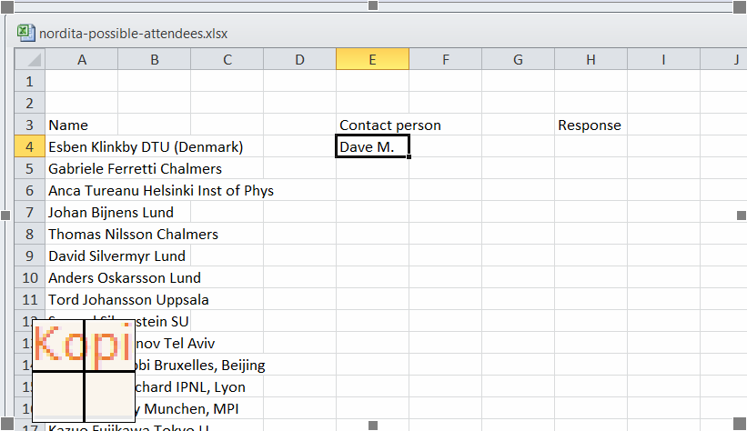
Attendees:
https://docs.google.com/spreadsheets/d/15BCJY_kQse0tv8PpctlxpKR0gnUoNhnriCz7flUxoOU/edit?usp=sharing
Pls fill in if you know a person and will contact them.
Pls add names.

